Slide 1
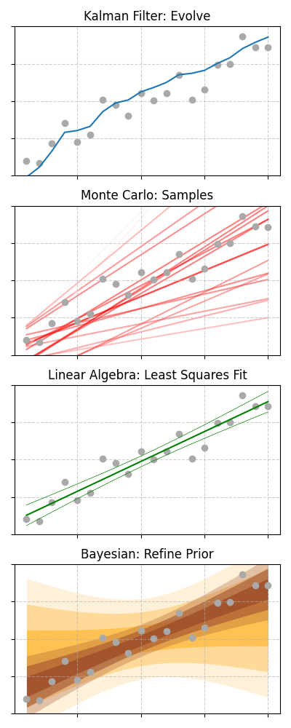
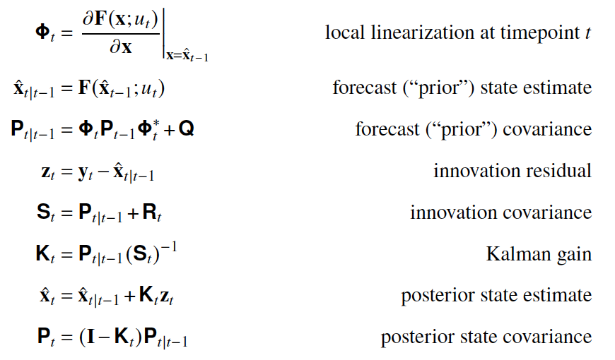
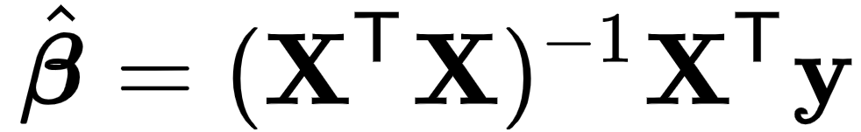
Dynamics
Statistics
linear [CO₂]
Linear
-
Aer
+
H₂O
?
+
+
4
GHG
Land
-
Surface Ocean
EBM-KF
?
Deep Ocean
O₃
Aer
GHG
H₂O
-
+
FaIR
Land
Surface Ocean
Middle Ocean
Deep Ocean
(FaIR used within each GWI compartment)
Natural
Anthropogenic
GHG
-
Aer
GWI
Land
Surface Ocean
Fast adjust: ~4.1 yrs
-
Deep Ocean
Slow adjust: ~209 yrs
ROF
hist-nat
hist-GHG
hist (or SSP-245)
hist-aer
ROF &
KCC
KCC
GHG
-
Aer

