Slide 1
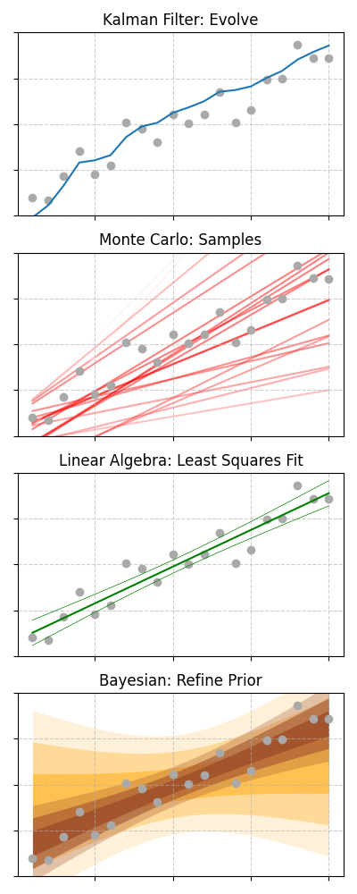
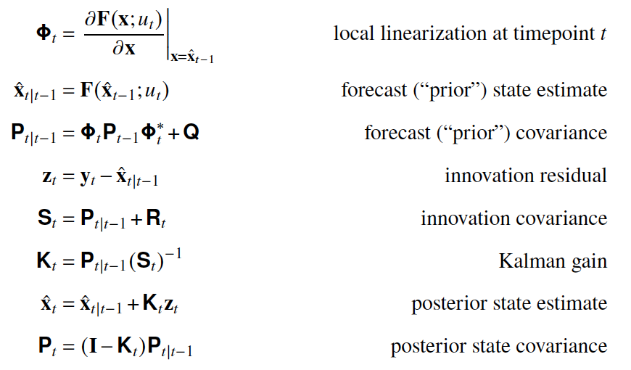
Method
Forced response (dynamics)
Internal variability
Observational constraint (statistics)
Linear
Sect. 4.4.1
linear [CO₂]
Regression residuals (dots), modelled as AR(1)
Weighted least squares
GMST on CO₂ concentration with AR(1) errors; Monte Carlo for uncertainty
EBM-KF
Sect. 4.4.2
Aer
+
H₂O
?
+
+
-
4
GHG
Land
Surface Ocean
Obs departures from the 30-yr mean, used as fitted obs-error covariance
?
Deep Ocean
Extended Kalman filter
EBM forecast updated each year with GMST and ocean heat content; for attribution, assimilates single-forcing ESM runs
FaIR
O₃
Sect. 4.4.3
Aer
GHG
H₂O
-
+
Land
Surface Ocean
Stochastic red-noise forcing + temperature noise, CMIP6-calibrated; one realisation per member
Middle Ocean
Deep Ocean
Monte Carlo constraint
~1.5 M prior members → GMST RMSE < 0.17 K → reweighted to 8 assessed metrics → 841 posterior members
GWI
Natural
GHG
Other human
Sect. 4.4.4.1
repeated over a
~10⁷-member ensemble
GHG
Aer
Land
-
CMIP6 piControl segments (drift-filtered), regressed alongside the obs
Surface Ocean
τ ≈ 1 yr
-
Middle Ocean
τ ≈ 8 yr
Multiple linear regression (OLS)
of obs on GHG, other-human and natural responses; scalings from piControl added to sample variability
Deep Ocean
τ ≈ 320 yr
FaIR v2 boxes,
28 CMIP6 emulations
ROF
hist-nat
hist-GHG
hist + SSP2-4.5
Sect. 4.4.4.3
GHG
Aer
other human =
ALL − NAT − GHG
Intra-ensemble anomalies (member − ensemble mean) of the same CMIP6 runs
-
CMIP6 ESMs
(multi-model)
Regularised total least squares
5-yr blended-masked GMST regressed on multi-model ALL, NAT and GHG fingerprints
KCC
or from 1%CO₂ runs →
hist-GHG
hist + SSP2-4.5
Sect. 4.4.4.2
GHG
Aer
Two AR(1) processes (slow + fast), fitted to obs minus the CMIP6 mean
-
Bayesian update (kriging)
CMIP6 prior on ALL, NAT and GHG; obs constrain ALL and the others shift through the prior covariance
NAT: EBM
ALL, GHG: CMIP6 ESMs
Key
Forcing time series
Feedback
Shortwave flux
Longwave flux
Inter-layer heat exchange
Heat capacity
Colour
Observed / measured
Fitted to observations
From CMIP6 coupled models
Assumed statistical form
Gridded coupled model
Variability
Residuals of observations
Synthetic noise from a statistical model
Coupled-model runs (thin = members, thick = mean)

