Slide 1
FP MISC uArch
202012
Larry

Slide 2
Agenda
List of abbreviation/parameter
Overview
Configuration
uArch overview
Conversion Instructions
Round digit/2’sc inc generation
Comparing & Others instructions
Cross Lane Forwarding Path
Enhancements
Instruction list

Slide 3
List of abbreviation (1/)
Abbreviation | Definition
F2I/F2F/I2F | F: Floating-point, I: integer
ABS | Alignment barrel shift
NBS | Normalization barrel shift
2’sc | 2’s complement
LZD | Leading zero detection
LZC | Leading zero count
mant_width_max | max of mantissa width of supported precisions
mant_width_min | min of mantissa width of supported precisions
dst_mant_width | Destination mantissa width
src_mant_width | Source mantissa width

Slide 4
List of parameter (1/)
Abbreviation | Definition
XLEN | The current width of an x register in bits (32 for RV32 or 64 for RV64)
FLEN | The current width of a f register in bits (32 for SP, 64 for DP)
VLEN | Vector length
ELEN | Element width

Slide 5
Overview (1/)
2-stage pipeline
Supported data types
BFloat16/HP/SP/DP
Int8/Int16/Int32/Int64
The followings are supported instructions and the corresponding latency
Conversion (I2F, F2F, F2I)
Comparing/min/max
Sign injection/classify/move
Precision | Width | Sign | Expo | Mant
HP | 16 | 1 | 5 | 10
Bfloat16 | 16 | 1 | 8 | 7
SP | 32 | 1 | 8 | 23
DP | 64 | 1 | 11 | 52

Slide 6
Overview (2/)
Instruction latency
Instruction | Latency
 | Scalar | Vector
Conversion | 2 | Widening | 2
 |  | Narrowing | 3
Sign injection | 2 | 2
Min/max | 2 | 2
Comparing | 1 | 2
Classify | 1 | 2
Move | toX:1 toF:2 | 2

Slide 7
Configurability
Feature | Options
XLEN | 64
FLEN* | 16/32/64
VLEN | 512/256/128
SIMD_WIDTH | 512/256/128
ELEN* | 32/64
*If RVV = 0, FLEN can be configured to 32/64
*If RVV = 1, FLEN is equivalent to ELEN

Slide 8
uArch overview

Slide 9
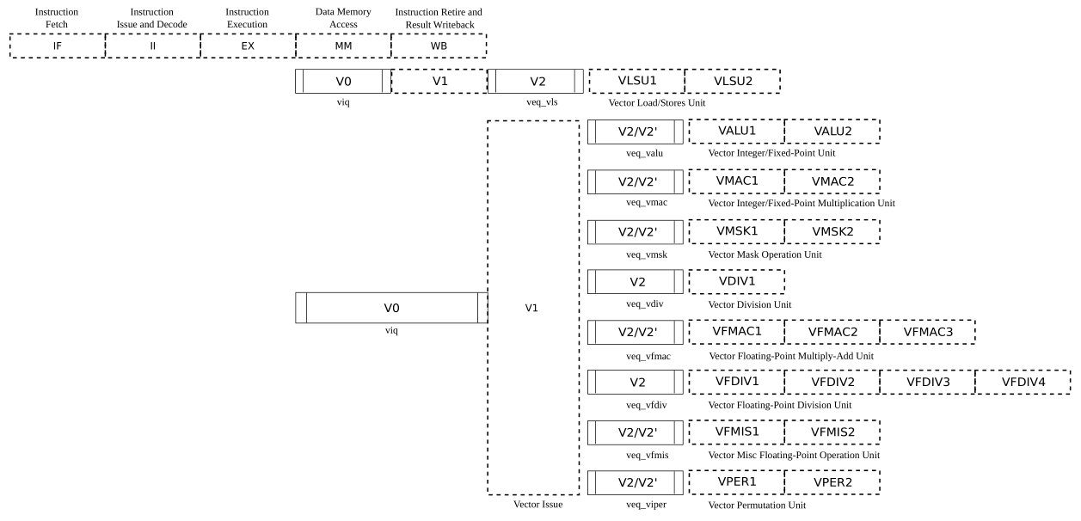
VPU stage
Frontend
Function unit

Slide 10
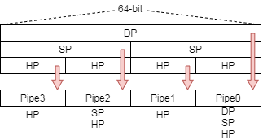
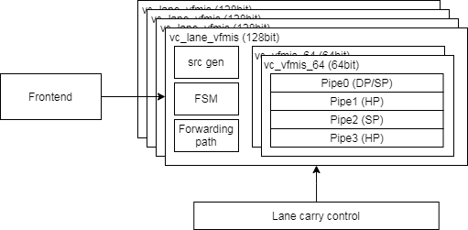
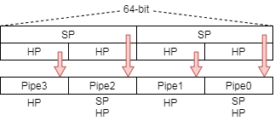
Function Unit Lane Hierarchy
ELEN=64
Src_gen is for source data selection
FSM is for reduction instructions to generate control signals
Lane_carry_control handle data forwarding between each lane
ELEN=32

Slide 11
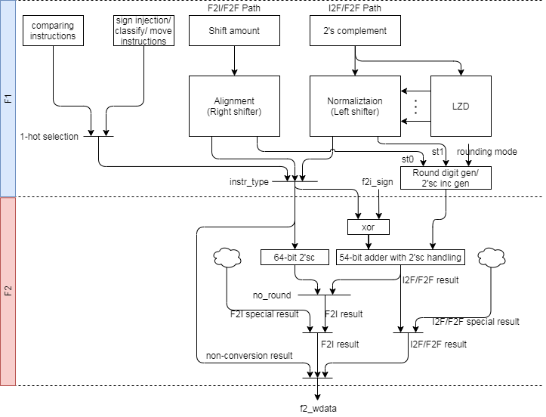
FMIS uArch (1/)

Slide 12
FMIS uArch (2/)
INT to FP

Slide 13
FMIS uArch (3/)
FP to INT (exp < 52)
FP to INT (52 <= exp)

Slide 14
FMIS uArch (4/)
FP widening
FP narrowing

Slide 15
FMIS uArch (5/)
Comparing instructions
Others instructions
Add scalar path

Slide 16
Conversion instructions

Slide 17
Integer to FP Datapath
Conversion datapath
INT to FP

Slide 18
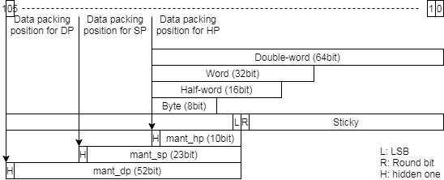
Integer to FP (1/)
Integer to floating-point dataflow
2’sc for negative integer
All integer source types are aligned at XLEN-bit
Do 3 things in parallel
Count leading zero
Normalize aligned data
Generate sticky bit
Pack to significand format according destination precision
Do rounding
Notes:
Bit width is (1+FLEN_MAX) - (1+FLEN_MIN) + XLEN

Slide 19
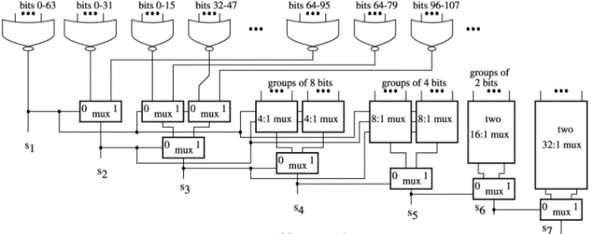
Integer to FP (2/)
Normalization
Calculate leading zero number
rd_exp = type_expo – LZC
Apply structuralized or network to calculate LZC
Apply barrel shift to normalize source data
Apply structuralized or network to generate sticky bit
The above shifter and or network can work in parallel and reduce latency
Rounding
According to round mode and sticky, add 1 on LSB or on Round bit
Increase exponent by 1 and set mantissa to zero if carry bit is set
Source type | Type_expo
DWORD | 63
WORD | 31
HWORD | 15
BYTE | 7

Slide 20
FP to Integer Datapath
Conversion datapath
FP to INT64 && (52 <= exp)
FP to INT (other cases)

Slide 21
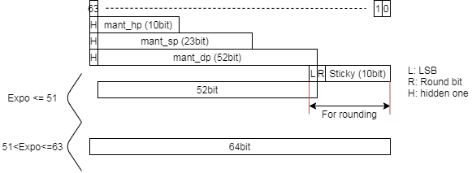
FP to integer (1/)
Floating to integer dataflow
Data packing
Right shift by sh_amount (subnormal don’t care)
Expo < 52
Exponent: (52 – expo)
Rounding: rounded by 54-bit adder
52 <= expo <= 63
Exponent: (63 – expo)
Rounding: no rounding
Expo without bias
Do rounding
2’s complement if source value is negative
Round digit/2’sc inc generation merge rounding and 2’sc steps

Slide 22
FP to integer (2/)
Exponent
Expo < 52
Exponent: (52 – expo)
Rounding: rounded by 54-bit adder
52 <= expo <= 63
Exponent: (63 – expo)
Rounding: no rounding
Rounding (SP to long)
Expo < 52
Right shift (52 – expo) bits because leading 12 bits are 0
Need to round (at least 1bit shifted to bit[10:0])
Result is {12’b0, bit[62:11]}
52 <= Expo <= 63
Right shift (63 – expo)
No need to round
Result is {bit[63:0]}
64 <= Expo
Source value is greater than max integer value
Expo < 52
63 11 10 0
LRS
12’d0
Result
For rounding
52<= Expo <= 63
63 11 10 0
Result
No rounding

Slide 23
FP to FP Datapath
FP narrowing to FP widening
FP widening to narrowing

Slide 24
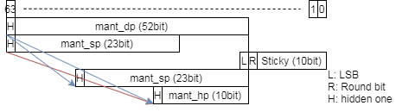
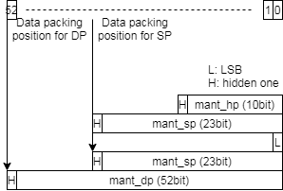
FP to FP (1/)
The F2F conversion is dividend into two parts.
Wider to narrow
Narrow to wider
Floating-point to floating-point methodology
Wider to narrow (abs)
Calculate exponent directly
Shift amount
Result > subnormal
(src_expo – (src_mant_width – dst_mant_width))
Result <= subnormal
(~src_expo - dst_bias + (src_mant_width – dst_mant_width) + 1)
Rounding
Narrow to wider (nbs)
Use NBS (left shift) for normal or subnormal input
No Rounding is needed
1 for subnormal

Slide 25
Round digit/2’sc inc generation

Slide 26
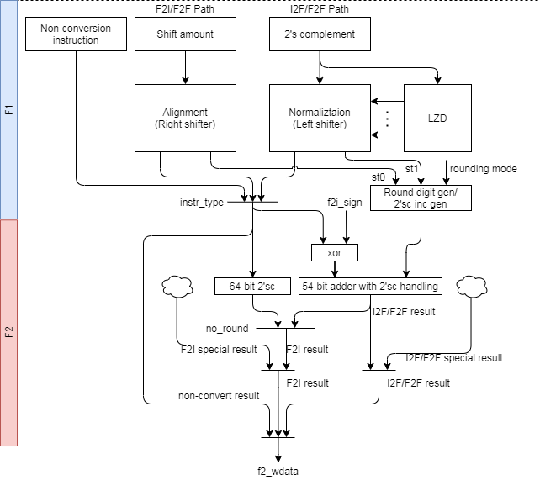
Round digit/2’sc inc generation (1/)

Slide 27
Round digit/2’sc inc generation (2/)
Do rounding and 2’sc at the same time or one of those
Merge rounding and 2’sc steps to improve critical path
No inclement LSB Inclement LSB0 Inclement LSB1
If rounding no inclement LSB => set inc=1
If rounding inclement LSB => set inc=0
If RNE tie clear LSB and LSB was 1 => set inc=1
Round-bit=1 & round_digit=01 & LSB = 1
should inclement LSB, but LSB will be cleared, so set inc=1
No Round-to-odd in F2I instruction
3 round to 3
0011 -> 0011
2’s c: inv+1
1100
+ 1
-------- ---------
1101 1101
-3 -3
4 round to 5
0100 -> 0101
2’s c: inv+0
1011 1010
+ 1 + 1
-------- ---------
1100 1011
-4 -5
3 round to 4
0011 -> 0100
2’s c: inv+0
1100 1011
+ 1 + 1
-------- ---------
1101 1100
-3 -4
Notes:
A is value after rounding
R is rounding inclement
B = A+R
Result = B’+1 = (A+R)’+1
R = 0, Result = A’+1
R = 1, Result = A’-1+1 = A’

Slide 28
comparing & others instructions

Slide 29
Comparing & Others Instructions
Comparing instructions
Others instructions

Slide 30
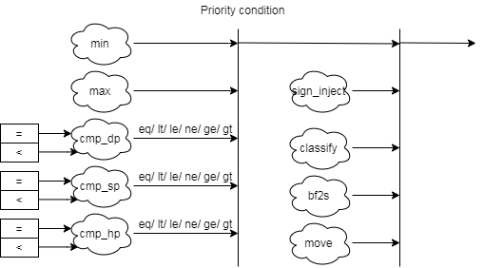
Comparing & Others Instructions
Comparing & others instruction block diagram detail
bf2s: bfloat16 to single

Slide 31
Comparing Instructions
Comparing instructions
Scalar: return 0/1
Vector: Write the comparison result to a mask register
Min/Max instructions
The rm field indicates MIN/MAX
FMIN: Write the smaller of rs1 and rs2 to rd
FMAX: Write the larger of rs2 and rs2 to rd
The value −0.0 is considered to be less than the value +0.0.
Both inputs are NaNs, the result is the canonical NaN.
Only one operand is a NaN, the result is the non-NaN operand.
Signaling NaN inputs raise the invalid operation exception, even when the result is not NaN.

Slide 32
Others Instructions
Sign-injection instructions
The result takes all bits except the sign bit form the vector vs2 operands.
The rm (rounding mode) field indicates J[N]/JX
Classify instructions
The 10-bit mask produced by this instruction is placed in the LSB of the result elements.
This instruction is only defined for SEW=16b above, so the result will always fit in the destination elements.
Rd bit | Meaning
0 | rs1 is -inf
1 | rs1 is a -normal number
2 | rs1 is a -subnormal number
3 | rs1 is -0
4 | rs1 is +0
5 | rs1 is a +subnormal number
6 | rs1 is a +normal number
7 | rs1 is +inf
8 | rs1 is a signaling NaN
9 | rs1 is a quiet NaN

Slide 33
Cross Lane forwarding path

Slide 34
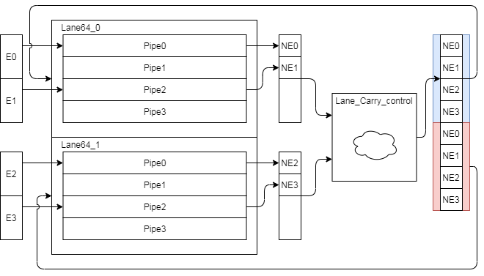
Narrowing & Mask Instruction Forwarding Path
Narrowing and mask instruction format is special and those instruction result will go through to lower lane. (e.g. Lane 1→ Lane 0)
The following instruction need to shift to narrowing format
Lane produce result and pack result
Lane_Carry_control pack result and duplicated

Slide 35
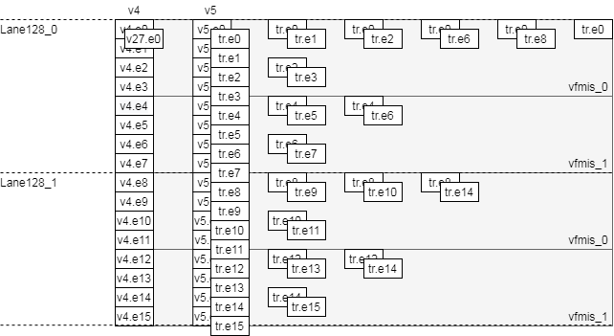
Reduction instructions Forwarding Path
Reduction instruction data flow
Do the corresponding operator to deal with each vector datas
Merge elements in lane first then merge remain results
VLEN=256, SIMD=256, LMUL=2, SEW=16, VL=VLMAX

Slide 36
Enhancements

Slide 37
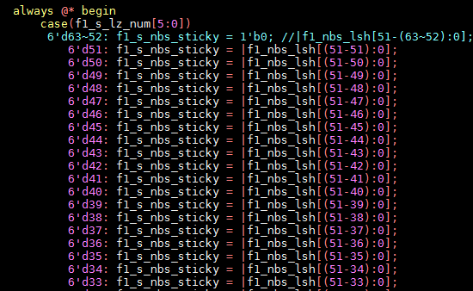
Enhancement list (1/)
Enhance sticky generation path (st1)
Detect Leading zero before 2’sc
Early detection for leading zero
1bit error correction
Reduce integer value mux
Merge 64bit and 54bit adder (?)
Merge non-conversion result path

Slide 38
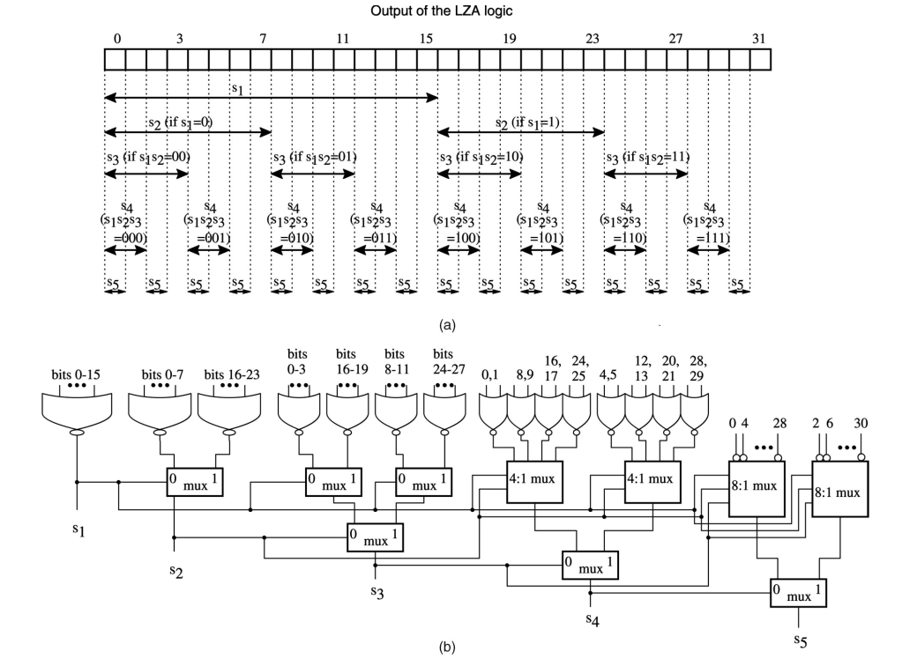
Sticky generation for normalization (1/)
LZC logic

Slide 39
Sticky generation for normalization (2/)
LZC = 5d’13 = 5’b01101
LZC[4] = 0, L4_sticky = |bit[15:0]
LZC[3] = 1, L3_sticky = L4_sticky | 1’b0
LZC[2] = 1, L2_sticky = L3_sticky | 1’b0
LZC[1] = 0, L1_sticky = L2_sticky | bit[17:16]
LZC[0] = 1, L0_sticky = L1_sticky | (LZC[0]) ? bit[18] : |bit[19:18];
0 | 1 | 2 | 3 | 4 | 5 | 6 | 7 | 8 | 9 | 10 | 11 | 12 | 13 | 14 | 15 | 16 | 17 | 18 | 19 | 20 | 21 | 22 | 23 | 24 | 25 | 26 | 27 | 28 | 29 | 30 | 31
0 | 0 | 0 | 0 | 0 | 0 | 0 | 0 | 0 | 0 | 0 | 0 | 0 | 1 | 1 | 1 | 0 | 0 | 0 | 0 | 1 | 0 | 1 | 0 | 1 | 1 | 1 | 0 | 0 | 1 | 1 | 0
0
1
1
0
1
Notes:
l5_sticky = 1’b0
l4_sticky = (f1_s_lz_num[5] == 1’b1) ? l5_sticky :|bit[15:0]
L3_sticky = (f1_s_lz_num[5:4] == 2’b11) ? l4_sticky :
l4_sticky | (| bit[27:24])

Slide 40
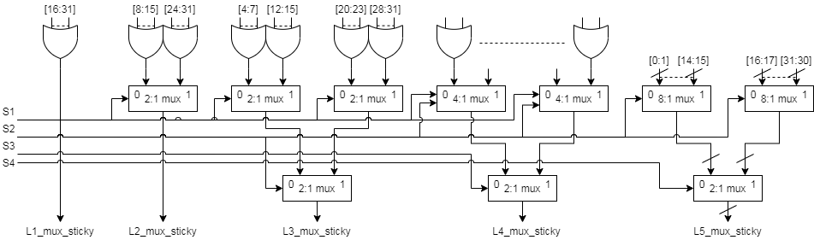
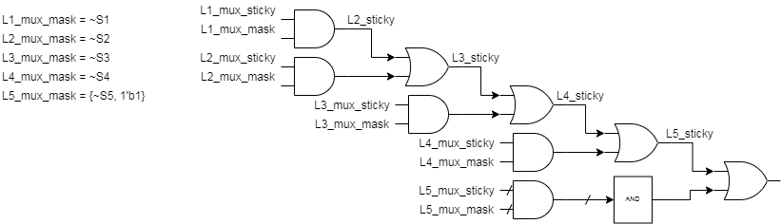
Sticky generation for normalization (3/)
Notes:
l5_sticky = 1’b0
l4_sticky = (f1_s_lz_num[5] == 1’b1) ? l5_sticky :|bit[15:0]
L3_sticky = (f1_s_lz_num[5:4] == 2’b11) ? l4_sticky :
l4_sticky | (| bit[27:24])

Slide 41
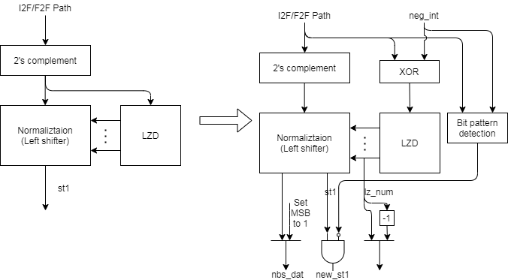
Leading zero detection before 2’sc (1/)
Extra logics to handle LZD 1 bit error
Bit pattern detection (1+0*)
8bit example → 11110000
LZC correction
Clear st1
Set nbs dat

Slide 42
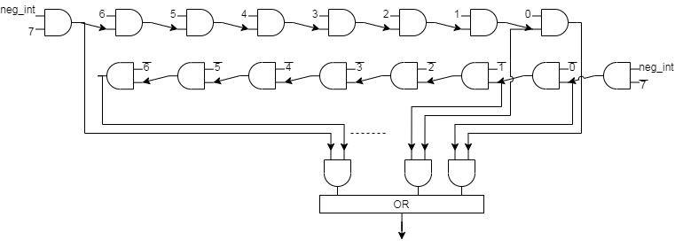
Leading zero detection before 2’sc (2/)
Bit pattern detection logic
LZD error bit patterns
Example
A → 8’b11110000 (neg int)
A 1’sc → 8’b00001111 → LZC = 4, sticky = 1, nds_dat = 8’b00000000
A 2’sc → 8’b00010000 → LZC = 3, sticky = 0, nds_dat = 8’b10000000
Hit bit pattern
LZC = LZC -1
Sticky = 0
nds_dat = 8’b10000000

Slide 43
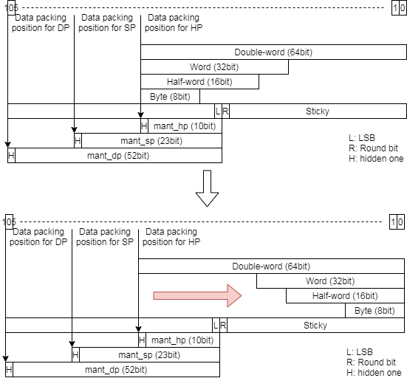
Reduce integer value mux (1/)
Modify integer value alignment from 63-bit to 0-bit
Reduce data type selection

Slide 44
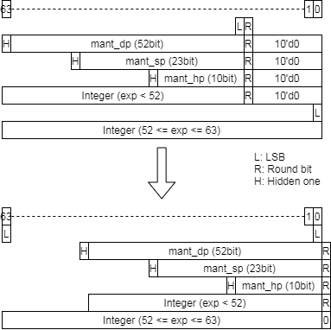
Merge 64bit and 54bit adder (1/)
Use 65-bit adder to do 64-bit 2’sc and 54-bit rounding (lsb is round bit)
For 64-bit 2’sc, just add 1 at round bit.

Slide 45
Instruction List

Slide 46
Supported scalar fp instruction list (1/)
Sign-injection instruction
fsgnj.[hsd]
fsgnjn.[hsd]
fsgnjx.[hsd]
Compare instruction
feq.[hsd]
flt.[hsd]
fle.[hsd]
Classify instruction
fclass.[hsd]
Move instruction
fmv.x.[hwd]
fmv.[hwd].x

Slide 47
Supported scalar fp instruction list (2/)
Conversion between int and fp
Conversion between fp and fp
Int width\fp_width | F16(HP) | F32(SP) | F64(DP)
I32 | fcvt.w.h fcvt.wu.h fcvt.h.w fcvt.h.wu | fcvt.w.s fcvt.wu.s fcvt.s.w fcvt.s.wu | fcvt.w.d fcvt.wu.d fcvt.d.w fcvt.d.wu
I64 | fcvt.l.h fcvt.lu.h fcvt.h.l fcvt.h.lu | fcvt.l.s fcvt.lu.s fcvt.s.l fcvt.s.lu | fcvt.l.d fcvt.lu.d fcvt.d.l fcvt.d.lu
SRC \ DST | F16(HP) | Bfloat16 | F32(SP) | F64(DP)
F16(HP) | X | X | fcvt.s.h | fcvt.d.h
Bfloat16 | X | X | fcvt.s.bf16 | X
F32(SP) | fcvt.h.s | fcvt.bf16.s | X | fcvt.d.s
F64(DP) | fcvt.h.d | X | fcvt.s.d | X

Slide 48
Supported vector fp instruction list (1/)
14.11. Vector Floating-Point MIN/MAX Instructions
Floating-point minimum
vfmin.vv vd, vs2, vs1, vm # Vector-vector
vfmin.vf vd, vs2, rs1, vm # Vector-scalar
Floating-point maximum
vfmax.vv vd, vs2, vs1, vm # Vector-vector
vfmax.vf vd, vs2, rs1, vm # Vector-scalar
14.12. Vector Floating-Point Sign-Injection Instructions
For vfsgnj, the result’s sign bit is v/rs1’s sign bit.
vfsgnj.vv vd, vs2, vs1, vm # Vector-vector
vfsgnj.vf vd, vs2, rs1, vm # Vector-scalar
For vfsgjn, the result’s sign bit is the opposite of v/rs1’s sign bit.
vfsgnjn.vv vd, vs2, vs1, vm # Vector-vector
vfsgnjn.vf vd, vs2, rs1, vm # Vector-scalar
For vfsgnjx, the sign bit is the XOR of the sign bits of v/rs1 and vs2.
vfsgnjx.vv vd, vs2, vs1, vm # Vector-vector
vfsgnjx.vf vd, vs2, rs1, vm # Vector-scalar

Slide 49
Supported vector fp instruction list (2/)
14.13. Vector Floating-Point Compare Instructions
Compare equal
vmfeq.vv vd, vs2, vs1, vm # Vector-vector
vmfeq.vf vd, vs2, rs1, vm # Vector-scalar
Compare not equal
vmfne.vv vd, vs2, vs1, vm # Vector-vector
vmfne.vf vd, vs2, rs1, vm # Vector-scalar
Compare less than
vmflt.vv vd, vs2, vs1, vm # Vector-vector
vmflt.vf vd, vs2, rs1, vm # Vector-scalar
Compare less than or equal
vmfle.vv vd, vs2, vs1, vm # Vector-vector
vmfle.vf vd, vs2, rs1, vm # Vector-scalar
Compare greater than
vmfgt.vf vd, vs2, rs1, vm # Vector-scalar
Compare greater than or equal
vmfge.vf vd, vs2, rs1, vm # Vector-scalar

Slide 50
Supported vector fp instruction list (3/)
14.14. Vector Floating-Point Classify Instruction
vfclass.v vd, vs2, vm # Vector-vector
14.15. Vector Floating-Point Merge Instruction
vfmerge.vfm vd, vs2, rs1, v0 # vd[i] = v0.mask[i] ? f[rs1] : vs2[i]
14.16. Vector Floating-Point Move Instruction
vfmv.v.f vd, rs1 # vd[i] = f[rs1]
14.17. Single-Width Floating-Point/Integer Type-Convert Instructions
vfcvt.xu.f.v vd, vs2, vm # Convert float to unsigned integer.
vfcvt.x.f.v vd, vs2, vm # Convert float to signed integer.
vfcvt.rtz.xu.f.v vd, vs2, vm # Convert float to unsigned integer, truncating.
vfcvt.rtz.x.f.v vd, vs2, vm # Convert float to signed integer, truncating.
vfcvt.f.xu.v vd, vs2, vm # Convert unsigned integer to float.
vfcvt.f.x.v vd, vs2, vm # Convert signed integer to float.

Slide 51
Supported vector fp instruction list (4/)
14.18. Widening Floating-Point/Integer Type-Convert Instructions
vfwcvt.xu.f.v vd, vs2, vm # Convert float to double-width unsigned integer.
vfwcvt.x.f.v vd, vs2, vm # Convert float to double-width signed integer.
vfwcvt.rtz.xu.f.v vd, vs2, vm # Convert float to double-width unsigned integer truncating.
vfwcvt.rtz.x.f.v vd, vs2, vm # Convert float to double-width signed integer truncating.
vfwcvt.f.xu.v vd, vs2, vm # Convert unsigned integer to double-width float.
vfwcvt.f.x.v vd, vs2, vm # Convert signed integer to double-width float.
vfwcvt.f.f.v vd, vs2, vm # Convert single-width float to double-width float.
14.19. Narrowing Floating-Point/Integer Type-Convert Instructions
vfncvt.xu.f.w vd, vs2, vm # Convert double-width float to unsigned integer.
vfncvt.x.f.w vd, vs2, vm # Convert double-width float to signed integer.
vfncvt.rtz.xu.f.w vd, vs2, vm # Convert double-width float to unsigned integer truncating.
vfncvt.rtz.x.f.w vd, vs2, vm # Convert double-width float to signed integer truncating.
vfncvt.f.xu.w vd, vs2, vm # Convert double-width unsigned integer to float.
vfncvt.f.x.w vd, vs2, vm # Convert double-width signed integer to float.
vfncvt.f.f.w vd, vs2, vm # Convert double-width float to single-width float.
vfncvt.rod.f.f.w vd, vs2, vm # Convert double-width float to single-width float rounding towards odd.

Slide 52
Supported vector fp instruction list (5/)
15.3. Vector Single-Width Floating-Point Reduction Instructions
vfredmax.vs vd, vs2, vs1, vm # Maximum value
vfredmin.vs vd, vs2, vs1, vm # Minimum value
Custom instruction
vfwcvt.s.bf16 vd, vs2, vm
vfncvt.bf16.s vd, vs2, vm

Slide 53
Backup

Slide 54
Rounding mode (1/)
Alternative rounding options are also available. IEEE 754 specifies the following rounding modes:
round to nearest
where ties round to the nearest even digit in the required position (the default and by far the most common mode)
round to nearest
where ties round away from zero (optional for binary floating-point and commonly used in decimal)
round up (toward +∞;)
negative results thus round toward zero
round down (toward −∞)
negative results thus round away from zero
round toward zero (truncation)
it is similar to the common behavior of float-to-integer conversions, which convert −3.9 to −3 and 3.9 to 3

Slide 55
Rounding mode (2/)
Sign,LSB,round,stick | RNE | RTZ | RDN | RUP | RMM
0_000 | +0 | +0
0_001 | +0 | +0
0_010 | +0 | +0
0_011 | +1 | +0
0_100 | +0 | +0
0_101 | +0 | +0
0_110 | +1 | +0
0_111 | +1 | +0
1_000 | +0 | +0
1_001 | +0 | +0
1_010 | +0 | +0
1_011 | +1 | +0
1_100 | +0 | +0
1_101 | +0 | +0
1_110 | +1 | +0
1_111 | +1 | +0

