Slide 1
FP SIMD DIV/SQRT uArch
202104
Larry

Slide 2
Agenda
List of abbreviation
Overview
Configuration
Interface
uArch Overview
FP DIV/SQRT/Estimation Instructions
Data Placement
Instruction list

Slide 3
List of abbreviation (1/)
Abbreviation | Definition
DSU | Divider and Square Root Unit
LZC | Leading zero count

Slide 4
List of parameter (1/)
Abbreviation | Definition
XLEN | The current width of an x register in bits (32 for RV32 or 64 for RV64)
FLEN | The current width of a f register in bits (32 for SP, 64 for DP)

Slide 5
Overview (1/)
2-stage pipeline
Supported data types
Instruction handling
FP DIV/SQRT instruction using radix-4 SRT algorithm
FP estimation instruction using look-up table
Precision | Width | Sign | Expo | Mant
HP | 16 | 1 | 5 | 10
SP | 32 | 1 | 8 | 23
DP | 64 | 1 | 11 | 52

Slide 6
Overview (2/)
Instruction latency
*DIV/SQRT instruction have not forwarding path
x is not supported
Instruction | Latency
 | Scalar |  | Vector
DIV/SQRT | HP | 13* | HP | 13*
 | SP | 20* | SP | 20*
 | DP | 34* | DP | 34*
VFRECE7 | x | x | 3*
VFRSQRTE7 | x | x | 3*

Slide 7
Configurability
Feature | Options
XLEN | 64
FLEN* | 16/32/64
VLEN | 512/256/128
SIMD_WIDTH | 512/256/128
ELEN* | 32/64
*If RVV = 0, FLEN can be configured to 32/64
*If RVV = 1, FLEN is equivalent to ELEN

Slide 8
Interface

Slide 9
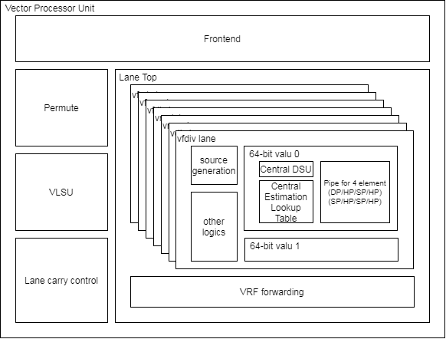
Pipe Interface (1/)
Module name is vc_vfp_fdiv_simd64.v
Supported FLENs are 32/64 and XLEN is the same with FLEN
Hierarchy diagram

Slide 10
Pipe Interface (2/)
Signal name | Type | Description
core_clk | Input | Clock
core_reset_n | Input | Negative Edge Reset
f1_valid[3:0] | Input | Valid signal
f1_ex_ctrl[4:0] | Input | Control signal for encoding. More info in instruction encoding slide.
f1_sew[2:0] | Input | Indicate element width
f1_ediv[1:0] | Input | Un-used
f1_round_mode[2:0] | Input | Round mode. 3’b000: RNE, 3’b001: RTZ, 3’b010: RDN, 3’b011: RUP, 3’b100: RMM
f1_op1_data[63:0] | Input | Source oprand1. The format is {DP}, {SP, SP} or {HP, HP, HP, HP}. DP, SP and HP width are 64-bit, 32-bit and 16-bit
f1_op2_data[63:0] | Input | Source oprand2. The format is {DP}, {SP, SP} or {HP, HP, HP, HP}. DP, SP and HP width are 64-bit, 32-bit and 16-bit

Slide 11
Pipe Interface (3/)
Signal name | Type | Description
f2_wdata_en[7:0] | Output | Byte write enable.
f2_wdata[63:0] | Output | Result data. Result format is {DP}, {SP, SP} or {HP, HP, HP, HP}. DP, SP and HP width are 64-bit, 32-bit and 16-bit
f2_flag_set[4:0] | Output | Result flag {Invalid Operation (nv), Divide by zero (dz), overflow(of), underflow(uf), Inexact(nx)}

Slide 12
uArch overview

Slide 13
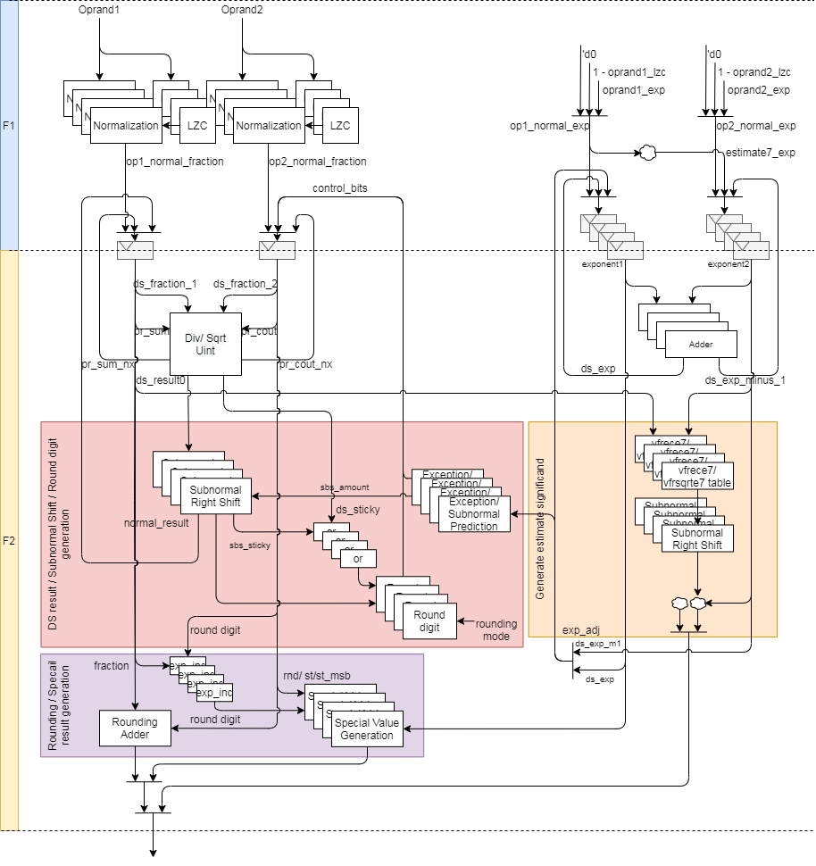
FDIV uArch (1/)

Slide 14
FDIV uArch (2/)
Div instruction datapath
Step 1: Normalize source value
Step 2: Compute result by DSU
Step 3: Calculate sticky
Step 4: Shift right for subnormal
Step 5: Do rounding
Sqrt instruction datapath
Step 1: normalize source value
Step 2: Compute result by DSU
Step 3: Calculate sticky
Step 4: Shift right for subnormal
Step 5: Do rounding

Slide 15
FDIV uArch (3/)
Vector estimation instruction

Slide 16
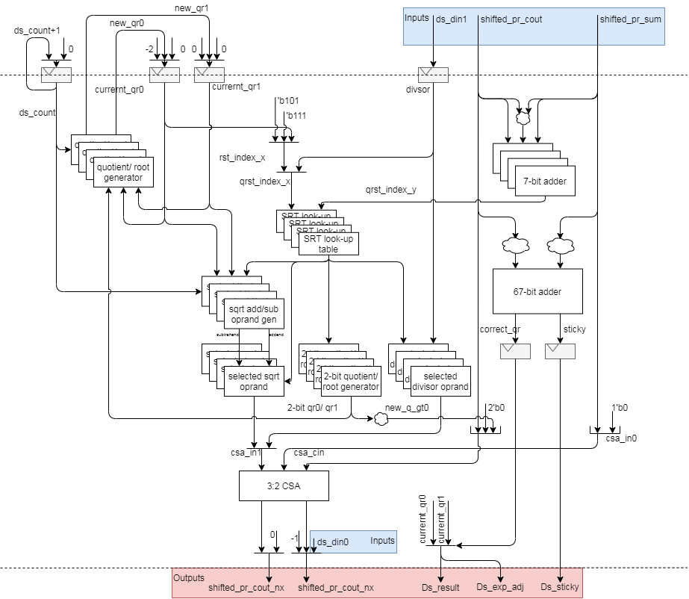
FDIV uArch (4/)
DSU Datapath
Input
Output
For 2’sc

Slide 17
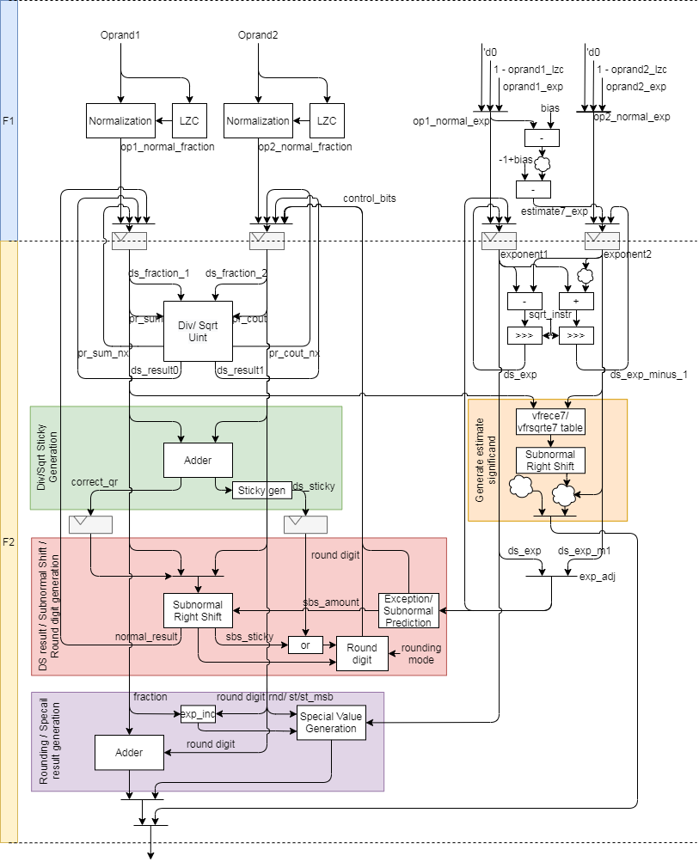
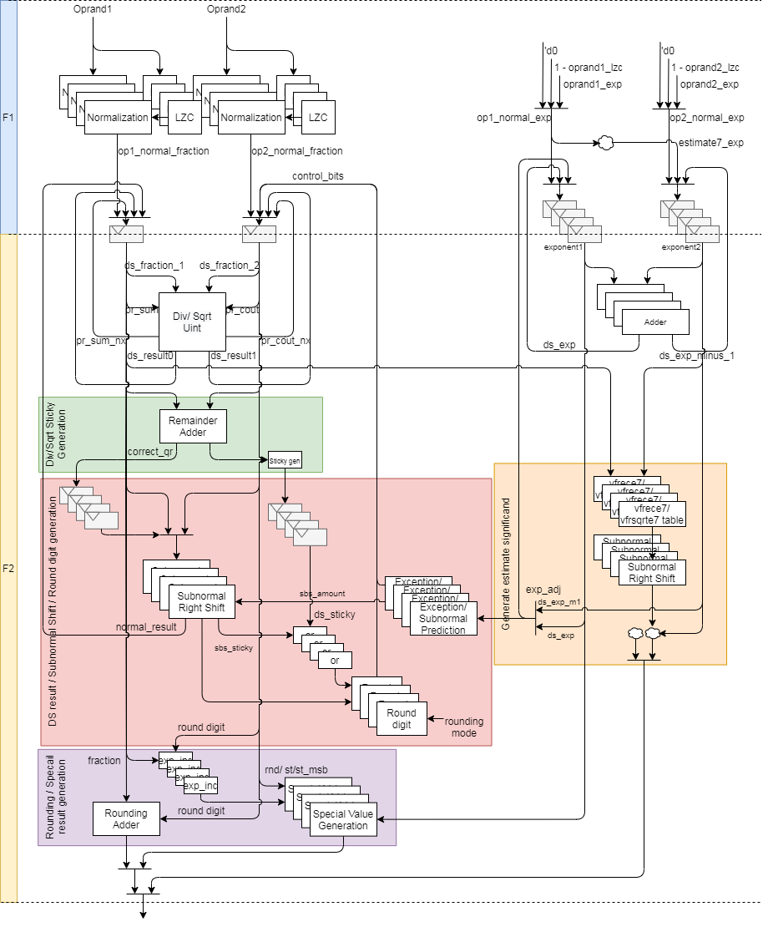
FDIV uArch - Compare (5/)
For 1 element
For 4 elements
Red circles indicates shared logics

Slide 18
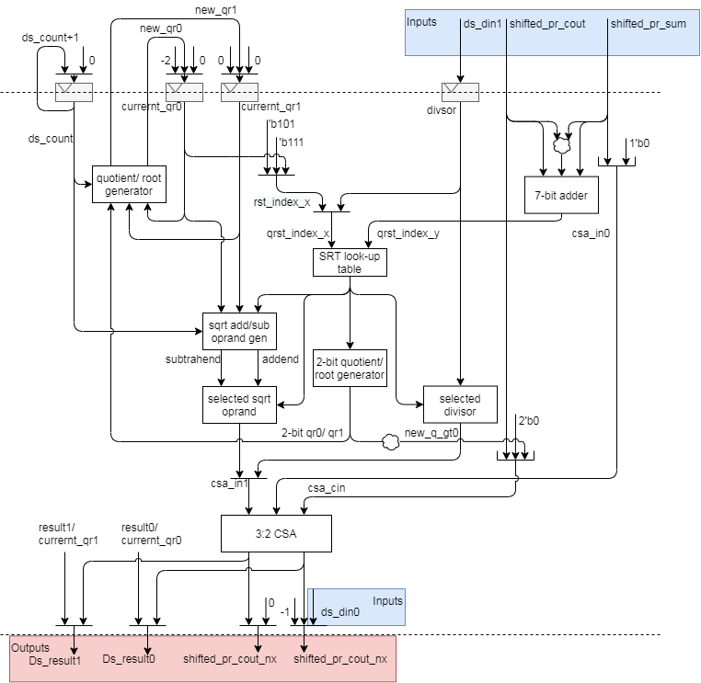
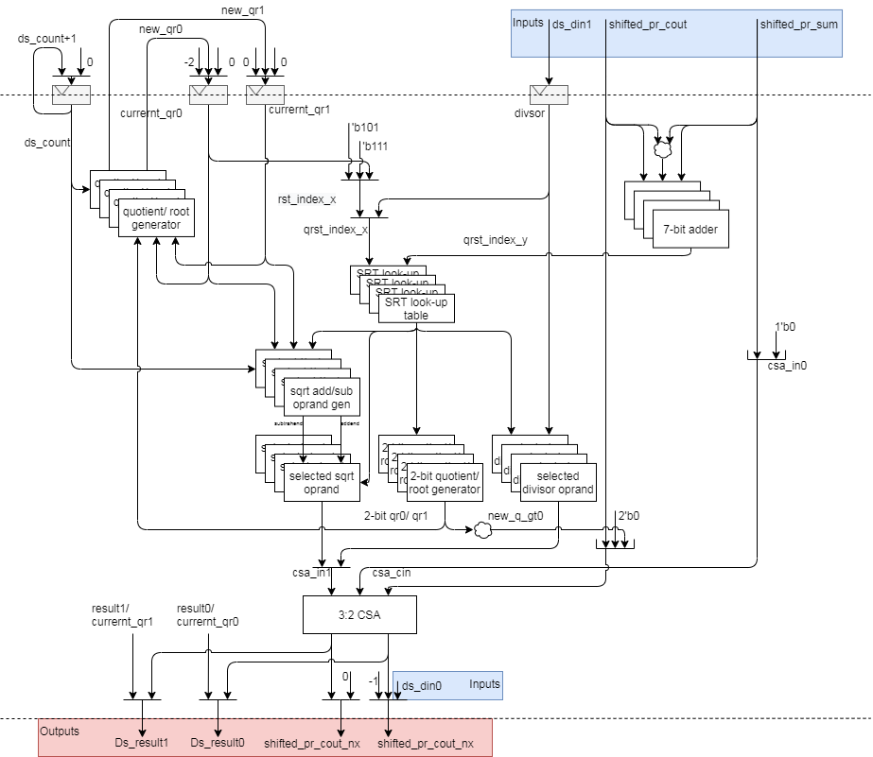
FDIV uArch - Compare (6/)
For 1 element
For 4 elements
Red circles indicates shared logics

Slide 19
FP DIV/SQRT/Estimation Instructions

Slide 20
FP DIV/SQRT/Estimation Instructions
The detail is FDIV_design_spec in T:\users\klmn\larryzzr\FP_design_spec_Larry\FDIV

Slide 21
Data Alignment

Slide 22
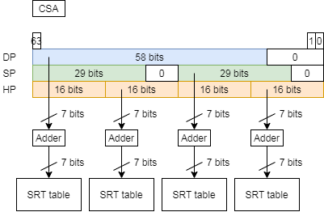
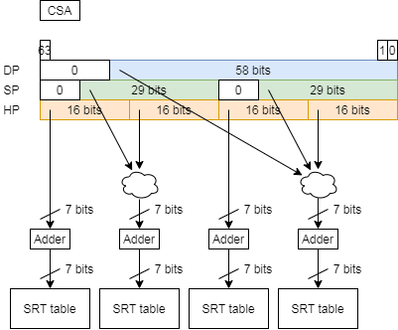
Data Alignment – DSU (1/)
The two method data alignment will affect related alignment.
The data should add extra multiplexers to select data if the data align LSB
If the data align MSB, we can use data directly

Slide 23
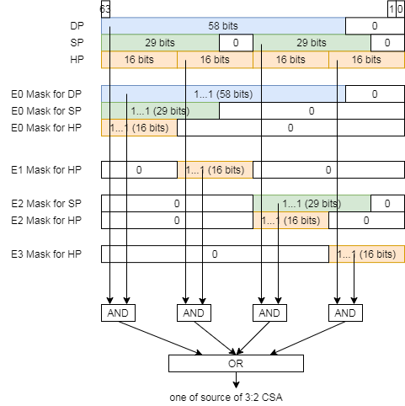
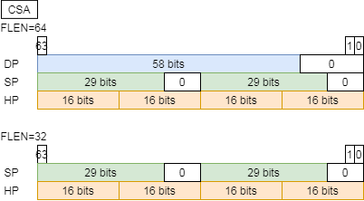
Data Alignment – DSU (2/)
The shared 3:2 CSA calculate sum and carry words and source data align MSB and just use masks to disable unneeded part of selected divisor/sqrt operand and then do logic-or to get final divisor/sqrt operand

Slide 24
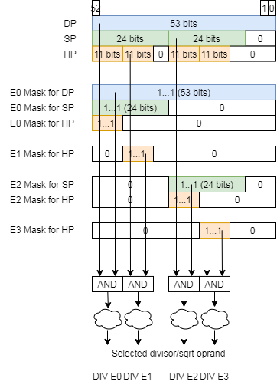
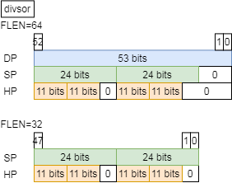
Data Alignment – DSU (3/)
The shared divisor keep normalized significand. We tend to align LSB and use masks to pick needed bits up then to generate the corresponding selected divisor/sqrt operand

Slide 25
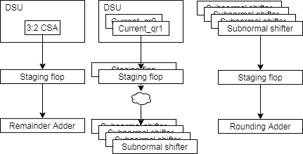
Data Alignment – VFP_FIV64 (4/)
The shared staging flop keep data for remainder adder, quotient/ quotient-1 from DSU and rounding adder. We need to find data alignment for the following path to get minimize area or highest freq.
3:2 CSA → Staging flop → 3:2 CSA
Keep original data alignment
3:2 CSA → Staging flop → Remainder adder
Current_qr(Quotient) → Staging flop → Subnormal
Subnormal shifter → Staging flop → Rounding adder

Slide 26
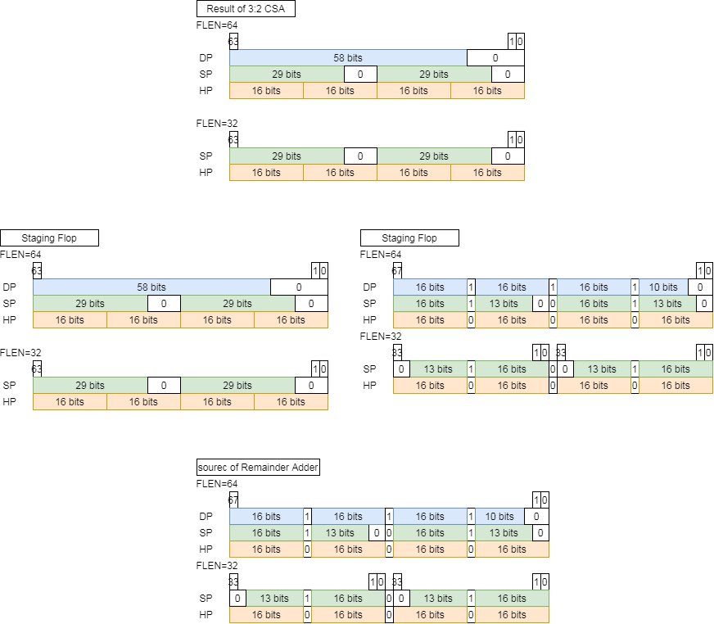
Data Alignment – VFP_FIV64 (5/)
The data flow is 3:2 CSA → Staging flop → Remainder adder
TYPE1: Align data after staging flop
Extra multiplexer logics
May affect timing (mux + 67-bit adder + sticky gen)
TYPE2: Align data before staging flop
Extra multiplexer logics
Use more 3 FFs to keep aligned data
TYPE1
TYPE2
align
TYPE1
TYPE2
3:2 CSA
3:2 CSA
Staging FFs
align
Staging FFs
Remainder Adder
Remainder Adder

Slide 27
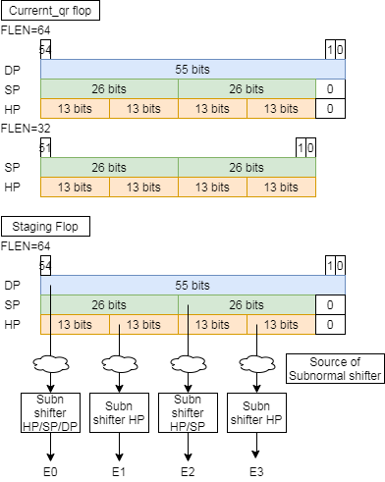
Data Alignment – VFP_FIV64 (6/)
The data flow is Current_qr → Staging flop → Subnormal shifter
The data align to LSB and it is better for subnormal shifter because we can generate round and sticky bit easily.

Slide 28
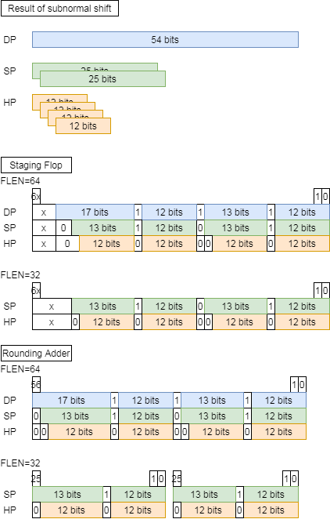
Data Alignment – VFP_FIV64 (7/)
Subnormal shifter → Staging flop → Rounding adder
Align data before staging flop
There is timing gap between subnormal shifter and staging flop. The extra multiplexer can be added to there and haven’t timing effect.
Subnormal shifter
HP
Subnormal shifter
HP/ SP
Subnormal shifter
HP
Subnormal shifter HP/ SP/ DP
Mask and Logic-OR
Staging Flop
Rounding Adder

Slide 29
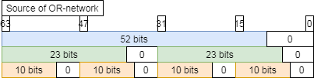
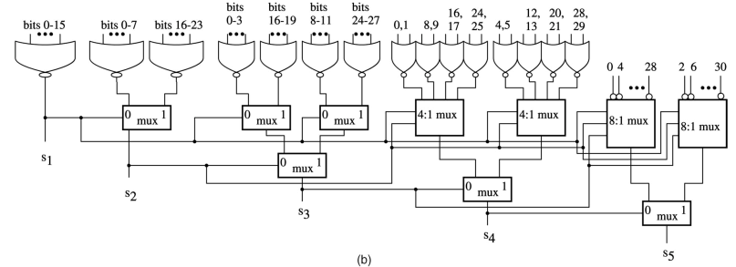
Data Alignment – VFP_FIV64 (8/)
Shared OR network for LZC align to MSB for counting leading zero and use mask to pick needed bits up. The following right Fig. is shared OR-network and the orange rectangle is shared gates under FLEN32
Please note the figure is an example for 32-bit LZC

Slide 30
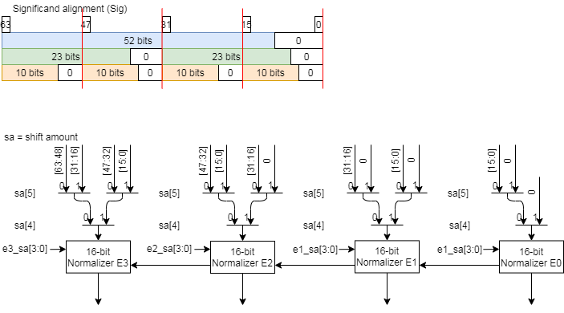
Data Alignment – VFP_FIV64 (9/)
Shared normalization shifter structure is as below and use 4 16-bit normalizer and extra logics to support 1-DP, 2-SP, 4-HP normalization.

Slide 31
Data Alignment – VFP_FIV64 (10/)
Use 1, 2 or 4 16-bit normalizer to shift HP, SP or DP
If the source data type is SP, we chain 2 16-bit normalizer to shift this data. Propagation path will propagate shifted out data from low part normalizer
For DP, E0 → E1 → E2 → E3
For SP, E2 → E3, E0 → E1
propagate
propagate
Notes:
sa[5] = DP & ~(|sig[63:32])
sa[4] = (DP|SP) & ~(|sig[63:48])
e3_sa[3:0] = (sa[5:4] == 0) ? E3_LZC[3:0] : (sa[5:4] == 1) ? E2_LZC[3:0] : (sa[5:4] == 2) ? E1_LZC[3:0] : E0_LZC[3:0] ;
e2_sa[3:0] = (sa[5:4] == 0) ? E2_LZC[3:0] : (sa[5:4] == 1) ? E1_LZC[3:0] : (sa[5:4] == 2) ? E0_LZC[3:0] : 0;
e1_sa[3:0] = (sa[5:4] == 0) ? E1_LZC[3:0] : (sa[5:4] == 1) ? E0_LZC[3:0] : (sa[5:4] == 2) ? 0 : 0 ;
e0_sa[3:0] = (sa[5:4] == 0) ? E0_LZC[3:0] : (sa[5:4] == 1) ? 0 : (sa[5:4] == 2) ? 0 : 0 ;

Slide 32
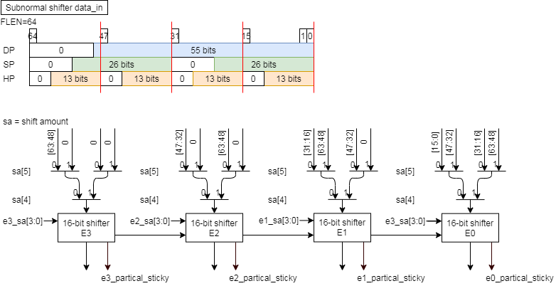
Data Alignment – VFP_FIV64 (11/)
Shared subnormal shifter structure is as below and use 4 16-bit shifter and extra logics to support 1-DP, 2-SP, 4-HP subnormal shift.

Slide 33
Data Alignment – VFP_FIV64 (12/)
Use 1, 2 or 4 16-bit shifter to shift HP, SP or DP
If the source data type is SP, we chain 2 16-bit shifter to shift the corresponding data. Propagation path will propagate shifted out data from high part shifter
For DP, E3 → E2 → E1 → E0
For SP, E3 → E2, E1 → E0
propagate
propagate

Slide 34
Data Alignment – DSU (13/)
The following table show reduced FFs and logics
Name | Before |  | After |  | Reduce FFs
FLEN | 64 | 32 | 64 | 32 | 64 | 32
Divisor | 99 | 70 | 53 | 48 | 46 | 22
Current_qr0/1 | 214 | 156 | 110 | 104 | 114 | 52
Counter | 15 | 14 | 5 | 4 | 10 | 10
ds_ctr_cs | 8 |  | 2 |  | 6
ds_busy | 4 |  | 1 |  | 3
 | 340 | 252 | 171 | 159 | 179 | 93
Name | Before |  | After |  | Reduced logics
FLEN | 64 | 32 | 64 | 32 | 64 | 32
3:2 CSA | 58-bit 3:2 CSA 29-bit 3:2 CSA 2x16-bit 3:2 CSA | 2x29-bit 3:2 CSA 2x16-bit 3:2 CSA | 64-bit 3:2 CSA |  | 55 FAs | 26 FAs

Slide 35
Data Alignment – VFP_FIV64 (14/)
The following table show reduced FFs
Name | Before |  | After |  | Reduce FFs
FLEN | 64 | 32 | 64 | 32 | 64 | 32
Staging Flop | 238 | 180 | 128/134 | 128/134 | 110/104 | 52/46
ds_busy_d1 | 4 |  | 1 |  | 3
f2_scalar_fpu_instr | 4 |  | 1 |  | 3
f2_frs_hp | 4 |  | 1 |  | 3
f2_frs_sp | 4 |  | 1 |  | 3
f2_frs_dp | 4 |  | 1 |  | 3
f2_round_mode | 12 |  | 3 |  | 9
f2_div_instr | 4 |  | 1 |  | 3
f2_sqrt_instr | 4 |  | 1 |  | 3
f2_vfrece7_instr | 4 |  | 1 |  | 3
f2_vfrsqrte7_instr | 4 |  | 1 |  | 3
 | 286 | 228 | 140/146 | 140/146 | 146/140 | 88/82
The highlight(red) indicate that staging flop width is 67-bit

Slide 36
Data Alignment – VFP_FIV64 (15/)
The following table show reduced logics
Name | Before |  | After
FLEN | 64 | 32 | 64 | 32
Remainder adder | 58-bit adder 29-bit adder 2x16-bit adder | 2x29-bit adder 2x16-bit adder | 67-bit adder | 2x33-bit adder
Rounding adder | 54-bit adder 25-bit adder 2x12-bit adder | 2x25-bit adder 2x12-bit adder | 57-bit adder* | 2x26-bit adder*
*if we reuse remainder adder, then we can reduce 57-bit adder or 2x26-bit adder.

Slide 37
Data Alignment – Summary (16/)
The following table show reduced FFs
Name | Before |  | After |  | Reduce FFs
FLEN | 64 | 32 | 64 | 32 | 64 | 32
VFP_FDIV64+DSU | 626 | 480 | 311/317 | 299/305 | 325/329 | 181/175
SIMD_WIDTH=512 |  |  |  |  | 2600/2552 | 1448/1400
The highlight(red) indicate that staging flop width is 67-bit
Name | Before |  | After |  |  | Reduced logics
FLEN | 64 | 32 | 64 | 32 |  | 64 | 32
CSA | 58-bit CSA 29-bit CSA 2x16-bit CSA | 2x29-bit CSA 2x16-bit CSA | 64-bit CSA |  |  | 55 FAs | 26 FAs
Remainder adder | 58-bit adder 29-bit adder 2x16-bit adder | 2x29-bit adder 2x16-bit adder | 67-bit adder |  | 2x33-bit adder
Rounding adder | 54-bit adder 25-bit adder 2x12-bit adder | 2x25-bit adder 2x12-bit adder | 57-bit adder* |  | 2x26-bit adder*
*if remainder adder is reused, then we can reduce 57-bit adder or 2x26-bit adders.

Slide 38
Instruction list

Slide 39
Instruction list
The fdiv function unit encoding
ex_ctrl[4] indicates scalar fp instruction

