Slide 1
Square Rooting Algorithm
Yuan-Yuan Shih

Slide 2
Outline
Pencil-and-Paper Algorithm
Radix-2 Algorithm
  Restoring Algorithm
  Non-Restoring Algorithm
  SRT Algorithm
High Radix Square Rooting
  Radix-4

Slide 3
Pencil-and-Paper Algorithm(1/3)
Notation:
  Z: Radicand
  S: Square Root
  S(i): The S at i’th iteration
  S_{j}: The j’th digit of S
  R: Remainder
  R(i): The partial remainder at i’th iteration
Square root equation
  Z = S² + R, where R<= 2S

Slide 4
Pencil-and-Paper Algorithm(2/3)
Break Z into group of 2 digits starting at right end
  Assume k is the number of groups, i.e. S has k digits
Calculate each digit of S from the leftmost
  S(0) = 0,
  If the value of leftmost group != 0, S_{k} = 1; else S_{k}=0.
  For each iteration i ( 1< i <= k), k > J >=0, performs following action:
    S_{j} = 1; if R(i-1) >= {S(i-1), 2’b01}
    S_{j} = 0; if R(i-1) < {S(i-1), 2’b01}

Slide 5
Pencil-and-Paper Algorithm(3/3)
If the j’th digit of S is determined, the square of new S(i) is
  (2S(i-1) + S_{j})² = 4S²(i-1) + 4S(i-1)*S_{j} + S_{j}²
Because the 4S²(i-1) is subtracted during calculate R(i-1), the R(i) is calculated by
  R(i) = 4R(i-1) - 4S(i-1)*S_{j} - S_{j}²
  = 4R(i-1) - S_{j}(4S(i-1)+S_{j})
Looking for S_{j} such that R(i) >0. Because the digit set of S_{j} is {0, 1}, if S_{j} = 1, above equation is simplified to
  R(i) = 4R(i-1) – (4S(i-1) + 1)
  = 4R(i-1) – {S(i-1), 2’b01}
Thus S_{j} is determined by following formula:
S_{j} = 1; 4R(i-1) – {S(i-1), 2’b01} >= 0;
S_{j} = 0; otherwise

Slide 6
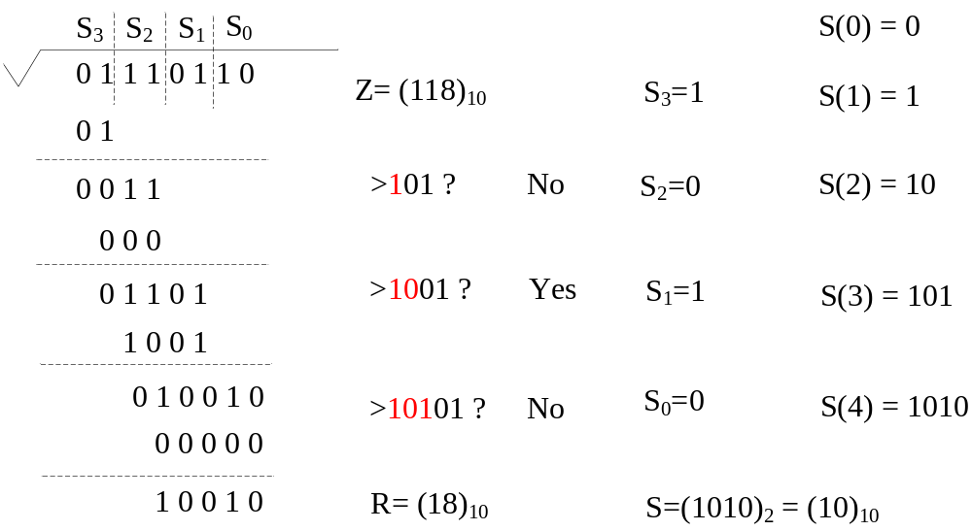
Pencil-and-Paper Algorithm Example

Slide 7
Restoring Algorithm (1/2)
For IEEE 754, following notations are used
  Z: Radicand Z₁Z₀.Z₋₁Z₋₂…Z_{-l} (1 <=Z <4)
  S: Square root 1.S₋₁S₋₂…S_{-l} (0 <=S <2)
  R: Scaled remainder R₁R₀.R₋₁R₋₂…R_{-l} (1 <=R <4)
Following recurrence equation is used to calculate the S:
  R(i) = 2R(i-1) – S_{-i}(2S(i-1)+2^{-i}S_{-i}) with
  R(0) = Z-1, S(0) = 1, R(l) = R
Where, the digit set of S is {0, 1}, thus the term
  S_{-i}(2S(i-1)+2^{-i}S_{-i}) will become 2S(i-1) + 2^{-i} or 0

Slide 8
Restoring Algorithm (2/2)
For each iteration I (i>0) perform following action:
  Step 1. R(i) = 2R(i-1) – (2S(i-1)+2^{-i})
  = 2R(i-1) – 2(S(i-1)+2^{-i-1})
  = 2R(i-1) – 2{S(i-1), 2’b01}
  Step 2. If R(i) >= 0
  S_{-i}= 1
  else
  S_{-i}= 0 and restore R(i), i.e., R(i) = 2R(i-1)

Slide 9
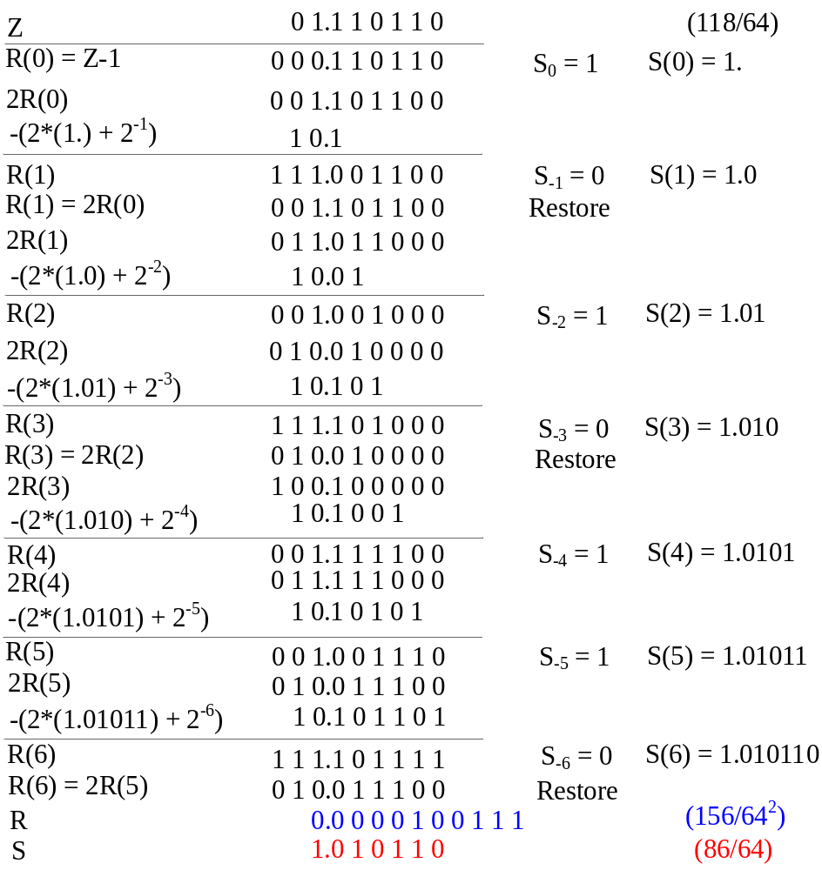
Restoring Algorithm Example

Slide 10
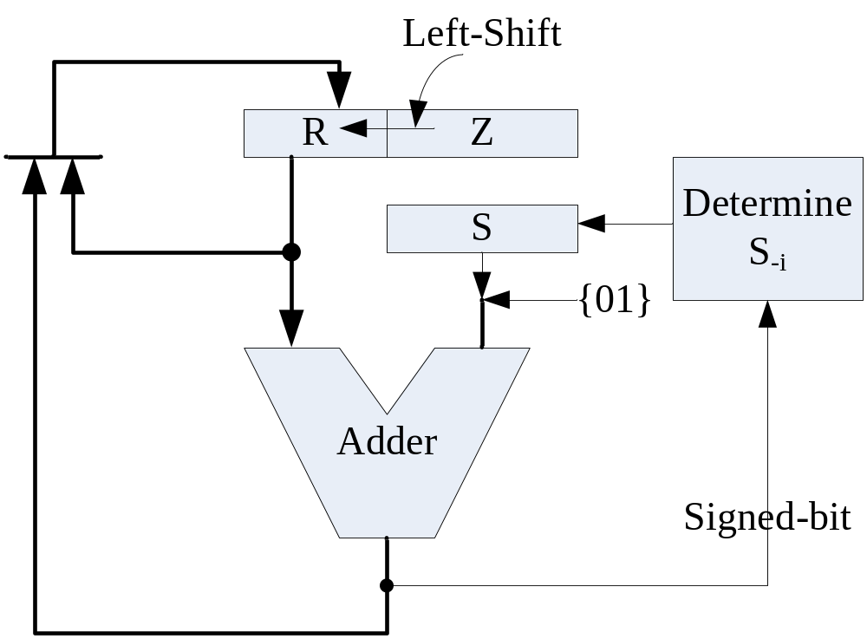
Restoring Algorithm HW Implementation

Slide 11
Non-Restoring Algorithm (1/2)
Following recurrence equation is used to calculate the S:
  R(i) = 2R(i-1) – S_{-i}(2S(i-1)+2^{-i}S_{-i}) with
  R(0) = Z-1, S(0) = 1, R(l) = R
Where, the digit set of S is {-1, 1}, thus the term
S_{-i}(2S(i-1)+2^{-i}S_{-i}) will become 2S(i-1) + 2^{-i} or –(2S(i-1)- 2^{-i})

Slide 12
Non-Restoring Algorithm (2/2)
Following algorithm is used to find final result
  for (i = 1; i<=l; i=i+1) begin
  if R(i-1) >= 0 begin
  S_{-i}= 1;
  R(i) = 2R(i-1) – (2S(i-1)+2^{-i}) ;
  end
  else begin
  S_{-i}= -1;
  R(i) = 2R(i-1) + (2S(i-1) - 2^{-i}) ;
  end
  end
  if R(l) < 0 begin
  R = R(l) + 2S(i-1) - 2^{-i ;}
  S = S(l) -1;
  end
  else begin
  R = R(l);
  S = S(l);
  end

Slide 13
On-The-Fly Square Root Conversion
Adopt 2 registers to store partial root
  Q = S(i);
  Q* = S(i) - 2^{-i}
Following rule is to determine Q & Q*
  S_{-i} = 1 => Q = {Q, 1’b1}, Q* = {Q, 1’b0}
  S_{-i} = -1 => Q = {Q*, 1’b1}, Q* = {Q*, 1’b0}
The terms 2S(i-1)+2^{-i} and 2S(i-1)- 2^{-i} will be formed as bellow
  2S(i-1)+2^{-i} = 2{Q, 2’b01}
  2S(i-1) -2^{-i} = 2(S(i-1)+2^{-i+1} - 2^{-i+1}) -2^{-i}
  = 2{(S(i-1) - 2^{-i+1}) + 2^{-i+1} -2^{-i-1}}
  = 2{Q*, 2’b11}
The final S is
  R(l) >=0 => S = Q;
  R(l) <0 => S = Q*

Slide 14
Modified Non-Restoring Algorithm
  for (i = 1; i<=l; i=i+1) begin
  if R(i-1) >= 0 begin
  S_{-i}= 1; Q= {Q, 1’b1}; Q* = {Q, 1’b0};
  R(i) = 2R(i-1) – 2{Q, 2’b01};
  end
  else begin
  S_{-i}= -1; Q= {Q*, 1’b1}; Q* = {Q* , 1’b0};
  R(i) = 2R(i-1) + 2{Q*, 2’b11};
  end
  end
  if R(l) < 0 begin
  R = R(l) + 2{Q, 2’b01};
  S = Q*;
  end
  else begin
  R = R(l);
  S = Q;
  end

Slide 15
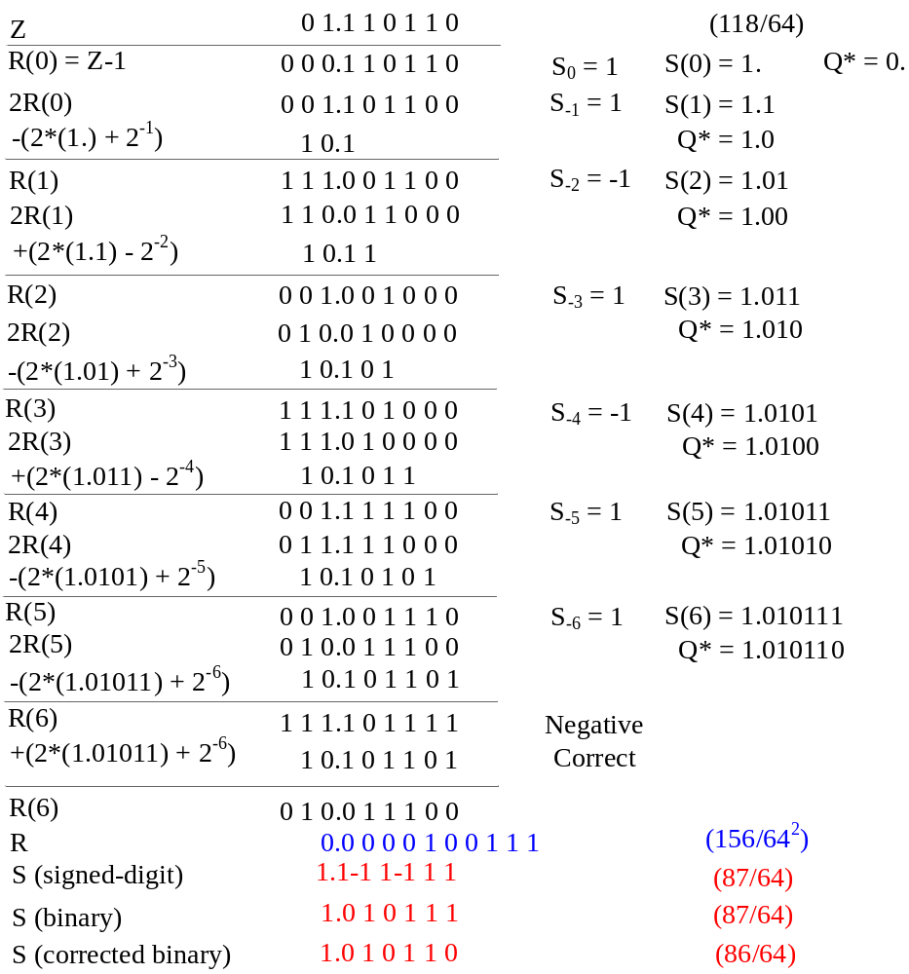
Non-Restoring Shift/Subtract Algorithm Example

Slide 16
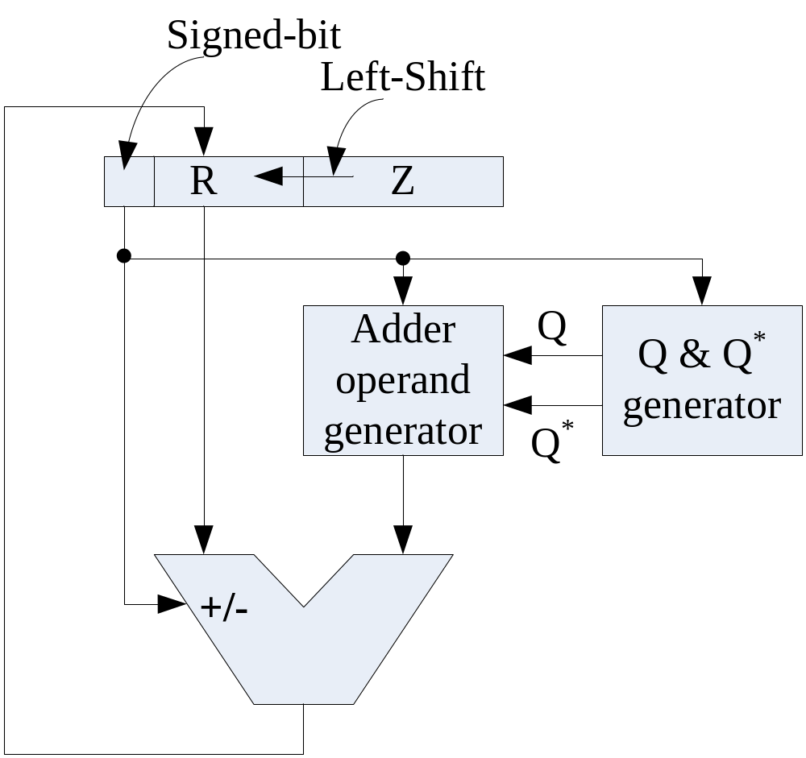
Non-Restoring HW Implementation

Slide 17
Radix-2 SRT Algorithm (1/2)
The digit set of S is {-1, 0, 1}
Need an extra rule to update Q & Q*
S_{-i} = 0 => Q = {Q, 1’b0}; Q* = {Q*, 1’b1};
To determine S_{-i} by following rule
S_{-i} = 1, if R(i-1) >= 1
S_{-i} = 0, if 1 > R(i-1) >= -1
S_{-i} = -1, if -1 > R(i-1)

Slide 18
Radix-2 SRT Algorithm (2/2)
  for (i> 0; i<=l; i=i+1) begin
  if R(i-1) >= 1 begin
  R(i) = 2R(i-1) – 2{Q, 2’b01};
  S_{-i}= 1; Q= {Q, 1’b1}; Q* = {Q, 1’b0};
  end
  else if 1> R(i-1) >= -1 begin
  R(i) = 2R(i-1);
  S_{-i}= 0; Q= {Q*, 1’b0}; Q* = {Q* , 1’b1};
  end
  else begin
  R(i) = 2R(i-1) + 2{Q*, 2’b11};
  S_{-i}= -1; Q= {Q*, 1’b1}; Q* = {Q* , 1’b0};
  end
  end
  if R(l) < 0 begin
  R = R(l) + 2S(i-1) + 2^{-i} ; (???)
  S = Q*;
  end
  else begin
  R = R(l);
  S = Q;
  end

Slide 19
High Radix Square Rooting
The recurrence for fraction radix-r square-rooting
R(i) = rR(i-1) – S_{-i}(2S(i-1)+r^{-i}S_{-i}),
For Radix-4,
  Recurrence equation
R(i) = 4R(i-1) – S_{-i}(2S(i-1)+4^{-i}S_{-i})
  The digit set of S is [-2, 2]
  Let
    Q = S(i-1)
    Q* = S(i-1) – 4^{-i}

Slide 20
Radix-4 SRT Square-Rooting (1/2)
R(i) = 4R(i-1) – X or 4R(i-1) + X depends on S_{-i}
S_{-i} | Operation | X
 |  | Form 1 | Form 2
2 | Sub | 4S(i-1)+2^{-2i+2} | 4{Q, 3’b010}
1 | Sub | 2S(i-1)+2^{-2i} | 2{Q, 3’b001}
0 | Shift only | 0 | 0
-1 | Add | 2S(i-1)-2^{-2i} | 2{Q*, 3’b111}
-2 | Add | 4S(i-1)-2^{-2i+2} | 4{Q*, 3’b110}

Slide 21
Radix-4 SRT Square-Rooting (2/2)
Updating rule of Q & Q*
S_{-i} | Q(i) | Q*(i)
2 | {Q(i-1), 2’b10} | {Q(i-1), 2’b01}
1 | {Q(i-1), 2’b01} | {Q(i-1), 2’b00}
0 | {Q(i-1), 2’b00} | {Q*(i-1), 2’b11}
-1 | {Q*(i-1), 2’b11} | {Q*(i-1), 2’b10}
-2 | {Q*(i-1), 2’b10} | {Q*(i-1), 2’b01}

Slide 22
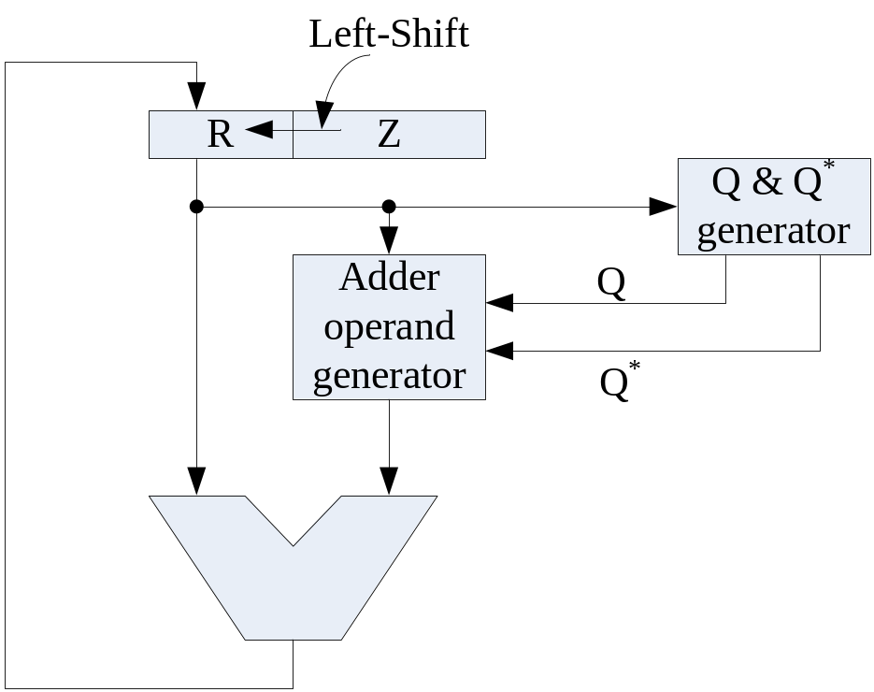
SRT Square-Rooting HW Implementation

