Slide 1
Andes FPU
Eric Chen
Architecture for Next-generation
Digital Engine for SoC

Slide 2
Outline
Introduction
Andes Floating-point registers
FPU Core u-Architecture
Instruction Decode Stage
Register File Stage
Add and Subtract
Multiply
Divide and Square-Root
Normalization and Rounding
Architecture for Next-generation
Digital Engine for SoC

Slide 3
Introduction
Floating Point Formats
  (-1)^{S}‧2^{e-bias}‧1.b₁b₂…b_{p-1}
Denormalized Number
  Single precision: e = 0, f ≠ 0, value = (-1)^{S}‧2⁻¹²⁶‧(0.f)
  Double precision: e = 0, f ≠ 0, value = (-1)^{S}‧2⁻¹⁰²²．(0.f)
Architecture for Next-generation
Digital Engine for SoC

Slide 4
Parameter | Single precision | Double precision
Bits of precision, p | 23+1 | 52+1
Representation of b0 integer bit | Hidden 1 | Hidden 1
Bits for Significand field (f) | 23 | 52
Significand range | [1 , 2 - 2⁻²³] | [1 , 2 - 2⁻⁵²]
Bits for Exponent field (e) | 8 | 11
Exponent bias | 127 | 1023
Max exponent, E_max (E-e-bias) | 127 (e == 254) | 1023 (e == 2046)
Minimum exponent, E_max (E-e-bias) | -126 (e == 1) | -1022 (e == 1)
Reserved Biased Exponent (e) | 0,255 | 0,2047
Architecture for Next-generation
Digital Engine for SoC

Slide 5
Introduction (cont’d)
Zero
  +0 : S = 0, e = 0, and f = 0
  -0 : S = 1, e = 0, and f = 0
Infinities
  +∞
    Single precision: S = 0, e = 255 (0xFF), and f = 0
    Double precision: S = 0, e = 2047 (0x7FF), and f = 0
  -∞
    Single precision: S = 1, e = 255 (0xFF), and f = 0
    Double precision: S = 1, e = 2047 (0x7FF), and f = 0
Architecture for Next-generation
Digital Engine for SoC

Slide 6
Introduction (cont’d)
NaNs
  Single precision: e = 255 (0xFF), and f ≠ 0, regardless of S
  Double precision: e = 2047 (0x7FF), and f ≠ 0, regardless of S
  Single precision
    Signaling NaNs: Bit[22] = 0, others: any, but ≠ 0
    Quiet NaNs: Bit[22] = 1 , others: any, but ≠ 0
  Double precision
    Signaling NaNs: Bit[51] = 0 , others: any, but ≠ 0
    Quiet NaNs: Bit[51] = 1 , others: any, but ≠ 0
Floating-point Format | New QNaN value
Single-precision | 0xFFFFFFFF
Double-precision | 0xFFFFFFFF FFFFFFFF
Architecture for Next-generation
Digital Engine for SoC

Slide 7
Introduction (cont’d)
IEEE Rounding Modes
  Round to Nearest (Even)
    The representable value nearest to the infinitely precise result shall be delivered
    Two nearest representable values are equally near, the one with its least significant bit zero (even) shall be delivered (default)
  Round towards +∞
  Round towards -∞
  Round towards 0
Architecture for Next-generation
Digital Engine for SoC

Slide 8

Introduction (cont’d)
Floating-point Exceptions
  Invalid Operation exception
    signaling NaN, (± ∞) + (∓ ∞), 0* ∞, 0/0, ∞/ ∞
    , translate NAN or ∞ to Integer
  Inexact exception
    rounded result overflows in non-trapped mode.
  Overflow exception
  Underflow exception
  Divide by Zero exception
0 11111110.111…1<= round 1
0 11111111.000…0 => ∞
Architecture for Next-generation
Digital Engine for SoC

Slide 9
Introduction (cont’d)
Non-IEEE Standard Required Exceptions
  Reserved instruction exception (core-generated):
    FUCOP_EXIST.FPUE = 0
  FPU disabled exception:
    FUCOP_EXIST.FPUE = 1 and FUCOP_CTL.FPUE=0
  Reserved instruction exception (FPU-generated):
    only one of SP or DP is implemented, out of FPCFG.FREG[0, Max-1]
  Denorm input exception:
    Flush-to-Zero mode in FPCSR is not turned on
Non-IEEE Flush-to-Zero Mode
Architecture for Next-generation
Digital Engine for SoC

Slide 10
Floating point instructions
Arithmetic Instructions
Compare Instructions
Copy and Move Instructions
Load and Store Instructions
Data Format Conversion Instructions
Architecture for Next-generation
Digital Engine for SoC

Slide 11
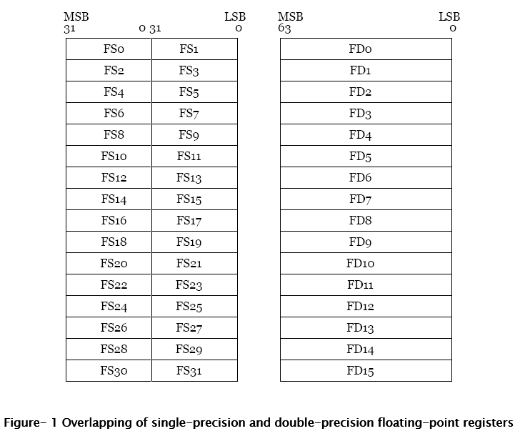
Andes Floating-point registers
The first 16 64-bit FP regs overlapped with the 32 32-bit single-precision FP regs
Architecture for Next-generation
Digital Engine for SoC

Slide 12
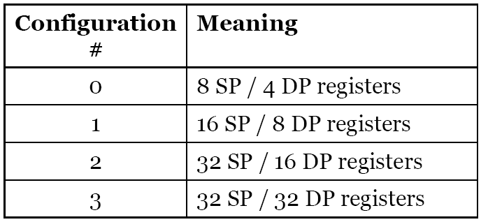
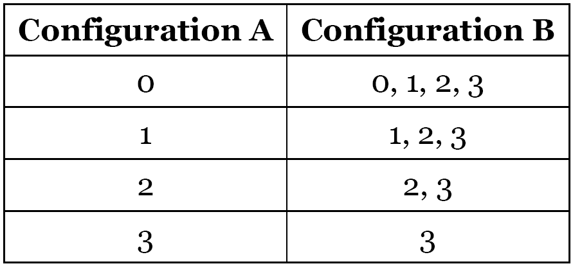
Configuration options
Architecture for Next-generation
Digital Engine for SoC

Slide 13
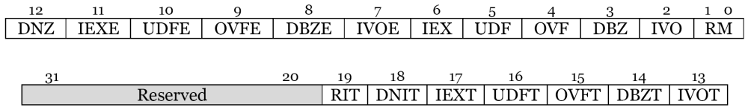
Other registers
FPCSR (Floating-Point Control & Status Register)
RM:
rounding mode
DNZ:
Denormalized
flush-to-Zero mode
DNIT:
Denormalized-input
exception type
RIT:
Reserved
instruction
exception type
 | cumulative exception flag | Trap enable | trap type (RO)
Invalid op | IVO | IVOE | IVOT
Divide by Zero | DBZ | DBZE | DBZT
Overflow | OVF | OVFE | OVFT
Underflow | UDF | UDFE | UDFT
Inexact | IEX | IEXE | IEXT
Architecture for Next-generation
Digital Engine for SoC

Slide 14
Other registers
FPCFG (Floating-Point Unit Configuration)
SP | SP extension exists?
DP | DP extension exists?
FREG | The number of single/double-precision floating-point registers
FMA | If fused-multiply-add instructions are supported
IMVER | FPU implementation and revision number.
AVER | FPU ISA extension architecture version number.
Architecture for Next-generation
Digital Engine for SoC

Slide 15
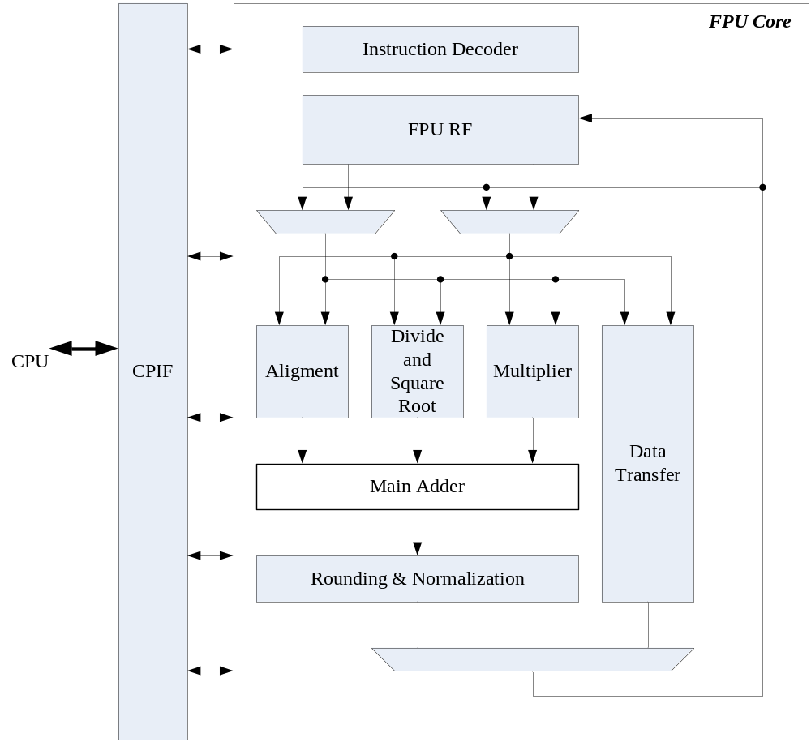
Andes FPU Block Diagram
Architecture for Next-generation
Digital Engine for SoC

Slide 16
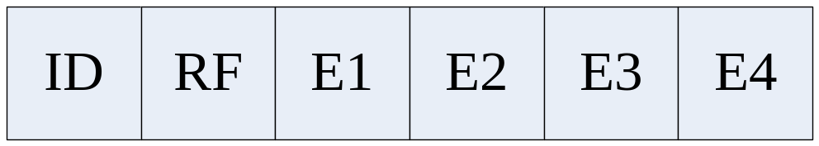
FPU Pipeline
ID: Instruction decode
RF: Register file accesses & dependency check
E1: The first multiply/alignment cycle (exp diff)
E2: The second multiply/alignment cycle
E3: The first post processing cycle
E4: Normalization, Rounding and Write back
Architecture for Next-generation
Digital Engine for SoC

Slide 17
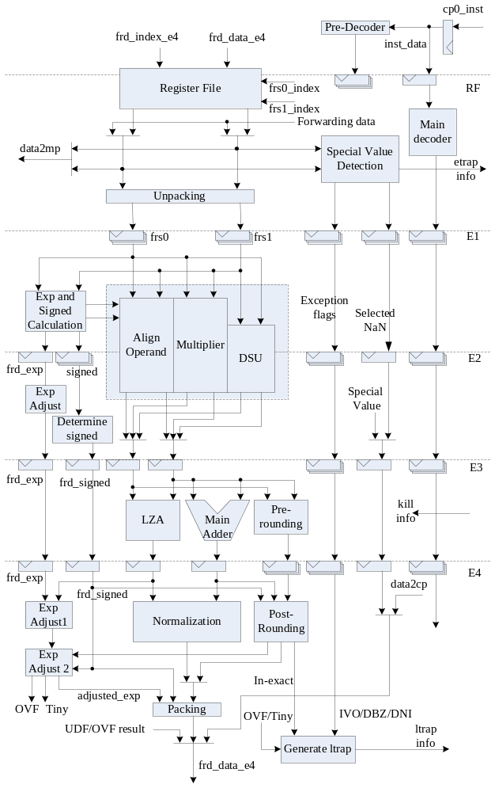
FPU Core
u-Architecture
Architecture for Next-generation
Digital Engine for SoC

Slide 18
Instruction Decode Stage
Receive instruction from CPIF and
pre-decode the FPU instruction
  The index to read data from register file.
  Operand data format for register read.
Architecture for Next-generation
Digital Engine for SoC

Slide 19
Register File Stage
Instruction decode
Register file access
Data hazard checking and data forwarding
Unpacking IEEE 754 data format
Detect following exception
  Reserved instruction
  Denormal input
  Invalid operation
  Divide by zero
Architecture for Next-generation
Digital Engine for SoC

Slide 20
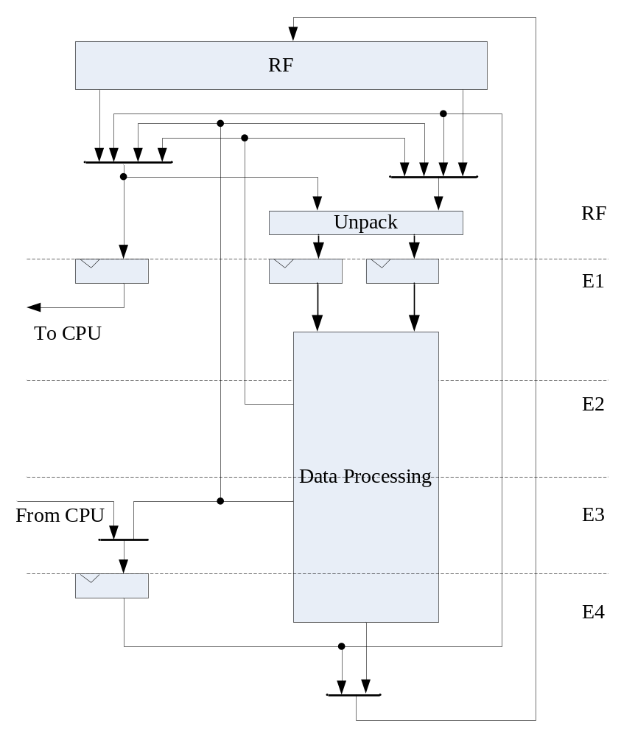
Forwarding Path
Consumer will be
stalled in RF stage
result is forward to RF
only forwards
the same precision result
Architecture for Next-generation
Digital Engine for SoC

Slide 21
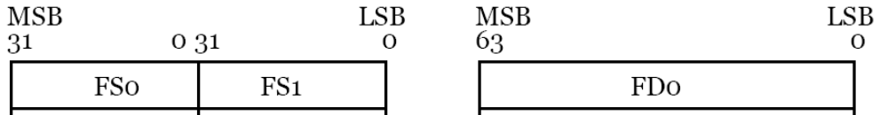
Unpacking Operand (RF stage)
If the operation type is DP or INT2FP
unpcak0_type = 0, else unpack0_type = 1
unpack1_type as well
frs0_signed = unpack0_type ? frs0_data_lo[31] : frs0_data_hi[31]
frs0_exp = unpack0_type ? {3’d0, frs0_data_lo[30:23]} : frs0_data_hi[30:20]
frs0_fraction = unpack0_type ? {30'd1, frs0_data_lo[22:0]} :
{1’b1, frs0_data_hi[19:0], frs0_data_lo[31:0]}
hi
lo
Architecture for Next-generation
Digital Engine for SoC

Slide 22
Add and Subtract
1.11001…x2^4
+1.00110…x2^2
1.11001…x2^4
+0.0100110x2^4
Alignment
  Shifting the operand with smaller exponent to right
  needs an adder to calculate the shifting amount
  needs an alignment (right-shift) barrel shifter
  For Rounding: 3 extra bits need to be generated.
  The guard bits: the 2 LSBs of alignment BS output the sticky bit: OR all of the bits which are shifted out
Calculation of Significand
  57-bit adder at E3 stage is adopted to calculate the sum or difference of two significands.
  2’s c sign bit +hidden 1 + 52 ma +RGS=57bits
Architecture for Next-generation
Digital Engine for SoC

Slide 23
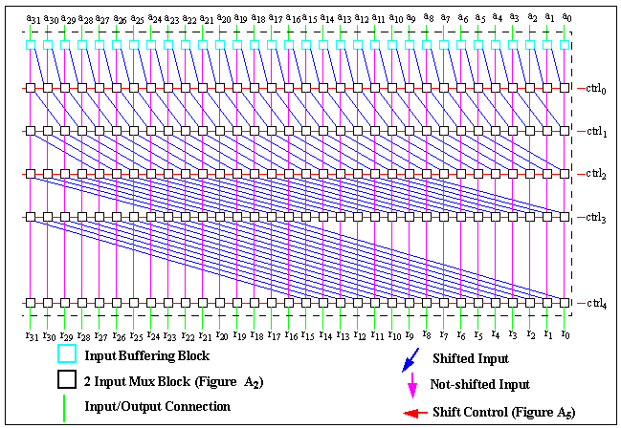
Barrel Shifter
Architecture for Next-generation
Digital Engine for SoC

Slide 24
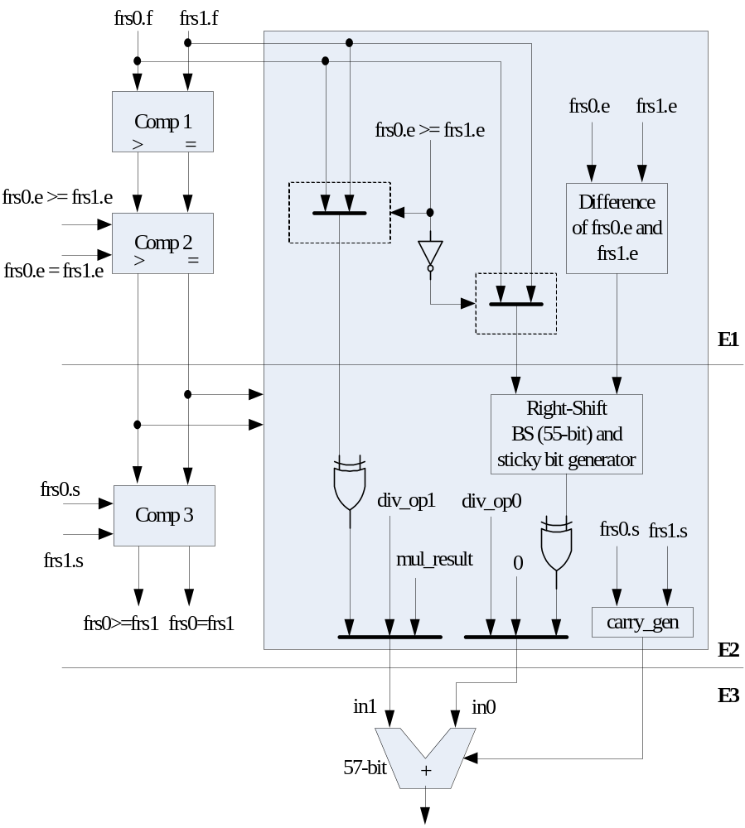
Architecture for Next-generation
Digital Engine for SoC

Slide 25
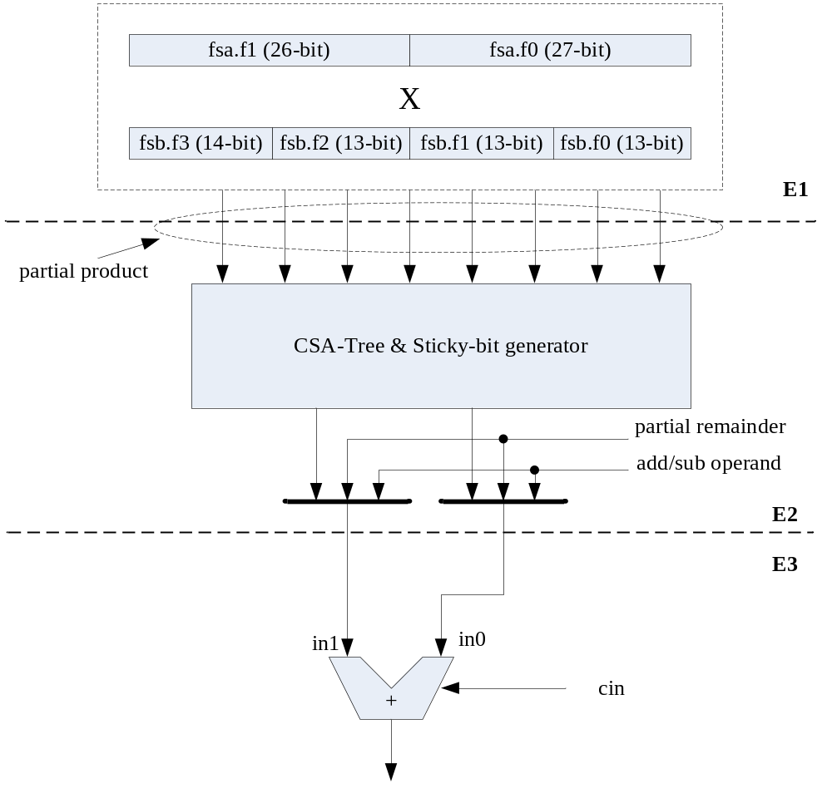
Multiply
(E1) is to generate partial products
(E2) is to sum up partial products via CSA (carry save adder).
(E3) is to calculate the final product.
Architecture for Next-generation
Digital Engine for SoC

Slide 26

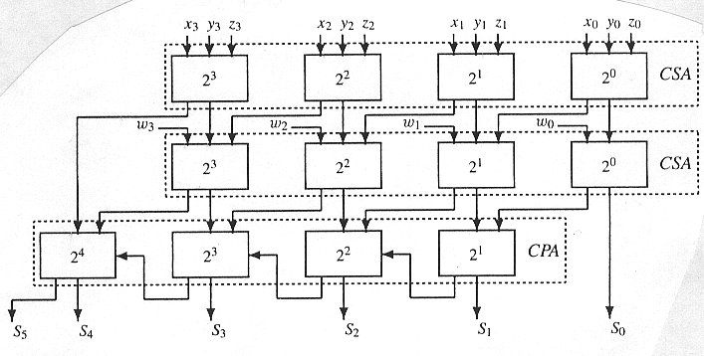

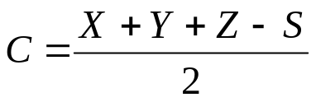
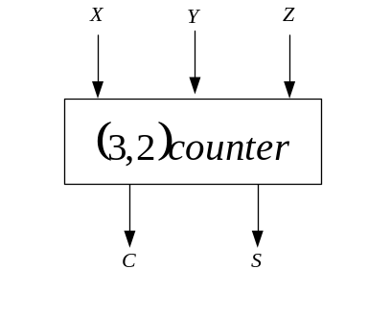
Carry Save Adder
`ifdef NDS_FPU_USE_DESIGN_WARE
// Slice 3
DW02_mult #(14, 14) u_mul_pp33 (
.A(mul_op1_e1[52:39]),
.B(mul_op2_e1[52:39]),
.TC(1'b0),
.PRODUCT(mul_pp33_e2_nx)
);
Architecture for Next-generation
Digital Engine for SoC

Slide 27
mul_pp00_e2_nx = mul_op1_e1[12:0] * mul_op2_e1[12:0]; //pp00*2^0 26 bits
mul_pp01_e2_nx = mul_op1_e1[12:0] * mul_op2_e1[25:13]; //pp01*2^13 (0+13)
mul_pp02_e2_nx = mul_op1_e1[12:0] * mul_op2_e1[38:26]; //pp02*2^26
mul_pp03_e2_nx = mul_op1_e1[12:0] * mul_op2_e1[52:39]; //pp03*2^39 27 bits
mul_pp10_e2_nx = mul_op1_e1[25:13] * mul_op2_e1[12:0]; //pp10*2^13
mul_pp11_e2_nx = mul_op1_e1[25:13] * mul_op2_e1[25:13]; //pp11*2^26 (13+13)
mul_pp12_e2_nx = mul_op1_e1[25:13] * mul_op2_e1[38:26]; //pp12*2^39
mul_pp13_e2_nx = mul_op1_e1[25:13] * mul_op2_e1[52:39]; //pp13*2^52 27 bits
mul_pp20_e2_nx = mul_op1_e1[38:26] * mul_op2_e1[12:0]; //pp20*2^26
mul_pp21_e2_nx = mul_op1_e1[38:26] * mul_op2_e1[25:13]; //pp21*2^39 (26+13)
mul_pp22_e2_nx = mul_op1_e1[38:26] * mul_op2_e1[38:26]; //pp22*2^52
mul_pp23_e2_nx = mul_op1_e1[38:26] * mul_op2_e1[52:39]; //pp23*2^65 27 bits
mul_pp30_e2_nx = mul_op1_e1[52:39] * mul_op2_e1[12:0]; //pp30*2^39 27 bits
mul_pp31_e2_nx = mul_op1_e1[52:39] * mul_op2_e1[25:13]; // pp31*2^52 (39+13)
mul_pp32_e2_nx = mul_op1_e1[52:39] * mul_op2_e1[38:26]; // pp32*2^65 27 bits
mul_pp33_e2_nx = mul_op1_e1[52:39] * mul_op2_e1[52:39]; // pp33*2^78 28 bits
Architecture for Next-generation
Digital Engine for SoC

Slide 28
Level 0
assign csa_l0_sum_0[12:0] = mul_pp00_e2[12:0];
assign csa_l0_cout_0[12:0] = 13'd0;
assign csa_l0_sum_1[38:0] = 39'd0;
assign csa_l0_cout_1[38:0] = 39'd0;
csa3_2 #13 u_csa_l0_0 (
.in0(mul_pp00_e2[25:13]), 2^13
.in1(mul_pp01_e2[12:0]), 2^13
.cin(mul_pp10_e2[12:0]), 2^13
.sum(csa_l0_sum_0[25:13]), 2^13
.cout(csa_l0_cout_0[25:13]) 2^13+1
);
csa3_2 #13 u_csa_l0_1 (
.in0(mul_pp01_e2[25:13]), 2^26
.in1(mul_pp02_e2[12:0]), 2^26
.cin(mul_pp10_e2[25:13]), 2^26
.sum(csa_l0_sum_0[38:26]), 2^26
.cout(csa_l0_cout_0[38:26])); 2^26+1
csa3_2 #13 u_csa_l0_2_0 (
.in0(mul_pp02_e2[25:13]), 2^39
.in1(mul_pp03_e2[12:0]), 2^39
.cin(mul_pp11_e2[25:13]), 2^39
.sum(csa_l0_sum_0[51:39]), 2^39
.cout(csa_l0_cout_0[51:39])); 2^39+1
pp00*2^0
pp01*2^13
pp10*2^13
pp02*2^26
pp03*2^39
pp11*2^26
pp00[25:13]
2^(13+0)
pp01[12:0]
2^(0+13)
pp10[12:0]
2^(0+13)
C S A
csa_10_c0[25:13]
2^(13+1)
csa_10_s0[25:13]
2^13
pp02[25:13]
2^(13+26)
pp03[12:0]
2^(0+39)
pp11[25:13]
2^(13+26)
C S A
csa_10_c0[51:39]
2^(39+1)
csa_10_s0[51:39]
2^39
Architecture for Next-generation
Digital Engine for SoC

Slide 29
csa3_2 #13 u_csa_l0_2_1 (
.in0(mul_pp12_e2[12:0]), //2^39
.in1(mul_pp20_e2[25:13]), //2^39
.cin(mul_pp21_e2[12:0]), //2^39
.sum(csa_l0_sum_1[51:39]), //2^39
.cout(csa_l0_cout_1[51:39]) //2^39+1
);
csa3_2 #13 u_csa_l0_3_0 (
.in0(mul_pp12_e2[25:13]), //2^52
.in1(mul_pp13_e2[12:0]), //2^52
.cin(mul_pp21_e2[25:13]), //2^52
.sum(csa_l0_sum_0[64:52]), //2^52
.cout(csa_l0_cout_0[64:52]) //2^52+1
);
csa3_2 #13 u_csa_l0_3_1 (
.in0(mul_pp03_e2[25:13]), //2^52
.in1(mul_pp22_e2[12:0]), //2^52
.cin(mul_pp31_e2[12:0]), //2^52
.sum(csa_l0_sum_1[64:52]), //2^52
.cout(csa_l0_cout_1[64:52]) //2^52+1
);
{csa_l0_cout_0[65], csa_l0_sum_0[65]} = mul_pp03_e2[26] + mul_pp13_e2[13] + mul_pp22_e2[13];
{csa_l0_cout_1[65], csa_l0_sum_1[65]} = mul_pp23_e2[0] + mul_pp31_e2[13] + mul_pp32_e2[0];
pp12*2^39
pp13*2^52
pp21*2^39
pp22*2^52
pp12[25:13]
2^(13+39)
pp13[12:0]
2^(0+52)
pp21[25:13]
2^(13+39)
C S A
csa_10_c0[64:52]
2^(52+1)
csa_10_s0[64:52]
2^52
Architecture for Next-generation
Digital Engine for SoC

Slide 30
csa3_2 #12 u_csa_l0_4 (
.in0(mul_pp13_e2[25:14]), //2^66
.in1(mul_pp22_e2[25:14]), //2^66
.cin(mul_pp23_e2[12:1]), //2^66
.sum(csa_l0_sum_0[77:66]), //2^66
.cout(csa_l0_cout_0[77:66]) //2^66+1
);
csa3_2 #14 u_csa_l0_5 (
.in0(mul_pp23_e2[26:13]), //2^78
.in1(mul_pp32_e2[26:13]), //2^78
.cin(mul_pp33_e2[13:0]), //2^78
.sum(csa_l0_sum_0[91:78]), //2^78
.cout(csa_l0_cout_0[91:78]) //2^78+1
);
assign csa_l0_sum_0[105:92] = 14'd0;
assign csa_l0_cout_0[105:92] = 14'd0;
assign csa_l0_sum_1[105:66] = 40'd0;
assign csa_l0_cout_1[105:66] = 40'd0;
pp13[25:14]
2^(14+52)
pp22[25:14]
2^(14+39)
pp23[12:1]
2^(1+65)
C S A
csa_10_c0[77:66]
2^(66+1)
csa_10_s0[77:66]
2^66
pp13*2^52
pp22*2^52
pp23*2^65
Architecture for Next-generation
Digital Engine for SoC

Slide 31
Level 1
csa3_2 #13 u_csa_l1_0 (
.in0 (mul_pp11_e2[12:0]), //2^26
.in1 (mul_pp20_e2[12:0]), //2^26
.cin (csa_l0_cout_0[37:25]), //2^26
.sum (csa_l1_sum_0 [38:26]), //2^26
.cout(csa_l1_cout_0[38:26]) //2^26+1
);
assign {csa_l1_cout_0[39], csa_l1_sum_0[39]} = csa_l0_cout_0[38] + csa_l0_sum_1[39] + mul_pp30_e2[0];
csa3_2 #26 u_csa_l1_1 (
.in0 (mul_pp30_e2[26:1]), //2^40
.in1 (csa_l0_sum_1 [65:40]), //2^40
.cin (csa_l0_cout_1[64:39]), //2^40
.sum (csa_l1_sum_0 [65:40]), //2^40
.cout(csa_l1_cout_0[65:40]) //2^40+1
);
assign {csa_l1_cout_0[66], csa_l1_sum_0[66]} = csa_l0_cout_1[65] + mul_pp31_e2[14] + mul_pp32_e2[1];
csa3_2 #11 u_csa_l1_2 (
.in0 (mul_pp31_e2[25:15]), //2^67
.in1 (mul_pp32_e2[12:2]), //2^67
.cin (csa_l0_cout_0[76:66]), //2^67
.sum (csa_l1_sum_0 [77:67]), //2^67
.cout(csa_l1_cout_0[77:67]) //2^67
);
assign {csa_l1_cout_0[78], csa_l1_sum_0[78]} = csa_l0_cout_0[77] + mul_pp13_e2[26] + mul_pp31_e2[26];
pp11[12:0]
2^(0+26)
pp20[12:0]
2^(0+26)
csa_10_c_0[37:25]
2^(1+65)
C S A
csa_11_c0[38:26]
2^(26+1)
csa_11_s0[38:26]
2^26
Architecture for Next-generation
Digital Engine for SoC

Slide 32
// Level 3
assign u_csa_l3_0_in0 = {csa_l0_cout_0[91:79], 13'd0, csa_l0_cout_0[65:39]};
assign u_csa_l3_0_in1 = {mul_pp33_e2[14], csa_l0_sum_0[91:80], csa_l2_sum_0[79:40]};
assign u_csa_l3_0_cin = {12'd0, csa_l2_cout_0[79:39]};
csa3_2 #53 u_csa_l3_0 (
.in0 (u_csa_l3_0_in0),
.in1 (u_csa_l3_0_in1),
.cin (u_csa_l3_0_cin),
.sum (csa_l3_sum_0 [92:40]),
.cout(csa_l3_cout_0[92:40])
);
assign csa_l3_sum_0 [39:0] = csa_l2_sum_0[39:0];
assign csa_l3_cout_0[39:0] = {1'b0, csa_l2_cout_0[38:0]};
assign csa_l3_sum_0 [105:93] = mul_pp33_e2[27:15];
assign csa_l3_cout_0[105:93] = 13'd0;
assign mul_final_pp0_e2 = mul_1st_cycle ? {28'd0, csa_l3_sum_0[48:21], 1'b0} ://24bx24b
csa_l3_sum_0[105:49]; //53bx53b=106b =>57b
assign mul_final_pp1_e2 = mul_1st_cycle ? {28'd0, csa_l3_cout_0[47:20], 1'b0} :
csa_l3_cout_0[104:48];
28b left only
Architecture for Next-generation
Digital Engine for SoC

Slide 33
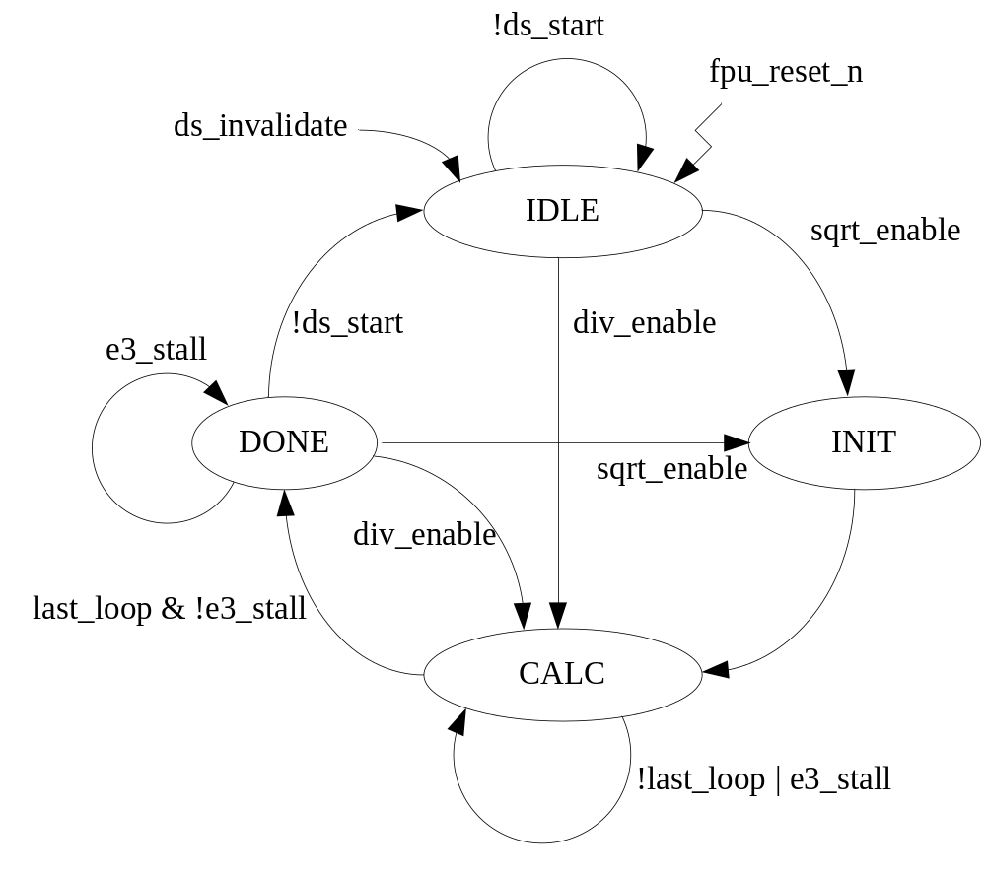
Divide and Square-Root Unit
DSU State Machine
IDLE: DSU initial/idle state.
No operation occurs in this state.
INIT: Initial operands for SQRT operation
CALC: At last cycle, two partial remainder is sent to main adder for sticky bit generation.
  SP: 13 cycles
  DP: 27 cycles
DONE: Output quotient/root
to main adder. The sticky bit
is generated at this state.
Architecture for Next-generation
Digital Engine for SoC

Slide 34
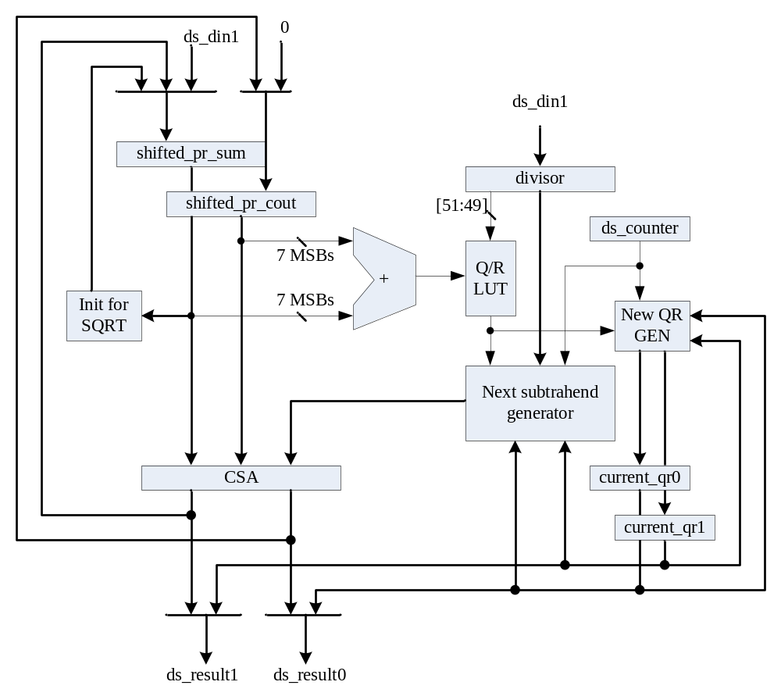
DSU
Datapath
Architecture for Next-generation
Digital Engine for SoC

Slide 35
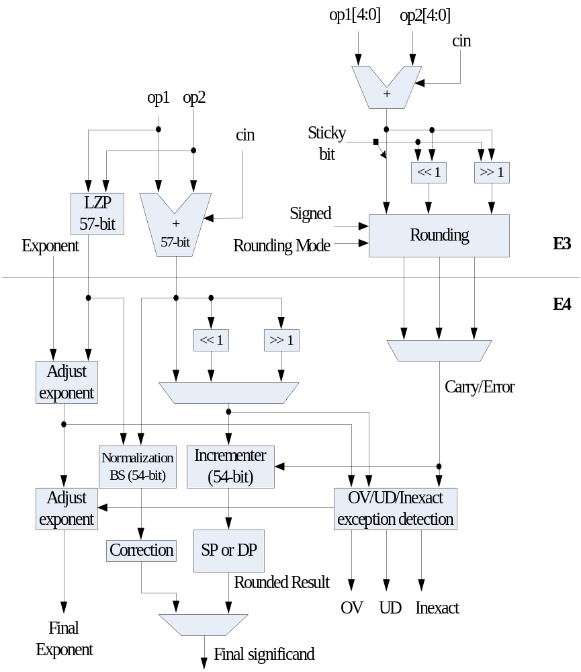
Normalization and Rounding
Architecture for Next-generation
Digital Engine for SoC

Slide 36
Rounding and normalization
At E3 stage, a pre-rounding process is adopted to generate 3 kinds of rounding carry and error
  not necessary to be shifted: (normalized)
  shifted right by 1-bit: in multi and sum of two ops.
  shifted left by 1-bit: in div and diff of two ops.
  shifted left by 2-bit :diff. of two closed operands
    inputs was shifted right by 1 bit or not , RGS=0
The normalization process
  to find the leading one position of main adder output
  generated the normalized number.
  needs a number of leading zero predictor or generator, and a barrel shift.
Architecture for Next-generation
Digital Engine for SoC

Slide 37
Thank You !!
Architecture for Next-generation
Digital Engine for SoC

Slide 38
assign mul_pp00_e2_nx = mul_op1_e1[12:0] * mul_op2_e1[12:0]; //13b*13b=26b
assign mul_pp01_e2_nx = mul_op1_e1[12:0] * mul_op2_e1[25:13]; //13b*13b=26b
assign mul_pp02_e2_nx = mul_op1_e1[12:0] * mul_op2_e1[38:26]; //13b*13b=26b
assign mul_pp03_e2_nx = mul_op1_e1[12:0] * mul_op2_e1[52:39]; //13b*14b=27b
assign mul_pp10_e2_nx = mul_op1_e1[25:13] * mul_op2_e1[12:0]; //13b*13b=26b
assign mul_pp11_e2_nx = mul_op1_e1[25:13] * mul_op2_e1[25:13]; //13b*13b=26b
assign mul_pp12_e2_nx = mul_op1_e1[25:13] * mul_op2_e1[38:26]; //13b*13b=26b
assign mul_pp13_e2_nx = mul_op1_e1[25:13] * mul_op2_e1[52:39]; //13b*14b=27b
assign mul_pp20_e2_nx = mul_op1_e1[38:26] * mul_op2_e1[12:0]; //13b*13b=26b
assign mul_pp21_e2_nx = mul_op1_e1[38:26] * mul_op2_e1[25:13]; //13b*13b=26b
assign mul_pp22_e2_nx = mul_op1_e1[38:26] * mul_op2_e1[38:26]; //13b*13b=26b
assign mul_pp23_e2_nx = mul_op1_e1[38:26] * mul_op2_e1[52:39]; //13b*14b=27b
assign mul_pp30_e2_nx = mul_op1_e1[52:39] * mul_op2_e1[12:0]; //14b*13b=27b
assign mul_pp31_e2_nx = mul_op1_e1[52:39] * mul_op2_e1[25:13]; //14b*13b=27b
assign mul_pp32_e2_nx = mul_op1_e1[52:39] * mul_op2_e1[38:26]; //14b*13b=27b
assign mul_pp33_e2_nx = mul_op1_e1[52:39] * mul_op2_e1[52:39]; //14b*14b=28b
Architecture for Next-generation
Digital Engine for SoC

