Slide 1
VFMAC Design Spec

Slide 2
instruction list
addition
fadd/vfadd/vfwadd: a*1+c
fsub/vfsub/vfwsub/vfrsub: a*1-c
multiply
fmul/vfmul/vfwmul: a*b+0
mac
fmadd/vfmadd/vfmacc/vfwmacc: a*b+c
fmsub/vfmsub/vfmsac/vfwmsac: a*b-c
fnmsub/vfnmsub/vfnmsac/vfwnmsac: -(a*b)+c
fnmadd/vfnmadd/vfnmacc/vfwnmacc: -(a*b)-c
reduction
dot-product

Slide 3
V2/F0 stage
Reduction/dot-product FSM
src_gen: VRF, scalar FRF selection
Constant generation
constant 1 for addition
constant 0 for multiplication: 0 for multiply is generated in F1, because dot-product needs f1_op3 to backup the addend
delay might be hide into
Operand SEW adjustment for widening operations
Pipe valid generation from FSM/mask

Slide 4
Data Path
expA
expB
expC
fracC
fracA
fracB
f1
inv
encode
special value detection
csa(56-a+b-c-bias)
Eff. sub
4:2 CSA
partial product reduction
164-bits align. shifter
partial sticky: st1
sign-ext
f2
164
st1
Eff. sub
3:2 CSA
110
164
eff. sub
d
LZA pos + neg
HA carry
HA sum
HA inv. carry
sign detection
eff. sub
Part of dual adder
Part of dual adder
complement : 161 bits compare
ha+partial adder: xor + xor + 2 aoi
LZA string
OR network
complement
f3
d<=2
lshift 54/25/12 bits
LZC_{subnorm}[6]
normalization
LZC_{subnorm}[5]
LZC_{subnorm}[0]
164bit = 1 // preserved 1 bit for big addend round to exp+1
+ 53 // addend
+ 2 // guard bits between addend and multiply result
+106 // multiply result
+ 2 // see subnormal corner case 1

Slide 5
after normalization
format
161 110 109 107 106 0
xx.x.......x xxx x......x
DP as an example
52
3
107
st1
dual adder
S+1 S
4-bit adder
carry/sticky calc
carry
sticky
f4
ovf
round decision
novf
4-bit adder
4-bit adder
Y0
Y1
Z
neg (a*b) + sub(c)
eff_sub = (neg ^ sign_a ^ sign_b) ^ (sub ^ sign_c)
final sign = eff_sub &comp. | (sub ^ sign(c))
inc
ovf = Y0[51] | Y1[51] & Z[4]
LSB correction
sticky
RI
RI = RUP & ~final_sign | RDN & final_sign
RN = RNE | RMM

Slide 6
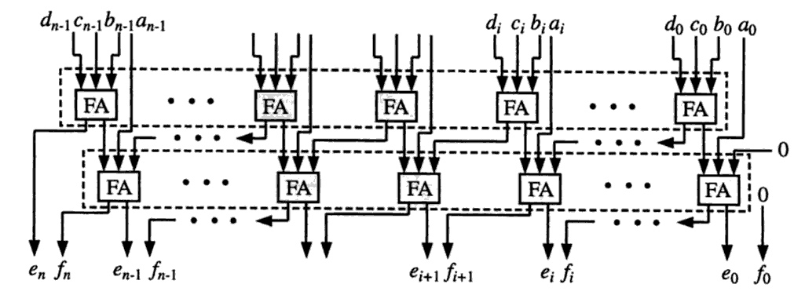
F1: 4:2 CSA
Don’t cascade two FAs directly, convert it to canonical form
Propagation Delay is about 1.5 times of 3:2 CSA

Slide 7
F1: Modified Booth Encoding
Partial product is sign-extended when encoded as -1X or -2X
To eliminate the width of CSA arrays:
invert the MSB of sign-extension bit of the multiplicand and rewrite the partial product into the grey background part + our new partial product:
The carry chain will be the same. But with the greyed out constants for sign-extension, we can add them together:

Slide 8
F1: Addend Alignment and Partial Sticky Bit Generation
d = expC` - expA` + expB` - bias
Alignment amount = 56-d

Slide 9
exponent calculation
align diff > 2
align_amount
x
…
x
x
…
exp = expC’ – eff_sub
0…0
x
…
eff. add
x
lzc_gt2 = align_amount
0…0
0
…
eff. sub
x
x
lzc_gt2 = align_amount +1
align diff <= 2
x
…
x
x
…
exp = expA’ + expB’ + 2 - lzc
0…0
x
x
x…x
55
LZC
without LZA error
0
1
x…x
with
LZA error
1
x
x…x

Slide 10
F2: LZA
LZA
eff. sub
LZA eff. add
LZA pos
LZA neg
sign detection
effective sub
LZA string
OR network
LZA string
OR network
LZA string
OR network
extra positive LZA cost
extra LZD cost

Slide 11
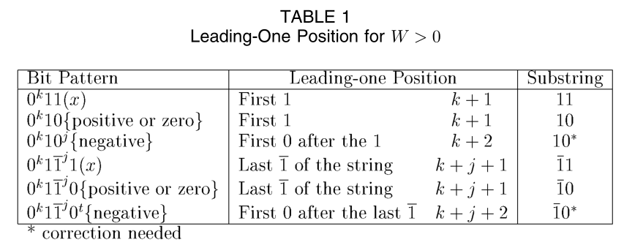
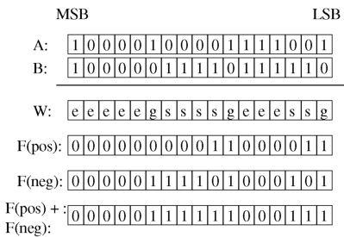
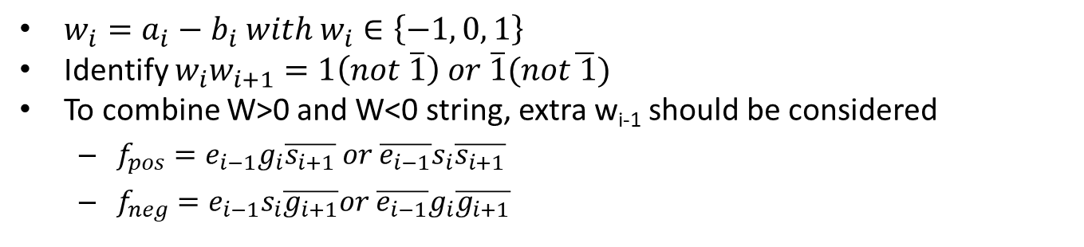
F2: LZA for A-B
$w_{i}=a_{i}−b_{i} with w_{i}∈\left\{−1, 0, 1\right\}$
Identify $w_{i}w_{i+1}=1\left(not \overline{1}\right) or \overline{1}(not\overline{ 1})$
To combine W>0 and W<0 string, extra w_{i-1} should be considered
$f_{pos}=e_{i−1}g_{i}\overline{s_{i+1}} or \overline{e_{i−1}}s_{i}\overline{s_{i+1}}$
$f_{neg}=e_{i−1}s_{i}\overline{g_{i+1}}or \overline{e_{i−1}}g_{i}\overline{g_{i+1}}$

Slide 12
F2: LZA
Only applicable to X-Y case, both X and Y > 0
Leading zero of X+Y can’t simply derive from max(expX, expY)
Normal + Normal * Sub-Normal
1.x * 2⁻¹⁰²⁰ + x.x * 2⁻¹⁰²⁰ =>
Normal * Sub-Normal produces a case

Slide 13
F2: Sign Detection
using tree comparator
A + B => normal case
A – B => compared with ~B
when A = ~B then A < B

Slide 14
F3: Normalization, sub-normal prediction
d = expC’ - expA’ + expB’
for DP, exp_{subnorm}=-1022
53
106
56-d < 0
C_{inv}
x
x
…
x
A*B
x
x
x
…
x
expC’ – LZC <= exp_{subnorm}
56-d < 0
56-1
106
d = 1
x
x
…
x
LZC
x
x
x
…
x
expA’ + expB’ + 56 – LZC <= exp_{subnorm}
56-d
106
d < 0
x
x
…
x
expA’ + expB’ + 56 – LZC <= exp_{subnorm}
LZC
x
x
x
…
x
LZC_{subnorm} = (56-d) < 0 ? expC’ – exp_{subnorm}
expA’ + expB’ + 56 - exp_{subnorm}
LZC[6] < LZC_{subnorm}[6]
Final LZC selection
LZC[5] < LZC_{subnorm}[5]
LZC[0] < LZC_{subnorm}[0]

Slide 15
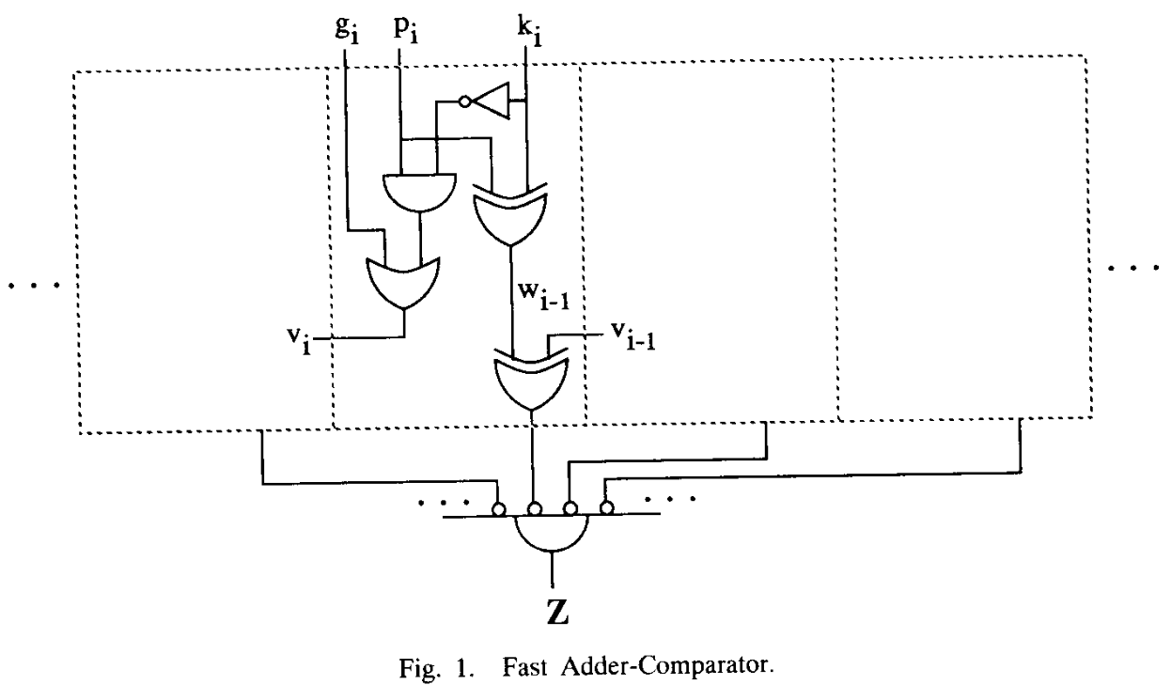
F4: sticky bit generation
Evalution of A+B=K Conditions Without Carry Propagation

Slide 16
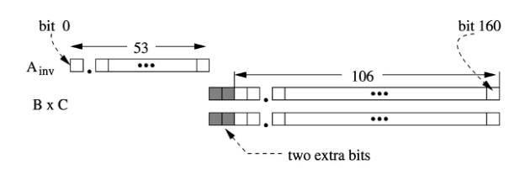
subnormal
Input
hidden 1 should be calculated from exponent
Result
right shift needed?
shift amount adjustment

Slide 17
critical path improvement opportunity
hidden 1 generation before partial sum encoding
no optimize
3:2 csa, latency = 1, 53-bit -> 27 partial product + 1 carry array
27 -> 18 -> 12 -> 8+1 -> 6 -> 4 ->3-> 2 = 7
4:2 csa, latency = 1.5
27+1 -> 14 -> 6+2 -> 4 -> 2 = 6
(a.x * b.y) = (ab+ay)+bx+xy :27+1 + 2 PPs
4:2 csa
27+1 -> 14+2 -> 8 -> 4 -> 2 = 6
summarize slow parts to one partial product:26+1+2 PPs
4:2 csa
26 -> 12+2+2 -> 8+1 -> 6 -> 4 -> 2 = 6.5
stick bit and final exponent selection on fraction = 0
can’t reuse A+PP CSA with A+B=K equation, the CSA used in F2 is A + PP
A+B=K ⇒ A+B+~K = -1 ⇒ 2C + S = -1 ⇒ 2C = ~S
slow bits
carry

Slide 18
MAC subnormal corner case 1
opA is minimum of subnormal 0x00000000_00001
opB is normal number
expC’ < expA’ + expB’ - 52
missing round bit, sticky bit
mul result
104
52
0
0
0
00…0 …
1
aligned addend
x
…
…
s

Slide 19
MAC subnormal corner case 2
Widening instruction with subnormal addend
and align diff > 3
LZA range 109b
mul result
104
align amount
x
x
…
0
000000
aligned addend
1
opC_lzc
solutions
extend LZA to 161 bits
extra 52 bits LZA
extra one level LZC OR-tree
recalculate normalization amount by opC LZC
LZC for opC subnormal input, one 23-bit LZC and one 10-bit LZC
Addition adder for alignamount + opC_lzc

Slide 20
UF exception
After rounding: the result is strictly between ±e^{min} as the exponent is unbounded
When the result is subnormal
When the result is round from subnormal to normal:
if the result is a subnormal when round as a normal number

Slide 21
backup slides

Slide 22
exponent calculation
src HP: 11 bits
x
…
src SP: 24 bits
x
…
src DP: 53 bits
x
…
x
x
…
align_amount:
DP fw.vv: 56 - expC + expA + expB - DP_BIAS
DP wid.vv: 56 - expC + expA + expB - SP_BIAS
DP wid.wv: 56 - expC + expA + expB + DP_BIAS - SP_BIAS * 2
f/w.vv/wv:
fw – fixed width
wid – widening
wv – op3 is widening
vv – op3 is not wideing
104

Slide 23
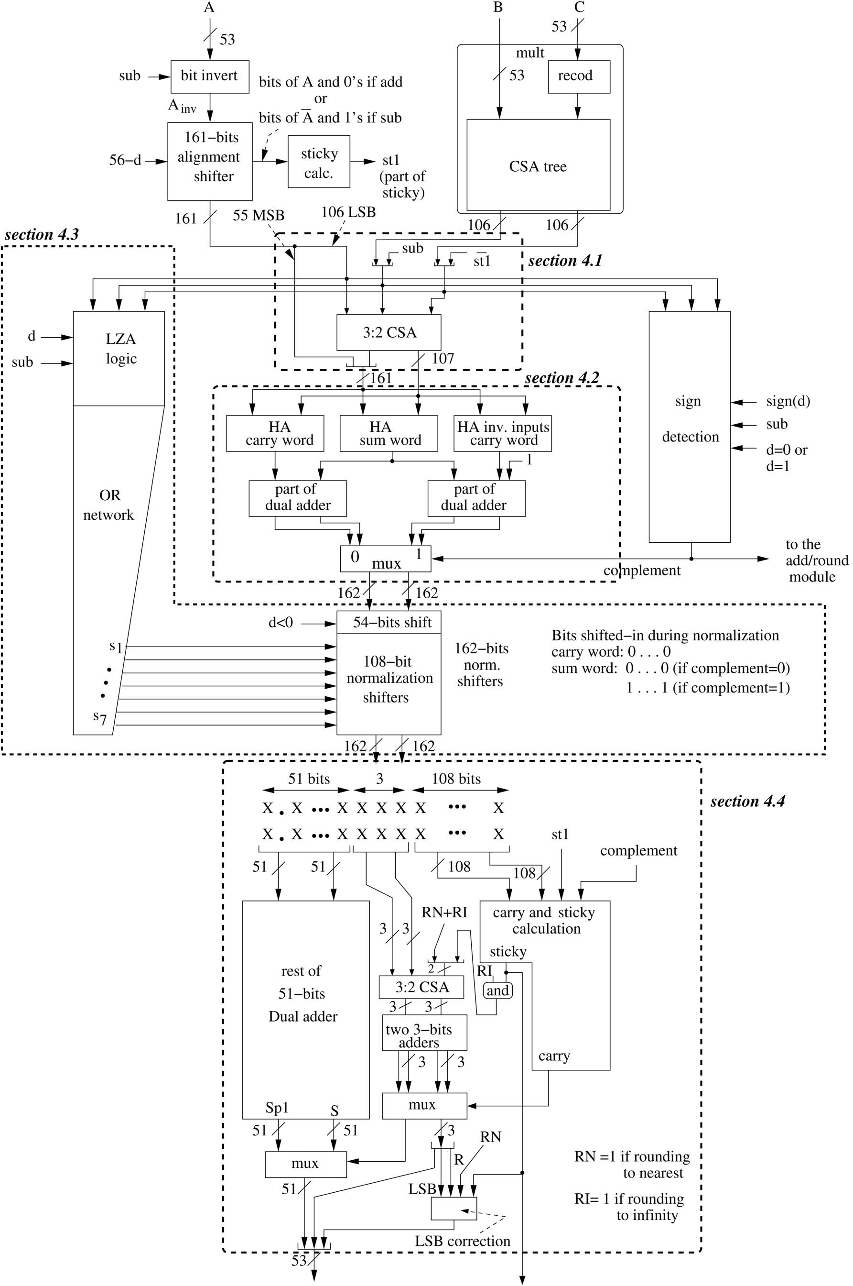

Slide 25
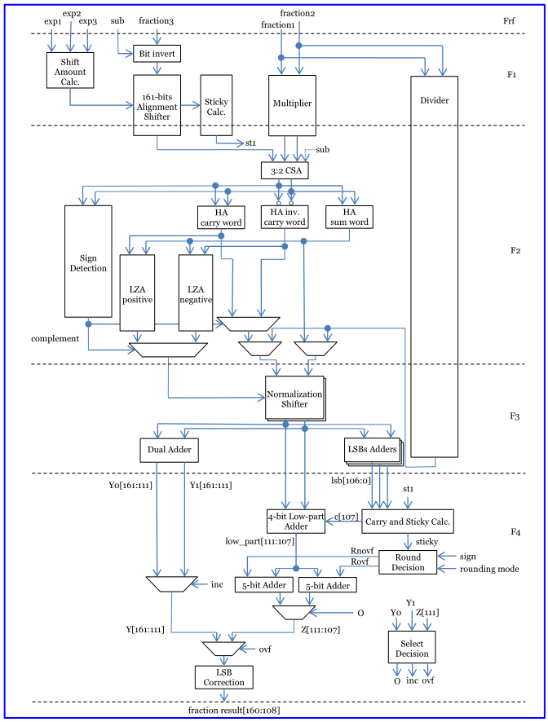

Slide 26
after normalization
format
0 50 51 53 54 161
x.x........x xxx x......x
DP as an example
51
3
108
st1
comp
dual adder
S+1 S
RI|RN
sticky
3-bit CSA
RI
adders
carry
4
4
carry
LSB
R
RN
LSB correction

