Slide 1
[Alpaca]: FPU DSU Revision
Driving Innovations™
Eric
2020/6/4

Slide 2
DSU Pipeline Instructions
Single width instruction only
Divide instructions
Floating-point divide
vfdiv.vv vd, vs2, vs1, vm # vector-vector, vm: mask
vfdiv.vf vd, vs2, rs1, vm # vector-scalar
Reverse floating-point divide vector = scalar / vector
vfrdiv.vf vd, vs2, rs1, vm # scalar-vector, vd[i] = f[rs1]/vs2[i]
Square root instruction
Floating-point square root
vfsqrt.v vd, vs2, vm # vector-vector square root

Slide 3
DSU Pipeline Instructions (cont’d)
Reciprocal Estimate Instructions
Vector Floating-Point Reciprocal Estimate Instruction
vfrece7.v vd, vs2, vm
# Floating-point reciprocal estimate to 7 bits.
Vector Floating-Point Reciprocal Square-Root Estimate Instruction
vfrsqrte7.v vd, vs2, vm
# Floating-point reciprocal square-root estimate to 7 bits.

Slide 4
Previous Design
Fast migrated from tightly coupled N25 FPU
F1 stage is dedicated for subnormal to normal conversion
Divide/Square-root operands are unpacked at F2
SRT iterations loops at F3 stage
At Sticky Generation state, remainder from Carry-Save Adder are added for result selection at next cycle
At Done state, the result is chosen (Q-1 if remainder is negative, else Q) and is right shift if result is subnormal
Rounding is done at F4 stage
Using Y0/Y1/z algorithm (z: LSB 4-bit add with round bit)

Slide 5
Previous Design (DIV Pipeline)
V2
VF1
VF2
VF3
Vector
Register
file
op1
Subnormal detection & normalization
div_op1
Divider
result0
op2
div_op2
result1
FSM
V2
VF1
div_op1
op1
Subnormal normalization
Subnormal detection
div_op2
op2
Subnormal normalization
Subnormal detection

Slide 6
Previous Design (DIV Pipeline)
VF2
VF3
VF4
rounding mode
remainder0
adder & stick Gen.
Round & Stick
remainder1
Round Decision
quotient_sel
quotient0
Subnormal Shifter
>>
quotient1
special value
detection
result
Result+1
exp
Special Value Detection

Slide 7
Detail Rounding Scheme of Previous DSU
VF2
VF3
VF4
5-bit adder
St1
Sum
Right Shifter
4-bit low part adder
5-bit adder
St1
sign
rounding mode
Subnorm?
LSB
Carry and stick Calc.
Round Decision
inc
ovf
LSB Correction & special value detection
MSBs Dual-adder
Result
1

Slide 8
Improvement Opportunity
Only one div/sqrt will be executed in DSU pipe
Four stages (3 groups of staging flop) are used
Use one group of staging flops to flop instruction at F2 stage
Special input values are detected at F2 stage
F1 stage is dedicated for I/P conversion, need to pipe original inputs to F2 stage
Detect special I/P at F1: only need to flop converted inputs
Rounding scheme Y0/Y1/Z is complicated
Used in DP MAC, for 161-bit CSA addition (107 sticky bits)
DSU DP result has only 58-bit (53 fraction, 1 round, 4 sticky bits)
Two 5-bit adders and a MUX for LZA prediction error
No LZA is needed for DSU result generation

Slide 9
Revision Items
One group of staging flop for 4 calculation state
Move special value detection from F2 to F1
Simplify rounding scheme to a simple 54-bit adder
Support Double Precision FPU divide/square root
Add DP subnormal I/P to normal RTL

Slide 10
DSU uArch
Special Value Detection
Operand 1 Subnormal Input Normalization
Operand 2 Subnormal Input Normalization
Exponent Calculation
FP1
Reg
Reg
F4 state
Result
Rounding
F3 state
Sticky Gen/
Subnormal
Right shift
F2 state
DSU
Radix-4
SRT
F3 state
Exception/ Subnormal
Prediction
F4 state
Exception
Detection
FP2
F4 state
Normal
Result Generation
Calculation state (SP:13 DP:27 cycles)
Sticky Gen state (CS form remainder)
Done state (Result, Result-1)
F4 state
Special Value
Generation

Slide 11
Operand1
Operand2
Subnorm Convert
Subnorm Convert
Special Value Detection
F1 state
Fraction1 Reg
Fraction2 Reg
Exponent1 Reg
Exponent2 Reg
Special Value Reg
bias
f2_op1_exp
f2_op2_exp
F2 state
div_enable
SRT
Subtractor
Subtractor
sqrt_enable
f2_sqrt_exp
f2_div_exp
f3_ds_exp_nx
1
Remainder0/Q0
Remainder1/Q1
Subtractor
f3_ds_exp_minus_1_nx
Remainder0
Remainder1
F3 state sticky gen
MSB
Adder
Sticky
Reg
Reg
to f4 round
Q0
Q1
f3_ds_exp
f3_ds_exp_minus_1
f4_dsu_exp_nx
f3_adj
F3 state ds result/ subnor shift
Subnormal Right Shift
f3_sbs_amount
Exception/Subnormal Prediction
f4_fraction_nx
f4_fraction
f4_dsu_exp
F4 state Result Rounding
F4 state Exception Detection
F4 state Exponent Calculation
F4 state Normal Result Generation
F4 state Special Value Generation

Slide 12
Subnormal Input Normalization
operand
Subnormal
Detection
Leading Zero Counter
msb
Normalization Barrel
Shifter
msb
Exponent
Adjustment
…
…
lsb
lsb
Normalized fraction
Normalized exponent

Slide 13
Rounding
DS result MSBs
DS result LSBs
Remainder sticky
rounding_mode
Round digit gen
54-bit round adder (DP)
Round result

Slide 14
Vfrece7 and Vfrsqrte7 instructions
Two stages design
F1:
subnormal => normalization,
special value input detection
F2:
Table lookup,
exception detection
special value output
Subnormal result right shifted
Exponent output calculation

Slide 15
Operand1
Normalization Barrel Shifter
Subnormal Leading Zero Detection
Exponent Calculation
F1 state
F2_exp[0]
Vfrece7 Table
Vfrsqrte7 Table
Subnormal Detection and Shift Amount Generation
F2 state
Subnormal Right Shift
subnorm_shamt
0
result_subnormal
fraction
exponent

Slide 16
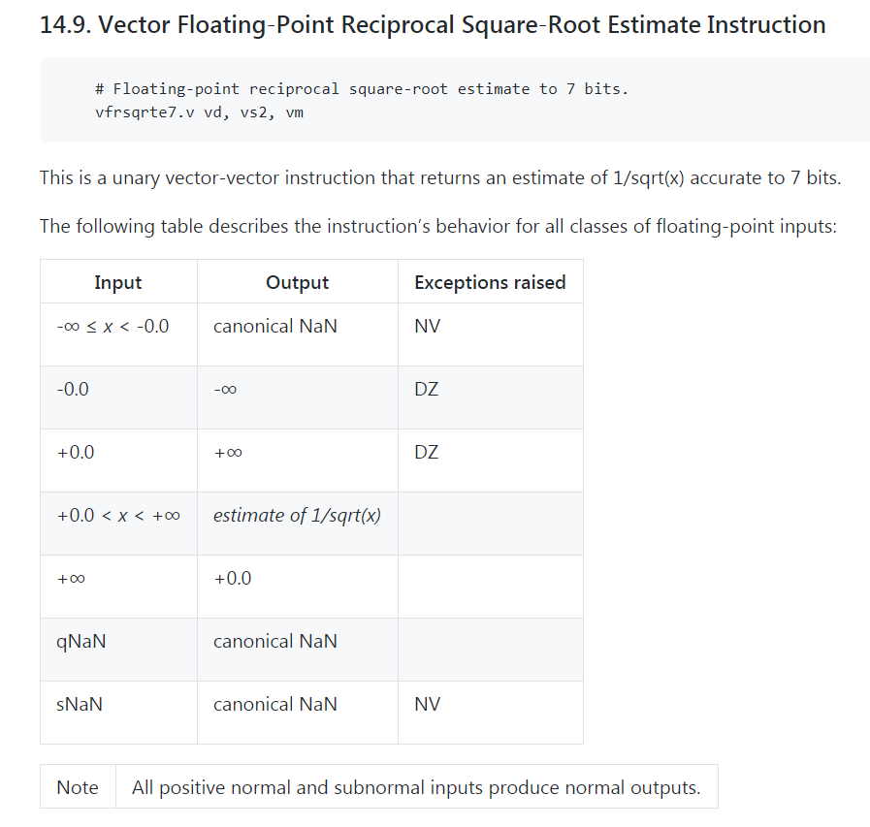

Slide 17
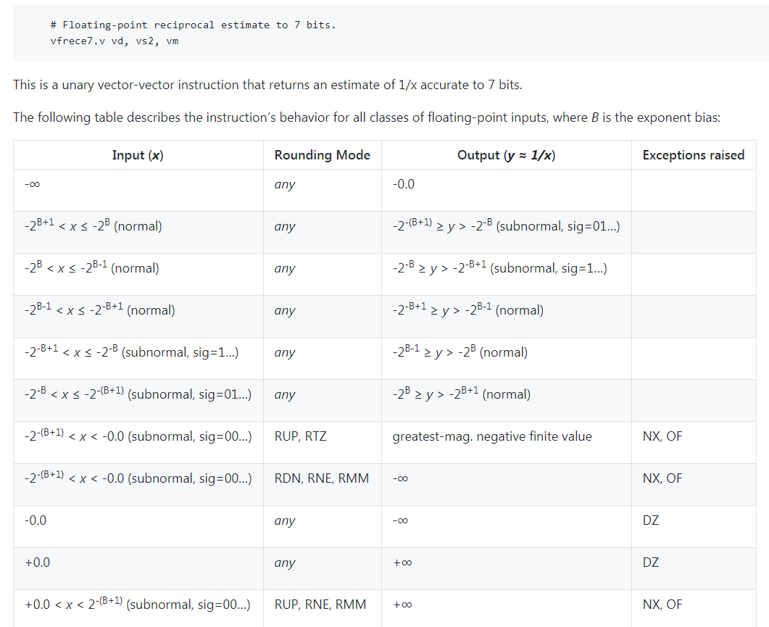

Slide 18
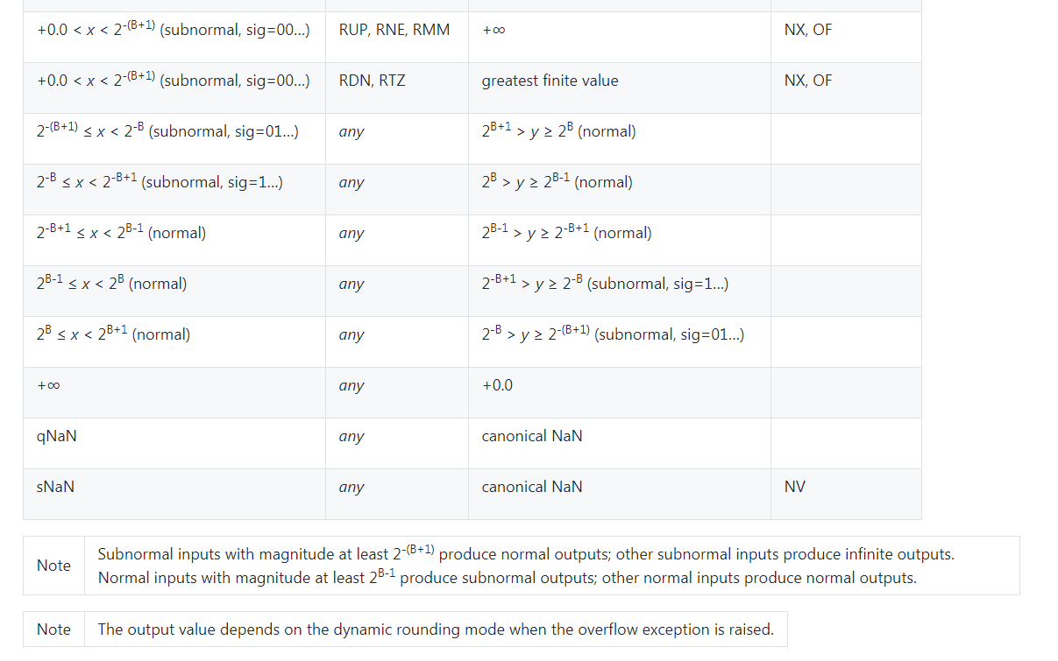

Slide 19
Thank You!

