Slide 1
FP SIMD DIV/SQRT uArch
202104
Larry

Slide 2
Agenda
List of abbreviation
Overview
Configuration
Interface
uArch Overview
FP DIV/SQRT/Estimation Instructions
Data Placement
Instruction list

Slide 3
List of abbreviation (1/)
Abbreviation | Definition
DSU | Divider and Square Root Unit
LZD | Leading zero detection
LZC | Leading zero count

Slide 4
List of parameter (1/)
Abbreviation | Definition
XLEN | The current width of an x register in bits (32 for RV32 or 64 for RV64)
FLEN | The current width of a f register in bits (32 for SP, 64 for DP)

Slide 5
Overview (1/)
2-stage pipeline
Supported data types
Instruction handling
FP DIV/SQRT instruction using radix-4 SRT algorithm
FP estimation instruction using look-up table
Precision | Width | Sign | Expo | Mant
HP | 16 | 1 | 5 | 10
SP | 32 | 1 | 8 | 23
DP | 64 | 1 | 11 | 52

Slide 6
Overview (2/)
Instruction latency
*DIV/SQRT instruction have not forwarding path
x is not supported
Instruction | Latency
 | Scalar |  | Vector
DIV/SQRT | HP | 13* | HP | 13*
 | SP | 20* | SP | 20*
 | DP | 34* | DP | 34*
VFRECE7 | x | x | 3*
VFRSQRTE7 | x | x | 3*

Slide 7
Configurability
Feature | Options
XLEN | 64
FLEN* | 16/32/64
VLEN | 512/256/128
SIMD_WIDTH | 512/256/128
ELEN* | 32/64
*If RVV = 0, FLEN can be configured to 32/64
*If RVV = 1, FLEN is equivalent to ELEN

Slide 8
Interface

Slide 9
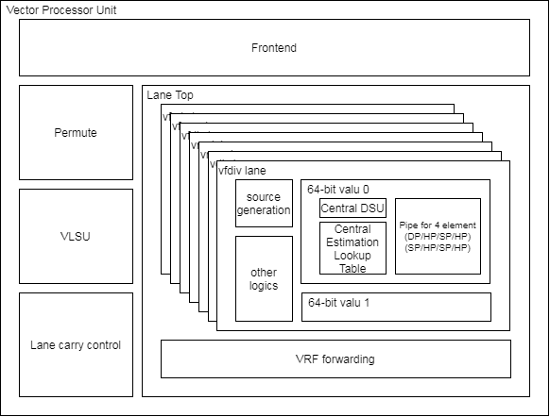
Pipe Interface (1/)
Module name is vc_vfp_fdiv64.v
Supported FLENs are 32/64 and XLEN is the same with FLEN
Hierarchy diagram

Slide 10
Pipe Interface (2/)
Signal name | Type | Description
core_clk | Input | Clock
core_reset_n | Input | Negative Edge Reset
f1_valid[3:0] | Input | Valid signal
f1_ex_ctrl[4:0] | Input | Control signal for encoding. More info in instruction encoding slide.
f1_sew[2:0] | Input | Indicate element width
f1_ediv | Input | Un-used
f1_round_mode[2:0] | Input | Round mode. 3’b000: RNE, 3’b001: RTZ, 3’b010: RDN, 3’b011: RUP, 3’b100: RMM
f1_op1_data[63:0] | Input | Source oprand1. The format is {DP}, {SP, SP} or {HP,HP,HP,HP}. DP, SP and HP width are 64-bit, 32-bit and 16bit
f1_op2_data[63:0] | Input | Source oprand2. The format is {DP}, {SP, SP} or {HP,HP,HP,HP}. DP, SP and HP width are 64-bit, 32-bit and 16bit

Slide 11
Pipe Interface (3/)
Signal name | Type | Description
f2_result_type | Output | Result data type 2’b11 → DP, scalar FPU 2’b01 → SP 2’b00 → HP
f2_wdata_en[7:0] | Output | Write enable.
f2_wdata[63:0] | Output | Result data. Result format is {DP}, {SP, SP} or {HP,HP,HP,HP} DP, SP and HP width are 64-bit, 32-bit and 16bit
f2_flag_set[4:0] | Output | Result flag {,nx}

Slide 12
uArch overview

Slide 13
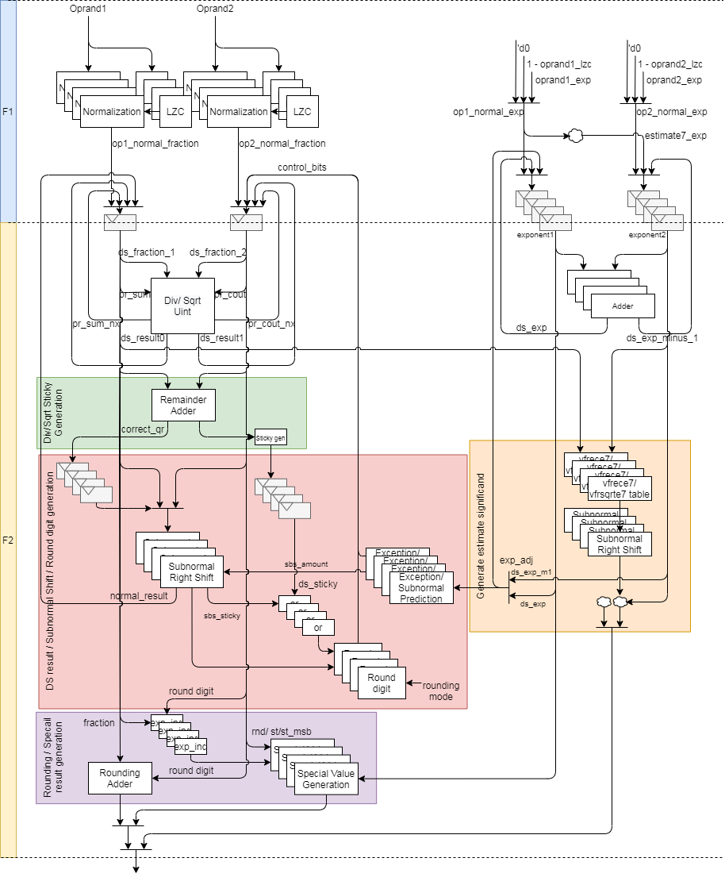
FDIV uArch (1/)
*Remainder and rounding adder blocks share 67-bit adder

Slide 14
FDIV uArch (2/)
Div instruction datapath
Step 1: Normalize source value
Step 2: Compute result by DSU
Step 3: Calculate sticky
Step 4: Shift right for subnormal
Step 5: Do rounding
Sqrt instruction datapath
Step 1: normalize source value
Step 2: Compute result by DSU
Step 3: Calculate sticky
Step 4: Shift right for subnormal
Step 5: Do rounding

Slide 15
FDIV uArch (3/)
Vector estimation instruction

Slide 16
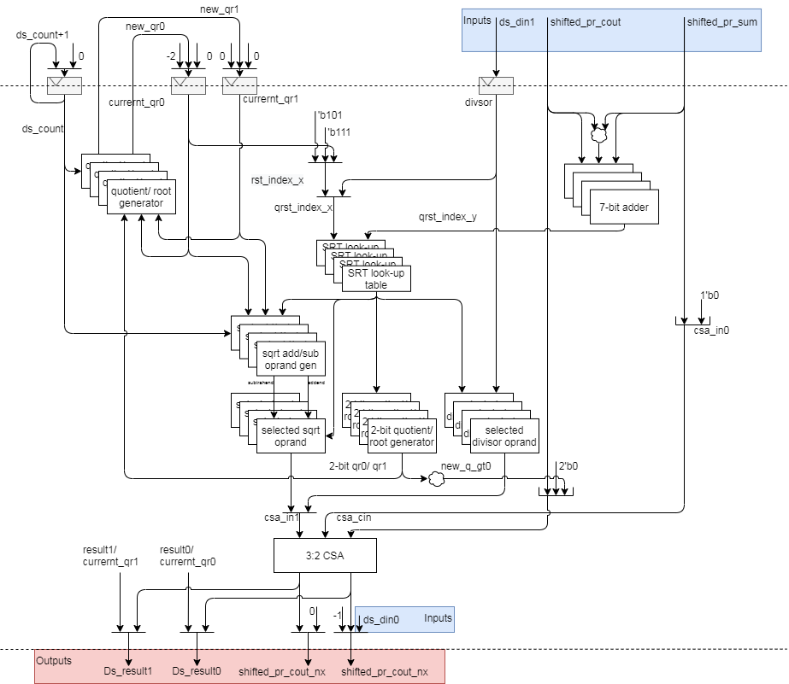
FDIV uArch (4/)
DSU Datapath
Input
Output
For 2’sc

Slide 17
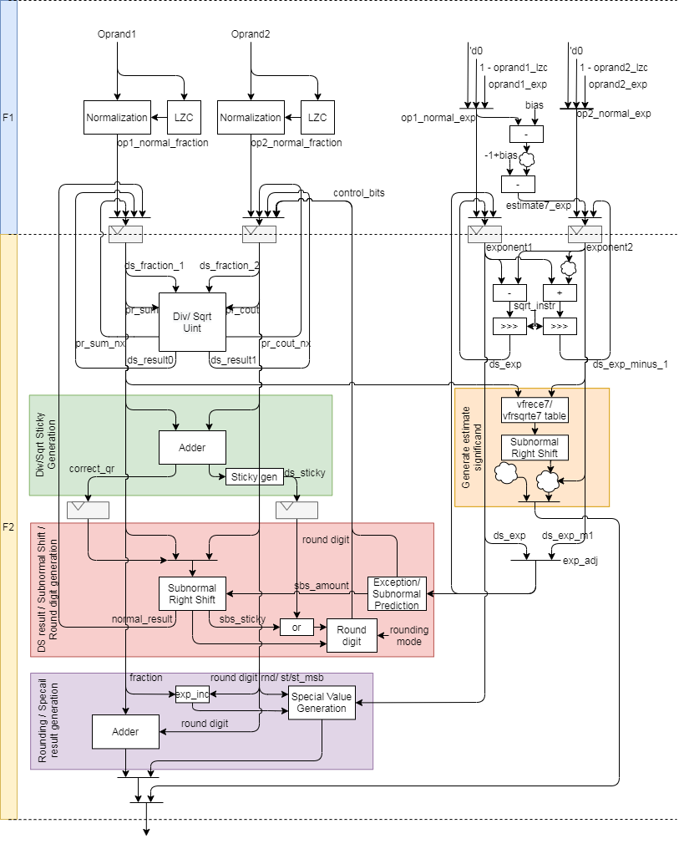
FDIV uArch - Compare (5/)
For 1 element
For 4 elements
Red circles indicates shared logics

Slide 18
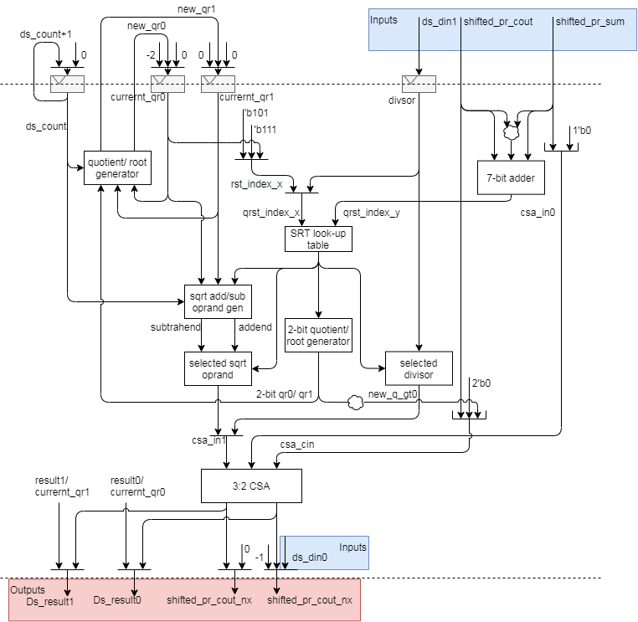
FDIV uArch - Compare (6/)
For 1 element
For 4 elements
Red circles indicates shared logics

Slide 19
FP DIV/SQRT/Estimation Instructions

Slide 20
FP DIV/SQRT/Estimation Instructions
The detail is FDIV_design_spec in T:\users\klmn\larryzzr\FP_design_spec_Larry\FDIV

Slide 21
Data placement

Slide 22
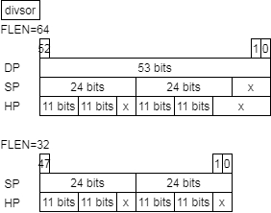
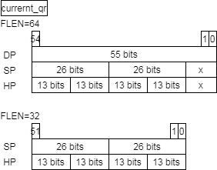
Data Placement – DSU (1/)

Slide 23
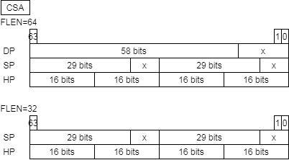
Data Placement – DSU (2/)

Slide 24
Data Placement – DSU (3/)
The following table show reduced FFs
Name | Before |  | After |  | Reduce FFs
FLEN | 64 | 32 | 64 | 32 | 64 | 32
Divisor | 99 | 70 | 53 | 48 | 46 | 22
Current_qr0/1 | 214 | 156 | 110 | 104 | 114 | 52
Counter | 15 | 14 | 5 | 4 | 10 | 10
ds_ctr_cs | 8 |  | 2 |  | 6
ds_busy | 4 |  | 1 |  | 3
 |  |  |  |  | 179 | 93

Slide 25
Data Placement – DSU (4/)
The following table show reduced logics
Name | Before |  | After
FLEN | 64 | 32 | 64 | 32
CSA | 58-bit CSA 29-bit CSA 2x16-bit CSA | 2x29-bit CSA 2x16-bit CSA | 64-bit CSA

Slide 26
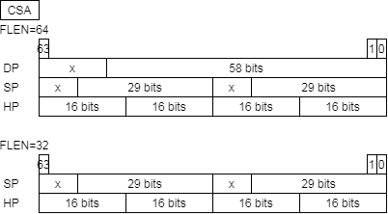

Data Placement – VFP_FIV64 (5/)

Slide 27
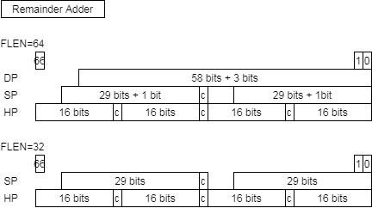
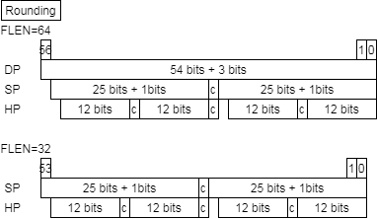
Data Placement – VFP_FIV64 (6/)

Slide 28
Data Placement – VFP_FIV64 (7/)
The following table show reduced FFs
Name | Before |  | After |  | Reduce FFs
FLEN | 64 | 32 | 64 | 32 | 64 | 32
CSA/Result(staging FFs) | 238 | 180 | 128 | 128 | 110 | 52
ds_busy_d1 | 4 |  | 1 |  | 3
f2_scalar_fpu_instr | 4 |  | 1 |  | 3
f2_frs_hp | 4 |  | 1 |  | 3
f2_frs_sp | 4 |  | 1 |  | 3
f2_frs_dp | 4 |  | 1 |  | 3
f2_round_mode | 12 |  | 3 |  | 9
f2_div_instr | 4 |  | 1 |  | 3
f2_sqrt_instr | 4 |  | 1 |  | 3
f2_vfrece7_instr | 4 |  | 1 |  | 3
f2_vfrsqrte7_instr | 4 |  | 1 |  | 3
 |  |  |  |  | 146 | 88

Slide 29
Data Placement – VFP_FIV64 (8/)
The following table show reduced logics
Name | Before |  | After
FLEN | 64 | 32 | 64 | 32
Remainder adder | 58-bit adder 29-bit adder 2x16-bit adder | 2x29-bit adder 2x16-bit adder | 67-bit adder
Rounding adder | 54-bit adder 25-bit adder 2x12-bit adder | 2x25-bit adder 2x12-bit adder

Slide 30
Data Placement – Summary (9/)
The following table show reduced FFs
Name | Before |  | After |  | Reduce FFs
FLEN | 64 | 32 | 64 | 32 | 64 | 32
VFP_FDIV64 |  |  |  |  | 146 | 88
DSU |  |  |  |  | 179 | 93
 |  |  |  |  | 325 | 181
VLEN=512 |  |  |  |  | 2600 | 1448

Slide 31
Data Placement – Summary (10/)
The following table show reduced logics
Name | Before |  | After
FLEN | 64 | 32 | 64 | 32 | 64 | 32
CSA | 58-bit CSA 29-bit CSA 2x16-bit CSA | 2x29-bit CSA 2x16-bit CSA | 64-bit CSA |  | 55 FAs | 26 FAs
Remainder adder | 58-bit adder 29-bit adder 2x16-bit adder | 2x29-bit adder 2x16-bit adder | 67-bit adder
Rounding adder | 54-bit adder 25-bit adder 2x12-bit adder | 2x25-bit adder 2x12-bit adder

Slide 32
Instruction list

Slide 33
Instruction list
The fdiv function unit encoding

Slide 34
Interface

Slide 35
Pipe Interface (1/)
Module name is vc_vfp_fdiv64.v
Supported FLENs are 32/64 and XLEN is the same with FLEN
Hierarchy diagram

Slide 36
Pipe Interface (2/)
Signal name | Type | Description
core_clk | Input | Clock
core_reset_n | Input | Negative Edge Reset
f1_valid | Input | Valid signal
f1_ex_ctrl | Input | Control signal for encoding. More info in instruction encoding slide.
f1_sew | Input | Indicate element width
f1_ediv | Input | Un-used
f1_round_mode | Input | Round mode. 3’b000: RNE, 3’b001: RTZ, 3’b010: RDN, 3’b011: RUP, 3’b100: RMM
f1_op1_data | Input | Source oprand1. The format is {DP}, {SP, SP} or {HP,HP,HP,HP}. DP, SP and HP width are 64-bit, 32-bit and 16bit
f1_op2_data | Input | Source oprand2. The format is {DP}, {SP, SP} or {HP,HP,HP,HP}. DP, SP and HP width are 64-bit, 32-bit and 16bit

Slide 37
Pipe Interface (3/)
Signal name | Type | Description
f2_result_type | Output | Result data type 2’b11 → DP, scalar FPU 2’b01 → SP 2’b00 → HP
f2_wdata_en | Output | Write enable.
f2_wdata | Output | Result data. Result format is {DP}, {SP, SP} or {HP,HP,HP,HP} DP, SP and HP width are 64-bit, 32-bit and 16bit
f2_flag_set | Output | Result flag

