Slide 1
FP MISC uArch
202012
Larry

Slide 2
Agenda
List of abbreviation/parameter
Overview
Configuration
Interface (TODO)
uArch overview
Conversion Instructions
Round digit/2’sc inc generation
Comparing & Others instructions
Cross Lane Forwarding Path
Enhancements
Data Alignment
Instruction list
Instruction encoding (TODO)

Slide 3
List of abbreviation (1/)
Abbreviation | Definition
F2I/F2F/I2F | F: Floating-point, I: integer
ABS | Alignment barrel shift
NBS | Normalization barrel shift
2’sc | 2’s complement
LZD | Leading zero detection
LZC | Leading zero count

Slide 4
List of parameter (1/)
Abbreviation | Definition
XLEN | The current width of an x register in bits (32 for RV32 or 64 for RV64)
FLEN | The current width of a f register in bits (32 for SP, 64 for DP)
VLEN | Vector length
ELEN | Element width

Slide 5
Overview (1/)
2-stage pipeline
Supported data types
BFloat16/HP/SP/DP
Int8/Int16/Int32/Int64
The followings are supported instructions and the corresponding latency
Conversion (I2F, F2F, F2I)
Comparing/min/max
Sign injection/classify/move
Precision | Width | Sign | Expo | Mant
HP | 16 | 1 | 5 | 10
Bfloat16 | 16 | 1 | 8 | 7
SP | 32 | 1 | 8 | 23
DP | 64 | 1 | 11 | 52

Slide 6
Overview (2/)
Instruction latency
Instruction | Latency
 | Scalar |  | Vector
Conversion | 2 |  | Widening | 2
 |  |  | Narrowing | 3
Sign injection | 2 |  | 2
Min/max | 2 |  | 2
Comparing | 1 |  | 2
Classify | 1 |  | 2
Move | toFRF | 2 | 2
 | toXRF | 1

Slide 7
Configurability
Feature | Options
XLEN | 64
FLEN* | 16/32/64
VLEN | 512/256/128
SIMD_WIDTH | 512/256/128
ELEN* | 32/64
*If RVV = 0, FLEN can be configured to 32/64
*If RVV = 1, FLEN is equivalent to ELEN

Slide 8
uArch overview

Slide 9
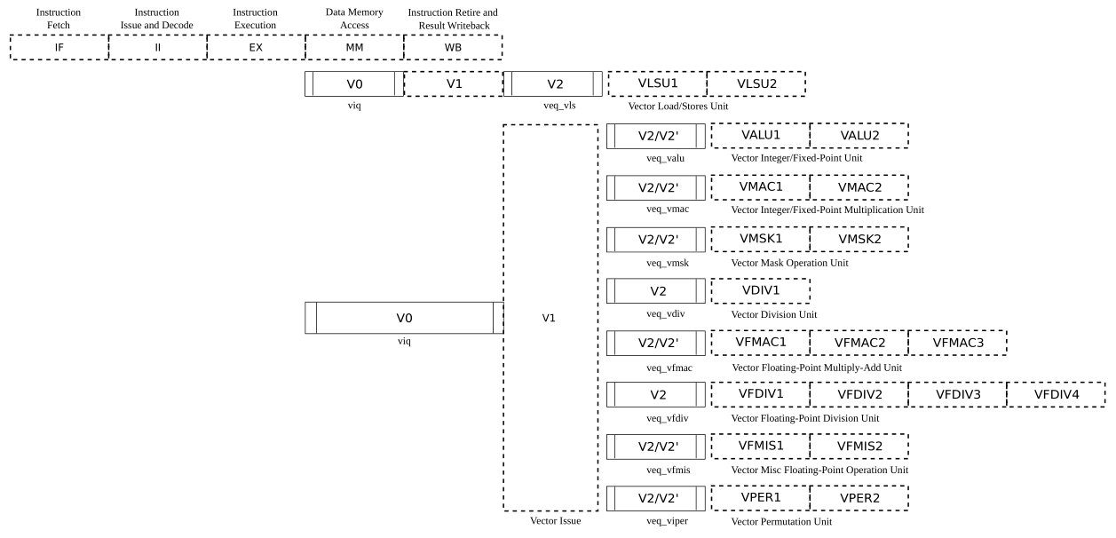
VPU stage
Frontend
Function unit

Slide 10
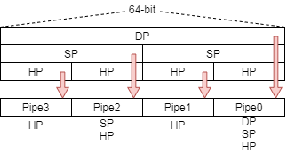
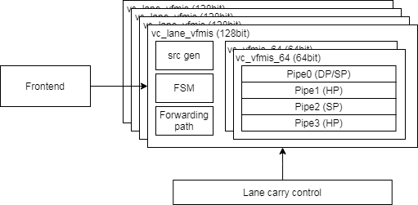
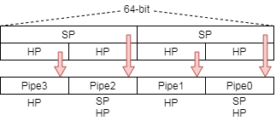
Function Unit Lane Hierarchy
ELEN=64
src_gen is for source data selection
Select data for read port 0/ 1/ 2/ 3 or scalar register
FSM is for reduction instructions to generate control signals
Lane_carry_control handle data forwarding between each lane
ELEN=32

Slide 11
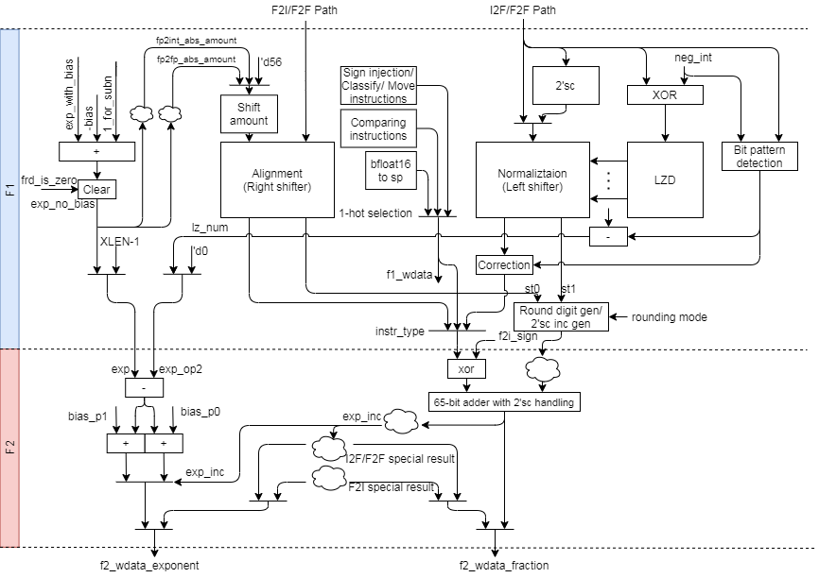
FMIS uArch (1/)

Slide 12
FMIS uArch (2/)
INT to FP

Slide 13
FMIS uArch (3/)
FP to INT
Zero

Slide 14
FMIS uArch (4/)
FP widening
FP narrowing
Bfloat16 to SP
Zero

Slide 15
FMIS uArch (5/)
Comparing instructions
Others instructions
Scalar fp result (XRF)

Slide 16
Conversion instructions

Slide 17
Integer to FP Datapath
INT to FP

Slide 18
Integer to FP (1/)
Integer to floating-point dataflow
Data packing
Do 3 things in parallel
Do 2’sc for negative integer
Generate LZC
Find bit pattern for correction
Normalize data and generate sticky bit
Pack to significand format according destination precision
Do rounding
Enhancements
Detect Leading zero before 2’sc
Structuralized OR network
Rearrange data alignment for I2F
Reduce selection multiplexers
Notes:
Bit width is (1+FLEN_MAX) - (1+FLEN_MIN) + XLEN

Slide 19
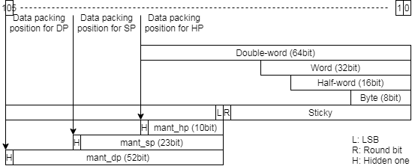
Integer to FP (2/)
Data packing
Reduce selection mux
Notes:
Bit width is (1+FLEN_MAX) - (1+FLEN_MIN) + XLEN

Slide 20
Integer to FP (3/)
Normalization
Calculate leading zero number
Generate string for LZC (Detect Leading zero before 2’sc)
Exponent calculation
Rearrange data alignment for reducing selection mux
Result expo = (XLEN – 1) – LZC (expo hasn’t bias)
Apply structuralized OR network to calculate LZC
Apply barrel shift to normalize source data
Apply structuralized OR network to generate sticky bit
Rounding
Generate round digit according to round mode and sticky
Select (exponent) or (exponent+1) according to carry bit

Slide 21
FP to Integer Datapath
FP to INT
Zero

Slide 22
FP to integer (1/)
Floating to integer dataflow
Data packing
Right shift packed data according to difference of exponent
Generate round digit
Do rounding and 2’sc at the same time
Enhancements
Rearrange data alignment for F2I
Merge 64bit and 54bit adder

Slide 23
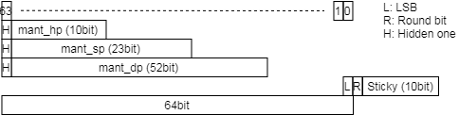
FP to integer (2/)
Unpack and align data
Align all precision source value at (XLEN - 1) bit like as following fig
Shift amount (exponent hasn’t bias)
ABS should support 65 shift amount value when XLEN is 64`
Shift all significand to sticky field
Add logic to detect shift amout == 64, 65
Apply 65-bit adder to handle (exponent < 64)
Shift amount: (XLEN – 1) – exponent (exponent hasn’t bias)
Round digit/2’sc inc generation merge rounding and 2’sc steps

Slide 24
FP to FP Datapath
FP widening
FP narrowing
Bfloat16 to SP
SP to Bfloat16

Slide 25

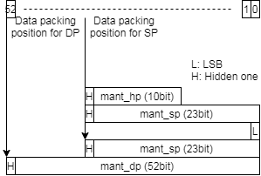
FP to FP – Widening FP (1/)
Widening instruction dataflow
Calculate LZC for subnormal value and do normalization
No Rounding is needed
No subnormal result
Data packing
Align hidden one and calculate LZC
Subnormal input will be shifted to normal fp format
Packing data according to destination precision

Slide 26
FP to FP – Narrowing FP (2/)
Narrowing instruction dataflow
Calculate subnormal result flag
Use subnormal result flag to select shift amount (shift to normal/subnormal)
Calculate exponent without bias
Generate shifted value and round digit
Do rounding
Enhancement
Rearrangement data alignment for narrowing FP
Because 64-bit and 54-bit adders are merged.

Slide 27
FP to FP – Narrowing FP (3/)
Calculate subnormal result flag
Use exponent to detect that result may be subnormal value (exponent has bias)
DP to SP subnormal (exponent - 1023 <= -127, exponent < 897)
DP to HP subnormal (exponent - 1023 <= -15, exponent < 1009)
SP to HP subnormal (exponent - 127 <= -15, exponent < 113)

Slide 28
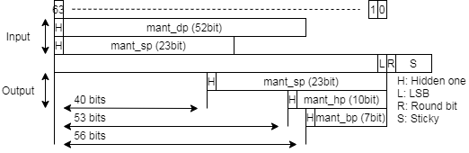
FP to FP – Narrowing FP (4/)
Shift amount
If normal result, ABS shift input value to normal format
DP to SP: 40
DP to HP: 53
SP to HP: 53
SP to Bfloat16: 56
If subnormal result, ABS shift input value to subnormal format
DP to SP: – exponent – 127 + 40 + 1 = ~exponent + 1 – 86 = ~exponent – 85 (use +)
DP to HP: – exponent – 15 + 53 + 1 = ~exponent + 1 + 39 = ~exponent + 40
SP to HP: – exponent – 15 + 53 + 1 = ~exponent + 1 + 39 = ~exponent + 40
exponent hasn’t bias

Slide 29
Round digit/2’sc inc generation

Slide 30
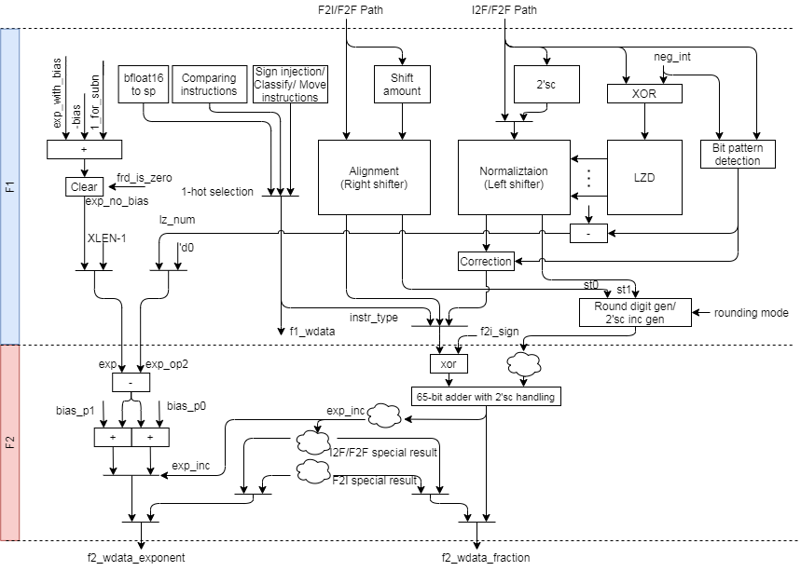
Round digit/2’sc inc generation (1/)

Slide 31
Round digit/2’sc inc generation (2/)
Do rounding and 2’sc at the same time or one of those
Merge rounding and 2’sc steps to improve critical path
No inclement LSB Inclement LSB0 Inclement LSB1
If rounding no inclement LSB => set inc=1
If rounding inclement LSB => set inc=0
If RNE tie clear LSB and LSB was 1 => set inc=1
Round-bit=1 & round_digit=01 & LSB = 1
should inclement LSB, but LSB will be cleared, so set inc=1
No Round-to-odd in F2I instruction
3 round to 3
0011 -> 0011
2’s c: inv+1(inc)
1100
+ 1
-------- ---------
1101 1101
-3 -3
4 round to 5
0100 -> 0101
2’s c: inv+0(inc)
1011 1010
+ 1 + 1
-------- ---------
1100 1011
-4 -5
3 round to 4
0011 -> 0100
2’s c: inv+0(inc)
1100 1011
+ 1 + 1
-------- ---------
1101 1100
-3 -4
Add Proof steps
Notes:
A is value after rounding
R is rounding inclement
B = A+R
Result = B’+1 = (A+R)’+1
R = 0, Result = A’+1
R = 1, Result = A’-1+1 = A’

Slide 32
comparing & others instructions

Slide 33
Comparing & Others instructions datapath
Comparing instructions
Others instructions
Scalar fp result (XRF)

Slide 34
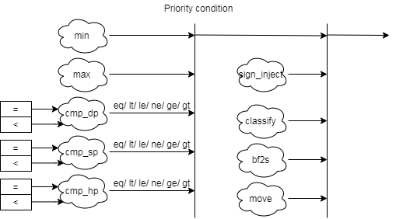
Comparing & Others Instructions
Comparing & others instruction block diagram detail
bf2s: bfloat16 to single

Slide 35
Comparing Instructions
Comparing instructions
Scalar: return 0/1
Vector: Write the comparison result to a mask register
Min/Max instructions
The rm field indicates MIN/MAX
FMIN: Write the smaller of rs1 and rs2 to rd
FMAX: Write the larger of rs2 and rs2 to rd
The value −0.0 is considered to be less than the value +0.0.
Both inputs are NaNs, the result is the canonical NaN.
Only one operand is a NaN, the result is the non-NaN operand.
Signaling NaN inputs raise the invalid operation exception, even when the result is not NaN.

Slide 36
Others Instructions
Sign-injection instructions
The result takes all bits except the sign bit form the vector vs2 operands.
The rm (rounding mode) field indicates J[N]/JX
Classify instructions
The 10-bit mask produced by this instruction is placed in the LSB of the result elements.
This instruction is only defined for SEW=16b above, so the result will always fit in the destination elements.
Rd bit | Meaning
0 | rs1 is -inf
1 | rs1 is a -normal number
2 | rs1 is a -subnormal number
3 | rs1 is -0
4 | rs1 is +0
5 | rs1 is a +subnormal number
6 | rs1 is a +normal number
7 | rs1 is +inf
8 | rs1 is a signaling NaN
9 | rs1 is a quiet NaN

Slide 37
Cross Lane datapath

Slide 38
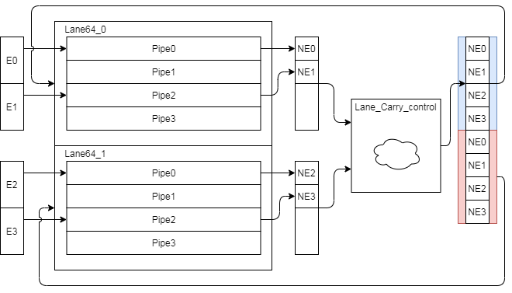
Narrowing & Mask Instruction Datapath
Narrowing and mask instruction format is special and those instruction result will go through to lower lane. (e.g. Lane 1→ Lane 0)
The following instruction need to shift to narrowing format
Lane produce result and pack result
Lane_Carry_control pack result and duplicated

Slide 39
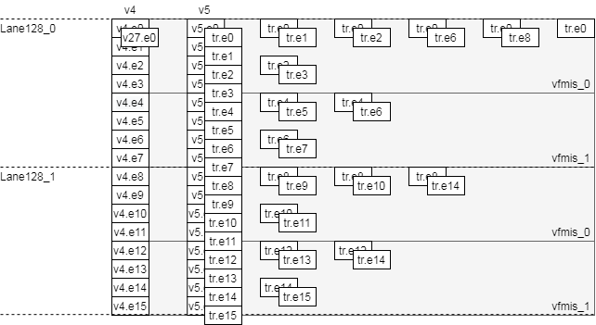
Reduction Instructions Datapath
Reduction instruction data flow
Do the corresponding operator to deal with each vector data
Merge elements in lane first then merge remain results
Add FSM diag
Time
VLEN=256, SIMD=256, LMUL=2, SEW=16, VL=VLMAX

Slide 40
Enhancements

Slide 41
Enhancement list (1/)
Enhance sticky generation path (st1)
Detect Leading zero before 2’sc
Rearrange data alignment for I2F
Rearrange data alignment for F2I
Rearrange data alignment for narrowing FP
Merge 64bit and 54bit adder and non-conversion data path
MISC

Slide 42
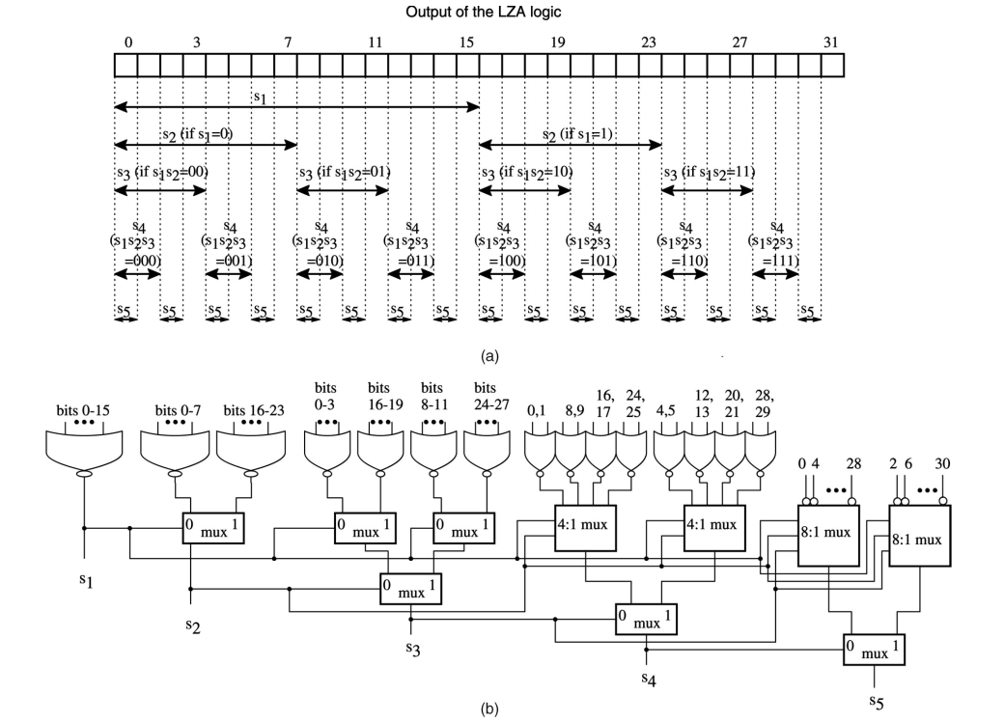
Structuralized OR network (1/)
LZC logic

Slide 43
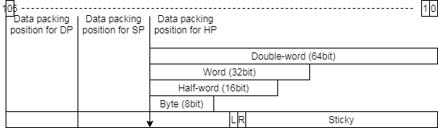
Structuralized OR network (2/)
LZC = 5d’13 = 5’b01101
LZC[4] = 0, L4_sticky = |bit[15:0]
LZC[3] = 1, L3_sticky = L4_sticky | 1’b0
LZC[2] = 1, L2_sticky = L3_sticky | 1’b0
LZC[1] = 0, L1_sticky = L2_sticky | bit[17:16]
LZC[0] = 1, L0_sticky = L1_sticky | (LZC[0]) ? bit[18] : |bit[19:18];
0 | 1 | 2 | 3 | 4 | 5 | 6 | 7 | 8 | 9 | 10 | 11 | 12 | 13 | 14 | 15 | 16 | 17 | 18 | 19 | 20 | 21 | 22 | 23 | 24 | 25 | 26 | 27 | 28 | 29 | 30 | 31
0 | 0 | 0 | 0 | 0 | 0 | 0 | 0 | 0 | 0 | 0 | 0 | 0 | 1 | 1 | 1 | 0 | 0 | 0 | 0 | 1 | 0 | 1 | 0 | 1 | 1 | 1 | 0 | 0 | 1 | 1 | 0
or
0
1
1
0
1
or
Notes:
l5_sticky = 1’b0
l4_sticky = (f1_s_lz_num[5] == 1’b1) ? l5_sticky :|bit[15:0]
L3_sticky = (f1_s_lz_num[5:4] == 2’b11) ? l4_sticky :
l4_sticky | (| bit[27:24])

Slide 44
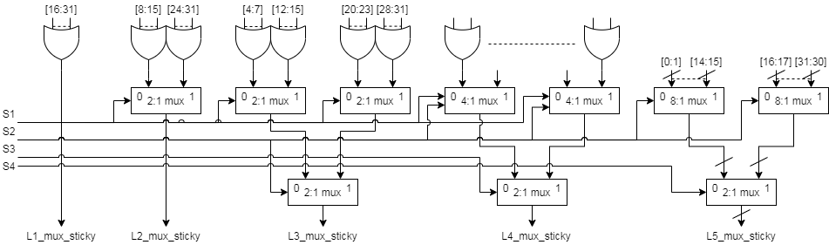
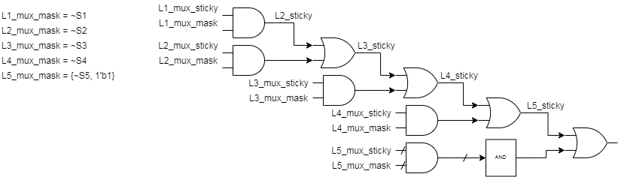
Structuralized OR network (3/)
BACK
Notes:
l5_sticky = 1’b0
l4_sticky = (f1_s_lz_num[5] == 1’b1) ? l5_sticky :|bit[15:0]
L3_sticky = (f1_s_lz_num[5:4] == 2’b11) ? l4_sticky :
l4_sticky | (| bit[27:24])

Slide 45
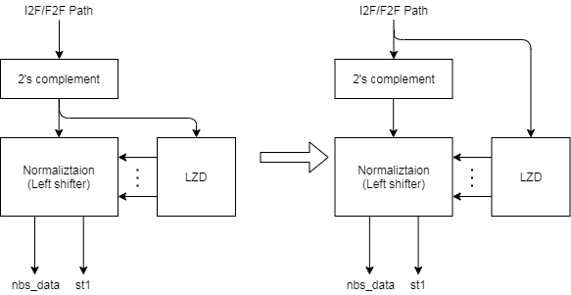
Leading zero detection before 2’sc (1/)
Generate LZC early
What’s input string?

Slide 46
Leading zero detection before 2’sc (2/)
String for LZD is invert negative integer value
LZD 1-bit error
Example
A → 8’b11110000 (neg integer) (1+0*)
A 1’sc → 8’b00001111 → LZC = 4, sticky = 0, nds_dat = 8’b00000000
A 2’sc → 8’b00010000 → LZC = 3, sticky = 0, nds_dat = 8’b10000000
Correction
LZC minus 1
LZC = LZC – 1 (4 – 1 = 3)
Sticky is zero because all source is shifted out
Sticky = 0
Set MSB of normalization data
Nor_data = 8’b10000000 (8’b00000000 | 8’b10000000)

Slide 47
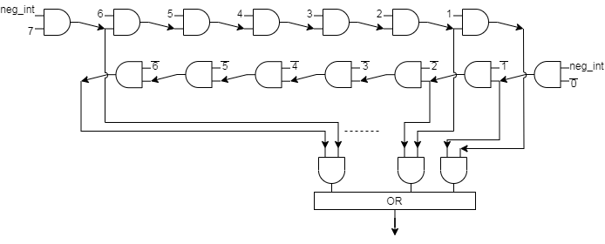
Leading zero detection before 2’sc (3/)
Bit pattern detection

Slide 48
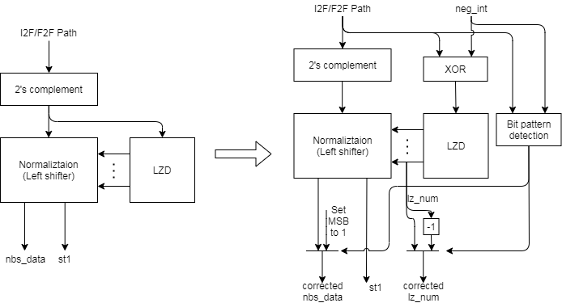
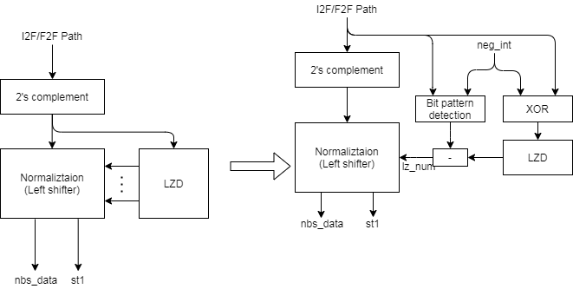
Leading zero detection before 2’sc (4/)
Plan A:
Timing is better than Plan B
Extra logics
6-bit subtractor
1-bit or gate
Plan B:
Extra logic
6-bit subtractor
BACK

Slide 49
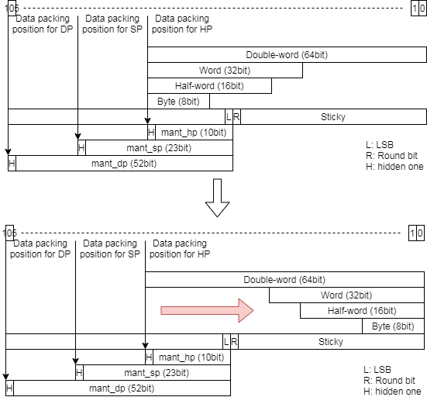
Rearrange data alignment for I2F (1/)
Modify integer value alignment from 63-bit to 0-bit
Reduce data type selection
For FLEN 32 (pipe0, pipe2)
Just force lz_num[5] to 1’b1
For FLEN 16 (pipe1, pipe3)
Just force lz_num[5:4] to 2’b11
After 2’sc
lz_num is leading zero count

Slide 50
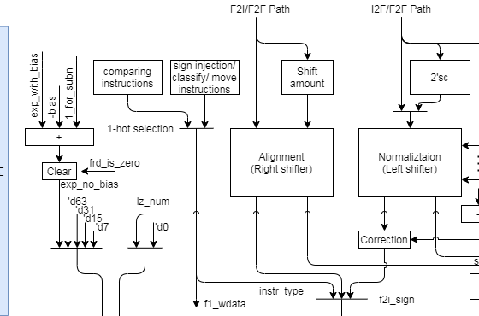
Rearrange data alignment for I2F (2/)
The following show reduced multiplexers
BACK

Slide 51
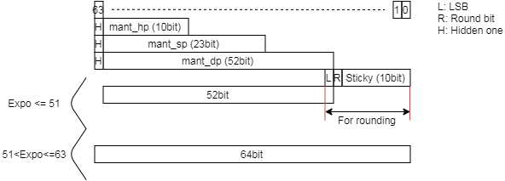
Rearrange data alignment for F2I (1/)
Apply a 65-bit adder and keep round bit at [-1]
65-bit adder
BACK

Slide 52
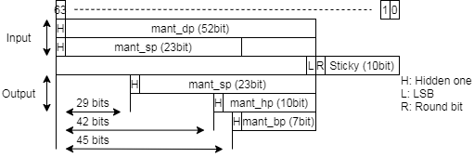
Rearrange data alignment for narrowing FP (1/)
This rearrangement is for merging two adders
All destination result types are aligned at LSB
ABS should support 65-bit right shift
BACK

Slide 53
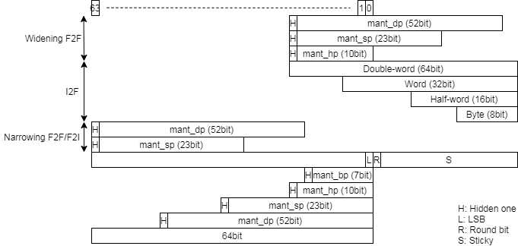
Merge 64bit and 54bit adder (1/)
Use 65-bit adder to do 64-bit 2’sc and 54-bit rounding
LSB of 65-bit is for round bit
Rearrange data alignment for all conversion instructions
Adjust shift amount according to changing alignment
BACK

Slide 54
MISC (1/)
Move logics before 65-bit adder to F1 stage if meet target timing
Generate exp_inc before 65-bit adder
Bit pattern detection

Slide 55
Interface

Slide 56
Back-End Hierarchy

Slide 57
Function Unit Interface

Slide 58
VFP_FMIS Interface (1/)
Signal name | Type | Description
core_clk | Input | Clock
core_reset_n | Input | Negative Edge Reset
lane_pipe_id_0 | Input | ID
f1_valid | Input
f1_fmis_scalar_valid | Input | Indicate scalar type instruction
f1_ex_ctrl | Input | Control signal for encoding
f1_sew | Input | Indicate element width
f1_ediv | Input | Un-used
f1_round_mode | Input | Round mode
f1_widen | Input | Widening instruction
f1_narrow | Input | Narrowing instruction
f1_sign | Input | Signed integer source
f1_vmask | Input | Mask

Slide 59
VFMIS_64 Interface (2/)
Signal name | Type | Description
f1_op1_invalid | Input
f1_op2_invalid | Input
f1_op1_data | Input
f1_op2_data | Input
f1_cmp_inv_op | Output
f1_wdata_en | Output
f1_wdata | Output
f2_result_type | Output
f2_cmp_result | Output
f2_narr_wdata | Output
f2_wdata_en | Output
f2_wdata | Output
f2_flag_set | Output

Slide 60
Instruction List

Slide 61
Supported scalar fp instruction list (1/)
Sign-injection instruction
fsgnj.[hsd]
fsgnjn.[hsd]
fsgnjx.[hsd]
Compare instruction
feq.[hsd]
flt.[hsd]
fle.[hsd]
Classify instruction
fclass.[hsd]
Move instruction
fmv.x.[hwd]
fmv.[hwd].x

Slide 62
Supported scalar fp instruction list (2/)
Conversion between int and fp
Conversion between fp and fp
Int width\fp_width | F16(HP) | F32(SP) | F64(DP)
I32 | fcvt.w.h fcvt.wu.h fcvt.h.w fcvt.h.wu | fcvt.w.s fcvt.wu.s fcvt.s.w fcvt.s.wu | fcvt.w.d fcvt.wu.d fcvt.d.w fcvt.d.wu
I64 | fcvt.l.h fcvt.lu.h fcvt.h.l fcvt.h.lu | fcvt.l.s fcvt.lu.s fcvt.s.l fcvt.s.lu | fcvt.l.d fcvt.lu.d fcvt.d.l fcvt.d.lu
SRC \ DST | F16(HP) | Bfloat16 | F32(SP) | F64(DP)
F16(HP) | X | X | fcvt.s.h | fcvt.d.h
Bfloat16 | X | X | fcvt.s.bf16 | X
F32(SP) | fcvt.h.s | fcvt.bf16.s | X | fcvt.d.s
F64(DP) | fcvt.h.d | X | fcvt.s.d | X

Slide 63
Supported vector fp instruction list (1/)
14.11. Vector Floating-Point MIN/MAX Instructions
Floating-point minimum
vfmin.vv vd, vs2, vs1, vm # Vector-vector
vfmin.vf vd, vs2, rs1, vm # Vector-scalar
Floating-point maximum
vfmax.vv vd, vs2, vs1, vm # Vector-vector
vfmax.vf vd, vs2, rs1, vm # Vector-scalar
14.12. Vector Floating-Point Sign-Injection Instructions
For vfsgnj, the result’s sign bit is v/rs1’s sign bit.
vfsgnj.vv vd, vs2, vs1, vm # Vector-vector
vfsgnj.vf vd, vs2, rs1, vm # Vector-scalar
For vfsgjn, the result’s sign bit is the opposite of v/rs1’s sign bit.
vfsgnjn.vv vd, vs2, vs1, vm # Vector-vector
vfsgnjn.vf vd, vs2, rs1, vm # Vector-scalar
For vfsgnjx, the sign bit is the XOR of the sign bits of v/rs1 and vs2.
vfsgnjx.vv vd, vs2, vs1, vm # Vector-vector
vfsgnjx.vf vd, vs2, rs1, vm # Vector-scalar

Slide 64
Supported vector fp instruction list (2/)
14.13. Vector Floating-Point Compare Instructions
Compare equal
vmfeq.vv vd, vs2, vs1, vm # Vector-vector
vmfeq.vf vd, vs2, rs1, vm # Vector-scalar
Compare not equal
vmfne.vv vd, vs2, vs1, vm # Vector-vector
vmfne.vf vd, vs2, rs1, vm # Vector-scalar
Compare less than
vmflt.vv vd, vs2, vs1, vm # Vector-vector
vmflt.vf vd, vs2, rs1, vm # Vector-scalar
Compare less than or equal
vmfle.vv vd, vs2, vs1, vm # Vector-vector
vmfle.vf vd, vs2, rs1, vm # Vector-scalar
Compare greater than
vmfgt.vf vd, vs2, rs1, vm # Vector-scalar
Compare greater than or equal
vmfge.vf vd, vs2, rs1, vm # Vector-scalar

Slide 65
Supported vector fp instruction list (3/)
14.14. Vector Floating-Point Classify Instruction
vfclass.v vd, vs2, vm # Vector-vector
14.15. Vector Floating-Point Merge Instruction
vfmerge.vfm vd, vs2, rs1, v0 # vd[i] = v0.mask[i] ? f[rs1] : vs2[i]
14.16. Vector Floating-Point Move Instruction
vfmv.v.f vd, rs1 # vd[i] = f[rs1]
14.17. Single-Width Floating-Point/Integer Type-Convert Instructions
vfcvt.xu.f.v vd, vs2, vm # Convert float to unsigned integer.
vfcvt.x.f.v vd, vs2, vm # Convert float to signed integer.
vfcvt.rtz.xu.f.v vd, vs2, vm # Convert float to unsigned integer, truncating.
vfcvt.rtz.x.f.v vd, vs2, vm # Convert float to signed integer, truncating.
vfcvt.f.xu.v vd, vs2, vm # Convert unsigned integer to float.
vfcvt.f.x.v vd, vs2, vm # Convert signed integer to float.

Slide 66
Supported vector fp instruction list (4/)
14.18. Widening Floating-Point/Integer Type-Convert Instructions
vfwcvt.xu.f.v vd, vs2, vm # Convert float to double-width unsigned integer.
vfwcvt.x.f.v vd, vs2, vm # Convert float to double-width signed integer.
vfwcvt.rtz.xu.f.v vd, vs2, vm # Convert float to double-width unsigned integer truncating.
vfwcvt.rtz.x.f.v vd, vs2, vm # Convert float to double-width signed integer truncating.
vfwcvt.f.xu.v vd, vs2, vm # Convert unsigned integer to double-width float.
vfwcvt.f.x.v vd, vs2, vm # Convert signed integer to double-width float.
vfwcvt.f.f.v vd, vs2, vm # Convert single-width float to double-width float.
14.19. Narrowing Floating-Point/Integer Type-Convert Instructions
vfncvt.xu.f.w vd, vs2, vm # Convert double-width float to unsigned integer.
vfncvt.x.f.w vd, vs2, vm # Convert double-width float to signed integer.
vfncvt.rtz.xu.f.w vd, vs2, vm # Convert double-width float to unsigned integer truncating.
vfncvt.rtz.x.f.w vd, vs2, vm # Convert double-width float to signed integer truncating.
vfncvt.f.xu.w vd, vs2, vm # Convert double-width unsigned integer to float.
vfncvt.f.x.w vd, vs2, vm # Convert double-width signed integer to float.
vfncvt.f.f.w vd, vs2, vm # Convert double-width float to single-width float.
vfncvt.rod.f.f.w vd, vs2, vm # Convert double-width float to single-width float rounding towards odd.

Slide 67
Supported vector fp instruction list (5/)
15.3. Vector Single-Width Floating-Point Reduction Instructions
vfredmax.vs vd, vs2, vs1, vm # Maximum value
vfredmin.vs vd, vs2, vs1, vm # Minimum value
Custom instruction
vfwcvt.s.bf16 vd, vs2, vm
vfncvt.bf16.s vd, vs2, vm

Slide 68
Backup

Slide 69
Data alignment

Slide 70
Data Alignment (1/)
XLEN = 64 and FLEN = 64 (For pipe0)

Slide 71
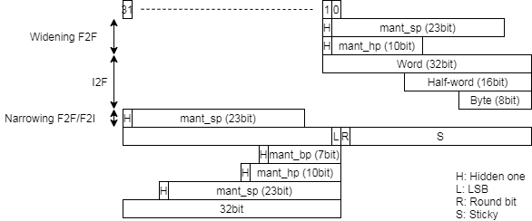
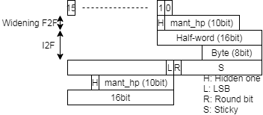
Data Alignment (2/)
XLEN = 32 and FLEN = 32 (For pipe0, pipe2)
XLEN = 16 and FLEN = 16 (For pipe1, pipe3 )

Slide 72
Rounding mode (1/)
Alternative rounding options are also available. IEEE 754 specifies the following rounding modes:
round to nearest
where ties round to the nearest even digit in the required position (the default and by far the most common mode)
round to nearest
where ties round away from zero (optional for binary floating-point and commonly used in decimal)
round up (toward +∞;)
negative results thus round toward zero
round down (toward −∞)
negative results thus round away from zero
round toward zero (truncation)
it is similar to the common behavior of float-to-integer conversions, which convert −3.9 to −3 and 3.9 to 3

Slide 73
Rounding mode (2/)
Sign,LSB,round,stick | RNE | RTZ | RDN | RUP | RMM
0_000 | +0 | +0
0_001 | +0 | +0
0_010 | +0 | +0
0_011 | +1 | +0
0_100 | +0 | +0
0_101 | +0 | +0
0_110 | +1 | +0
0_111 | +1 | +0
1_000 | +0 | +0
1_001 | +0 | +0
1_010 | +0 | +0
1_011 | +1 | +0
1_100 | +0 | +0
1_101 | +0 | +0
1_110 | +1 | +0
1_111 | +1 | +0

