Slide 1
FP MISC uArch
202012
Larry

Slide 2
Agenda
List of abbreviation/parameter
Overview
Configuration
uArch overview
Conversion Instructions
Round digit/2’sc inc generation
Comparing & Others instructions
Cross Lane Forwarding Path
Enhancements
Interface (TODO)
Instruction encoding

Slide 3
List of abbreviation (1/)
Abbreviation | Definition
F2I/F2F/I2F | F: Floating-point, I: integer
ABS | Alignment barrel shift
NBS | Normalization barrel shift
2’sc | 2’s complement
LZD | Leading zero detection
LZC | Leading zero count

Slide 4
List of parameter (1/)
Abbreviation | Definition
XLEN | The current width of an x register in bits (32 for RV32 or 64 for RV64)
FLEN | The current width of a f register in bits (32 for SP, 64 for DP)
VLEN | Vector length
ELEN | Element width

Slide 5
Overview (1/)
2-stage pipeline
Supported data types
BFloat16/HP/SP/DP
Int8/Int16/Int32/Int64
The followings are supported instructions and the corresponding latency
Conversion (I2F, F2F, F2I)
Comparing/min/max
Sign injection/classify/move
Precision | Width | Sign | Expo | Mant
HP | 16 | 1 | 5 | 10
Bfloat16 | 16 | 1 | 8 | 7
SP | 32 | 1 | 8 | 23
DP | 64 | 1 | 11 | 52

Slide 6
Overview (2/)
Instruction latency
Instruction | Latency
 | Scalar |  | Vector
Conversion | 2 |  | Widening | 2
 |  |  | Narrowing | 3
Sign injection | 2 |  | 2
Min/max | 2 |  | 2
Comparing | 1 |  | 2
Classify | 1 |  | 2
Move | toFRF | 2 | 2
 | toXRF | 1

Slide 7
Configurability
Feature | Options
XLEN | 64
FLEN* | 16/32/64
VLEN | 512/256/128
SIMD_WIDTH | 512/256/128
ELEN* | 32/64
*If RVV = 0, FLEN can be configured to 32/64
*If RVV = 1, FLEN is equivalent to ELEN

Slide 8
uArch overview

Slide 9
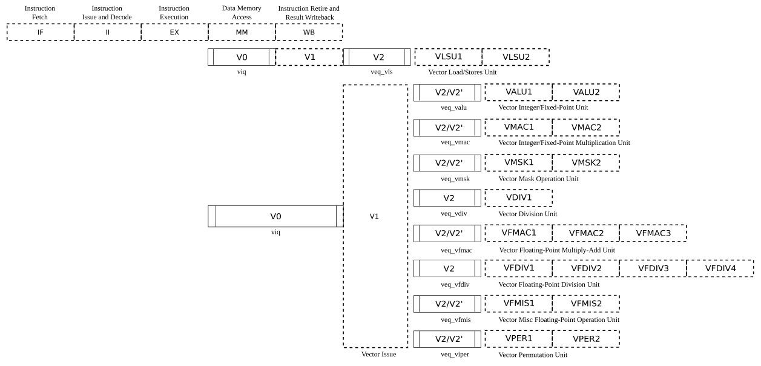
VPU stage
Frontend
Function unit

Slide 10
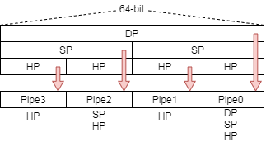
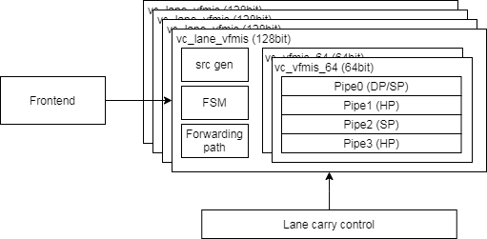
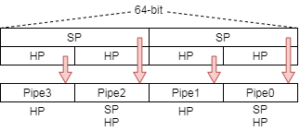
Function Unit Lane Hierarchy
ELEN=64
src_gen is for source data selection
Select data for read port 0/ 1/ 2/ 3 or scalar register
FSM is for reduction instructions to generate control signals
Lane_carry_control handle data forwarding between each lane
ELEN=32

Slide 11
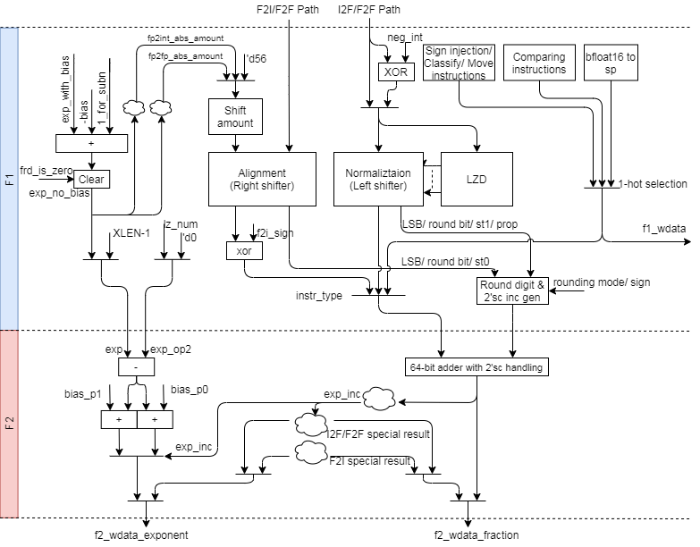
FMIS uArch (1/)

Slide 12
FMIS uArch (2/)
INT to FP

Slide 13
FMIS uArch (3/)
FP to INT

Slide 14
FMIS uArch (4/)
FP widening
FP narrowing
Bfloat16 to SP
SP to Bfloat16

Slide 15
FMIS uArch (5/)
Comparing instructions
Others instructions
Scalar fp result (XRF

Slide 16
Conversion instructions

Slide 17
Integer to FP Datapath
INT to FP

Slide 18
Integer to FP (1/)
Integer to floating-point dataflow
Data packing
Do 3 things in parallel
Do 2’sc for negative integer
Generate LZC
Find bit pattern for correction
Normalize data and generate sticky bit
Pack to significand format according destination precision
Do rounding
Enhancements
Detect Leading zero before 2’sc
Structuralized OR network
Structuralized AND network
Rearrange data alignment for I2F
Reduce selection multiplexers
Notes:
Bit width is (1+FLEN_MAX) - (1+FLEN_MIN) + XLEN

Slide 19
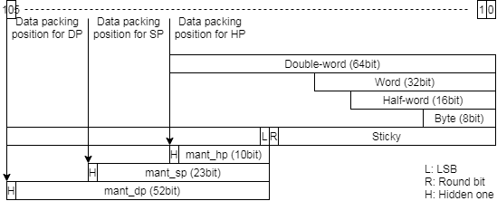
Integer to FP (2/)
Data packing
Reduce selection mux
Notes:
Bit width is (1+FLEN_MAX) - (1+FLEN_MIN) + XLEN

Slide 20
Integer to FP (3/)
Normalization
Calculate leading zero number
Generate string for LZC
Exponent calculation
Rearrange data alignment for reducing selection mux
Result expo = (XLEN – 1) – LZC (expo hasn’t bias)
Apply structuralized OR network to calculate LZC, sticky bit and propagation bit
Apply barrel shift to normalize source data
Rounding
Generate round digit according to round mode, sticky bit and propagation bit
Select (exponent) or (exponent+1) according to carry bit

Slide 21
FP to Integer Datapath
FP to INT

Slide 22
FP to integer (1/)
Floating to integer dataflow
Data packing
Right shift packed data according to difference of exponent
Generate round digit
Do rounding and 2’sc at the same time
Enhancements
Rearrange data alignment for F2I
Merge 64bit and 54bit adder

Slide 23
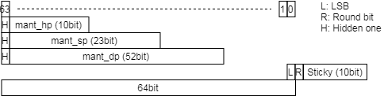
FP to integer (2/)
Unpack and align data
Align all precision source value at (XLEN - 1) bit like as following fig
Shift amount (exponent hasn’t bias)
ABS should support 65 shift amount value when XLEN is 64
ABS_amount == 64
aligned data LSB is hidden one
Sticky is (|abs_in[62:11]) / (|abs_in[62:0])
ABS_amount >= 65
aligned data LSB is zero
Sticky is set
Shift all significand to sticky field
Apply 64-bit adder to handle (exponent < 64)
Shift amount: (XLEN – 1) – exponent (exponent hasn’t bias)
XLEN=64 → 63–exponent → ~exponent & ‘d63
XLEN=32 → 31–exponent → ~exponent & ‘d31
Round digit/2’sc inc generation merge rounding and 2’sc steps

Slide 24
FP to FP Datapath
FP widening
FP narrowing
Bfloat16 to SP
SP to Bfloat16

Slide 25

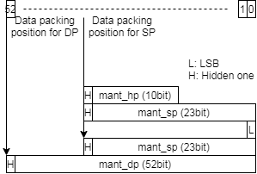
FP to FP – Widening FP (1/)
Widening instruction dataflow
Calculate LZC for subnormal value and do normalization
No Rounding is needed
No subnormal result
Data packing
Align hidden one and calculate LZC
Subnormal input will be shifted to normal fp format
Packing data according to destination precision

Slide 26
FP to FP – Narrowing FP (2/)
Narrowing instruction dataflow
Calculate subnormal result flag
Use subnormal result flag to select shift amount (shift to normal/subnormal)
Calculate exponent without bias
Generate shifted value and round digit
Do rounding
Enhancement
Rearrangement data alignment for narrowing FP
Because 64-bit and 54-bit adders are merged.

Slide 27
FP to FP – Narrowing FP (3/)
Calculate subnormal result flag
Use exponent to detect that result may be subnormal value (exponent has bias)
DP to SP subnormal (exponent - 1023 <= -127, exponent < 897)
DP to HP subnormal (exponent - 1023 <= -15, exponent < 1009)
SP to HP subnormal (exponent - 127 <= -15, exponent < 113)

Slide 28
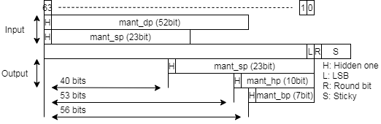
FP to FP – Narrowing FP (4/)
Shift amount
If normal result, ABS shift input value to normal format
DP to SP: 40
DP to HP: 53
SP to HP: 53
SP to Bfloat16: 56
If subnormal result, ABS shift input value to subnormal format
DP to SP: – exponent – 127 + 40 + 1 = ~exponent + 1 – 86 = ~exponent – 85 (use +)
DP to HP: – exponent – 15 + 53 + 1 = ~exponent + 1 + 39 = ~exponent + 40
SP to HP: – exponent – 15 + 53 + 1 = ~exponent + 1 + 39 = ~exponent + 40
exponent hasn’t bias

Slide 29
Round digit/2’sc inc generation

Slide 30
Round digit/2’sc inc generation (1/)

Slide 31
Round digit/2’sc inc generation (2/)
Merge the following steps to reduce dummy adder
increment 1 of 2’sc
rounding
The round digit support the following features
Rounding
Positive integer to floating-point
Floating-point to floating-point
Increment 1 then rounding
Negative integer to floating-point
Rounding then increment 1
Floating-point to negative integer

Slide 32
Round digit/2’sc inc generation (3/)
Rounding increment under different rounding mode
Sign | L | R | S |  | RNE | RTZ | RDN | RUP | RMM | ROD
0 | 0 | 0 | 0 |  | +0 | +0 | +0 | +0 | +0 | +1
0 | 0 | 0 | 1 |  | +0 | +0 | +0 | +1 | +0 | +1
0 | 0 | 1 | 0 |  | +0 | +0 | +0 | +1 | +1 | +1
0 | 0 | 1 | 1 |  | +1 | +0 | +0 | +1 | +1 | +1
0 | 1 | 0 | 0 |  | +0 | +0 | +0 | +1 | +0 | +0
0 | 1 | 0 | 1 |  | +0 | +0 | +0 | +1 | +0 | +0
0 | 1 | 1 | 0 |  | +1 | +0 | +0 | +1 | +1 | +0
0 | 1 | 1 | 1 |  | +1 | +0 | +0 | +1 | +1 | +0
1 | 0 | 0 | 0 |  | +0 | +0 | +0 | +0 | +0 | +1
1 | 0 | 0 | 1 |  | +0 | +0 | +1 | +0 | +0 | +1
1 | 0 | 1 | 0 |  | +0 | +0 | +1 | +0 | +1 | +1
1 | 0 | 1 | 1 |  | +1 | +0 | +1 | +0 | +1 | +1
1 | 1 | 0 | 0 |  | +0 | +0 | +1 | +0 | +0 | +0
1 | 1 | 0 | 1 |  | +0 | +0 | +1 | +0 | +0 | +0
1 | 1 | 1 | 0 |  | +1 | +0 | +1 | +0 | +1 | +0
1 | 1 | 1 | 1 |  | +1 | +0 | +1 | +0 | +1 | +0

Slide 33
Round digit/2’sc inc generation (4/)
1. Do rounding only
A + increment (1 bit) (A has not round bit)
Abbreviation
L is LSB/ R is round bit / S is sticky bit / Tie is (R & ~S)
Rounding mode | Rounding inc
RNE (Round to Nearest, ties to Even) | 1. R then clear sum LSB if tie/ 2. R & (L | S)
RTZ (Round Towards Zero) | 0
RDN (Round DowN) | ~sign & (R | S)
RUP (Round UP) | sign & (R | S)
RMM (Round to nearest, ties to Max Magnitude) | R
ROD (Round towards ODd) | 1. Set LSB 2. ~L

Slide 34
Round digit/2’sc inc generation (5/)
L | R | S | P |  | Correct L | Correct R | Correct S | 2’sc inc | Rounding inc
0 | 0 | 0 | 0 |  | 0 | 0 | 0 | +0 | +0/+1
0 | 0 | 0 | 1 |  | * | * | * | * | *
0 | 0 | 1 | 0 |  | 0 | 0 | 1 | +0 | +0/+1
0 | 0 | 1 | 1 |  | 0 | 1 | 0 | +0 | +0/+1
0 | 1 | 0 | 0 |  | 1 | 1 | 0 | +0 | +0/+1
0 | 1 | 0 | 1 |  | * | * | * | * | *
0 | 1 | 1 | 0 |  | 1 | 1 | 1 | +0 | +0/+1
0 | 1 | 1 | 1 |  | 1 | 0 | 0 | +1 | +0/+1
1 | 0 | 0 | 0 |  | 0 | 0 | 0 | +0 | +0/+1
1 | 0 | 0 | 1 |  | * | * | * | * | *
1 | 0 | 1 | 0 |  | 1 | 0 | 1 | +0 | +0/+1
1 | 0 | 1 | 1 |  | 1 | 1 | 0 | +0 | +0/+1
1 | 1 | 0 | 0 |  | 1 | 0 | 0 | +0 | +0/+1
1 | 1 | 0 | 1 |  | * | * | * | * | *
1 | 1 | 1 | 0 |  | 1 | 1 | 0 | +0 | +0/+1
1 | 1 | 1 | 1 |  | 0 | 0 | 0 | +1 | +0/+1
2. Increment 1 then rounding
Abbreviation
L is LSB
R is round bit
S is sticky bit
Do OR operand with sticky field
P is propagation bit
Do AND operand with sticky field
L, R, S is from 1’sc source value
Summary
Round digit is 64’b1 or 64’b2
+1: Do 2’sc inc or rounding
+2: Do 2’sc inc and rounding
Correction logic
Correction_S = S&~P
{Correction_L , Correction_R}
{L,R} + S&P
* Unreachable

Slide 35
Round digit/2’sc inc generation (6/)
3.Rounding then increment 1
Proof
B = A + r (A is before rounding, B is after rounding)
~A + inc = ~B + 1 = ~(A + r) + 1
R = 0 → ~A + inc = ~(A + 0) + 1 → inc = 1
R = 1 → ~A + inc = ~(A + 1) + 1 = ~A – 1 + 1 → inc = 0
-1 → A = 8’b11111111
~ (A + 1) = 8’b11111111
~A = 8’b00000000, ~A – 1 = 8’b11111111
-128 → A = 8’b10000000
~ (A + 1) = 8’b01111110
~A = 8’b01111111, ~A – 1 = 8’b01111110
Summary
inc is 0 if rounding increment is 1
inc is 1 if rounding increment is 0
Correction logic
neg_int_result ^ rounding inc
Notes:
A is value after rounding
R is rounding inclement
B = A+R
Result = B’+1 = (A+R)’+1
R = 0, Result = A’+1
R = 1, Result = A’-1+1 = A’

Slide 36
Round digit/2’sc inc generation (7/)
Abbreviation
r_inc is rounding increment
c_inc is 2’sc increment
neg_int_src is negative integer source
neg_int_res is negative integer result
Round digit
Round digit[1] is neg_int_src & c_inc
Round digit[0] is neg_int_res ^ r_inc
Then the sum of Round_digit[1], Round digit[0] and shifted data is the result
Notes:
A is value after rounding
R is rounding inclement
B = A+R
Result = B’+1 = (A+R)’+1
R = 0, Result = A’+1
R = 1, Result = A’-1+1 = A’

Slide 37
comparing & others instructions

Slide 38
Comparing & Others Instructions Datapath
Comparing instructions
Others instructions
Scalar fp result (XRF

Slide 39
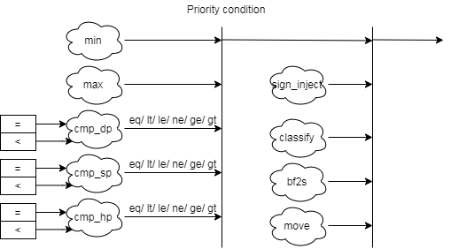
Comparing & Others Instructions
Comparing & others instruction block diagram detail
bf2s: bfloat16 to single

Slide 40
Comparing Instructions
Comparing instructions
Scalar: return 0/1
Vector: Write the comparison result to a mask register
Min/Max instructions
The rm field indicates MIN/MAX
FMIN: Write the smaller of rs1 and rs2 to rd
FMAX: Write the larger of rs2 and rs2 to rd
The value −0.0 is considered to be less than the value +0.0.
Both inputs are NaNs, the result is the canonical NaN.
Only one operand is a NaN, the result is the non-NaN operand.
Signaling NaN inputs raise the invalid operation exception, even when the result is not NaN.

Slide 41
Others Instructions
Sign-injection instructions
The result takes all bits except the sign bit form the vector vs2 operands.
The rm (rounding mode) field indicates J[N]/JX
Classify instructions
The 10-bit mask produced by this instruction is placed in the LSB of the result elements.
This instruction is only defined for SEW=16b above, so the result will always fit in the destination elements.
Rd bit | Meaning
0 | rs1 is -inf
1 | rs1 is a -normal number
2 | rs1 is a -subnormal number
3 | rs1 is -0
4 | rs1 is +0
5 | rs1 is a +subnormal number
6 | rs1 is a +normal number
7 | rs1 is +inf
8 | rs1 is a signaling NaN
9 | rs1 is a quiet NaN

Slide 42
Cross Lane datapath

Slide 43
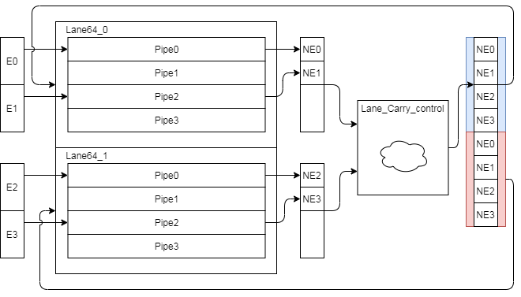
Narrowing & Mask Instruction Datapath
Narrowing and mask instruction format is special and those instruction result will go through to lower lane. (e.g. Lane 1→ Lane 0)
The following instruction need to shift to narrowing format
Lane produce result and pack result
Lane_Carry_control pack result and duplicated
Redraw

Slide 44
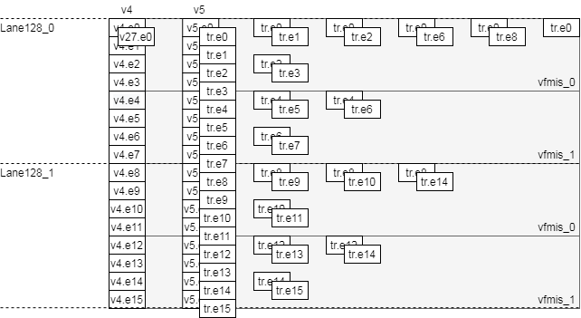
Reduction Instructions Datapath
Reduction instruction data flow
Do the corresponding operator to deal with each vector data
Merge elements in lane first then merge remain results
Add FSM diag
Time
VLEN=256, SIMD=256, LMUL=2, SEW=16, VL=VLMAX

Slide 45
Enhancements

Slide 46
Enhancement list (1/)
Enhance sticky generation path (st1)
Detect Leading zero before 2’sc
Rearrange data alignment for I2F
Rearrange data alignment for F2I
Rearrange data alignment for narrowing FP
Merge 64bit and 54bit adder and non-conversion data path
MISC
Move Bfloat16 to SP to fmv datapath
Reduce 65-bit adder to 64-bit

Slide 47
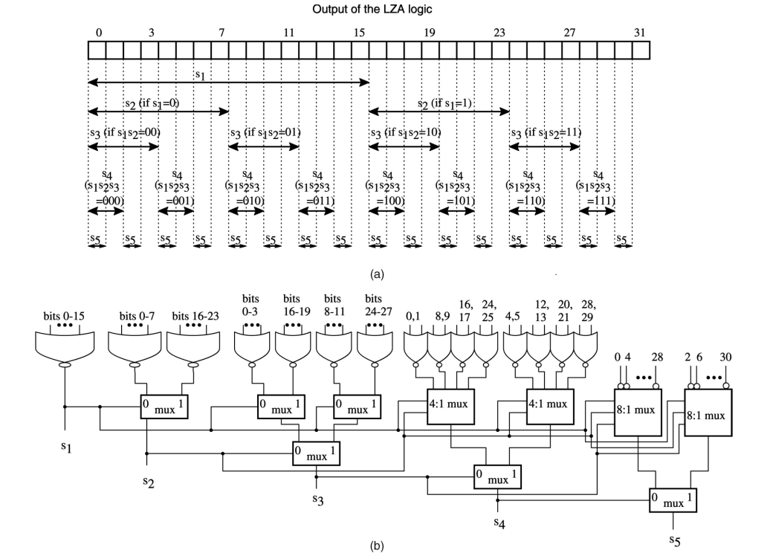
Structuralized OR network (1/)
LZC logic

Slide 48
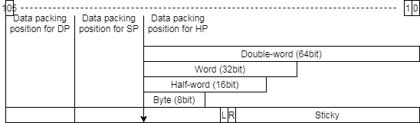
Structuralized OR network (2/)
LZC = 5d’13 = 5’b01101
LZC[4] = 0, L4_sticky = |bit[15:0]
LZC[3] = 1, L3_sticky = L4_sticky | 1’b0
LZC[2] = 1, L2_sticky = L3_sticky | 1’b0
LZC[1] = 0, L1_sticky = L2_sticky | bit[17:16]
LZC[0] = 1, L0_sticky = L1_sticky | (LZC[0]) ? bit[18] : |bit[19:18];
0 | 1 | 2 | 3 | 4 | 5 | 6 | 7 | 8 | 9 | 10 | 11 | 12 | 13 | 14 | 15 | 16 | 17 | 18 | 19 | 20 | 21 | 22 | 23 | 24 | 25 | 26 | 27 | 28 | 29 | 30 | 31
0 | 0 | 0 | 0 | 0 | 0 | 0 | 0 | 0 | 0 | 0 | 0 | 0 | 1 | 1 | 1 | 0 | 0 | 0 | 0 | 1 | 0 | 1 | 0 | 1 | 1 | 1 | 0 | 0 | 1 | 1 | 0
or
0
1
1
0
1
or
Notes:
l5_sticky = 1’b0
l4_sticky = (f1_s_lz_num[5] == 1’b1) ? l5_sticky :|bit[15:0]
L3_sticky = (f1_s_lz_num[5:4] == 2’b11) ? l4_sticky :
l4_sticky | (| bit[27:24])

Slide 49
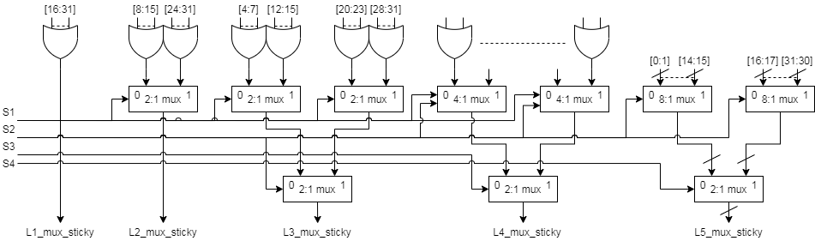
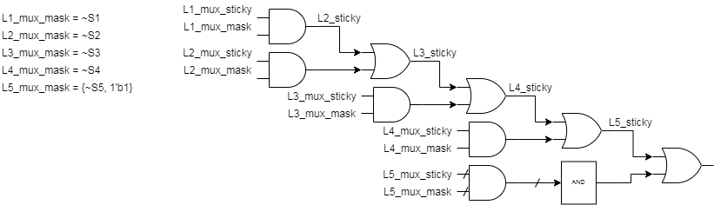
Structuralized OR network (3/)
BACK
Notes:
l5_sticky = 1’b0
l4_sticky = (f1_s_lz_num[5] == 1’b1) ? l5_sticky :|bit[15:0]
L3_sticky = (f1_s_lz_num[5:4] == 2’b11) ? l4_sticky :
l4_sticky | (| bit[27:24])

Slide 50
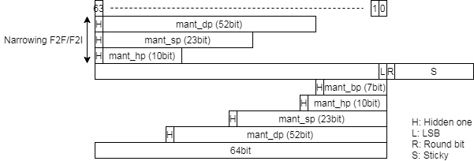
Structuralized OR network - ABS(1/)
Generate sticky
Do OR with the shifted sticky field
Notes:
l5_sticky = 1’b0
l4_sticky = LZC[4] & (|bit[16:31])
L3_mux_sticky = (LZC[4:3] == 2’b00) ? (|bit[16:31])

Slide 51
Structuralized OR network - ABS(2/)
LZC = 5d’13 = 5’b01101
LZC[4] = 0, L4_sticky = LZC[4] & (|bit[16:31])
LZC[3] = 1, L3_sticky = LZC[3] & (|bit[24:31])
LZC[2] = 1, L2_sticky = LZC[2] & (|bit[20:23])
LZC[1] = 0, L1_sticky = LZC[1] & (|bit[18:19])
LZC[0] = 1, L0_sticky = LZC[0] & bit[19]
Sticky = L4_sticky | L3_sticky | L2_sticky | L1_sticky | L0_sticky;
0 | 1 | 2 | 3 | 4 | 5 | 6 | 7 | 8 | 9 | 10 | 11 | 12 | 13 | 14 | 15 | 16 | 17 | 18 | 19 | 20 | 21 | 22 | 23 | 24 | 25 | 26 | 27 | 28 | 29 | 30 | 31
0 | 0 | 0 | 0 | 0 | 0 | 0 | 0 | 0 | 0 | 0 | 0 | 0 | 1 | 1 | 1 | 0 | 0 | 0 | 0 | 1 | 0 | 1 | 0 | 1 | 1 | 1 | 0 | 0 | 1 | 1 | 0
LZC[4]=0
LZC[3]= 1
LZC[2]= 1
LZC[1]= 0
LZC[0]= 1
LZC[4]=0
or
LZC[4:3]=01
or
LZC[4:1]=0110
Notes:
l5_sticky = 1’b0
l4_sticky = LZC[4] & (|bit[16:31])
L3_mux_sticky = (LZC[4:3] == 2’b00) ? (|bit[16:31])

Slide 52
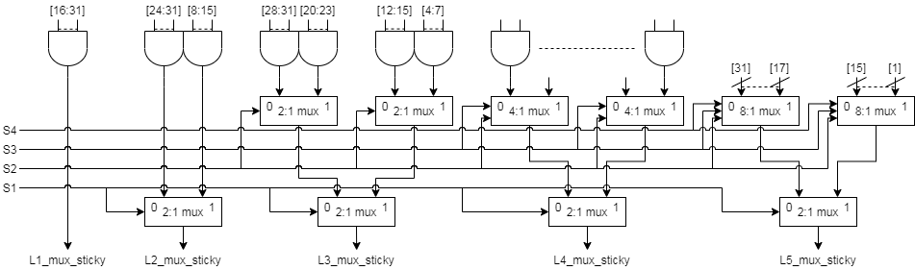
Structuralized OR network - ABS(3/)
Notes:
l5_sticky = 1’b0
l4_sticky = LZC[4] & (|bit[16:31])
L3_mux_sticky = (LZC[4:3] == 2’b00) ? (|bit[16:31])

Slide 53
Structuralized AND network (1/)
Structuralized AND network is similar to OR network
Do AND(&) operation on field and increase normalized value for increasing of 2’sc
Notes:
l5_sticky = 1’b0
l4_sticky = (f1_s_lz_num[5] == 1’b1) ? l5_sticky :|bit[15:0]
L3_sticky = (f1_s_lz_num[5:4] == 2’b11) ? l4_sticky :
l4_sticky | (| bit[27:24])

Slide 54
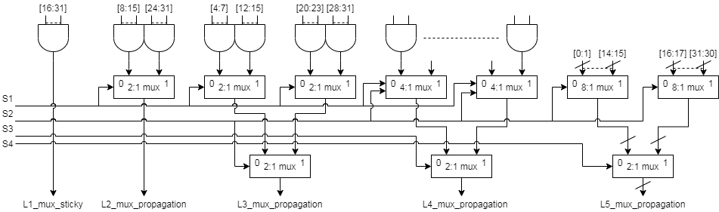

Structuralized AND network (2/)
BACK
Notes:
l5_sticky = 1’b0
l4_sticky = (f1_s_lz_num[5] == 1’b1) ? l5_sticky :|bit[15:0]
L3_sticky = (f1_s_lz_num[5:4] == 2’b11) ? l4_sticky :
l4_sticky | (| bit[27:24])

Slide 55
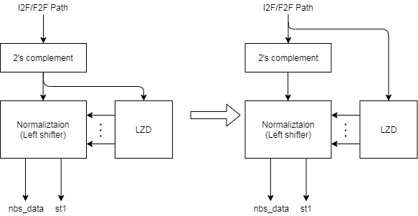
Leading zero detection before 2’sc (1/)
Generate LZC early
What’s input string?

Slide 56
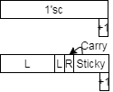
Leading zero detection before 2’sc (2/)
Merge increment of 2’sc (for negative integer source) to round digit generation
Add structuralized AND network to deal with carry (from sticky part) because of 2’sc increment
If (1’sc + 1) raise carry bit then exp_inc can select correct exponent
Negative integer is 16’b1111_1000_0000_0000
1’sc →16’b0000_0111_1111_1111
Pack to HP format → 01.1111_1111_11 and increment 1 for 2’sc
Result → 10.0000_0000_00 and carry is set then exponent increase 1

Slide 57
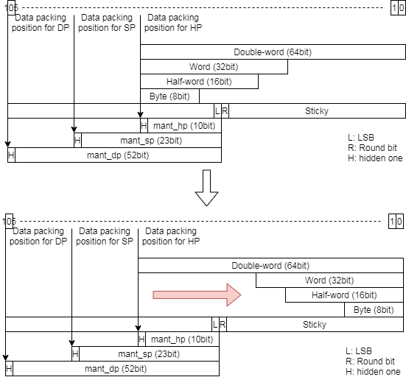
Rearrange data alignment for I2F (1/)
Modify integer value alignment from 63-bit to 0-bit
Reduce data type selection
For FLEN 32 (pipe0, pipe2)
Just force lz_num[5] to 1’b1
For FLEN 16 (pipe1, pipe3)
Just force lz_num[5:4] to 2’b11
After 2’sc
lz_num is leading zero count

Slide 58
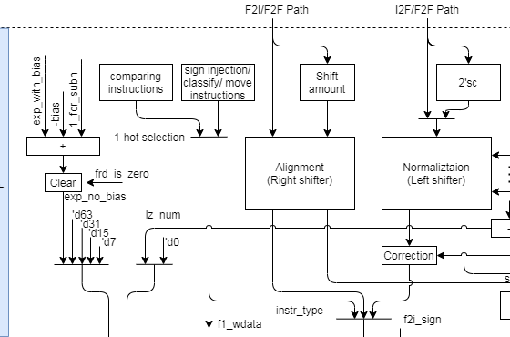
Rearrange data alignment for I2F (2/)
The following show reduced multiplexers
BACK

Slide 59
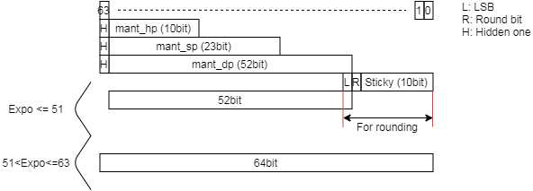
Rearrange data alignment for F2I (1/)
Apply a 64-bit adder
BACK

Slide 60
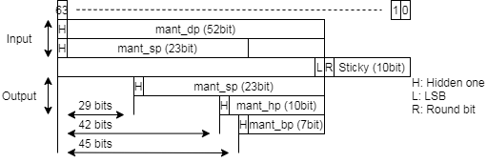
Rearrange data alignment for narrowing FP (1/)
This rearrangement is for merging two adders
All destination result types are aligned at LSB
ABS should support 65-bit right shift
BACK

Slide 61
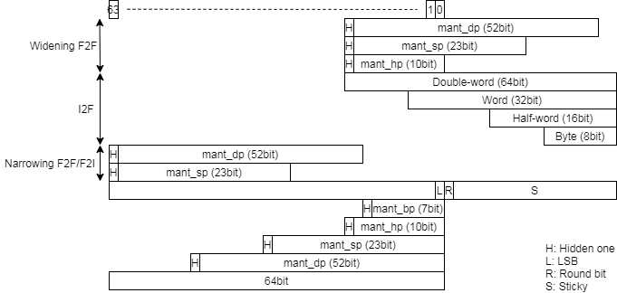
Merge 64bit and 54bit adder (1/)
Use 64-bit adder to do 64-bit 2’sc and 54-bit rounding
LSB of 64-bit is for round bit
Rearrange data alignment for all conversion instructions
Adjust shift amount according to changing alignment
BACK

Slide 62
MISC (1/)
Generate exp_inc in F1 stage
Bit pattern detection
Move exponent computation to F1 stage

Slide 63
Interface

Slide 64
Back-End Hierarchy

Slide 65
Function Unit Interface

Slide 66
VFP_FMIS Interface (1/)
Signal name | Type | Description
core_clk | Input | Clock
core_reset_n | Input | Negative Edge Reset
lane_pipe_id_0 | Input | ID
f1_valid | Input
f1_fmis_scalar_valid | Input | Indicate scalar instruction
f1_ex_ctrl | Input | Control signal for encoding. More info in instruction encoding slide.
f1_sew | Input | Indicate element width
f1_ediv | Input | Un-used
f1_round_mode | Input | Round mode
f1_widen | Input | Widening instruction for vector instruction
f1_narrow | Input | Narrowing instruction for vector instruction
f1_sign | Input | Indicate signed integer source or decode instruction
f1_vmask | Input | The corresponding element v0.t value

Slide 67
VFMIS_64 Interface (2/)
Signal name | Type | Description
f1_op1_invalid | Input | Invalid oprand1
f1_op2_invalid | Input | Invalid oprand2
f1_op1_data | Input | Source oprand1
f1_op2_data | Input | Source oprand2
f1_cmp_inv_op | Output | Set invalid operation exception flag for scalar fp instruction (destination is XRF)
f1_wdata_en | Output | Write enable for F1 retired instruction (Instruction latency is 1)
f1_wdata | Output | Result data for F1 retired instruction (Instruction latency is 1)

Slide 68
VFMIS_64 Interface (3/)
Signal name | Type | Description
f2_result_type | Output | Result data type 3’b111 → DP 3’b110 → SP 3’b101 → HP 3’b100 → Bfloat16 3’b011 → Double-word 3’b010 → Word 3’b001 → Half-word 3’b000 → Byte
f2_cmp_result | Output | Partial compare result and upper module need to merging and shifting data.
f2_narr_wdata | Output | Partial narrowing result and upper module need to merging and shifting data.
f2_wdata_en | Output | Write enable for non F1 retired instruction (Instruction latency is 2/3)
f2_wdata | Output | Result data for non F1 retired instruction (Instruction latency is 2/3)
f2_flag_set | Output | Result exception flag

Slide 69
Instruction Encoding

Slide 70
Instruction encoding

