Slide 1
SP FMADD with Parallel Alignment
Yuan-Yuan Shih
2008/7/8

Slide 2
Outline
Alignment
  Scheme 1
  Scheme 2
Normalization for Scheme 2
  After Addition
  Before Addition

Slide 3
Alignment: Scheme 1
To perform D = A + B * C
  D.exp = A.exp – B.exp + C.exp
Shift Amount: SA = D.exp - bias
  SA > 0: (B * C) >> SN
  SA = 0: no shift
  SA < 0: A >> ABS(SA)
Alignment is processed after the result of multiply is generated.
Long Latency
Pre-Rounding can be applied

Slide 4
Alignment: Scheme 2 (1)
Pre-shift A left 27-bit
  1 signed bit
  24-bit significand
  2 guard bits
SN = 27 – (D.exp – bias)
Always shift A right
Need a 74-bit alignment shifter
  27 (width of A) + 47 (multiply PP)
Pre-rounding can not be applied

Slide 5
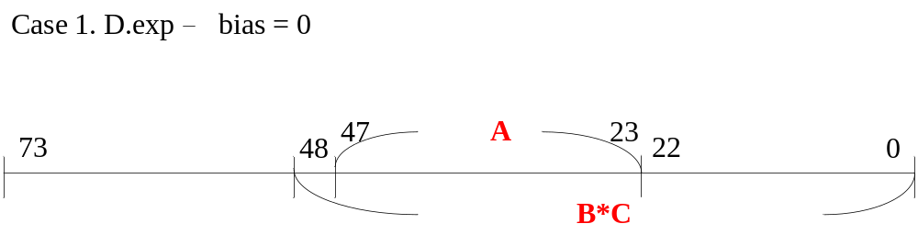
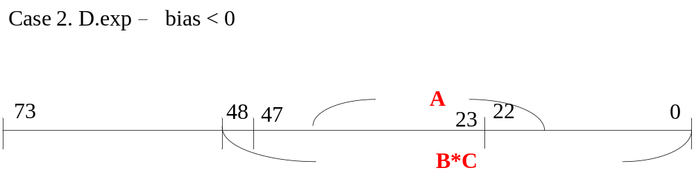
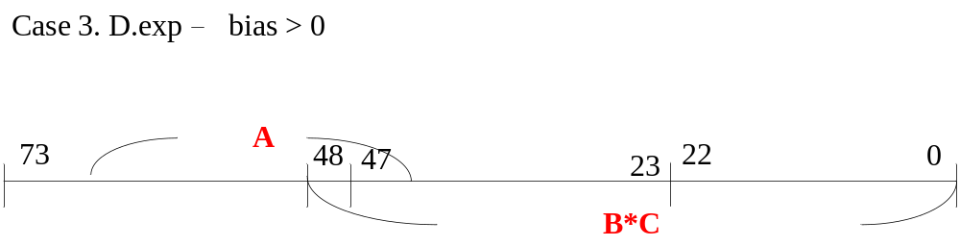
How To Align in Scheme 2

Slide 6
Normalization After Addition
Need 74-bit Adder, Normalizer and LZA
Normalization & Rounding can be performed in parallel
2 incrementors are necessary
  One for calculating final significand
  One for calculating final exponment
Latency
  T_{add} + T_{nor} + T_{inc1} + T_{inc2}

Slide 7
Normalization Before Addition
Need 74-bit normalizer and LZA
Need 24-bit adder (only consider SP)
Rounding & Addition can be performed in parallel
Latency
  2 main adder: T_{nor} + T_{add} + T_{mux} + T_{inc2}
  1 main adder: T_{nor} + T_{add} + T_{inc1} + T_{inc2}

Slide 8
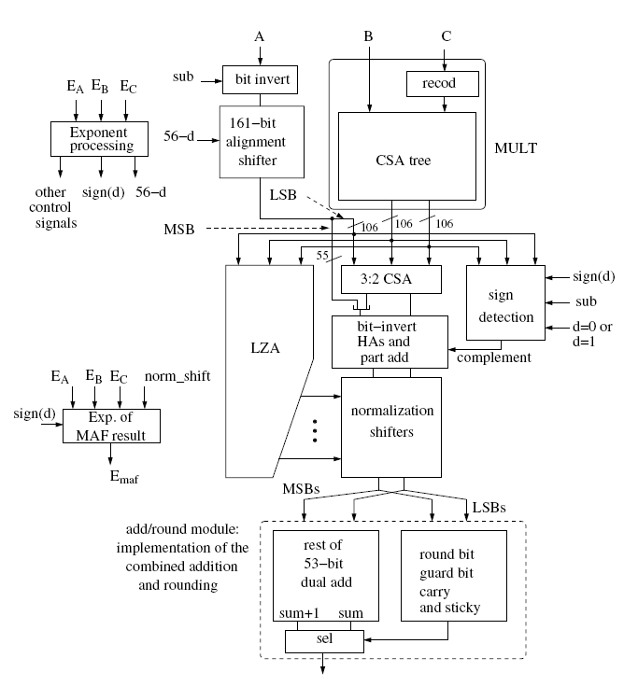
Block Diagram – Before Addition

