Slide 1
VFMAC Design Spec

Slide 2
Interface
input | Bit width | Description
core_clk | 1 | clock signal
core_reset_n | 1 | reset signal, active low
lane_pipe_id0 | 1 | indicates whether this is pipe0 of lane0, which also takes scalar operations
f1_valid | 1 | valid input
f1_round_mode | 3 | rounding mode
f1_ex_ctrl | 5 | operation, see andes_vip/patterns/plan/Vector_inst_decode_v0stage.xlsx for encodings
f1_sew | 2 | element width 0:reserved 1:16-bit 2:32-bit 3:64-bit
f1_ediv | 2 | unused
f1_op_wide | 1 | widening operation

Slide 3
Interface
input | Bit width | Description
f1_op1/2/3 | 64 | operands 1/2/3: op1 * op2 + op3
f1_op_mask | 1 | indicates whether the input operand is masked used with ordered reduction to bypass un-canonicalized operand
f1_op1/3_hp | 1 | indicates op1/3 is in HP format
f1_align_amount_adjustment | 10 | a value to adjust the alignment amount (this is for timing consideration, move the calculation to F0)
f1_op1/2/3_subnormal_hp | 1 | indicates operand1/2/3 is a subnormal value in HP format
f1_op1/2/3_subnormal_sp | 1 | indicates operand1/2/3 is a subnormal value in SP format

Slide 4
Interface
output | Bit width | Description
f4_wdata_en | 1 | valid output
f4_wdata | 64 | output data of operation
f4_flag_set | 5 | exceptions {invalid, divide-by-zero, underflow, overflow, inexact}
f4_result_type | 2 | result format 0: reserved 1: half-precision/bfloat16 2: TF32 3: reserved

Slide 5
instruction list
addition
fadd/vfadd/vfwadd: a*1+c
fsub/vfsub/vfwsub/vfrsub: a*1-c
multiply
fmul/vfmul/vfwmul: a*b+0
mac
fmadd/vfmadd/vfmacc/vfwmacc: a*b+c
fmsub/vfmsub/vfmsac/vfwmsac: a*b-c
fnmsub/vfnmsub/vfnmsac/vfwnmsac: -(a*b)+c
fnmadd/vfnmadd/vfnmacc/vfwnmacc: -(a*b)-c
reduction
dot-product

Slide 6
V2/F0 stage
Reduction/dot-product FSM
src_gen: VRF, scalar FRF selection
Constant generation
constant 1 for addition
constant 0 for multiplication: 0 for multiply is generated in F1, because dot-product needs f1_op3 to backup the addend
delay might be hide into
Operand SEW adjustment for widening operations
Pipe valid generation from FSM/mask

Slide 7
Data Path
expA
expB
expC
fracC
fracA
fracB
f1
inv
encode
special value detection
csa(56-a+b-c-bias)
Eff. sub
4:2 CSA
partial product reduction
161-bits align. shifter
partial sticky: st1
55msb
106lsb
st1
Eff. sub
f2
3:2 CSA
107lsb
eff. sub
d
LZA pos + neg
HA carry
HA sum
HA inv. carry
sign detection
eff. sub
d
Part of dual adder
Part of dual adder
LZA string
OR network
complement
f3
d<0
Left shift 54 bits
LZC_{subnorm}[6]
normalization
LZC_{subnorm}[5]
LZC_{subnorm}[0]
f4

Slide 8
after normalization
format
0 50 51 54 55 161
x.x........x xxxx x......x
DP as an example
51
3
107
st1
Rest dual adder
S+1 S
carry/sticky calc
4-bit adder
carry
sticky
round decision
Z
5-bit adder
5-bit adder
Y0[161:111]
Y1
Y0[161] | Y1[161] & Z[4]
Y0[161]
neg (a*b) + sub(c)
eff_sub = (neg ^ sign_a ^ sign_b) ^ (sub ^ sign_c)
final sign = eff_sub &comp. | (sub ^ sign(c))
LSB correction
sticky
RI
RI = RUP & ~final_sign | RDN & final_sign
RN = RNE | RMM

Slide 9
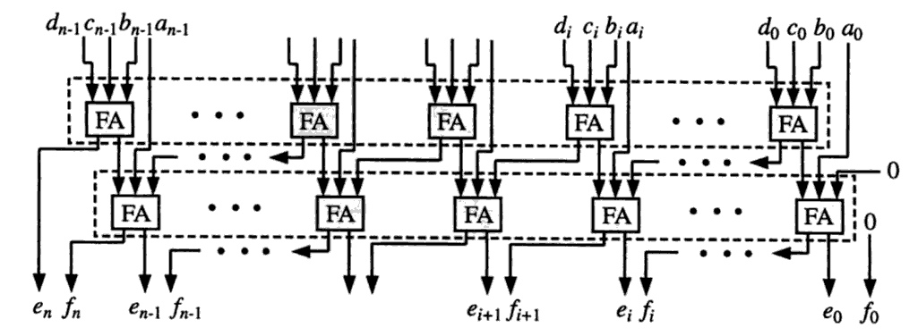
F1: 4:2 CSA
Don’t cascade two FAs directly, convert it to canonical form
Propagation Delay is about 1.5 times of 3:2 CSA

Slide 10
F1: Modified Booth Encoding
Partial product is sign-extended when encoded as -1X or -2X
To eliminate the width of CSA arrays:
invert the MSB of sign-extension bit of the multiplicand and rewrite the partial product into the grey background part + our new partial product:
The carry chain will be the same. But with the greyed out constants for sign-extension, we can add them together:

Slide 11
F1: Addend Alignment and Partial Sticky Bit Generation
d = expC` - expA` + expB` - bias
Alignment amount = 56-d

Slide 12
F2: LZA
AX25V100 | A25 series
latency
LZA pos
LZA neg
sign detection
LZA pos
LZA neg
sign detection
LZA
A-B
LZA
B-A
LZA eff. add
LZA string
OR network
LZA string
OR network
LZA string
OR network
LZA string
OR network
delay = log(64)
long latency
low cost
extra LZD cost
extra positive LZA cost

Slide 13
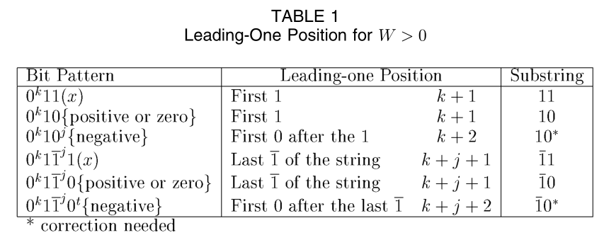
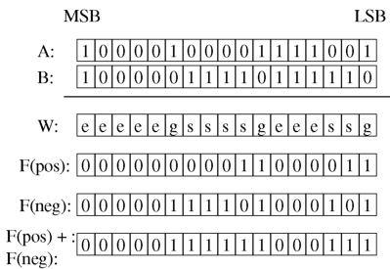
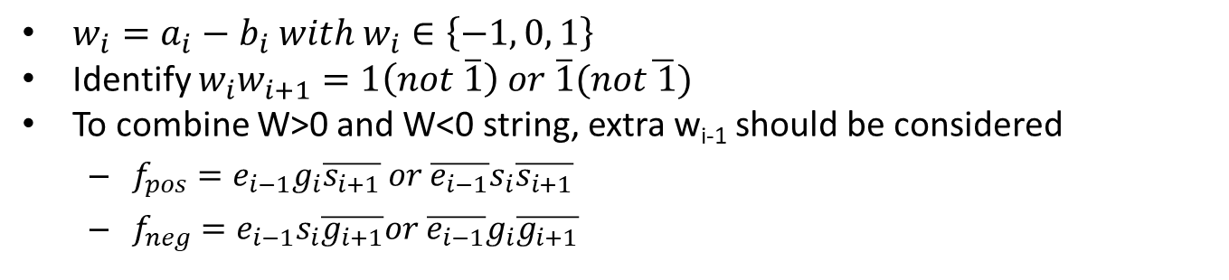
F2: LZA
$w_{i}=a_{i}−b_{i} with w_{i}∈\left\{−1, 0, 1\right\}$
Identify $w_{i}w_{i+1}=1\left(not \overline{1}\right) or \overline{1}(not\overline{ 1})$
To combine W>0 and W<0 string, extra w_{i-1} should be considered
$f_{pos}=e_{i−1}g_{i}\overline{s_{i+1}} or \overline{e_{i−1}}s_{i}\overline{s_{i+1}}$
$f_{neg}=e_{i−1}s_{i}\overline{g_{i+1}}or \overline{e_{i−1}}g_{i}\overline{g_{i+1}}$

Slide 14
F2: LZA
Only applicable to X-Y case, both X and Y > 0
Leading zero of X+Y can’t simply derive from max(expX, expY)
Normal + Normal * Sub-Normal
1.x * 2⁻¹⁰²⁰ + x.x * 2⁻¹⁰²⁰ =>
Normal * Sub-Normal produces a case

Slide 15
F2: Sign Detection
using tree comparator
A + B => complemnt = 0
A – B => compared with ~B
when A = ~B then A < B

Slide 16
F3: Normalization, sub-normal prediction
d = expC’ – (expA’ + expB’)
for DP, exp_{subnorm}=-1023
53
106
56-d < 0
C_{inv}
x
x
…
x
A*B
x
x
x
…
x
expC’ – LZC <= exp_{subnorm}
56-d < 0
56-1
106
d = 1
x
x
…
x
LZC
x
x
x
…
x
expA’ + expB’ + 56 – LZC <= exp_{subnorm}
56-d
106
d < 0
x
x
…
x
expA’ + expB’ + 56 – LZC <= exp_{subnorm}
LZC
x
x
x
…
x
LZC_{subnorm} = (56-d) < 0 ? expC’ – exp_{subnorm}
expA’ + expB’ + 56 - exp_{subnorm}
LZC[6] < LZC_{subnorm}[6]
Final LZC selection
LZC[5] < LZC_{subnorm}[5]
LZC[0] < LZC_{subnorm}[0]

Slide 17
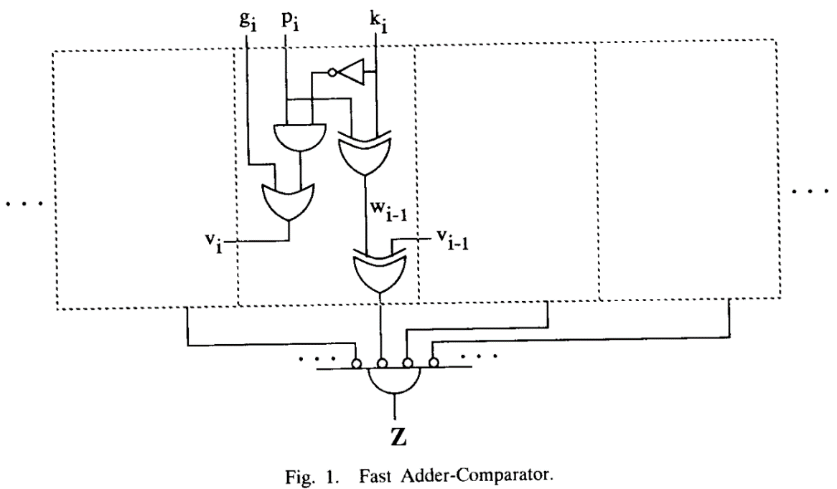
F4: sticky bit generation
Evalution of A+B=K Conditions Without Carry Propagation

Slide 18
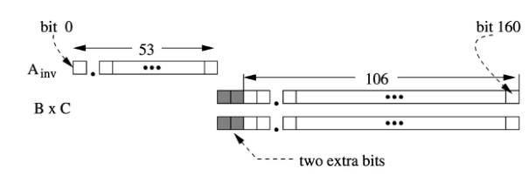
subnormal
Input
hidden 1 should be calculated from exponent
Result
right shift needed?
shift amount adjustment

Slide 19
critical path improvement opportunity
hidden 1 generation before partial sum encoding
no optimize
3:2 csa, latency = 1, 53-bit -> 27 partial product + 1 carry array
27 -> 18 -> 12 -> 8+1 -> 6 -> 4 ->3-> 2 = 7
4:2 csa, latency = 1.5
27+1 -> 14 -> 6+2 -> 4 -> 2 = 6
(a.x * b.y) = (ab+ay)+bx+xy :27+1 + 2 PPs
4:2 csa
27+1 -> 14+2 -> 8 -> 4 -> 2 = 6
summarize slow parts to one partial product:26+1+2 PPs
4:2 csa
26 -> 12+2+2 -> 8+1 -> 6 -> 4 -> 2 = 6.5
stick bit and final exponent selection on fraction = 0
can’t reuse A+PP CSA with A+B=K equation, the CSA used in F2 is A + PP
A+B=K ⇒ A+B+~K = -1 ⇒ 2C + S = -1 ⇒ 2C = ~S
slow bits
carry

Slide 20
Multiplication subnormal corner case

Slide 21
backup slides

Slide 22
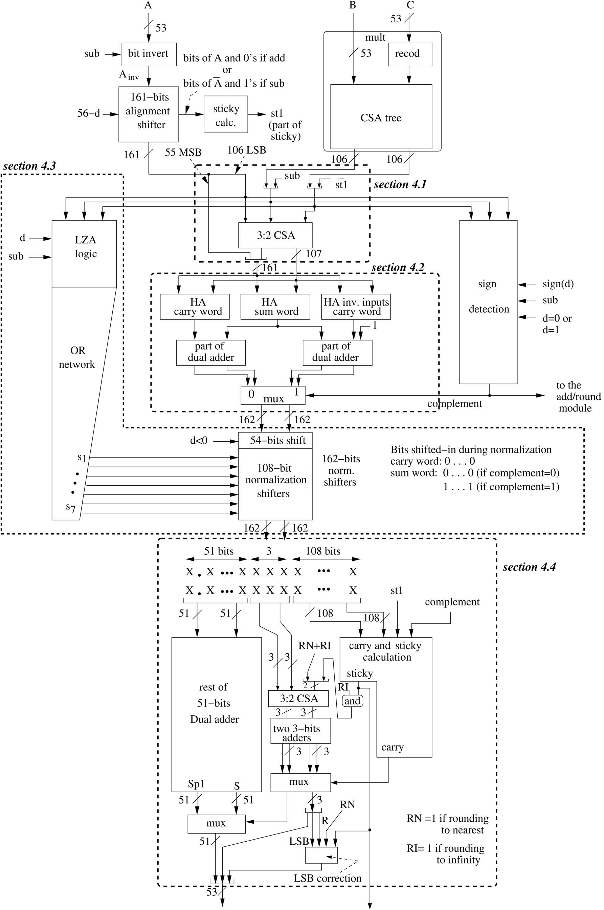

Slide 24
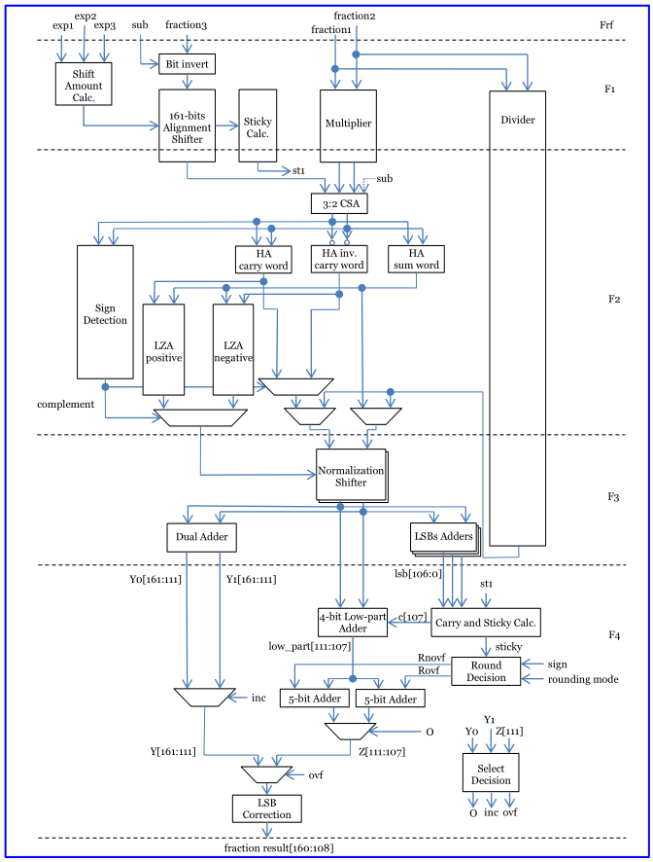

Slide 25
after normalization
format
0 50 51 53 54 161
x.x........x xxx x......x
DP as an example
51
3
108
st1
comp
dual adder
S+1 S
RI|RN
sticky
3-bit CSA
RI
adders
carry
4
4
carry
LSB
R
RN
LSB correction

