Slide 1
TLC2AXI500
Bill 2020/10/21

Slide 2
Features
Compliant with AXI4 protocols
Supports AXI exclusive access
Supports AxCACHE information
Supports AxPROT information
Compliant with TileLink Cached (TL-C)
Supports beat interleaving in TileLink channel D
Configurable clock synchronization
asynchronous
synchronous N:1 (TileLink clock frequency : AXI clock frequency)
Configurable 32–64 bits address width
Configurable 32/64/128/256 bits data width
Configurable 4–8 ID width
Supports up to 128 bytes burst size
Configurable sink id width
Support user sidebands

Slide 3
Latency
A/C Channel Latency
a_valid/c_valid to arvalid/awvalid/wvalid
1 cycle (min)
D Channel Latency
rvalid/bvalid to d_valid
1 cycle
E channel latency
0 cycle
B channel
Hardwired to 0

Slide 4
Parameters
ACLK_SYNC: sync, async
ADDR_WIDTH: 32-64
DATA_WIDTH: 32/64/128/256
ID_WIDTH: 4-8
AXI_USER_WIDTH
TL_SINK_WIDTH
ASYNC_DEPTH

Slide 5
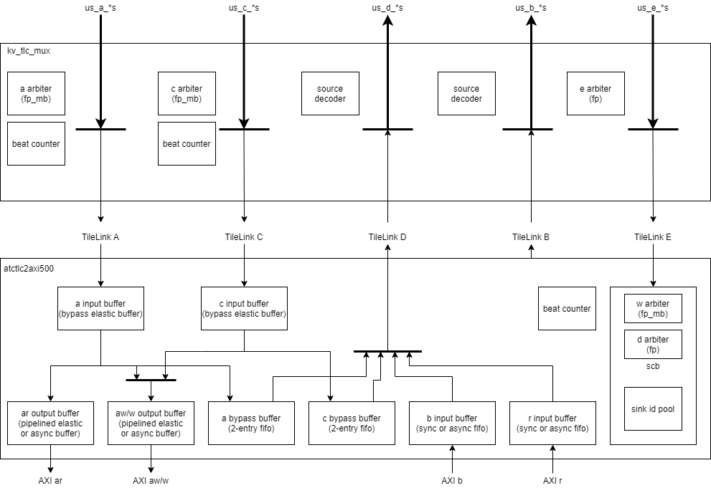
Block Diagram

Slide 6
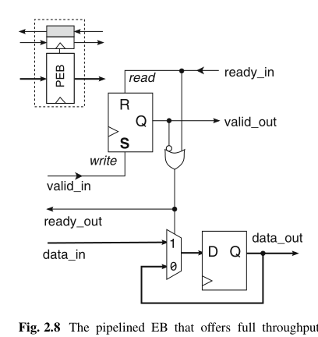
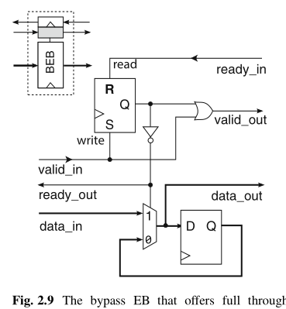
Elastic Buffer
Microarchitecture of Network-on-Chip Routers

Slide 7
User
The width is defined by AXI_USER_WIDTH
TileLink A, C channels to AXI AW, W, R channels
AXI R, B channels to TileLink D channels
TileLink A, C channels to TileLink D channels

Slide 8
New BIU

