Slide 1
D23 LBIU

Slide 2
Discussion (3/29)
PLIC (CLIC) / PLMT (embedded) / PLDM (embedded)
optional / internal / peripheral
ae350_cpu_subsystem
core_top/core/ucore
Plans for internal IPs

Slide 3
Discussion (3/29)
N22 internal IP gate_count
uTLB+PMP
CLIC

Slide 4
Requirement
CPU_SUBSYSTEM
3 Bus interface:
Master (output): CPU to System Bus
Master (output): Debug to System Bus
Slave (input) : Slave Port (System Bus to LM)
The BMC in CPU_SUBSYSTEM supports data_width 32 / 64
Use Size-Down if data_width > 64
PLMT / Internal Timer
Supports free clock ratio between core_clk and mtime_clk

Slide 5
Requirement
PLIC / CLIC
PLDM
Internal DM supports System bus Access(?
Supports debug spec v0.14
JDTM port (cpu_subsystem interface)
DMI_AHB or JTAG?
** PPA for internal IP
Ref to N8 EDM (SIZE CPU:EDM)

Slide 6
Reference: AE350_CPU_SUBSYSTEM in 25/27
AE350_CPU_SUBSYSTEM
CORE_TOP
BUSDEC200 (AHB)
AXX
i_AXX
d_AXX
*BMC MAX DATA_WIDTH = 256
BMC300(AXI) / BMC200(AHB)
slv1
SIZEDN
slv8
slv9
slv10
*PIP MAX DATA_WIDTH = 64
AXI2AHB
BUSDEC300(AXI) / BUSDEC200 (AHB)
slv0
slv1
slv2
slv3
PLIC
PLMT
PLIC_SW
DEBUG
cpuslv_AXX
*BIU_DATA_WIDTH
*AE350_DATA_WIDTH
SYSTEM BUS

Slide 7
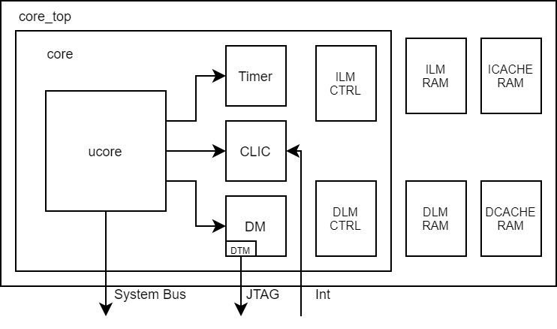
Reference: ucore/core/core_top in N22
If the internal PL-IPs are selected, the Timer/CLIC/DM will be Instantiated in core level
N22 has ucore level
In 25/27 ucore and LM_ctrls are packed as vc_core level
Core level includes LM control
Core-Top level includes core and RAMs
N22 has JTAG interface on core_top

Slide 8
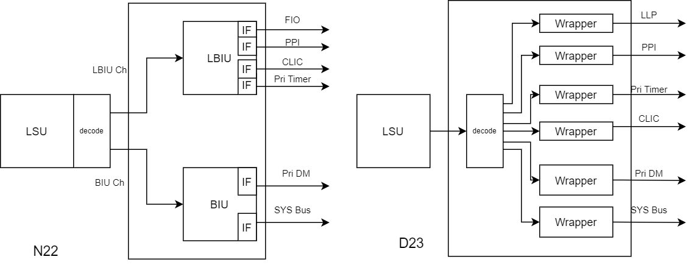
Reference: N22 BIU and LBIU
read timer behavior
N22 gate-count for private IP
In N22, the address decode is done in LSU and issues the request to BIU or LBIU.
To BIU part: Private DM / System Bus To LBIU part: FIO/PPI/ CLIC/Private Timer
N22 has hardwire priority: CLIC > timer > FIO > PPI > System Bus

Slide 9
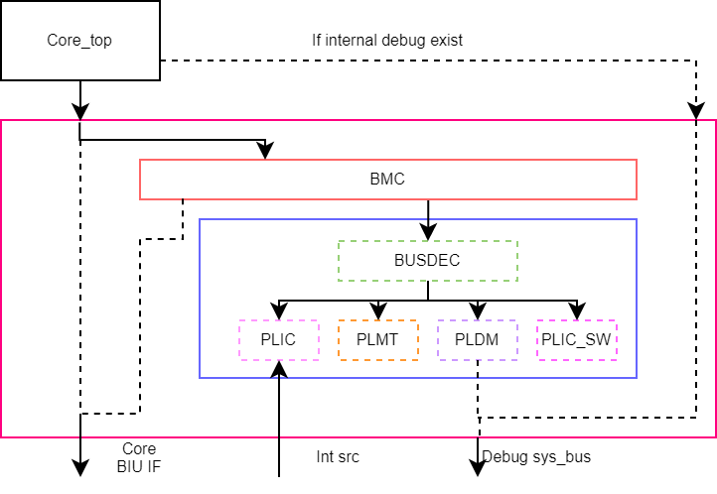
CPU_SUBSYSTEM with internal IPs
If any peripheral IP exist, the CPU subsystem looks like original version.
Pack BMC and peripheral IPs to simplified the cpu_subsystem code structure.
cpu_subsystem coding issue:
MP?
CORE_BIU AXI or AHB
internal IPs
peripheral IP interface AHB/AXI
LM + AHB-Lite
*** AHB only

Slide 10
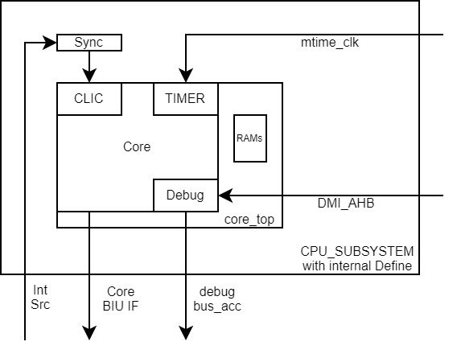
CPU_SUBSYSTEM with internal IPs
If all peripheral IPs are selected as internal version, the BMC will not be instantiated
The cpu_subsystem hierarchy will be simplified to:
core_top
busdec200 (for Slave Port)

Slide 11
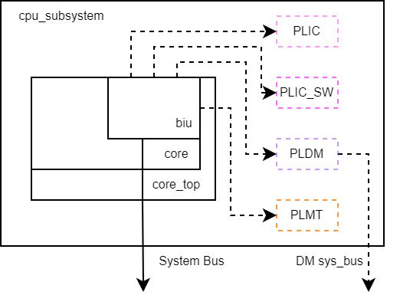
Simplified CPU_SUBSYSTEM (1)
Default has specific ports for PLIC/PLDM/PLMT
Reduce BMC/BUSDEC
Don’t need AXI/AHB for the interface between BIU and PIP (?)
BIU gate-count (X)

Slide 12
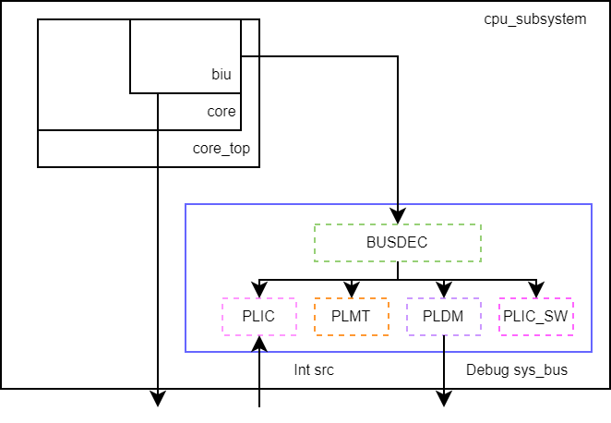
Simplified CPU_SUBSYSTEM (2)
If one of PLMT/PLDM/PLIC is not internal version.
Turns on a specific port to access peripheral IPs
Reduce BMC
The BUSDEC can be implemented by address only (don’t need BUSDEC100/BUSDEC300 here)
BIU gate-count (X)

Slide 13
CPU_SUBSYSTEM coding(?
core_top (
`ifdef AXI
AXIIF
`endif
`ifdef AHB
AHBIF
`endif
`ifdef INTERNAL_DEBUG_AXI
DEBUG_IF_AXI
`endif
`ifdef INTERNAL_DEBUG_AHB
DEBUG_IF_AHB
`endif
)
pack (
`ifdef AXI
CORE_AXIIF
SYS_BUS_AXIIF
`endif
`ifdef AHB
CORE_AHBIF
SYS_BUS_AHBIF
`endif
`ifdef INTERNAL_DEBUG_AXI
DEBUG_IF_AXI_in
DEBUG_IF_AXI_out
`endif
`ifdef INTERNAL_DEBUG_AHB
DEBUG_IF_AHB_in
DEBUG_IF_AHB_out
`endif
)
ifdef AHB
AHBIF
AHB BMC
Core_top
AXIIF
AXI BMC
ifdef AXI

Slide 14
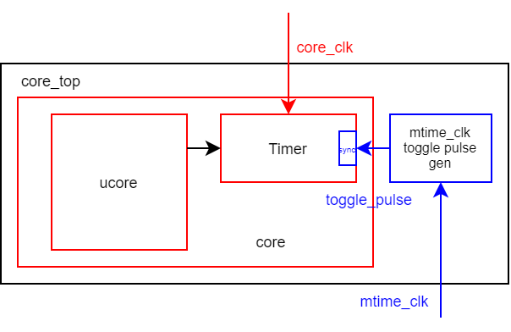
Reference: N22 Private Timer
The private timer for N22 which is driven by core_clk is in core level
It means the core_clk can’t be stopped
In core_top level, there is a toggle pulse generator. This pulse will toggle when every mtime_clk pose-edge
The private timer sync and count the toggle-pulse for mtime_clk counting, it means:
The core_clk must faster than mtime_clk
The core_clk : mtime_clk is better limited at 2:1 (Freq)

Slide 15
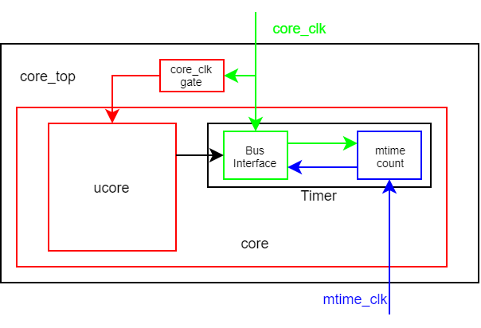
Plan: Internal Timer for D23
input clk: core_clk, aopd_timer_clk, aopd_debug_clk, aopd_clic_clk
(mtime_clk)
To allow core_clk be stopped, separate core_clk:
Always on core_clk → for internal timer / debug(DMI) / CLIC(?)
Gated core_clk → for ucore
The gating module will be added in core_top level
The NCEPLMT100 supports the free clock ratio between mtime_clk and core_clk
Instantiate the NCEPLMT100 in core level directly
Add mtime_clk at core_top interface and connect to NCEPLMT100
Gate Count may be a problem:
NCEPLMT100 → 4.1K (AHB)
busif → 3.4K
mtime → 0.7K
Maybe use self-define interface can reduce gate-count in busif

Slide 16
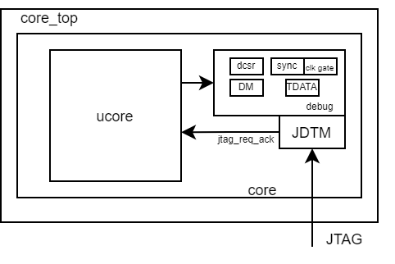
Reference: N22 Private DM
N22 reduce the PLDM’s code
Halt resume is not supported
DM.SYS_BUS_ACC is not supported
JTAG module is instantiated in core level (has JTAG signal on core interface)
N22 integrate PLDM + debug CSR + TRIGER(TDATA) as debug subsystem.

Slide 17
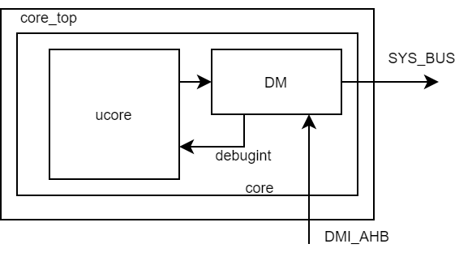
Plan: Internal Debug for D23
Internal DM will not support SYS_BUS
Keep all functions in debug spec v0.14
Use PLDM directory
move JDTM to ae350
The JDTM is in AE350_AOPD now (always on)
The Core_top interface for debug will be DMI_AHB

Slide 18
Reference: N22 CLIC

Slide 19
Plan: CLIC for D23

Slide 20
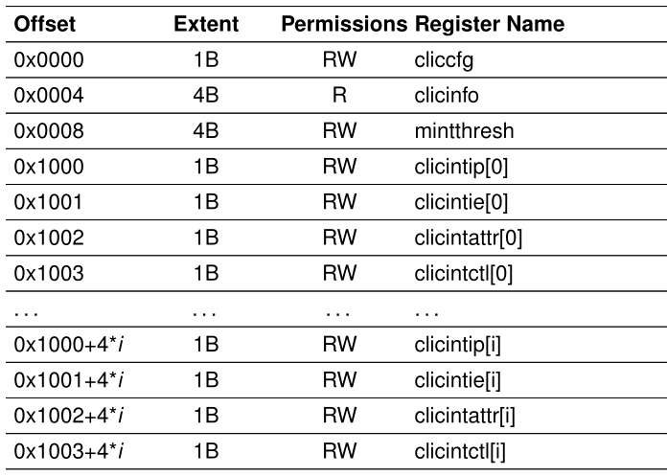
CLIC – Register for each Int control

Slide 21
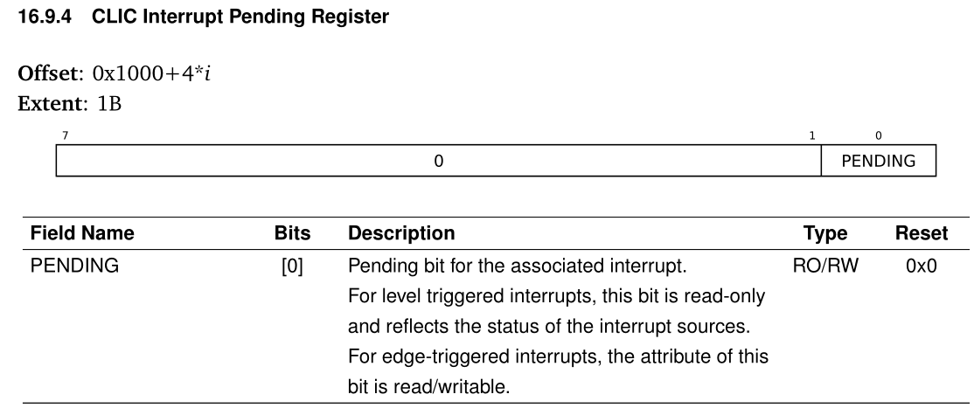
CLIC – CLICINTIP

Slide 22
CLIC – setup priority
Use cliccfg.NLBITS to setup the priority bits:
ex. 8bits => max priority 255
set clicintctl.PRIORITY for priority setting

Slide 23
Gate Count
 | Internal | On Bus
Timer | 1.58K | 4.1K
 |  | BusIF 0.7K
debug | 8K (*include jtag 1.3K) | PLDM
 | DM 5.88K | 7K
 | JTAG 1.3K
CLIC / PLIC | 1.47K | 6.3K / 4.7K (HW/SW)
 | 0.7K (sync) (0.1K*7)

Slide 24
Gate Count - Timer
Timer | Internal Timer (in N22) | NCEPLMT100 | Diff
Total Gate Count | 1.58K | 3.99K | -2.41K
BusIF | - | 3.19K | -
Mtime | 1.55K | 0.7K | -
Synchronizer | 0.03K | 0.06K | -
Interface | Self-Define (valid/ready) | AHB | -
Data Width | 32 | 32 | -

Slide 25
Gate Count - Debug
Debug | Internal Debug(in N22) | NCEPLDM200 | Diff
Total Gate Count | 8K | 7K | -
DM | 5.88K | 7K | -1.12K
JTAG | 1.3K | - | -
Interface | AHB | AHB | -
SYS_BUS_ACCESS | no | no (SYS_BUS AHB: 0.7K) | -
Data Width | 32 | 32 | -

Slide 26
Gate Count – CLIC/PLIC
Debug | CLIC | PLIC (HW) | PLIC (SW)
Total Gate Count | 8K | 5.16K
DM | 5.88K | 7K
JTAG | 1.3K | -
Interface | AHB | AHB (Don’t support DW)
SYS_BUS_ACCESS | no | no
Data Width | 32 | 32

Slide 27
Limitation - Timer
 | Integrated PIP | NCEPLMT100
Clock Ratio (Freq) (Core : Mtime) | > 2:1 | Any Ratio
Bus interface | Self-Define (32) | AHB/AXI (32/64)
Response Latency | About 4 mtime cycle (?) | illegal inst + mtime handler
core_clk status | core_clk always alive | core_clk can be stopped
target number | 1 | 1~1024
mtime clk sync/async
Remove shadow in integrated timer
mtime clk use async handling but connect with sync bus_clk
self-define uses req/ack
Add always-on core_clk from clkgen

Slide 28
Limitation - Debug
 | Integrated PIP | NCEPLDM200
Program Buffer Size | 1 / 2 / 8 | 1 / 2 / 8
Bus Interface | self-define (32) | AHB / AXI (32/64)
DMI Interface | AHB (32) | AHB (32)
Halt Group | Not Supported | Supported
Group Resume | Not Supported | Supported
Cross Trigger | Not Supported | Supported
System Bus Access | Not Supported | Supported
Debug Wait State | Not Supported | Supported
Program buffer Size use 1 / 2 / 8 in design.
New AE350 for D23, include JDTM in AE350_AOPD + AE350_CPU_SUBSYSTEM
How to support debug wait state → TBD
In first CHH stage: PLDM has two implement stage:
For first version: use PLDM and add a new port in BIU
2nd: Reduce integrated Debug Gate Count (Interface Enhance)

Slide 29
Limitation - CLIC
 | CLIC | PLIC
Interrupt number | 1~1024 | 1~1024
Bus Interface | self-define (32) | AHB / AXI (32/64)
DMI Interface | AHB (32) | AHB (32)
Target Number | 1 | 1~16
Max Priority | 3/7/15/31/63/127/255 | 3/7/15/31/63/127/255
Async Int | Supported | Supported
Edge Trigger | Supported | Supported

Slide 30
Ref: N22 CLIC Interface
Signal | Source | Destination | Description
msip | core IF | CLIC
mtip | core IF / Timer | CLIC
meip | core IF | CLIC
mip_imecci | ucore | CLIC
mip_bwei | ucore | CLIC
mip_pmovi | ucore | CLIC
clic_irq[CLIC_IRQ_NUM-20:0] | core IF | CLIC

Slide 31
Ref: N22 CLIC Interface
Signal | Source | Destination | Description
icb_cmd_valid | BIU | CLIC | Self-Define interface (BIU → CLIC) The CLIC.CSR in N22 is accessed by BIU Same Cycle response
icb_cmd_ready | BIU | CLIC
icb_cmd_addr | BIU | CLIC
icb_cmd_wmask | BIU | CLIC
icb_cmd_read | BIU | CLIC
icb_cmd_wdata | BIU | CLIC
icb_rsp_valid | CLIC | BIU
icb_rsp_ready | CLIC | BIU
icb_rsp_rdata | CLIC | BIU
icb_rsp_err | CLIC | BIU

Slide 32
Ref: N22 CLIC Interface
Signal | Source | Destination | Description
clic_irq_taken | ucore (n22_ucore) | CLIC
core_in_int | ucore (n22_ucore) | CLIC
clic_int_mode | ucore (n22_ucore) | CLIC
mnxti_valid_taken | ucore (n22_ucore) | CLIC

Slide 33
Ref: N22 CLIC Interface
Signal | Source | Destination | Description
clic_active | CLIC | CLK_CTRL
clic_irq_o | CLIC | ucore (n22_exu)
clic_irq_id | CLIC | ucore (n22_exu)
clic_irq_shv | CLIC | ucore (n22_exu) | vector CLIC is selected 0: Jump to mtvec 1: Jump to mtvt
mintstatus_mil_r | ucore (n22_exu) | CLIC
clic_irq_lvl | CLIC | ucore (n22_exu)
clic_prio_gt_thod | CLIC | ucore (n22_exu)

Slide 34
Integrated PIPs Clock Gating
Requirement:
Gate the CLIC, Timer, and Debug Module when they are IDLE
Debug Module IDLE:
Core free run + JTAG state machine in IDLE
In halt mode: debug wait state
Timer IDLE:
Gate Timer_clk: No timer setting
Gate mtime_clk: Stoptime
CLIC IDLE:
No interrupt
No CLIC setting request

Slide 35
chh_core and clkgen
As figure

Slide 36
Clocks in chh_core Level
 | Source | Clock (default) | Clock Enable Source
Core Clock |  | on | WFI
LM Clock | Core Clock | on
Timer Clock | Core Clock | off | BIU (biu_path)
Mtime Clock | PCLK (AE350) | on | Core (stoptime)
DM Clock | Core Clock | off | JTAG FSM + CORE (csr_halt_mode + dbg_wait_state)
CLIC Clock | Core Clock | off | BIU (biu_path)
AON core clk |  | on

Slide 37
Clock Gating – Timer (1)
Timer Programming Sequence
Write mtime
Write mtimecmp
---- wait for mtip ----
Write mtimecmp to clear mtip
stoptime
from core to timer
stoptime only issues in debug mode

Slide 38
Clock Gating – Timer (1)
Turns on timer_clk
BIU receives the mtime/mtimecmp requests
Turns off timer_clk
mtime/mtimecmp request done
Turns off mtime_clk
Stoptime asserted
Turns on mtime_clk
Stoptime de-asserted

Slide 39
Clock Gating – Debug Module
Backup S0, S1
debugint taken
PLDM Issues debugint when:
haltreq
resumereq
ABS command
Read RV_COMMAND
Has new abs_cmd
Y
Restore S0, S1
Do abstract command
N
Do
Resume
Y
Restore S0, S1
+ dret
ebreak
N
Restore S0, S1
+ ebreak
jump to wait state
by ebreak in debug mode
Wait State
Gate dm_clk here

Slide 40
Clock Gating – Debug Module
Both DMI and Core interface use dm_clk
Turns on dm_clk
JTAG FSM active (JTAG leaves IDLE state)
Turns off dm_clk
Core stays in free run (~halt_mode)
Core stays in debug wait state (halt_mode & dbg_wait state)
No JTAG active (JTAG stays in IDLE State)

Slide 41
Clock Gating – CLIC
In N22, the clic_clk only drives the clic registers
The interrupt handling uses always-on core_clk

Slide 42
Interface – Bus IF to Internal IF
Signal | Source | Destination | Note
Read Channel
read_req_valid | Bus IF | PIP Core | For Bus IF == AHB, read_req_valid indicates the A-Phase
read_addr | Bus IF | PIP Core | araddr(AXI) / haddr(AHB)
read_data | PIP Core | Bus IF | Flop out
Write Channel
write_req_valid | Bus IF | PIP Core | For Bus IF == AHB, write_req_valid indicates the D-Phase
write_addr | Bus IF | PIP Core | awaddr(AXI) / haddr(AHB)
write_data | Bus IF | PIP Core | wdata(AXI) / hwdata(AHB)
The request from Bus IF to Internal IF is assumed as no wait cycle.
Separate R/W channel may be easier for AXI IF implement. (?)

Slide 43
Interface – integrated PIP IF
Signal | Source | Destination | Note
biu_pip_req | BIU | PIP | For Bus IF == AHB, read_req_valid indicates the A-Phase
pip_biu_ack | PIP | BIU | bus transfer done
biu_pip_addr | BIU | PIP | axaddr(AXI) / haddr(AHB)
biu_pip_write | BIU | PIP | Indicates a write transfer
biu_pip_wdata | BIU | PIP | wdata(AXI) / hwdata(AHB)
biu_pip_byte_en | BIU | PIP | byte write enable
pip_biu_rdata | PIP | BIU | can’t be flopped out if ACK is same cycle response
pip_biu_resp | PIP | BIU | 0: OK 1: Error → handle as bus error
All R/W request in PIP don’t have wait cycle.
The bus_ack usually be same cycle response for bus_req
After the shadow register is removed in TIMER, the wait cycle handling is needed

