Slide 1
Power Control Flow
Driving Innovations™
2019-03-04

Slide 2
Outline
Terminology
System block diagram
Power domain
System overall flow for power off
Power off sequence
Power on sequence
Architecture state backup and recovery

Slide 3
Terminology
SMU: System Management Unit
WFI: Wait for interrupt instruction in RISC-V
BTB: Branch target predictor
STLB: Shared Translation Lookaside Buffer
ILM: Instruction local memory
DLM: Data local memory
PMP: Physical Memory Protection
HPM: High Performance Monitor

Slide 4
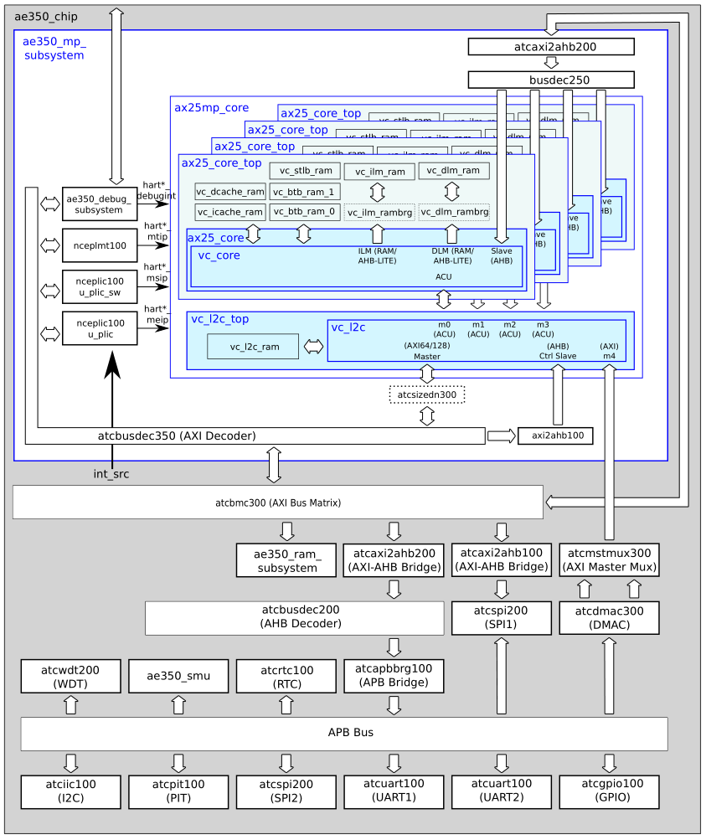
System block diagram

Slide 5
Power domain
Always on region
Core region
Always on region

Slide 6
System overall flow for power off
Core control
Normal
Software
procedure
Software
procedure
WFI
Core
reset
Hardware
handshaking
Hardware
handshaking
Power off sequence
Power on sequence
Power domain off
SMU control

Slide 7
Power on sequence
Hardware handshaking by SMU
  Assert reset signal for core/memory/L2
  Assert coren_reset_vector to restore program
  Enable power/clock switch for core/memory/L2 region
  Disable isolation/retention cell
  De-assert reset signal for core/memory/L2
Software procedure by Core
  Redirect PC to software restore program
    Software restore CSR/RF/FRF status from RAM
  Restore interrupt-enable bit (mie) and handle pending interrupt
  Redirect PC to previous program sequence

Slide 8
Power off sequence
Software procedure by Core
  Disable interrupt-enable bit (mie)
  Execute FENCE.I for writeback dirty cache line in D-Cache
  Execute L2 flush command for L2 shutdown
  Program save CSR/RF/FRF status and resume PC to RAM
  Execute WFI
Hardware handshaking by SMU
  Waits core_wfi_mode asserted from core
  Enables isolation/retention cell
  Disable power/clock switch for Core/Memory region

Slide 9
Architecture state backup and recovery
Baseline RV32/64 register file (x1 ~ x31)
Floating point RVF/D register file (f0 ~ f31)
CSRs (Total about 200 CSRs)
  Status CSRs
  Trap CSRs
  PMP CSRs
  HPM CSRs
  Debug CSRs
  AndeStarV5 CSRs

Slide 10
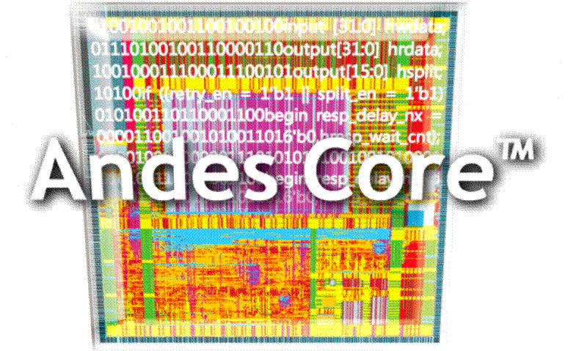
Thank You!
www.andestech.com

Slide 11
Thank You!

