Slide 1
Vicuna AE350 SMU Design Specification
Driving Innovations™
Ellis Chen
2019-02-26

Slide 2
Outline
Feature of ae350_smu_pd
ae350_rstgen
  Add path for reset core 0
ae350_smu
  Old/New hierarchy block diagram
ae350_smu_apbif
  New register for power control
ae350_smu_mpd (Main power domain)
  Remove core clock/power related logic
ae350_smu_pd (Core/L2 power domain)
  Interface
  FSM for power control

Slide 3
Feature of ae350_smu_pd
Support for a power/clock domain control
  Power source
  Clock source
  Isolation cell
  Retention cell
  Memory region power source
Support for wakeup event mask
Support for sleep/shutdown modes
Support for dynamic voltage frequency scaling (DVFS)

Slide 4
ae350_rstgen
In ae350_rstgen, core0_resetn is controlled by aresetn_src.
core[1~3]_resetn is controlled by SMU.
Add a path for reset core 0

Slide 5
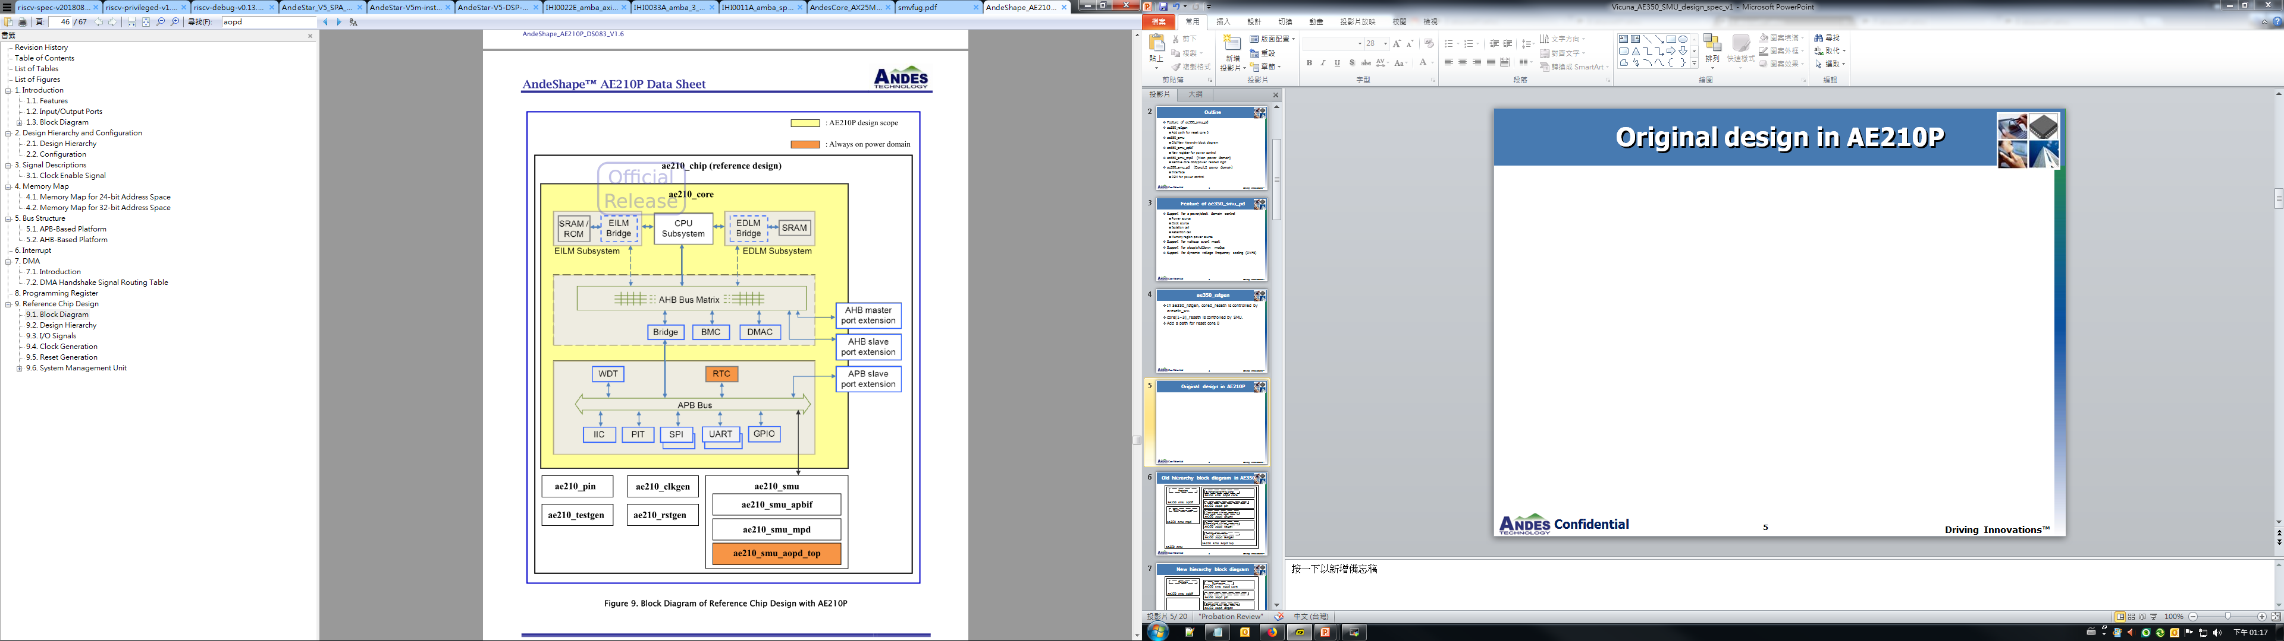
Original design in AE210P

Slide 6
  Old hierarchy block diagram in AE350
Registers
Synchronizer for RTC signal
ae350_smu_aopd_core
ae350_smu_apbif
IO Pad for aopd_porb/om/jtag_tck/wakeup/rtc_wakeup/mpd_pwr_pff
ae350_aopd_pin
FSM for power mode
Clock signal with test_mode mux
ae350_aopd_clkgen
ae350_smu_mpd
Reset signal with test_mode mux
ae350_aopd_rstgen
Test signal connection
ae350_aopd_testgen
ae350_smu_aopd_top
ae350_smu

Slide 7
  New hierarchy block diagram
Registers
Synchronizer
ae350_smu_aopd_core
ae350_smu_apbif
IO Pad for aopd_porb/om/jtag_tck/wakeup/rtc_wakeup/mpd_pwr_pff
ae350_aopd_pin
Clock signal with test_mode mux
ae350_aopd_clkgen
ae350_smu_mpd
Reset signal with test_mode mux
FSM for power mode
ae350_aopd_rstgen
Test signal connection
ae350_smu_pd
ae350_aopd_testgen
Core 0~3/L2
ae350_smu(Always-on region)

Slide 8
Original CSR for ae350_smu_apbif
0x00: `AE350_PRODUCT_ID
0x04: `AE350_BOARD_ID
0x10: {21'h0, wrsr_dbg, wrsr_alm, wrsr_extw, 3'h0, wrsr_sw, wrsr_wdt, wrsr_hw, wrsr_mpor, wrsr_apor}
0x1C: {21'h0, wr_mask_reg, 8'h0}
0x20: {21'h0, clock_en_reg}
0x24: {28'h0, clock_ratio_reg}
0x30: userdr0_reg_out[31:0]
0x34: userdr1_reg_out[31:0]
0x40: scratch_reg_out[31:0]
0x44: core_resetn_reg_out
0x50: core0_reset_vector[31:0]
0x54: core1_reset_vector[31:0]
0x58: core2_reset_vector[31:0]
0x5c: core3_reset_vector[31:0]
Notes:
Wake-up and Reset Status Register

Slide 9
New CSR for ae350_smu_apbif
SMU address mapping=0xF0100000~0xF01FFFFF
// Core 0
// Power Status Register
0x100: core0_pwr_st[3:0]
// Wakeup Enable Register
0x104: core0_wakeup_en[3:0]
// Power Control Register
0x108: core0_icache_disable_init, core0_dcache_disable_init, core0_pwr_ctrl_frq[3:0], core0_pwr_ctrl_vol[3:0], core0_pwr_ctrl_cmd[3:0]
…
// Core 3
0x130: core3_pwr_st[3:0]
0x134: core3_wakeup_en[3:0]
0x138: core3_icache_disable_init, core3_dcache_disable_init, core3_pwr_ctrl_frq[3:0], core3_pwr_ctrl_vol[3:0], core3_pwr_ctrl_cmd[3:0]
…
// L2
0x140: l2_pwr_st[3:0]
0x144: l2_wakeup_en[3:0]
0x148: l2_disable_init, l2_pwr_ctrl_frq[3:0], l2_pwr_ctrl_vol[3:0], l2_pwr_ctrl_cmd[3:0]

Slide 10
ae350_smu_mpd
Remove core clock/power related logic
  standby state machine
  smu2core_standby_req
  smu2core_wakeup_ok
  core2smu_wfi_mode

Slide 11
  ae350_smu_pd Interface
Control signal from power domain (with synchronizer)
  pd_ready(input): Indicate this power domain is ready for power change
    Connect to core_wfi_mode that core ready for power change
  pd_wakeup_event[31:0](input): Indicate this power domain should be wakeup
    Connect to msip/meip/mtip/ueip for cores wakeup event
Control signal with ae350_smu_apbif
  smu_wakeup_enable[31:0](input): Indicate pd_wakeup_event is valid for wakeup
  smu_disable_init[1:0](input): Indicate signal which is asserted in wakeup event
    For icache_disable_init/dcache_disable_init
  smu_pwr_ctrl_frq[3:0] (input): Indicate frequency vector
  smu_pwr_ctrl_vol[3:0] (input): Indicate voltage vector
  smu_pwr_ctrl_cmd[3:0] (input): Indicate power command
    DVFS
    SLEEP
    SHUTDOWN
  smu_pwr_st[3:0] (output): Indicate power status

Slide 12
  ae350_smu_pd Interface
Power control signal with voltage/clock source
  pd_pwr_ok(input): Power is stable for the power domain from voltage regulator
  pd_vol_scale_req(output): Voltage scaling vector require to voltage regulator
  pd_vol_scale(output): Voltage scaling vector to voltage regulator
  pd_vol_scale_ack(input): Voltage scaling vector ack from voltage regulator
  pd_frq_scale_req(output): Frequency scaling vector require to clock generator
  pd_frq_scale(output): Frequency scaling vector to clock generator
  pd_frq_scale_ack(input): Frequency scaling vector ack from clock generator
Power control signal for power domain
  pd_iso_en(output): Isolation indicator
  pd_ret_en(output): Retention indicator
  pd_clk_off(output): Clock shut-off indicator
  pd_pwr_off(output): Power region shut-off indicator
  pd_mem_off(output): Memory region shut-off indicator

Slide 13
Sample block diagram for power domain
pd_vol_scale_req
VRM
pd_vol_scale
pd_pwr_ok
pd_vol_scale_ack
vout
pd_pwr_off
Power switch
Power switch
pd_mem_off
pd_vdd
pd_mem_vdd
Power domain
Memory
Power domain
SRAM
pd_frq_scale_req
clk
pd_frq_scale
PLL
Isolation cell
pd_frq_scale_ack
Retention cell
pd_ret_en
pd_clk_off
pd_ready
pd_iso_en

Slide 14
FSM status
ST_NORMAL
ST_WFI
ST_ISOLATION
ST_RETENTION
ST_SLEEP
ST_SHUTDOWN
ST_DVFS

Slide 15
  ae350_smu_pd FSM for sleep/shutdown
pd_ready==1
ST_NORMAL
ST_WFI
Receive power command
No command
pd_wakeup_event
ST_ISOLATION
command=Shutdown/Sleep
ST_RETENTION
Wakeup event from
pd_wakeup_event
and pd_pwr_ok
ST_SHUTDOWN
/ST_SLEEP
Shutdown/Sleep command is cleared

Slide 16
  ae350_smu_pd FSM for DVFS
Receive DVFS command
pd_ready==1
Command=DVFS
ST_NORMAL
ST_WFI
ST_DVFS
An interrupt by PMU
Receive ACK signal
DVFS command is cleared

Slide 17
Power control signal by FSM
 | pd_iso_en | pd_ret_en | pd_clk_off | pd_pwr_off | pd_mem_off
ST_NORMAL ST_DVFS | 0 | 0 | 0 | 0 | 0
ST_WFI | 0 | 0 | 0 | 0 | 0
ST_ISOLATION | 1 | 0 | 0 | 0 | 0
ST_RETENTION | 1 | 1 | 0 | 0 | 0
ST_SLEEP | 1 | 1 | 1 | 1 | 0
ST_SHUTDOWN | 1 | 1 | 1 | 1 | 1

Slide 18
Request for L2 design
For DVFS
  Standby command and standby signal
  Wakeup event source

Slide 19
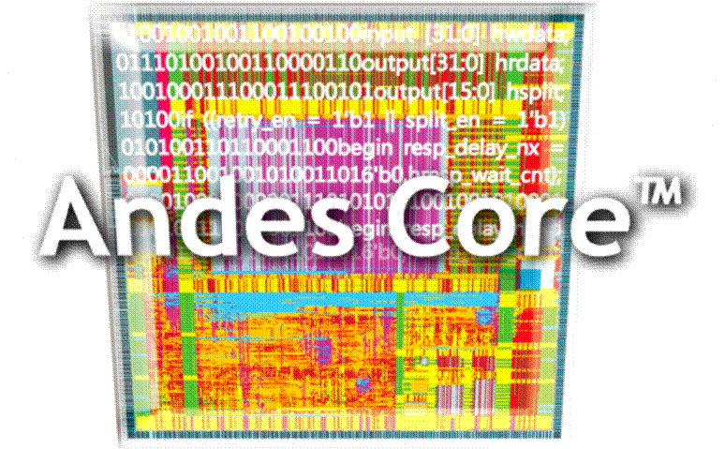
Thank You!
www.andestech.com

Slide 20
Thank You!

