Slide 1
Verilog Design Coding Style
Driving Innovations™
Osban
2017/2/24

Slide 2
RTL Coding Style (v1.0)
The code will be used for 10 years or longer
Readability
Maintainability
Extensibility
Notes:
2

Slide 3
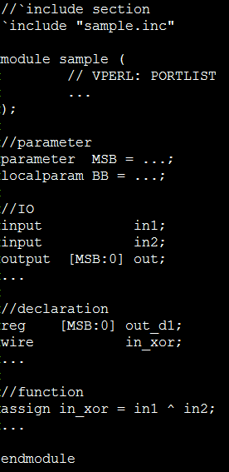
Module
One module per file
Use function to name the module
Section
Include
Parameter
IO declaration
Wire and register declaration
Function

Slide 4
Naming Rule
The parameter/macro name should be all upper cases
`define NDS_DCACHE_SUPPORT
localparam NDS_DCACHE_REQ_NUM = 8;
Macro prefix
NDS_XXX_YYY
The net and register name should be all lower cases
wire dfb_data2_valid_set;
Signal name should be meaningful.
reg [MSB:0] reg0;
reg [MSB:0] tmpX;

Slide 5
Naming Rule (2)
Interface signals
Source_Desti_Name_Stage
iiu_ieu_p1_current_pc_ex
Single meaning
mtlb_itlb_asstribute
mtlb_itlb_c, mtlb_itlb_m …
Pipeline signals
Name_Stage
Name_Stage_nx

Slide 6
Naming Rule (3)
Global system register signals
Named by mnemonics_name and field_name defined in SPA
reg_(Mnemonics)_(field) or reg_(field)
EX: reg_psw_dt, reg_psw_cpl

Slide 7
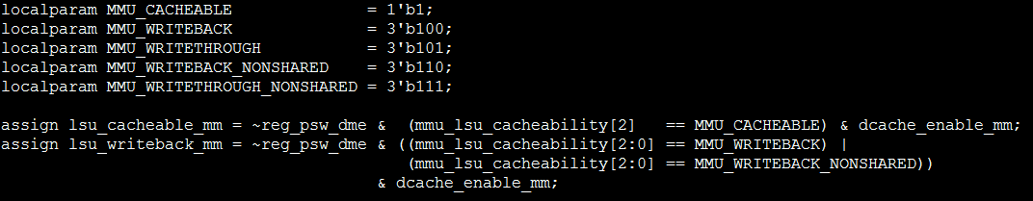
Constant
Declare parameter for meaningful constant
System register value

Slide 8
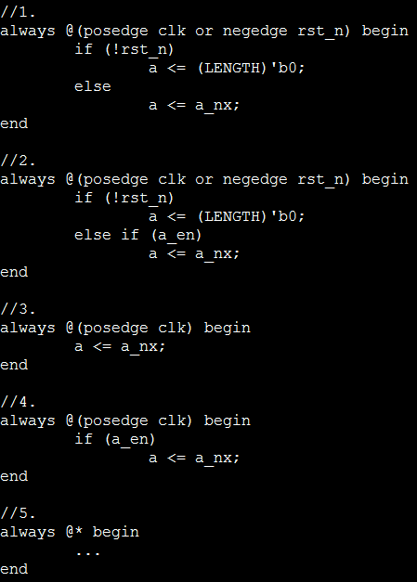
Always Block
5 kinds of always block
There is NO equation and `ifdef in the always block

Slide 9
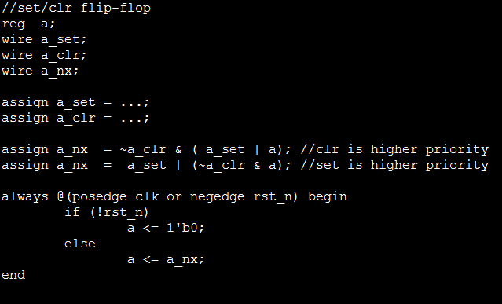
Example: Set/clr Flip Flop

Slide 10
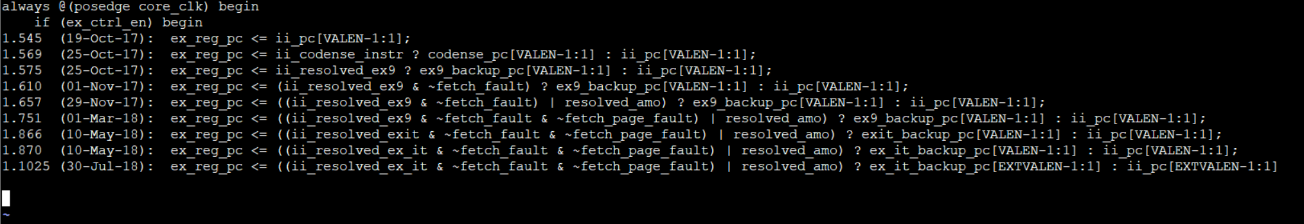
Example

Slide 11
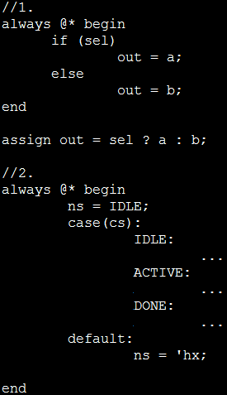
Unknown Propagation
Use “assign” instead of “always … if“
Set unknown in the default case

Slide 12
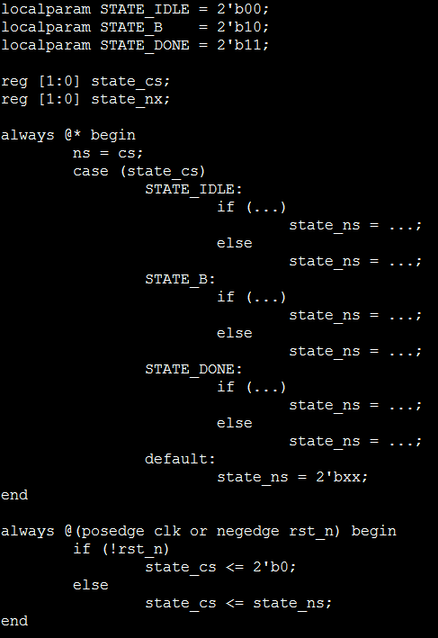
State Machine
2 always block
Parameter for all states
Unknown for the default state

Slide 13
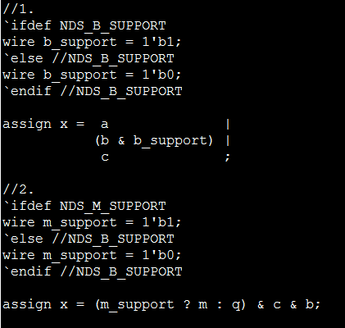
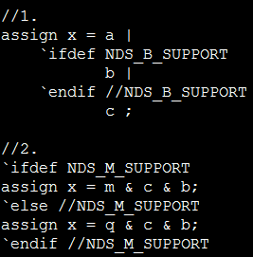
Assignment
Do not
`ifdef in the assignment
Different assignment equations in different features

Slide 14
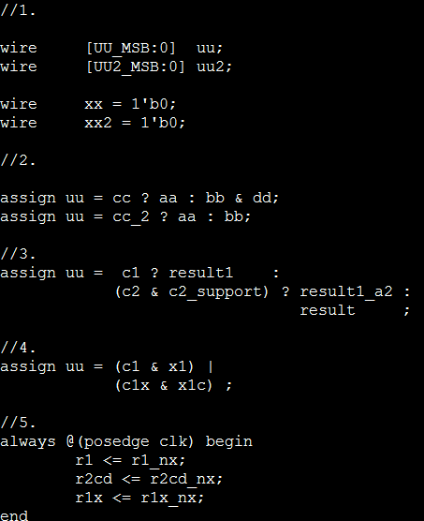
Alignment
Indent
Tab Or 8 spaces ?
Align the
“=“, “<=“
“? “, “:“, “; “
“&“, “|“

Slide 15
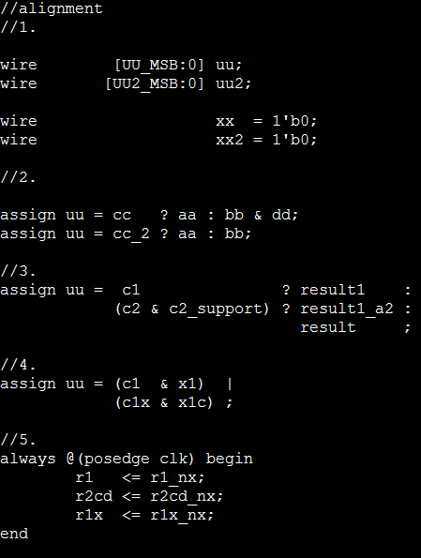
Alignment (2)

Slide 16
Vperl
Generate ports
Connection in the top module
Generate similar code

Slide 17
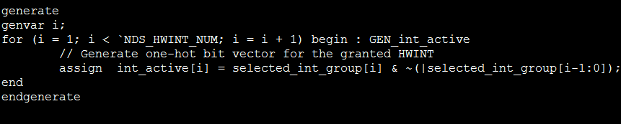
Generate
Add a label after the “begin”

Slide 18
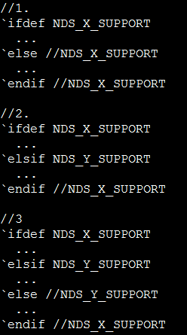
Comments in the `else and `endif
`else and `endif
With comment from which `define

Slide 19

Thank You!
www.andestech.com

Slide 20
Thank You!

