Slide 1
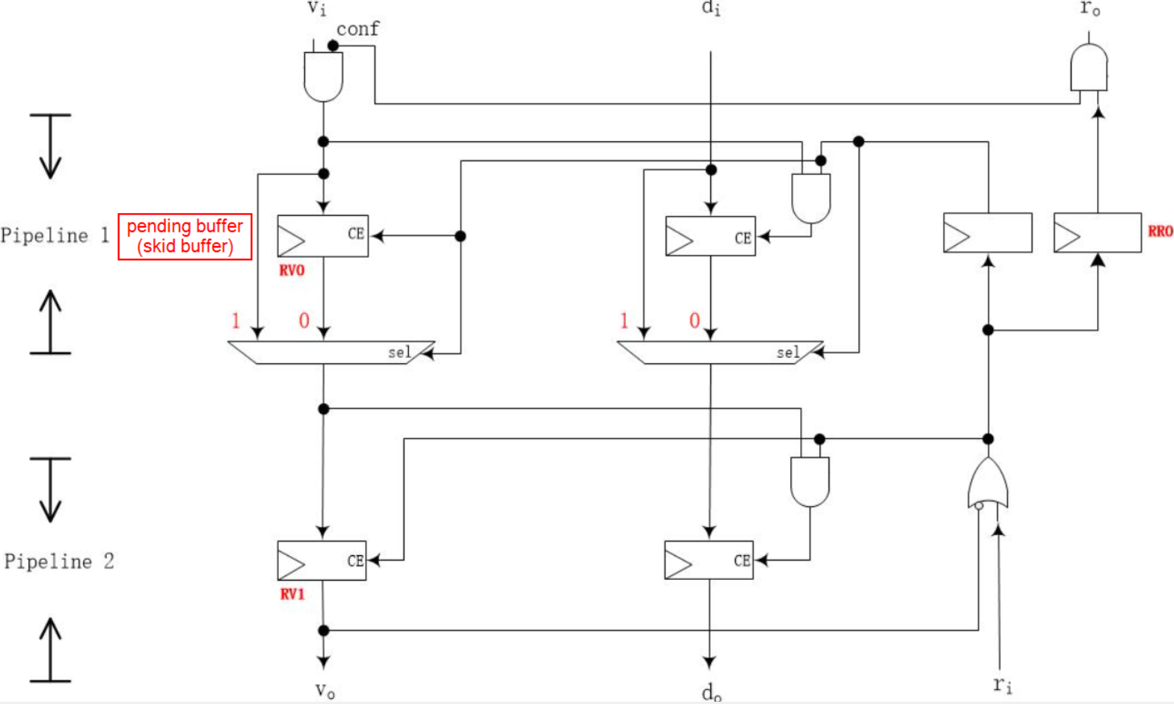
Greenshot image editor
us
us_ready
pending_arvalid
master/slave
master_arvalid
master_arready
mst/slv
slv[n]_arvalid
mst_data
mst_arvalid[n]
slv[n]_arready

