Slide 1
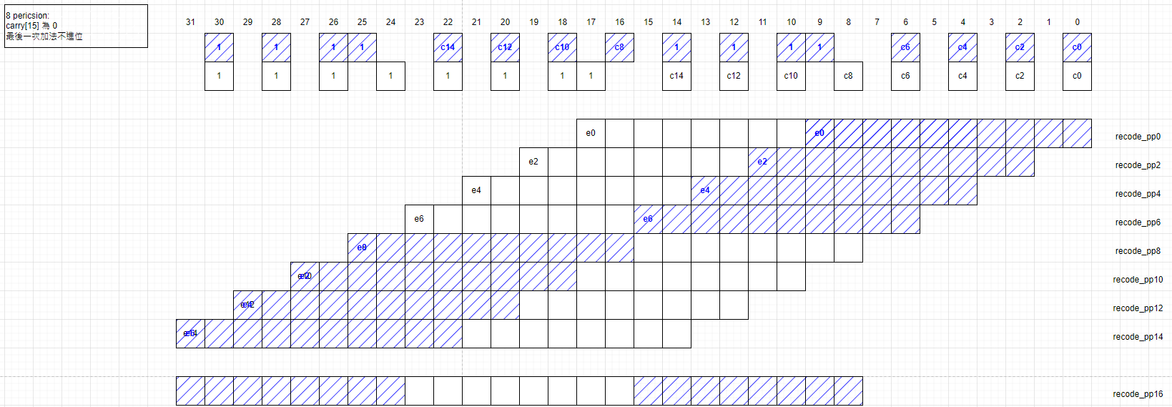

Slide 2
signed_ext16 = sign_en & in0[15]
pp
cin
0
X
X
2X
-2X
-X
-X
0
000: {1, 0}
001: ~signed_ext16, signed_ext16, in0
010: ~signed_ext16, signed_ext16, in0
011: ~signed_ext16, in0, 1’b0
100: signed_ext16, ~in0, 1‘b1
101: signed_ext16, ~signed_ext16, ~in0
110: signed_ext16, ~signed_ext16, ~in0
111: {1, 0}
0
0
0
0
1
1
1
0
[e]
[ext]

