Slide 1
High Speed RTL
Driving Innovations™
Alex
2020-12-04

Slide 2
Outline
Concepts
RTL frequency enhancements
Max frequency =
uArch (Upper Bound) x Logic Optimization (0% ~ 100%)
uArch Optimization (Not covered in this presentation)
pipeline, multi-cycle, stall, prediction, replay
Logic Optimization
Computer Arithmetic
Use One-Hot Encoding
Duplicate Logic Before Arbitration
Separate Control-Data Path
Avoid Reentrant
Dummy requests
SRAM banking

Slide 3
Concept #1
1GHz
Clock Period = 1000 ps
Uncertainty = 300 ps (30% of clock period)
Path delay = 700 ps
R to R: 700 ps
Input delay: 467 ps (66.7% of path delay)
Output delay: 467 ps (66.7% of path delay)
10 ps matters
10 ps is 1.4% of path delay for 1GHz processor

Slide 4
Concept #2: Frequency Enhancements
Frequency enhancements can be incremental
N45: 28HPC+
Trail-run: 1000 MHz
2020-03: 1200 MHz (Beta)
2020-05: 1250 MHz (Beta)
2020-07: 1300 MHz (Beta)
2020-09: 1333 MHz (Official)
Frequency is not scaling well with process technology
N45: 40LP v.s. 28HPC+
No optimization: 380 MHz v.s. 1333 MHz
Optimized: 650 MHz v.s. 1333 MHz
Verification quality is the foundation of frequency enhancements
Frequency enhancements are refactoring

Slide 5
Logic Optimization

Slide 6
Computer Arithmetic: Fast Address Comparator
wire [VALEN-1:ILM_AMSB+1] csa_c;
wire [VALEN-1:ILM_AMSB+1] csa_s;
wire [ILM_AMSB:0] s;
wire c;
genvar i;
// carry save
for (i=ILM_AMSB+1; i<VALEN; i=i+1) begin
assign {csa_c[i], csa_s[i]} = {1'b0, ex_src1[i]} + {1'b0, ex_ag_op1[i]} + {1'b0, ~ILM_BASE[i]};
end
assign {c, s} = {1'b0, ex_src1[ILM_AMSB:0]} + {1'b0, ex_ag_op1[ILM_AMSB:0]};
assign ex_hit_ilm = ~csa_s[VALEN-1:ILM_AMSB+1] == {csa_c[VALEN-2:ILM_AMSB+1], c};
Fast address comparator can be used for comparing ILM/DLM base, MPU/TLB entries
(A+B)[m:n] == K[m:n]
// Fast Address Compare
// Let {AH, AL} = {A[m:n], A[n-1:0]}
// Let {BH, BL} = {B[m:n], B[n-1:0]}
// Let {KH, KL} = {K[m:n], K[n-1:0]}
// Let {C, Partial Sum} = AL + BL
//
// (A+B)[m:n] == K[m:n]
// => AH + BH + C == KH
// => AH + BH - KH + C == 0
// => AH + BH + ~KH + 1 + C == 0
//
// Let {CSA_C, 1'b0} + CAS_S = AH + BH + ~KH
// => {CSA_C, 1'b0} + CSA_S + 1 + C == 0
// => {CSA_C, 1'b0} + 1 + C == -CSA_S
// => {CSA_C, 1'b0} + 1 + C == ~CSA_S + 1
// => {CSA_C, 1'b0} + C == ~CSA_S
// => {CSA_C, C} == ~CSA_S
A[2]
B[2]
K[2]
FA
CSA_C[2]
CSA_S[2]
A[1]
B[1]
K[1]
FA
CSA_C[1]
CSA_S[1]
A[0]
B[0]
K[0]
FA
CSA_C[0]
CSA_S[0]

Slide 7


Using sum of product
assign ex_src1 = ex_src1_bypass[0] ? wb_wdata :
ex_src1_bypass[1] ? mm_wdata :
ex_src1_bypass[2] ? lsu_ipipe_wb_bypass_data :
ex_reg_src1;
assign fetch_pc = (retire_ptr==2’d0) ? fq0_pc :
(retire_ptr==2’d1) ? fq1_pc :
fq2_pc ;
Priority
Encoder
assign ex_src1 = ex_reg_src1
| ({XLEN{ex_src1_bypass[0]}} & wb_wdata)
| ({XLEN{ex_src1_bypass[1]}} & mm_wdata)
| ({XLEN{ex_src1_bypass[2]}} & lsu_ipipe_wb_bypass_data)
;
assign fetch_pc = ({VALEN{retire_ptr[0]}} & fq0_pc)
| ({VALEN{retire_ptr[1]}} & fq1_pc)
| ({VALEN{retire_ptr[2]}} & fq2_pc)
;
Sun of
Product
Using sum of product when control signals are one-hot
Changing control signals to one-hot and using sum of product
Priority Encoder and Sun of Product are not Logic Equivalent

Slide 8
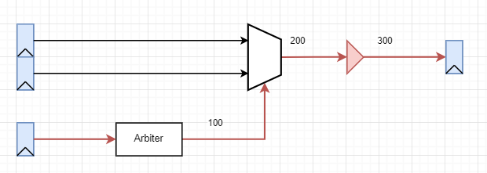
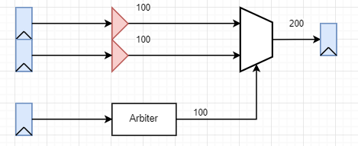
Duplicate Logic Before Arbitration

Slide 9
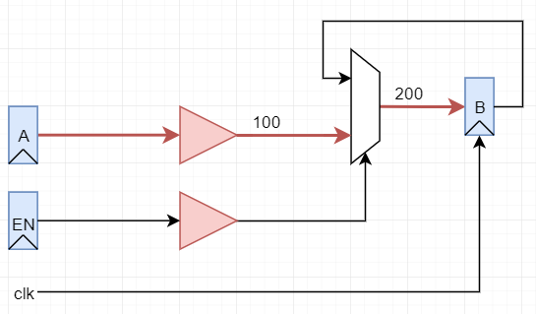
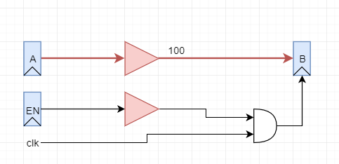
Separating Control and Data Path
// Coding #1
always @(posedge clk)
begin
B <= EN ? A : B;
end
// Coding #2
always @(posedge clk) begin
if (EN)
B <= A;
end
For equivalent logics, synthesizer might be able to generate GCK for both coding #1 and #2

Slide 10
Separating Control and Data Path
wire mdu_req_in = mdu_req_valid & mdu_req_ready & ~mdu_kill;
assign mdu_req_ready = state == IDLE;
always @(posedge core_clk) begin
if (mdu_req_in)
reg0 <= reg0_req_nx;
else if (state == PRE)
reg0 <= reg0_pre_nx;
else if (state == EXE)
reg0 <= reg0_exe_nx;
else if (state == POST)
reg0 <= reg0_post_nx;
end
Typically,
Data path has more fan-outs
Control signal has worse timing
mdu_req_valid
mdu_req_ready
mdu_req_kill
When control signal is propagated to data path, synthesizer need to optimize more paths.
always @(posedge core_clk) begin
if (reg0_en) // reg0_en is control signal
reg0 <= reg0_nx; // reg0_nx is data path
end
assign reg0_en = (state == PRE )
| (state == EXE )
| (state == POST)
| (mdu_req_valid & mdu_req_ready)
;
assign reg0_nx = ({(2*XLEN+1){(state == PRE )}} & reg0_pre_nx )
| ({(2*XLEN+1){(state == EXE )}} & reg0_exe_nx )
| ({(2*XLEN+1){(state == POST)}} & reg0_post_nx)
| ({(2*XLEN+1){(state == IDLE)}} & reg0_req_nx )
;

Slide 11
Separating Control and Data Path
assign rf_we = ~wb_stall & ( (wb_valid & wb_reg_rf_we & ~wb_abort) |
(mdu_resp_valid & mdu_write_enable) |
init_rf
);
assign rs1_rf_rdata = (wb_valid & wb_reg_rf_we && (wb_rd == ii_rs1)) ? rf_wdata : rf_rdata1;
assign rs2_rf_rdata = (wb_valid & wb_reg_rf_we && (wb_rd == ii_rs2)) ? rf_wdata : rf_rdata2;
Control
rf_we is real write enable signal, but the timing is worse
Data Path
wb_reg_rf_we has better timing

Slide 12
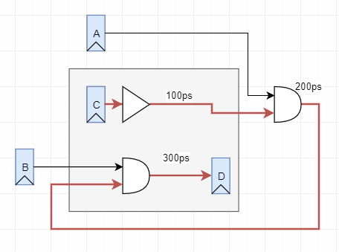
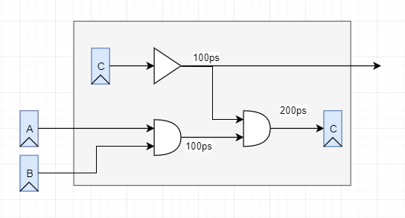
Avoid Reentrant
D = A & B & C

Slide 13
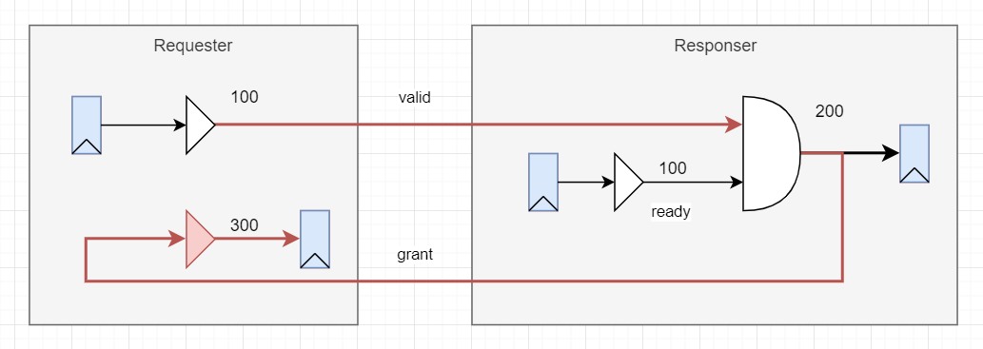
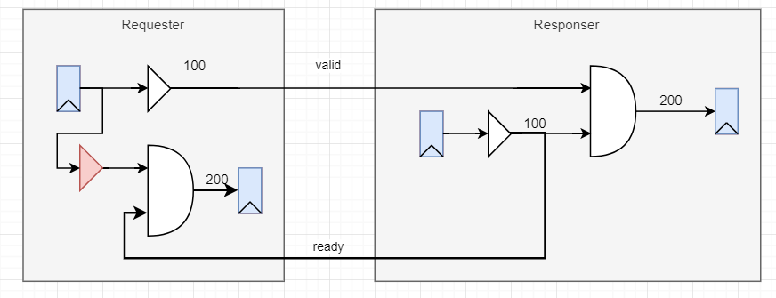
Arbiter: Valid and Ready

Slide 14
Arbiter: Valid and Ready
valid/ready
ready should NOT be qualified with valid
valid should NOT be qualified with ready

Slide 15
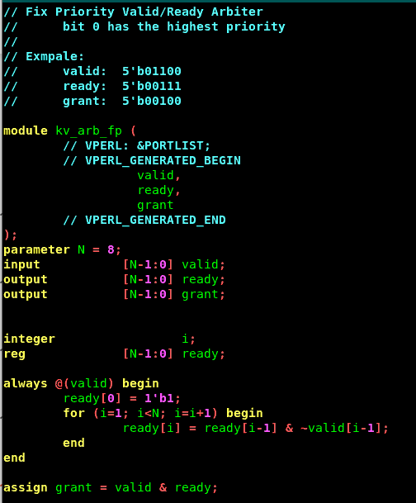
Arbiter Module

Slide 16
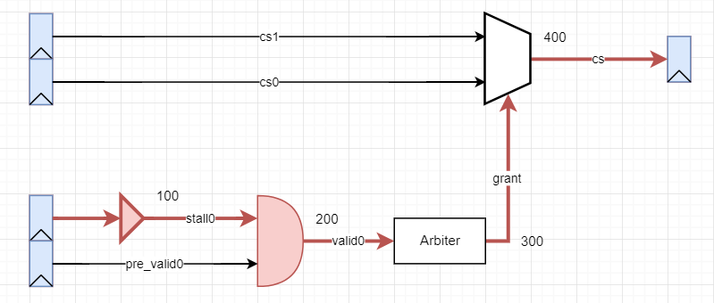
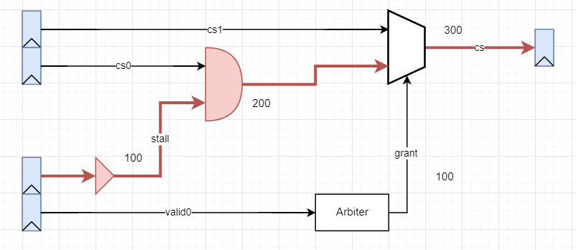
Cancelled Requests

Slide 17
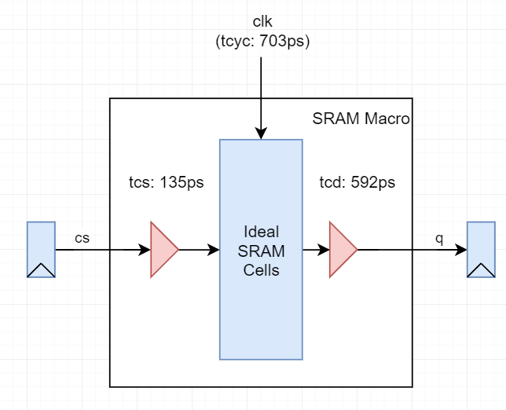
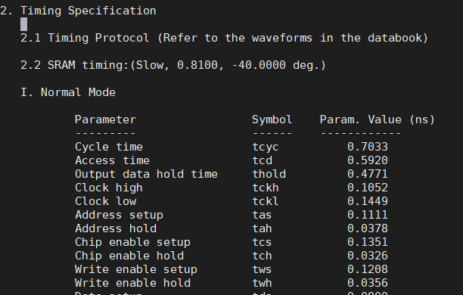
SRAM Timing
28HPC+ LVT 1024x64 SRAM

Slide 18
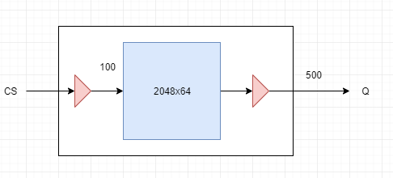
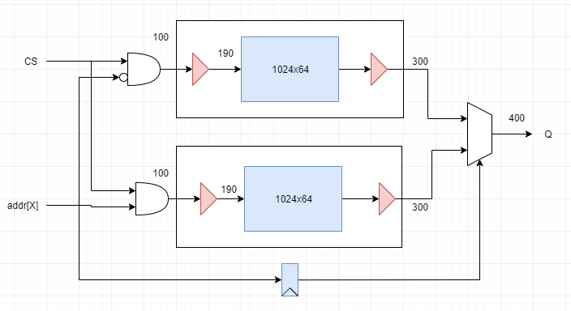
SRAM Banking
Note: There are many other banking methods

Slide 19
Summary
Verification quality is the foundation of frequency enhancements

Slide 20

Thank You!
www.andestech.com

Slide 21
Thank You!

