Slide 1
FP DIV/SQRT uArch
202101
Larry

Slide 2
Agenda
List of abbreviation
Overview
Configuration
uArch Overview
FP DIV/SQRT Instructions
FP Estimation Instructions
Round digit generation
Underflow Flag Detection
Enhancements
SIMD VFDIV64
Merge IDIV and FDIV methods
Interface
Instruction list

Slide 3
TODO list
Redraw final datapath and clarify FFs
Add a abstract functional block/datapath
Show result and after rounding difference

Slide 4
List of abbreviation (1/)
Abbreviation | Definition
DSU | Divider and Square Root Unit
LZD | Leading zero detection
LZC | Leading zero count

Slide 5
List of parameter (1/)
Abbreviation | Definition
XLEN | The current width of an x register in bits (32 for RV32 or 64 for RV64)
FLEN | The current width of a f register in bits (32 for SP, 64 for DP)

Slide 6
Overview (1/)
2-stage pipeline
Supported data types
Instruction handling
FP DIV/SQRT instruction using radix-4 SRT algorithm
FP estimation instruction using look-up table
Precision | Width | Sign | Expo | Mant
HP | 16 | 1 | 5 | 10
SP | 32 | 1 | 8 | 23
DP | 64 | 1 | 11 | 52

Slide 7
Overview (2/)
Instruction latency
*DIV/SQRT instruction have no forwarding path
x is not supported
Instruction | Latency
 | Scalar |  | Vector
DIV/SQRT | HP | 13* | HP | 13*
 | SP | 20* | SP | 20*
 | DP | 34* | DP | 34*
VFRECE7 | x | x | 3*
VFRSQRTE7 | x | x | 3*

Slide 8
Configurability
Feature | Options
XLEN | 64
FLEN* | 16/32/64
VLEN | 512/256/128
SIMD_WIDTH | 512/256/128
ELEN* | 32/64
*If RVV = 0, FLEN can be configured to 32/64
*If RVV = 1, FLEN is equivalent to ELEN

Slide 9
uArch overview

Slide 10
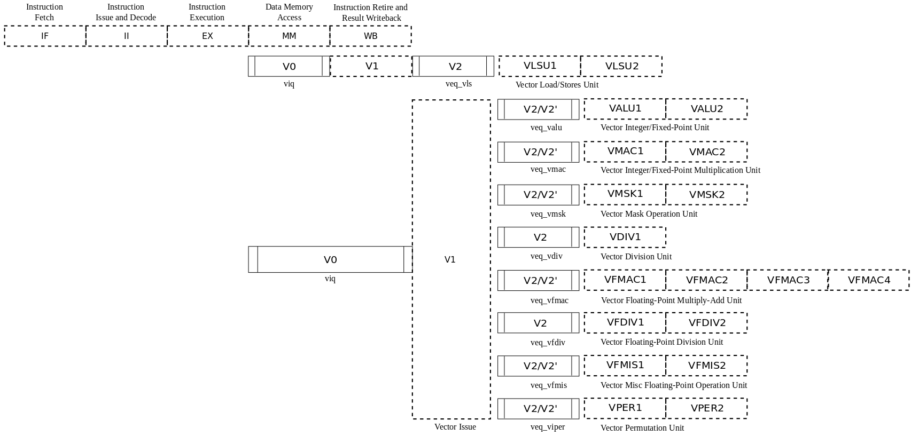
VPU stage
Frontend
Function unit

Slide 11
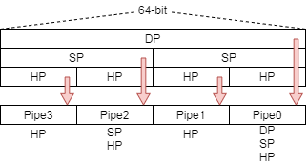
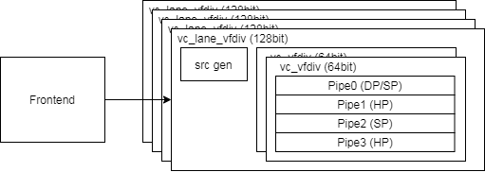
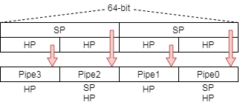
Function Unit Lane Hierarchy
ELEN=64
src_gen is for source data selection
Select data for read port 0/ 1/ 2/ 3 or scalar register
Describe detail according to Chevy’s latest spec or v0/v1 decode table
Central DSU (DIV/SQRT Unit) produce result and remainder sticky
ELEN=32

Slide 12
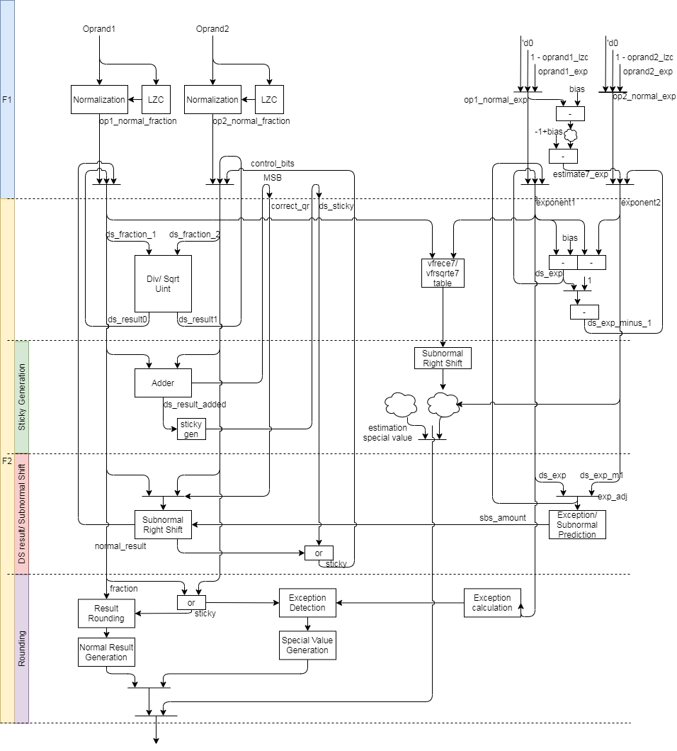
FDIV uArch (1/)
The original datapath
Generate sticky 3 times
Reduce staging FFs
Rounding method
Reduce 2-level adder to 1-level

Slide 13
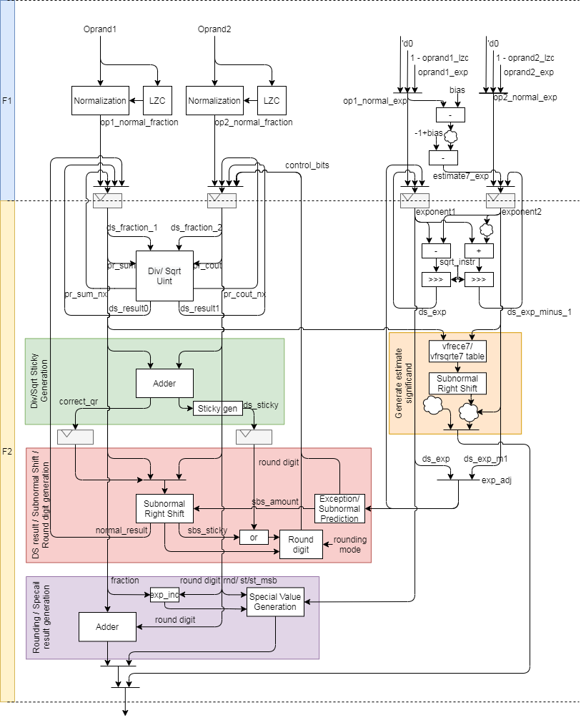
FDIV uArch (2/)
The modified datapath
Generate sticky 3 → 2 times
Rounding method

Slide 14
FDIV uArch (3/)
Div instruction datapath
Step 1: Normalize source value
Step 2: Compute result by DSU
Step 3: Calculate sticky
Step 4: Shift right for subnormal
Step 5: Do rounding
Sqrt instruction datapath
Step 1: normalize source value
Step 2: Compute result by DSU
Step 3: Calculate sticky
Step 4: Shift right for subnormal
Step 5: Do rounding

Slide 15
FDIV uArch (4/)
Vector estimation instruction

Slide 16
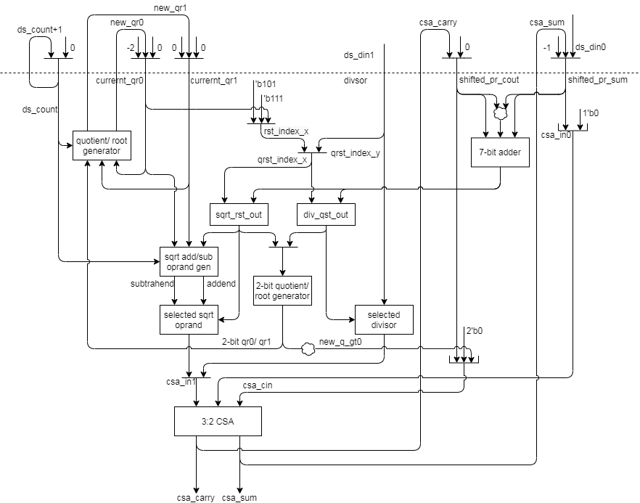
FDIV uArch (5/)
DSU Datapath
For 2’sc

Slide 17
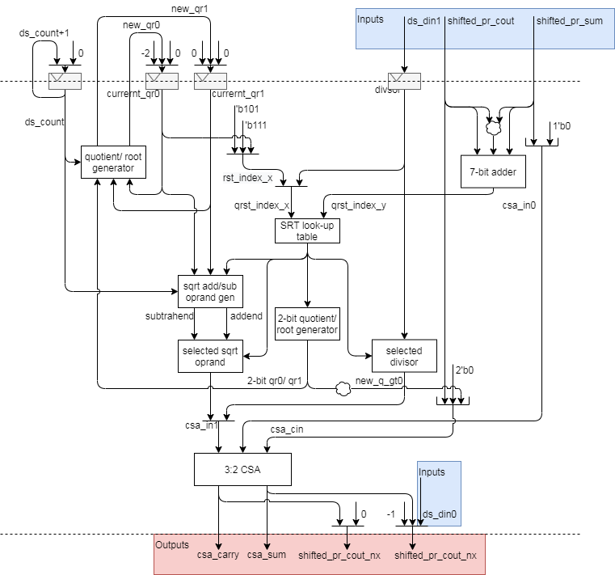
FDIV uArch (5/)
DSU Datapath
For 2’sc

Slide 18
FDIV uArch (5/)
DSU Datapath
For 2’sc

Slide 19
FP Div/SQRT Instructions

Slide 20
FP Div/SQRT Instructions datapath
Div instruction datapath
Step 1: Normalize source value
Step 2: Compute result by DSU
Step 3: Calculate sticky
Step 4: Shift right for subnormal
Step 5: Do rounding
Sqrt instruction datapath
Step 1: normalize source value
Step 2: Compute result by DSU
Step 3: Calculate sticky
Step 4: Shift right for subnormal
Step 5: Do rounding

Slide 21
FP Div/SQRT Instructions (1/)
DSU dataflow
Unpack source data
Normalize significand and increase exponent
Use DSU to compute result of div/sqrt
Generate partial sticky
Shift right significand and generate partial sticky if exponent value is subnormal
Generate round digit
Do rounding
Enhancements
Reducing look-up table
Reduce instruction latency (1 cycle)
Reduce sticky generation times
Modified rounding method
Reduce 2 level adder to 1 level
Notes:
Bit width is (1+FLEN_MAX) - (1+FLEN_MIN) + XLEN

Slide 22
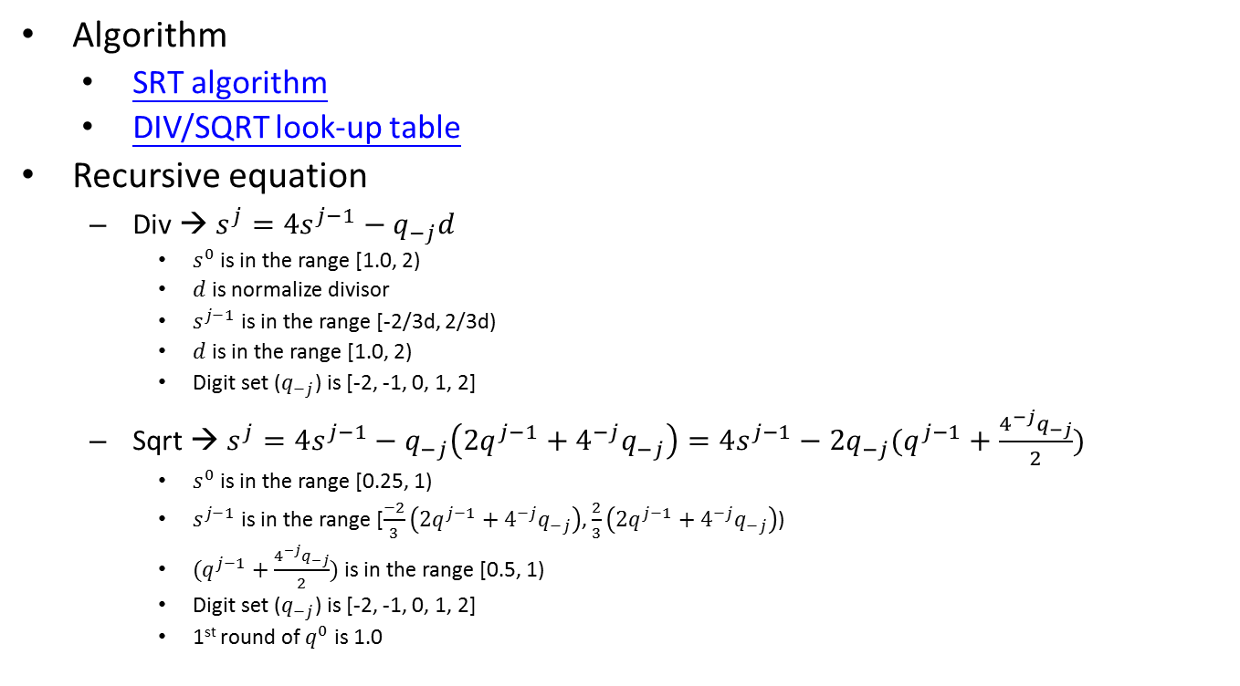
FP Div/SQRT Instructions (2/)
Algorithm
SRT algorithm
DIV/SQRT look-up table
Recursive equation
Div → $s^{j}=4s^{j−1}−q_{−j}d$
$s^{0}$ is in the range [1.0, 2)
$d$ is normalize divisor
$s^{j−1}$ is in the range [-2/3d, 2/3d)
$d$ is in the range [1.0, 2)
Digit set ($q_{−j}$) is [-2, -1, 0, 1, 2]
Sqrt → $s^{j}=4s^{j−1}−q_{−j}\left(2q^{j−1}+4^{−j}q_{−j}\right)=4s^{j−1}−2q_{−j}(q^{j−1}+\frac{4^{−j}q_{−j}}{2})$
$s^{0}$ is in the range [0.25, 1)
$s^{j−1}$ is in the range [$\frac{−2}{3}\left(2q^{j−1}+4^{−j}q_{−j}\right)$, $\frac{2}{3}\left(2q^{j−1}+4^{−j}q_{−j}\right)$)
$(q^{j−1}+\frac{4^{−j}q_{−j}}{2})$ is in the range [0.5, 1)
Digit set ($q_{−j}$) is [-2, -1, 0, 1, 2]
1st round of $q^{0}$ is 1.0
Notes:
Bit width is (1+FLEN_MAX) - (1+FLEN_MIN) + XLEN

Slide 23
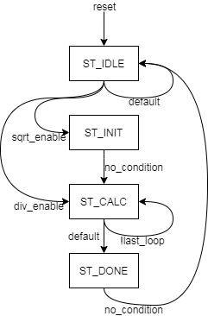
FP Div/SQRT Instructions (3/)
FSM behavior
ST_IDLE is no activity
ST_INIT is for sqrt instruction to initialize root (1.00) and do (z-1)*4
The counter is enabled in ST_INIT and ST_CALC states
ST_CALC is to calculate partial quotient/root/remainder
The counter is enabled in ST_INIT and ST_CALC states
The counter count up from 0 to the corresponding last loop value
The last round return partial remainder by carry save form.
ST_DONE is to return quotient and (quotient – 1)
Precision | Last loop
HP | 7
SP | 14
DP | 28
1st round is for hidden 1 and other round are for mantissa, round bit and sticky MSB
Notes:
Bit width is (1+FLEN_MAX) - (1+FLEN_MIN) + XLEN

Slide 24
FP Estimation Instructions

Slide 25
FP Estimation Instructions (1/)
Instruction dataflow
Unpack input data
Normalize data, compute exponent and detect special value in parallel
Look-up vfrece7/vfesqrte7 table and do exception detection
Calculate result exponent
Shift right significand value if exponent is subnormal
Produce special value according to the corresponding exception if detected
F1 stage works
Normalize data
Compute exponent
Detect special value
F2 stage works
Look-up vfrece7/vfesqrte7 table
Do exception detection
Shift right significand value if exponent is subnormal
Produce special value according to the corresponding exception if detected
Notes:
Bit width is (1+FLEN_MAX) - (1+FLEN_MIN) + XLEN

Slide 26
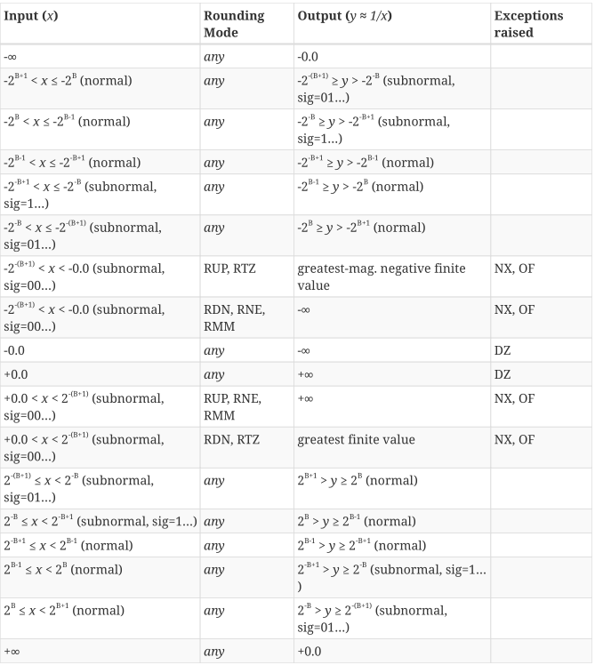
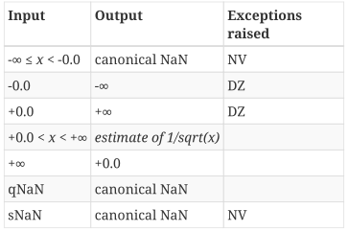
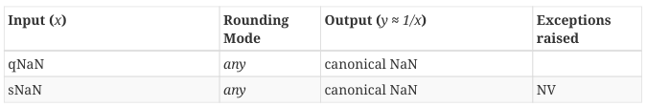
FP Estimation Instructions (2/)
vfrece7.v
Produce special value, exception flag according to the corresponding table in vector-spec
vfrsqrte7.v
Notes:
Bit width is (1+FLEN_MAX) - (1+FLEN_MIN) + XLEN

Slide 27
Round digit generation & Twice Rounding Detection

Slide 28
Round digit generation (1/)
Generate rounding carry according to rounding modes
Rounding modes
RNE (Round to Nearest, ties to Even)
Rounding carry is 1 if the value is greater than tie
The value is round to even if the value is tie
RTZ (Round Towards Zero)
Truncate
RDN (Round DowN)
Truncate if the value is positive
Rounding carry is 1 if the value is negative
RUP (Round UP)
Rounding carry is 1 if the value is positive
Truncate if the value is negative
RMM (Round to nearest, ties to Max Magnitude)
Rounding carry is 1 if the value is greater than and equal tie
ROD (Round towards ODd)
Rounding carry is 1 if LSB is 0

Slide 29
Round digit generation (2/)
1. Do rounding only
A + increment (1 bit) (A has not round bit)
Abbreviation
L is LSB/ R is round bit / S is sticky bit / Tie is (R & ~S)
Rounding mode | Rounding inc
RNE (Round to Nearest, ties to Even) | R & (L | S)
RTZ (Round Towards Zero) | 0
RDN (Round DowN) | ~sign & (R | S)
RUP (Round UP) | sign & (R | S)
RMM (Round to nearest, ties to Max Magnitude) | R
ROD (Round towards ODd) | ~L

Slide 30
Underflow Flag Detection

Slide 31
Underflow Flag Detection – Special Case (1/)
Tininess is detected after rounding.
The exponent range are unbounded and the significand is not bounded to the corresponding format and keep normal format.
The above unbounded value is in subnormal range when exponent is unbounded. The bounded value will round to min normal value and it is not in subnormal range and underflow flag is not asserted because of rounding to min normal value. Thus, this special case should be detected.
 | Significand (HP) | Exponent
Unbounded | 01.1111_1111_11xxx | -15
bounded | 00.1111_1111_111xx | -14

Slide 32
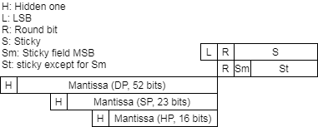
Underflow Flag Detection – Special Case (2/)
The Fig. show result format, L, R, S, Sm and St field.
The bit pattern is all-one mantissa and the next slide show underflow special case detection.
RM | Underflow special case
RNE | BP & R & ~Sm
RTZ | 0
RDN | BP & sign & (R^S)
RUP | BP & ~sign & (R^S)
RMM | BP & R & ~Sm
ROD | 0

Slide 33
Underflow Flag Detection – Normal Case (4/)
The underflow just qualify bit pattern, rounding carry (round digit) and other signals.
The bit pattern is the same with the special case

Slide 34
Enhancements

Slide 35
Enhancements (1/)
Reduce 2-level adder
Produce Exp and Exp – 1 (without bias)
ExpA and ExpB have bias
Method 1: Generate (Exp) first then calcule (Exp – 1)
Method 2: Generate (Exp – 1) first then calcule (Exp)
Method 3: Generate (Exp) and (Exp – 1) in parallel
Instruction | Exp | Exp - 1
DIV | ExpA – ExpB | ExpA + ~ExpB
SQRT | (ExpA – Bias) >> 1 | (ExpA + (~Bias – 1)) >> 1
 | HP | SP | DP
Bias | b0_0000_0000_1111 | b0_0000_0111_1111 | b0_0011_1111_1111
~Bias - 1 | b1_1111_1110_1111 | b1_1111_0111_1111 | b1_1011_1111_1111
Notes:
Method 3: Generate (Exp) and (Exp – 1) in parallel
DIV Exp = ExpA – ExpB
DIV Exp – 1 = ExpA – ExpB – 1 = ExpA + (~ExpB + 1) – 1 = ExpA + ~ExpB
SQRT Exp = (ExpA – Bias) >> 1
SQRT Exp – 1 = (ExpA – Bias) >> 1 – 1 = (ExpA – Bias - 2) >> 1 = (ExpA + (~Bias – 1)) >> 1
Bias = 15
15 => b0_0000_0000_1111
~15 => b1_1111_1111_0000
~15-1 => b1_1111_1110_1111
Bias = 127
127 => b0_0000_0111_1111
~127 => b1_1111_1000_0000
~127-1 => b1_1111_0111_1111
Bias = 1023
1023 => b0_0011_1111_1111
~1023 => b1_1100_0000_0000
~1023-1 => b1_1011_1111_1111

Slide 36
Enhancements (2/)
Compare 3 methods
The following reports are VFDIV64 PPA under different method and Freq.
Methods | Result | DIV | SQRT | EXP | EXP - 1
Exp first (origin) | Exp | ExpA – ExpB | (ExpA – Bias)>>1
 | Exp – 1 |  |  |  | Exp - 1
Exp_m1 first | Exp |  |  | (Exp – 1) + 1
 | Exp – 1 | ExpA + ~ExpB | (ExpA – (Bias+2)) >> 1
Parallel | Exp | ExpA - ExpB | (ExpA – Bias)>>1
 | Exp – 1 | ExpA + ~ExpB | (ExpA + (~Bias-1)) >> 1
Methods | FLEN | Lib | Freq. | Area | Note
Exp first (original) | 64 | 28HPC+ | 1.00GHz | 27.47kgates
Exp_m1 first | 64 | 28HPC+ | 1.00GHz | 27.69kgates
Parallel | 64 | 28HPC+ | 1.00GHz | 27.52kgates | Arithmetic right shift for SQRT
Exp first (original) | 64 | 28HPC+ | 1.25GHz | 31.24kgates
Parallel | 64 | 28HPC+ | 1.25GHz | 30.39kgates | Arithmetic right shift for SQRT
Notes:
Bias = 15
15 => b0_0000_0000_1111
~15 => b1_1111_1111_0000
~15-1 => b1_1111_1110_1111
Bias = 127
127 => b0_0000_0111_1111
~127 => b1_1111_1000_0000
~127-1 => b1_1111_0111_1111
Bias = 1023
1023 => b0_0011_1111_1111
~1023 => b1_1100_0000_0000
~1023-1 => b1_1011_1111_1111

Slide 37
SIMD VFDIV64

Slide 38
SIMD VFDIV64
The detail is in FDIV_SIMD_design_spec
T:\users\klmn\larryzzr\FP_design_spec_Larry\FDIV

Slide 39
Merge IDIV and FDIV methods

Slide 40
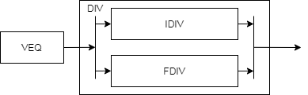
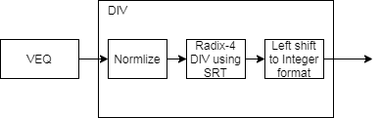
Merge IDIV and FDIV methods (1/)
Two methods to merge/fuse IDIV and FDIV function units.
Merge two function units
Reuse staging FFs and return result according to instruction type
Fuse two function units
Support 64-bit data in and widen related logics
Do 2’sc for input and output if negative
Support 8 bit div
Reuse radix-4 SRT look-up table
Extend quotient handling logics
Add Left shifting logic to handle integer result
Hard to implement remainder instruction using SRT
Merge 2 function units
Fuse 2 function units

Slide 41
Merge IDIV and FDIV methods (2/)
Why hard to implement remainder instruction
Apply radix-4 algorithm so 2-bit partial quotient is generated in each iteration
The extra fraction bit should recover to partial remainder
Remainder (Integer) = Remainder (fraction) x divisor
Method 1: 10/3 = 3.333… → 3 * 0.333… = 1
Method 2: 10/3 = 3.333… → 10 - 3 * 3 = 1
Conclusion
Keep the current design
Integer | iteration | Extra fraction bit
INT8 | 1+4 | 1 bits
INT16 | 1+8 | 1 bits
INT32 | 1+16 | 1 bits
INT64 | 1+32 | 1 bits
1 is for hidden one

Slide 42
Interface

Slide 43
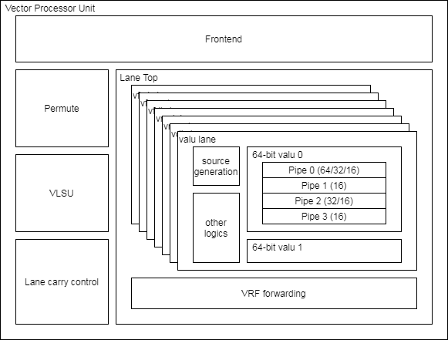
VPU Hierarchy

Slide 44
Lane Interface (1/)
Module name is vc_lane_vfmis.v
Hierarchy diagram

Slide 45
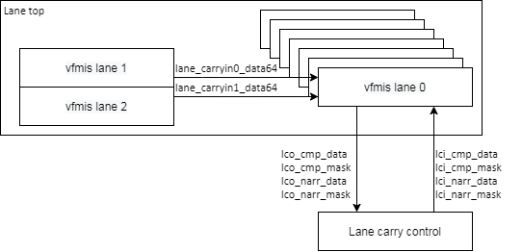
Lane Interface (2/)
Block connection diagram

Slide 46
Lane Interface (3/)
Signal name | Type | Description
core_clk | Input | Clock
core_reset_n | Input | Negative Edge Reset
lane_id | Input | Lane ID and it indicate lane0 for scalar floating-point logics
vfdiv_vtype_sew | Input | Apply vsew to execute instruction
vfdiv_csr_ediv | Input | Apply vediv to execute instruction
vfdiv_vtype_lmul | Input | Apply vlmul to execute instruction
vfdiv_rmode | Input | Apply frm to execute instruction
vfdiv_valid | Input | Instruction valid signal
vfmis_uop_cnt | Input | Micro-op counter start from 0
vfdiv_uop_first | Input | Indicate the 1st micro-op
vfdiv_msk_bits | Input | The source data valid signal
vfdiv_ex_ctrl | Input | Instruction encoding and please see Instruction encoding slide
vfdiv_op_wide | Input | Indicate 2x width destination or source
vfdiv_sign | Input | Indicate sign data (XRF)

Slide 47
Lane Interface (4/)
Signal name | Type | Description
vrf_data[0/1/2/3]_in | Input | The data is from VRF read port 0/1/2/3
frf_data[0/1/2]_out | Input | The data is from FRF read port 0/1/2/3
fdiv_scalar_valid | Input | Indicate that the scalar data is valid
vfdiv_[vs1/vs2/vs3]_valid | Input | The corresponding source data is valid
vfdiv_[vs1/vs2/vs3]_select | Input | The corresponding source is from read port
vfdiv_[rs1/rs2]_valid | Input | The corresponding source data is valid
vfdiv_rs_data | Input | Indicate the scalar source data of vector instruction
vfdiv_data | Output | Result VRF data
vfdiv_mask | Output | Result byte-write enable
vfdiv_vfcsr_flag_set | Output | Result exception flag

Slide 48
Pipe Interface (1/)
Module name is vc_vfp_fdiv.v
Supported FLENs are 16/32/64 and XLEN is the same with FLEN
Hierarchy diagram

Slide 49
Pipe Interface (2/)
Signal name | Type | Description
core_clk | Input | Clock
core_reset_n | Input | Negative Edge Reset
f1_valid | Input | Valid signal
f1_ex_ctrl | Input | Control signal for encoding. More info in instruction encoding slide.
f1_sew | Input | Indicate element width
f1_ediv | Input | Un-used
f1_round_mode | Input | Round mode. 3’b000: RNE, 3’b001: RTZ, 3’b010: RDN, 3’b011: RUP, 3’b100: RMM
f1_op1_data | Input | Source oprand1
f1_op2_data | Input | Source oprand2

Slide 50
Pipe Interface (3/)
Signal name | Type | Description
f4_result_type | Output | Result data type 3’b111 → DP 3’b110 → SP 3’b101 → HP 3’b100 → Bfloat16 3’b011 → Double-word 3’b010 → Word 3’b001 → Half-word 3’b000 → Byte
f4_wdata_en | Output | Write enable.
f4_wdata | Output | Result data.
f4_flag_set | Output | Result exception flag

Slide 51
Instruction list

Slide 52
Instruction list
The fdiv function unit encoding

Slide 53
Backup

Slide 54
Radix-2 Algorithm (1/)
Radix-2 have
Restoring algorithm
Non-restoring algorithm
SRT algorithm (also non-restoring algorithm)

Slide 55
Radix-2 Algorithm (2/)
Restoring algorithm
Quotient digit set is {0, 1}

Slide 56
Radix-2 Algorithm (3/)
Non-restoring algorithm
Quotient digit set is {-1, 0, 1}

Slide 57
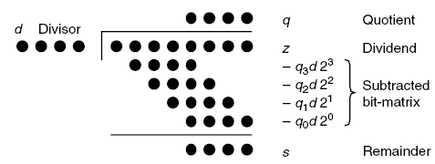


Radix-2 divider using SRT (1/)
SRT named for its creators (Sweeney, Robertson, and Tocher) and it is non-restoring algorithm
Generate 1-bit partial remainder in 1 iteration
Quotient $q_{−1}q_{−2}…$
$$s^{0}$$

Slide 58
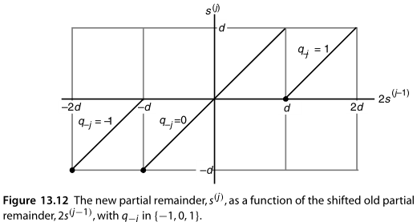

Radix-2 divider using SRT (2/)
$s^{j}=2s^{j−1}−q_{−j}d with s^{0}=z$
Shifted partial remainder $s^{j−1}$ is in the range [-d, d)
Digit set $q_{j}∈\{−1, 0, 1\}$
-1 → subtract -d
0 → subtract 0
1 → subtract d

Slide 59
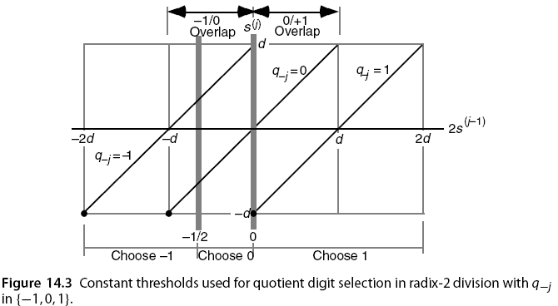
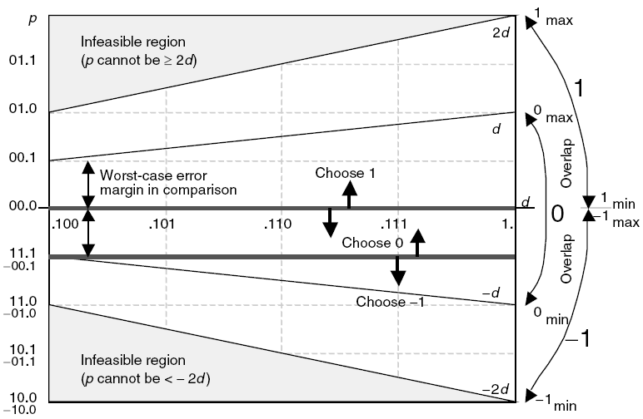

Radix-2 divider using SRT & CSA(1/)
$s^{j}=2s^{j−1}−q_{−j}d with s^{0}=z and s^{k}=2^{k}s$
Shifted partial remainder (${2s}^{j−1}$) is in the range [-2d, 2d)
Digit set $q_{j}∈\{−1, 0, 1\}$
-1 → [-2d, -1/2)
0 → [-1/2, 0)
1 → [0, 2d)

Slide 60
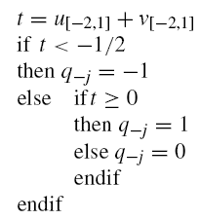

Radix-2 divider using SRT & CSA(2/)
Let $u=(u_{1}u_{0}.u_{−1}u_{−2}…)$ and $u=(v_{1}v_{0}.v_{−1}v_{−2}…)$
Add the most significant 4 bits of u and v, t result may have 1 bit error (’b0.01 = 0.25) because of carry from low part. The threshold gap is greater than 0.25.
XXXX XXXX
XXXX XXXX
X
carry

Slide 61
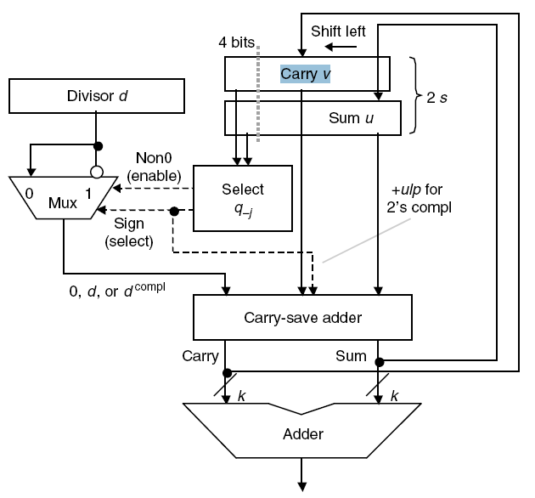

Radix-2 divider using SRT & CSA(3/)
The following Fig. is radix-2 divider datapath
Use sum of partial carry and sum string to select $q_{−j}$
BACK

Slide 62
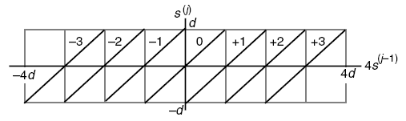
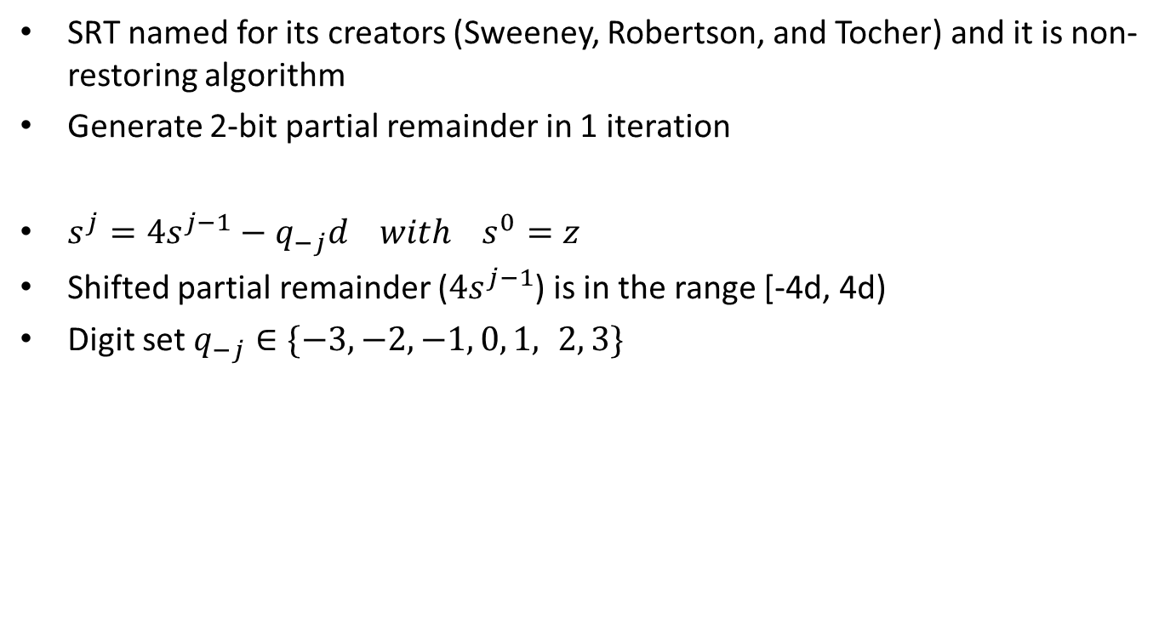
Radix-4 divider using SRT (1/)
SRT named for its creators (Sweeney, Robertson, and Tocher) and it is non-restoring algorithm
Generate 2-bit partial remainder in 1 iteration
$s^{j}=4s^{j−1}−q_{−j}d with s^{0}=z$
Shifted partial remainder ($4s^{j−1}$) is in the range [-4d, 4d)
Digit set $q_{−j}∈\{−3,−2,−1, 0, 1, 2, 3\}$

Slide 63
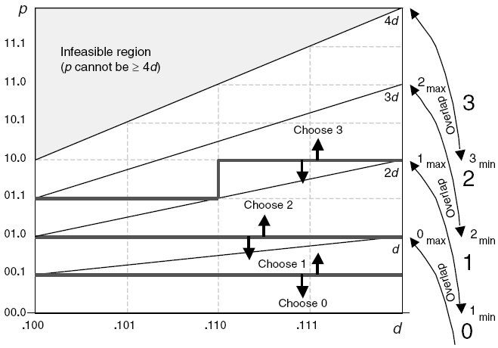
Radix-4 divider using SRT (2/)
p is shifted partial remainder and d is divisor
(3 * divisor) is complex so we want to restrict the quotient digits to [−2, 2] from [-3, 3].

Slide 64
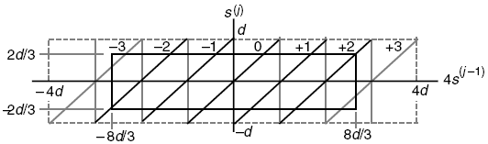

Radix-4 divider using SRT (3/)
Restrict the quotient digits to [−2, 2] from [-3, 3]
$s^{j−1}$ is in the range [-hd, hd)
$4s^{j−1}$ is in the range [-4hd, 4hd)
We should be able to bring the worst-case values to within [-hd, hd) by adding ±2d to it
$4hd−2d≤hd$ → $3hd≤2d$ → $h≤\frac{2}{3}$

Slide 65
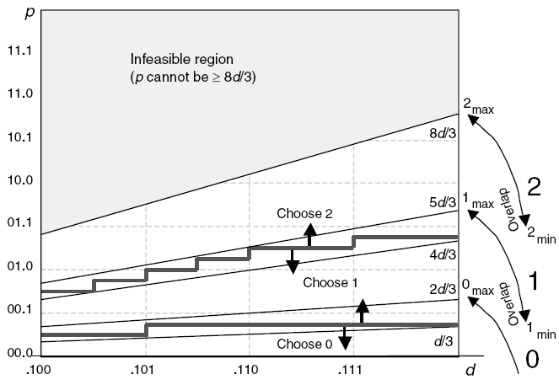


Radix-4 divider using SRT (4/)
quotient digits to [−2, -1, 0, 1, 2] from [-3, -2, -1, 0, 1, 2, 3]
$s^{j−1}$ is in the range [-d, d)
quotient digits is [−2, -1, 0, 1, 2]
$s^{j−1}$ is in the range [-2/3d, 2/3d)

Slide 66
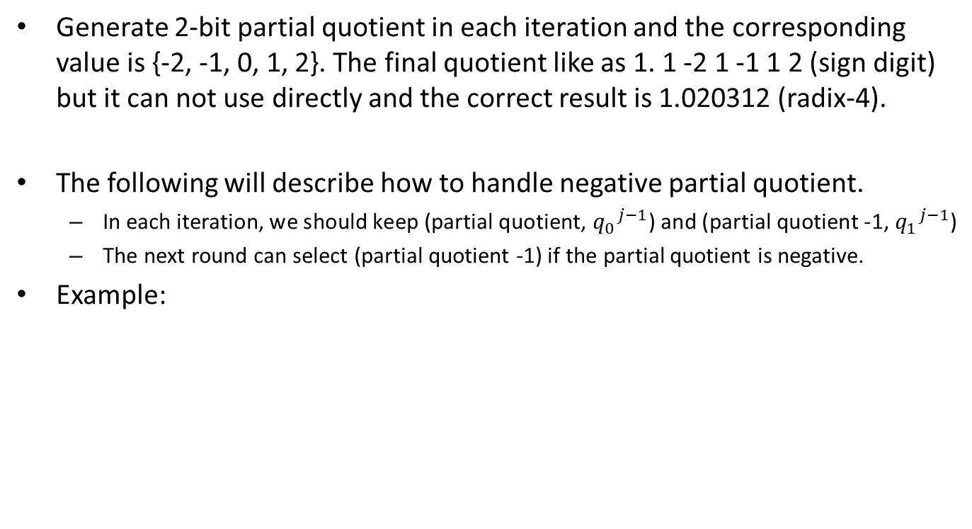
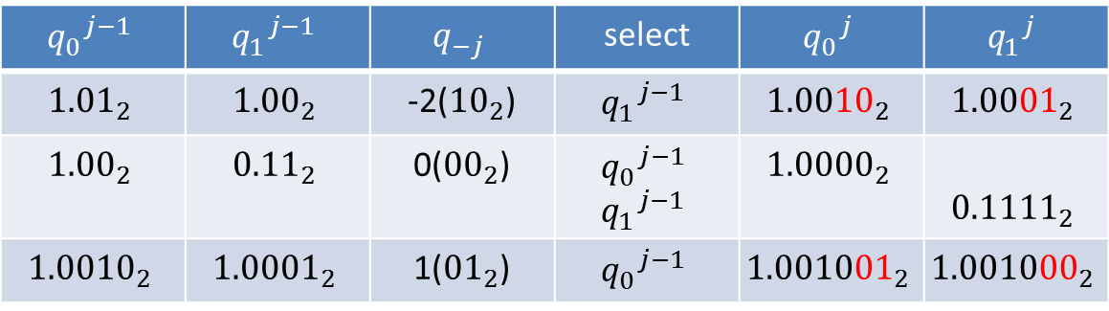
Radix-4 SRT - Quotient Handling (1/)
Generate 2-bit partial quotient in each iteration and the corresponding value is {-2, -1, 0, 1, 2}. The final quotient like as 1. 1 -2 1 -1 1 2 (sign digit) but it can not use directly and the correct result is 1.020312 (radix-4).
The following will describe how to handle negative partial quotient.
In each iteration, we should keep (partial quotient, ${q_{0}}^{j−1}$) and (partial quotient -1, ${q_{1}}^{j−1}$)
The next round can select (partial quotient -1) if the partial quotient is negative.
Example:
$${q_{0}}^{j−1}$$ | $${q_{1}}^{j−1}$$ | $$q_{−j}$$ | select | $${q_{0}}^{j}$$ | $${q_{1}}^{j}$$
$${\text{1.01}}_{2}$$ | $${\text{1.00}}_{2}$$ | -2(${\text{10}}_{2}$) | $${q_{1}}^{j−1}$$ | $${1.0010}_{2}$$ | $${1.0001}_{2}$$
$${\text{1.00}}_{2}$$ | $${\text{0.11}}_{2}$$ | 0(${\text{00}}_{2}$) | $${q_{0}}^{j−1}$$ $${q_{1}}^{j−1}$$ | $${1.0000}_{2}$$ | $${0.1111}_{2}$$
$${\text{1.0}010}_{2}$$ | $${\text{1.0}001}_{2}$$ | 1(${\text{01}}_{2}$) | $${q_{0}}^{j−1}$$ | $${1.001001}_{2}$$ | $${1.001000}_{2}$$
BACK

Slide 67

Radix-2 SQRT - Example
The example is non-restoring algorithm
$s^{j}=4s^{j−1}−q_{−j}(2q^{j−1}+2^{−j}q_{−j})$

Slide 68
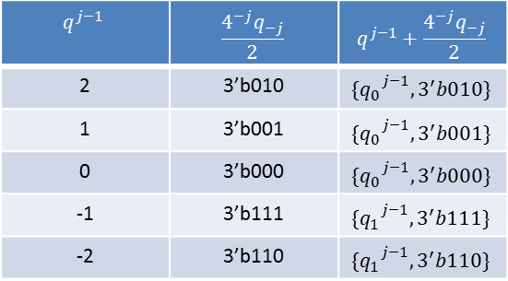
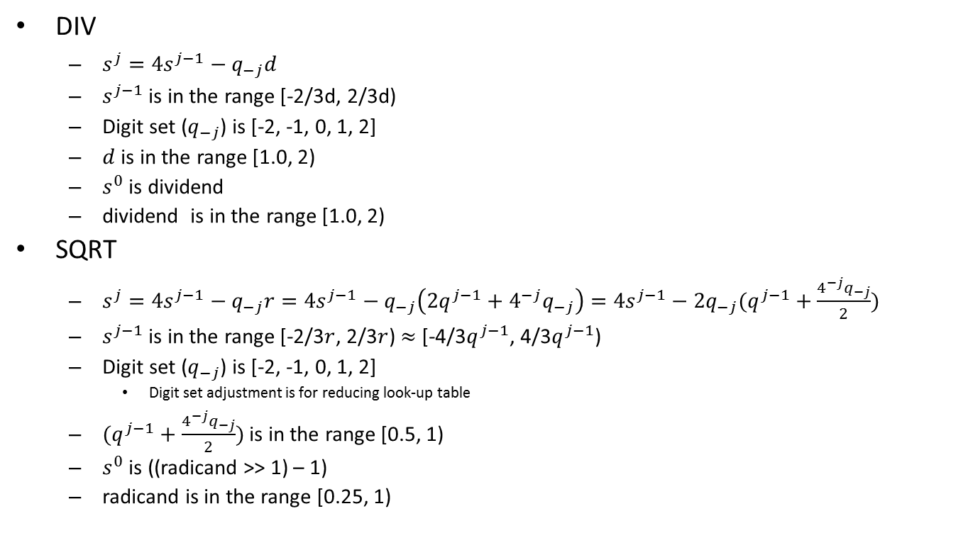
Radix-4 DIV and SQRT
DIV
$s^{j}=4s^{j−1}−q_{−j}d$
$s^{j−1}$ is in the range [-2/3d, 2/3d)
Digit set ($q_{−j}$) is [-2, -1, 0, 1, 2]
$d$ is in the range [1.0, 2)
$s^{0}$ is dividend
dividend is in the range [1.0, 2)
SQRT
$s^{j}=4s^{j−1}−q_{−j}r=4s^{j−1}−q_{−j}\left(2q^{j−1}+4^{−j}q_{−j}\right)=4s^{j−1}−2q_{−j}(q^{j−1}+\frac{4^{−j}q_{−j}}{2})$
$s^{j−1}$ is in the range [-2/3$r$, 2/3$r$) $≈$ [-4/3$q^{j−1}$, 4/3$q^{j−1}$)
Digit set ($q_{−j}$) is [-2, -1, 0, 1, 2]
Digit set adjustment is for reducing look-up table
$(q^{j−1}+\frac{4^{−j}q_{−j}}{2})$ is in the range [0.5, 1)
$s^{0}$ is ((radicand >> 1) – 1)
radicand is in the range [0.25, 1)
$$q^{j−1}$$ | $$\frac{4^{−j}q_{−j}}{2}$$ | $$q^{j−1}+\frac{4^{−j}q_{−j}}{2}$$
2 | 3’b010 | $${\{q_{0}}^{j−1}, 3^{′}b010\}$$
1 | 3’b001 | $${\{q_{0}}^{j−1}, 3^{′}b001\}$$
0 | 3’b000 | $${\{q_{0}}^{j−1}, 3^{′}b000\}$$
-1 | 3’b111 | $${\{q_{1}}^{j−1}, 3^{′}b111\}$$
-2 | 3’b110 | $${\{q_{1}}^{j−1}, 3^{′}b110\}$$

Slide 69
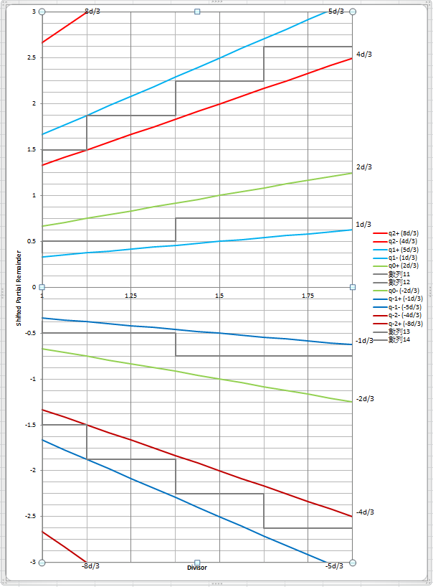
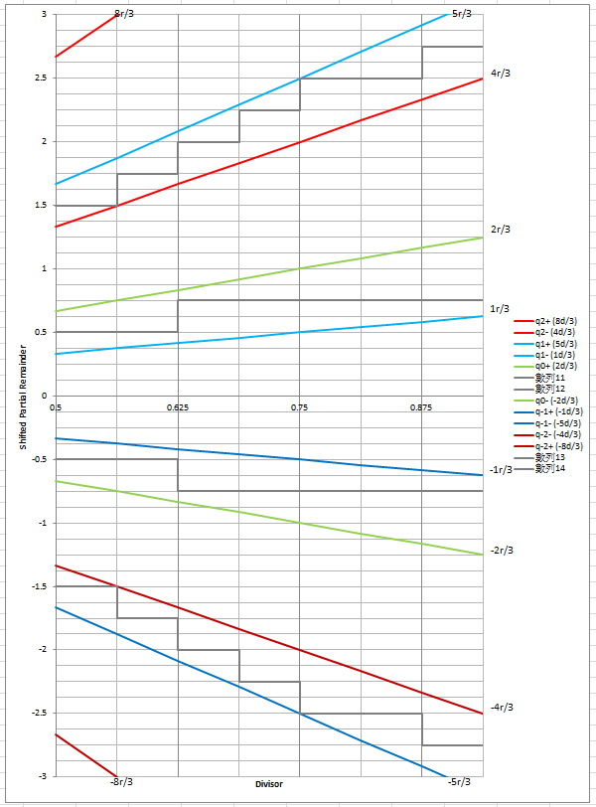
Radix-4 SRT Look-up Table (1/)
The Fig is DIV SRT look-up table.
Quotient of DIV is in [1, 2)
The Fig is SQRT SRT look-up table.
Quotient of SQRT is in [0.5, 1)
BACK

Slide 70
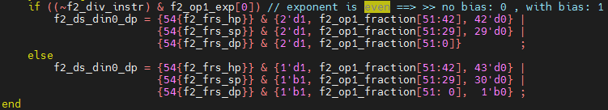
How to subtract 1/adjust data for SQRT (1/)
The significand do *2 if exponent is odd and the radicand is in the range [0.25, 1)
The following value is in the range [0.5, 2) and the value(din0) is 2x radicand
Notes:
The sqrt result of each values
0.9375 => 0.9682458365518542212948163499456 0.1111
0.875 => 0.93541434669348534639593718307914 0.1110
0.8125 => 0.90138781886599732327980531686762 0.1110
0.75 => 0.86602540378443864676372317075294 0.1101
0.6875 => 0.82915619758884996227873318416767 0.1101
0.625 => 0.79056941504209483299972338610818 0.1100
0.5625 => 0.75 0.1100
0.5 => 0.70710678118654752440084436210485 0.1011

Slide 71
How to subtract 1/adjust data for SQRT (2/)
For SQRT initialization, (Z-1)
Shift left and 1 extension for SQRT instruction
4((radicand >> 1) – 1) → 2radicand - 4
DS_DIN | Shift left 1 bit | 1 extension
0001.1111 | 0011.111 (3.875) | 1111.111 (-0.125)
0001.1110 | 0011.110 (3.75) | 1111.110 (-0.25)
0001.1101 | 0011.101 (3.625) | 1111.101 (-0.375)
0001.1100 | 0011.100 (3.5) | 1111.100 (-0.5)
0001.1011 | 0011.011 (3.375) | 1111.011 (-0.625)
0001.1010 | 0011.010 (3.25) | 1111.010 (-0.75)
0001.1001 | 0011.001 (3.125) | 1111.001 (-0.875)
0001.1000 | 0011.000 (3) | 1111.000 (-1)
DS_DIN | Shift left 1 bit | 1 extension
0000.1111 | 0001.111 (1.875) | 1101.111 (-2.125)
0000.1110 | 0001.110 (1.75) | 1101.110 (-2.25)
0000.1101 | 0001.101 (1.625) | 1101.101 (-2.375)
0000.1100 | 0001.100 (1.5) | 1101.100 (-2.5)
0000.1011 | 0001.011 (1.375) | 1101.011 (-2.625)
0000.1010 | 0001.010 (1.25) | 1101.010 (-2.75)
0000.1001 | 0001.001 (1.125) | 1101.001 (-2.875)
0000.1000 | 0001.000 (1) | 1101.000 (-3)
Notes:
The sqrt result of each values
0.9375 => 0.9682458365518542212948163499456 0.1111
0.875 => 0.93541434669348534639593718307914 0.1110
0.8125 => 0.90138781886599732327980531686762 0.1110
0.75 => 0.86602540378443864676372317075294 0.1101
0.6875 => 0.82915619758884996227873318416767 0.1101
0.625 => 0.79056941504209483299972338610818 0.1100
0.5625 => 0.75 0.1100
0.5 => 0.70710678118654752440084436210485 0.1011

Slide 72
1st Round Root selection for SQRT (1/)
Root digit selection rule cannot be used for all iterations because root is unknown in early iterations. SQRT instruction will use high-order root (0.1xxx) to generate 2-bit root in each iteration.
To find the 1st round root value and the steps like as below diagram
Initial value
(Z-1) * 4
1.0000
1st round root
Lookup table
1st partial remainder
-2/-1/0
2nd round root
0
-2
+
1.0000
-1
0.1000
<<2
‘b100
2nd partial remainder
0.1100
Lookup table
The corresponding 2nd round root is illegal if partial remainder is unbounded
-2/-1/0/1/2
+
3rd round root
2
1
-0
-1
-2
3rd partial remainder
0.1110
0.1101
0.1100
0.1010
0.1011
The corresponding 3rd round root is illegal if partial remainder is unbounded
The corresponding root is illegal if unbounded
Notes:
The sqrt result of each values
0.9375 => 0.9682458365518542212948163499456 0.1111
0.875 => 0.93541434669348534639593718307914 0.1110
0.8125 => 0.90138781886599732327980531686762 0.1110
0.75 => 0.86602540378443864676372317075294 0.1101
0.6875 => 0.82915619758884996227873318416767 0.1101
0.625 => 0.79056941504209483299972338610818 0.1100
0.5625 => 0.75 0.1100
0.5 => 0.70710678118654752440084436210485 0.1011
0.4375 => 0.66143782776614764762540393840982 0.1010
0.375 => 0.61237243569579452454932101867647 0.1001
0.3125 => 0.55901699437494742410229341718282 0.1000
0.25 => 0.5 0.1000

Slide 73
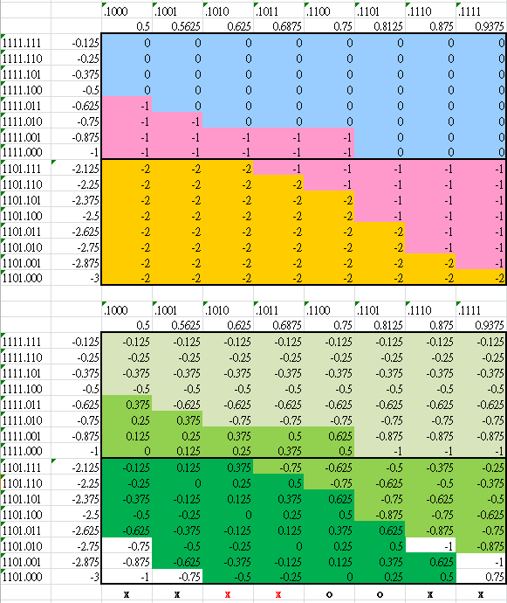

1st Round Root selection for SQRT (2/)
The Fig. show $s^{1}$ value according to digit set and the corresponding bounded value are (1 * 4/3) , (0.75 * 4/3) and (0.5 * 4/3)
0 →1.00
-1→0.11
-2→0.10
Root is 1.00
Root is 0.11
Root is 0.10
Notes:
The sqrt result of each values
0.9375 => 0.9682458365518542212948163499456 0.1111
0.875 => 0.93541434669348534639593718307914 0.1110
0.8125 => 0.90138781886599732327980531686762 0.1110
0.75 => 0.86602540378443864676372317075294 0.1101
0.6875 => 0.82915619758884996227873318416767 0.1101
0.625 => 0.79056941504209483299972338610818 0.1100
0.5625 => 0.75 0.1100
0.5 => 0.70710678118654752440084436210485 0.1011
0.4375 => 0.66143782776614764762540393840982 0.1010
0.375 => 0.61237243569579452454932101867647 0.1001
0.3125 => 0.55901699437494742410229341718282 0.1000
0.25 => 0.5 0.1000

Slide 74
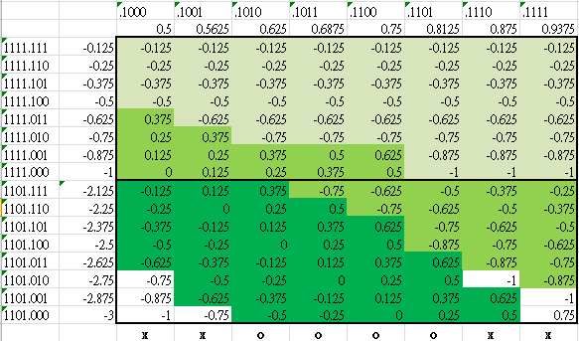
1st Round Root selection for SQRT (3/)
The first round pick up the corresponding root value we can calculate the corresponding partial remainder according to input value.
Several root will produce unbounded partial remainder like as white field.
The three green color will produce 3 roots (1.00, 0.11 and 0.10) in 1st iteration then the next round use it to calculate new partial remainder.
Then All values in red rectangle are 4x and then check the 2nd round will not produce unbounded value or illegal root.
Root is 1.00
Root is 0.11
Root is 0.10

Slide 75
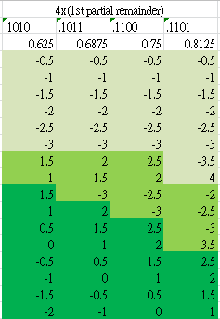
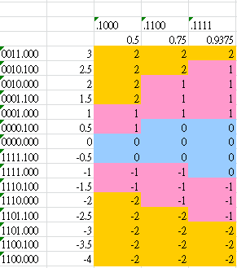
1st Round Root selection for SQRT (4/)
The second iteration use previous 3 roots (1.00, 0.11 and 0.10) to select partial root and calculate partial remainder.
Partial root selection
Partial Root 1.00 will select -2, -1, 0 partial root because partial remainders are in range [-4, -0.5].
Partial Root 0.11 will select -2, -1, 0, 1, 2 partial root because partial remainder are in range [-3.5, 2.5].
Partial Root 0.10 will select -2, -1, 0, 1, 2 partial root because partial remainder are in [-2, 2.5]
We can find 2nd round partial root according to right Figs and calculate the 2nd round partial remainder.
Partial Root 1.00
Partial Root 0.11
Partial Root 0.10

Slide 76
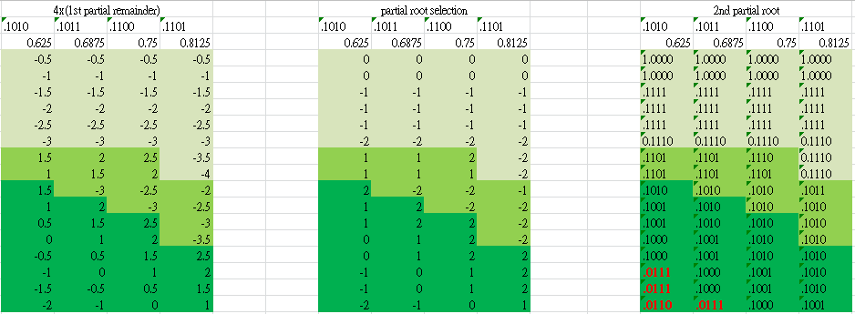
1st Round Root selection for SQRT (5/)
The right Fig. is produced according to partial root selection table and the corresponding 1st round partial root.
The root is in range [0.5, 1] so 0.0111 and 0.0110 are illegal. Thus, 0.1010 and 0.1011 cannot be applied as 1st round root.

Slide 77

1st Round Root selection for SQRT (6/)
Check the partial remainders are bounded [-2r/3, 2r/3)
According to 2nd partial remainder table, all partial remainder values are in the corresponding boundary. Thus, we can apply 0.1100 and 0.1101 as 1st round root.
The current design apply 0.1101 as 1st round root.
Notes:
The sqrt result of each values
0.9375 => 0.9682458365518542212948163499456 0.1111
0.875 => 0.93541434669348534639593718307914 0.1110
0.8125 => 0.90138781886599732327980531686762 0.1110
0.75 => 0.86602540378443864676372317075294 0.1101
0.6875 => 0.82915619758884996227873318416767 0.1101
0.625 => 0.79056941504209483299972338610818 0.1100
0.5625 => 0.75 0.1100
0.5 => 0.70710678118654752440084436210485 0.1011
0.4375 => 0.66143782776614764762540393840982 0.1010
0.375 => 0.61237243569579452454932101867647 0.1001
0.3125 => 0.55901699437494742410229341718282 0.1000
0.25 => 0.5 0.1000

Slide 78


Merge DIV and SQRT Look-up Table (1/)
DIV Look-up table
SQRT Look-up table
Merge 2 look-up tables to reduce area.
The red rectangles are different with SQRT look-up table.
The sum of high-order partial remainder may be actually sum or sum without carry.
Check that red rectangles are replaceable
Sum with carry=1
+1
Sum with carry=0

Slide 79

Merge DIV and SQRT Look-up Table (2/)
+2
+1/+2
+1

Slide 80


Merge DIV and SQRT Look-up Table (3/)
+1
+0/+1
+0

Slide 81


Merge DIV and SQRT Look-up Table (4/)
+0
+0/-1
-1

Slide 82


Merge DIV and SQRT Look-up Table (5/)
-2
-1/-2
-1

Slide 83
Merge DIV and SQRT Look-up Table (6/)
DIV Look-up table
SQRT Look-up table
Merge div & sqrt look-up
Merge the look-up tables (use only one table and it is original SQRT look-up table)
VFDIV64
Lib | Feq. | FLEN | Original | Modified
28HPC+ | 1.00Ghz | 32 | 21.3kgates | 21.2kgates | 0.5%
28HPC+ | 1.25Ghz | 32 | 22.7kgates | 22.5kgates | 0.9%
28HPC+ | 1.00Ghz | 64 | 27.5kgates | 27.3kgates | 0.7%
28HPC+ | 1.25Ghz | 64 | 31.2kgates | 30.1kgates | 3.6%

Slide 84
Round digit generation (1/)
Generate rounding increment according to rounding modes
Rounding modes
RNE (Round to Nearest, ties to Even)
RTZ (Round Towards Zero)
RDN (Round DowN)
RUP (Round UP)
RMM (Round to nearest, ties to Max Magnitude)
ROD (Round towards ODd)
Sign | L | R | S |  | RNE | RTZ | RDN | RUP | RMM | ROD
0 | 0 | 0 | 0 |  | +0 | +0 | +0 | +0 | +0 | +1
0 | 0 | 0 | 1 |  | +0 | +0 | +0 | +1 | +0 | +1
0 | 0 | 1 | 0 |  | +0 | +0 | +0 | +1 | +1 | +1
0 | 0 | 1 | 1 |  | +1 | +0 | +0 | +1 | +1 | +1
0 | 1 | 0 | 0 |  | +0 | +0 | +0 | +0 | +0 | +0
0 | 1 | 0 | 1 |  | +0 | +0 | +0 | +1 | +0 | +0
0 | 1 | 1 | 0 |  | +1 | +0 | +0 | +1 | +1 | +0
0 | 1 | 1 | 1 |  | +1 | +0 | +0 | +1 | +1 | +0
1 | 0 | 0 | 0 |  | +0 | +0 | +0 | +0 | +0 | +1
1 | 0 | 0 | 1 |  | +0 | +0 | +1 | +0 | +0 | +1
1 | 0 | 1 | 0 |  | +0 | +0 | +1 | +0 | +1 | +1
1 | 0 | 1 | 1 |  | +1 | +0 | +1 | +0 | +1 | +1
1 | 1 | 0 | 0 |  | +0 | +0 | +0 | +0 | +0 | +0
1 | 1 | 0 | 1 |  | +0 | +0 | +1 | +0 | +0 | +0
1 | 1 | 1 | 0 |  | +1 | +0 | +1 | +0 | +1 | +0
1 | 1 | 1 | 1 |  | +1 | +0 | +1 | +0 | +1 | +0

Slide 85
Underflow Flag Detection – Special Case (1/)
Format
The table show all cases of asserting underflow under twice rounding case.
Left V → subnormal to normal
Right V → Assert underflow flag
Assert special underflow flag if the condition have 2V.
R: round bit
Sm: MSB of sticky field
St: other sticky field
S = (Sm | St)
Sign | R | Sm | St |  | RNE |  | RTZ |  | RDN |  | RUP |  | RMM |  | ROD
0 | 0 | 0 | 0
0 | 0 | 0 | 1 |  |  | V |  | V |  | V | V | V |  | V |  | V
0 | 0 | 1 | 0 |  |  | V |  | V |  | V | V | V |  | V |  | V
0 | 0 | 1 | 1 |  |  | V |  | V |  | V | V | V |  | V |  | V
0 | 1 | 0 | 0 |  | V | V |  | V |  | V | V | V | V | V |  | V
0 | 1 | 0 | 1 |  | V | V |  | V |  | V | V |  | V | V |  | V
0 | 1 | 1 | 0 |  | V |  |  | V |  | V | V |  | V |  |  | V
0 | 1 | 1 | 1 |  | V |  |  | V |  | V | V |  | V |  |  | V
1 | 0 | 0 | 0 |  |  |  |  |  |  |  |  |  |  |  |  | V
1 | 0 | 0 | 1 |  |  | V |  | V | V | V |  | V |  | V |  | V
1 | 0 | 1 | 0 |  |  | V |  | V | V | V |  | V |  | V |  | V
1 | 0 | 1 | 1 |  |  | V |  | V | V | V |  | V |  | V |  | V
1 | 1 | 0 | 0 |  | V | V |  | V | V | V |  | V | V | V |  | V
1 | 1 | 0 | 1 |  | V | V |  | V | V |  |  | V | V | V |  | V
1 | 1 | 1 | 0 |  | V |  |  | V | V |  |  | V | V |  |  | V
1 | 1 | 1 | 1 |  | V |  |  | V | V |  |  | V | V |  |  | V

Slide 86
Underflow Flag Detection – Special Case (2/)
The condition should qualify bit pattern (BP) and the following condition under different rounding mode
BP | Sign | R | Sm | St |  | RNE | RTZ | RDN | RUP | RMM | ROD
Match | 0 | 0 | 0 | 0
Match | 0 | 0 | 0 | 1 |  |  |  |  | A
Match | 0 | 0 | 1 | 0 |  |  |  |  | A
Match | 0 | 0 | 1 | 1 |  |  |  |  | A
Match | 0 | 1 | 0 | 0 |  | A |  |  | A | A
Match | 0 | 1 | 0 | 1 |  | A |  |  |  | A
Match | 0 | 1 | 1 | 0
Match | 0 | 1 | 1 | 1
Match | 1 | 0 | 0 | 0
Match | 1 | 0 | 0 | 1 |  |  |  | A
Match | 1 | 0 | 1 | 0 |  |  |  | A
Match | 1 | 0 | 1 | 1 |  |  |  | A
Match | 1 | 1 | 0 | 0 |  | A |  | A |  | A
Match | 1 | 1 | 0 | 1 |  | A |  |  |  | A
Match | 1 | 1 | 1 | 0
Match | 1 | 1 | 1 | 1
RM | Underflow
RNE | BP & R & ~Sm
RTZ | 0
RDN | BP & sign & (R^S)
RUP | BP & ~sign & (R^S)
RMM | BP & R & ~Sm
ROD | 0

Slide 87
VFDIV64 PPA (1/)
The following RTL SHA-1 are
Original: master branch 30d18f15f
V1: master branch c261b5975
V2: master branch 5c4668b24
V3: master branch 01cd85b79
Synthesis tool: DC v2019.03-sp3
Tech_lib: tcbn28hpcplusbwp30p140ssg0p81vm40c
The following reports has output delay
Flag output delay is 50ps, outputs in F1 are 100ps and outputs in F2 are 200ps, and then FDIV F2 stage just have 340ps@1.25GHz and 500ps@1.00GHz
Feq. | XLEN/FLEN | Original (Kgates/ ps) | V1 (Kgates/ ps/ %) | V2 (Kgates/ ps/ %) | V3 (Kgates/ ps/ %)
1.00GHz | 64/32 | 21.59 / MET | 20.53 / MET / -4.91 | 20.29 / MET / -6.02 | 20.19 / MET / -6.48
 | 64/64 | 27.77 / MET | 26.20 / MET / -5.65 | 25.80 / MET / -7.09 | 25.65 / MET / -7.63
1.25GHz | 64/32 | 24.89 / MET | 22.61 / MET / -9.16 | 22.79 / MET / -8.44 | 22.52 / MET / -9.52
 | 64/64 | 33.32 / MET | 29.37 / MET / -11.85 | 29.37 / MET / -12.82 | 29.09 / MET / -12.70
Notes:
set input_delay_ratio 0.3
set_input_delay [expr $clk_period * $input_delay_ratio] -clock CORE_CLK [all_inputs]
set_output_delay [expr 0.2] -clock CORE_CLK [get_ports vfdiv_data64]
set_output_delay [expr 0.2] -clock CORE_CLK [get_ports vfdiv_mask8]
set_output_delay [expr 0.05] -clock CORE_CLK [get_ports vfdiv_vfcsr_flag_set]

Slide 88
VFDIV64 PPA – Detail (2/)
Feq. | XLEN/FLEN | Module | Original | V1 | V2 | V3
1.00GHz | 64/32 | vc_vfdiv64 fdiv_pipe0 fdiv_pipe1 fdiv_pipe2 fdiv_pipe3 | 8149.4279 2459.898 1387.512 2406.6 1387.26 | 7756.0559 / -4.83% 2337.5520 / -4.97% 1293.7680 / -6.76% 2322.4320 / -3.50% 1301.2020 / -6.20% | 7664.8319 / -5.95% 2313.4860 / -5.95% 1275.4980 / -8.07% 2295.4680 / -4.62% 1277.8920 / -7.88% | 7624.6379 / -6.44% 2273.7960 / -7.57% 1284.0660 / -7.46% 2280.0960 / -5.26% 1288.9800 / -7.08%
 | 64/64 | vc_vfdiv64 fdiv_pipe0 fdiv_pipe1 fdiv_pipe2 fdiv_pipe3 | 10496.4299 4780.6919 1384.11 2417.058 1390.536 | 9901.9619 / -5.66% 4479.1740 / -6.31% 1306.2420 / -5.63% 2315.3760 / -4.21% 1290.6180 / -7.19% | 9748.3679 / -7.13% 4382.5320 / -8.33% 1279.9080 / -7.53% 2294.5860 / -5.07% 1281.9240 / -7.81% | 9694.9439 / -7.64% 4340.8260 / -9.20% 1282.8060 / -7.32% 2276.0640 / -5.83% 1283.3100 / -7.71%
1.25GHz | 64/32 | vc_vfdiv64 fdiv_pipe0 fdiv_pipe1 fdiv_pipe2 fdiv_pipe3 | 9400.6079 2889.18 1511.118 2830.842 1541.61 | 8542.4219 / -9.13% 2581.6140 / -10.65% 1405.1520 / -7.01% 2571.0300 / -9.18% 1415.4840 / -8.18% | 8613.2339 / -8.38% 2674.3500 / -7.44% 1388.3940 / -8.12% 2567.6280 / -9.30% 1396.3320 / -9.42% | 8506.7639 / -9.51% 2559.8160 / -11.40% 1411.0740 / -6.62% 2543.0580 / -10.17% 1412.4600 / -8.38%
 | 64/64 | vc_vfdiv64 fdiv_pipe0 fdiv_pipe1 fdiv_pipe2 fdiv_pipe3 | 12590.4239 6055.9379 1527.246 2780.946 1560.258 | 11098.0799 / -11.85% 5131.6020 / -15.26% 1384.6140 / -9.34% 2575.0620 / -7.40% 1401.1200 / -10.20% | 10977.7499 / -12.81% 5020.5960 / -17.10% 1377.5580 / -9.80% 2583.1260 / -7.11% 1404.5220 / -9.98% | 10993.8779 / -12.68% 5047.6860 / -16.65% 1400.4900 / -8.30% 2523.1500 / -9.27% 1414.4760 / -9.34%

Slide 89
VFDIV64 PPA (3/)
The following RTL SHA-1 are
Original: master branch 30d18f15f
V1: master branch c261b5975
V2: master branch 5c4668b24
V3: master branch 01cd85b79
FLEN | Feq. | Ori | V1 | V2 | V3
32 | 1000 (1.00ns) | 21.59 kagtes / MET | 20.53 kagtes / MET | 20.29 kagtes / MET | 20.19 kagtes / MET
32 | 1250 (0.80ns) | 24.89 kagtes / MET | 22.61 kagtes / MET | 22.79 kagtes / MET | 22.52 kagtes / MET
32 | 1333 (0.75ns) |  | 24.42 kagtes / MET | 24.65 kagtes / MET | 23.95 kgates / MET
32 | 1429 (0.70ns) |  | 27.31 kagtes / MET | 27.81 kagtes / MET | 28.27 kagtes / MET
32 | 1667 (0.60ns) |  | 32.67 kagtes / -75ps
64 | 1000 (1.00ns) | 27.77 kgates / MET | 26.20 kgates / MET | 25.80 kgates / MET | 25.65 kgates / MET
64 | 1250 (0.80ns) | 33.32 kgates / MET | 29.37 kgates / MET | 29.05 kgates / MET | 29.09 kgates / MET
64 | 1333 (0.70ns) | 36.59 kgates / -31ps | 31.88 kgates / MET | 31.46 kgates / MET | 31.29 kgates / MET
64 | 1429 (0.65ns) | 38.36 kgates / -68ps | 36.22 kgates / -30ps |  | 34.73 kgates / -14ps
64 | 1667 (0.60ns) |  | 37.63 kgates / -49ps

Slide 90
VFDIV64 PPA (1/)
The following RTL SHA-1 are
Original: master branch 30d18f15f
V3: master branch 01cd85b79
V4: master branch
Synthesis tool: DC v2019.03-sp3
Tech_lib: tcbn28hpcplusbwp30p140ssg0p81vm40c
The following reports has output delay
Flag output delay is 50ps, outputs in F1 are 100ps and outputs in F2 are 200ps, and then FDIV F2 stage just have 340ps@1.25GHz and 500ps@1.00GHz
Feq. | XLEN/FLEN | Original (Kgates/ ps) | V3 (Kgates/ ps/ %) | V4 (Kgates/ ps/ %)
1.00GHz | 64/32 | 21.59 / MET | 20.19 / MET / -6.48 | 20.19 / MET / -6.48
 | 64/64 | 27.77 / MET | 25.65 / MET / -7.63 | 25.64 / MET / -7.67
1.25GHz | 64/32 | 24.89 / MET | 22.52 / MET / -9.52 | 22.30 / MET / -10.41
 | 64/64 | 33.32 / MET | 29.09 / MET / -12.70 | 28.60 / MET / -14.17
Notes:
set input_delay_ratio 0.3
set_input_delay [expr $clk_period * $input_delay_ratio] -clock CORE_CLK [all_inputs]
set_output_delay [expr 0.2] -clock CORE_CLK [get_ports vfdiv_data64]
set_output_delay [expr 0.2] -clock CORE_CLK [get_ports vfdiv_mask8]
set_output_delay [expr 0.05] -clock CORE_CLK [get_ports vfdiv_vfcsr_flag_set]

Slide 91
VFDIV64 PPA – Detail (FLEN32)(2/)
Feq. | XLEN/FLEN | Module | Original | V3 |  | V4
1.00GHz | 64/32 | vc_vfdiv64 fdiv_pipe0 fdiv_pipe0/vc_vfp_dsu fdiv_pipe1 fdiv_pipe1/vc_vfp_dsu fdiv_pipe2 fdiv_pipe2/vc_vfp_dsu fdiv_pipe3 fdiv_pipe3/vc_vfp_dsu | 8149.4279 2459.8980 906.8220 1387.5120 497.0700 2406.6000 910.6020 1387.2600 498.2040 | 7624.6379 2273.7960 736.9740 1284.0660 407.1060 2280.0960 738.6120 1288.9800 409.6260 | -6.44% -7.57% -18.73% -7.46% -18.10% -5.26% -18.89% -7.08% -17.78%
1.25GHz | 64/32 | vc_vfdiv64 fdiv_pipe0 fdiv_pipe0/vc_vfp_dsu fdiv_pipe1 fdiv_pipe1/vc_vfp_dsu fdiv_pipe2 fdiv_pipe2/vc_vfp_dsu fdiv_pipe3 fdiv_pipe3/vc_vfp_dsu | 9400.6079 2889.1800 961.2540 1511.1180 531.9720 2830.8420 970.0740 1541.6100 536.7600 | 8506.7639 2559.8160 782.7120 1411.0740 451.3320 2543.0580 779.9400 1412.4600 443.6460 | -9.51% -11.40% -18.57% -6.62% -15.16% -10.17% -19.60% -8.38% -17.35%

Slide 92
VFDIV64 PPA – Detail (FLEN64)(2/)
Feq. | XLEN/FLEN | Module | Original | V3 |  | V4
1.00GHz | 64/64 | vc_vfdiv64 fdiv_pipe0 fdiv_pipe0/vc_vfp_dsu fdiv_pipe1 fdiv_pipe1/vc_vfp_dsu fdiv_pipe2 fdiv_pipe2/vc_vfp_dsu fdiv_pipe3 fdiv_pipe3/vc_vfp_dsu | 10496.4299 4780.6919 1849.3020 1384.11 497.4480 2417.058 907.7040 1390.536 497.3220 | 9694.9439 4340.8260 1487.8080 1282.8060 406.7280 2276.0640 740.1240 1283.3100 405.4680 | -7.64% -9.20% -19.55% -7.32% -18.24% -5.83% -18.46% -7.71% -18.47% | 9689.7779 4335.0300 1479.3660 1277.3880 402.4440 2288.4120 744.4080 1283.6880 400.0500 | -7.69% -9.32% -20.00% -7.71% -19.10% -5.32% -17.99% -7.68% -19.56%
1.25GHz | 64/64 | vc_vfdiv64 fdiv_pipe0 fdiv_pipe0/vc_vfp_dsu fdiv_pipe1 fdiv_pipe1/vc_vfp_dsu fdiv_pipe2 fdiv_pipe2/vc_vfp_dsu fdiv_pipe3 fdiv_pipe3/vc_vfp_dsu | 12590.4239 6055.9379 1990.4220 1527.2460 529.0740 2780.9460 967.0500 1560.2580 530.5860 | 10993.8779 5047.6860 1553.9580 1400.4900 441.3780 2523.1500 785.7360 1414.4760 440.2440 | -12.68% -16.65% -21.93% -8.30% -16.58% -9.27% -18.75% -9.34% -17.03% | 10807.0199 4868.0100 1544.3820 1403.5140 441.3780 2548.8540 800.9820 1395.7020 444.9060

Slide 93
VFDIV64 PPA (1/)
The following RTL SHA-1 are
Original: master branch 30d18f15f
V3: master branch 01cd85b79
V4: master branch
Synthesis tool: DC v2019.03-sp3
Tech_lib: tcbn28hpcplusbwp30p140ssg0p81vm40c
The following reports has output delay
Flag output delay is 50ps, outputs in F1 are 100ps and outputs in F2 are 200ps, and then FDIV F2 stage just have 340ps@1.25GHz and 500ps@1.00GHz
Feq. | XLEN/FLEN | Original (Kgates/ ps) | V3 (Kgates/ ps/ %) | SIMD64 V1 (Kgates/ ps/ %)
1.00GHz | 64/32 | 21.59 / MET | 20.19 / MET / -6.48 | 18.02 / MET / -16.54
 | 64/64 | 27.77 / MET | 25.65 / MET / -7.63 | 21.54 / MET / -22.43
1.25GHz | 64/32 | 24.89 / MET | 22.52 / MET / -9.52 | 21.47 / MET / -13.74
 | 64/64 | 33.32 / MET | 29.09 / MET / -12.70 | 26.50 / MET / -20.47
Notes:
set input_delay_ratio 0.3
set_input_delay [expr $clk_period * $input_delay_ratio] -clock CORE_CLK [all_inputs]
set_output_delay [expr 0.2] -clock CORE_CLK [get_ports vfdiv_data64]
set_output_delay [expr 0.2] -clock CORE_CLK [get_ports vfdiv_mask8]
set_output_delay [expr 0.05] -clock CORE_CLK [get_ports vfdiv_vfcsr_flag_set]

