Slide 1
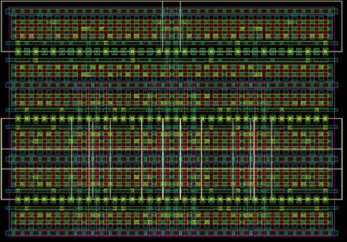
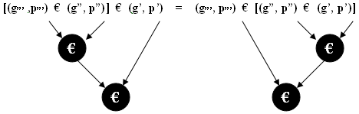
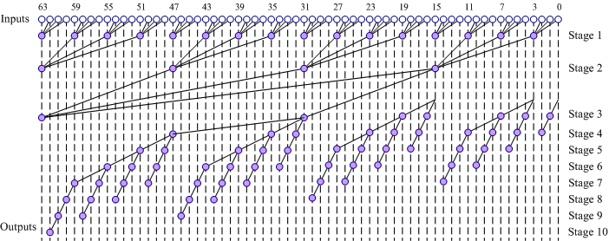
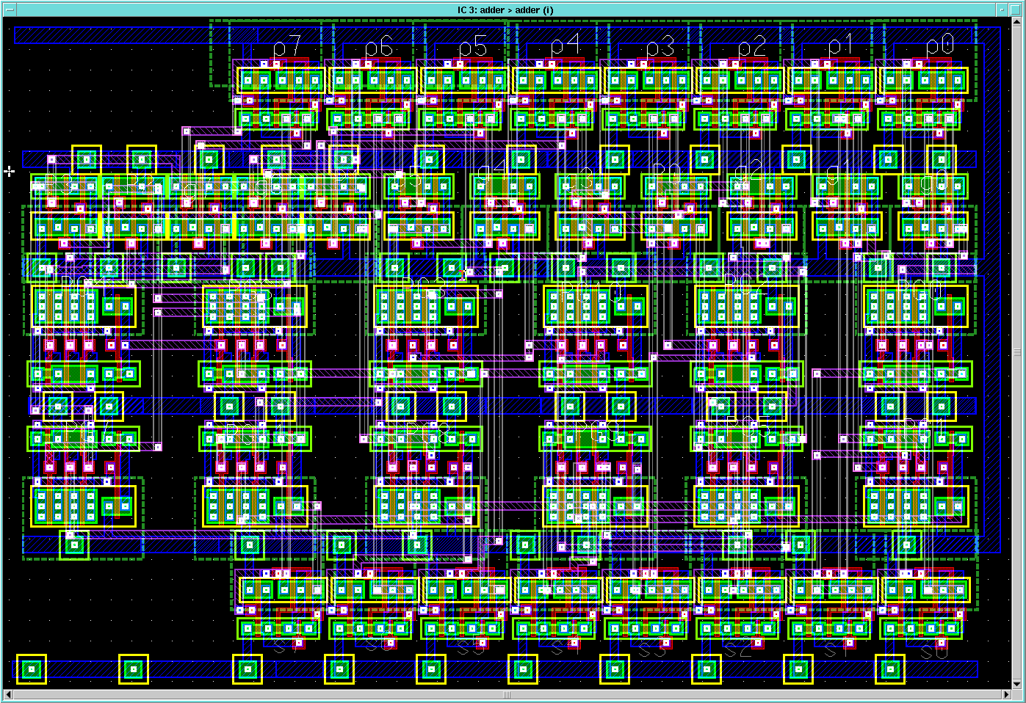
Parallel Prefix Adders
A Case Study
Muhammad Shoaib Bin Altaf
CS/ECE 755

Slide 2
Outline
Motivation
Introduction
Various Tree adders
Comparison
Layout of Kogge-Stone
Conclusion

Slide 3
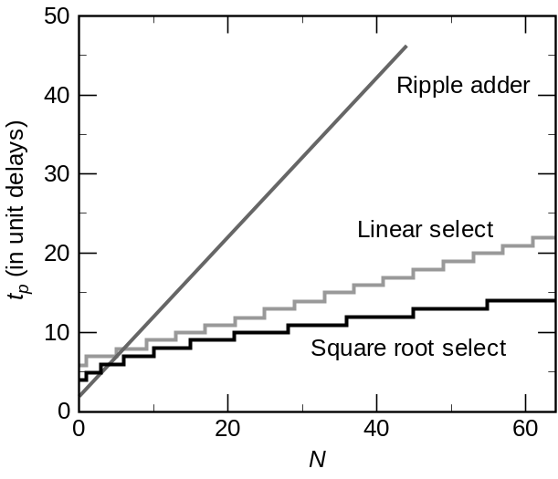
Motivation
Addition: a fundamental operation
  Basic block of most arithmetic operations
  Address calculation
Faster, faster and faster
How?
  Ripple Carry Adder ➔ Look Ahead
  Carry Select, carry Skip
  Good for small number of bits but…
  Need some change for wider adders

Slide 4
Propagate and Generate Logic
For a full adder, define what happens to carries
  Generate: C_{out} = 1 independent of C
    G = A • B
  Propagate: C_{out} = C
    P = A ⊕ B

Slide 5
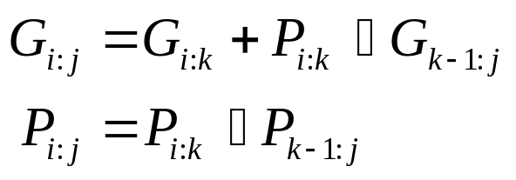
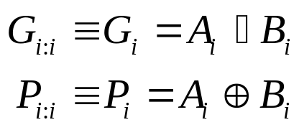
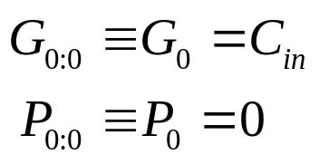



Prefix Adder Equations
Equations often factored into G and P
Generate and propagate for groups spanning i:j
Base case
Sum:

Slide 6
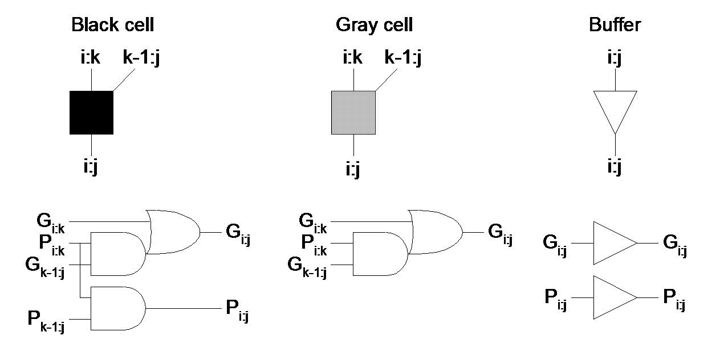
Notations

Slide 7
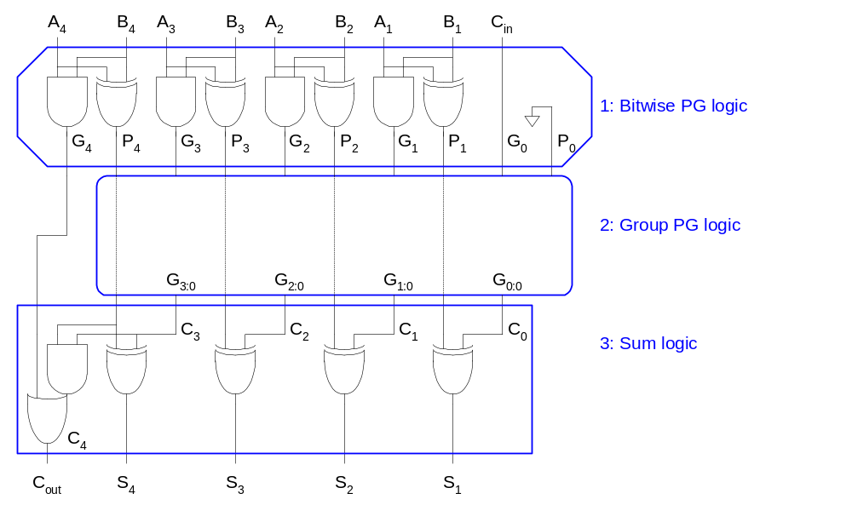
Ripple Carry Adder

Slide 8

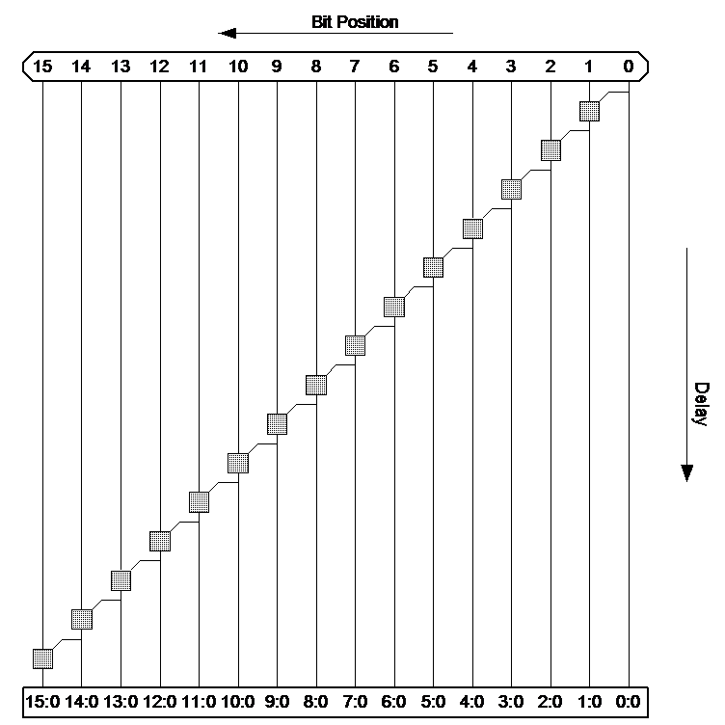



Ripple Carry Adder

Slide 9
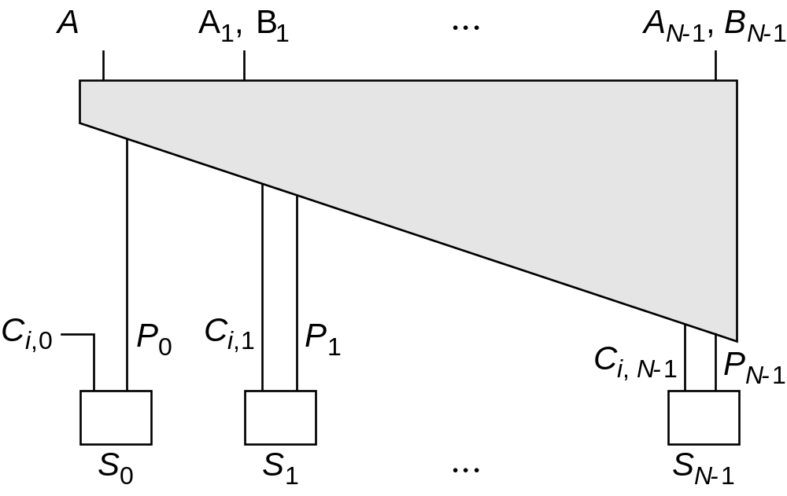
Look Ahead Basic idea

Slide 10
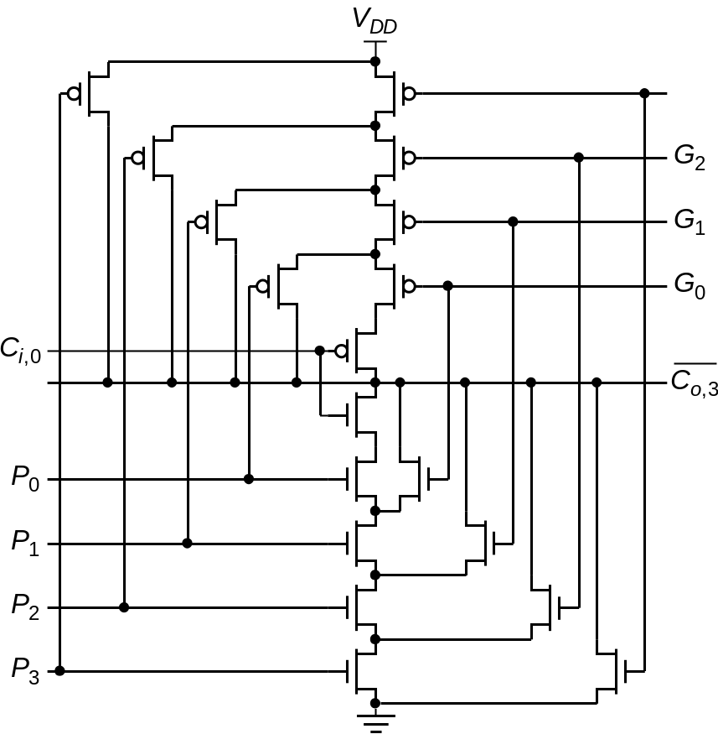

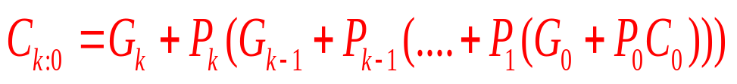
Lookahead: Topology
Expanding Lookahead equations:
All the way:

Slide 11

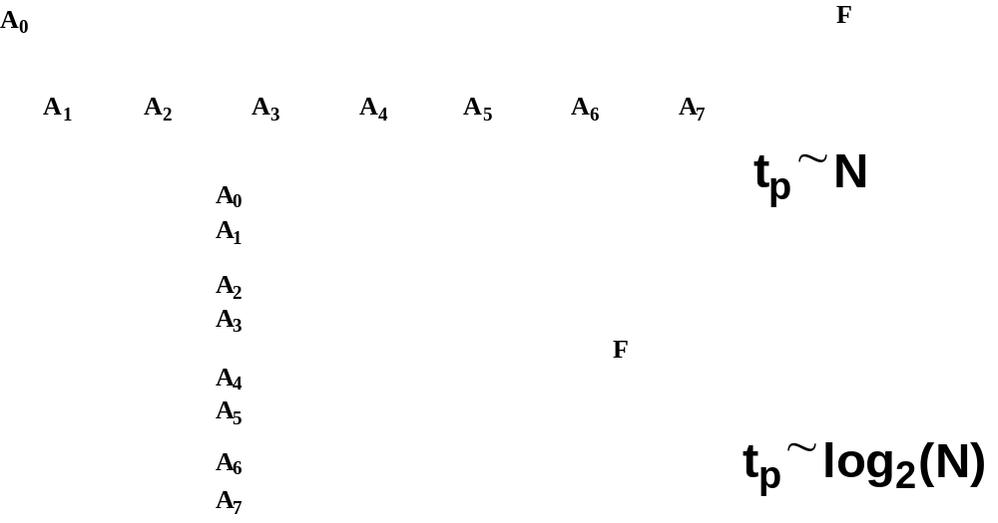
Logarithmic Lookahead Adder

Slide 12
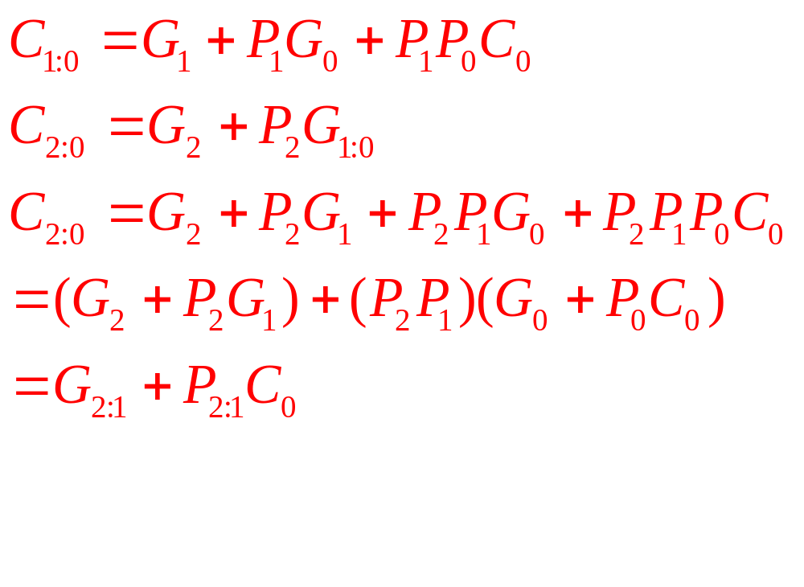
Carry lookahead Trees
This idea can be extended to build hierarchal trees

Slide 13
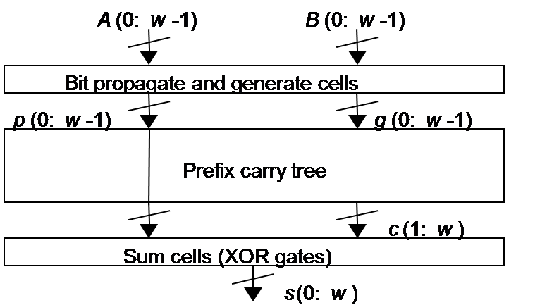
Prefix Adder Structure
Implement the idea of Carry Lookahead tree

Slide 14
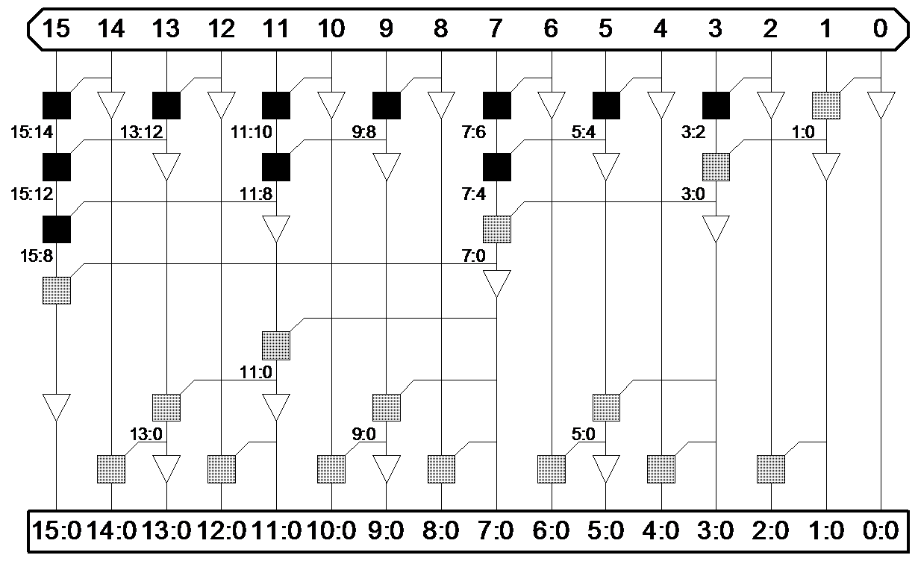
Brent-Kung Adder
Stages
  2(logN-1)
Fan out
  2
Avoids Explosion of wires
Odd Computation then even
In any row at the most one pair

Slide 15






Brent-Kung Adder

Slide 16
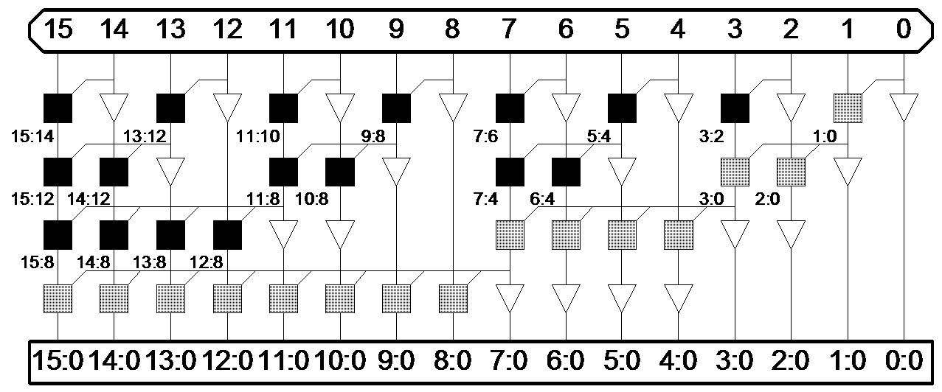
Sklansky Adder
Stages
  Log N
Fan out
  Doubles at each level
Large delay at end

Slide 17



Sklansky Adder

Slide 18
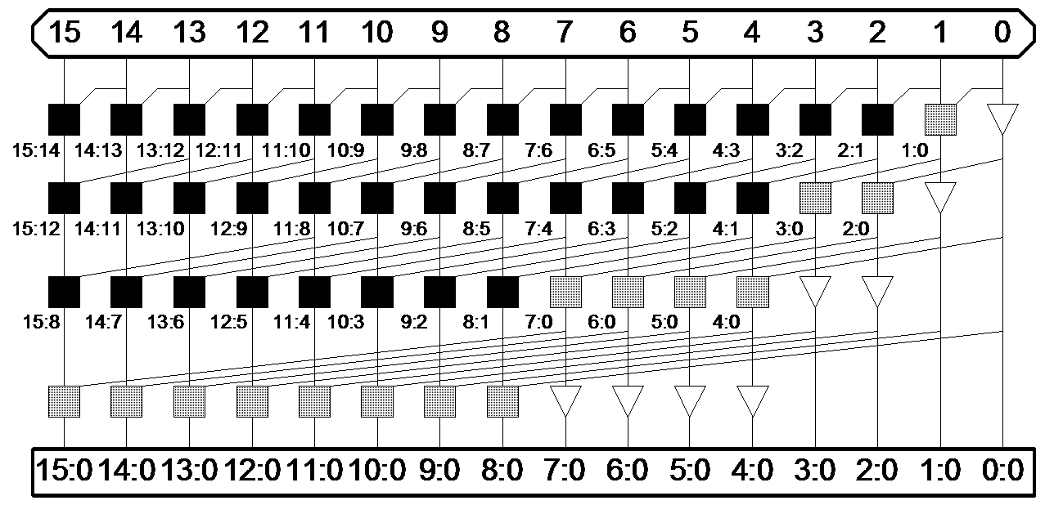
Kogge-Stone Adder
Stages
  Log N
Fan out
  2 at each stage
Long wires
More PG cells➔ Power
Widely Used

Slide 19
Kogge-Stone Adder

Slide 20
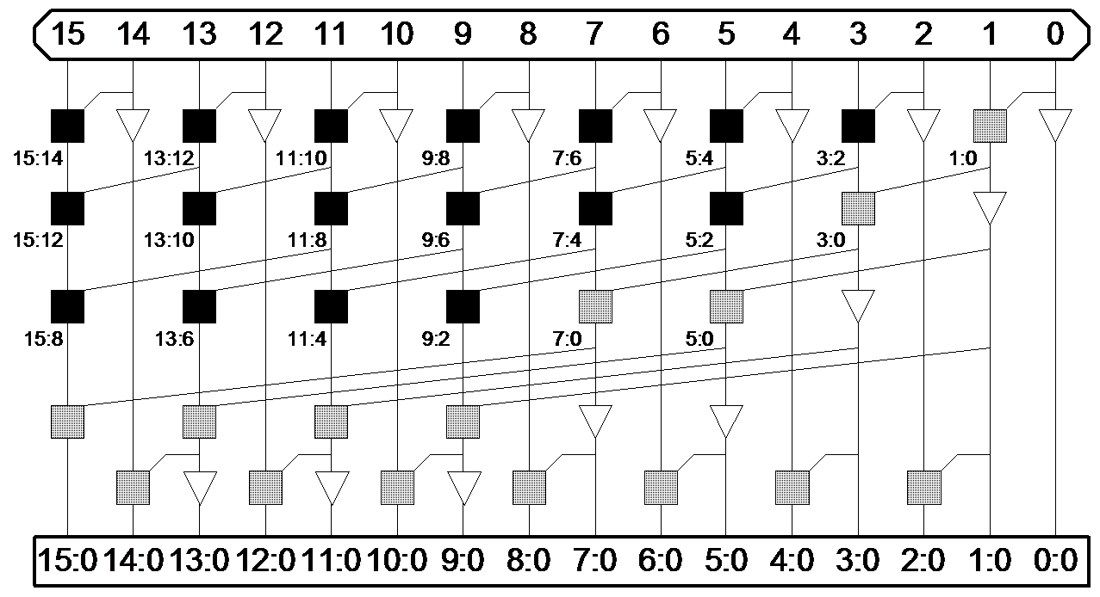
Han-Carlson Adder
Mix of Kogge-Stone and Brent-Kung
Stages
  Log N +1
Fan out
  2
Trades logical level for wire length
In any row at the most one pair

Slide 21

Han-Carlson Adder

Slide 22

Knowles Adder
Using Kogge-stone and Sklansky
Stages
  Log N
Fan out
  3
Wires

Slide 23


Knowles Adder

Slide 24
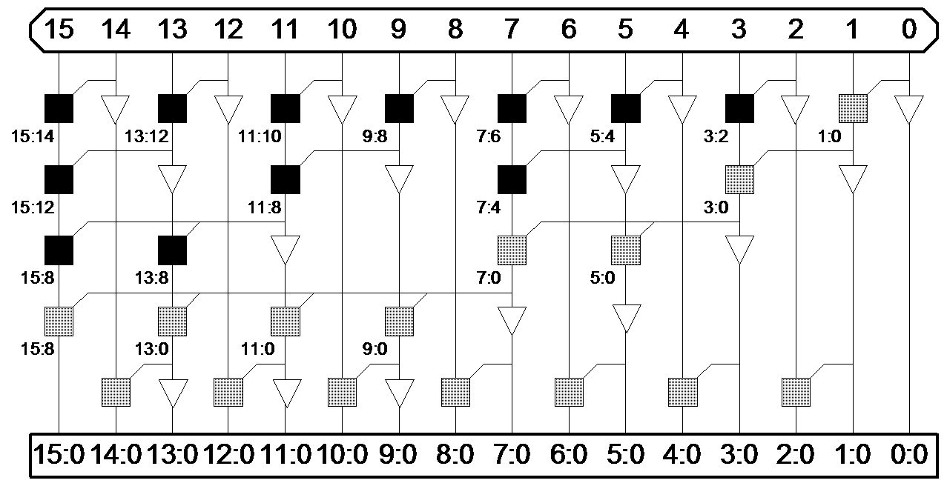
Ladner-Fischer Adder
By Combining Brent-Kung and Sklansky
Stages
  Log N +1
Fan out
  N/4 +1
Wires

Slide 25



Ladner-Fischer Adder

Slide 26
Comparison Among Adders
In term of delays
 | N=16 | N=32 | N=64 | N=128
Brent-Kung | 10.4 | 13.7 | 18.1 | 24.9
Sklansky | 13 | 21.6 | 38.2 | 70.8
Kogge-Stone | 9.4 | 12.4 | 17 | 24.8
Han-Carlson | 9.9 | 12.1 | 15.1 | 19.7
Knowles | 9.7 | 12.7 | 17.3 | 25.1
Ladner-Fischer | 9.9 | 11.5 | 14.9 | 18.9
Carry Incre. | 15.7 | 27.5 | 46.8 | 84.3
If wire capacitance neglected Kogge-Stone is best
Logical effort of carry propagate adders, David Harris, 2003

Slide 27
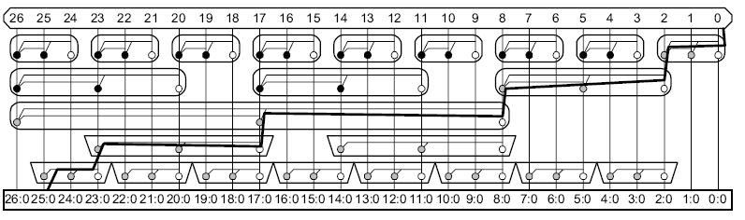
Valency of a Tree
Valency
  Number of groups combine together to make larger groups
  Earlier examples were of valency 2
  High Valency
    Less logic levels
    Each stage has grater delay
  Doesn’t make sense for static CMOS

Slide 28
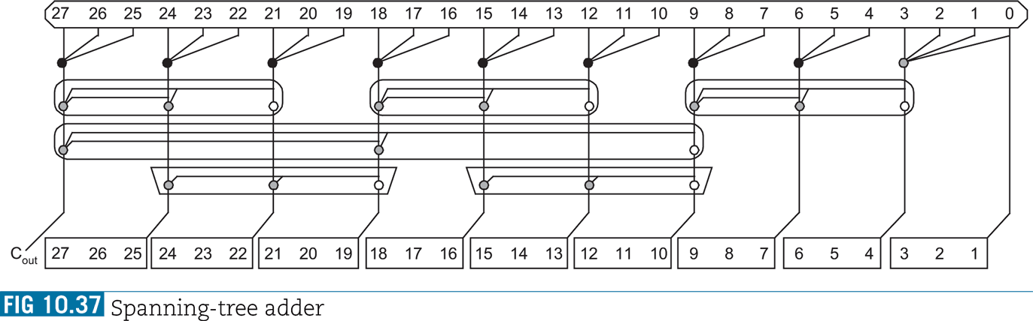
Sparseness of Tree
Compute Carries for blocks only
Reduce
  Wire count
  Gate count
  Power

Slide 29
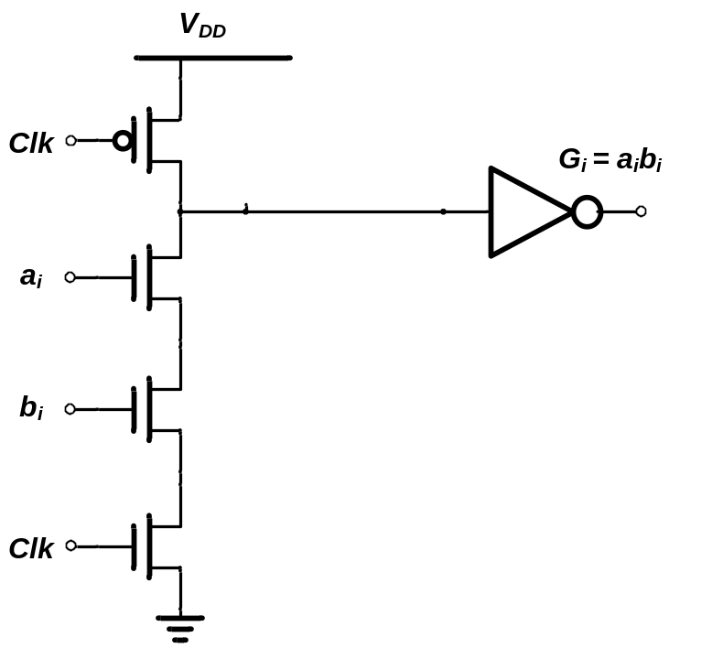
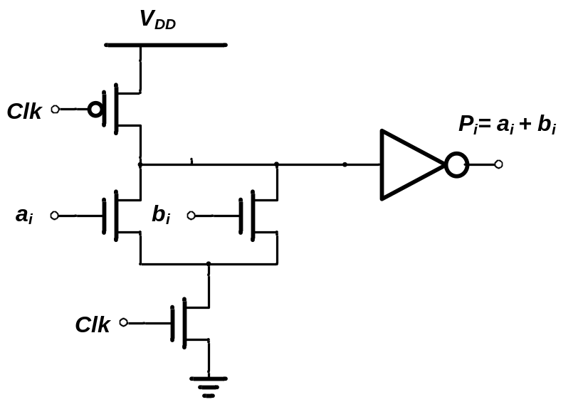
Implementation of KS Adder
Domino Logic when performance is major concern
Propagate
Generate

Slide 30
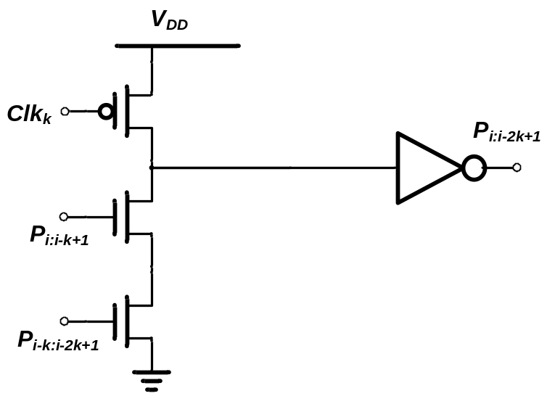
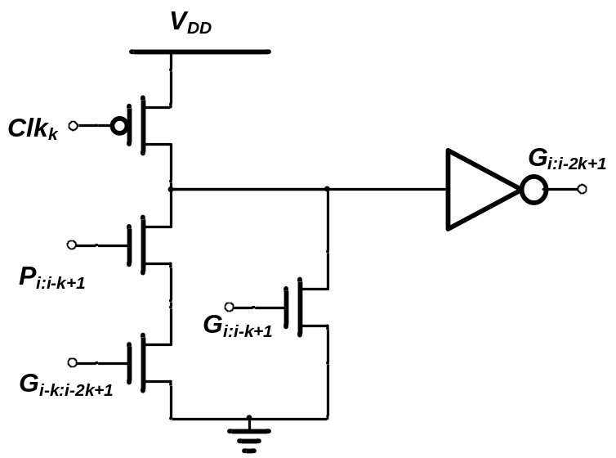
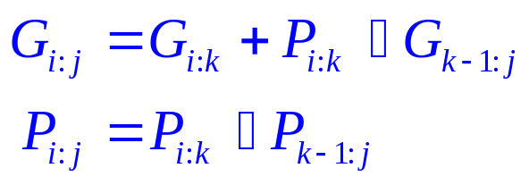
Implementation of KS Adder
Propagate
Generate

Slide 31
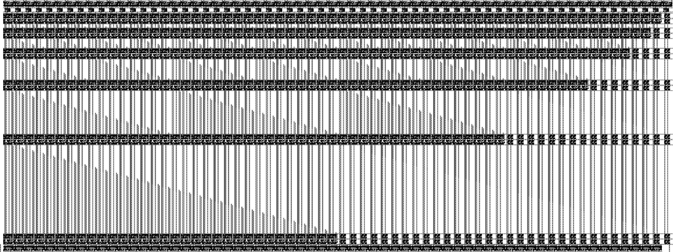
Layout of KS Adder
64 bit Adder

Slide 32

Layout of KS Adder
Area completely dominated by wires
Delay
  7.46 ns
Power
  26.1 mW
904 Cells with 8 levels
A comparison with 3D implementation is also given

Slide 33
Few Observations
Wire delay exceeds logic delay in many cases
The wire delay increases with width of adder
Effect of feature size
3D stacking can help in decreasing area, power and delay

Slide 34
Conclusion
Fast Adders required for N>32
Irregular hybrid schemes are possible
Kogge-Stone, Knowels require large number of parallel wiring tracks
Large wires will increase wiring capacitances
Choice is yours….
Trade off between delays and Area
3D integration can help in reducing the delays further

Slide 35


