Slide 1
FP MISC nibble/byte to hp/sp uArch
202012
Larry

Slide 2
Agenda
Overview
Interface
Data path
Conversion from nibble/byte to HP/SP

Slide 3
Overview (1/)
This design is a combination logics
Supported data types
Input is in8
Extend int4 to 8-bit
Output is hp/sp/dp
Precision | Width | Sign | Expo | Mant
HP | 16 | 1 | 5 | 10
SP | 32 | 1 | 8 | 23
DP | 64 | 1 | 11 | 52

Slide 4
Configurability
Feature | Options
FLEN* | 16/32/64

Slide 5
Interface
Signal name | Width | Type | Description
sew | 3 | Input | Indicate result fp type. 3’b010 indicates SP and others indicate HP
sign | 1 | Input | 0 is unsigned and 1 is signed
data | 8 | Input | 8-bit integer value. Int4 value should do signed extension or zero extension according to sign signal
wdata | FLEN (16/32) | Output | Result data. Do nan-boxing for hp result when result type is HP and FLEN is 32.

Slide 6
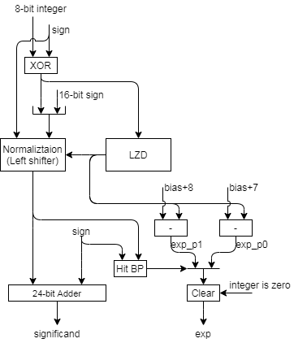

Data path
The following figures are the corresponding datapath
FLEN 32
FLEN 16

Slide 7
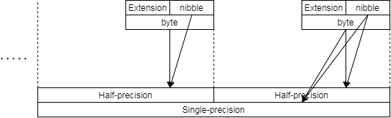
Data alignment
Data alignment
Do extension for nibble value according to signed or unsigned
Signed → signed extension
Unsigned → zero extension

