Slide 1
FP DIV/SQRT uArch
202101
Larry

Slide 2
Agenda
List of abbreviation
Overview
Configuration
uArch Overview
FP DIV/SQRT Instructions
FP Estimation Instructions
Round digit generation
Underflow Flag Detection
Enhancements
Merge IDIV and FDIV methods
Instruction list

Slide 3
List of abbreviation (1/)
Abbreviation | Definition
DSU | Divider and Square Root Unit
LZD | Leading zero detection
LZC | Leading zero count

Slide 4
List of parameter (1/)
Abbreviation | Definition
XLEN | The current width of an x register in bits (32 for RV32 or 64 for RV64)
FLEN | The current width of a f register in bits (32 for SP, 64 for DP)

Slide 5
Overview (1/)
2-stage pipeline
Supported data types
Instruction handling
FP DIV/SQRT instruction using radix-4 SRT algorithm
FP estimation instruction using look-up table
Precision | Width | Sign | Expo | Mant
HP | 16 | 1 | 5 | 10
SP | 32 | 1 | 8 | 23
DP | 64 | 1 | 11 | 52

Slide 6
Overview (2/)
Instruction latency
*DIV/SQRT instruction can not be dispatch to function unit back-to-back and the instructions reduce 1 cycle.
x is not supported
Instruction | Latency
 | Scalar |  | Vector
DIV/SQRT | HP | 13* | HP | 13*
 | SP | 20* | SP | 20*
 | DP | 34* | DP | 34*
VFRECE7 | x | x | 3
VFRSQRTE7 | x | x | 3

Slide 7
Configurability
Feature | Options
XLEN | 64
FLEN* | 16/32/64
VLEN | 512/256/128
SIMD_WIDTH | 512/256/128
ELEN* | 32/64
*If RVV = 0, FLEN can be configured to 32/64
*If RVV = 1, FLEN is equivalent to ELEN

Slide 8
uArch overview

Slide 9
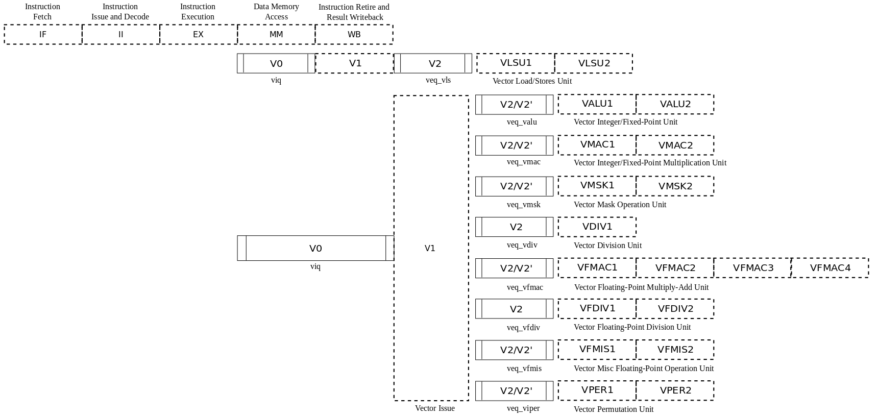
VPU stage
Frontend
Function unit

Slide 10
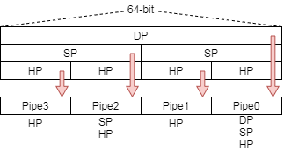
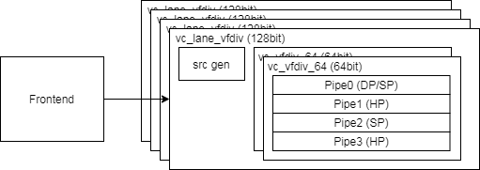
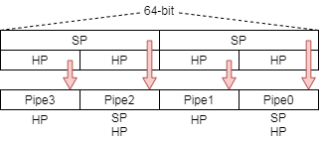
Function Unit Lane Hierarchy
ELEN=64
src_gen is for source data selection
Select data for read port 0/ 1/ 2/ 3 or scalar register
Describe detail according to Chevy’s latest spec or v0/v1 decode table
ELEN=32

Slide 11
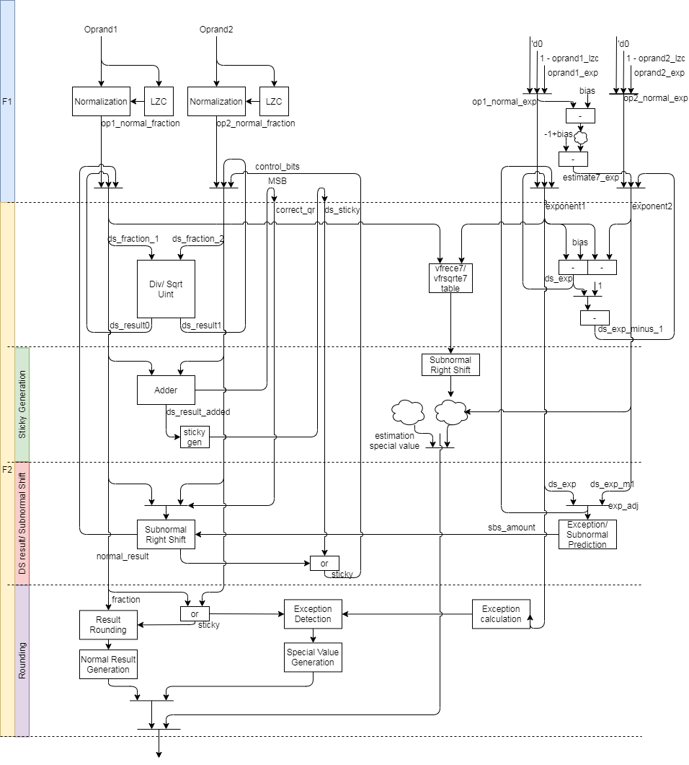
FDIV uArch (1/)
The original datapath
Generate sticky 3 times
Reduce staging FFs
Rounding method
Reduce 2-level adder to 1-level

Slide 12
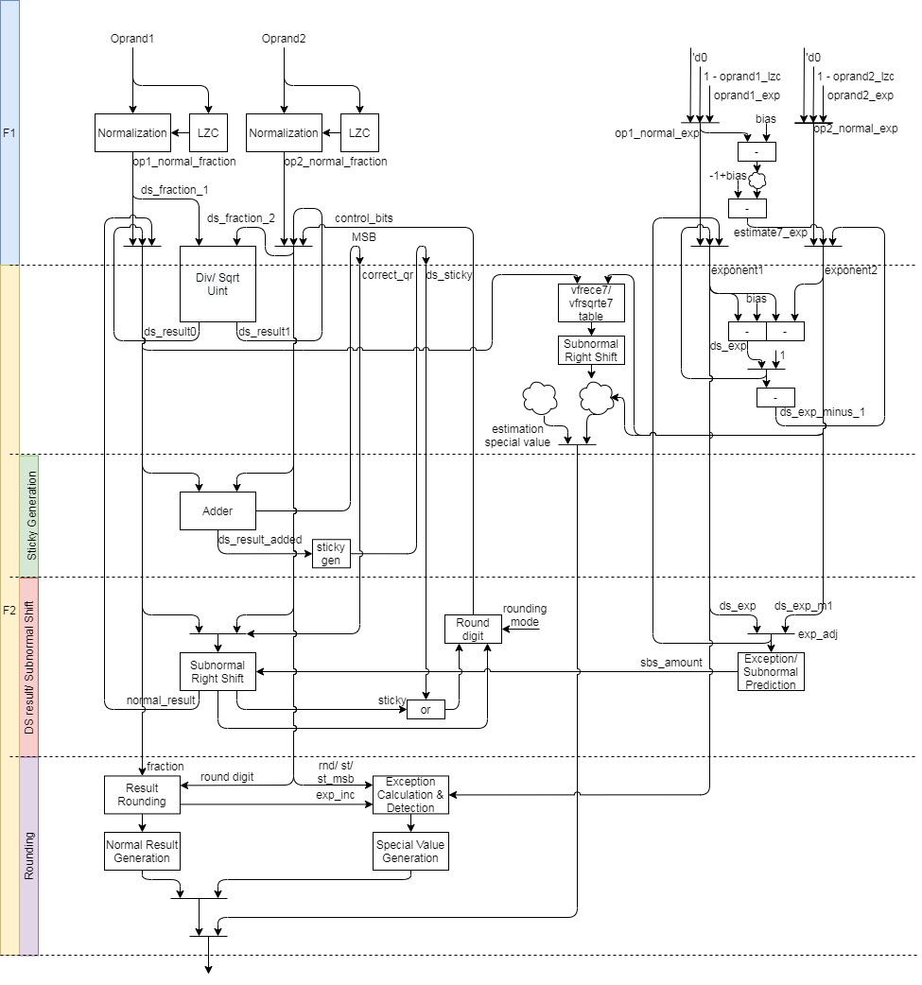
FDIV uArch (2/)
The modified datapath
Generate sticky 3 → 2 times
Rounding method

Slide 13
FDIV uArch (3/)
Div instruction datapath
Step 1: Normalize source value
Step 2: Compute result by DSU
Step 3: Calculate sticky
Step 4: Shift right for subnormal
Step 5: Do rounding
Sqrt instruction datapath
Step 1: normalize source value
Step 2: Compute result by DSU
Step 3: Calculate sticky
Step 4: Shift right for subnormal
Step 5: Do rounding

Slide 14
FDIV uArch (4/)
Vector estimation instruction

Slide 15
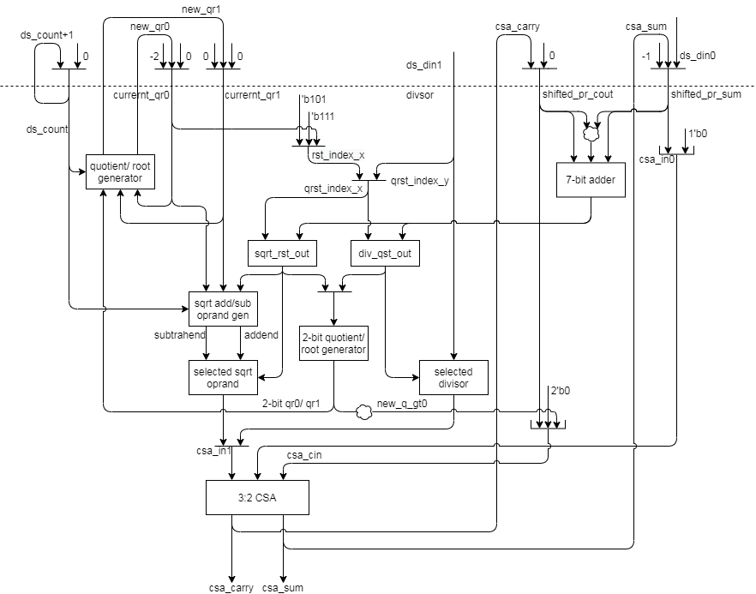
FDIV uArch (5/)
DSU Datapath
For 2’sc

Slide 16
FP Div/SQRT Instructions

Slide 17
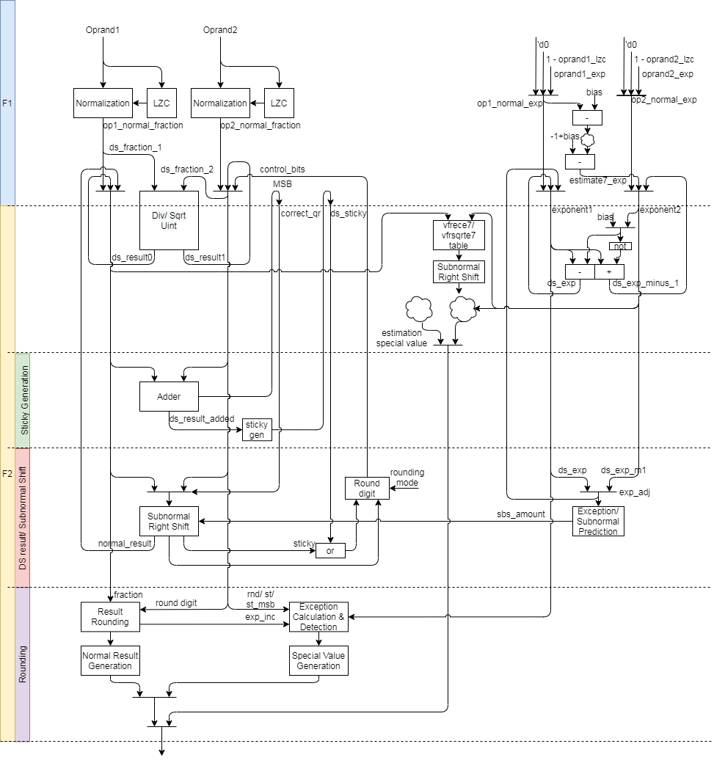
FP Div/SQRT Instructions datapath
Div instruction datapath
Step 1: Normalize source value
Step 2: Compute result by DSU
Step 3: Calculate sticky
Step 4: Shift right for subnormal
Step 5: Do rounding
Sqrt instruction datapath
Step 1: normalize source value
Step 2: Compute result by DSU
Step 3: Calculate sticky
Step 4: Shift right for subnormal
Step 5: Do rounding

Slide 18
FP Div/SQRT Instructions (1/)
DSU dataflow
Unpack source data
Normalize significand and increase exponent
Use DSU to compute result of div/sqrt
Generate partial sticky
Shift right significand and generate partial sticky if exponent value is subnormal
Generate round digit
Do rounding
Enhancements
Reducing look-up table
Reduce instruction latency (1 cycle)
Reduce sticky generation times
Modified rounding method
Reduce 2 level adder to 1 level
Notes:
Bit width is (1+FLEN_MAX) - (1+FLEN_MIN) + XLEN

Slide 19
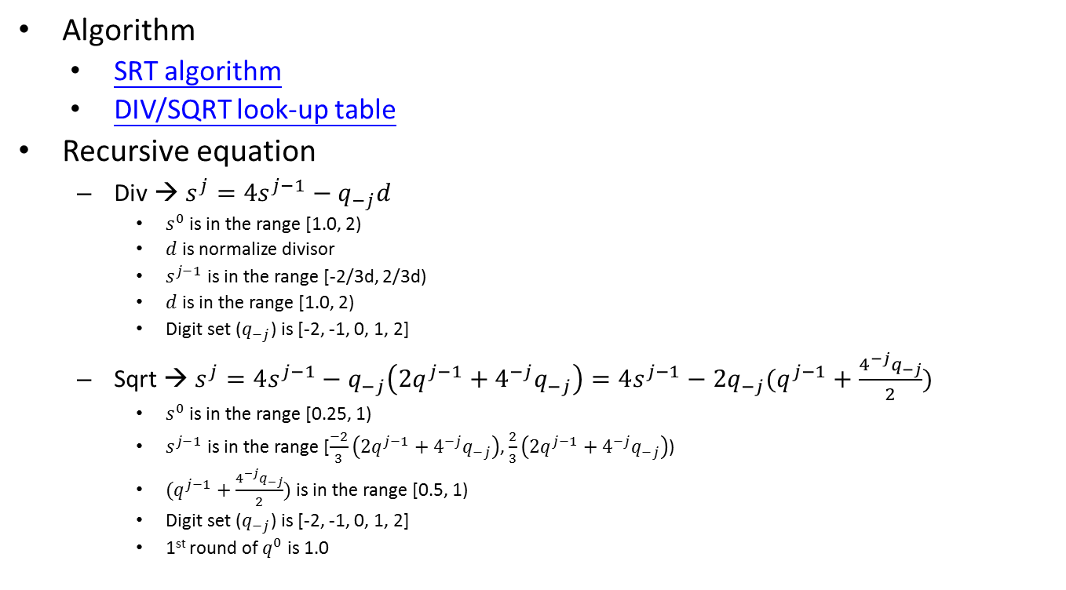
FP Div/SQRT Instructions (2/)
Algorithm
SRT algorithm
DIV/SQRT look-up table
Recursive equation
Div → $s^{j}=4s^{j−1}−q_{−j}d$
$s^{0}$ is in the range [1.0, 2)
$d$ is normalize divisor
$s^{j−1}$ is in the range [-2/3d, 2/3d)
$d$ is in the range [1.0, 2)
Digit set ($q_{−j}$) is [-2, -1, 0, 1, 2]
Sqrt → $s^{j}=4s^{j−1}−q_{−j}\left(2q^{j−1}+4^{−j}q_{−j}\right)=4s^{j−1}−2q_{−j}(q^{j−1}+\frac{4^{−j}q_{−j}}{2})$
$s^{0}$ is in the range [0.25, 1)
$s^{j−1}$ is in the range [$\frac{−2}{3}\left(2q^{j−1}+4^{−j}q_{−j}\right)$, $\frac{2}{3}\left(2q^{j−1}+4^{−j}q_{−j}\right)$)
$(q^{j−1}+\frac{4^{−j}q_{−j}}{2})$ is in the range [0.5, 1)
Digit set ($q_{−j}$) is [-2, -1, 0, 1, 2]
1st round of $q^{0}$ is 1.0
Notes:
Bit width is (1+FLEN_MAX) - (1+FLEN_MIN) + XLEN

Slide 20
FP Estimation Instructions

Slide 21
FP Estimation Instructions (1/)
Instruction dataflow
Unpack input data
Normalize data, compute exponent and detect special value in parallel
Look-up vfrece7/vfesqrte7 table and do exception detection
Calculate result exponent
Shift right significand value if exponent is subnormal
Produce special value according to the corresponding exception if detected
F1 stage works
Normalize data
Compute exponent
Detect special value
F2 stage works
Look-up vfrece7/vfesqrte7 table
Do exception detection
Shift right significand value if exponent is subnormal
Produce special value according to the corresponding exception if detected
Notes:
Bit width is (1+FLEN_MAX) - (1+FLEN_MIN) + XLEN

Slide 22
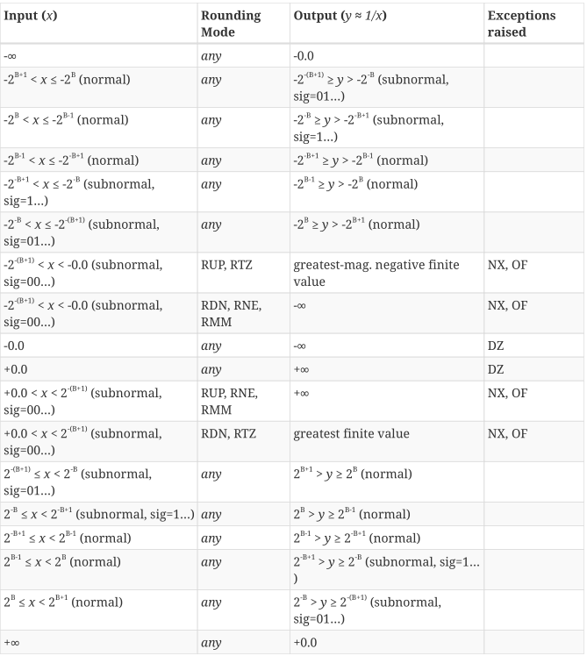
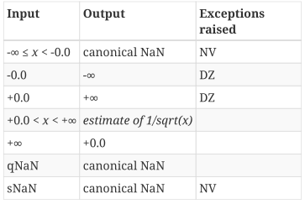
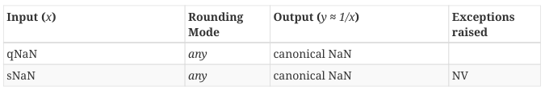
FP Estimation Instructions (2/)
vfrece7.v
Produce special value, exception flag according to the corresponding table in vector-spec
vfrsqrte7.v
Notes:
Bit width is (1+FLEN_MAX) - (1+FLEN_MIN) + XLEN

Slide 23
Round digit generation & Twice Rounding Detection

Slide 24
Round digit generation (1/)
Generate rounding increment according to rounding modes
Rounding modes
RNE (Round to Nearest, ties to Even)
RTZ (Round Towards Zero)
RDN (Round DowN)
RUP (Round UP)
RMM (Round to nearest, ties to Max Magnitude)
ROD (Round towards ODd)
Rounding increment according to different rounding mode
Sign | L | R | S |  | RNE | RTZ | RDN | RUP | RMM | ROD
0 | 0 | 0 | 0 |  | +0 | +0 | +0 | +0 | +0 | +1
0 | 0 | 0 | 1 |  | +0 | +0 | +0 | +1 | +0 | +1
0 | 0 | 1 | 0 |  | +0 | +0 | +0 | +1 | +1 | +1
0 | 0 | 1 | 1 |  | +1 | +0 | +0 | +1 | +1 | +1
0 | 1 | 0 | 0 |  | +0 | +0 | +0 | +0 | +0 | +0
0 | 1 | 0 | 1 |  | +0 | +0 | +0 | +1 | +0 | +0
0 | 1 | 1 | 0 |  | +1 | +0 | +0 | +1 | +1 | +0
0 | 1 | 1 | 1 |  | +1 | +0 | +0 | +1 | +1 | +0
1 | 0 | 0 | 0 |  | +0 | +0 | +0 | +0 | +0 | +1
1 | 0 | 0 | 1 |  | +0 | +0 | +1 | +0 | +0 | +1
1 | 0 | 1 | 0 |  | +0 | +0 | +1 | +0 | +1 | +1
1 | 0 | 1 | 1 |  | +1 | +0 | +1 | +0 | +1 | +1
1 | 1 | 0 | 0 |  | +0 | +0 | +0 | +0 | +0 | +0
1 | 1 | 0 | 1 |  | +0 | +0 | +1 | +0 | +0 | +0
1 | 1 | 1 | 0 |  | +1 | +0 | +1 | +0 | +1 | +0
1 | 1 | 1 | 1 |  | +1 | +0 | +1 | +0 | +1 | +0

Slide 25
Round digit generation (2/)
1. Do rounding only
A + increment (1 bit) (A has not round bit)
Abbreviation
L is LSB/ R is round bit / S is sticky bit / Tie is (R & ~S)
Rounding mode | Rounding inc
RNE (Round to Nearest, ties to Even) | 1. R then clear sum LSB if tie/ 2. R & (L | S)
RTZ (Round Towards Zero) | 0
RDN (Round DowN) | ~sign & (R | S)
RUP (Round UP) | sign & (R | S)
RMM (Round to nearest, ties to Max Magnitude) | R
ROD (Round towards ODd) | 1. Set LSB 2. ~L

Slide 26
Underflow Flag Detection

Slide 27
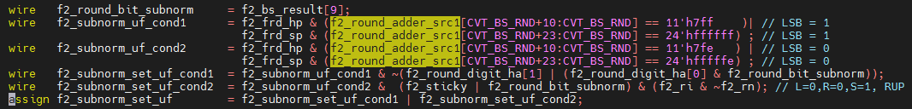
Underflow Flag Detection (1/)
Do the rounding for subnormal value and the significand is packed to subnormal format then round up to normal value
Subnormal value → Round to normal value because of packing to subnormal format
The design just do rounding once and detect this case like as Fig.
Example
SP(0x387FE000, exponent = -15, sig = 1.11111111110000000000000) → HP, RM is RUP
The result will be subnormal HP, so the function do round first and then bound to subnormal format.
Subnormal value 0.1111111111100xxx
Let subnormal value as normal format then do rounding
0.1111111111_100 → 1.1111111111_000
Bound to subnormal format 0.1111111111_1 → raise underflow flag
Bounded subnormal result should be round up to 1.0000000000_0

Slide 28
Underflow Flag Detection (2/)
In this condition f2_round_adder_src1 is subnormal format because of exponent
Detect bit pattern like as
HP → 0.1111111111
SP → 0.11111111111111111111111
DP → 0.111111111111111111111111111111111111111111111111111
To find the all one bit pattern (fraction and round bit) and other condition according to rounding mode. The following slide will describe it.

Slide 29
Underflow Flag Detection (3/)
Format
The table show all cases of asserting underflow under twice rounding case.
Left V → subnormal to normal
Right V → Assert underflow flag
Assert special underflow flag if the condition have 2V.
R: round bit
Sm: MSB of sticky field
St: other sticky field
S = (Sm | St)
Sign | R | Sm | St |  | RNE |  | RTZ |  | RDN |  | RUP |  | RMM |  | ROD
0 | 0 | 0 | 0
0 | 0 | 0 | 1 |  |  | V |  | V |  | V | V | V |  | V |  | V
0 | 0 | 1 | 0 |  |  | V |  | V |  | V | V | V |  | V |  | V
0 | 0 | 1 | 1 |  |  | V |  | V |  | V | V | V |  | V |  | V
0 | 1 | 0 | 0 |  | V | V |  | V |  | V | V | V | V | V |  | V
0 | 1 | 0 | 1 |  | V | V |  | V |  | V | V |  | V | V |  | V
0 | 1 | 1 | 0 |  | V |  |  | V |  | V | V |  | V |  |  | V
0 | 1 | 1 | 1 |  | V |  |  | V |  | V | V |  | V |  |  | V
1 | 0 | 0 | 0 |  |  |  |  |  |  |  |  |  |  |  |  | V
1 | 0 | 0 | 1 |  |  | V |  | V | V | V |  | V |  | V |  | V
1 | 0 | 1 | 0 |  |  | V |  | V | V | V |  | V |  | V |  | V
1 | 0 | 1 | 1 |  |  | V |  | V | V | V |  | V |  | V |  | V
1 | 1 | 0 | 0 |  | V | V |  | V | V | V |  | V | V | V |  | V
1 | 1 | 0 | 1 |  | V | V |  | V | V |  |  | V | V | V |  | V
1 | 1 | 1 | 0 |  | V |  |  | V | V |  |  | V | V |  |  | V
1 | 1 | 1 | 1 |  | V |  |  | V | V |  |  | V | V |  |  | V

Slide 30
Underflow Flag Detection (4/)
A : Assert underflow flag.
The condition should qualify bit pattern and the following condition under different rounding mode
RNE → R&~Sm
RTZ → 0
RDN →sign&(R^(Sm|St)) → sign&(R^S)
RUP → ~sign&(R^(Sm|St)) → ~sign&(R^S)
RMM → R&~Sm
ROD →0
Sign | L R | R Sm | S St |  | RNE | RTZ | RDN | RUP | RMM | ROD
0 | 0 | 0 | 0
0 | 0 | 0 | 1 |  |  |  |  | A
0 | 0 | 1 | 0 |  |  |  |  | A
0 | 0 | 1 | 1 |  |  |  |  | A
0 | 1 | 0 | 0 |  | A |  |  | A | A
0 | 1 | 0 | 1 |  | A |  |  |  | A
0 | 1 | 1 | 0
0 | 1 | 1 | 1
1 | 0 | 0 | 0
1 | 0 | 0 | 1 |  |  |  | A
1 | 0 | 1 | 0 |  |  |  | A
1 | 0 | 1 | 1 |  |  |  | A
1 | 1 | 0 | 0 |  | A |  | A |  | A
1 | 1 | 0 | 1 |  | A |  |  |  | A
1 | 1 | 1 | 0
1 | 1 | 1 | 1

Slide 31
Enhancements

Slide 32
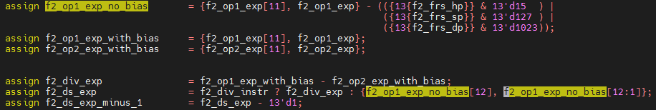
Enhancements (1/)
Reduce gate delay
1-A → 1 + (~A+1) → 2+~A
Reduce 2-level adder
Produce Exp and Exp – 1 (without bias)
ExpA and ExpB have bias
DIV
Exp = ExpA – ExpB
Exp – 1 = ExpA – ExpB – 1 = ExpA + (~ExpB + 1) – 1 = ExpA + ~ExpB
SQRT
Exp = (ExpA – Bias) >> 1
Exp – 1 = (ExpA – Bias) >> 1 – 1 = (ExpA – Bias - 2) >> 1 = (ExpA + (~Bias – 1)) >> 1
 | HP | SP | DP
Bias | b0_0000_0000_1111 | b0_0000_0111_1111 | b0_0011_1111_1111
~Bias - 1 | b1_1111_1110_1111 | b1_1111_0111_1111 | b1_1011_1111_1111
Notes:
Bias = 15
15 => b0_0000_0000_1111
~15 => b1_1111_1111_0000
~15-1 => b1_1111_1110_1111
Bias = 127
127 => b0_0000_0111_1111
~127 => b1_1111_1000_0000
~127-1 => b1_1111_0111_1111
Bias = 1023
1023 => b0_0011_1111_1111
~1023 => b1_1100_0000_0000
~1023-1 => b1_1011_1111_1111

Slide 33
Enhancements (2/)
Reduce staging FFs
Keep divisor RF(vc_vfp_dsu) value at ds_fraction_2 RF(vc_vfp_fdiv)
Reduce 100-bit FFs per lane (2*(54(pipe0) +11(pipe1)+24(pipe2)+11(pipe3)))
Reduce 1 latency for div and sqrt
Dispatch div/sqrt instruction 1 cycle early

Slide 34
Merge IDIV and FDIV methods

Slide 35
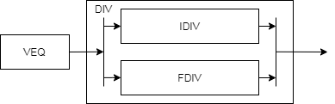
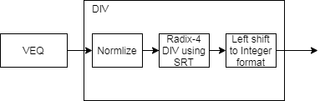
Merge IDIV and FDIV methods (1/)
Two methods to merge/fuse IDIV and FDIV function units.
Merge two function units
Reuse staging FFs and return result according to instruction type
Fuse two function units
Support 64-bit data in and widen related logics
Do 2’sc for input and output if negative
Reuse radix-4 SRT look-up table
Extend quotient handling logics
Add Left shifting logic to handle integer result
Hard to implement remainder instruction using SRT
Merge 2 function units
Fuse 2 function unit

Slide 36
Merge IDIV and FDIV methods (2/)
Why hard to implement remainder instruction
Apply radix-4 algorithm so 2-bit partial quotient is generated in each iteration
The extra fraction bit should recover to partial remainder
Remainder (Integer) = Remainder (fraction) x divisor
Method 1: 10/3 = 3.333… → 3 * 0.333… = 1
Method 2: 10/3 = 3.333… → 10 - 3 * 3 = 1
Integer | iteration | Extra fraction bit
INT8 | 1+4 | 1 bits
INT16 | 1+8 | 1 bits
INT32 | 1+16 | 1 bits
INT64 | 1+32 | 1 bits
1 is for hidden one

Slide 37
Instruction list

Slide 38
Instruction list
The fdiv function unit encoding

Slide 39
Backup

Slide 40
Radix-2 Algorithm (1/)
Radix-2 have
Restoring algorithm
Non-restoring algorithm
SRT algorithm (also non-restoring algorithm)

Slide 41
Radix-2 Algorithm (2/)
Restoring algorithm
Quotient digit set is {0, 1}

Slide 42
Radix-2 Algorithm (3/)
Non-restoring algorithm
Quotient digit set is {-1, 0, 1}

Slide 43
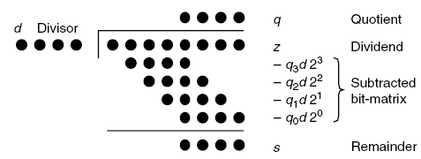


Radix-2 divider using SRT (1/)
SRT named for its creators (Sweeney, Robertson, and Tocher) and it is non-restoring algorithm
Generate 1-bit partial remainder in 1 iteration
Quotient $q_{−1}q_{−2}…$
$$s^{0}$$

Slide 44
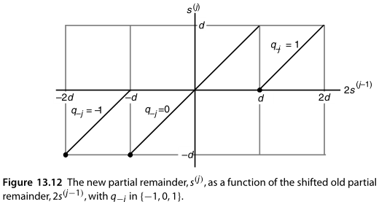

Radix-2 divider using SRT (2/)
$s^{j}=2s^{j−1}−q_{−j}d with s^{0}=z$
Shifted partial remainder $s^{j−1}$ is in the range [-d, d)
Digit set $q_{j}∈\{−1, 0, 1\}$
-1 → subtract -d
0 → subtract 0
1 → subtract d

Slide 45
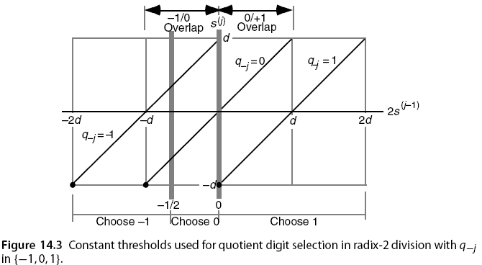
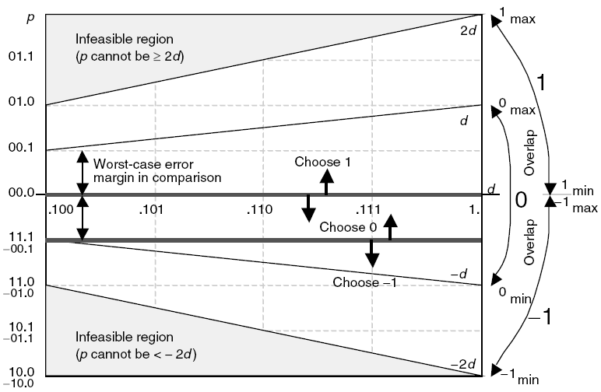

Radix-2 divider using SRT & CSA(1/)
$s^{j}=2s^{j−1}−q_{−j}d with s^{0}=z and s^{k}=2^{k}s$
Shifted partial remainder (${2s}^{j−1}$) is in the range [-2d, 2d)
Digit set $q_{j}∈\{−1, 0, 1\}$
-1 → [-2d, -1/2)
0 → [-1/2, 0)
1 → [0, 2d)

Slide 46
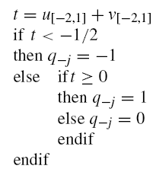

Radix-2 divider using SRT & CSA(2/)
Let $u=(u_{1}u_{0}.u_{−1}u_{−2}…)$ and $u=(v_{1}v_{0}.v_{−1}v_{−2}…)$
Add the most significant 4 bits of u and v, t result may have 1 bit error (’b0.01 = 0.25) because of carry from low part. The threshold gap is greater than 0.25.
XXXX XXXX
XXXX XXXX
X
carry

Slide 47
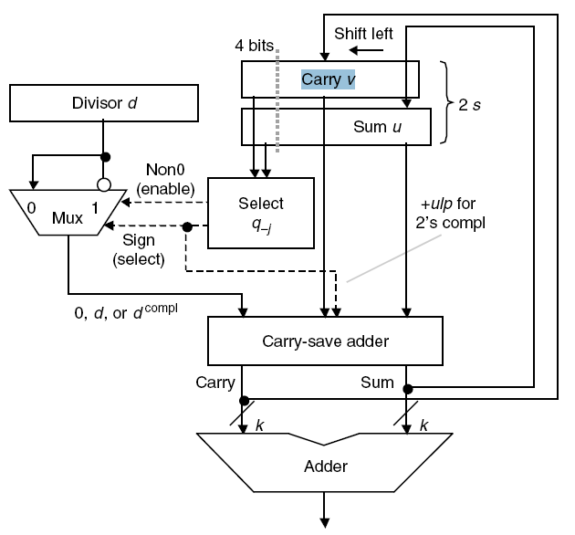

Radix-2 divider using SRT & CSA(3/)
The following Fig. is radix-2 divider datapath
Use sum of partial carry and sum string to select $q_{−j}$
BACK

Slide 48
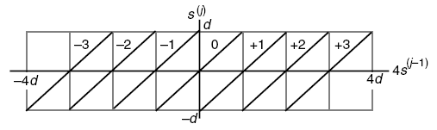
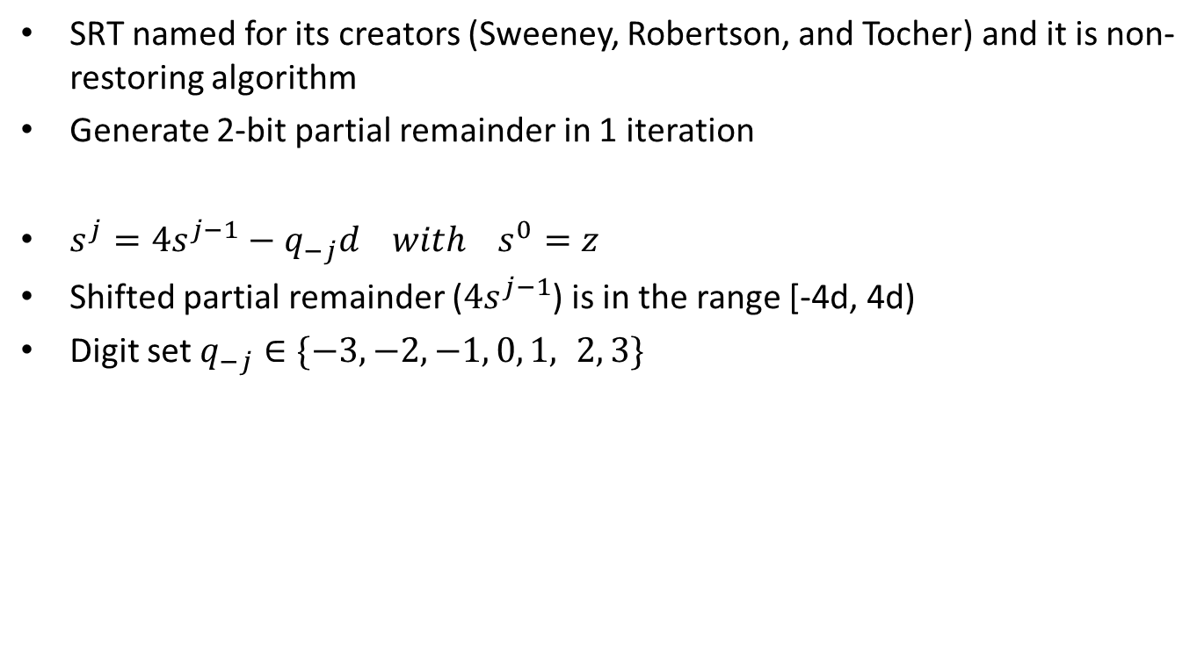
Radix-4 divider using SRT (1/)
SRT named for its creators (Sweeney, Robertson, and Tocher) and it is non-restoring algorithm
Generate 2-bit partial remainder in 1 iteration
$s^{j}=4s^{j−1}−q_{−j}d with s^{0}=z$
Shifted partial remainder ($4s^{j−1}$) is in the range [-4d, 4d)
Digit set $q_{−j}∈\{−3,−2,−1, 0, 1, 2, 3\}$

Slide 49
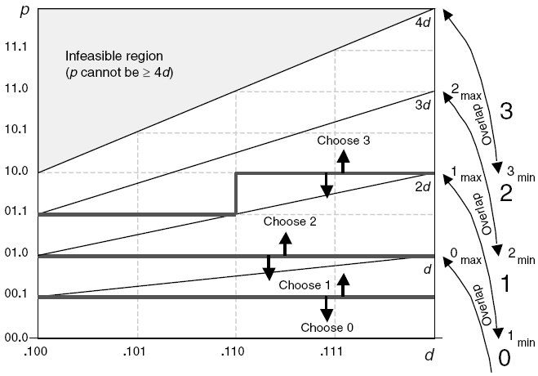
Radix-4 divider using SRT (2/)
p is shifted partial remainder and d is divisor
(3 * divisor) is complex so we want to restrict the quotient digits to [−2, 2] from [-3, 3].

Slide 50
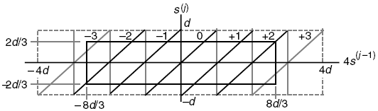

Radix-4 divider using SRT (3/)
Restrict the quotient digits to [−2, 2] from [-3, 3]
$s^{j−1}$ is in the range [-hd, hd)
$4s^{j−1}$ is in the range [-4hd, 4hd)
We should be able to bring the worst-case values to within [-hd, hd) by adding ±2d to it
$4hd−2d≤hd$ → $3hd≤2d$ → $h≤\frac{2}{3}$

Slide 51
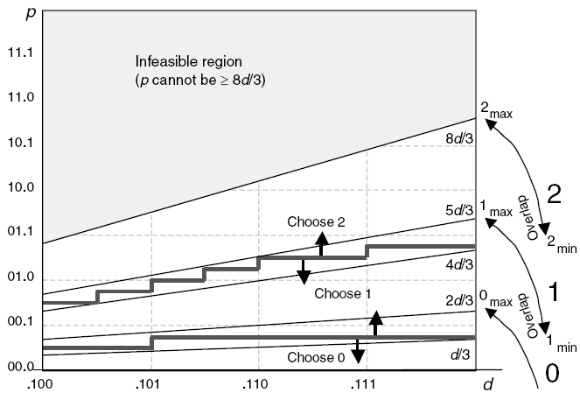


Radix-4 divider using SRT (4/)
quotient digits to [−2, -1, 0, 1, 2] from [-3, -2, -1, 0, 1, 2, 3]
$s^{j−1}$ is in the range [-d, d)
quotient digits is [−2, -1, 0, 1, 2]
$s^{j−1}$ is in the range [-2/3d, 2/3d)

Slide 52
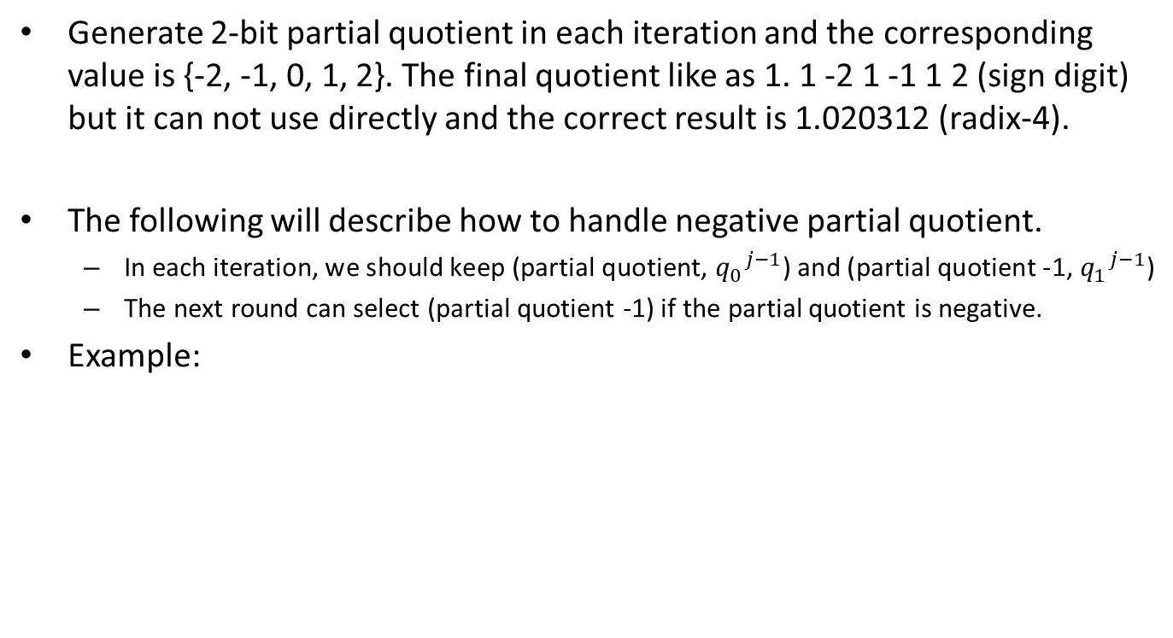
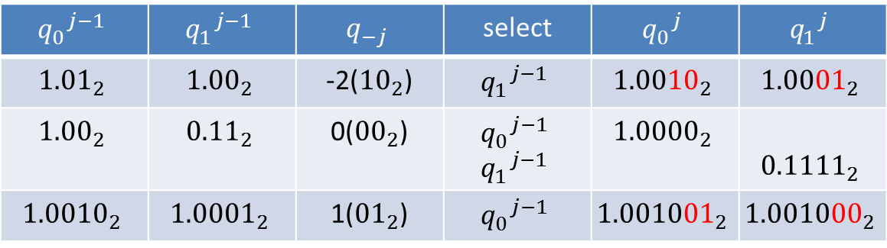
Radix-4 SRT - Quotient Handling (1/)
Generate 2-bit partial quotient in each iteration and the corresponding value is {-2, -1, 0, 1, 2}. The final quotient like as 1. 1 -2 1 -1 1 2 (sign digit) but it can not use directly and the correct result is 1.020312 (radix-4).
The following will describe how to handle negative partial quotient.
In each iteration, we should keep (partial quotient, ${q_{0}}^{j−1}$) and (partial quotient -1, ${q_{1}}^{j−1}$)
The next round can select (partial quotient -1) if the partial quotient is negative.
Example:
$${q_{0}}^{j−1}$$ | $${q_{1}}^{j−1}$$ | $$q_{−j}$$ | select | $${q_{0}}^{j}$$ | $${q_{1}}^{j}$$
$${\text{1.01}}_{2}$$ | $${\text{1.00}}_{2}$$ | -2(${\text{10}}_{2}$) | $${q_{1}}^{j−1}$$ | $${1.0010}_{2}$$ | $${1.0001}_{2}$$
$${\text{1.00}}_{2}$$ | $${\text{0.11}}_{2}$$ | 0(${\text{00}}_{2}$) | $${q_{0}}^{j−1}$$ $${q_{1}}^{j−1}$$ | $${1.0000}_{2}$$ | $${0.1111}_{2}$$
$${\text{1.0}010}_{2}$$ | $${\text{1.0}001}_{2}$$ | 1(${\text{01}}_{2}$) | $${q_{0}}^{j−1}$$ | $${1.001001}_{2}$$ | $${1.001000}_{2}$$
BACK

Slide 53

Radix-2 SQRT - Example
The example is non-restoring algorithm
$s^{j}=4s^{j−1}−q_{−j}(2q^{j−1}+2^{−j}q_{−j})$

Slide 54
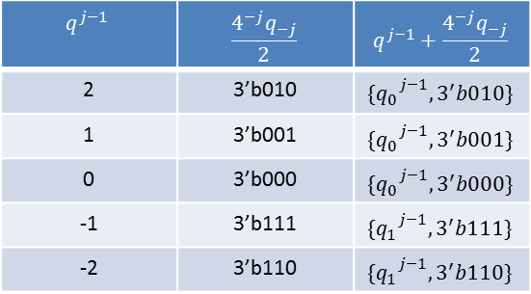
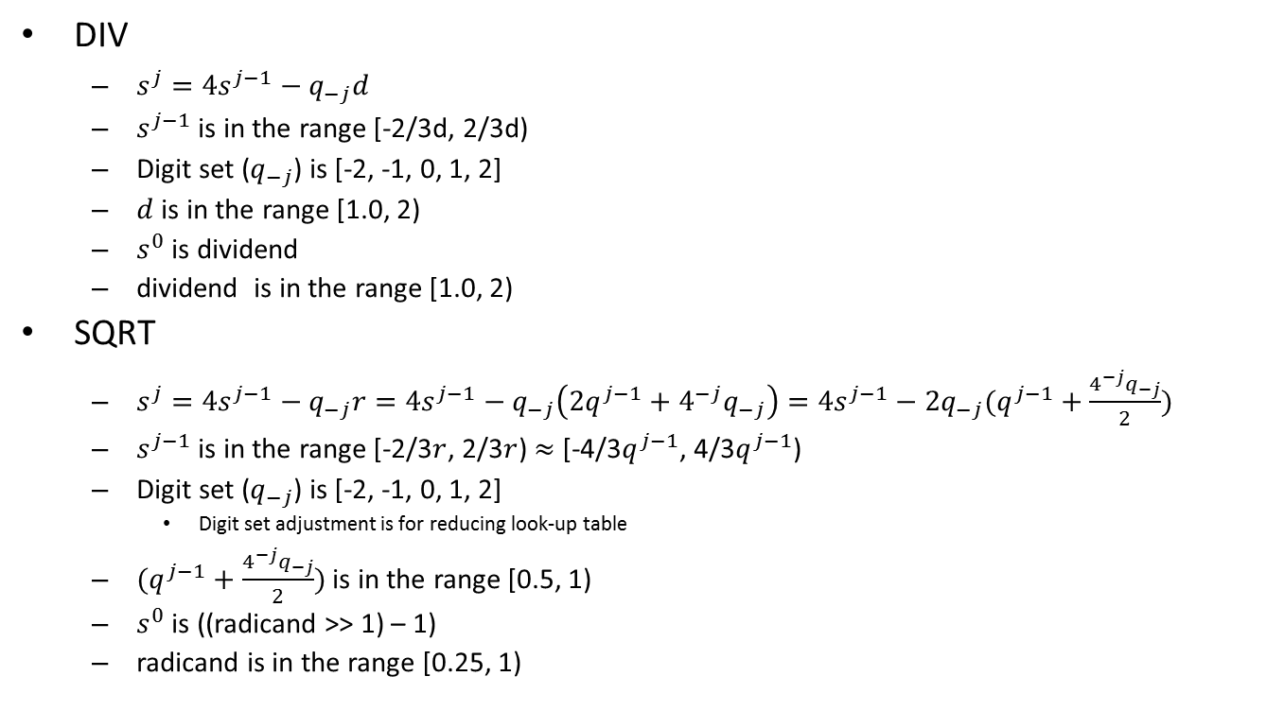
Radix-4 DIV and SQRT
DIV
$s^{j}=4s^{j−1}−q_{−j}d$
$s^{j−1}$ is in the range [-2/3d, 2/3d)
Digit set ($q_{−j}$) is [-2, -1, 0, 1, 2]
$d$ is in the range [1.0, 2)
$s^{0}$ is dividend
dividend is in the range [1.0, 2)
SQRT
$s^{j}=4s^{j−1}−q_{−j}r=4s^{j−1}−q_{−j}\left(2q^{j−1}+4^{−j}q_{−j}\right)=4s^{j−1}−2q_{−j}(q^{j−1}+\frac{4^{−j}q_{−j}}{2})$
$s^{j−1}$ is in the range [-2/3$r$, 2/3$r$) $≈$ [-4/3$q^{j−1}$, 4/3$q^{j−1}$)
Digit set ($q_{−j}$) is [-2, -1, 0, 1, 2]
Digit set adjustment is for reducing look-up table
$(q^{j−1}+\frac{4^{−j}q_{−j}}{2})$ is in the range [0.5, 1)
$s^{0}$ is ((radicand >> 1) – 1)
radicand is in the range [0.25, 1)
$$q^{j−1}$$ | $$\frac{4^{−j}q_{−j}}{2}$$ | $$q^{j−1}+\frac{4^{−j}q_{−j}}{2}$$
2 | 3’b010 | $${\{q_{0}}^{j−1}, 3^{′}b010\}$$
1 | 3’b001 | $${\{q_{0}}^{j−1}, 3^{′}b001\}$$
0 | 3’b000 | $${\{q_{0}}^{j−1}, 3^{′}b000\}$$
-1 | 3’b111 | $${\{q_{1}}^{j−1}, 3^{′}b111\}$$
-2 | 3’b110 | $${\{q_{1}}^{j−1}, 3^{′}b110\}$$

Slide 55
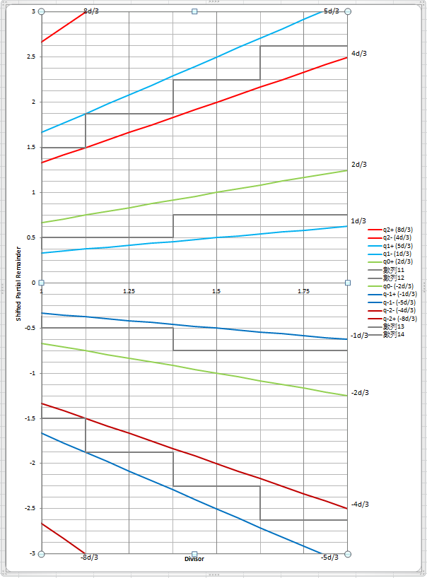
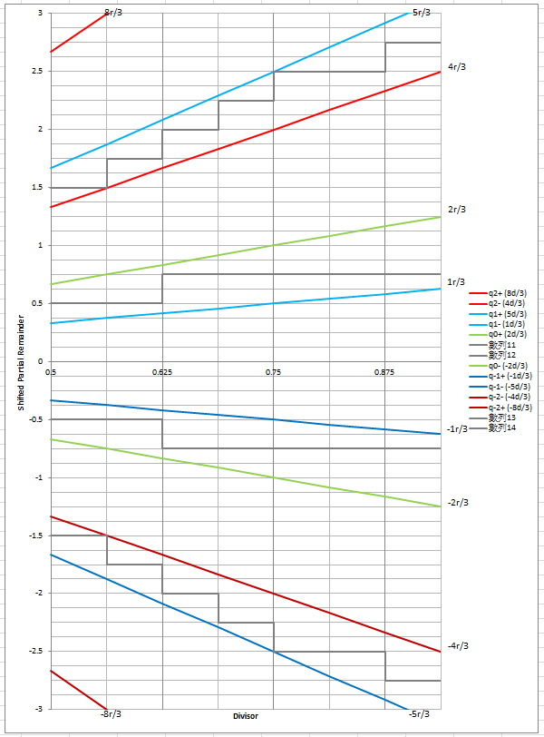
Radix-4 SRT Look-up Table (1/)
The Fig is DIV SRT look-up table.
Quotient of DIV is in [1, 2)
The Fig is SQRT SRT look-up table.
Quotient of SQRT is in [0.5, 1)
BACK

Slide 56
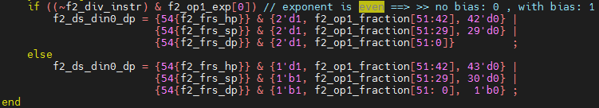
How to subtract 1/adjust data for SQRT (1/)
The significand do *2 if exponent is odd and the radicand is in the range [0.25, 1)
The following value is in the range [0.5, 2) and the value(din0) is 2x radicand
Notes:
The sqrt result of each values
0.9375 => 0.9682458365518542212948163499456 0.1111
0.875 => 0.93541434669348534639593718307914 0.1110
0.8125 => 0.90138781886599732327980531686762 0.1110
0.75 => 0.86602540378443864676372317075294 0.1101
0.6875 => 0.82915619758884996227873318416767 0.1101
0.625 => 0.79056941504209483299972338610818 0.1100
0.5625 => 0.75 0.1100
0.5 => 0.70710678118654752440084436210485 0.1011

Slide 57
How to subtract 1/adjust data for SQRT (2/)
For SQRT initialization, (Z-1)
Shift left and 1 extension for SQRT instruction
4((radicand >> 1) – 1) → 2radicand - 4
DS_DIN | Shift left 1 bit | 1 extension
0001.1111 | 0011.111 (3.875) | 1111.111 (-0.125)
0001.1110 | 0011.110 (3.75) | 1111.110 (-0.25)
0001.1101 | 0011.101 (3.625) | 1111.101 (-0.375)
0001.1100 | 0011.100 (3.5) | 1111.100 (-0.5)
0001.1011 | 0011.011 (3.375) | 1111.011 (-0.625)
0001.1010 | 0011.010 (3.25) | 1111.010 (-0.75)
0001.1001 | 0011.001 (3.125) | 1111.001 (-0.875)
0001.1000 | 0011.000 (3) | 1111.000 (-1)
DS_DIN | Shift left 1 bit | 1 extension
0000.1111 | 0001.111 (1.875) | 1101.111 (-2.125)
0000.1110 | 0001.110 (1.75) | 1101.110 (-2.25)
0000.1101 | 0001.101 (1.625) | 1101.101 (-2.375)
0000.1100 | 0001.100 (1.5) | 1101.100 (-2.5)
0000.1011 | 0001.011 (1.375) | 1101.011 (-2.625)
0000.1010 | 0001.010 (1.25) | 1101.010 (-2.75)
0000.1001 | 0001.001 (1.125) | 1101.001 (-2.875)
0000.1000 | 0001.000 (1) | 1101.000 (-3)
Notes:
The sqrt result of each values
0.9375 => 0.9682458365518542212948163499456 0.1111
0.875 => 0.93541434669348534639593718307914 0.1110
0.8125 => 0.90138781886599732327980531686762 0.1110
0.75 => 0.86602540378443864676372317075294 0.1101
0.6875 => 0.82915619758884996227873318416767 0.1101
0.625 => 0.79056941504209483299972338610818 0.1100
0.5625 => 0.75 0.1100
0.5 => 0.70710678118654752440084436210485 0.1011

Slide 58
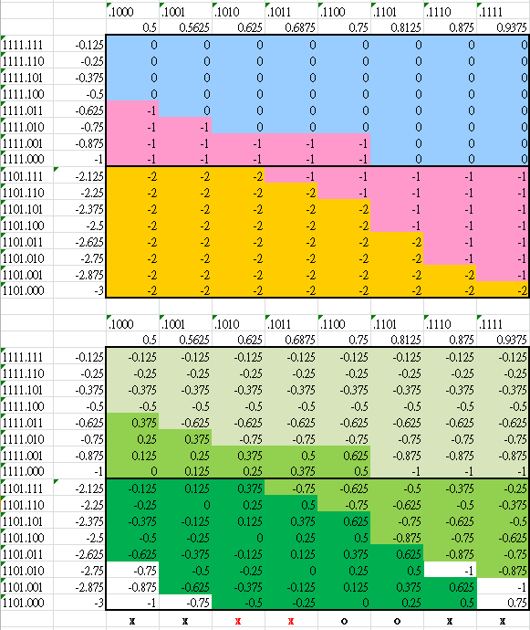
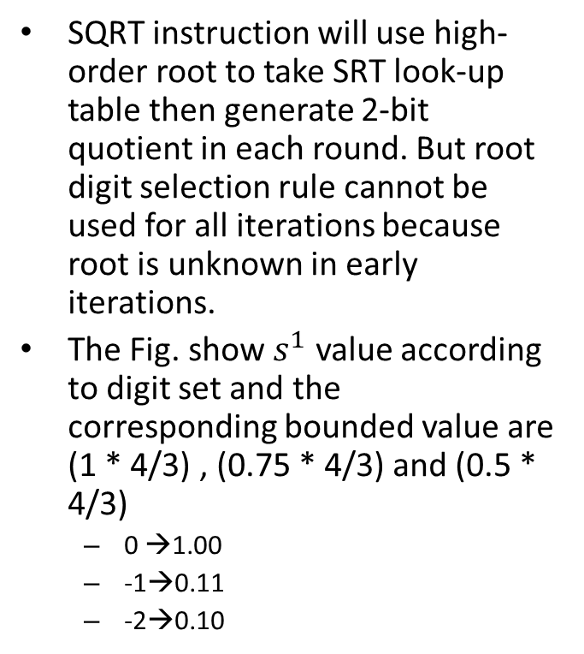
1st Round Root selection for SQRT (1/)
SQRT instruction will use high-order root to take SRT look-up table then generate 2-bit quotient in each round. But root digit selection rule cannot be used for all iterations because root is unknown in early iterations.
The Fig. show $s^{1}$ value according to digit set and the corresponding bounded value are (1 * 4/3) , (0.75 * 4/3) and (0.5 * 4/3)
0 →1.00
-1→0.11
-2→0.10
Notes:
The sqrt result of each values
0.9375 => 0.9682458365518542212948163499456 0.1111
0.875 => 0.93541434669348534639593718307914 0.1110
0.8125 => 0.90138781886599732327980531686762 0.1110
0.75 => 0.86602540378443864676372317075294 0.1101
0.6875 => 0.82915619758884996227873318416767 0.1101
0.625 => 0.79056941504209483299972338610818 0.1100
0.5625 => 0.75 0.1100
0.5 => 0.70710678118654752440084436210485 0.1011
0.4375 => 0.66143782776614764762540393840982 0.1010
0.375 => 0.61237243569579452454932101867647 0.1001
0.3125 => 0.55901699437494742410229341718282 0.1000
0.25 => 0.5 0.1000

Slide 59
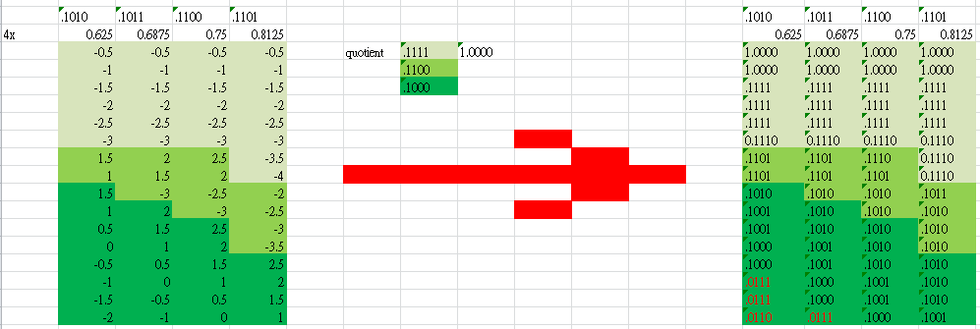

1st Round Root selection for SQRT (1/)
0.1010 and 0.1011 will produce out of range root in the second round and 0.1100 and 0.1101 can produce bounded $s^{j}$. Thus we just can chose one of them.
The first round root is 0.1101 in the current design
Notes:
The sqrt result of each values
0.9375 => 0.9682458365518542212948163499456 0.1111
0.875 => 0.93541434669348534639593718307914 0.1110
0.8125 => 0.90138781886599732327980531686762 0.1110
0.75 => 0.86602540378443864676372317075294 0.1101
0.6875 => 0.82915619758884996227873318416767 0.1101
0.625 => 0.79056941504209483299972338610818 0.1100
0.5625 => 0.75 0.1100
0.5 => 0.70710678118654752440084436210485 0.1011
0.4375 => 0.66143782776614764762540393840982 0.1010
0.375 => 0.61237243569579452454932101867647 0.1001
0.3125 => 0.55901699437494742410229341718282 0.1000
0.25 => 0.5 0.1000

Slide 60
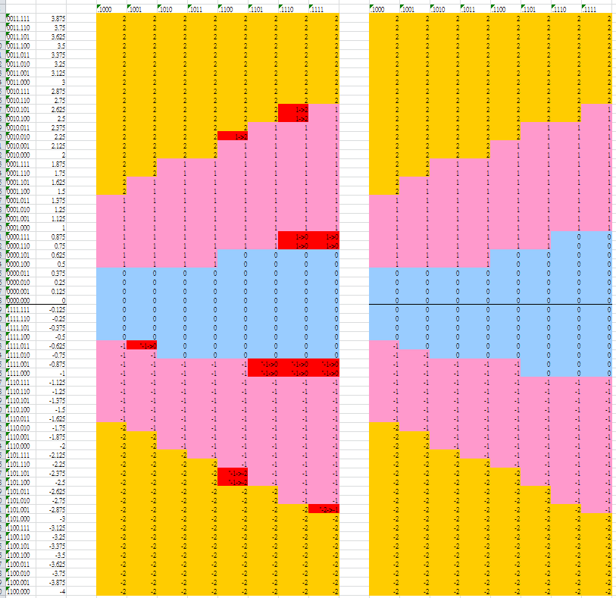
Look-up Table Adjustment
Merge div & sqrt look-up
Merge the look-up tables (use only one table and it is original SQRT look-up table)
VFDIV64
Lib | Feq. | Original | Modified
28HPC+ | 1Ghz | 21.3kgates | 21.2kgates
28HPC+ | 1.25Ghz | 22.7kgates | 22.5kgates

