Slide 1
FP DIV/SQRT uArch
202101
Larry

Slide 2
Agenda
List of abbreviation
Overview
Configuration
uArch Overview
FP DIV/SQRT Instructions
FP Estimation Instructions
Round digit generation
Underflow Flag Detection
Enhancements
Merge IDIV and FDIV methods
Instruction list

Slide 3
List of abbreviation (1/)
Abbreviation | Definition
DSU | Divider and Square Root Unit
LZD | Leading zero detection
LZC | Leading zero count

Slide 4
List of parameter (1/)
Abbreviation | Definition
XLEN | The current width of an x register in bits (32 for RV32 or 64 for RV64)
FLEN | The current width of a f register in bits (32 for SP, 64 for DP)

Slide 5
Overview (1/)
2-stage pipeline
Supported data types
Instruction handling
FP DIV/SQRT instruction using radix-4 SRT algorithm
FP estimation instruction using look-up table
Precision | Width | Sign | Expo | Mant
HP | 16 | 1 | 5 | 10
SP | 32 | 1 | 8 | 23
DP | 64 | 1 | 11 | 52

Slide 6
Overview (2/)
Instruction latency
*DIV/SQRT instruction can not be dispatch to function unit back-to-back and the instructions reduce 1 cycle.
x is not supported
Instruction | Latency
 | Scalar |  | Vector
DIV/SQRT | HP | 13* | HP | 13*
 | SP | 20* | SP | 20*
 | DP | 34* | DP | 34*
VFRECE7 | x | x | 3
VFRSQRTE7 | x | x | 3

Slide 7
Configurability
Feature | Options
XLEN | 64
FLEN* | 16/32/64
VLEN | 512/256/128
SIMD_WIDTH | 512/256/128
ELEN* | 32/64
*If RVV = 0, FLEN can be configured to 32/64
*If RVV = 1, FLEN is equivalent to ELEN

Slide 8
uArch overview

Slide 9
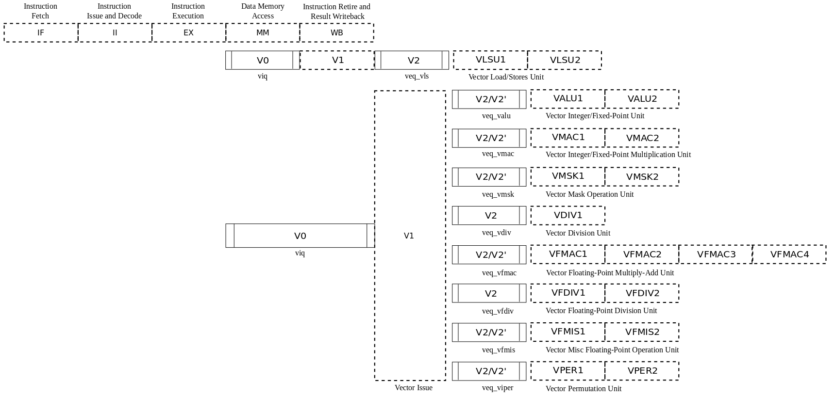
VPU stage
Frontend
Function unit

Slide 10
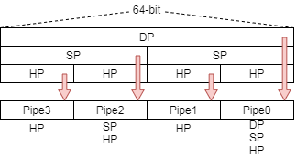
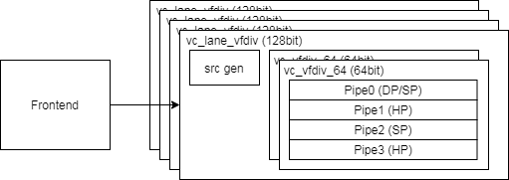
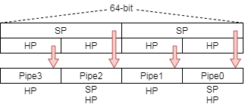
Function Unit Lane Hierarchy
ELEN=64
src_gen is for source data selection
Select data for read port 0/ 1/ 2/ 3 or scalar register
Describe detail according to Chevy’s latest spec or v0/v1 decode table
ELEN=32

Slide 11
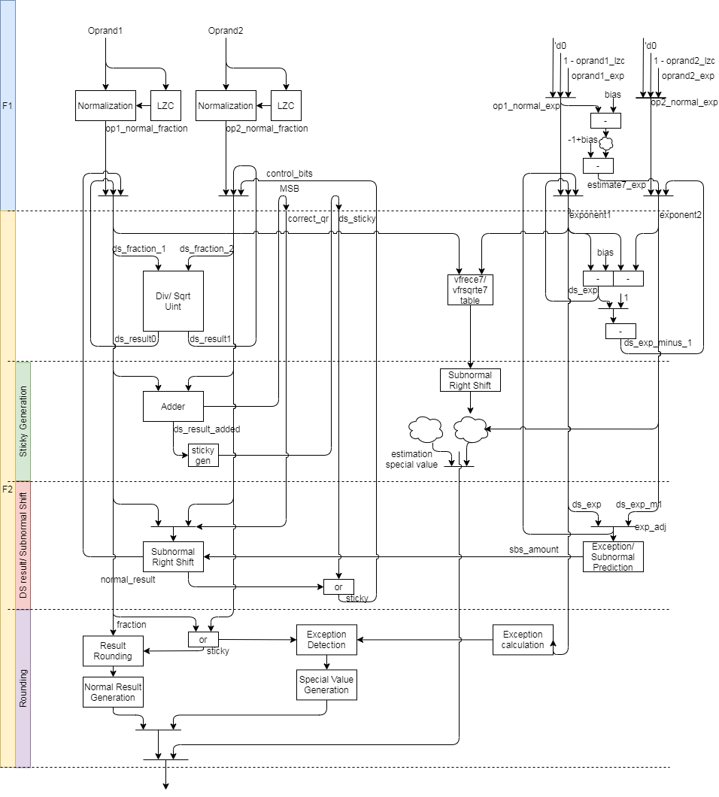
FDIV uArch (1/)
The original datapath
Generate sticky 3 times
Reduce staging FFs
Rounding method
Reduce 2-level adder to 1-level

Slide 12
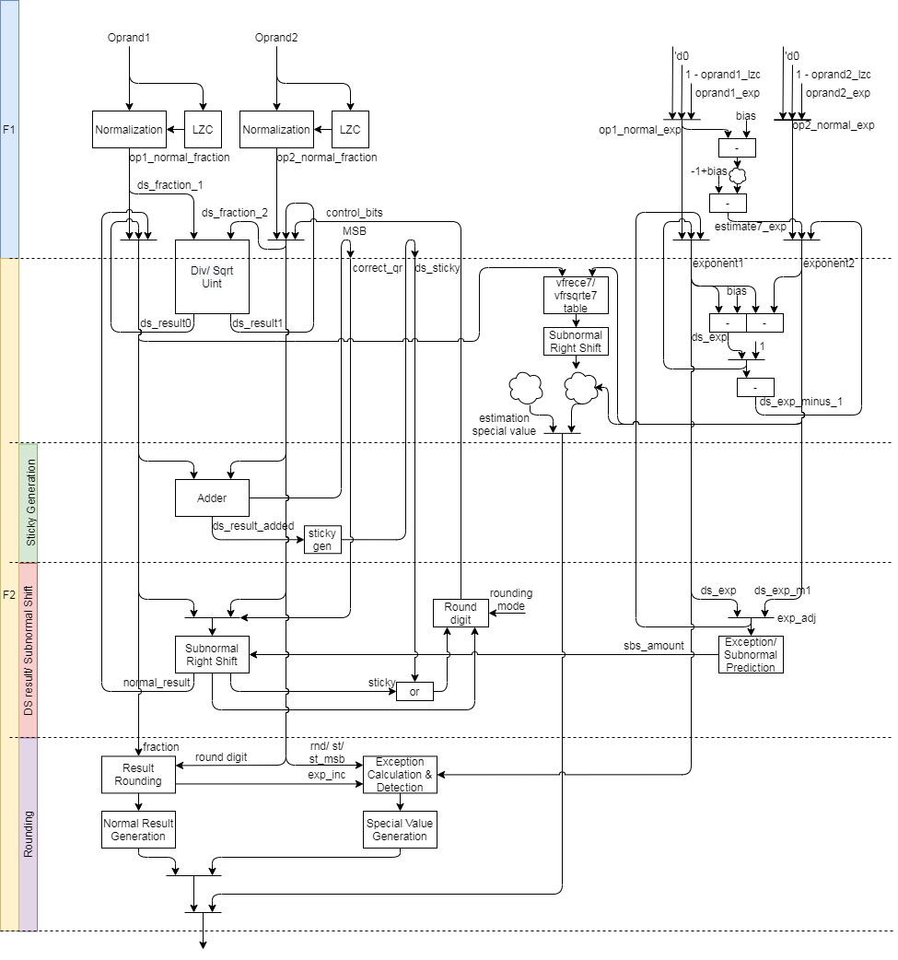
FDIV uArch (2/)
The modified datapath
Generate sticky 3 → 2 times
Rounding method

Slide 13
FDIV uArch (3/)
Div instruction datapath
Step 1: Normalize source value
Step 2: Compute result by DSU
Step 3: Calculate sticky
Step 4: Shift right for subnormal
Step 5: Do rounding
Sqrt instruction datapath
Step 1: normalize source value
Step 2: Compute result by DSU
Step 3: Calculate sticky
Step 4: Shift right for subnormal
Step 5: Do rounding

Slide 14
FDIV uArch (4/)
Vector estimation instruction

Slide 15
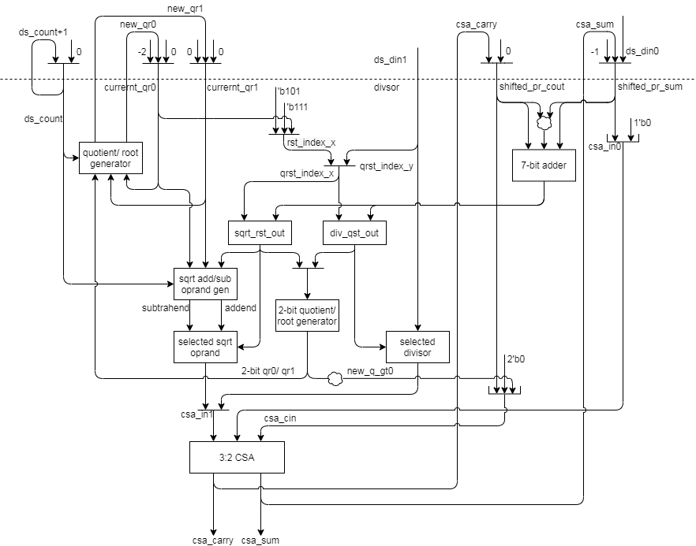
FDIV uArch (5/)
DSU Datapath
For 2’sc

Slide 16
FP Div/SQRT Instructions

Slide 17
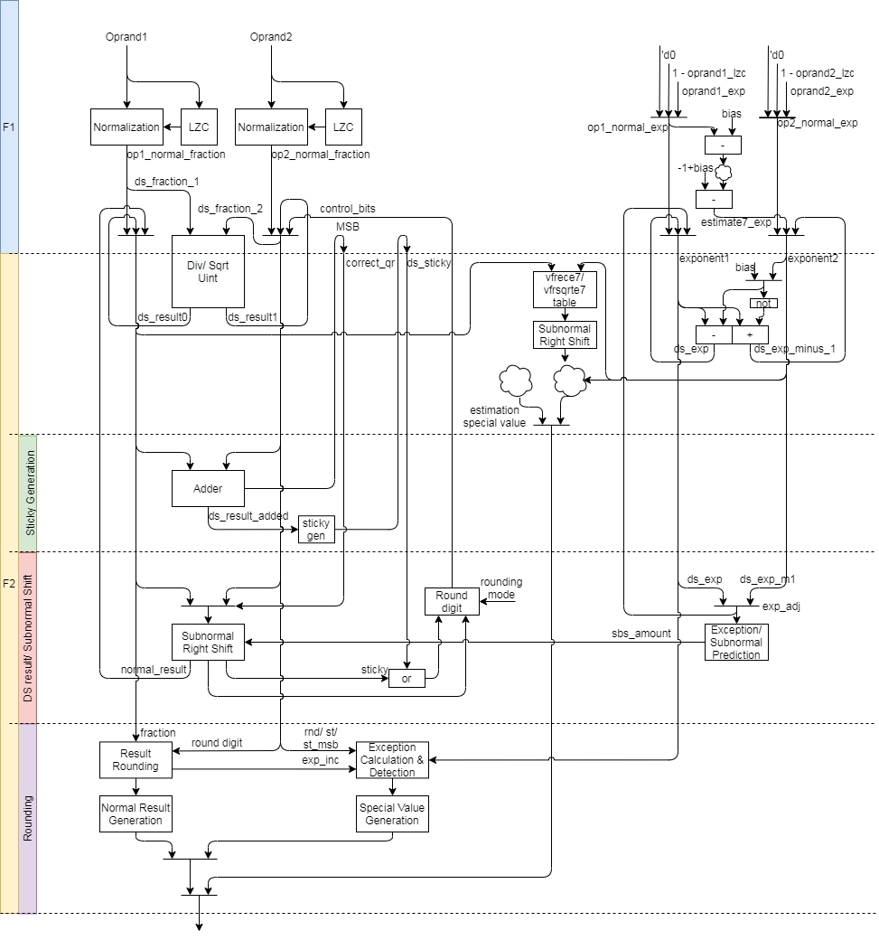
FP Div/SQRT Instructions datapath
Div instruction datapath
Step 1: Normalize source value
Step 2: Compute result by DSU
Step 3: Calculate sticky
Step 4: Shift right for subnormal
Step 5: Do rounding
Sqrt instruction datapath
Step 1: normalize source value
Step 2: Compute result by DSU
Step 3: Calculate sticky
Step 4: Shift right for subnormal
Step 5: Do rounding

Slide 18
FP Div/SQRT Instructions (1/)
DSU dataflow
Unpack source data
Normalize significand and increase exponent
Use DSU to compute result of div/sqrt
Generate partial sticky
Shift right significand and generate partial sticky if exponent value is subnormal
Generate round digit
Do rounding
Enhancements
Reducing look-up table
Reduce instruction latency (1 cycle)
Reduce sticky generation times
Modified rounding method
Reduce 2 level adder to 1 level
Notes:
Bit width is (1+FLEN_MAX) - (1+FLEN_MIN) + XLEN

Slide 19
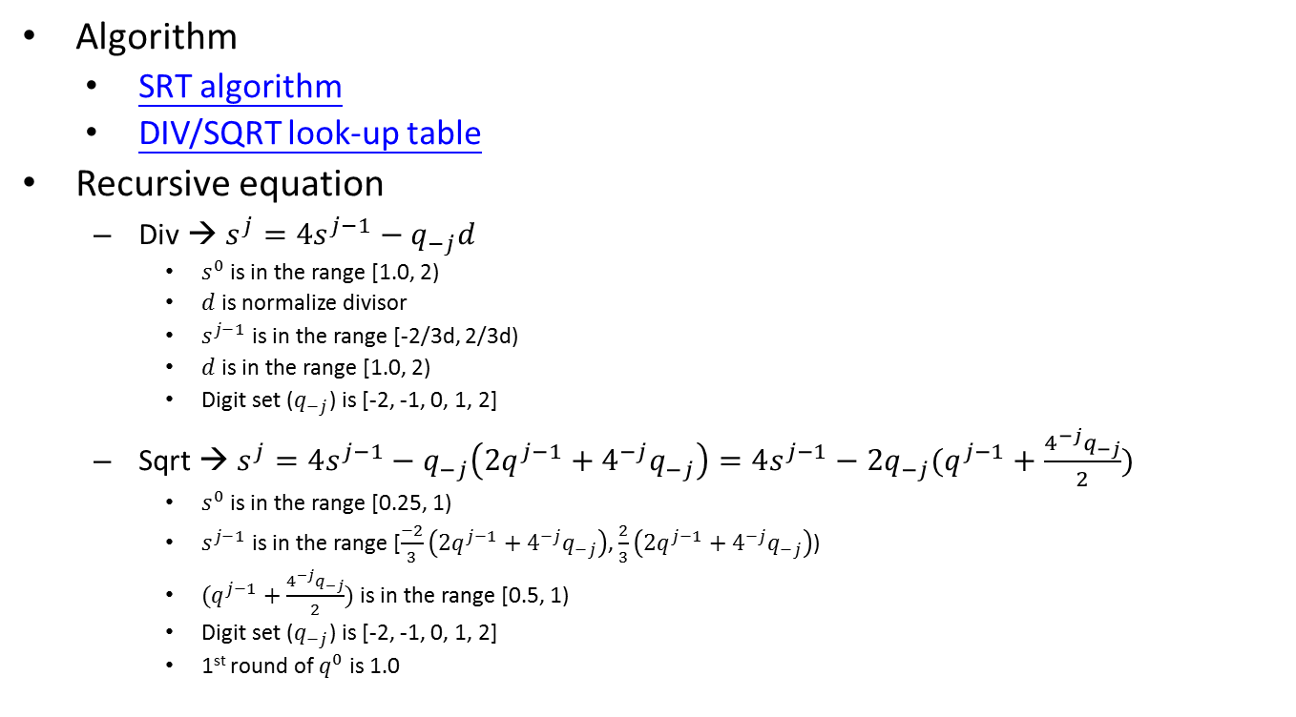
FP Div/SQRT Instructions (2/)
Algorithm
SRT algorithm
DIV/SQRT look-up table
Recursive equation
Div → $s^{j}=4s^{j−1}−q_{−j}d$
$s^{0}$ is in the range [1.0, 2)
$d$ is normalize divisor
$s^{j−1}$ is in the range [-2/3d, 2/3d)
$d$ is in the range [1.0, 2)
Digit set ($q_{−j}$) is [-2, -1, 0, 1, 2]
Sqrt → $s^{j}=4s^{j−1}−q_{−j}\left(2q^{j−1}+4^{−j}q_{−j}\right)=4s^{j−1}−2q_{−j}(q^{j−1}+\frac{4^{−j}q_{−j}}{2})$
$s^{0}$ is in the range [0.25, 1)
$s^{j−1}$ is in the range [$\frac{−2}{3}\left(2q^{j−1}+4^{−j}q_{−j}\right)$, $\frac{2}{3}\left(2q^{j−1}+4^{−j}q_{−j}\right)$)
$(q^{j−1}+\frac{4^{−j}q_{−j}}{2})$ is in the range [0.5, 1)
Digit set ($q_{−j}$) is [-2, -1, 0, 1, 2]
1st round of $q^{0}$ is 1.0
Notes:
Bit width is (1+FLEN_MAX) - (1+FLEN_MIN) + XLEN

Slide 20
FP Estimation Instructions

Slide 21
FP Estimation Instructions (1/)
Instruction dataflow
Unpack input data
Normalize data, compute exponent and detect special value in parallel
Look-up vfrece7/vfesqrte7 table and do exception detection
Calculate result exponent
Shift right significand value if exponent is subnormal
Produce special value according to the corresponding exception if detected
F1 stage works
Normalize data
Compute exponent
Detect special value
F2 stage works
Look-up vfrece7/vfesqrte7 table
Do exception detection
Shift right significand value if exponent is subnormal
Produce special value according to the corresponding exception if detected
Notes:
Bit width is (1+FLEN_MAX) - (1+FLEN_MIN) + XLEN

Slide 22
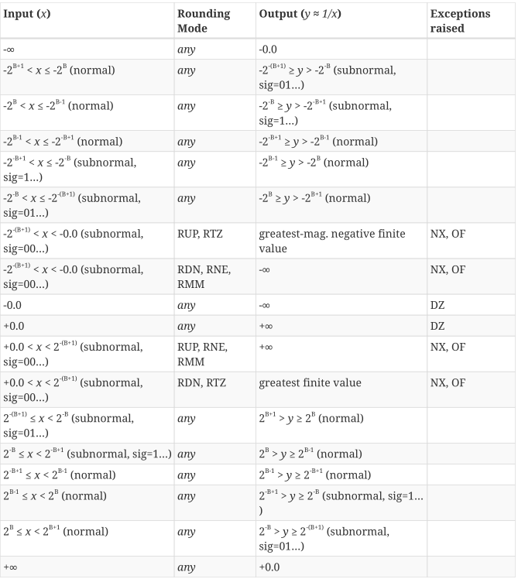
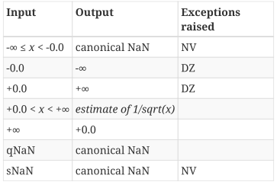
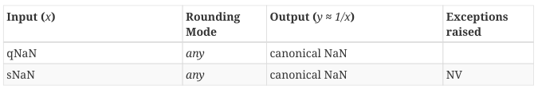
FP Estimation Instructions (2/)
vfrece7.v
Produce special value, exception flag according to the corresponding table in vector-spec
vfrsqrte7.v
Notes:
Bit width is (1+FLEN_MAX) - (1+FLEN_MIN) + XLEN

Slide 23
Round digit generation & Twice Rounding Detection

Slide 24
Round digit generation (1/)
Generate rounding increment according to rounding modes
Rounding modes
RNE (Round to Nearest, ties to Even)
RTZ (Round Towards Zero)
RDN (Round DowN)
RUP (Round UP)
RMM (Round to nearest, ties to Max Magnitude)
ROD (Round towards ODd)
Rounding increment according to different rounding mode
Sign | L | R | S |  | RNE | RTZ | RDN | RUP | RMM | ROD
0 | 0 | 0 | 0 |  | +0 | +0 | +0 | +0 | +0 | +1
0 | 0 | 0 | 1 |  | +0 | +0 | +0 | +1 | +0 | +1
0 | 0 | 1 | 0 |  | +0 | +0 | +0 | +1 | +1 | +1
0 | 0 | 1 | 1 |  | +1 | +0 | +0 | +1 | +1 | +1
0 | 1 | 0 | 0 |  | +0 | +0 | +0 | +0 | +0 | +0
0 | 1 | 0 | 1 |  | +0 | +0 | +0 | +1 | +0 | +0
0 | 1 | 1 | 0 |  | +1 | +0 | +0 | +1 | +1 | +0
0 | 1 | 1 | 1 |  | +1 | +0 | +0 | +1 | +1 | +0
1 | 0 | 0 | 0 |  | +0 | +0 | +0 | +0 | +0 | +1
1 | 0 | 0 | 1 |  | +0 | +0 | +1 | +0 | +0 | +1
1 | 0 | 1 | 0 |  | +0 | +0 | +1 | +0 | +1 | +1
1 | 0 | 1 | 1 |  | +1 | +0 | +1 | +0 | +1 | +1
1 | 1 | 0 | 0 |  | +0 | +0 | +0 | +0 | +0 | +0
1 | 1 | 0 | 1 |  | +0 | +0 | +1 | +0 | +0 | +0
1 | 1 | 1 | 0 |  | +1 | +0 | +1 | +0 | +1 | +0
1 | 1 | 1 | 1 |  | +1 | +0 | +1 | +0 | +1 | +0

Slide 25
Round digit generation (2/)
1. Do rounding only
A + increment (1 bit) (A has not round bit)
Abbreviation
L is LSB/ R is round bit / S is sticky bit / Tie is (R & ~S)
Rounding mode | Rounding inc
RNE (Round to Nearest, ties to Even) | 1. R then clear sum LSB if tie/ 2. R & (L | S)
RTZ (Round Towards Zero) | 0
RDN (Round DowN) | ~sign & (R | S)
RUP (Round UP) | sign & (R | S)
RMM (Round to nearest, ties to Max Magnitude) | R
ROD (Round towards ODd) | 1. Set LSB 2. ~L

Slide 26
Underflow Flag Detection

Slide 27
Underflow Flag Detection (1/)
We need to detect the special underflow case that the result is min normal value but it should raise overflow flag.
The result exponent is in subnormal and unbounded value is all-one after rounding.
Example
SP(0x387FE000, exponent = -15, sig = 1.11111111110000000000000) → HP, RM is RUP
Do rounding for sig(1.11111111110000000000000).
Unbounded value is 1.1111111111 and exponent(-15) is in subnormal range.
Bound sig to subnormal format (sig = 0.11111111111 and exponent = -15) then the value will round to min normal value (sig = 1.000000000 and exponent = -14).

Slide 28
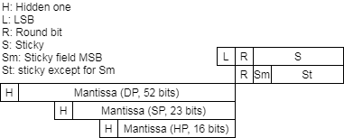
Underflow Flag Detection (2/)
The Fig. show result format, L, R, S, Sm and St field.
The bit pattern is all-one mantissa and the next slide show underflow special case detection.

Slide 29
Underflow Flag Detection (3/)
The condition should qualify bit pattern (BP) and the following condition under different rounding mode
BP | Sign | R | Sm | St |  | RNE | RTZ | RDN | RUP | RMM | ROD
Match | 0 | 0 | 0 | 0
Match | 0 | 0 | 0 | 1 |  |  |  |  | A
Match | 0 | 0 | 1 | 0 |  |  |  |  | A
Match | 0 | 0 | 1 | 1 |  |  |  |  | A
Match | 0 | 1 | 0 | 0 |  | A |  |  | A | A
Match | 0 | 1 | 0 | 1 |  | A |  |  |  | A
Match | 0 | 1 | 1 | 0
Match | 0 | 1 | 1 | 1
Match | 1 | 0 | 0 | 0
Match | 1 | 0 | 0 | 1 |  |  |  | A
Match | 1 | 0 | 1 | 0 |  |  |  | A
Match | 1 | 0 | 1 | 1 |  |  |  | A
Match | 1 | 1 | 0 | 0 |  | A |  | A |  | A
Match | 1 | 1 | 0 | 1 |  | A |  |  |  | A
Match | 1 | 1 | 1 | 0
Match | 1 | 1 | 1 | 1
RM | Underflow
RNE | BP & R & ~Sm
RTZ | 0
RDN | BP & sign & (R^S)
RUP | BP & ~sign & (R^S)
RMM | BP & R & ~Sm
ROD | 0

Slide 30
Enhancements

Slide 31
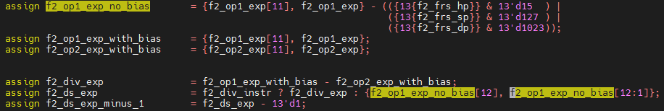
Enhancements (1/)
Reduce gate delay
1-A → 1 + (~A+1) → 2+~A
Reduce 2-level adder
Produce Exp and Exp – 1 (without bias)
ExpA and ExpB have bias
DIV
Exp = ExpA – ExpB
Exp – 1 = ExpA – ExpB – 1 = ExpA + (~ExpB + 1) – 1 = ExpA + ~ExpB
SQRT
Exp = (ExpA – Bias) >> 1
Exp – 1 = (ExpA – Bias) >> 1 – 1 = (ExpA – Bias - 2) >> 1 = (ExpA + (~Bias – 1)) >> 1
 | HP | SP | DP
Bias | b0_0000_0000_1111 | b0_0000_0111_1111 | b0_0011_1111_1111
~Bias - 1 | b1_1111_1110_1111 | b1_1111_0111_1111 | b1_1011_1111_1111
Notes:
Bias = 15
15 => b0_0000_0000_1111
~15 => b1_1111_1111_0000
~15-1 => b1_1111_1110_1111
Bias = 127
127 => b0_0000_0111_1111
~127 => b1_1111_1000_0000
~127-1 => b1_1111_0111_1111
Bias = 1023
1023 => b0_0011_1111_1111
~1023 => b1_1100_0000_0000
~1023-1 => b1_1011_1111_1111

Slide 32
Merge IDIV and FDIV methods

Slide 33
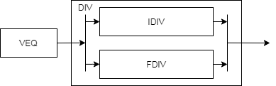
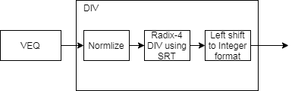
Merge IDIV and FDIV methods (1/)
Two methods to merge/fuse IDIV and FDIV function units.
Merge two function units
Reuse staging FFs and return result according to instruction type
Fuse two function units
Support 64-bit data in and widen related logics
Do 2’sc for input and output if negative
Reuse radix-4 SRT look-up table
Extend quotient handling logics
Add Left shifting logic to handle integer result
Hard to implement remainder instruction using SRT
Merge 2 function units
Fuse 2 function units

Slide 34
Merge IDIV and FDIV methods (2/)
Why hard to implement remainder instruction
Apply radix-4 algorithm so 2-bit partial quotient is generated in each iteration
The extra fraction bit should recover to partial remainder
Remainder (Integer) = Remainder (fraction) x divisor
Method 1: 10/3 = 3.333… → 3 * 0.333… = 1
Method 2: 10/3 = 3.333… → 10 - 3 * 3 = 1
Integer | iteration | Extra fraction bit
INT8 | 1+4 | 1 bits
INT16 | 1+8 | 1 bits
INT32 | 1+16 | 1 bits
INT64 | 1+32 | 1 bits
1 is for hidden one

Slide 35
Instruction list

Slide 36
Instruction list
The fdiv function unit encoding

Slide 37
Backup

Slide 38
Radix-2 Algorithm (1/)
Radix-2 have
Restoring algorithm
Non-restoring algorithm
SRT algorithm (also non-restoring algorithm)

Slide 39
Radix-2 Algorithm (2/)
Restoring algorithm
Quotient digit set is {0, 1}

Slide 40
Radix-2 Algorithm (3/)
Non-restoring algorithm
Quotient digit set is {-1, 0, 1}

Slide 41
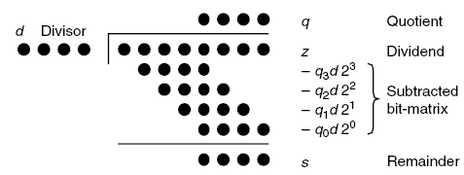


Radix-2 divider using SRT (1/)
SRT named for its creators (Sweeney, Robertson, and Tocher) and it is non-restoring algorithm
Generate 1-bit partial remainder in 1 iteration
Quotient $q_{−1}q_{−2}…$
$$s^{0}$$

Slide 42
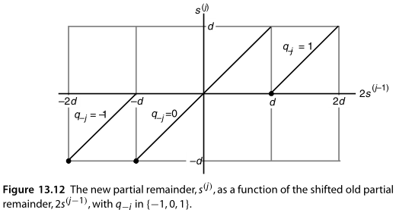

Radix-2 divider using SRT (2/)
$s^{j}=2s^{j−1}−q_{−j}d with s^{0}=z$
Shifted partial remainder $s^{j−1}$ is in the range [-d, d)
Digit set $q_{j}∈\{−1, 0, 1\}$
-1 → subtract -d
0 → subtract 0
1 → subtract d

Slide 43
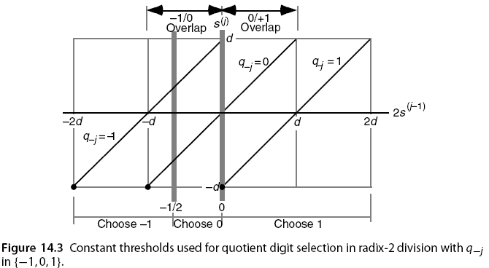
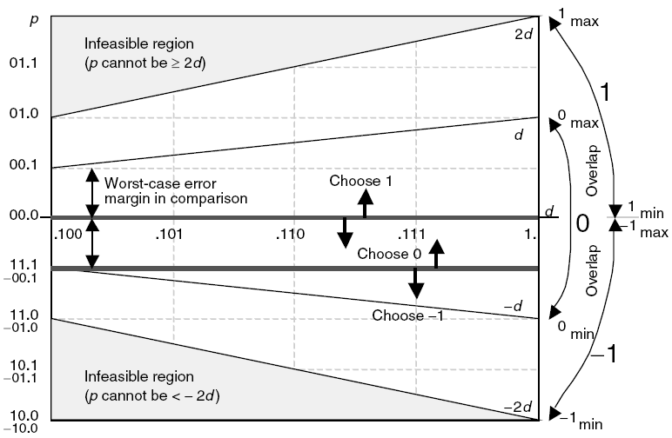

Radix-2 divider using SRT & CSA(1/)
$s^{j}=2s^{j−1}−q_{−j}d with s^{0}=z and s^{k}=2^{k}s$
Shifted partial remainder (${2s}^{j−1}$) is in the range [-2d, 2d)
Digit set $q_{j}∈\{−1, 0, 1\}$
-1 → [-2d, -1/2)
0 → [-1/2, 0)
1 → [0, 2d)

Slide 44
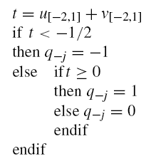

Radix-2 divider using SRT & CSA(2/)
Let $u=(u_{1}u_{0}.u_{−1}u_{−2}…)$ and $u=(v_{1}v_{0}.v_{−1}v_{−2}…)$
Add the most significant 4 bits of u and v, t result may have 1 bit error (’b0.01 = 0.25) because of carry from low part. The threshold gap is greater than 0.25.
XXXX XXXX
XXXX XXXX
X
carry

Slide 45
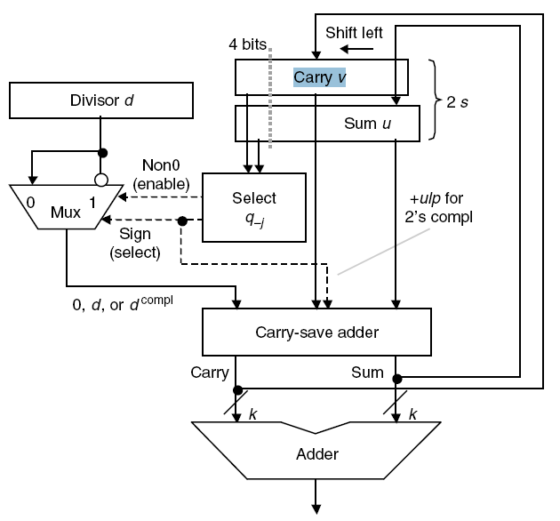

Radix-2 divider using SRT & CSA(3/)
The following Fig. is radix-2 divider datapath
Use sum of partial carry and sum string to select $q_{−j}$
BACK

Slide 46
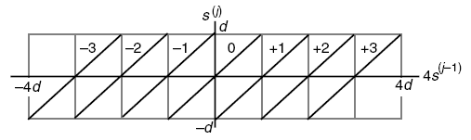
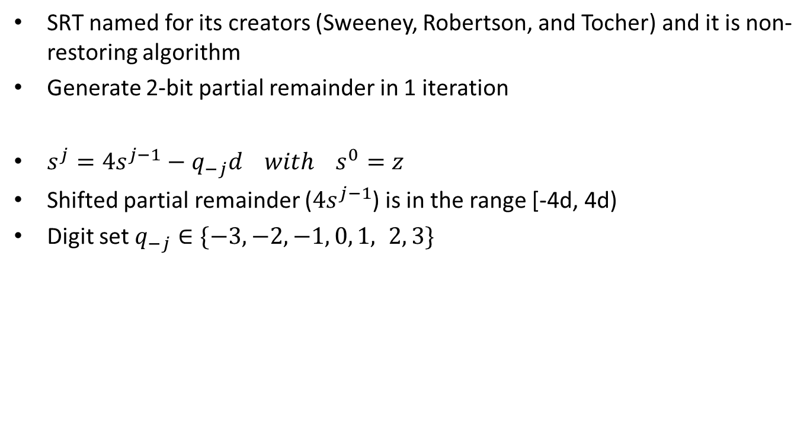
Radix-4 divider using SRT (1/)
SRT named for its creators (Sweeney, Robertson, and Tocher) and it is non-restoring algorithm
Generate 2-bit partial remainder in 1 iteration
$s^{j}=4s^{j−1}−q_{−j}d with s^{0}=z$
Shifted partial remainder ($4s^{j−1}$) is in the range [-4d, 4d)
Digit set $q_{−j}∈\{−3,−2,−1, 0, 1, 2, 3\}$

Slide 47
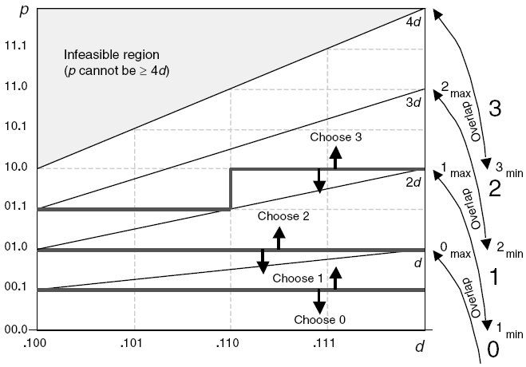
Radix-4 divider using SRT (2/)
p is shifted partial remainder and d is divisor
(3 * divisor) is complex so we want to restrict the quotient digits to [−2, 2] from [-3, 3].

Slide 48
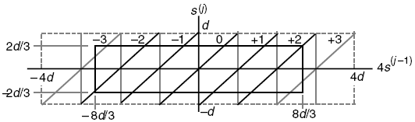

Radix-4 divider using SRT (3/)
Restrict the quotient digits to [−2, 2] from [-3, 3]
$s^{j−1}$ is in the range [-hd, hd)
$4s^{j−1}$ is in the range [-4hd, 4hd)
We should be able to bring the worst-case values to within [-hd, hd) by adding ±2d to it
$4hd−2d≤hd$ → $3hd≤2d$ → $h≤\frac{2}{3}$

Slide 49
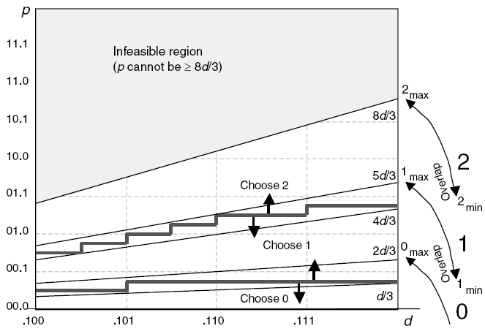


Radix-4 divider using SRT (4/)
quotient digits to [−2, -1, 0, 1, 2] from [-3, -2, -1, 0, 1, 2, 3]
$s^{j−1}$ is in the range [-d, d)
quotient digits is [−2, -1, 0, 1, 2]
$s^{j−1}$ is in the range [-2/3d, 2/3d)

Slide 50
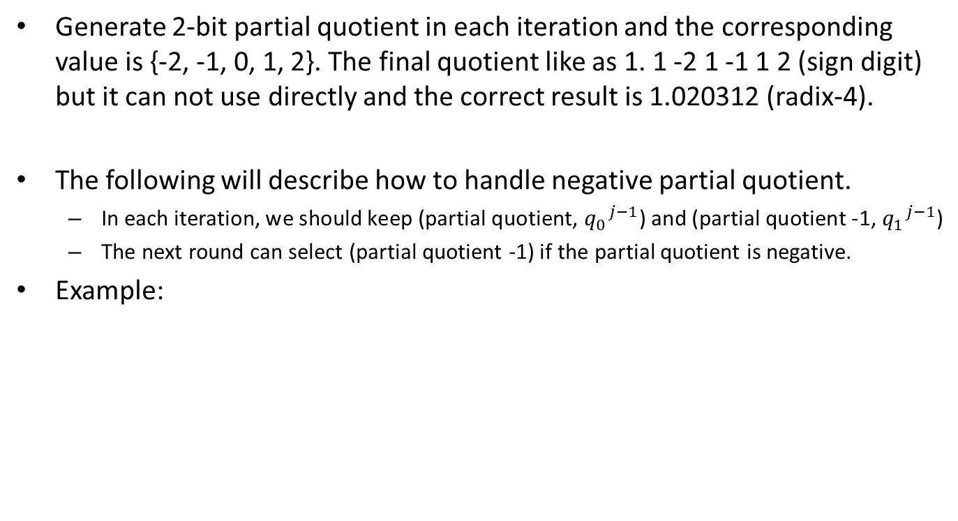
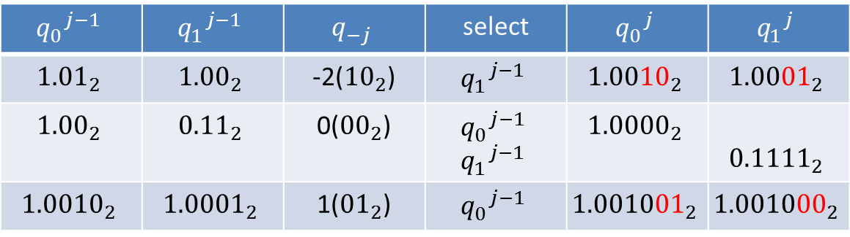
Radix-4 SRT - Quotient Handling (1/)
Generate 2-bit partial quotient in each iteration and the corresponding value is {-2, -1, 0, 1, 2}. The final quotient like as 1. 1 -2 1 -1 1 2 (sign digit) but it can not use directly and the correct result is 1.020312 (radix-4).
The following will describe how to handle negative partial quotient.
In each iteration, we should keep (partial quotient, ${q_{0}}^{j−1}$) and (partial quotient -1, ${q_{1}}^{j−1}$)
The next round can select (partial quotient -1) if the partial quotient is negative.
Example:
$${q_{0}}^{j−1}$$ | $${q_{1}}^{j−1}$$ | $$q_{−j}$$ | select | $${q_{0}}^{j}$$ | $${q_{1}}^{j}$$
$${\text{1.01}}_{2}$$ | $${\text{1.00}}_{2}$$ | -2(${\text{10}}_{2}$) | $${q_{1}}^{j−1}$$ | $${1.0010}_{2}$$ | $${1.0001}_{2}$$
$${\text{1.00}}_{2}$$ | $${\text{0.11}}_{2}$$ | 0(${\text{00}}_{2}$) | $${q_{0}}^{j−1}$$ $${q_{1}}^{j−1}$$ | $${1.0000}_{2}$$ | $${0.1111}_{2}$$
$${\text{1.0}010}_{2}$$ | $${\text{1.0}001}_{2}$$ | 1(${\text{01}}_{2}$) | $${q_{0}}^{j−1}$$ | $${1.001001}_{2}$$ | $${1.001000}_{2}$$
BACK

Slide 51

Radix-2 SQRT - Example
The example is non-restoring algorithm
$s^{j}=4s^{j−1}−q_{−j}(2q^{j−1}+2^{−j}q_{−j})$

Slide 52
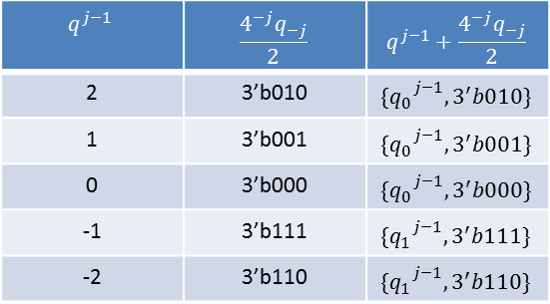
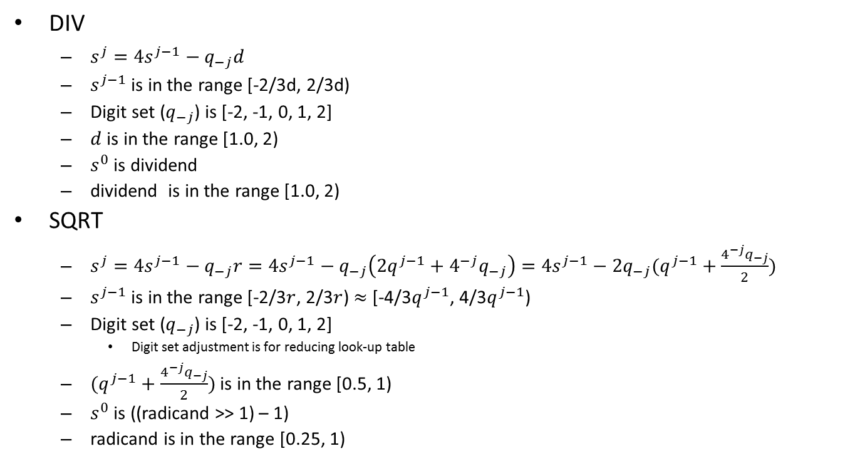
Radix-4 DIV and SQRT
DIV
$s^{j}=4s^{j−1}−q_{−j}d$
$s^{j−1}$ is in the range [-2/3d, 2/3d)
Digit set ($q_{−j}$) is [-2, -1, 0, 1, 2]
$d$ is in the range [1.0, 2)
$s^{0}$ is dividend
dividend is in the range [1.0, 2)
SQRT
$s^{j}=4s^{j−1}−q_{−j}r=4s^{j−1}−q_{−j}\left(2q^{j−1}+4^{−j}q_{−j}\right)=4s^{j−1}−2q_{−j}(q^{j−1}+\frac{4^{−j}q_{−j}}{2})$
$s^{j−1}$ is in the range [-2/3$r$, 2/3$r$) $≈$ [-4/3$q^{j−1}$, 4/3$q^{j−1}$)
Digit set ($q_{−j}$) is [-2, -1, 0, 1, 2]
Digit set adjustment is for reducing look-up table
$(q^{j−1}+\frac{4^{−j}q_{−j}}{2})$ is in the range [0.5, 1)
$s^{0}$ is ((radicand >> 1) – 1)
radicand is in the range [0.25, 1)
$$q^{j−1}$$ | $$\frac{4^{−j}q_{−j}}{2}$$ | $$q^{j−1}+\frac{4^{−j}q_{−j}}{2}$$
2 | 3’b010 | $${\{q_{0}}^{j−1}, 3^{′}b010\}$$
1 | 3’b001 | $${\{q_{0}}^{j−1}, 3^{′}b001\}$$
0 | 3’b000 | $${\{q_{0}}^{j−1}, 3^{′}b000\}$$
-1 | 3’b111 | $${\{q_{1}}^{j−1}, 3^{′}b111\}$$
-2 | 3’b110 | $${\{q_{1}}^{j−1}, 3^{′}b110\}$$

Slide 53
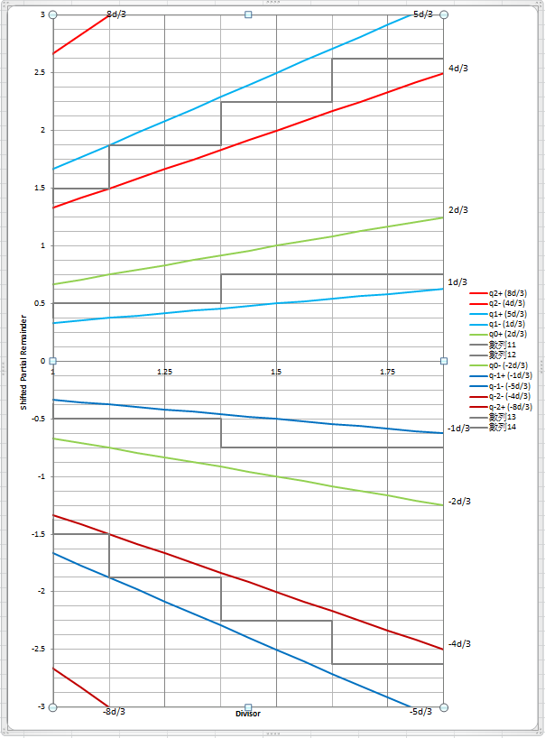
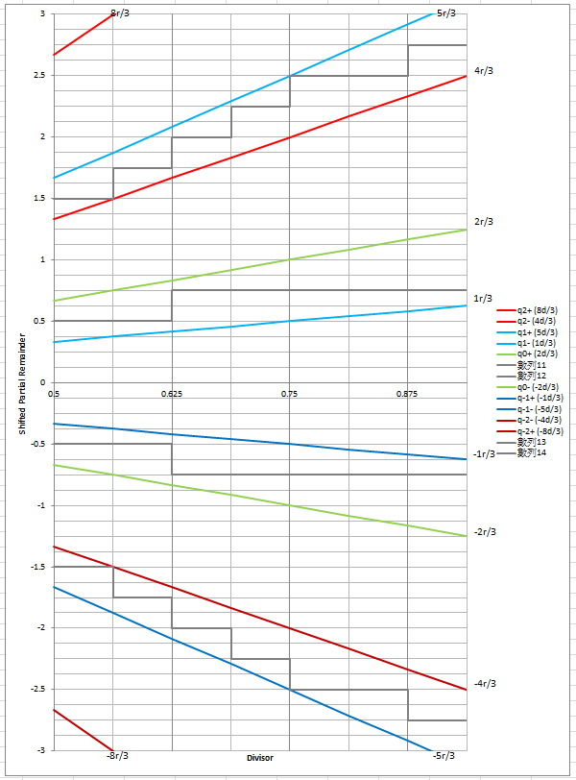
Radix-4 SRT Look-up Table (1/)
The Fig is DIV SRT look-up table.
Quotient of DIV is in [1, 2)
The Fig is SQRT SRT look-up table.
Quotient of SQRT is in [0.5, 1)
BACK

Slide 54
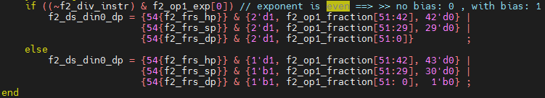
How to subtract 1/adjust data for SQRT (1/)
The significand do *2 if exponent is odd and the radicand is in the range [0.25, 1)
The following value is in the range [0.5, 2) and the value(din0) is 2x radicand
Notes:
The sqrt result of each values
0.9375 => 0.9682458365518542212948163499456 0.1111
0.875 => 0.93541434669348534639593718307914 0.1110
0.8125 => 0.90138781886599732327980531686762 0.1110
0.75 => 0.86602540378443864676372317075294 0.1101
0.6875 => 0.82915619758884996227873318416767 0.1101
0.625 => 0.79056941504209483299972338610818 0.1100
0.5625 => 0.75 0.1100
0.5 => 0.70710678118654752440084436210485 0.1011

Slide 55
How to subtract 1/adjust data for SQRT (2/)
For SQRT initialization, (Z-1)
Shift left and 1 extension for SQRT instruction
4((radicand >> 1) – 1) → 2radicand - 4
DS_DIN | Shift left 1 bit | 1 extension
0001.1111 | 0011.111 (3.875) | 1111.111 (-0.125)
0001.1110 | 0011.110 (3.75) | 1111.110 (-0.25)
0001.1101 | 0011.101 (3.625) | 1111.101 (-0.375)
0001.1100 | 0011.100 (3.5) | 1111.100 (-0.5)
0001.1011 | 0011.011 (3.375) | 1111.011 (-0.625)
0001.1010 | 0011.010 (3.25) | 1111.010 (-0.75)
0001.1001 | 0011.001 (3.125) | 1111.001 (-0.875)
0001.1000 | 0011.000 (3) | 1111.000 (-1)
DS_DIN | Shift left 1 bit | 1 extension
0000.1111 | 0001.111 (1.875) | 1101.111 (-2.125)
0000.1110 | 0001.110 (1.75) | 1101.110 (-2.25)
0000.1101 | 0001.101 (1.625) | 1101.101 (-2.375)
0000.1100 | 0001.100 (1.5) | 1101.100 (-2.5)
0000.1011 | 0001.011 (1.375) | 1101.011 (-2.625)
0000.1010 | 0001.010 (1.25) | 1101.010 (-2.75)
0000.1001 | 0001.001 (1.125) | 1101.001 (-2.875)
0000.1000 | 0001.000 (1) | 1101.000 (-3)
Notes:
The sqrt result of each values
0.9375 => 0.9682458365518542212948163499456 0.1111
0.875 => 0.93541434669348534639593718307914 0.1110
0.8125 => 0.90138781886599732327980531686762 0.1110
0.75 => 0.86602540378443864676372317075294 0.1101
0.6875 => 0.82915619758884996227873318416767 0.1101
0.625 => 0.79056941504209483299972338610818 0.1100
0.5625 => 0.75 0.1100
0.5 => 0.70710678118654752440084436210485 0.1011

Slide 56
1st Round Root selection for SQRT (1/)
Root digit selection rule cannot be used for all iterations because root is unknown in early iterations. SQRT instruction will use high-order root (0.1xxx) to generate 2-bit root in each iteration.
To find the 1st round root value and the steps like as below diagram
Initial value
(Z-1) * 4
1.0000
1st round root
Lookup table
-2/-1/0
2nd round root
0
-2
+
1.0000
-1
0.1000
‘b100
2nd partial remainder
0.1100
Lookup table
The corresponding 1st round root is illegal if partial remainder is unbounded
-2/-1/0/1/2
+
3rd round root
2
1
-0
-1
-2
3rd partial remainder
0.1110
0.1101
0.1100
0.1010
0.1011
The corresponding 1st round root is illegal if partial remainder is unbounded
The corresponding root is illegal if unbounded
Notes:
The sqrt result of each values
0.9375 => 0.9682458365518542212948163499456 0.1111
0.875 => 0.93541434669348534639593718307914 0.1110
0.8125 => 0.90138781886599732327980531686762 0.1110
0.75 => 0.86602540378443864676372317075294 0.1101
0.6875 => 0.82915619758884996227873318416767 0.1101
0.625 => 0.79056941504209483299972338610818 0.1100
0.5625 => 0.75 0.1100
0.5 => 0.70710678118654752440084436210485 0.1011
0.4375 => 0.66143782776614764762540393840982 0.1010
0.375 => 0.61237243569579452454932101867647 0.1001
0.3125 => 0.55901699437494742410229341718282 0.1000
0.25 => 0.5 0.1000

Slide 57
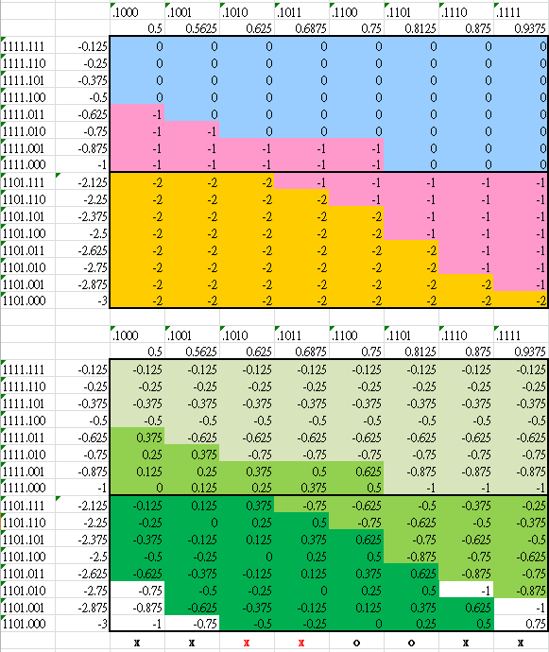

1st Round Root selection for SQRT (2/)
The Fig. show $s^{1}$ value according to digit set and the corresponding bounded value are (1 * 4/3) , (0.75 * 4/3) and (0.5 * 4/3)
0 →1.00
-1→0.11
-2→0.10
Root is 1.00
Root is 0.11
Root is 0.10
Notes:
The sqrt result of each values
0.9375 => 0.9682458365518542212948163499456 0.1111
0.875 => 0.93541434669348534639593718307914 0.1110
0.8125 => 0.90138781886599732327980531686762 0.1110
0.75 => 0.86602540378443864676372317075294 0.1101
0.6875 => 0.82915619758884996227873318416767 0.1101
0.625 => 0.79056941504209483299972338610818 0.1100
0.5625 => 0.75 0.1100
0.5 => 0.70710678118654752440084436210485 0.1011
0.4375 => 0.66143782776614764762540393840982 0.1010
0.375 => 0.61237243569579452454932101867647 0.1001
0.3125 => 0.55901699437494742410229341718282 0.1000
0.25 => 0.5 0.1000

Slide 58
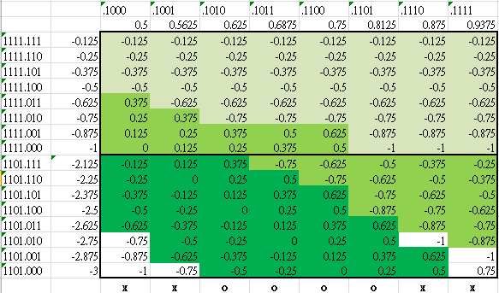
1st Round Root selection for SQRT (3/)
The first round pick up the corresponding root value we can calculate the corresponding partial remainder according to input value.
Several root will produce unbounded partial remainder like as white field.
The three green color will produce 3 roots (1.00, 0.11 and 0.10) in 1st iteration then the next round use it to calculate new partial remainder.
Then All values in red rectangle are 4x and then check the 2nd round will not produce unbounded value or illegal root.
Root is 1.00
Root is 0.11
Root is 0.10

Slide 59
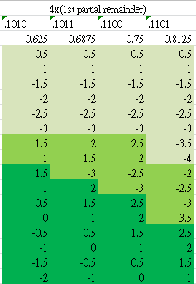
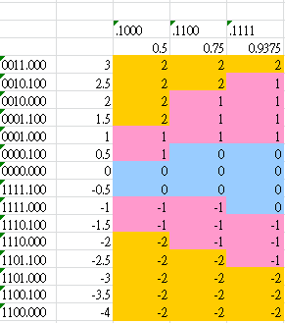
1st Round Root selection for SQRT (4/)
The second iteration use previous 3 roots (1.00, 0.11 and 0.10) to select partial root and calculate partial remainder.
Partial root selection
Partial Root 1.00 will select -2, -1, 0 partial root because partial remainders are in range [-4, -0.5].
Partial Root 0.11 will select -2, -1, 0, 1, 2 partial root because partial remainder are in range [-3.5, 2.5].
Partial Root 0.10 will select -2, -1, 0, 1, 2 partial root because partial remainder are in [-2, 2.5]
We can find 2nd round partial root according to right Figs and calculate the 2nd round partial remainder.
Partial Root 1.00
Partial Root 0.11
Partial Root 0.10

Slide 60
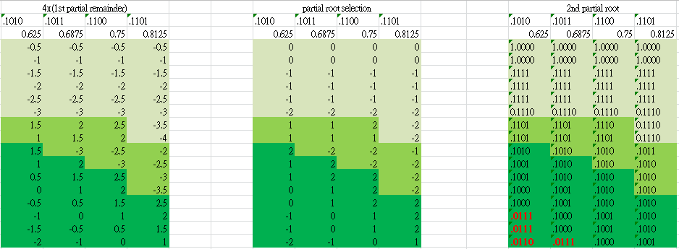
1st Round Root selection for SQRT (5/)
The right Fig. is produced according to partial root selection table and the corresponding 1st round partial root.
The root is in range [0.5, 1] so 0.0111 and 0.0110 are illegal. Thus, 0.1010 and 0.1011 cannot be applied as 1st round root.

Slide 61
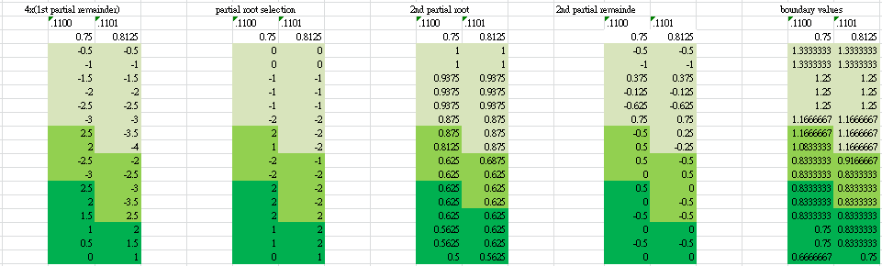
1st Round Root selection for SQRT (6/)
Check the partial remainders are bounded [-2r/3, 2r/3)
According to 2nd partial remainder table, all partial remainder values are in the corresponding boundary. Thus, we can apply 0.1100 and 0.1101 as 1st round root.
The current design apply 0.1101 as 1st round root.
Notes:
The sqrt result of each values
0.9375 => 0.9682458365518542212948163499456 0.1111
0.875 => 0.93541434669348534639593718307914 0.1110
0.8125 => 0.90138781886599732327980531686762 0.1110
0.75 => 0.86602540378443864676372317075294 0.1101
0.6875 => 0.82915619758884996227873318416767 0.1101
0.625 => 0.79056941504209483299972338610818 0.1100
0.5625 => 0.75 0.1100
0.5 => 0.70710678118654752440084436210485 0.1011
0.4375 => 0.66143782776614764762540393840982 0.1010
0.375 => 0.61237243569579452454932101867647 0.1001
0.3125 => 0.55901699437494742410229341718282 0.1000
0.25 => 0.5 0.1000

Slide 62
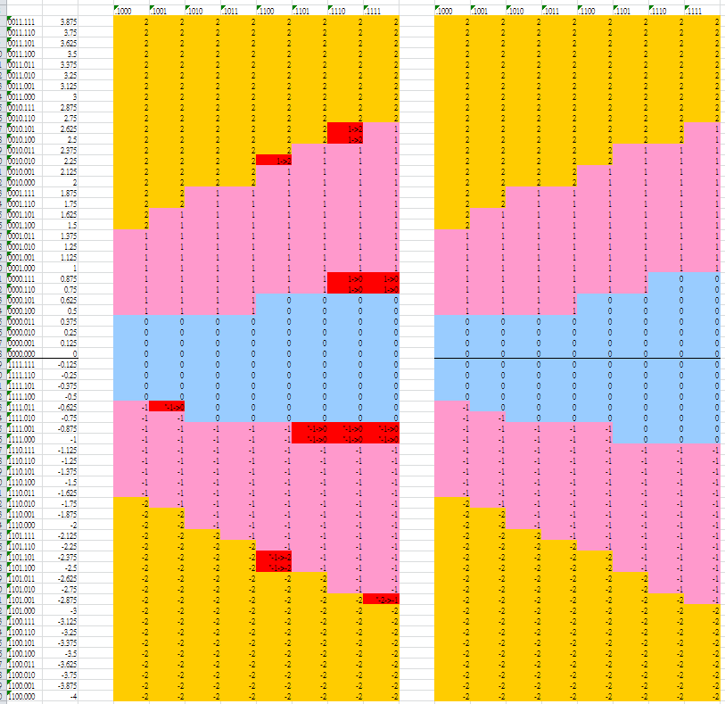

Merge DIV and SQRT Look-up Table (1/)
DIV Look-up table
SQRT Look-up table
Merge 2 look-up tables to reduce area.
The red rectangles are different with SQRT look-up table.
The sum of high-order partial remainder may be actually sum or sum without carry.
Check that red rectangles are replaceable
Sum with carry=1
+1
Sum with carry=0

Slide 63

Merge DIV and SQRT Look-up Table (2/)
+2
+1/+2
+1

Slide 64


Merge DIV and SQRT Look-up Table (3/)
+1
+0/+1
+0

Slide 65


Merge DIV and SQRT Look-up Table (4/)
+0
+0/-1
-1

Slide 66


Merge DIV and SQRT Look-up Table (5/)
-2
-1/-2
-1

Slide 67
Merge DIV and SQRT Look-up Table (6/)
DIV Look-up table
SQRT Look-up table
Merge div & sqrt look-up
Merge the look-up tables (use only one table and it is original SQRT look-up table)
VFDIV64
Lib | Feq. | FLEN | Original | Modified
28HPC+ | 1.00Ghz | 32 | 21.3kgates | 21.2kgates | 0.5%
28HPC+ | 1.25Ghz | 32 | 22.7kgates | 22.5kgates | 0.9%
28HPC+ | 1.00Ghz | 64 | 27.5kgates | 27.3kgates | 0.7%
28HPC+ | 1.25Ghz | 64 | 31.2kgates | 30.1kgates | 3.6%

