Slide 1
FP Fused-MAC uArch
202104
Larry

Slide 2
Agenda
List of abbreviation
Overview
Configuration
uArch overview
Multiplication
Alignment
Partial adder
Complement
LZA and Normalization
Enhancements
Interface
Instruction list

Slide 3
List of abbreviation (1/)
Abbreviation | Definition
ABS | Alignment barrel shift
NBS | Normalization barrel shift
2’sc | 2’s complement
LZA | Leading zero anticipation

Slide 4
List of parameter (1/)
Abbreviation | Definition
XLEN | The current width of an x register in bits (32 for RV32 or 64 for RV64)
FLEN | The current width of a f register in bits (32 for SP, 64 for DP)

Slide 5
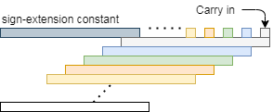
Multiplication (1/)
Apply radix-4 booth algorithm for multiplication result (A*B) and use CSA tree to calculate partial products (PP)
(a.x * b.y) = ab + ay + bx + xy = ay + b(a.x) + xy
(27 + 1 + 2) PPs (for DP)

Slide 6
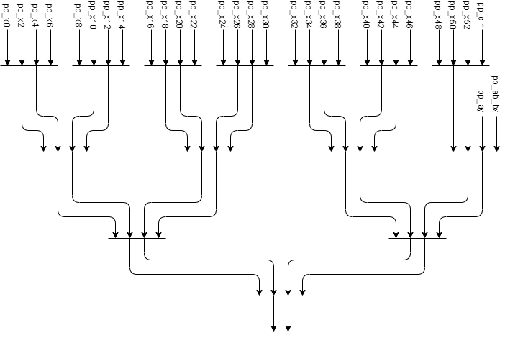
Multiplication (2/)
CSA tree
PP_cin can be merge to another PP

Slide 7
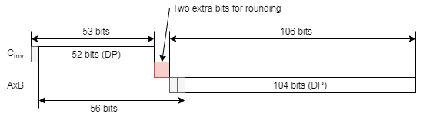
Alignment (1/)
161bits barrel right shifter to align A and BxC and the shift amount is 56-d
Alignment shift amount (ASA) is (56 + ExpA+ExpB-ExpC - bias)
d is (ExpA+ExpB-ExpC – bias)
The valid (56-d) is in range (0, 161)
If ASA is negative, then ASA will be set to zero
If A*B is zero, then ASA will be set to zero

Slide 8
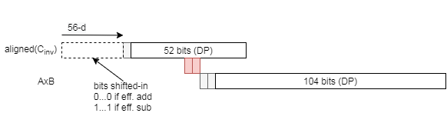
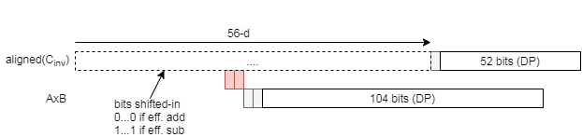
Alignment (2/)
(56-d) < 56
(56-d) >= 56

Slide 9
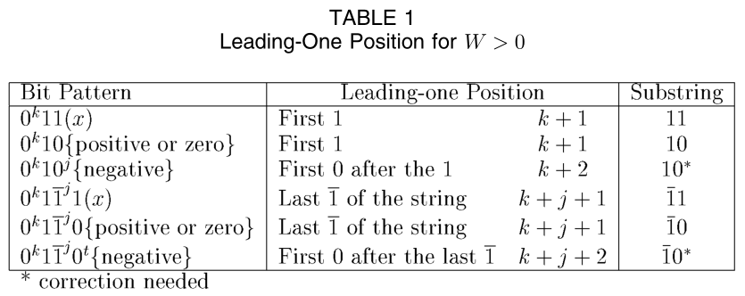

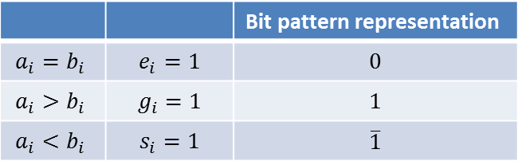
LZA (1/)
The following table list all bit pattern for leading-one position when $w=a −b$ and $w>0$
 |  | Bit pattern representation
$$a_{i}=b_{i}$$ | $$e_{i}=1$$ | $$0$$
$$a_{i}>b_{i}$$ | $$g_{i}=1$$ | $$1$$
$$a_{i}<b_{i}$$ | $$s_{i}=1$$ | $$\overline{1}$$

Slide 10
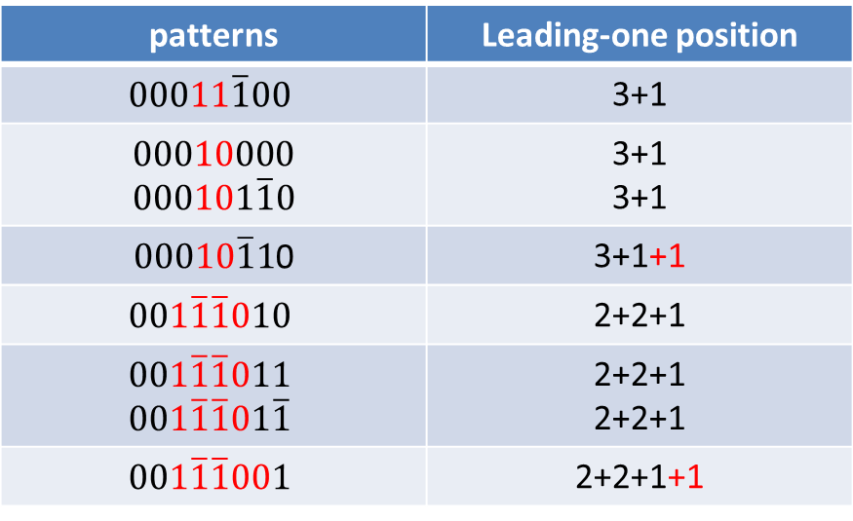
LZA (2/)
Example
patterns | Leading-one position
$$00011\overline{1}00$$ | 3+1
$0001000$0 $$000101\overline{1}0$$ | 3+1 3+1
$00010\overline{1}1$0 | 3+1+1
$$001\overline{1}\overline{1}010$$ | 2+2+1
$$001\overline{1}\overline{1}011$$ $$001\overline{1}\overline{1}01\overline{1}$$ | 2+2+1 2+2+1
$$001\overline{1}\overline{1}001$$ | 2+2+1+1

Slide 11
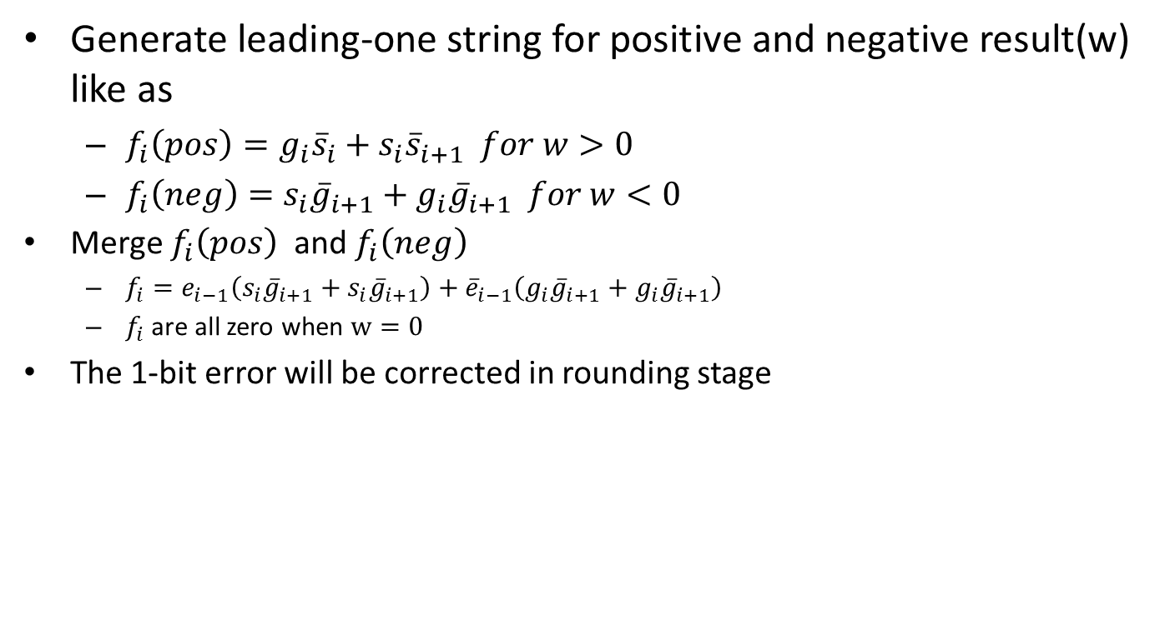
LZA (3/)
Generate leading-one string for positive and negative result(w) like as
$f_{i}\left(pos\right)=g_{i}{\overline{s}}_{i}+s_{i}{\overline{s}}_{i+1} for w>0$
$f_{i}\left(neg\right)=s_{i}{\overline{g}}_{i+1}+g_{i}{\overline{g}}_{i+1} for w<0$
Merge $f_{i}\left(pos\right)$ and $f_{i}\left(neg\right)$
$f_{i}=e_{i−1}\left(s_{i}{\overline{g}}_{i+1}+s_{i}{\overline{g}}_{i+1}\right)+{\overline{e}}_{i−1}\left(g_{i}{\overline{g}}_{i+1}+g_{i}{\overline{g}}_{i+1}\right)$
$f_{i}$ are all zero when $w=0$
The 1-bit error will be corrected in rounding stage

Slide 12
Complement (1/)
The complement indicated that (S+C) is negative
S+C <= -1 → S <= -C - 1 → S <= ~C
The complement need to qualify
~C > S (analysis shows qualify [MAC_MSB:MAC_LSB+1] is enough)
~C == S

Slide 13
Complement (2/)
If S+C is negative and the operator is eff. Sub , then do 2’s complement (-S-C)
–S – C = ~S +1 + ~C +1
One of +1 will be packed to carry word LSB and another +1 will be descripted in rounding slides

Slide 14
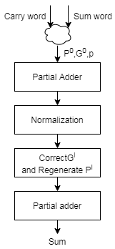

Partial Adder (1/)
For fill timing gap, dual adders are split around normalization and those partial adders can fill timing gap and improve timing. Partial adder method like as carry look-ahead adder
The partial adder produce ${P^{j}}_{i}$, ${G^{j}}_{i}$ and $p$ then correct ${G^{j}}_{i}$ and re-generate ${P^{j}}_{i}$ after normalization

Slide 15

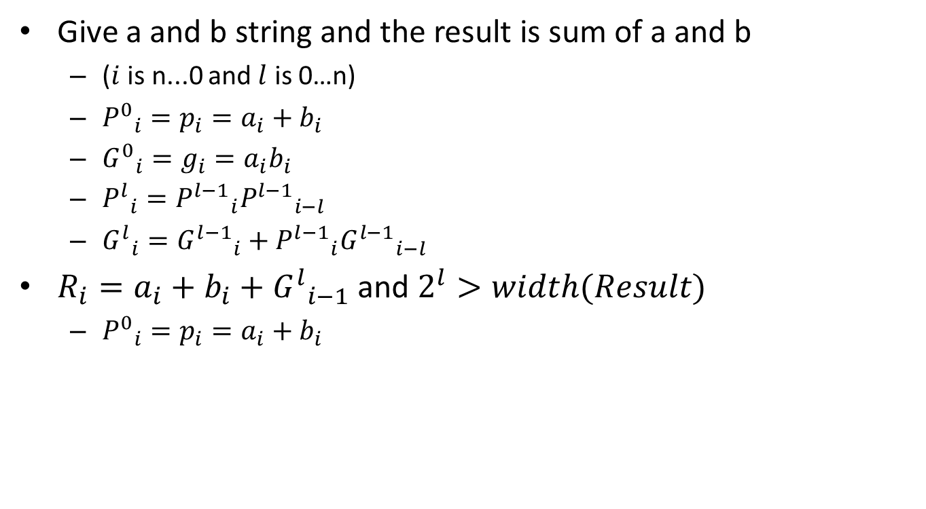



Partial Adder (2/)
Give a and b string and the result is sum of a and b
($i$ is n...0 and $l$ is 0…n)
${P^{0}}_{i}=p_{i}=a_{i}+b_{i}$
${G^{0}}_{i}=g_{i}=a_{i}b_{i}$
${P^{l}}_{i}={P^{l−1}}_{i}{P^{l−1}}_{i−l}$
${G^{l}}_{i}={G^{l−1}}_{i}+{P^{l−1}}_{i}{G^{l−1}}_{i−l}$
$R_{i}=a_{i}+b_{i}+{G^{l}}_{i−1}$ and $2^{l}>width(Result)$
${P^{0}}_{i}=p_{i}=a_{i}+b_{i}$
$$a_{i}$$
$$b_{i}$$
Adder
Cin = ${G^{l}}_{i−1}$
$$R_{i}$$

Slide 16
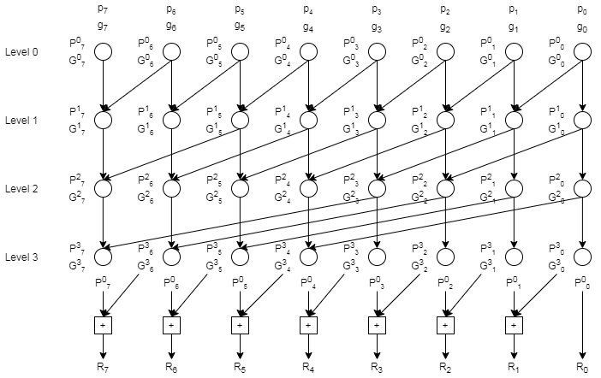

Partial Adder (3/)
Example of the anticipation of part of the prefix adder without normalization
generate ${P^{j}}_{i}$, ${G^{j}}_{i}$ and $p$ then produce result

Slide 17
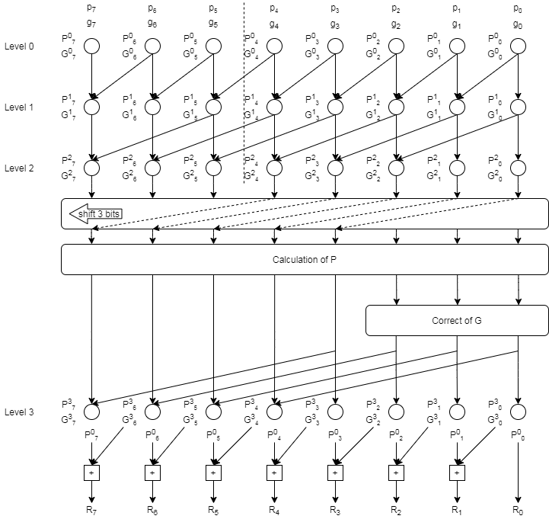

Partial Adder (4/)
Example of shifted the anticipation of part of the prefix adder
Correct $\left(2^{j}−1\right)$ bit of shifted G LSB
${G^{j}}_{i}^{}=shifted {G^{j}}_{i}^{}∙\overline{{P^{j}}_{i}^{}}$
Regenerate $P^{j}$

Slide 18
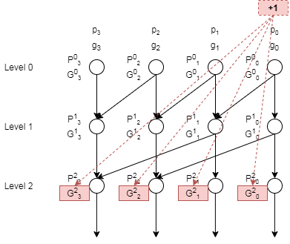

Partial Adder (5/)
Compute Y
Y is ${G^{l}}_{i}^{}^{P^{0}}_{i}^{}$
Compute Y+1
If the propagation bits (start from 0 to i) of Y are 1, then
Modify $2^{j}$ LSBs of ${G^{j}}_{i}^{}$to get Y + 1
The modified Y+1 is $({G^{j}}_{i}^{} or {P^{j}}_{i}^{})$

Slide 19
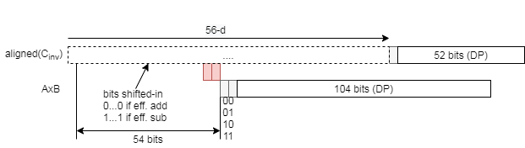
Normalization (1/)
The 162-bit normalization shifter can be implemented as 54-bits shift followed by a 108 bit-shifter
If (56-d) <= 2, 54MSBs are all zero and shift 54-bit
If (56-d) > 2,

Slide 20
Backup

Slide 21
Booth algorithm (1/)
Booth algorithm deal with the signed multiplier.
The multiplier need to add extra logic to deal with unsigned value(add extra bits to multiplicand and multiplier).
Use radix-4 to implement the multiplier
Y[2i+1, 2i] = 00 → 0
Y[2i+1, 2i] = 01 → X
Y[2i+1, 2i] = 10 → 2X → 4X – 2X
Y[2i+1, 2i] = 11 → 3X → 4X – X
Y[2i+1:2i-1] | PP
00_0 | 0
00_1 | X
01_0 | X
01_1 | 2X
10_0 | -2X
10_1 | -X
11_0 | -X
11_1 | 0

Slide 22
Booth algorithm (2/)
List all partial product
the yellow background digits are sign extensions for supporting signed/unsigned multiplication
The grey background digits are sign extensions

Slide 23
Booth algorithm (3/)
Partial product is sign-extended when encoded as -1X or -2X
To eliminate the width of CSA arrays:
invert the MSB of sign-extension bit of the multiplicand and rewrite the partial product into the grey background part + our new partial product:
The carry chain will be the same. But with the greyed out constants for sign-extension, we can add them together:

Slide 24
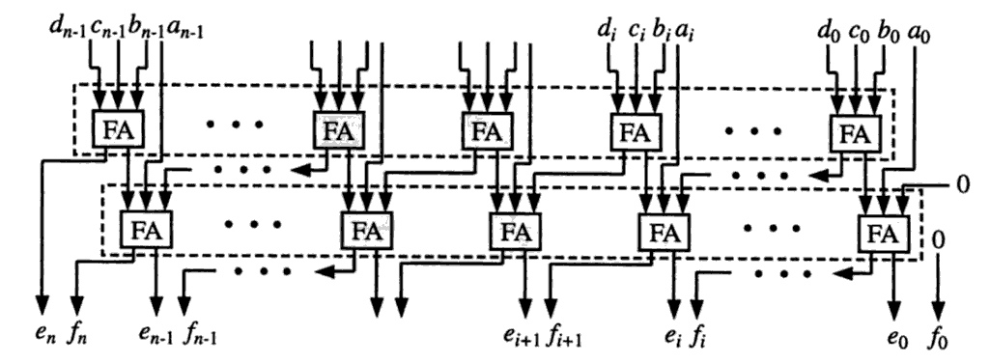
4:2 CSA
Propagation Delay is about 1.5 times of 3:2 CSA

Slide 25
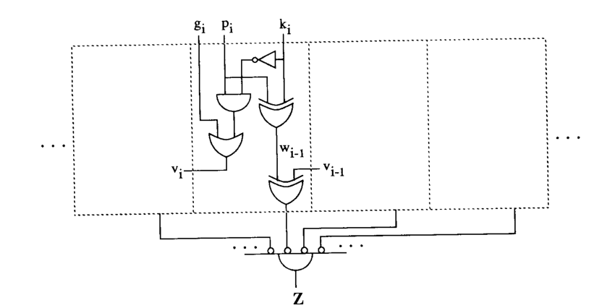
A + B = K
Evaluation of A+B=K conditions without carry propagation

Slide 26
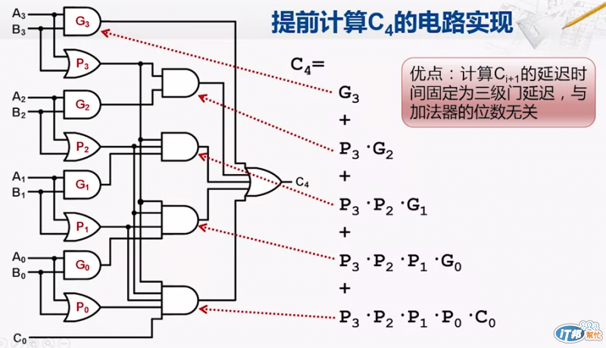
Partial Adder for Y+1
C0 of Y and Y+1 are 0 and 1.

