Slide 1
FP MISC uArch
202012
Larry

Slide 2
Agenda
List of abbreviation/parameter
Overview
Configuration
uArch overview
Conversion Instructions
Round digit/2’sc inc generation
Underflow Flag Detection
Comparing & Others instructions
Cross Lane Forwarding Path
Conversion from nibble/byte to HP/SP
Enhancements
Interface
Instruction encoding

Slide 3
List of abbreviation (1/)
Abbreviation | Definition
F2I/F2F/I2F | F: Floating-point, I: integer
ABS | Alignment barrel shift
NBS | Normalization barrel shift
2’sc | 2’s complement
LZD | Leading zero detection
LZC | Leading zero count

Slide 4
List of parameter (1/)
Abbreviation | Definition
XLEN | The current width of an x register in bits (32 for RV32 or 64 for RV64)
FLEN | The current width of a f register in bits (32 for SP, 64 for DP)
VLEN | Vector length
ELEN | Element width

Slide 5
Overview (1/)
2-stage pipeline
Supported data types
BFloat16/HP/SP/DP
Int8/Int16/Int32/Int64
The followings are supported instructions and the corresponding latency
Conversion (I2F, F2F, F2I)
Comparing/min/max
Sign injection/classify/move
Precision | Width | Sign | Expo | Mant
HP | 16 | 1 | 5 | 10
Bfloat16 | 16 | 1 | 8 | 7
SP | 32 | 1 | 8 | 23
DP | 64 | 1 | 11 | 52

Slide 6
Overview (2/)
Instruction latency
Instruction | Latency
 | Scalar |  | Vector
Conversion | 2 |  | Widening | 2
 |  |  | Narrowing | 3
Sign injection | 2 |  | 2
Min/max | 2 |  | 2
Comparing | 1 |  | 2
Classify | 1 |  | 2
Move | toFRF | 2 | 2
 | toXRF | 1

Slide 7
Configurability
Feature | Options
XLEN | 64
FLEN* | 16/32/64
VLEN | 512/256/128
SIMD_WIDTH | 512/256/128
ELEN* | 32/64
*If RVV = 0, FLEN can be configured to 32/64
*If RVV = 1, FLEN is equivalent to ELEN

Slide 8
uArch overview

Slide 9
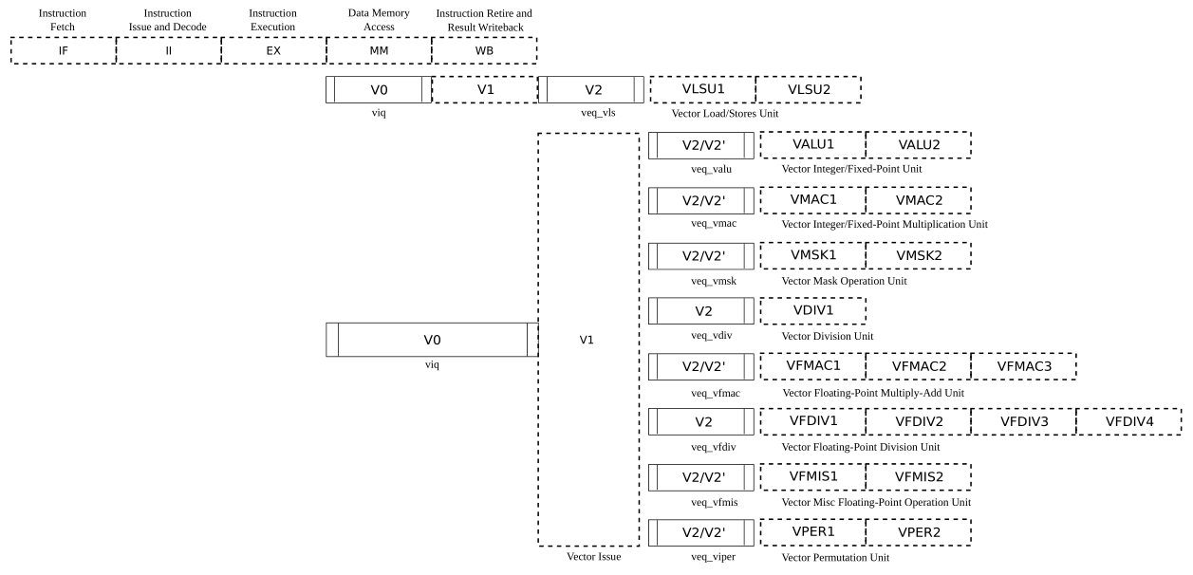
VPU stage
Frontend
Function unit

Slide 10
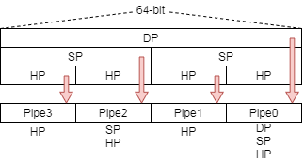
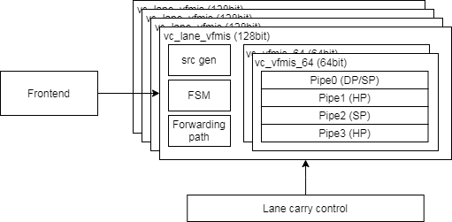
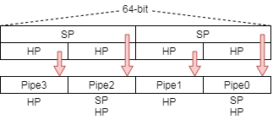
Function Unit Lane Hierarchy
ELEN=64
src_gen is for source data selection
Select data for read port 0/ 1/ 2/ 3 or scalar register
FSM is for reduction instructions to generate control signals
Lane_carry_control handle data forwarding between each lane
ELEN=32

Slide 11
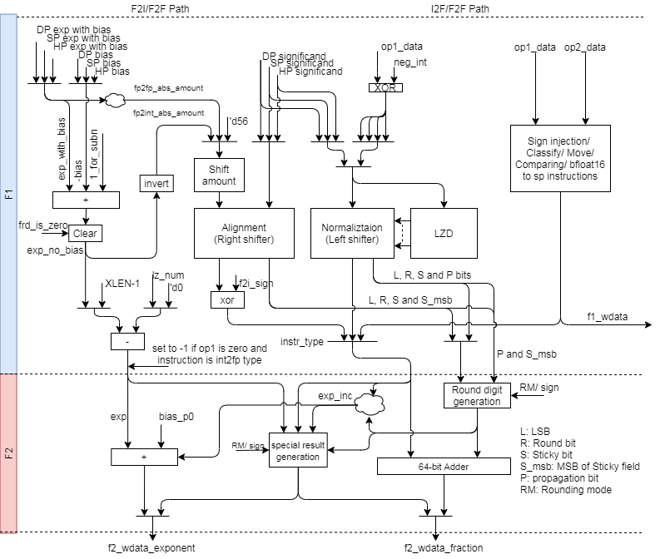
FMIS uArch (1/)

Slide 12
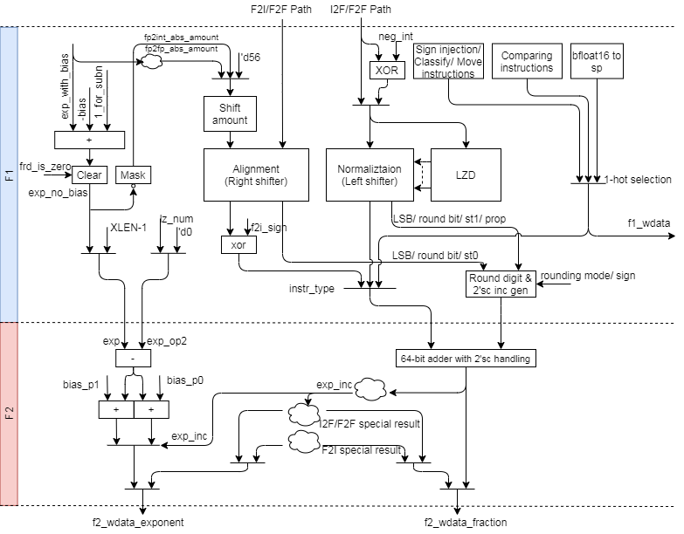
FMIS uArch (2/)
INT to FP

Slide 13
FMIS uArch (3/)
FP to INT

Slide 14
FMIS uArch (4/)
FP widening
FP narrowing
Bfloat16 to SP
SP to Bfloat16

Slide 15
FMIS uArch (5/)
Comparing instructions
Others instructions
Scalar fp result (XRF

Slide 16
Conversion instructions

Slide 17
Integer to FP Datapath
INT to FP

Slide 18
Integer to FP (1/)
Integer to floating-point dataflow
Data packing
Do 3 things in parallel
Do 2’sc for negative integer
Generate LZC
Find bit pattern for correction
Normalize data and generate sticky bit
Pack to significand format according destination precision
Do rounding
Enhancements
Detect Leading zero before 2’sc
Structuralized OR network
Structuralized AND network
Rearrange data alignment for I2F
Reduce selection multiplexers
Notes:
Bit width is (1+FLEN_MAX) - (1+FLEN_MIN) + XLEN

Slide 19
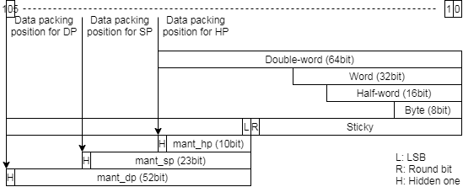
Integer to FP (2/)
Data packing
Reduce selection mux
Reduce shift amount computation
52/63 – LZC → 63 – LZC = ~LZC & mask (‘d63)
Notes:
Bit width is (1+FLEN_MAX) - (1+FLEN_MIN) + XLEN

Slide 20
Integer to FP (3/)
Normalization
Calculate leading zero number
Generate string for LZC
Exponent calculation
Rearrange data alignment for reducing selection mux
Result expo = (XLEN – 1) – LZC (expo hasn’t bias)
Apply structuralized OR network to calculate LZC, sticky bit and propagation bit
Apply barrel shift to normalize source data
Rounding
Generate round digit according to round mode, sticky bit and propagation bit
Select (exponent) or (exponent+1) according to carry bit

Slide 21
FP to Integer Datapath
FP to INT

Slide 22
FP to integer (1/)
Floating to integer dataflow
Data packing
Right shift packed data according to difference of exponent
Generate round digit
Do rounding and 2’sc at the same time
Enhancements
Rearrange data alignment for F2I
Merge 64bit and 54bit adder

Slide 23
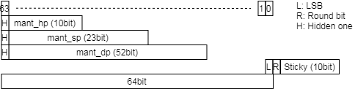
FP to integer (2/)
Unpack and align data
Align all precision source value at (XLEN - 1) bit like as following fig
Shift amount (exponent hasn’t bias)
ABS should support 65 shift amount value when XLEN is 64
ABS_amount == 64
aligned data LSB is hidden one
Sticky is (|abs_in[62:11]) / (|abs_in[62:0])
ABS_amount >= 65
aligned data LSB is zero
Sticky is set
Shift all significand to sticky field
Apply 64-bit adder to handle (exponent < 64)
Shift amount: (XLEN – 1) – exponent (exponent hasn’t bias)
XLEN=64 → 63–exponent → ~exponent & ‘d63
XLEN=32 → 31–exponent → ~exponent & ‘d31
Round digit/2’sc inc generation merge rounding and 2’sc steps

Slide 24
FP to FP Datapath
FP widening
FP narrowing
Bfloat16 to SP
SP to Bfloat16

Slide 25

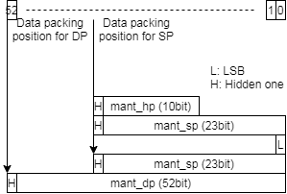
FP to FP – Widening FP (1/)
Widening instruction dataflow
Calculate LZC for subnormal value and do normalization
No Rounding is needed
No subnormal result
Data packing
Align hidden one and calculate LZC
Subnormal input will be shifted to normal fp format
Packing data according to destination precision

Slide 26
FP to FP – Narrowing FP (2/)
Narrowing instruction dataflow
Calculate subnormal result flag
Use subnormal result flag to select shift amount (shift to normal/subnormal)
Calculate exponent without bias
Generate shifted value and round digit
Do rounding
Enhancement
Rearrangement data alignment for narrowing FP
Because 64-bit and 54-bit adders are merged.

Slide 27
FP to FP – Narrowing FP (3/)
Calculate subnormal result flag
Use exponent to detect that result may be subnormal value (exponent has bias)
DP to SP subnormal (exponent - 1023 <= -127, exponent < 897)
DP to HP subnormal (exponent - 1023 <= -15, exponent < 1009)
SP to HP subnormal (exponent - 127 <= -15, exponent < 113)

Slide 28
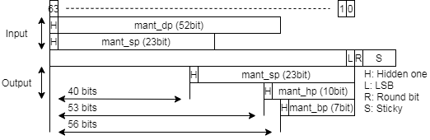
FP to FP – Narrowing FP (4/)
Shift amount
If normal result, ABS shift input value to normal format
DP to SP: 40
DP to HP: 53
SP to HP: 53
SP to Bfloat16: 56
If subnormal result, ABS shift input value to subnormal format
DP to SP: – (exponent – 1023) – 127 + 40 + 1 = ~exponent + 1 + 937 = ~exponent + 938
DP to HP: – (exponent – 1023) – 15 + 53 + 1 = ~exponent + 1 + 1062 = ~exponent + 1062
SP to HP: – (exponent – 127) – 15 + 53 + 1 = ~exponent + 1 + 166 = ~exponent + 167
exponent has bias

Slide 29
Round digit/2’sc inc generation

Slide 30
Round digit/2’sc inc generation (1/)

Slide 31
Round digit/2’sc inc generation (2/)
Merge the following steps to reduce dummy adder
increment 1 of 2’sc
rounding
The round digit support the following features
Rounding
Positive integer to floating-point
Floating-point to floating-point
Increment 1 then rounding
Negative integer to floating-point
Rounding then increment 1
Floating-point to negative integer

Slide 32
Round digit/2’sc inc generation (3/)
Rounding increment under different rounding mode
Sign | L | R | S |  | RNE | RTZ | RDN | RUP | RMM | ROD
0 | 0 | 0 | 0 |  | +0 | +0 | +0 | +0 | +0 | +1
0 | 0 | 0 | 1 |  | +0 | +0 | +0 | +1 | +0 | +1
0 | 0 | 1 | 0 |  | +0 | +0 | +0 | +1 | +1 | +1
0 | 0 | 1 | 1 |  | +1 | +0 | +0 | +1 | +1 | +1
0 | 1 | 0 | 0 |  | +0 | +0 | +0 | +0 | +0 | +0
0 | 1 | 0 | 1 |  | +0 | +0 | +0 | +1 | +0 | +0
0 | 1 | 1 | 0 |  | +1 | +0 | +0 | +1 | +1 | +0
0 | 1 | 1 | 1 |  | +1 | +0 | +0 | +1 | +1 | +0
1 | 0 | 0 | 0 |  | +0 | +0 | +0 | +0 | +0 | +1
1 | 0 | 0 | 1 |  | +0 | +0 | +1 | +0 | +0 | +1
1 | 0 | 1 | 0 |  | +0 | +0 | +1 | +0 | +1 | +1
1 | 0 | 1 | 1 |  | +1 | +0 | +1 | +0 | +1 | +1
1 | 1 | 0 | 0 |  | +0 | +0 | +0 | +0 | +0 | +0
1 | 1 | 0 | 1 |  | +0 | +0 | +1 | +0 | +0 | +0
1 | 1 | 1 | 0 |  | +1 | +0 | +1 | +0 | +1 | +0
1 | 1 | 1 | 1 |  | +1 | +0 | +1 | +0 | +1 | +0

Slide 33
Round digit/2’sc inc generation (4/)
1. Do rounding only
A + increment (1 bit) (A has not round bit)
Abbreviation
L is LSB/ R is round bit / S is sticky bit / Tie is (R & ~S)
Rounding mode | Rounding inc
RNE (Round to Nearest, ties to Even) | 1. R then clear sum LSB if tie/ 2. R & (L | S)
RTZ (Round Towards Zero) | 0
RDN (Round DowN) | sign & (R | S)
RUP (Round UP) | ~sign & (R | S)
RMM (Round to nearest, ties to Max Magnitude) | R
ROD (Round towards ODd) | 1. Set LSB when R or S is set 2. ~L & (R | S)

Slide 34
Round digit/2’sc inc generation (5/)
2. Increment 1 then rounding
Abbreviation
L is LSB
R is round bit
S is sticky bit
P is propagation bit
L, R, S is from 1’sc source value
Propagation bit
P is 1 if sticky field are all-one
P is 1 if the source LSB is moved to sticky MSB or higher.
* Unreachable

Slide 35
Round digit/2’sc inc generation (6/)
2’sc inc | S | P |  | Correct S | Carry
0 | 0 | 0 |  | 0 | 0
0 | 0 | 1 |  | 0 | 0
0 | 1 | 0 |  | 1 | 0
0 | 1 | 1 |  | 1 | 0
1 | 0 | 0 |  | 1 | 0
1 | 0 | 1 |  | 1 | 0
1 | 1 | 0 |  | 1 | 0
1 | 1 | 1 |  | 0 | 1
2. Increment 1 then rounding
Correction logic
Correction_S = (~2sc_inc & S) | (~(2sc_inc | (S & P)))
{Correction_L , Correction_R} = {L,R} + 2sc_inc & S & P
Round digit[1] is 2sc_inc & R & S & P
* Unreachable
Notes:
Correction_S
= (~2sc_inc & S) | (2sc_inc & (~S | ~P))
= (~2sc_inc & S) | (2sc_inc & ~(S & P))
= (~2sc_inc & S) | (~(2sc_inc | (S & P)))

Slide 36
Round digit/2’sc inc generation (7/)
3.Rounding then increment 1
Proof
B = A + r (A is before rounding, B is after rounding)
~A + inc = ~B + 1 = ~(A + r) + 1
R = 0 → ~A + inc = ~(A + 0) + 1 → inc = 1
R = 1 → ~A + inc = ~(A + 1) + 1 = ~A – 1 + 1 → inc = 0
-1 → A = 8’b11111111
~ (A + 1) = 8’b11111111
~A = 8’b00000000, ~A – 1 = 8’b11111111
-128 → A = 8’b10000000
~ (A + 1) = 8’b01111110
~A = 8’b01111111, ~A – 1 = 8’b01111110
Summary
inc is 0 if rounding increment is 1
inc is 1 if rounding increment is 0
Correction logic
neg_int_result ^ rounding inc
Notes:
A is value after rounding
R is rounding inclement
B = A+R
Result = B’+1 = (A+R)’+1
R = 0, Result = A’+1
R = 1, Result = A’-1+1 = A’

Slide 37
Round digit/2’sc inc generation (8/)
Abbreviation
r_inc is rounding increment
c_inc is 2’sc increment
neg_int_src is negative integer source
neg_int_res is negative integer result
Round digit
Round digit[1] is neg_int_src & c_inc
Round digit[0] is neg_int_res ^ r_inc
Then the sum of Round_digit[1], Round digit[0] and shifted data is the result
Notes:
A is value after rounding
R is rounding inclement
B = A+R
Result = B’+1 = (A+R)’+1
R = 0, Result = A’+1
R = 1, Result = A’-1+1 = A’

Slide 38
Underflow Flag Detection

Slide 39
Underflow Flag Detection – Special Case (1/)
Tininess is detected after rounding.
The exponent range are unbounded and the significand is not bounded to the corresponding format and keep normal format.
The above unbounded value is in subnormal range when exponent is unbounded. The bounded value will round to min normal value and it is not in subnormal range and underflow flag is not asserted because of rounding to min normal value. Thus, this special case should be detected.
 | Significand (HP) | Exponent
Unbounded | 01.1111_1111_11xxx | -15
bounded | 00.1111_1111_111xx | -14

Slide 40
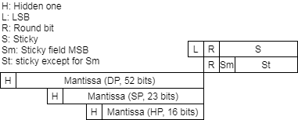
Underflow Flag Detection – Special Case (2/)
The Fig. show result format, L, R, S, Sm and St field.
The bit pattern is all-one mantissa and the next slide show underflow special case detection.
RM | Underflow special case
RNE | BP & R & ~Sm
RTZ | 0
RDN | BP & sign & (R^S)
RUP | BP & ~sign & (R^S)
RMM | BP & R & ~Sm
ROD | 0

Slide 41
Underflow Flag Detection – Normal Case (4/)
The underflow just qualify bit pattern, rounding carry (round digit) and other signals.
The bit pattern is the same with the special case

Slide 42
comparing & others instructions

Slide 43
Comparing & Others Instructions Datapath
Comparing instructions
Others instructions
Scalar fp result (XRF

Slide 44
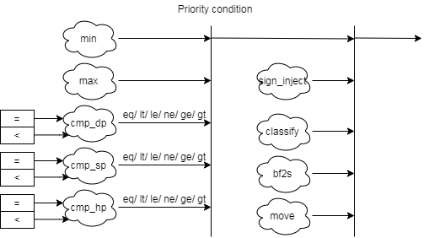
Comparing & Others Instructions
Comparing & others instruction block diagram detail
bf2s: bfloat16 to single

Slide 45
Comparing Instructions
Comparing instructions
Scalar: return 0/1
Vector: Write the comparison result to a mask register
Min/Max instructions
The rm field indicates MIN/MAX
FMIN: Write the smaller of rs1 and rs2 to rd
FMAX: Write the larger of rs2 and rs2 to rd
The value −0.0 is considered to be less than the value +0.0.
Both inputs are NaNs, the result is the canonical NaN.
Only one operand is a NaN, the result is the non-NaN operand.
Signaling NaN inputs raise the invalid operation exception, even when the result is not NaN.

Slide 46
Others Instructions
Sign-injection instructions
The result takes all bits except the sign bit form the vector vs2 operands.
The rm (rounding mode) field indicates J[N]/JX
Classify instructions
The 10-bit mask produced by this instruction is placed in the LSB of the result elements.
This instruction is only defined for SEW=16b above, so the result will always fit in the destination elements.
Rd bit | Meaning
0 | rs1 is -inf
1 | rs1 is a -normal number
2 | rs1 is a -subnormal number
3 | rs1 is -0
4 | rs1 is +0
5 | rs1 is a +subnormal number
6 | rs1 is a +normal number
7 | rs1 is +inf
8 | rs1 is a signaling NaN
9 | rs1 is a quiet NaN

Slide 47
Cross Lane datapath

Slide 48
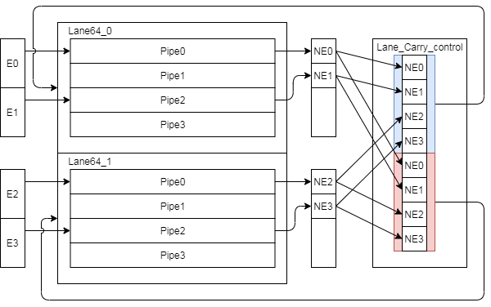
Narrowing & Mask Instruction Datapath
Narrowing and mask instruction format is special and those instruction result will go through to lower lane. (e.g. Lane 1→ Lane 0)
The following instruction need to shift to narrowing format
Lane produce result and pack result
Lane_Carry_control pack result and duplicated

Slide 49
Reduction Instructions (1/)
Reduction instruction data flow
Do the corresponding operator to deal with each vector element
Merge elements in lane first then merge remain results
LANE 2TO1
Lane2
Lane0
LANE 4TO2
Lane3
Lane1

Slide 50
Reduction Instructions (2/)
VLEN=512, 4*2 lanes * 64-bit
Inter lanes, op1 mux
Intra lane, op1 mux
Intra lane, op3 mux
Lane0 -64-bit
pipe0
pipe0
lane1
pipe1
pipe1
lane2
pipe2
pipe2
lane3
pipe3
pipe3
lane4
lane5
Unordered reduction
lane6
Ordered reduction
Dot-product, VD accumulation
lane7

Slide 51
Reduction Instructions (3/)
FSM
REDUCT_SCLR
State | Action
REDUCT_SCLR | also the idle state accumulate the scalar element
REDUCT_VEC | accumulate elements to its corresponded tree leaf node
PIPE_4TO2 | merge 4 pipe results in each lane to 2 p0 = p0 + p1, p2 = p2 + p3
PIPE_2TO1 | merge 2 pipe results in each lane to 1 p0 = p0 + p2
LANE_8TO4 | merge 8 lane results to 4
LANE_4TO2 | merge 4 lane results to 2
LANE_2TO1 | merge 2 lane result to 1, it’s the final result
DOTPROD_ACC
sew16
REDUCT_VEC
OREDUCT_VEC
PIPE_4TO2
sew32
uop_cnt != 0
uop_cnt != 0
PIPE_2TO1
sew64
VLEN | SIMD Ratio | Lane Count
512 | 1:1 | 8
256 | 1:1 | 4
128 | 1:1 | 2
512 | 2:1 | 4
256 | 2:1 | 2
128 | 2:1 | 1
lane_cnt = 8
LANE_8TO4
lane_cnt = 4
LANE_4TO2
lane_cnt = 2
LANE_2TO1

Slide 52
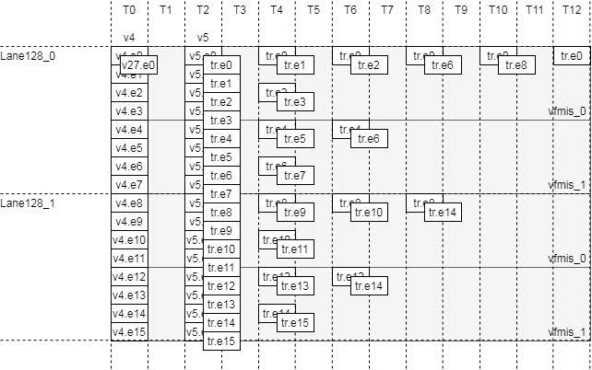
Reduction Instructions (4/)
VLEN=256, SIMD=256, LMUL=2, SEW=16, VL=VLMAX
REDUCT_VEC
REDUCT_VEC
PIPE_4TO2
PIPE_2TO1
LANE_4TO2
LANE_2TO1
REDUCT_SCLR
sew16
REDUCT_VEC
OREDUCT_VEC
PIPE_4TO2
sew32
uop_cnt != 0
uop_cnt != 0
PIPE_2TO1
sew64
lane_cnt = 8
LANE_8TO4
lane_cnt = 4
LANE_4TO2
lane_cnt = 2
LANE_2TO1

Slide 53
Conversion from nibble/byte to HP/SP (1/)
The design support conversion from nibble/byte to floating-point
The supported precisions are half-precision and single-precision
Interface
Signal name | Width | Description
sew | 3 | Indicate result fp type. 3’b010 indicates SP and others indicate HP
sign | 1 | 0 is unsigned and 1 is signed
data | 8 | 8-bit integer value
wdata | FLEN (16/32) | Result data. Do nan-boxing for hp result when result type is HP and FLEN is 32.

Slide 54
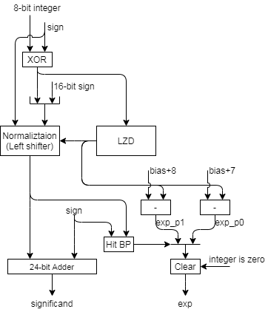

Conversion from nibble/byte to HP/SP (2/)
The following figures are the corresponding datapath
FLEN 32
FLEN 16

Slide 55
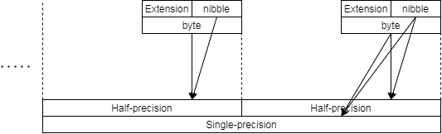
Conversion from nibble/byte to HP/SP (3/)
Data alignment
Do extension for nibble value according to signed or unsigned
Signed → signed extension
Unsigned → zero extension

Slide 56
Enhancements

Slide 57
Enhancement list (1/)
Enhance sticky generation path (st1)
Detect Leading zero before 2’sc
Rearrange data alignment for I2F
Rearrange data alignment for F2I
Rearrange data alignment for narrowing FP
Merge 64bit and 54bit adder and non-conversion data path
MISC
Move Bfloat16 to SP to fmv datapath

Slide 58
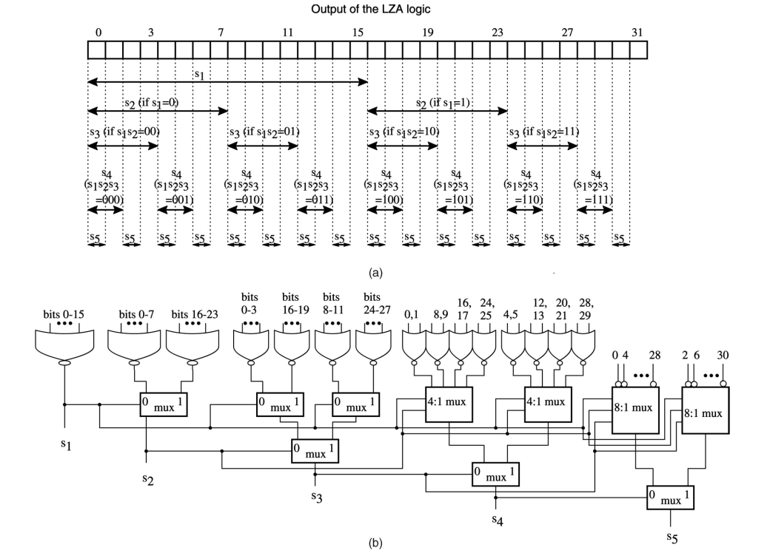
Structuralized OR network (1/)
LZC logic

Slide 59
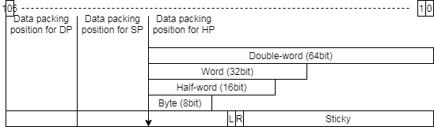
Structuralized OR network (2/)
LZC = 5d’13 = 5’b01101
LZC[4] = 0, L4_sticky = |bit[15:0]
LZC[3] = 1, L3_sticky = L4_sticky | 1’b0
LZC[2] = 1, L2_sticky = L3_sticky | 1’b0
LZC[1] = 0, L1_sticky = L2_sticky | bit[17:16]
LZC[0] = 1, L0_sticky = L1_sticky | (LZC[0]) ? bit[18] : |bit[19:18];
0 | 1 | 2 | 3 | 4 | 5 | 6 | 7 | 8 | 9 | 10 | 11 | 12 | 13 | 14 | 15 | 16 | 17 | 18 | 19 | 20 | 21 | 22 | 23 | 24 | 25 | 26 | 27 | 28 | 29 | 30 | 31
0 | 0 | 0 | 0 | 0 | 0 | 0 | 0 | 0 | 0 | 0 | 0 | 0 | 1 | 1 | 1 | 0 | 0 | 0 | 0 | 1 | 0 | 1 | 0 | 1 | 1 | 1 | 0 | 0 | 1 | 1 | 0
or
0
1
1
0
1
or
Notes:
l5_sticky = 1’b0
l4_sticky = (f1_s_lz_num[5] == 1’b1) ? l5_sticky :|bit[15:0]
L3_sticky = (f1_s_lz_num[5:4] == 2’b11) ? l4_sticky :
l4_sticky | (| bit[27:24])

Slide 60
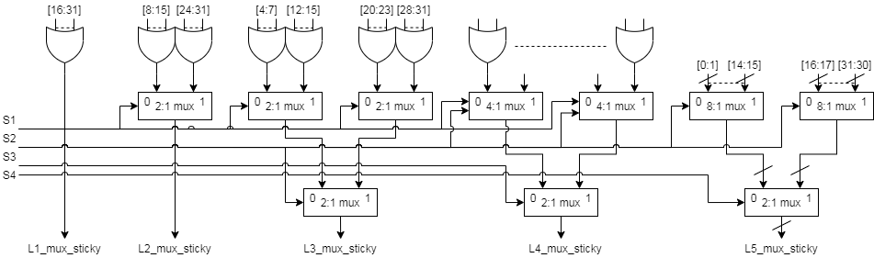
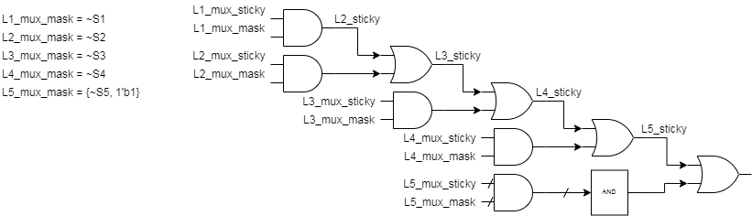
Structuralized OR network (3/)
BACK
Notes:
l5_sticky = 1’b0
l4_sticky = (f1_s_lz_num[5] == 1’b1) ? l5_sticky :|bit[15:0]
L3_sticky = (f1_s_lz_num[5:4] == 2’b11) ? l4_sticky :
l4_sticky | (| bit[27:24])

Slide 61
Structuralized OR network (4/)
63 | 62 | 61 | 60 | 59 | 58 | 57 | 56 | 55 | 54 | 53 | 52 | 51 | 50 | 49 | 48 | 47 | 46 | 45 | 44 | 43 | 42 | 41 | 40 | 39 | 38 | 37 | 36 | 35 | 34 | 33 | 32 | 31 | 30 | 29 | 28 | 27 | 26 | 25 | 24 | 23 | 22 | 21 | 20 | 19 | 18 | 17 | 16 | 15 | 14 | 13 | 12 | 11 | 10 | 9 | 8 | 7 | 6 | 5 | 4 | 3 | 2 | 1 | 0
0 | 0 | 0 | 0 | 0 | 0 | 0 | 0 | 0 | 0 | 0 | 0 | 0 | 1 | 1 | 1 | 0 | 0 | 0 | 0 | 1 | 0 | 1 | 0 | 1 | 1 | 1 | 0 | 0 | 1 | 1 | 0 | 0 | 0 | 0 | 0 | 0 | 0 | 0 | 0 | 0 | 0 | 0 | 0 | 1 | 1 | 1 | 0 | 0 | 0 | 0 | 1 | 0 | 1 | 0 | 1 | 1 | 1 | 0 | 0 | 1 | 1 | 0 | 0
LZC = 5d’13 = 5’b01101
LZC[4] = 0, L4_sticky = |bit[15:0]
LZC[3] = 1, L3_sticky = L4_sticky | 1’b0
LZC[2] = 1, L2_sticky = L3_sticky | 1’b0
LZC[1] = 0, L1_sticky = L2_sticky | bit[17:16]
LZC[0] = 1, L0_sticky = L1_sticky | (LZC[0]) ? bit[18] : |bit[19:18];
Notes:
l5_sticky = 1’b0
l4_sticky = (f1_s_lz_num[5] == 1’b1) ? l5_sticky :|bit[15:0]
L3_sticky = (f1_s_lz_num[5:4] == 2’b11) ? l4_sticky :
l4_sticky | (| bit[27:24])

Slide 62
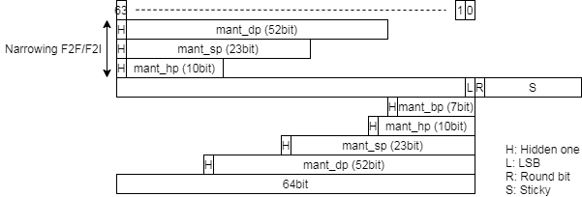
Structuralized OR network - ABS(1/)
Generate sticky
Do OR with the shifted sticky field
Notes:
l5_sticky = 1’b0
l4_sticky = LZC[4] & (|bit[16:31])
L3_mux_sticky = (LZC[4:3] == 2’b00) ? (|bit[16:31])

Slide 63
Structuralized OR network - ABS(2/)
LZC = 5d’13 = 5’b01101
LZC[4] = 0, L4_sticky = LZC[4] & (|bit[16:31])
LZC[3] = 1, L3_sticky = LZC[3] & (|bit[24:31])
LZC[2] = 1, L2_sticky = LZC[2] & (|bit[20:23])
LZC[1] = 0, L1_sticky = LZC[1] & (|bit[18:19])
LZC[0] = 1, L0_sticky = LZC[0] & bit[19]
Sticky = L4_sticky | L3_sticky | L2_sticky | L1_sticky | L0_sticky;
0 | 1 | 2 | 3 | 4 | 5 | 6 | 7 | 8 | 9 | 10 | 11 | 12 | 13 | 14 | 15 | 16 | 17 | 18 | 19 | 20 | 21 | 22 | 23 | 24 | 25 | 26 | 27 | 28 | 29 | 30 | 31
0 | 0 | 0 | 0 | 0 | 0 | 0 | 0 | 0 | 0 | 0 | 0 | 0 | 1 | 1 | 1 | 0 | 0 | 0 | 0 | 1 | 0 | 1 | 0 | 1 | 1 | 1 | 0 | 0 | 1 | 1 | 0
LZC[4]=0
LZC[3]= 1
LZC[2]= 1
LZC[1]= 0
LZC[0]= 1
LZC[4]=0
or
LZC[4:3]=01
or
LZC[4:1]=0110
Notes:
l5_sticky = 1’b0
l4_sticky = LZC[4] & (|bit[16:31])
L3_mux_sticky = (LZC[4:3] == 2’b00) ? (|bit[16:31])

Slide 64
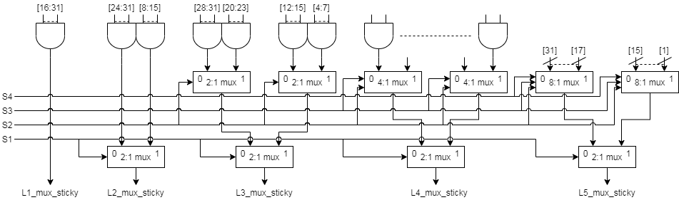
Structuralized OR network - ABS(3/)
Notes:
l5_sticky = 1’b0
l4_sticky = LZC[4] & (|bit[16:31])
L3_mux_sticky = (LZC[4:3] == 2’b00) ? (|bit[16:31])

Slide 65
Structuralized AND network (1/)
Structuralized AND network is similar to OR network
Do AND(&) operation on field and increase normalized value for increasing of 2’sc
Notes:
l5_sticky = 1’b0
l4_sticky = (f1_s_lz_num[5] == 1’b1) ? l5_sticky :|bit[15:0]
L3_sticky = (f1_s_lz_num[5:4] == 2’b11) ? l4_sticky :
l4_sticky | (| bit[27:24])

Slide 66
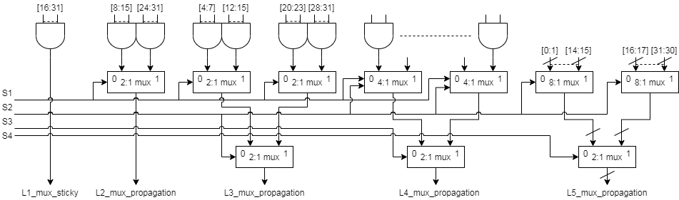

Structuralized AND network (2/)
BACK
Notes:
l5_sticky = 1’b0
l4_sticky = (f1_s_lz_num[5] == 1’b1) ? l5_sticky :|bit[15:0]
L3_sticky = (f1_s_lz_num[5:4] == 2’b11) ? l4_sticky :
l4_sticky | (| bit[27:24])

Slide 67
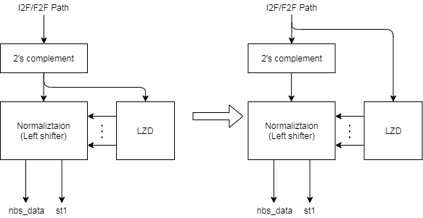
Leading zero detection before 2’sc (1/)
Generate LZC early
What’s input string?

Slide 68
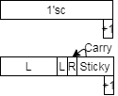
Leading zero detection before 2’sc (2/)
Merge increment of 2’sc (for negative integer source) to round digit generation and
Add structuralized AND network to deal with carry (from sticky part) because of 2’sc increment
If (1’sc + 1) raise carry bit then exp_inc can select correct exponent
Negative integer is 16’b1111_1000_0000_0000
1’sc →16’b0000_0111_1111_1111
Pack to HP format → 01.1111_1111_11 and increment 1 for 2’sc
Result → 10.0000_0000_00 and carry is set then exponent increase 1

Slide 69
Leading zero detection before 2’sc (3/)
The tail pack 1 string for carry when the integer LSB are shifted in significand field
Example
If (1’sc + 1) raise carry bit then exp_inc can select correct exponent
Negative integer is 16’b1111_1111_0000_0000
1’sc →16’b0000_0000_1111_1111_111
Pack to HP format → 01.1111_1111_11 and increment 1 for 2’sc
Result → 10.0000_0000_00 and carry is set then exponent increase 1

Slide 70
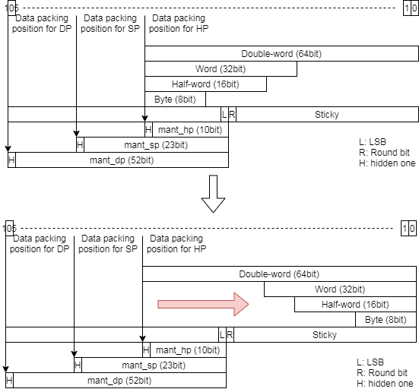
Rearrange data alignment for I2F (1/)
Modify integer value alignment from 63-bit to 0-bit
Reduce data type selection
For FLEN 32 (pipe0, pipe2)
Just force lz_num[5] to 1’b1
For FLEN 16 (pipe1, pipe3)
Just force lz_num[5:4] to 2’b11
After 2’sc
lz_num is leading zero count

Slide 71
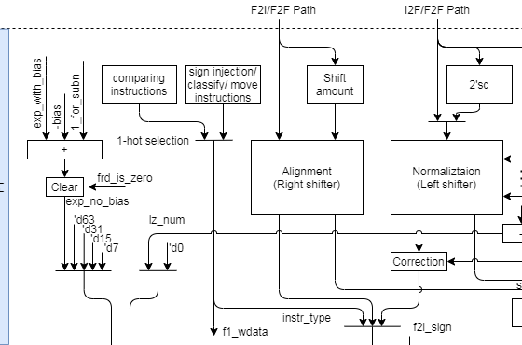
Rearrange data alignment for I2F (2/)
The following show reduced multiplexers
BACK

Slide 72
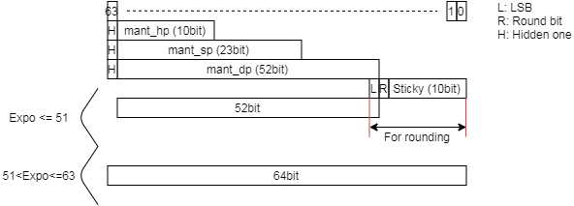
Rearrange data alignment for F2I (1/)
Apply a 64-bit adder
BACK

Slide 73
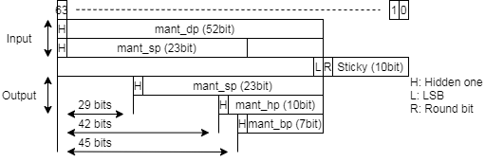
Rearrange data alignment for narrowing FP (1/)
This rearrangement is for merging two adders
All destination result types are aligned at LSB
ABS should support 65-bit right shift
BACK

Slide 74
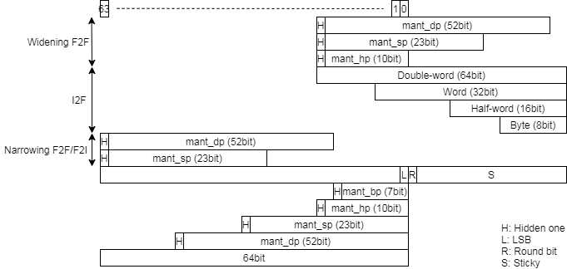
Merge 64bit and 54bit adder (1/)
Use 64-bit adder to do 64-bit 2’sc and 54-bit rounding
LSB of 64-bit is for round bit
Rearrange data alignment for all conversion instructions
Adjust shift amount according to changing alignment
BACK

Slide 75
MISC (1/)
Generate exp_inc in F1 stage
Bit pattern detection
Move exponent computation to F1 stage
Reduce 1 gate delay
Source data before clear
Use frd_is_zero to control mask

Slide 76
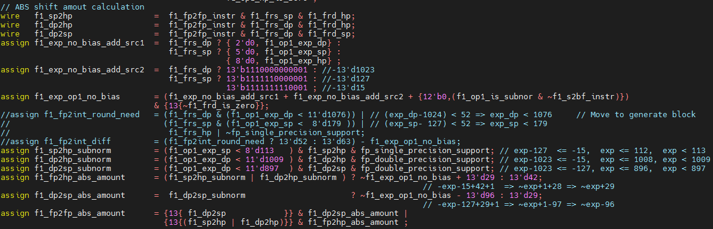
MISC (2/)
Compute F1_fp2hp_abs_amout with op1_exp
f1_exp_op1_no_bias = {2‘d0, f1_op1_exp_dp} – 13’d1023 if frs is DP
f1_exp_op1_no_bias = {5‘d0, f1_op1_exp_sp} – 13’d127 if frs is SP
Do not care subnormal source and special value will handle subnormal exponent
Modified shift amount
f1_dp2hp_abs_amount = (f1_dp2hp_subnorm) ? {2‘b11, ~f1_op1_exp_dp} + 13'd1052 : 13'd42;
f1_sp2hp_abs_amount = (f1_sp2hp_subnorm) ? {5‘b11111, ~f1_op1_exp_sp} + 13’d156 : 13'd42;
f1_dp2sp_abs_amount = (f1_dp2hp_subnorm) ? {2‘b11, ~f1_op1_exp_dp} + 13’d927 : 13'd29;

Slide 77
Interface

Slide 78
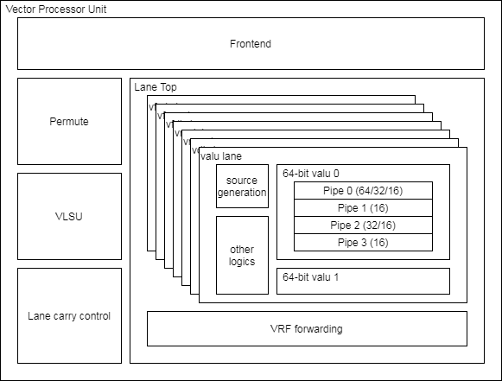
VPU Hierarchy

Slide 79
Lane Interface (1/)
Module name is vc_lane_vfmis.v
Hierarchy diagram

Slide 80
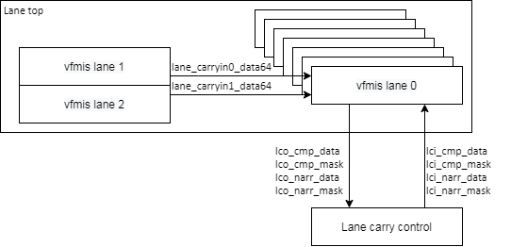
Lane Interface (2/)
Block connection diagram

Slide 81
Lane Interface (3/)
Signal name | Type | Description
core_clk | Input | Clock
core_reset_n | Input | Negative Edge Reset
lane_id | Input | Lane ID and it indicate lane0 for scalar floating-point logics
vfmis_vtype_sew | Input | Apply vsew to execute instruction
vfmis_csr_ediv | Input | Apply vediv to execute instruction
vfmis_vtype_lmul | Input | Apply vlmul to execute instruction
vfmis_rmode | Input | Apply frm to execute instruction
vfmis_valid | Input | Instruction valid signal
vfmis_uop_cnt | Input | Micro-op counter start from 0
vfmis_uop_first | Input | Indicate the 1st micro-op
vfmis_uop_last | Input | Indicate the last micro-op
vfmis_msk_bits | Input | The source data valid signal
vfmis_ex_ctrl | Input | Instruction encoding and please see Instruction encoding slide
vfmis_op_wide | Input | Indicate 2x width destination or source
vfmis_sign | Input | Indicate sign data (XRF)
vfmis_tail_bits | Input | Indicate the tail elements and the value is inversion of vfmis_msk_bits

Slide 82
Lane Interface (4/)
Signal name | Type | Description
vrf_data[0/1/2/3]_in | Input | The data is from VRF read port 0/1/2/3
frf_data[0/1/2]_out | Input | The data is from FRF read port 0/1/2/3
fmis_scalar_valid | Input | Indicate that the scalar data is valid
vfmis_[vs1/vs2/vs3]_valid | Input | The corresponding source data is valid
vfmis_[vs1/vs2/vs3]_select | Input | The corresponding source is from read port
vfmis_[rs1/rs2]_valid | Input | The corresponding source data is valid
vfmis_rs_data | Input | Indicate the scalar source data of vector instruction

Slide 83
Lane Interface (5/)
Signal name | Type | Description
vfmis_lane_carryin0_data64 | Input | The data is from other lanes and this port is for reduction instruction
vfmis_lane_carryin1_data64 | Input | The data is from other lanes and this port is for reduction instruction
vfmis_lane_carryout_data64 | Output | This is reduction instruction result and it will go to other lane
vfmis_lci_cmp_data | Input | Get permuted result from vc_lane_carry_control
vfmis_lci_cmp_mask | Input | Get permuted byte-write enable from vc_lane_carry_control
vfmis_lco_cmp_data | Output | This is comparing instruction result and the data will be permuted in vc_lane_carry_control
vfmis_lco_cmp_mask | Output | This is narrowing instruction byte-write enable and it will be permuted in vc_lane_carry_control
vfmis_lci_narr_data | Input | Get permuted result from vc_lane_carry_control
vfmis_lci_narr_mask | Input | Get permuted byte-write enable from vc_lane_carry_control
vfmis_lco_narr_data | Output | This is narrowing instruction result and the data will be permuted in vc_lane_carry_control
vfmis_lco_narr_mask | Output | This is narrowing instruction byte-write enable and it will be permuted in vc_lane_carry_control

Slide 84
Lane Interface (6/)
Signal name | Type | Description
vfmis_data | Output | Result VRF data
vfmis_frf_data | Output | Result FRF data
vfmis_xrf_data | Output | Result XRF data
vfmis_mask | Output | Result byte-write enable
vfmis_vfcsr_flag_set | Output | Result exception flag

Slide 85
Pipe Interface (1/)
Module name is vc_vfp_fmis.v
Supported FLENs are 16/32/64 and XLEN is the same with FLEN
Hierarchy diagram

Slide 86
Pipe Interface (2/)
Signal name | Type | Description
core_clk | Input | Clock
core_reset_n | Input | Negative Edge Reset
lane_pipe_id_0 | Input | Indicate Pipe 0 in Lane 0
f1_valid | Input | Valid signal
f1_fmis_scalar_valid | Input | Indicate scalar instruction
f1_ex_ctrl | Input | Control signal for encoding. More info in instruction encoding slide.
f1_sew | Input | Indicate element width
f1_ediv | Input | Un-used
f1_round_mode | Input | Round mode
f1_widen | Input | Widening instruction for vector instruction
f1_narrow | Input | Narrowing instruction for vector instruction
f1_sign | Input | Indicate signed integer source or decode instruction
f1_vmask | Input | The corresponding element v0.t value

Slide 87
Pipe Interface (3/)
Signal name | Type | Description
f1_op1_invalid | Input | Invalid oprand1
f1_op2_invalid | Input | Invalid oprand2
f1_op1_data | Input | Source oprand1
f1_op2_data | Input | Source oprand2
f1_cmp_inv_op | Output | Set invalid operation exception flag for scalar fp instruction (destination is XRF)
f1_wdata_en | Output | Write enable for F1 retired instruction (Instruction latency is 1)
f1_wdata | Output | Result data for F1 retired instruction (Instruction latency is 1)

Slide 88
Pipe Interface (4/)
Signal name | Type | Description
f2_result_type | Output | Result data type 3’b111 → DP 3’b110 → SP 3’b101 → HP 3’b100 → Bfloat16 3’b011 → Double-word 3’b010 → Word 3’b001 → Half-word 3’b000 → Byte
f2_cmp_result | Output | Partial compare result and upper module need to merging and shifting data.
f2_narr_wdata | Output | Partial narrowing result and upper module need to merging and shifting data.
f2_wdata_en | Output | Write enable for non F1 retired instruction (Instruction latency is 2 or 3)
f2_wdata | Output | Result data for non F1 retired instruction (Instruction latency is 2 or 3)
f2_flag_set | Output | Result exception flag

Slide 89
Instruction Encoding

Slide 90
Instruction encoding (1/)

Slide 91
Backup

Slide 92
Underflow Flag Detection – All cases
The condition should qualify bit pattern (BP) and the following condition under different rounding mode
BP | Sign | R | Sm | St |  | RNE | RTZ | RDN | RUP | RMM | ROD
Match | 0 | 0 | 0 | 0
Match | 0 | 0 | 0 | 1 |  |  |  |  | A
Match | 0 | 0 | 1 | 0 |  |  |  |  | A
Match | 0 | 0 | 1 | 1 |  |  |  |  | A
Match | 0 | 1 | 0 | 0 |  | A |  |  | A | A
Match | 0 | 1 | 0 | 1 |  | A |  |  |  | A
Match | 0 | 1 | 1 | 0
Match | 0 | 1 | 1 | 1
Match | 1 | 0 | 0 | 0
Match | 1 | 0 | 0 | 1 |  |  |  | A
Match | 1 | 0 | 1 | 0 |  |  |  | A
Match | 1 | 0 | 1 | 1 |  |  |  | A
Match | 1 | 1 | 0 | 0 |  | A |  | A |  | A
Match | 1 | 1 | 0 | 1 |  | A |  |  |  | A
Match | 1 | 1 | 1 | 0
Match | 1 | 1 | 1 | 1
RM | Underflow
RNE | BP & R & ~Sm
RTZ | 0
RDN | BP & sign & (R^S)
RUP | BP & ~sign & (R^S)
RMM | BP & R & ~Sm
ROD | 0

Slide 93
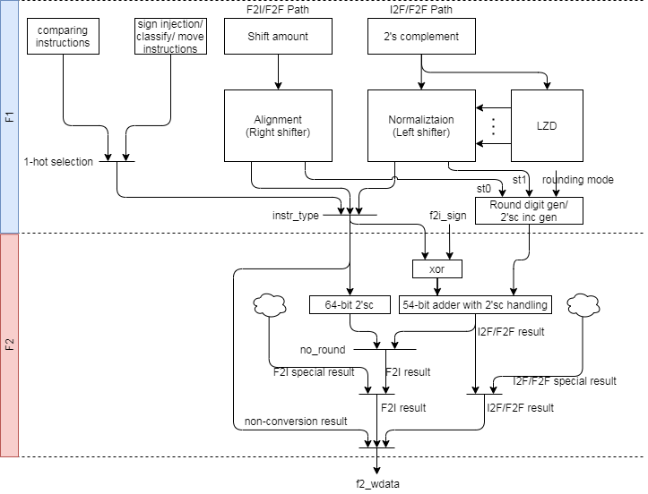
FMIS uArch – v0.1

Slide 94
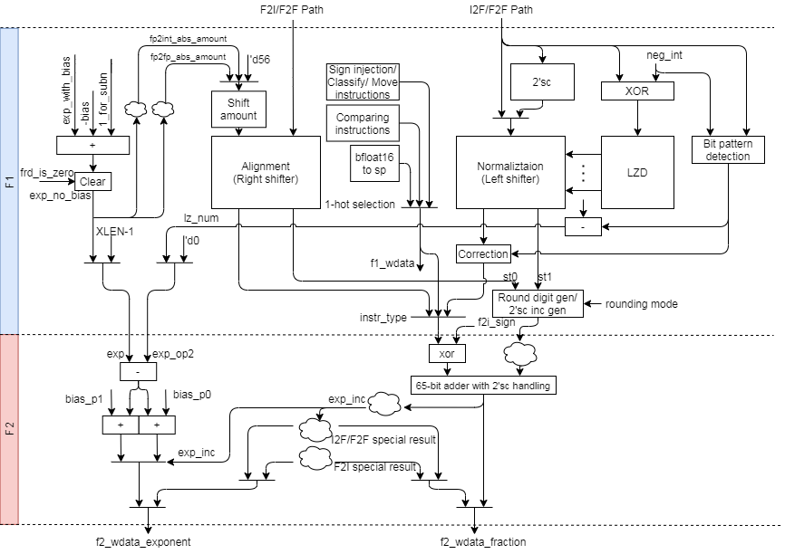
FMIS uArch – v0.2

Slide 95
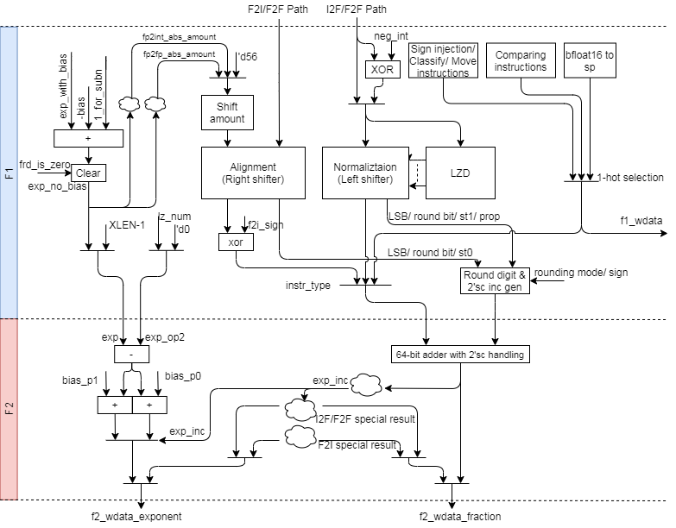
FMIS uArch – v0.3

Slide 96
FMIS uArch – v0.4

Slide 97
VFMIS64 PPA (1/)
The following RTL SHA-1 are
Original: master branch b81cf640d
V1: master branch 96a7f05b8
V2: master branch 4b13089c3
Synthesis tool: DC v2019.03-sp3
Tech_lib: tcbn28hpcplusbwp30p140ssg0p81vm40c
The following reports has output delay
Flag output delay is 50ps, outputs in F1 are 100ps and outputs in F2 are 200ps, and then FMIS F2 stage just have 340ps@1.25GHz and 500ps@1.00GHz
Feq. | XLEN/FLEN | Original (kgates/ps) | V1 (kgates/ps/ %) | V2 (kgates/ps / %)
1.00GHz | 64/32 | 23.32 / MET | 19.09 / MET / -18.14 | 18.17 / MET / -22.08
 | 64/64 | 26.82 / MET | 22.40 / MET / -16.48 | 21.17 / MET / -21.17
1.25GHz | 64/32 | 33.20 / -75ps | 26.66 / -40ps / -19.70 | 25.81 / -7ps / -22.26
 | 64/64 | 35.41 / -105ps | 32.39 / -50ps / -8.53 | 31.56 / -31ps / -10.87
Notes:
set input_delay_ratio 0.3
set_input_delay [expr $clk_period * $input_delay_ratio] -clock CORE_CLK [all_inputs]
set_output_delay [expr 0.1] -clock CORE_CLK [get_ports f1_wdata*]
set_output_delay [expr 0.1] -clock CORE_CLK [get_ports f1_cmp_inv_op]
set_output_delay [expr 0.2] -clock CORE_CLK [get_ports vfmis_data64]
set_output_delay [expr 0.2] -clock CORE_CLK [get_ports vfmis_narr_data64]
set_output_delay [expr 0.2] -clock CORE_CLK [get_ports vfmis_mask8]
set_output_delay [expr 0.2] -clock CORE_CLK [get_ports vfmis_cmp_data4]
set_output_delay [expr 0.2] -clock CORE_CLK [get_ports vfmis_vd_is_mr_mask8]
set_output_delay [expr 0.05] -clock CORE_CLK [get_ports vfmis_vfcsr_flag_set]

Slide 98
VFMIS64 PPA (2/)
Feq. | XLEN/FLEN | Module | Original | V1 | V2
1.00GHz | 64/32 | vc_vfmis64 fmis_pipe0 fmis_pipe1 fmis_pipe2 fmis_pipe3 | 8813.9520 2821.0140 789.7680 2551.6260 786.4920 | 7211.1059 / -18.19% 2440.872 / -13.48% 660.24 / -16.40% 1709.568 / -33.00% 666.288 / -15.28% | 6852.3840 / -22.26% 2412.3960 / -14.48% 615.1320 / -22.11% 1602.7200 / -37.19% 610.5960 / -22.36%
 | 64/64 | vc_vfmis64 fmis_pipe0 fmis_pipe1 fmis_pipe2 fmis_pipe3 | 10138.7160 3912.4260 786.6180 2643.9840 779.3100 | 8460.2699 / -16.55% 3500.7840 / -10.52% 676.1160 / -14.05% 1725.8220 / -34.73% 676.6200 / -13.18% | 7999.6139 / -21.10% 3393.8100 / -13.26% 607.9500 / -22.71% 1603.4760 / -39.35% 609.5880 / -21.78%
1.25GHz | 64/32 | vc_vfmis64 fmis_pipe0 fmis_pipe1 fmis_pipe2 fmis_pipe3 | 12544.8119 4448.5560 921.9420 3786.5520 902.2860 | 10071.306 / -19.72% 3575.502 / -19.63% 832.608 / -9.69% 2394.378 / -36.77% 874.314 / -3.10% | 9753.2820 / -22.25% 3553.5780 / -20.12% 815.9760 / -11.49% 2291.9400 / -39.47% 817.4880 / -9.40%
 | 64/64 | vc_vfmis64 fmis_pipe0 fmis_pipe1 fmis_pipe2 fmis_pipe3 | 13386.4919 5844.8880 859.9500 3352.2300 880.3620 | 12243.9239 / -8.54% 5645.304 / -3.41% 851.256 / -1.01% 2435.454 / -27.35% 877.338 / -0.34% | 11927.0339 / -10.90% 5768.6580 / -1.30% 776.1600 / -9.74% 2235.2400 / -33.32% 834.4980 / -5.21%

Slide 99
VFMIS64 PPA (3/)
The following RTL SHA-1 are
Original: master branch b81cf640d
V1: master branch 96a7f05b8
V2: master branch 4b13089c3
V3: separate data FFs for conversion and non-conversion instruction
Synthesis tool: DC v2019.03-sp3
Tech_lib: tcbn28hpcplusbwp30p140ssg0p81vm40c
The following reports has output delay
Flag output delay is 50ps, outputs in F1 are 100ps and outputs in F2 are 200ps, and then FMIS F2 stage just have 340ps@1.25GHz and 500ps@1.00GHz
Feq. | XLEN/FLEN | Original (kgates/ps) | V1 (kgates/ps/ %) | V2 (kgates/ps / %) | V3 (kgates/ps / %)
1.00GHz | 64/32 | 23.32 / MET | 19.09 / MET / -18.14 | 18.17 / MET / -22.08 | 19.26 / MET / -17.41
 | 64/64 | 26.82 / MET | 22.40 / MET / -16.48 | 21.17 / MET / -21.17 | 22.06 / MET / -17.75
1.25GHz | 64/32 | 33.20 / -75ps | 26.66 / -40ps / -19.70 | 25.81 / -7ps / -22.26 | 27.08 / -17ps / -18.34
 | 64/64 | 35.41 / -105ps | 32.39 / -50ps / -8.53 | 31.56 / -31ps / -10.87 | 31.54 / -23ps / -10.92
Notes:
set input_delay_ratio 0.3
set_input_delay [expr $clk_period * $input_delay_ratio] -clock CORE_CLK [all_inputs]
set_output_delay [expr 0.1] -clock CORE_CLK [get_ports f1_wdata*]
set_output_delay [expr 0.1] -clock CORE_CLK [get_ports f1_cmp_inv_op]
set_output_delay [expr 0.2] -clock CORE_CLK [get_ports vfmis_data64]
set_output_delay [expr 0.2] -clock CORE_CLK [get_ports vfmis_narr_data64]
set_output_delay [expr 0.2] -clock CORE_CLK [get_ports vfmis_mask8]
set_output_delay [expr 0.2] -clock CORE_CLK [get_ports vfmis_cmp_data4]
set_output_delay [expr 0.2] -clock CORE_CLK [get_ports vfmis_vd_is_mr_mask8]
set_output_delay [expr 0.05] -clock CORE_CLK [get_ports vfmis_vfcsr_flag_set]

Slide 100
VFMIS64 PPA (4/)
Feq. | XLEN/FLEN | Module | Original | V1 | V2 | V3
1.00GHz | 64/32 | vc_vfmis64 fmis_pipe0 fmis_pipe1 fmis_pipe2 fmis_pipe3 | 8813.9520 2821.0140 789.7680 2551.6260 786.4920 | 7211.1059 / -18.19% 2440.872 / -13.48% 660.24 / -16.40% 1709.568 / -33.00% 666.288 / -15.28% | 6852.3840 / -22.26% 2412.3960 / -14.48% 615.1320 / -22.11% 1602.7200 / -37.19% 610.5960 / -22.36% | 7273.2239 / -17.48% 2551.2480 / -9.56% 621.6840 / -21.28% 1622.2500 / -36.42% 629.6220 / -19.95%
 | 64/64 | vc_vfmis64 fmis_pipe0 fmis_pipe1 fmis_pipe2 fmis_pipe3 | 10138.7160 3912.4260 786.6180 2643.9840 779.3100 | 8460.2699 / -16.55% 3500.7840 / -10.52% 676.1160 / -14.05% 1725.8220 / -34.73% 676.6200 / -13.18% | 7999.6139 / -21.10% 3393.8100 / -13.26% 607.9500 / -22.71% 1603.4760 / -39.35% 609.5880 / -21.78% | 8329.9860 / -17.84% 3467.1420 / -11.38% 624.7080 / -20.58% 1619.6040 / -38.74% 627.8580 / -19.43%
1.25GHz | 64/32 | vc_vfmis64 fmis_pipe0 fmis_pipe1 fmis_pipe2 fmis_pipe3 | 12544.8119 4448.5560 921.9420 3786.5520 902.2860 | 10071.306 / -19.72% 3575.502 / -19.63% 832.608 / -9.69% 2394.378 / -36.77% 874.314 / -3.10% | 9753.2820 / -22.25% 3553.5780 / -20.12% 815.9760 / -11.49% 2291.9400 / -39.47% 817.4880 / -9.40% | 10233.2159 / -18.43% 3743.5860 / -15.85% 832.7340 / -9.68% 2296.8540 / -39.34% 823.6620 / -8.71%
 | 64/64 | vc_vfmis64 fmis_pipe0 fmis_pipe1 fmis_pipe2 fmis_pipe3 | 13386.4919 5844.8880 859.9500 3352.2300 880.3620 | 12243.9239 / -8.54% 5645.304 / -3.41% 851.256 / -1.01% 2435.454 / -27.35% 877.338 / -0.34% | 11927.0339 / -10.90% 5768.6580 / -1.30% 776.1600 / -9.74% 2235.2400 / -33.32% 834.4980 / -5.21% | 11913.2999 / -11.01% 5494.3560 / -6.00% 763.5600 / -11.21% 2245.0680 / -33.03% 790.1460 / -10.25%

Slide 101
VFMIS64 PPA (5/)
The following RTL SHA-1 are
Original: master branch b81cf640d
V3-1: master branch af2d1076d
V3-2: master branch af2d1076d with FMIS_PWR_REDUCTION macro
Synthesis tool: DC v2019.03-sp3
Tech_lib: tcbn28hpcplusbwp30p140ssg0p81vm40c
The following reports has output delay
Flag output delay is 50ps, outputs in F1 are 100ps and outputs in F2 are 200ps, and then FMIS F2 stage just have 340ps@1.25GHz and 500ps@1.00GHz
Feq. | XLEN/FLEN | Original (kgates/ps) | V3-1 (kgates/ps / %) | V3-2 (kgates/ps / %)
1.00GHz | 64/32 | 23.32 / MET | 17.67 / MET / -24.23% | 19.26 / MET / -17.41%
 | 64/64 | 26.82 / MET | 20.33 / MET / -24.20% | 22.06 / MET / -17.75%
1.25GHz | 64/32 | 33.20 / -75ps | 24.93 / -19ps / -24.91% | 27.08 / -17ps / -18.34%
 | 64/64 | 35.41 / -105ps | 29.69 / -33ps / -16.15% | 31.54 / -23ps / -10.92%
Notes:
set input_delay_ratio 0.3
set_input_delay [expr $clk_period * $input_delay_ratio] -clock CORE_CLK [all_inputs]
set_output_delay [expr 0.1] -clock CORE_CLK [get_ports f1_wdata*]
set_output_delay [expr 0.1] -clock CORE_CLK [get_ports f1_cmp_inv_op]
set_output_delay [expr 0.2] -clock CORE_CLK [get_ports vfmis_data64]
set_output_delay [expr 0.2] -clock CORE_CLK [get_ports vfmis_narr_data64]
set_output_delay [expr 0.2] -clock CORE_CLK [get_ports vfmis_mask8]
set_output_delay [expr 0.2] -clock CORE_CLK [get_ports vfmis_cmp_data4]
set_output_delay [expr 0.2] -clock CORE_CLK [get_ports vfmis_vd_is_mr_mask8]
set_output_delay [expr 0.05] -clock CORE_CLK [get_ports vfmis_vfcsr_flag_set]

Slide 102
VFMIS64 PPA (6/)
Feq. | XLEN/FLEN | Module | Original | V3-1 | V3-2
1.00GHz | 64/32 | vc_vfmis64 fmis_pipe0 fmis_pipe1 fmis_pipe2 fmis_pipe3 | 8813.9520 2821.0140 789.7680 2551.6260 786.4920 | 6668.5500 / -24.34% 2430.5400 / -13.84% 619.7940 / -21.52% 1641.0240 / -35.69% 622.5660 / -20.84% | 7273.2239 / -17.48% 2551.2480 / -9.56% 621.6840 / -21.28% 1622.2500 / -36.42% 629.6220 / -19.95%
 | 64/64 | vc_vfmis64 fmis_pipe0 fmis_pipe1 fmis_pipe2 fmis_pipe3 | 10138.7160 3912.4260 786.6180 2643.9840 779.3100 | 7677.0540 / -24.28% 3386.5020 / -13.44% 610.0920 / -22.44% 1610.9100 / -39.07% 619.2900 / -20.53% | 8329.9860 / -17.84% 3467.1420 / -11.38% 624.7080 / -20.58% 1619.6040 / -38.74% 627.8580 / -19.43%
1.25GHz | 64/32 | vc_vfmis64 fmis_pipe0 fmis_pipe1 fmis_pipe2 fmis_pipe3 | 12544.8119 4448.5560 921.9420 3786.5520 902.2860 | 9424.4220 / -24.87% 3465.3780 / -22.10% 771.8760 / -16.28% 2397.0240 / -36.70% 802.7460 / -11.03% | 10233.2159 / -18.43% 3743.5860 / -15.85% 832.7340 / -9.68% 2296.8540 / -39.34% 823.6620 / -8.71%
 | 64/64 | vc_vfmis64 fmis_pipe0 fmis_pipe1 fmis_pipe2 fmis_pipe3 | 13386.4919 5844.8880 859.9500 3352.2300 880.3620 | 11220.0479 / -16.18% 5520.4380 / -5.55% 760.5360 / -11.56% 2246.0760 / -33.00% 778.0500 / -11.62% | 11913.2999 / -11.01% 5494.3560 / -6.00% 763.5600 / -11.21% 2245.0680 / -33.03% 790.1460 / -10.25%

