Slide 1
FMADD datapath
Yuan-Yuan Shih
2007/12/25

Slide 2
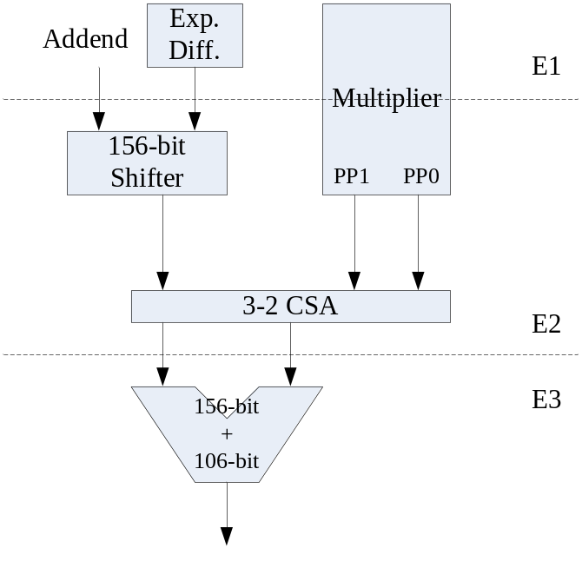
Scheme 1

Slide 3
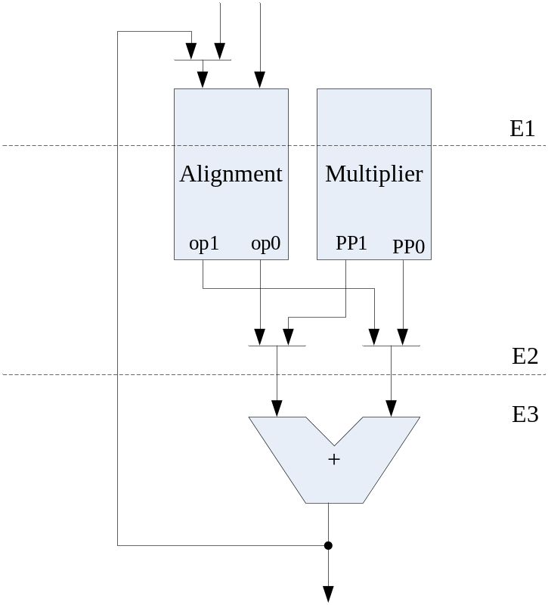
Scheme 2

Slide 4
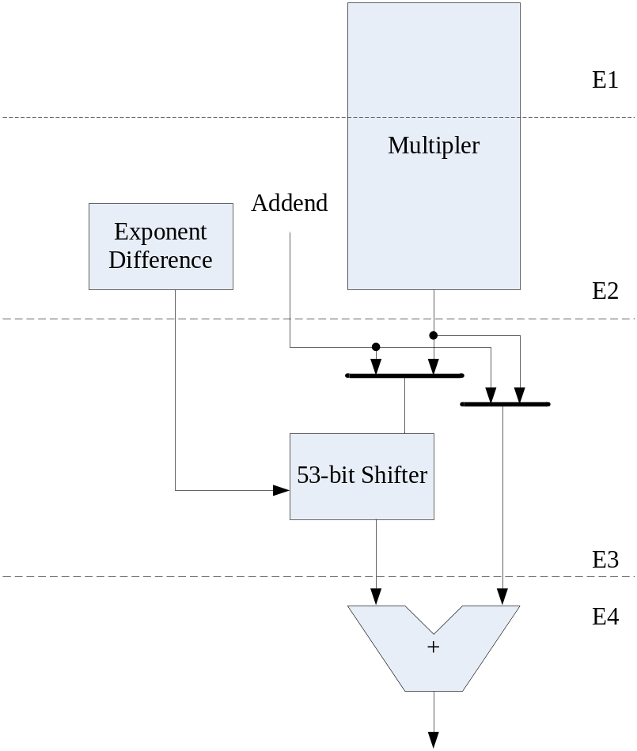
Scheme 3

