Slide 1
Panther Bus Interface
Driving Innovations™
Kane
2015-10-08

Slide 2
Basic Structure
Instruction and Data channel
AXI4 x2
Configurable address width: 24 to 64 bits
Data width: 64-bit
Synchronous bus clock domain
Clock phase enable signal
Synchronous FIFO
Snoop Channel
biu_path
core clk domain
sync_fifo
bus clk domain
ocp
ahb
axi_wrapper
SCU

Slide 3
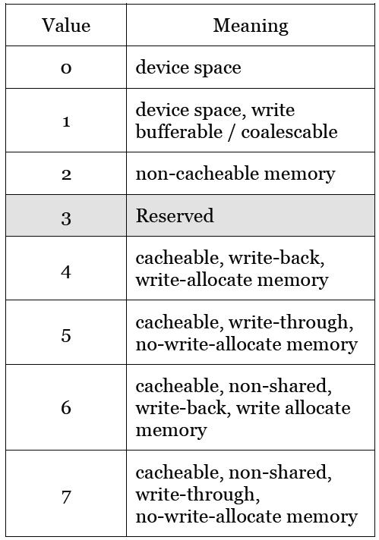
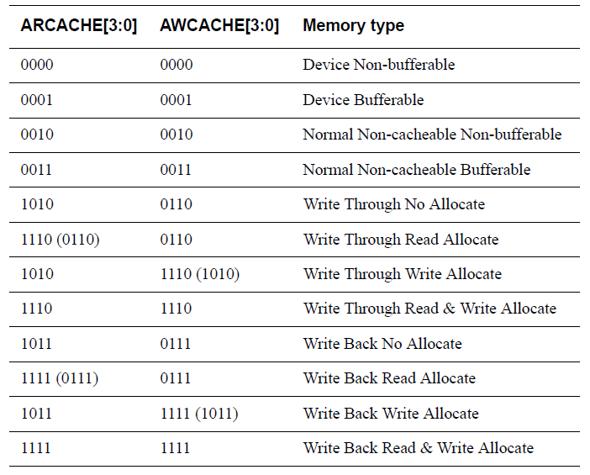
Requirement
Cacheability indication
Use “C” field from $MR3 (TLB_DATA)
Translate to output AR/WCACHE[3:0] for memory type encoding (AXI4)

Slide 4
Requirement - 2
Interface change between BIU and other internal modules
Add wait-cycle to return data phase
ready-valid (ack) handshaking protocol
Pros:
Other internal modules don’t have to receive the response data immediately (when “ack” is asserted)
No pre-allocated buffer is needed for each module, reduce area overhead
Cons:
The return data has to be kept in BIU, one extra buffer is needed for BIU

Slide 5
Requirement - 3
Snoop channel for ACU
How to cancel WB command/data queue entry after hit by snoop
In-queue
Not observed by AXI interface (not top)
BIU
LSU
ACU
cmd/data
wb_fifo_0
wb_fifo_1
Cancel FIFO entry
wb_fifo_2
lsu_wb_0
wb_fifo_3
lsu_wb_1
lsu_wb_2
SCU
lsu_wb_3
Provide snoop data

