Slide 1
PMA/PMP
Driving Innovations™
Along-Chiang

Slide 2
MMU Block Diagram
IFU
LSU
sfence
SFENCE
ITLB
DTLB
Shared TLB
PMP
PMA
LSU PTE PA query
Page table walker
BIU

Slide 3
Hierarchical PMA
Programmable PMA Structure
There has a maximum of 16 entries.
These regions can overlap, if overlap, the lowest-numbered PMA entry matching the memory access address will have the highest priority.
Statically Configured Background PMA Structure
There has a maximum of 8 entries for device and write-through(with read-allocation) regions.
The 8 device(write-through) regions cannot overlap by themselves.
If any write-through region overlaps with a device region, the device region will win the arbitration for a memory access.
The others non-define base is a memory region that is write-back(with read/write-allocate).
Next stage: extend to 16 entries

Slide 4
PMA Configuration Registers
RV32
RV64
 | 31 24 | 23 16 | 15 8 | 7 0
pmacfg0: | pma3cfg | pma2cfg | pma1cfg | pma0cfg
pmacfg1: | pma7cfg | pma6cfg | Pma5cfg | pma4cfg
pmacfg2: | pma11cfg | pma10cfg | pma9cfg | pma8cfg
pmacfg3: | pma15cfg | pma14cfg | pma13cfg | pma12cfg
 | 31 24 | 23 16 | 15 8 | 7 0
pmacfg0: | pma3cfg | pma2cfg | pma1cfg | pma0cfg
 | 63 56 | 55 48 | 47 40 | 39 32
 | pma7cfg | pma6cfg | Pma5cfg | pma4cfg
 | 31 24 | 23 16 | 15 8 | 7 0
pmacfg2: | pma11cfg | pma10cfg | pma9cfg | pma8cfg
 | 63 56 | 55 48 | 47 40 | 39 32
 | pma15cfg | pma14cfg | pma13cfg | pma12cfg
PMP

Slide 5
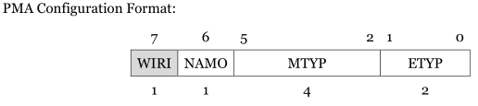
Programmable PMA CONFIG
Field Name | Bits | Description
ETYP | [1:0] | 00 | OFF: PMA entry is disabled
 |  | 01 | TOR: Top of range.
 |  | 10 | NA4: Naturally aligned 4-byte region
 |  | 11 | NAPOT: Naturally aligned power-of-2 region
MTYP | [5:2] | Memory type attribute
NAMO | [6] | Atomic Memory Operation instructions (including LR/SC) are not supported in this region.
WIRI | [7] | Reserved WIRI field.
When bit[6] is set and an AMO instruction is encountered in this region, an access fault/PMA NAMO exception will be generated.
# The TOR and NA4 are not supported.
# If set to TOR or NA4 will return OFF.

Slide 6
Memory attribute
Encoding Value | Type
0 | Device, Non-bufferable
1 | Device, bufferrable
2 | Memory, Non-cacheable, Non-bufferable
3 | Memory, Non-cacheable, Bufferable
4 | Memory, Write-through, No-allocate
5 | Memory, Write-through, Read-allocate
6 | Memory, Write-through, Write-allocate
7 | Memory, Write-through, Read and Write-allocate
8 | Memory, Write-back, No-allocate
9 | Memory, Write-back, Read-allocate
10 | Memory, Write-back, Write-allocate
11 | Memory, Write-back, Read and Write-allocate
12-14 | Reserved(return all ones)
15 | Empty hole, nothing exists.
The WT is not support in MP core.
And ETYP will change to OFF when MTYP set to WT.
The read data will be change to 4(5) if mtype set to 6(7) .
Instruction fetch will generate an Instruction access fault.
Load instruction access will generate a Load access fault.
Store instruction access will generate a Store access fault.

Slide 7
Transfer table for AXI
Encoding Value | Type | ARCACHE | AWCACHE
0 | Device, Non-bufferable | 0000 | 0000
1 | Device, bufferrable | 0001 | 0001
2 | Memory, Non-cacheable, Non-bufferable | 0010 | 0010
3 | Memory, Non-cacheable, Bufferable | 0011 | 0011
4 | Memory, Write-through, No-allocate | 1010 | 0110
5 | Memory, Write-through, Read-allocate | 0110 | 0110
6 | Memory, Write-through, Write-allocate | 1010 | 1010
7 | Memory, Write-through, Read and Write-allocate | 1110 | 1110
8 | Memory, Write-back, No-allocate | 1011 | 0111
9 | Memory, Write-back, Read-allocate | 0111 | 0111
10 | Memory, Write-back, Write-allocate | 1011 | 1011
11 | Memory, Write-back, Read and Write-allocate | 1111 | 1111
12-14 | Reserved(all ones) | - | -
15 | empty hole, not exist | - | -

Slide 8
Transfer table for AHB
Encoding Value | Type | HPROT[3] cacheable | HPROT[2] bufferable | HPROT[1] privileged | HPROT[0] data/fetch
0-1 | Device | 0 | 0 | - | -
2-3 | Memory, Non-cacheable | 0 | 0 | - | -
4-7 | Memory, Write-through | 1 | 0 | - | -
8-11 | Memory, Write-back | 1 | 1 | - | -

Slide 9
PMA A Word Address Registers
PMAADDR0~PMAADDR15
This register represents a 4-byte aligned word address for PMA matching.
In vicuna the PMA is set to 4K granularity
For NAPOT matching mode, the low-order bits of this register encode the size of the address range.
XLEN-1 0
address[XLEN+1:2]

Slide 10
NAPOT range encoding
Pmaaddr | Match Size (aligned byte range)
aaaa…aaaaaaaaaa0 | 8
aaaa…aaaaaaaaa10 | 16
aaaa…aaaaaaaa100 | 32
… | …
aaaa…a0111111111 | 4K
aaaa…01111111111 | 8K
… | …
aa01…1111 | 2^{XLEN}
a011…1111 | 2^{XLEN+1}
0111…1111 | 2^{XLEN+2}
1111…1111 | 2^{XLEN+2}
The bit[8:0] will return all ones when the pmaaddr is set to less than 4k size. And the return all zeros when the ETYP is set to OFF
Software may determine the PMA granularity by writing zero to pmaicfg, then writing all ones to pmaaddri, then reading back pmpaddri. See the return value can know the PMA granularity.

Slide 11
PMA decoder
The PMA information will be ignored when address base match I/DLM, any pma exception should not be asserted.
No PMA entry match | If a PMA entry match any-byte.
 | No all-byte match | All-byte match
Background PMA | Background PMA | MTYP & NAMO

Slide 12
PMA exception
PMA empty hole access(gen in MMU)
If the memory region is an empty hold should assert a PMA exception
PMA attribute inconsistency (gen in LSU)
An access with multiple PMA regions with different attributes should assert a PMA exception
PMA NAMO exception (gen in LSU)

Slide 13
PMA Inconsistency
MM
WB
WBD
mmu_lsu_mtype
mm_hold_mtype
Inconsistency compare result

Slide 14
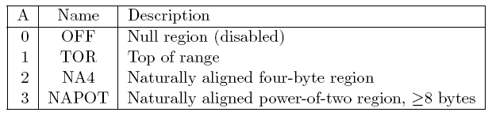
PMP Conf. Reg. Format
R : Read
W: Write
X : Execute
A : Address match
L : Lock
TOR
PMP entry i's A field is set to TOR, the entry matches any address a such that pmpaddr i-1 <= a < pmpaddr i.
PMP entry 0's A field is set to TOR, zero is used for the lower bound, and so it matches any address a < pmpaddr 0.
PMA

Slide 15
LOCK
Locked PMP entries may only be unlocked with a system reset.
If PMP entry i is locked, writes to pmpicfg and pmpaddri are ignored.
If pmpicfg.A is set to TOR, writes to pmpaddri-1 are ignored.
When the L bit is set, the R/W/X these permissions are enforced for all privilege modes.
When the L bit is clear, any M-mode access matching the PMP entry will succeed.

Slide 16
Priority and Matching Logic
- PMP entries are statically prioritized
- Failed accesses generate a load, store, or instruction access exception.
Mode | No PMP entry match | If a PMP entry match any-byte.
 |  | No all-byte match | All-byte match
 |  |  | L=0 | L=1
M | Success | Fail | Success | check R/W/X
S/U | Fail | Fail | check R/W/X

Slide 17
PMP Granularity
The PMP granularity is configurable.
There are 8, 16, 32, …, 4K byte can set.
The PMP checked logic bit should be variable with granularity.

Slide 18
Vector PMP 1/
Vector access and setting limitation
Overlap PMP region with higher priority should not less than 512bytes.
The vector access should be falls completely within a PMP entry.
The PMP entry should be greater than or equal than 512 bytes.
The TOR lower and upper bound should be aligned the 512 boundary.

Slide 19
Vector PMP 2/
Success
Any uop <=512B
uop15
…
Pmp region>=512B
uop1
uop0
Pmp region>=512B
uop1
uop0
Pmp region>=512B

Slide 20
Vector PMP 3/
fail
fail
Pmp region<512B
uop1
Pmp region<512B
uop0
uop0
pass
Pmp region>=512B
Can’t be set in vector pmp entries
Pmp(x) region<512B
Pmp(x+1) region=512B

Slide 21
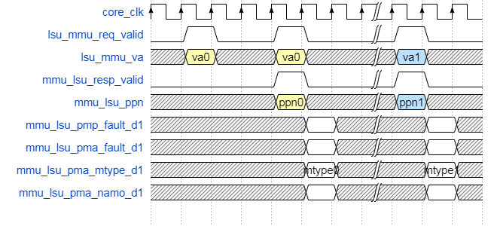
LSU access
MMU support
The request needs replay if no dtlb hit.
The PMP and PMA information will return at next cycle when DTLB hit.
No MMU
The response will be asserted when getting request, and return information at next cycle.

Slide 22
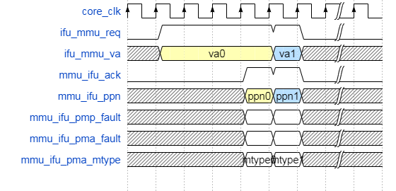
IFU access
Hit ITLB
The ack asserted will wait for the PMP/PMA ready.

Slide 23

Thank You!
www.andestech.com

Slide 24
Thank You!

