Slide 1
Synthesis

Slide 2
Run Command
Genus
run_flow vc_core_ae350.ctl --core_clk 0.833 --compile_itr 5 --config a27_config9.gen --define --syn_tool genus --syn_version v18.11 --formal no --formal_version v11.10.440 --tech_lib tcbn28hpcplusbwp30p140ssg0p81vm40c --mem_lib temn28hpcphssrammacros --report_power --title A27_config9_mmu_fpu_28nm_1200MHz --model vicuna.mdl
DC
run_flow vc_core_ae350.ctl --core_clk 0.833 --compile_itr 5 --config a25_config9.gen --define --syn_tool dc --syn_version v2019.03-sp3 --formal no --formal_version v11.10.440 --tech_lib tcbn28hpcplusbwp30p140ssg0p81vm40c --mem_lib temn28hpcphssrammacros --tech_lib_tc tcbn28hpcbwp12t35p140tt0p9v25c --report_power --pf_type saif --power_pattern dhrystone --title DC_A27_config9_mmu_fpu_28nm_1200MHz --model vicuna.mdl
Will trans to .inc in prepare_core_syn.pl

Slide 3
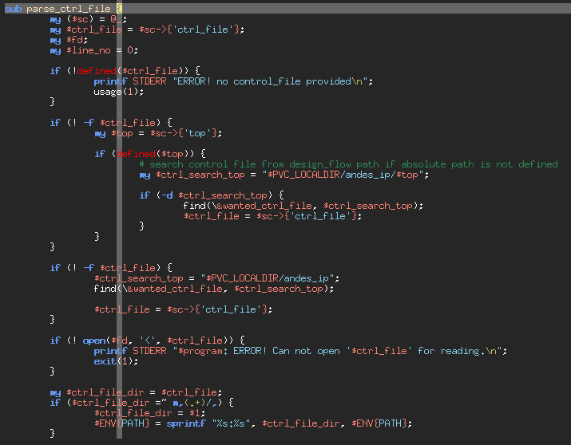
run_flow
run_flow ,w
/home/project/eda/pkgs/andes/design_flow/edge/bin/run_flow

Slide 4
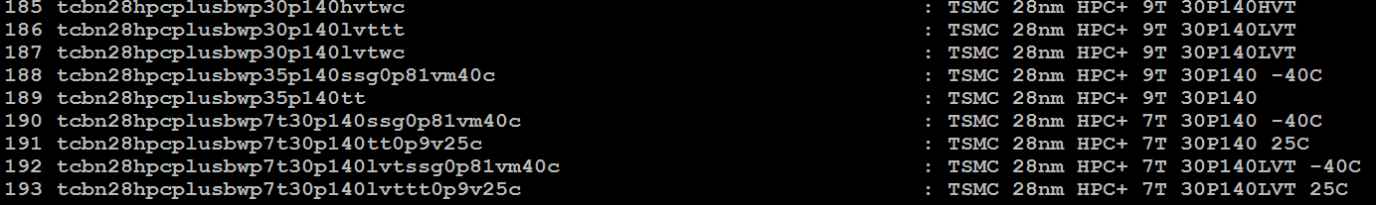
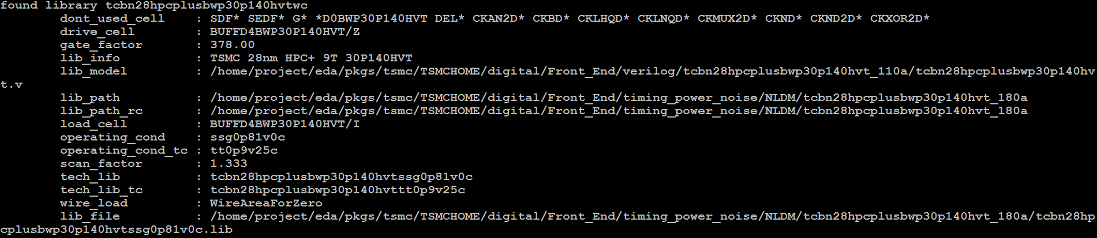
LIB
list_tech_lib | less
list_tech_lib tcbn28hpcplusbwp30p140hvtwc
Mem_lib: list_mem_lib | less

Slide 5
Add new Lib
/home/project/eda/pkgs/andes/design_flow/edge/bin/tech_lib.pl
/home/project/eda/pkgs/andes/design_flow/edge/bin/mem_lib.pl

Slide 6
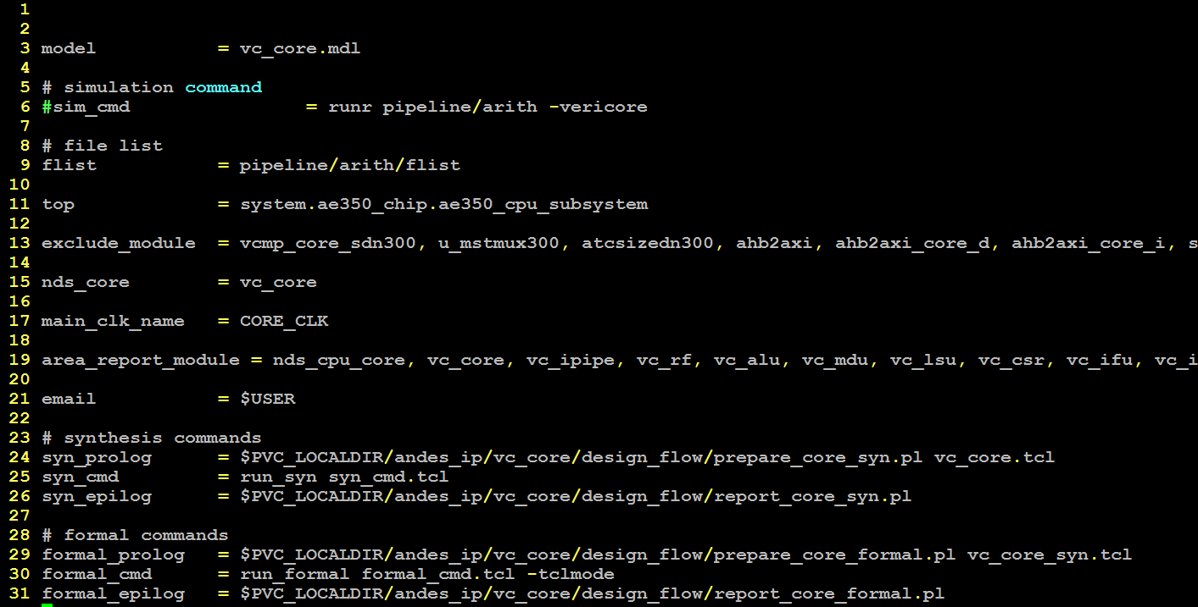
XXX.ctl
vc_core.ctl, vc_core_verify.ctl(random syn) for ae250
vc_core_ae350.ctl, vc_core_ae350_verify.ctl(random syn) for ae350

Slide 7
XXX.tcl
Synthesis env setting and run.
root design
File/Lib search path
Read lib/RTL
Constraints
…
Start synthesis

Slide 8
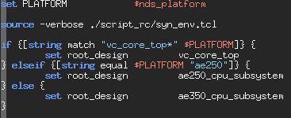
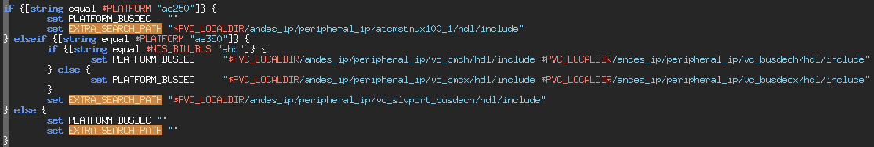
PLATFORM Set
Random synthesis needs to reset the search path for select AHB or AXI.

Slide 9
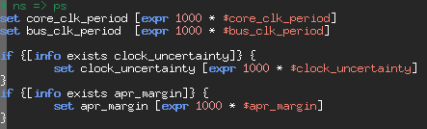
Timescale
The Genus(RC) timescale is ps.
So, the period need transfer from ns to ps
DC is ns.
Default 30%

Slide 10
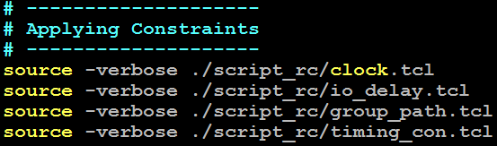
Constraints
clock: all clock port or pin should be created/generated.
io_delay: all input and output
group_path: focus some path to optimize
timing_con: relation of clock to clock and reset

Slide 11
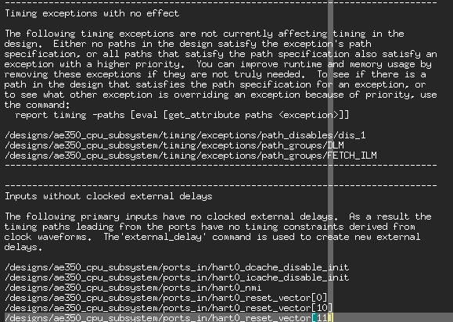
Constraints Check
The constraint check will put in “rpt/timing_lint.rpt”

Slide 12
Check Log
The Errors and Warnings will print to mail.
If any warnings can be waive please add to check_log, check_log_rc, and check_log_genus.

Slide 13
Regression
prj_scripts
vicuna_PPA_weekmeeting, genus
vicuna_PPA_weekmeeting_DC, dc
vicuna_design_flow_RC, raadam synthesis
vicuna_design_flow_DC, raadam synthesis

Slide 14
MP
The MP synthesis is bottom-up flow.
L2 and core should be ready before top.
The .ctl and script are independence.
See ~vicuna/bin/vicuna/vicuna_PPA_weekmeeting

