Slide 1
D23 BIU

Slide 2
Discussion (3/2)
Requirement Review
PPI data width
Fixed to 32 or not ?
FIO TYPE?
Should it be 1 cycle response?

Slide 3
Discussion (3/9)
Requirement Review (Requirement - 3)
CHECK APB related IP for AE350 (SIZEDN … etc.)
Low Latency Port (LLP) in AE350
HEXCL in AHB5
HMASTERLOCK in N22

Slide 4
Discussion (3/16)
Block Diagram
CMD/RESP Queue: configurable or remove
AHB5 – HPORT changes
Spec: AHB5 + AHB4 compatible?
AE350
Demo PPI and LLP usage on AE350

Slide 5
Discussion (3/22)
Block Diagram Detail
Arbiters
Decode
PPI/LLP Base + Size (Aligned)
Path function

Slide 6
Discussion (3/29) - TODO
BIU discussion is temporary done in 3/22
Start PMP/other discussion on 3/29
ePMP
ePMP
utlb(?)
CLIC or PLIC / PLMT (embedded) / PLDM (embedded)

Slide 7
D23 BIU Requirement - 1
Interface:
CPU internal:
IFU/LSU Load/LSU Store/MMU
Extendable to 4
CPU out: (Flop-Out) / (Input timing should be block at bus-wrapper) / (Bus protocol configurable)
System Bus (AHB-Lite or AXI) → Ref. to N22 BIU
Peripheral Port (APB or AHB) → Ref. to N22 PPI
Low Latency Port (AHB or AHB) → Ref. to N22 FIO
Spec - System Bus AHB
Data Width: 32/64 (power of 2, >32)
Address Width: 24 – 64 (parameter)
Type: SINGLE-BYTE/WORD/H-WORD/D-WORD, WRAP4/8/16-WORD, INCR4/8/16-WORD
WRAP and INCR support depends on Cache Config.
Always support sync N:1 clock ratio
HMASTERLOCK is supported.
(TODO: Detail) (HL2H support LOCK?) (How to support LOCK in AHB-L)

Slide 8
D23 BIU Requirement - 2
Spec – Peripheral Port APB
Data Width: Same as CPU data width
Depends on CPU data width => Add SIZEDN on platform when CPU data width is 64
Address Width: Depends on Peripheral Port SIZE
Type: SINGLE-BYTE/WORD/H-WORD/D-WORD
Handle Burst transaction from Internal request
Always sync N:1 clock ratio
Config/Control CSR support
Connect to APB-Subsystem in AE350
Outstanding request: AHB/APB/AHB-Low-Latency
Spec – Low Latency Port AHB
Configurable
Data Width: Same as CPU data width
Address Width: Depends on Low Latency Port SIZE Same as CPU address width
Type: Same as system port
Always support sync N:1 clock ratio
Connect to each bus slave (?)

Slide 9
D23 BIU Requirement - 3
Spec – Internal request support
Outstanding request to multiple destination port (response outstanding or in sequence?)
LSU is ID-based implementation => out-of-order response is acceptable
IFU is not ID-based now => the response should be in sequence now.
Different interface: No out-standing, Same interface: out-standing is acceptable.
*** consider no response buffer in BIU
*** 1. back-to-back 2. reduce gate-count
I/D Cache Support – burst transaction
The I/D Cache only issues WRAP burst
Spec – MISC.
Different Port region can not overlap
CPU-out Interface can issue back-to-back transfer.
AHB: should burst be early terminated when error response happen. (?)
In N22, the burst transaction is not be early terminated by error response now.
Report address when error response happens

Slide 10
Reference: N22 BIU Spec – AHB-L
AHB-Lite:
Address Width: 24/32
Data Width: Fixed to 32
Configurable sync N:1 clock ratio
Type: SINGLE-BYTE/WORD/H-WORD, INCR8-WORD (Only when I$ is supported)
HMASTERLOCK is supported.

Slide 11
Reference: N22 AMO by HMASTERLOCK
The HMASTERLOCK is an address phase signal
The HMASTLOCK signal is asserted to lock the AHB-Lite bus once the LR instruction is executed.
BIU will hold the lock until it executes the SC instruction or the internal lock is cleared.

Slide 12
Reference: AHB5 interface
Signal | Destination | Description
HNONSEC | Slave and decoder | Indicates that the current transfer is either a Non-secure transfer or a Secure transfer. This signal is supported if the AHB5 Secure_Transfers property is True.
HEXCL master out | Exclusive Access Monitor | Exclusive Transfer. Indicates that the transfer is part of an Exclusive access sequence. This signal is supported if the AHB5 Exclusive_Transfers property is True.
HEXOKAY. slv -> mst | Multiplexor | Exclusive Okay. Indicates the success or failure of an Exclusive Transfer. This signal is supported if the AHB5 Exclusive_Transfers property is True.

Slide 13
Reference: AHB5 Exclusive
An Exclusive access sequence is a sequence of Exclusive Transfers from a single master that operate using the
** The HEXCL is an address phase signal
** The Transaction with HEXCL is expectedly to get the HEXOKAY
following steps:
Perform an Exclusive Read transfer from an address. (LR)
Calculate a new data value to store to that address that is based on the data value obtained from the Exclusive Read.
Between the Exclusive Read and the Exclusive Write there can be other Non-exclusive transfers.
Perform an Exclusive Write transfer to the same address, with the new data value(SC)
The response to the Exclusive Write transfer indicates if the transfer was successful or if it failed.
HEXOKAY must only be asserted in the same cycle as HREADY is asserted.
HEXOKAY must not be asserted in the same cycle as HRESP is asserted.
Can add an assertion.

Slide 14
Reference: AHB5 HPROT
Bit | Name | Desctipion
HPROT[0] | Data/Inst | 0: Inst Fetch 1: Data Access
HPROT[1] | Privileged | 0: Unprivileged 1: Privileged
HPROT[2] | Bufferable | Memory Type setting (Next page.)
HPROT[3] | Modifiable
HPROT[4] | Lookup
HPROT[5] | Allocate
HPROT[6] | Shareable

Slide 15
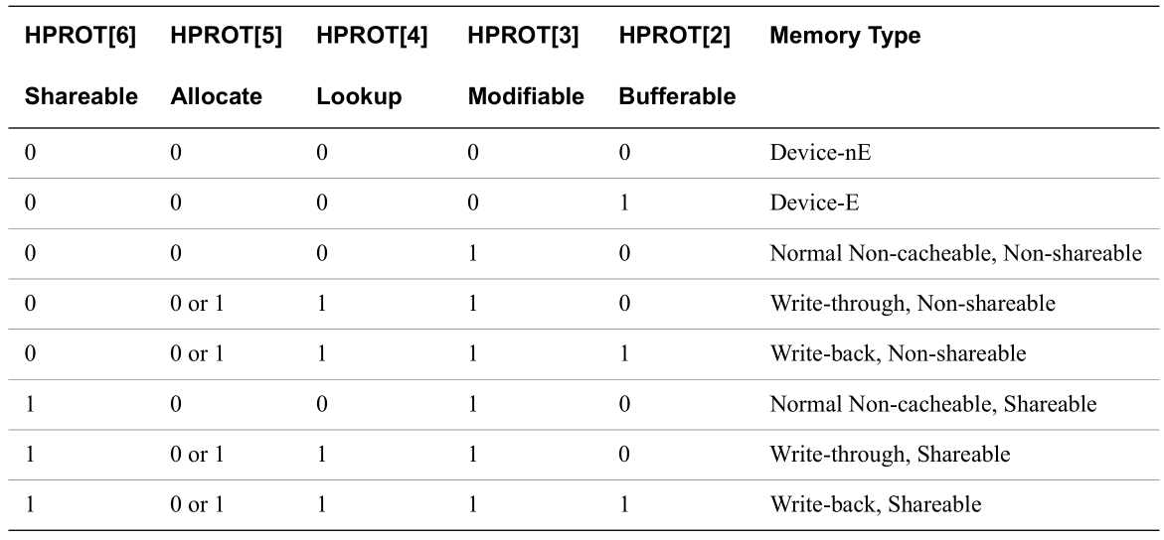
Reference: AHB5 HPROT
Device-nE / E: indicates the early write is acceptable or not:
Early write: the write response should be issued by the final-destination

Slide 16
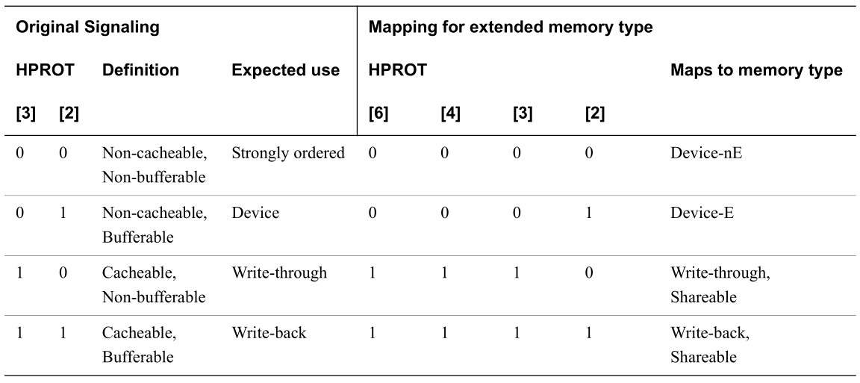
Reference: AHB5 HPROT
HPROT mapping between AHB5 and AHB4 AHB5/4 will be selected by core config
allocate/lookup means Cacheable: AHB5-HPROT[6] mapping to AHB4-HPROT[3] BIU will get MTYPE, use AHB4/5 decode
Bufferable has the same meaning: AHB5-HPROT[2] mapping to AHB4-HPROT[2] Prepare MTYPE to AHB5/4, AXI, APB (use case)

Slide 17
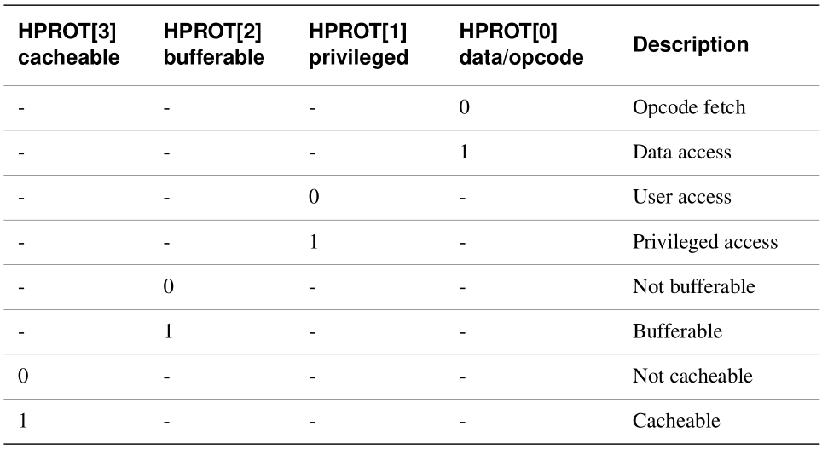
REF: HPROT in AHB4

Slide 18
HPROT [0], [1]
HPROT[0]
0: Inst
1: Data
HPROT[1]
0: U-Mode
1: M-Mode

Slide 19
MTYPE to AHB4.HPROT
MYPE |  | Description | HPROT[3] Cacheable | HPROT[2] Bufferable
4’b0000 | 0 | Device non-buffer | 0 | 0
4’b0001 | 1 | Device Bufferable | 0 | 1
4’b0010 | 2 | Normal Non-cacheable Non-bufferable | 0 | 0
4’b0011 | 3 | Normal Non-cacheable Bufferable | 0 | 1
4’b0100 | 4 | Write-through No-allocate | 1 | 0
4’b0101 | 5 | Write-through Read allocate | 1 | 0
4’b0110 | 6 | Write-through Write-allocate | 1 | 0
4’b0111 | 7 | Write-through Read and Write-allocate | 1 | 0
4’b1000 | 8 | Write-back No-allocate | 1 | 1
4’b1001 | 9 | Write-back Read-allocate | 1 | 1
4’b1010 | 10 | Write-back Write-allocate | 1 | 1
4’b1011 | 11 | Write-back Read and Write-allocate | 1 | 1

Slide 20
MTYPE to AHB5.HPROT
MYPE |  | Description | HPROT[6] Shareable | HPROT[5] Allocate | HPROT[4] Lookup | HPROT[3] Modifiable | HPROT[2] Bufferable
4’b0000 | 0 | Device non-buffer | 0 | 0 | 0 | 0 | 0
4’b0001 | 1 | Device Bufferable | 0 | 0 | 0 | 0 | 1
4’b0010 | 2 | Normal Non-cacheable Non-bufferable | 1 | 0 | 0 | 1 | 0
4’b0011 | 3 | Normal Non-cacheable Bufferable | 1 | 0 | 0 | 1 | 1
4’b0100 | 4 | Write-through No-allocate | 0 | 0 | 1 | 1 | 0
4’b0101 | 5 | Write-through Read allocate | 0 | 1 | 1 | 1 | 0
4’b0110 | 6 | Write-through Write-allocate | 0 | 1 | 1 | 1 | 0
4’b0111 | 7 | Write-through Read and Write-allocate | 0 | 1 | 1 | 1 | 0
4’b1000 | 8 | Write-back No-allocate | 0 | 0 | 1 | 1 | 1
4’b1001 | 9 | Write-back Read-allocate | 0 | 1 | 1 | 1 | 1
4’b1010 | 10 | Write-back Write-allocate | 0 | 1 | 1 | 1 | 1
4’b1011 | 11 | Write-back Read and Write-allocate | 0 | 1 | 1 | 1 | 1

Slide 21
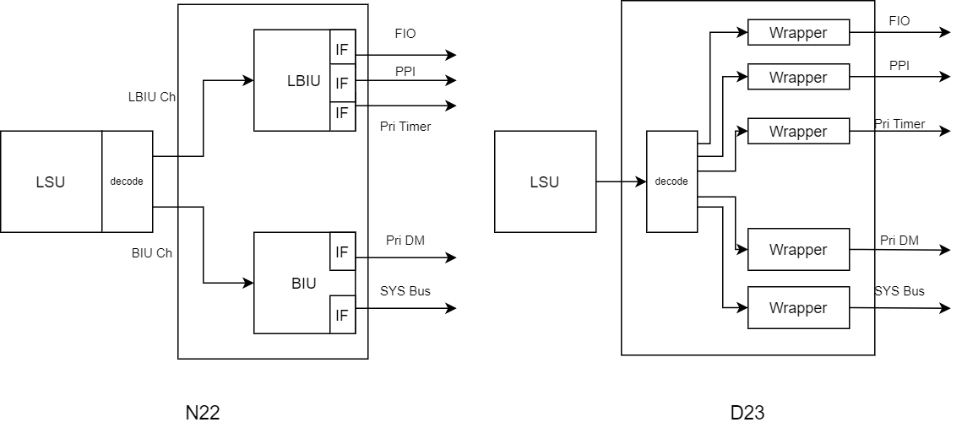
Reference – N22 and D23

Slide 22
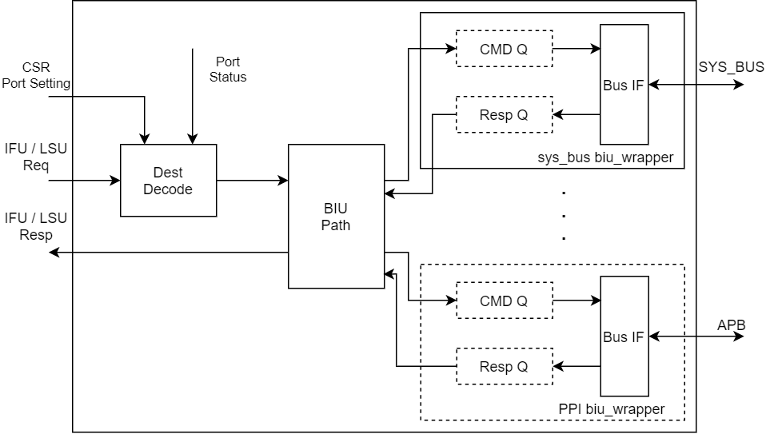
BIU Block Diagram
arbiter detail
decoder detail
Path = decoding + arbiter
Port crossing will not happen (define in interface)
PUSH/POP cross region
System bus wrapper
AHB/AXI … etc.
Bus interfaces are flop-out
It can be treated as 1 CMD queue
CMD Queue should have 1 entry for back-to-back transaction
Resp Queue at least 2 entry since the RDATA should be flopped before using.
BIU Path can reuse vc_biu_path.v
Dest Decode
Default port: system_bus
Decode the req_addr and issue to different biu_wrapper
(?) Keep each wrapper’s status, and block the different port req.
EX: system bus is doing the translation from LSU, Dest_dec should block the LSU-to-PPI request.
CSR-BIU interface: indicates the PPI/LLP setting
Parameter
Previous conclusion:
Different interface: No out-standing, Same interface: out-standing is acceptable.

Slide 23
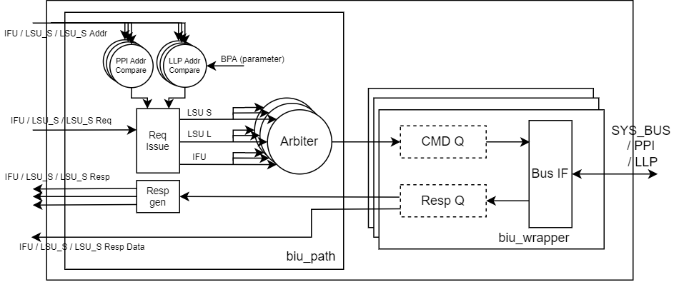
Block Diagram (3/22)
biu_path should record the out-standing request number for each port
If bus error happens, the addr should be return to LSU (can reuse resp data)
Resp Data width should be the max value of BIU_DATA and BIU_ADDR
ID: use the IFU/LSU’s ID (extend 2bit or define not overlap)
Req_Issue block should block the IFU/LSU request when the destination port is out-standing
Ex. SYS_BUS is handling a IFU request, than the next IFU request to PPI/LLP will be blocked
Since the spec define the BPA must aligned size, the comparator can be implemented by AND/OR
The ID will be issued by Req_Issue to indicate source, the Resp_Gen will generate the response by ID

Slide 24
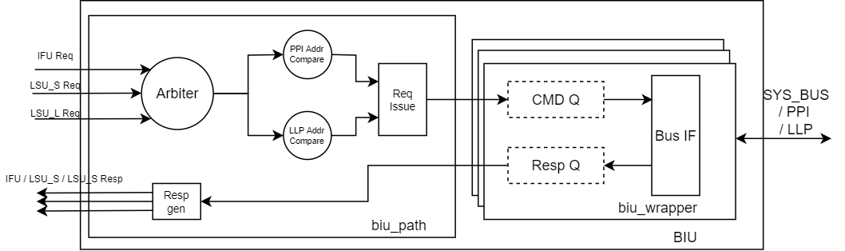
Block Diagram (3/22)
Do the arbitration first than issue the request can reduce comparators (?
keep it as a reduce gate count version

Slide 25
Reference: N22 BIU Spec – PPI
APB (PPI: private peripheral interface)
APB Bus interface
Data Width: Same as CPU data width
Addr Width: Depends on PPI-SIZE
Config/Control CSR:
Config: MMSC_CFG.PPI (Bit[25])
Control: MMPIB (0x7f0)
BPA
0
SIZE
EN
Field | Bits | Description | Type
BPA | [31:10] | PA Base | Read-Only
SIZE | [5:1] | PPI Size (0~2G) | Read-Only
EN | [0] | PPI Enable | Read-Only

Slide 26
Reference: N22 BIU Spec – FIO
FIO (Fast I/O)
Self-define interface (cmd valid/ready)
Data Width: Same as CPU data width
Addr Width: Depends on FIO size
Only Load/Store can access.
1 Cycle response.
Config/Control CSR:
Config: MMSC_CFG.FIO (Bit[26])
Control: MFIOB (0x7f1)
BPA
0
SIZE
EN
Field | Bits | Description | Type
BPA | [31:10] | PA Base | Read-Only
SIZE | [5:1] | FIO Size (0~2G) | Read-Only
EN | [0] | FIO Enable | Read-Only

Slide 27
Self Define Interface in N22
Signal name | Source | Destination | Description
biu_dm_cmd_valid | biu | dm | Transfer valid
biu_dm_cmd_dmode | biu | dm | Transfer in Debug Mode
biu_dm_cmd_mmode | biu | dm | Transfer in M-mode
biu_dm_cmd_addr | biu | dm | Address
biu_dm_cmd_wmask | biu | dm | Write data mask
biu_dm_cmd_wdata | biu | dm | Write data
biu_dm_cmd_read | biu | dm | Transfer direction
dm_biu_resp_rdata | dm | biu | Read data
dm_biu_resp_err | dm | biu | Error response

Slide 28
PPI/LLP Usage
[31:10]
[5:1]
BPA
0
SIZE
EN
SIZE: PPI Region Size
0: 0Byte
1: 1K
2: 2K
…
22: 2G
23 -> 31: reserved
PA = {BPA[31:10], 10’h0}
BPA: Base Physical Address
The BPA should be aligned to SIZE
The Config tool should check the alignment.
The Config tool will check the LLP/PPI region will not cross the max value of BIU_ADDR
Check the LLP and PPI region will not overlap.
Priority
Small size has the higher priority

