Slide 1
D23 Study

Slide 2
Discussion (3/29)
PMP
ePMP
utlb

Slide 3
PMP Requirement
PMP response should be blocked by utlb
PMP/ePMP should be configurable.
PMP_ENTRIES:
Support: 0~16 entries
(PMP_ENTRIES == 0) means no PMP supported.
PMP_GRANULARITY:
Support: 8, 16, 32, 64, 128, 256, 512, 1K, 2K, 4K (Byte)
Match Mode: NAPOT, TOR (optional)
uTLB entry will be 2 or 4 or 8 (pLRU)
In order response to IFU
Same cycle PMP response when hit uTLB

Slide 4
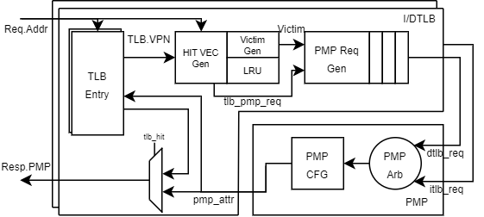
uTLB and PMP
PMP Req entry → 2
Always keep resp queue to solve hit/miss conflict
Prepare Interface to IFU/LSU/CSR
Select VA by PMP_Arb
IFU/LSU_KILL
The PMP CFG is the PMP hardware, it can be configured to PMP/ePMP
DTLB always has higher priority than ITLB
If the PMP granularity < 4K, the PMP response will be returned from PMP_CFG
Gate Count: (PMP-16 / uTLB-4 / no PMA)
Total: 12.7k
uTLB and related control: 3.4K
PMP_CFG: 9.3k
Queue list:
uTLB: entry 2 or 4 or 8
PMP Req queue: 2
PMP Resp queue 2
The resp queue was used in refactor to handle MMU response and PMP response ordering.

Slide 5
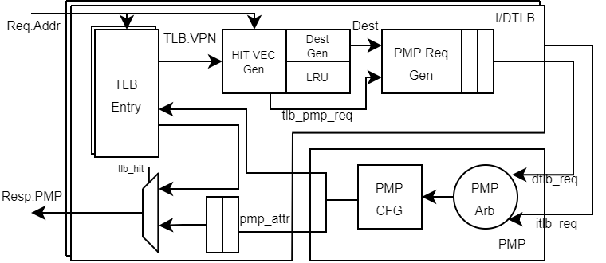
uTLB and PMP
PMP Req entry → 2
Always keep resp queue to solve hit/miss conflict
Prepare Interface to IFU/LSU/CSR
Select VA by PMP_Arb
IFU/LSU_KILL
The chh_pmp module includes:
itlb (chh_utlb.v)
dtlb (chh_utlb.v)
pmp_cfg (chh_pmp_cfg.v)

Slide 6
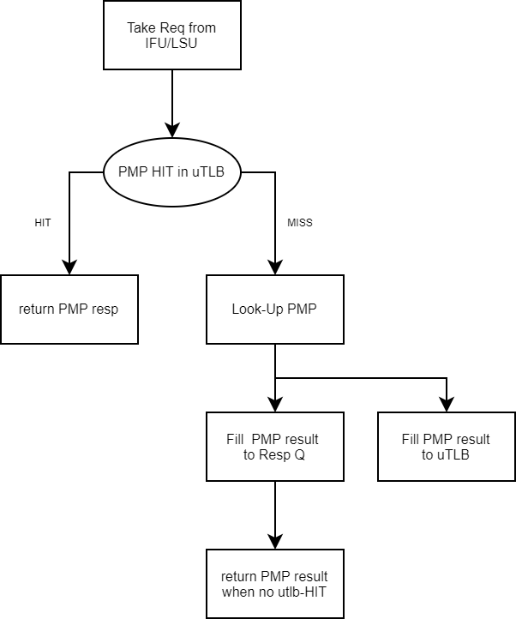
PMP response sequence
If utlb hit, the PMP response will be returned in the same cycle
If utlb miss, the PMP response will be returned at least 1 cycle delay.
The response from utlb will always be returned first
The PMP response will be out-of-order for IFU/LSU
The ID form IFU/LSU is needed.

Slide 7
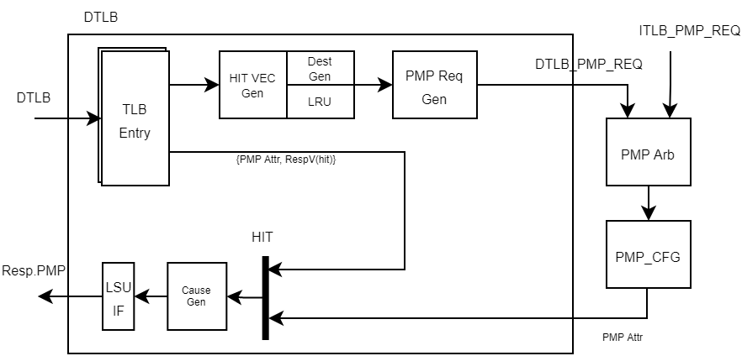
PMP Response (DTLB Only)

Slide 8
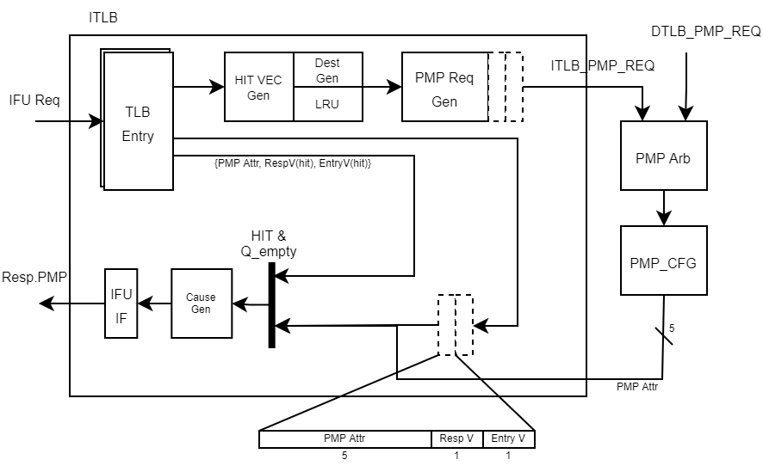
PMP Response Queue (ITLB Only)
show look-up TLB behavior in block diagram
Change red block to ordering-handle
Req queue behavior ➔ bypass FIFO
Response queue:
write_en:
HIT & ~Q_empty
Miss
read_en : IFU take PMP Resp
Queue Contain
PMP Attr: attribute, 5bits
Resp Valid: PMP Attr is valid
Entry Valid: Queue Entry is valid
IFU Interface wrapper returns the PMP response when:
QResp Valid + Entry Valid
Entry Valid + PMP Resp Valid

Slide 9
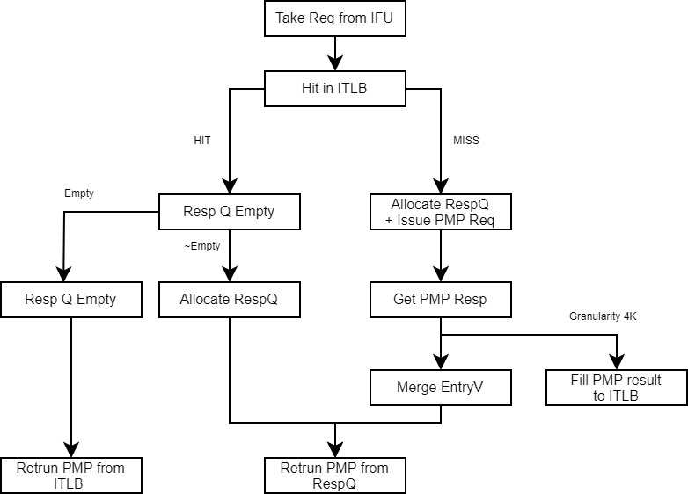
PMP response sequence (4/26)

Slide 10
uTLB to IFU response (Hit After Miss)
 | CYCLE1 | CYCLE2 | CYCLE3 | CYCLE4
Req (IFU to uTLB) | Fetch1 | Fetch 2
Status | Miss | Hit
Look-Up (ITLB to PMP) | ITLB-Req1
Request granted | granted
Resp (PMP to ITLB) |  | Attr (PMP combi)
PMP resp valid |  | Valid (flop)
Resp (uTLB to IFU) |  | Resp (Fetch1) | Resp (Fetch2)
Resp Queue | Empty |  |  | Empty
Entry 1 |  | Fetch 1 (Invalid) | Fetch 2 (Valid)
Entry 2

Slide 11
uTLB to IFU response (Hit After Miss)
 | CYCLE1 | CYCLE2 | CYCLE3
Req (IFU to uTLB) | Fetch1 |  | Fetch 2
Status | Miss |  | HIT
Look-Up (ITLB to PMP) | ITLB-Req1
Request granted | granted
Resp (PMP to ITLB) |  | Resp
PMP resp valid |  | Valid
Resp (uTLB to IFU) |  | Resp (Fetch1) | Resp (Fetch2)
Resp Queue | Empty |  | Empty
Entry 1 |  | Fetch 1 (Invalid)
Entry 2

Slide 12
uTLB to IFU response (Hit)
 | CYCLE1 | CYCLE2 | CYCLE3
Req (IFU to uTLB) | Fetch1 | Fetch 2
Status | Hit | Hit
Look-Up (ITLB to PMP)
Request granted
Resp (PMP to ITLB)
PMP resp valid
Resp (uTLB to IFU) | Resp (Fetch1) | Resp (Fetch2)
Resp Queue | Empty | Empty | Empty
Entry 1
Entry 2

Slide 13
uTLB to IFU response (Waiting Grant + Miss Pending)
Assertion: FULL & ~REQ
 | CYCLE1 | CYCLE2 | CYCLE3 | CYCLE4 | CYCLE5 | CYCLE6
Req (IFU to uTLB) | Fetch1 | Fetch2
Status | Miss | Miss
Look-Up (ITLB to PMP) | ITLB-Req1 (REQ GEN) | ITLB-Req1 (REQ FIFO) | ITLB-Req1 (REQ FIFO) | ITLB-Req2
Request granted |  |  | granted | granted
Resp (PMP to ITLB) |  |  |  | Resp | Resp
PMP resp valid |  |  |  | Valid | Valid
Resp (uTLB to IFU) |  |  |  | Resp (Fetch1) | Resp (Fetch2)
Resp Queue | Empty |  | FULL | FULL |  | Empty
Entry 1 |  | Fetch 1 (Invalid) | Fetch 1 (Invalid) | Fetch 1 (Invalid) | Fetch 2 (Invalid)
Entry 2 |  |  | Fetch 2 (Invalid) | Fetch 2 (Invalid)

Slide 14
uTLB to IFU response (Waiting Grant + no pending Miss)
 | CYCLE1 | CYCLE2 | CYCLE3 | CYCLE4 | CYCLE5 | CYCLE6
Req (IFU to uTLB) | Fetch1 |  |  | Fetch2
Status | Miss |  |  | Miss
Look-Up (ITLB to PMP) | ITLB-Req1 | ITLB-Req1 | ITLB-Req1 | ITLB-Req2
Request granted |  |  | granted | granted
Resp (PMP to ITLB) |  |  |  | Resp | Resp
PMP resp valid |  |  |  | Valid | Valid
Resp (uTLB to IFU) |  |  |  | Resp (Fetch1) | Resp (Fetch2)
Resp Queue | Empty |  |  |  |  | Empty
Entry 1 |  | Fetch 1 | Fetch 1 | Fetch 1 | Fetch 2
Entry 2

Slide 15
uTLB to IFU response (3 Req: miss, miss, hit)
 | CYCLE1 | CYCLE2 | CYCLE3 | CYCLE4 | CYCLE5 | CYCLE6 | CYCLE7
Req (IFU to uTLB) | Fetch1 | Fetch2 |  |  | Fetch3
Status | Miss | Miss |  |  | Hit
Look-Up (ITLB to PMP) | ITLB-Req1 | ITLB-Req1 | ITLB-Req1 | ITLB-Req2
Request granted |  |  | granted | granted
Resp (PMP to ITLB) |  |  |  | Resp | Resp
PMP resp valid |  |  |  | Valid | Valid
Resp (uTLB to IFU) |  |  |  | Resp (Fetch1) | Resp (Fetch2) | Resp (Fetch3)
Resp Queue | Empty |  | Full | Full |  |  | Empty
Entry 1 |  | Fetch 1 (Invalid) | Fetch 1 (Invalid) | Fetch 1 (Invalid) | Fetch 2 (Invalid) | Fetch 3 (Valid)
Entry 2 |  |  | Fetch 2 (Invalid) | Fetch 2 (Invalid)

Slide 16
uTLB to IFU response (3 Req: miss, miss, miss)
 | CYCLE1 | CYCLE2 | CYCLE3 | CYCLE4 | CYCLE5 | CYCLE6 | CYCLE7
Req (IFU to uTLB) | Fetch1 | Fetch2 |  |  | Fetch3
Status | Miss | Miss |  |  | Miss
Look-Up (ITLB to PMP) | ITLB-Req1 | ITLB-Req1 | ITLB-Req1 | ITLB-Req2 | ITLB-Req3
Request granted |  |  | granted | granted | granted
Resp (PMP to ITLB) |  |  |  | Resp | Resp | Resp
PMP resp valid |  |  |  | Valid | Valid | Valid
Resp (uTLB to IFU) |  |  |  | Resp (Fetch1) | Resp (Fetch2) | Resp (Fetch3)
Resp Queue | Empty |  | Full | Full |  |  | Empty
Entry 1 |  | Fetch 1 (Invalid) | Fetch 1 (Invalid) | Fetch 1 (Invalid) | Fetch 2 (Invalid) | Fetch 3 (Invalid)
Entry 2 |  |  | Fetch 2 (Invalid) | Fetch 2 (Invalid)

Slide 17
uTLB to IFU response (3 Req: miss, hit, miss)
 | CYCLE1 | CYCLE2 | CYCLE3 | CYCLE4 | CYCLE5 | CYCLE6 | CYCLE7
Req (IFU to uTLB) | Fetch1 | Fetch2 |  |  | Fetch3
Status | Miss | Hit |  |  | Miss
Look-Up (ITLB to PMP) | ITLB-Req1 | ITLB-Req1 | ITLB-Req1 |  | ITLB-Req3
Request granted |  |  | granted |  | granted
Resp (PMP to ITLB) |  |  |  | Resp |  | Resp
PMP resp valid |  |  |  | Valid |  | Valid
Resp (uTLB to IFU) |  |  |  | Resp (Fetch1) | Resp (Fetch2) | Resp (Fetch3)
Resp Queue | Empty |  | Full | Full |  |  | Empty
Entry 1 |  | Fetch 1 (Invalid) | Fetch 1 (Invalid) | Fetch 1 (Invalid) | Fetch 2 (Valid) | Fetch 3 (Invalid)
Entry 2 |  |  | Fetch 2 (Valid) | Fetch 2 (Valid)

Slide 18
uTLB status and PMA/PMP Response
u-TLB Status |  |  | Response Channel Action
Field | PMA | PMP | PMA_CH | PMP_CH (delay 1~N cycle)
Status | Miss | Miss | Return Miss | x
 | Hit | Miss | Return Hit | Return Hit
 | Hit | Hit | Return Hit | Return Hit (should be same cycle)

Slide 19
Interface – IFU to ITLB
Group | Signal Name | Source | Destination | bits
GLOBAL | ifu_tlb_kill | ifu | utlb | 1
IFU_TLB_REQ | ifu_tlb_req_valid | ifu | utlb | 1
 | tlb_ifu_req_ready | utlb | ifu | 1
 | ifu_tlb_req_va | ifu | utlb | (VALEN-1)
TLB_IFU_RESP | tlb_ifu_resp_valid | utlb | ifu | 1
 | ifu_tlb_resp_ready | ifu | utlb | 1
 | tlb_ifu_resp_hit | utlb | ifu | 1
 | tlb_ifu_resp_pma_fault | utlb | ifu | 1
 | tlb_ifu_resp_pma_mtype | utlb | ifu | 4
 | tlb_ifu_resp_pma_cause | utlb | ifu | 6
 | tlb_ifu_resp_pma_dcause | utlb | ifu | 5
TLB_IFU_PMP_RESP | tlb_ifu_pmp_resp_valid | utlb | ifu | 1
 | ifu_tlb_pmp_resp_ready | ifu | utlb | 1
 | tlb_ifu_pmp_resp_pmp_fault | utlb | ifu | 1
 | tlb_ifu_pmp_resp_cause | utlb | ifu | 6
 | tlb_ifu_pmp_resp_dcause | utlb | ifu | 5

Slide 20
Interface – LSU to uTLB
Group | Signal Name | Direction
GLOBAL | xxx_tlb_kill | input
LSU_TLB_REQ | lsu_tlb_req_valid | input
 | tlb_xxx_req_ready | output
 | xxx_tlb_req_va | input
 | xxx_tlb_req_store | input
 | xxx_tlb_req_id | input
TLB_LSU_RESP | tlb_xxx_resp_valid | output
 | xxx_tlb_resp_ready | input
 | tlb_xxx_resp_hit | output
 | tlb_xxx_resp_pma_fault | output
 | tlb_xxx_resp_pma_mtype | output
 | tlb_xxx_resp_pma_namo | output
 | tlb_xxx_resp_id | output
TLB_LSU_PMP_RESP | tlb_xxx_pmp_resp_valid | output
 | xxx_tlb_pmp_resp_ready | input
 | tlb_xxx_pmp_resp_hit | output
 | tlb_xxx_pmp_resp_pmp_fault | output
 | tlb_xxx_pmp_resp_id | output

Slide 21
Interface –uTLB to PMP
Group | Signal Name | Direction
TLB_PMP_REQ | tlb_pmp_req_valid | output
 | pmp_tlb_req_ready | input
 | tlb_pmp_req_va | output
 | tlb_pmp_req_dest | output
PMP_TLB_WE | pmp_tlb_we | input
 | pmp_tlb_dest | input
 | pmp_tlb_resp_x | input
 | pmp_tlb_resp_l | input
 | pmp_tlb_resp_r | input
 | pmp_tlb_resp_w | input
 | pmp_tlb_resp_4k | input
 | pmp_tlb_resp_vec_fault (no_all_match) | input

Slide 22
Kill from IFU/LSU to uTLB
The kill signal from LSU and IFU
lsu_utlb_kill
ifu_utlb_kill
The kill signal is an independent signal (not included in req or resp channel)
The response should not include kill
The pending request before kill signal:
Should be flushed in request/response queue (ITLB)
The request with kill signal is missed in uTLB
Will not response
For ITLB: PMA hit + PMP miss → same cycle PMA response + no PMP response

Slide 23
IFU KILL (Hit/Miss with Kill)
 | CYCLE1 | CYCLE2 | CYCLE3 | CYCLE4 | CYCLE5
Req (IFU to uTLB) | Fetch1 | Fetch 2 | Fetch 3
Status | Hit | Miss | Hit
IFU KILL | Kill | KILL
Look-Up (ITLB to PMP)
Request granted |  | ITLB-REQ2
Resp (PMP to ITLB) |  | granted
PMP resp valid |  |  | PMP_RESP2
Resp (uTLB to IFU) | RESP (Fetch1) |  | RESP (Fetch3)
Resp Queue | Empty | Empty | Empty | Empty | Empty
Entry 1 |  |  | Fetch2 (Blocked)
Entry 2

Slide 24
IFU KILL (Hit/Miss with Kill)
 | CYCLE1 | CYCLE2 | CYCLE3 | CYCLE4 | CYCLE5
Req (IFU to uTLB) | Fetch1 | Fetch 2 | Fetch 3
Status | Hit | Miss | Miss
IFU KILL | Kill | KILL
Look-Up (ITLB to PMP)
Request granted |  | ITLB-REQ2 | ITLB-REQ3
Resp (PMP to ITLB) |  | granted | granted
PMP resp valid |  |  | PMP_RESP2 | PMP_RESP3
Resp (uTLB to IFU) | RESP (Fetch1) |  |  | RESP (Fetch3)
Resp Queue | Empty | Empty | Empty |  | Empty
Entry 1 |  |  | Fetch2 (Blocked) | Fetch3 (Invalid)
Entry 2

Slide 25
IFU KILL (Fetch 3 hit + Fetch2-PMP-Valid)
 | CYCLE1 | CYCLE2 | CYCLE3 | CYCLE4 | CYCLE5
Req (IFU to uTLB) | Fetch1 | Fetch 2 |  | Fetch 3
Status | Hit | Miss |  | Hit
IFU KILL | Kill |  | KILL
Look-Up (ITLB to PMP)
Request granted |  | ITLB-REQ2 | ITLB-REQ2
Resp (PMP to ITLB) |  |  | granted
PMP resp valid
Resp (uTLB to IFU) | RESP (Fetch1) |  |  | RESP (Fetch3)
Resp Queue | Empty | Empty |  | Empty | Empty
Entry 1 |  |  | Fetch2 (Invalid) | Fetch2 (flushed)
Entry 2

Slide 26
IFU KILL (Fetch 3 with kill) ()
 | CYCLE1 | CYCLE2 | CYCLE3 | CYCLE4 | CYCLE5
Req (IFU to uTLB) | Fetch1 | Fetch 2 | Fetch 3
Status | Hit | Miss | Hit
IFU KILL | Kill |  | KILL
Look-Up (ITLB to PMP)
Request granted |  | ITLB-REQ2 | ITLB-REQ2
Resp (PMP to ITLB) |  |  | granted
PMP resp valid
Resp (uTLB to IFU) | RESP (Fetch1)
Resp Queue | Empty | Empty |  | Empty | Empty
Entry 1 |  |  | Fetch2 (Invalid) | Fetch2 (flushed)
Entry 2 |  |  |  | Fetch3 (blocked)

Slide 27
IFU KILL (Fetch 3 with kill) (Should be return?)
Return Resp(Fetch3) at CYCLE3
Same as HIT + KILL case
Return Resp(Fetch3) at CYCLE4
Keep ordering handler’s rule
No Response for Fetch3
Easier to implement

Slide 28
IFU KILL (Kill during ITLB-PMP req pending)
 | CYCLE1 | CYCLE2 | CYCLE3 | CYCLE4 | CYCLE5 | CYCLE6 | CYCLE7
Req (IFU to uTLB) | Fetch1 | Fetch2 |  |  | Fetch3
Status | Miss | Miss |  |  | Miss
IFU KILL |  |  | KILL
Look-Up (ITLB to PMP) | ITLB-Req1 | ITLB-Req1 | ITLB-Req1 | ITLB-Req2 | ITLB-Req3
Request granted |  |  | granted |  | granted
Resp (PMP to ITLB) |  |  |  | Resp |  | Resp
PMP resp valid |  |  |  | Valid (Fetch1) |  | Valid (Fetch3)
Resp (uTLB to IFU) |  |  |  |  |  | Resp (Fetch3)
Resp Queue | Empty |  | Full | Empty | Empty |  | Empty
Entry 1 |  | Fetch 1 (Invalid) | Fetch 1 (Invalid) | Fetch1 (Flushed) |  | Fetch 3 (Invalid)
Entry 2 |  |  | Fetch 2 (Invalid) | Fetch2 (Flushed)

Slide 29
IFU KILL (KILL when ReqQ Popped)
 | CYCLE1 | CYCLE2 | CYCLE3 | CYCLE4 | CYCLE5 | CYCLE6 | CYCLE7
Req (IFU to uTLB) | Fetch1 | Fetch2 |  |  | Fetch3
Status | Miss | Miss |  |  | Miss
IFU KILL |  |  |  | KILL
Look-Up (ITLB to PMP) | ITLB-Req1 | ITLB-Req1 | ITLB-Req1 | ITLB-Req2 | ITLB-Req3
Request granted |  |  | granted | granted | granted
Resp (PMP to ITLB) |  |  |  | Resp | Resp | Resp
PMP resp valid |  |  |  | Valid | valid | Valid
Resp (uTLB to IFU) |  |  |  | Resp (Fetch1) |  | Resp (Fetch3)
Resp Queue | Empty |  | Full | Full | Empty |  | Empty
Entry 1 |  | Fetch 1 (Invalid) | Fetch 1 (Invalid) | Fetch 1 (Invalid) | Fetch 2 (Flushed) | Fetch 3 (Invalid)
Entry 2 |  |  | Fetch 2 (Invalid) | Fetch 2 (Invalid)

Slide 30
IFU KILL (CYCLE5: ITLB-REQ-ADDR Change)
 | CYCLE1 | CYCLE2 | CYCLE3 | CYCLE4 | CYCLE5 | CYCLE6 | CYCLE7
Req (IFU to uTLB) | Fetch1 | Fetch2 |  |  | Fetch3
Status | Miss | Miss |  |  | Miss
IFU KILL |  |  |  | KILL
Look-Up (ITLB to PMP) | ITLB-Req1 | ITLB-Req1 | ITLB-Req1 | ITLB-Req2 | ITLB-Req2 ITLB-Req3
Request granted |  |  | granted |  | granted
Resp (PMP to ITLB) |  |  |  | Resp |  | Resp
PMP resp valid |  |  |  | Valid |  | Valid
Resp (uTLB to IFU) |  |  |  | Resp (Fetch1) |  | Resp (Fetch3)
Resp Queue | Empty |  | Full | Full | Empty |  | Empty
Entry 1 |  | Fetch 1 (Invalid) | Fetch 1 (Invalid) | Fetch 1 (Invalid) | Fetch 2 (Flushed) | Fetch 3 (Invalid)
Entry 2 |  |  | Fetch 2 (Invalid) | Fetch 2 (Invalid)

