Slide 1
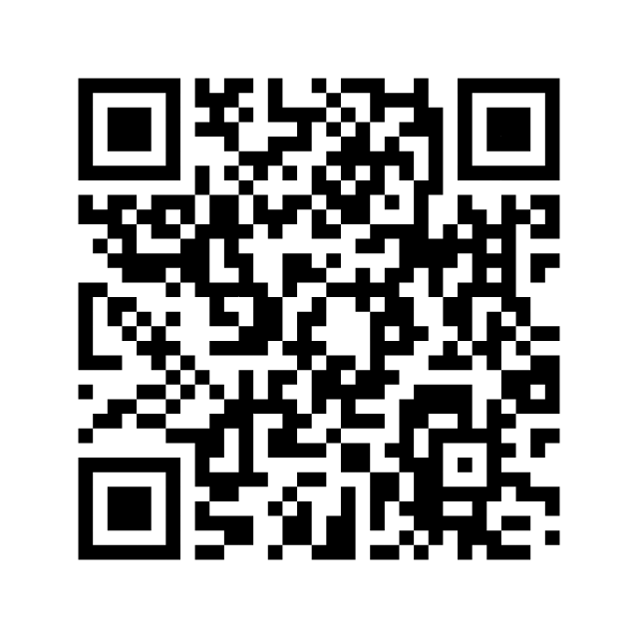
SECURITY AWARENESS MONTH // CYBERSECURITY ESCAPE ROOM
BREACH PROTOCOL
REGISTER YOUR TEAM
One captain signs up the group. Tick “Play the digital version” to play online.
Can your team stop BLACKFROST before time runs out?
A security lead has gone dark and ransomware is about to deploy. Follow the evidence, expose the insider and fire the kill switch. Suspicious emails, rogue Wi-Fi and convincing red herrings included.
🏢 PHYSICAL · Stavanger office
💻 DIGITAL · Play from anywhere
• A real room with props, clues and locks
• A host welcomes you and runs the session
• The same mission, fully in the browser
• Self-service with your team code and built-in hints
njolstad.no/security-awareness-month-escape-room
45
3–6
0
1
Sign up now →
minutes
players per team
tech skills needed
attempt + leaderboard
Want a taste first? Try the digital demo with the code DEMO.
Weekdays in October and November, 12:00–15:00 · Registration closes 16:00 the day before
TRUST NOTHING. VERIFY EVERYTHING. BEAT THE CLOCK.
Notes:
BREACH PROTOCOL is a 45-minute cybersecurity escape room for Security Awareness Month. Teams of 3–6 investigate a ransomware attack, expose the insider and stop BLACKFROST. Play in person at the Stavanger office with a host, or digitally from anywhere in the browser. No technical skills needed. Each team gets one attempt, and results go on a leaderboard. Scan the QR code or go to https://www.njolstad.no/security-awareness-month-escape-room/ to register. Curious? Try the demo with the code DEMO.

