Slide 1

PYD411
GMR structure for ultra high phase sensitivity
Navneet Singh 2017PH0832
Manmeet Kumar Kundal 2017PH10828

Slide 2
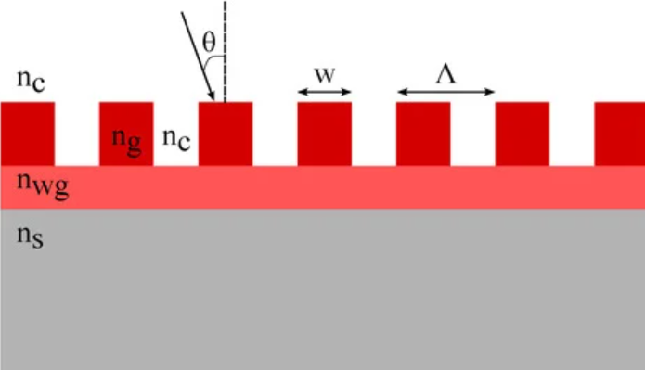
Guided Mode Resonance (GMR)
Guided Mode Resonance (GMR) is a resonance phenomenon where, after diffraction from grating, a particular diffracted order, couples into waveguide and excites a guided mode in the waveguide.
cover
grating
waveguide
substrate

Slide 3
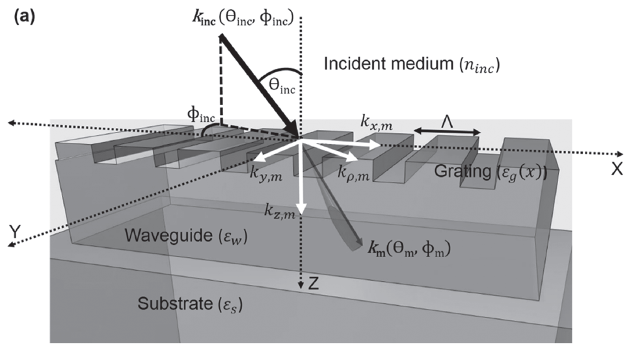
General Mechanism: Schematic Diagram
Azimuthal angle (φ_{inc})
Incidence angle (θ_{inc})
Incident wave vector (k_{inc})
Grating period (Λ)
mth order diffracted wave vector (k_{m})

Slide 4
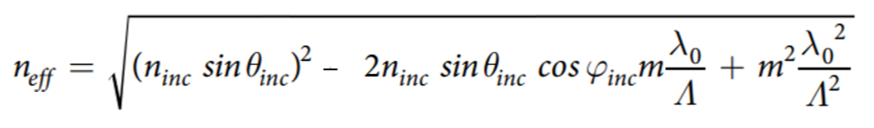

General Mechanism: Effective waveguide index
Using the previously mentioned setup, formula for n_{eff} is derived by equating the propagation constant with surface component of diffracted wave vector.
For resonance to occur, the condition for n_{eff} is :
Total internal
reflection
condition
n_{eff} = n_{w}sinθ
(θ = propagation angle)

Slide 5


General Mechanism: Phase for one round trip
The total phase for one round trip is given as:
1st term: phase acquired due to optical distance traversed by the diffracted light while propagating inside the waveguide.Here k_{c,w} is given as:
Φ_{w,s} and Φ_{w,f} are the phase shifts due to total internal reflection at the waveguide-substrate and waveguide-flm interface respectively.

Slide 6
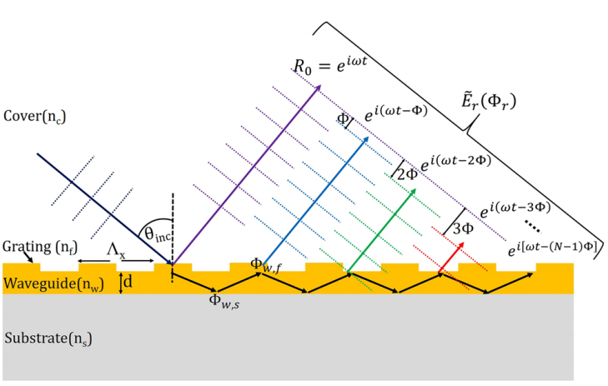
Total
resultant phase
Φ_{w,s} and Φ_{w,f} shown for one round trip

Slide 7
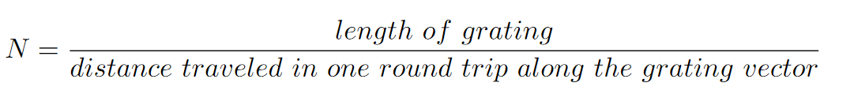
General Mechanism: Total resultant phase
The Final resultant phase is calculated by solving the field equation of the final resultant complex wave which is formed by the interaction of all the waves with different phase coming out of the waveguide and the 0th order reflected wave.
Here N is the total number of round trips. It is given as:

Slide 8
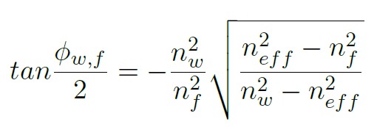
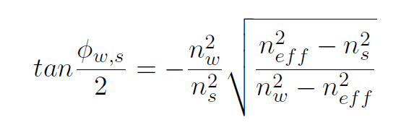
Polarization sensitivity
Referring to the configuration with dominant field parallel to grating grooves as TE mode and perpendicular one as TM
Rigorous coupled wave analysis simulations show that the comparatively sharper phase response of TM mode higher than that of TE.
The Phase shifts acquired from TIR at respective medium junctions for TM mode are:

Slide 9
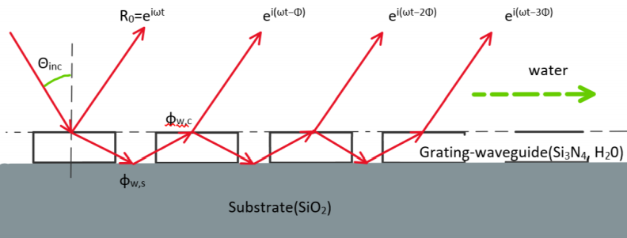
Analytical model : Sample and its parameters
Parameters:
Grating Thickness = 150 nm
Grating period = 572 nm
Fill factor = 75%
Grating length = 500 um
Grating material is Si₃N₄, RI = 2
Glass substrate RI = 1.45
Water Cover RI = 1.331
Azimuthal angle = 0
In our sample we did not used any waveguide. A grating when surrounded with lower refractive index medium materials can also behave as a waveguide, having a certain equivalent refractive index.

Slide 10
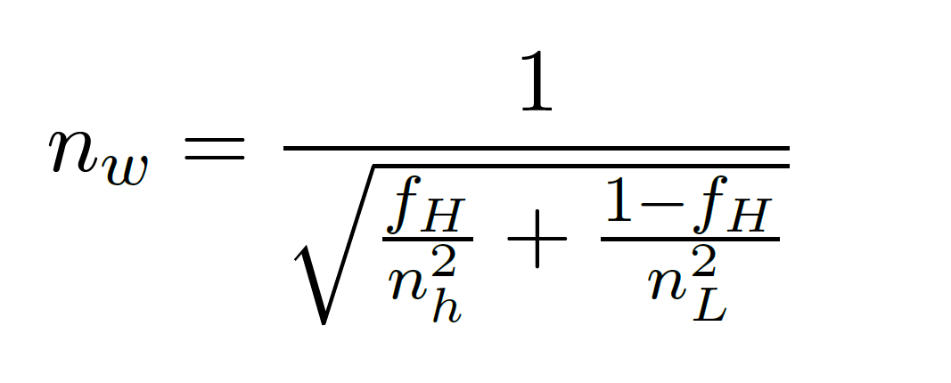

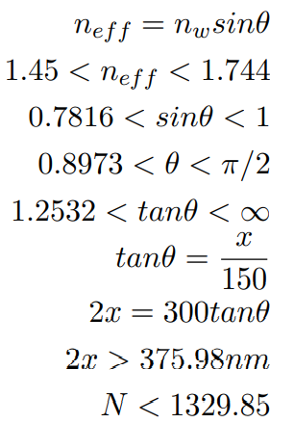
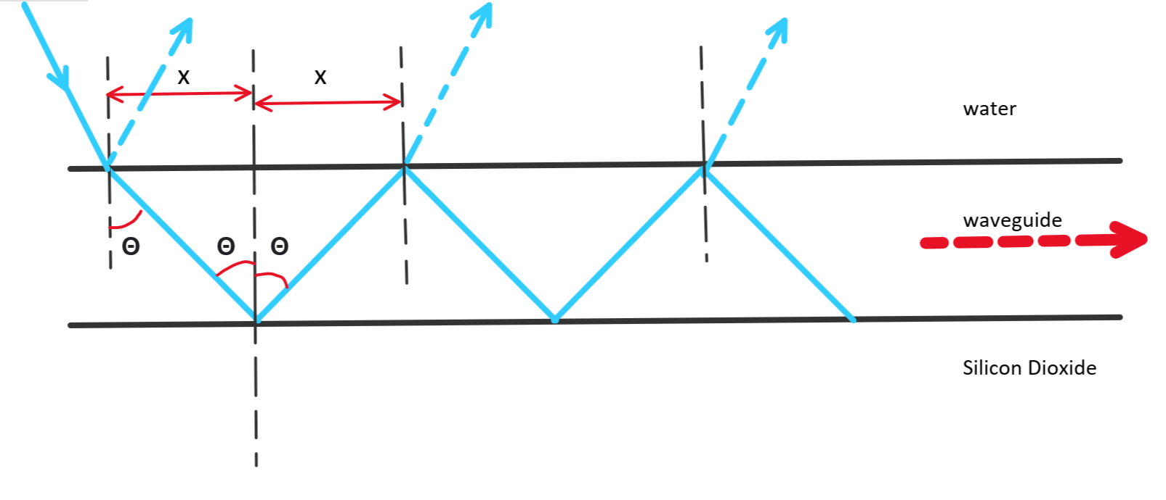
Analytical model : Sample and its parameters
Refractive index of equivalent waveguide for TM mode:
Number of round trips(N):

Slide 11
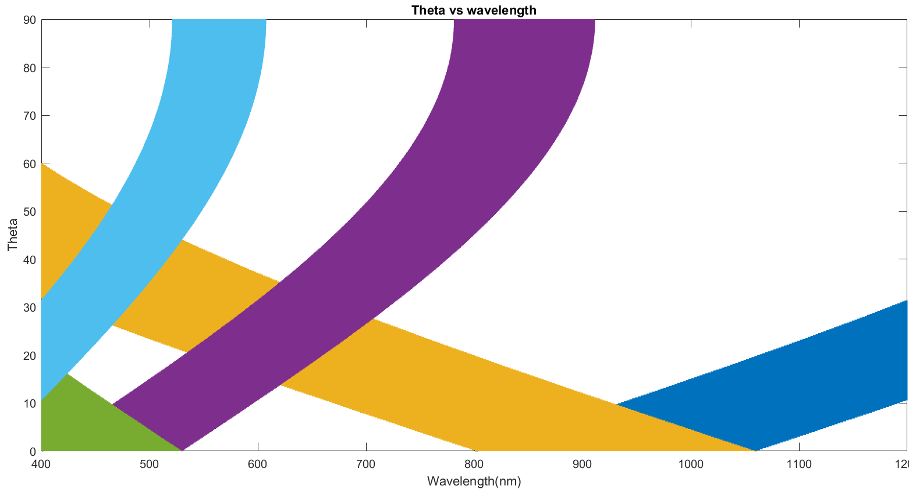

Analytical model : solving n_{eff} inequality
.
Solving the inequality gives us the possible wavelength regimes at different angle of incidence.(azimuthal angle is zero).
For a
wavelength = 855 nm resonance conditions can be achieved at
θ = 0.
m=3
m=2
m= -1
m=1
m=-2
m=1

Slide 12
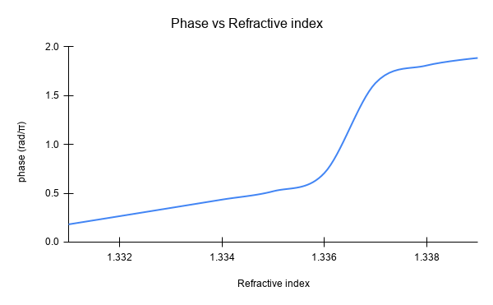
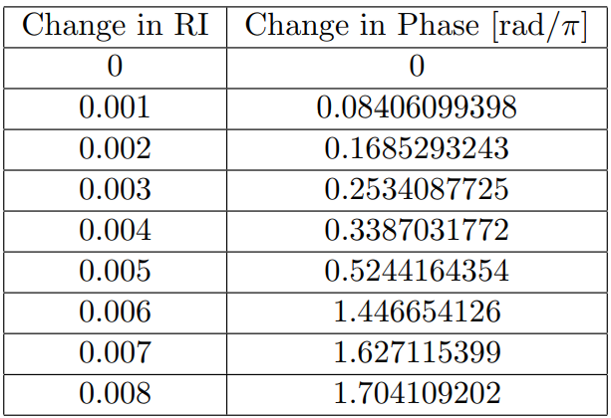
Analytical model : Phase observations
Using wavelength= 855nm and the conditions for normal incidence, phase for a one round trip was determined.
Using the above phase, the total phase was calculated at different refractive index values of cover. The plot is as shown

Slide 13
Conclusion
In this project we presented an analytical model employing phase detection mechanism for GMR sample.
In this model we solved the conditions under which GMR is allowed,for different wavelengths corresponding to different spatial orientations.
For our sample between the RI ranges from 1.336 to 1.337 the phase sensitivity is observed to be maximum and its value is nearly S=922 π per unit RI.

