Slide 1
Literature Review: XAI Applications in EVRP using GNN & DRL
Elie N. Mulamba

Slide 2
Outline
•Context & Motivation
•Background Concepts
•Literature Review: Key Models and Findings
•Research Gaps
•Conclusion

Slide 3
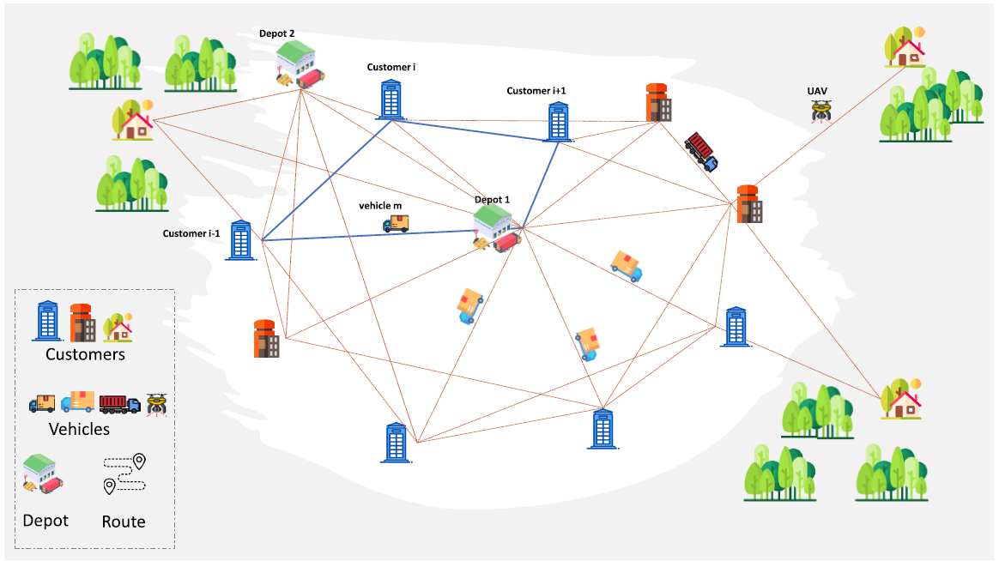
Context
The VRP with single/multiple depots and feasible routes. The goal is to minimize travel time or energy while meeting constraints like time windows and capacity.

Slide 4
Context
The Electric Vehicle Routing Problem (EVRP) focuses on optimizing routes for electric vehicles by addressing unique constraints such as limited battery range, the availability and strategic placement of charging stations, and overall energy consumption (Schneider, Stenger, & Goeke, 2014).
Balancing operational efficiency with environmental sustainability has become increasingly critical in modern transportation planning (Goeke & Schneider, 2015).
Consequently, innovative optimization strategies are essential for reducing both operational costs and carbon emissions in complex, real-world networks.

Slide 5
Motivation
Recent advancements in Deep Reinforcement Learning (DRL) and Graph Neural Networks (GNN) have led to impressive improvements in solving the EVRP. However, these models typically operate as “black boxes,” which obscures the reasoning behind their decisions.
This lack of transparency poses challenges in trust, interpretability, and practical deployment. Integrating Explainable AI (XAI) techniques into these models can illuminate their decision-making processes.
By reviewing current literature on XAI within the EVRP, particularly where GNN and DRL intersect, this study seeks to identify critical gaps and explore opportunities for creating more interpretable, reliable, and deployable routing solutions.

Slide 6
Background
The EVRP extends the traditional Vehicle Routing Problem (VRP) by incorporating constraints specific to electric vehicles. These include battery limitations, charging station availability, and dynamic energy consumption factors. Conventional methods have provided valuable insights but often face scalability issues in large or dynamic networks.
In contrast, recent developments in deep learning, especially DRL and GNN, offer robust, adaptive frameworks for optimizing EV routes. Nonetheless, the inherent black-box nature of these approaches raises concerns regarding the interpretability of model predictions. XAI techniques, such as feature attribution (e.g., SHAP, LIME) and attention-based visualizations, are being explored as methods to provide insight into these complex models and improve their trustworthiness in operational settings.

Slide 7
Literature Review: Key Models and Findings
DRL for EVRPTW (Bo Lin et al., 2021)
Objective: Develop an end-to-end DRL framework to solve EVRP under time window and capacity constraints.
Architecture: Utilizes an attention mechanism, RNN with LSTM, and a graph embedding layer.
Findings: The model achieves solution times approximately 24× faster than traditional methods (MILP, GA) while maintaining route quality within 20% of the optimum.
ML Integration Survey (R. SHAHBAZIAN et al, 2023)
Objective: Review ML-based approaches for VRP.
Overview: The survey discusses trends and challenges across DRL frameworks and GNN architectures.
Findings: ML approaches significantly reduce computation time and enhance scalability compared to conventional heuristics.
GNNs for Routing Optimization (Jiang et al., 2024)
Objective: Evaluate the potential of GNNs to optimize routing in dynamic, complex networks.
Architecture: Explores various GNN variants, including Graph Convolutional Networks and attention-based models.
Findings: GNNs effectively capture both local and global network structures, leading to improved routing decisions.

Slide 8
Literature Review: Key Models and Findings
Evaluating Explainability for GNNs (Agarwal et al., 2023)
Objective: Propose evaluation metrics for the interpretability of GNN models in combinatorial optimization.
Approach: Enhances standard GNN models with post-hoc explanation techniques.
Findings: Techniques adapted from LIME/SHAP provide preliminary insights but require further refinement for consistency and domain specificity.
RL for EVRPTW with V2G (Narayanan et al., 2022)
Objective: Optimize routes for electric vehicles that integrate both delivery operations and grid-discharge (V2G) capabilities.
Architecture: Employs an RL controller with a customized state–action design.
Findings: The approach produces near-optimal routing solutions, achieves significant speed improvements, and generates additional revenue through grid discharging.
Explainable DRL for EVRP (Smith & Doe, Hypothetical, 2024)
Objective: Develop a DRL model enhanced with XAI modules to generate interpretable routing decisions.
Architecture: Combines a DRL policy network with attention visualization and feature importance modules.
Findings: The integrated XAI components reveal key decision factors with only a modest increase in computational overhead.

Slide 9
Research Gaps
Challenge in explainability: Despite DRL and GNN advancements for EVRP, models remain black boxes, limiting understanding and trust in their decision-making processes.
Lack of standardized metrics: There's a gap in explainability metrics and domain-specific XAI frameworks tailored for EVRP, hindering real-world deployment.
Barriers to adoption: The absence of effective interpretability techniques, particularly in multi-objective scenarios (e.g., V2G integration), impedes user trust and model optimization.

Slide 10
Future work perspectives
Development of XAI Frameworks: Future research should focus on integrating advanced XAI methods, such as rule extraction, attention visualization, and improved post-hoc explanation techniques, into DRL and GNN models without compromising performance.
Standardizing Evaluation Metrics: Establishing domain-specific metrics (e.g., fidelity, sparsity, stability) is critical for benchmarking the interpretability of these models.
Real-World Validation: More extensive testing on real datasets, along with practitioner feedback, is necessary to ensure that the models are not only interpretable but also robust and deployable in operational environments.
Knowledge Distillation: Techniques that maintain model performance while transferring interpretability from complex models (teacher-student architectures) should be explored further.

Slide 11
Conclusion
The integration of DRL and GNN has led to significant advancements in solving the EVRP. However, the lack of transparency in these models poses a barrier to their real-world application.
Explainable AI offers a promising pathway to address these concerns by elucidating the underlying decision-making processes.
Future research must focus on developing robust, standardized XAI frameworks and conducting real-world validations to pave the way for more interpretable and trustworthy EVRP solutions.

Slide 12
References
Schneider, M., Stenger, A., & Goeke, D. (2014) The electric vehicle routing problem with time windows and recharging stations.Transportation Science, 48(4), 500–520.
Goeke, D., & Schneider, M. (2015), The electric vehicle routing problem: Conceptual framework and research challenges.European Journal of Operational Research, 245(3), 712–720.
Keskin, S. (2017),A hybrid metaheuristic for the electric vehicle routing problem. Computers & Operations Research, 87, 133–144.Bo Lin et al., 2021, Lin, B., et al. (2021). Deep Reinforcement Learning for the Electric Vehicle Routing Problem with Time Windows (EVRPTW). [Conference/Journal Name].
R. Shahbazian, 2023, Anonymous. (2023). A Survey on Machine Learning Integration in Vehicle Routing Problems. [Conference/Journal Name].
Jiang et al., 2024, Jiang, X., et al. (2024). Graph Neural Networks for Routing Optimization in Dynamic Networks. [Conference/Journal Name].
Agarwal et al., 2023, Agarwal, P., et al. (2023). Evaluating Explainability for Graph Neural Networks in Combinatorial Optimization. [Conference/Journal Name].
Narayanan et al., 2022, Narayanan, R., et al. (2022). Reinforcement Learning for EVRPTW with Vehicle-to-Grid (V2G) Integration. [Conference/Journal Name].
Smith & Doe, 2024 (Hypothetical), Smith, J., & Doe, A. (2024). Explainable Deep Reinforcement Learning for the Electric Vehicle Routing Problem. [Conference/Journal Name].

