Slide 1
Advances in eMobility research

Slide 2
eMobility interesting research areas
Smart EV charging station scheduling
Infrastructure & Grid stability
Vehicle to Grid (V2G)
Vehicle to Everything (V2X)
Hydrogen Vehicles
Battery Electric Vehicles & battery life prediction
Combinatorial Optimization (CO): vehicle routing problem (VRP)
TSP: Traveler Salesman Problem
VRP: Vehicle Routing Problem
EVRP: Electric Vehicle Routing Problem
CVRP: Capacitated VRP
CEVRP
VRPTW: VRP with Time Windows
EVRPTW
CVRPTW: Capacitated VRP with Time Windows
CEVRPTW
GVRP: Green VRP
Cross applications

Slide 3
Cross applications
VRP variants with charging station scheduling
VRP variants with battery swapping
VRP variants with economic & lifecycle studies: influence of VRP in CO2 emissions/ operational costs/etc..
VRP variants with grid stability
VRP variants with V2G: charging/discharging of battery
VRP variants with LLMs: “I need to charge my car fully by 7 AM, tomorrow morning”.
VRP variants with XAI

Slide 4
technology used
Non-ML
genetics algorithm, swarm, ants colony, etc..
heuristics/meta heuristics
ML based
DRL/RL
Multi-agent RL/DRL
Transformers
GNN
Transfer Learning
the new trend: Generative AI (GenAI)

Slide 5
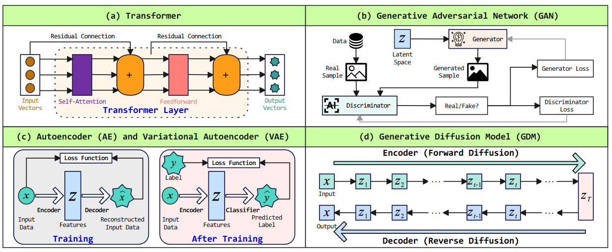
GenAI

Slide 6
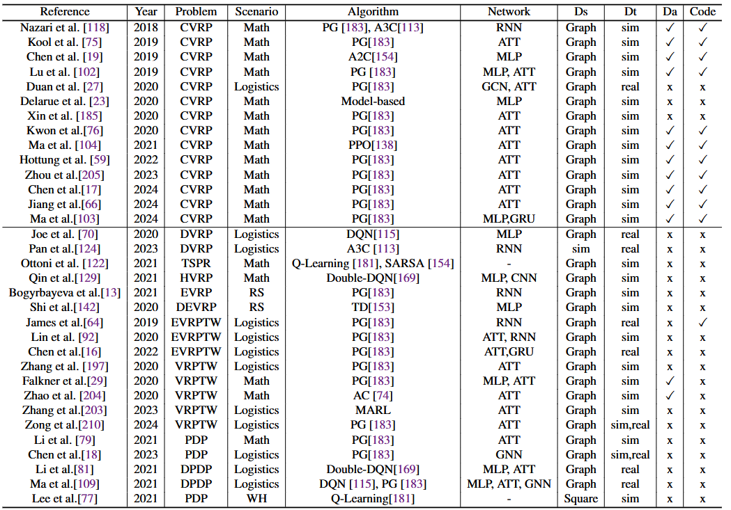
VRP Technology used
RL/DRL
Markov Decision Process
Partially Observable MDP
Parametric MDP
..
Attention Mechanism
Transformers

