Slide 1
eMobility opportunities
Dimeth Nouicer

Slide 2
Research papers
1 paper
DRL GNN models to solve EVRP
XAI for each model
Comparative study between models
Conference rank A*
NeurIPS 2025: Submission Deadline May 1, 2025

Slide 3
Research papers
1 paper
DRL GNN models to solve EVRP
XAI for each model
Comparative study between models
A* Conferences:
NeurIPS 2025: Submission Deadline May 1, 2025
Reinforcement learning (e.g., decision and control, planning, hierarchical RL, robotics)
AAAI: Last year Submission Deadline August 15, 2024
IJCAI
Conference rank A*

Slide 4
Research papers
1 paper
2 models to solve EVRP (for now)
~Attention trained with REINFORCE
Already exists in literature for VRP not EVRP
To my knowledge has the best results compared to other models
A second model
Conference rank A

Slide 5
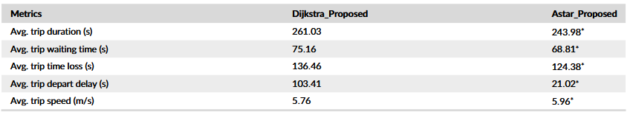
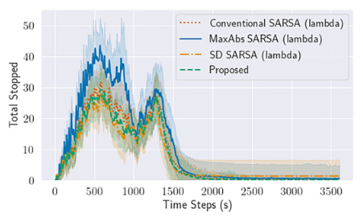
Research papers
This paper developed 2 models
Compared each model with its counterparts from the literature
Compared the 2 together based on metrics
Old models (dijkstra)
What If we use DRL and XAI?
Published in Q2 Journal
Publish in Q1 Journal ? or conference rank A

Slide 6
Research papers
Publish 2 papers:
1st paper: conference rank A or A*
2nd paper: journal Q1 in AI

Slide 7
Research papers
One of the developed models applied to real world application
charging/discharging
Opt Travel cost: Real data from a country with real costs, fleet data, etc.. [1]
~Hydrogen vehicles (constraints of hydrogen vehicle)
~Autonomous vehicles
2nd paper
Q1 Journal or conference rank A

Slide 8
Research papers
One of the developed models applied to real world application
charging/discharging
Opt Travel cost: Real data from a country with real costs, fleet data, etc.. [1]
~Hydrogen vehicles (constraints of hydrogen vehicle)
~Autonomous vehicles
One of the developed models deeper analysis
Try different reward formulations
1/ travel cost ; - travel cost
Multi objective reward: travel cost & customers satisfaction, fuel cost, etc..
Pareto front: minimize travel cost & visit charging stations when necessary
Compare with XAI the different outcomes from different rewards
2nd paper
Q1 Journal or conference rank A

Slide 9
Research papers
One of the developed models applied to real world application
charging/discharging
Opt Travel cost: Real data from a country with real costs, fleet data, etc.. [1]
~Hydrogen vehicles (constraints of hydrogen vehicle)
~Autonomous vehicles
One of the developed models deeper analysis
Try different reward formulations
1/ travel cost ; - travel cost
Multi objective reward: travel cost & customers satisfaction, fuel cost, etc..
Pareto front: minimize travel cost & visit charging stations when necessary
Compare with XAI the different outcomes from different rewards
One of the developed models case study
Same model compare ICEV, PHEV and BEV energy consumption/travel cost
~in a specific region if we get real data
2nd paper
Q1 Journal or conference rank A

Slide 10
Research papers
One of the developed models applied to real world application
charging/discharging
Opt Travel cost: Real data from a country with real costs, fleet data, etc.. [1]
~Hydrogen vehicles (constraints of hydrogen vehicle)
~Autonomous vehicles
One of the developed models deeper analysis
Try different reward formulations
1/ travel cost ; - travel cost
Multi objective reward: travel cost & customers satisfaction, fuel cost, etc..
Pareto front: minimize travel cost & visit charging stations when necessary
Compare with XAI the different outcomes from different rewards
One of the developed models case study
Same model compare ICEV, PHEV and BEV energy consumption/travel cost
~in a specific region if we get real data
2nd paper
Q1 Journal or conference rank A
Published in Q1 Journal; a case study of Xining, China [2]

Slide 11
Research papers
One of the developed models applied to real world application
charging/discharging
Opt Travel cost: Real data from a country with real costs, fleet data, etc.. [1]
~Hydrogen vehicles (constraints of hydrogen vehicle)
~Autonomous vehicles
One of the developed models deeper analysis
Try different reward formulations
1/ travel cost ; - travel cost ; etc..
Multi objective reward: travel cost & customers satisfaction, fuel cost, etc..
Pareto front: minimize travel cost & visit charging stations when necessary
Compare with XAI the different outcomes from different rewards
One of the developed models case study
Same model compare ICEV, PHEV and BEV energy consumption/travel cost
~in a specific region if we get real data
Possibility of 3rd paper
conference rank A or B

Slide 12
Research papers
1st paper
Dimeth, Elie, Mame, Jeremie, Souleymane, Imen
Write paper: Dimeth & Elie
Review paper: Mame & Jeremie
2nd paper
Mame, Jeremie, Imen, Souleymane, Elie, Dimeth
Write paper: Jeremie & Imen
Review paper: Mame & Elie
3rd paper
Souleymane, Imen, Jeremie, Mame, Elie, Dimeth
Write paper: Souleymane & Mame
Review paper: Jeremie & Dimeth
Names and order are flexible to change based on work

Slide 13
1st paper development
Develop the models DRL GNN for EVRP
First phase of Fine tune models + reward function ( hardest and longest part)
XAI to help fine tuning and decision making
Second phase of fine tuning + reward function
We document each fine tuning + reward function step, to save progress and results -> can be a potential of the 3rd research paper (to compare different reward formulations)

Slide 14

Project grant
solve challenge
Deadline to Submit
April 17, 2025
Up to $150,000 will be awarded
across several teams
If you know about any grant/challenge
Please share it with us

Slide 15
references
Y. Kim, N. Duan, G. Zardini, S. Samaranayake and D. Wischik, "Strategic Pricing and Routing to Maximize Profit in Congested Roads Considering Interactions With Travelers," in IEEE Transactions on Control of Network Systems, doi: 10.1109/TCNS.2025.3526714.
Jia, Z., Yin, J., Cao, Z., Wu, L., Wei, N., Zhang, Y., Jiang, Z., Guo, D., Zhang, Q., & Mao, H. (2025). Regional vehicle energy consumption evaluation framework to quantify the benefits of vehicle electrification in plateau city: A case study of Xining, China. Applied Energy, 377(C), 124626. https://doi.org/10.1016/j.apenergy.2024.124626

