Slide 1
First paper for Indaba 2025

Slide 2
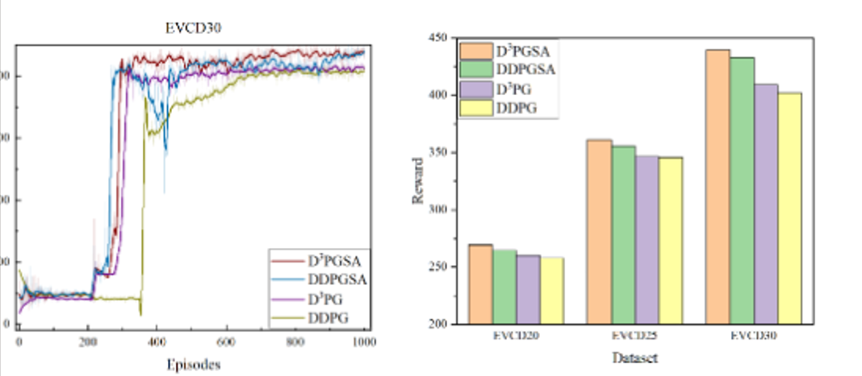
Models comparison: DQN and PPO
Compare training behavior: average reward and loss

Slide 3
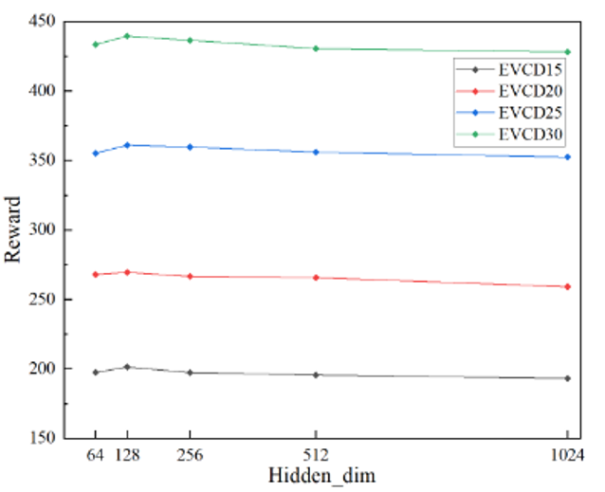
Models comparison: DQN and PPO
Compare training behavior
Fine tuning the two models
Compare reward value over different hyperparameters values

Slide 4
XAI application examples

Slide 5
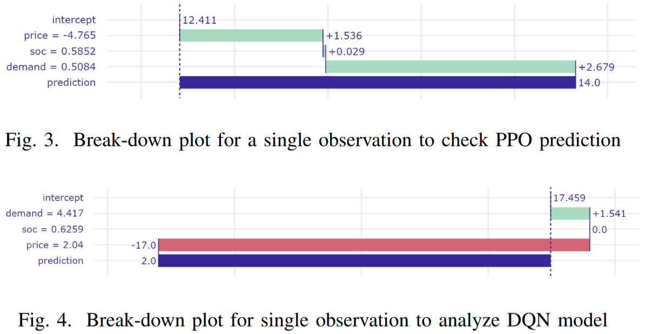
XAI on model state
Different models have different choices of features
Ref: https://ieeexplore.ieee.org/document/10799400

Slide 6
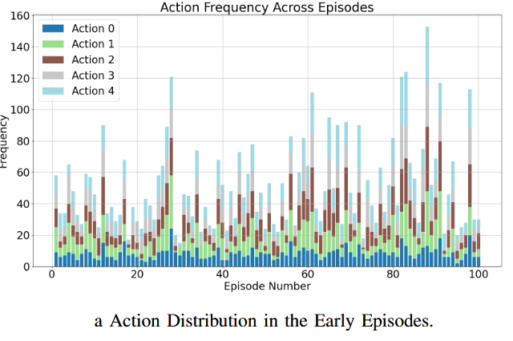
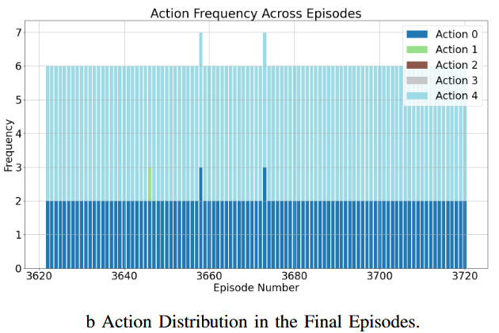
XAI on model state
Test state features frequency over the episodes -> See model evolution during training
Ref: https://ieeexplore.ieee.org/document/10311156

Slide 7
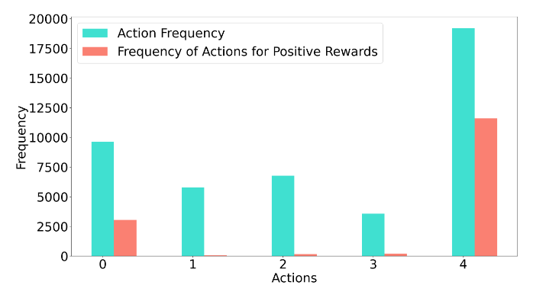
XAI on model decision making
Ref: https://ieeexplore.ieee.org/document/10311156

Slide 8
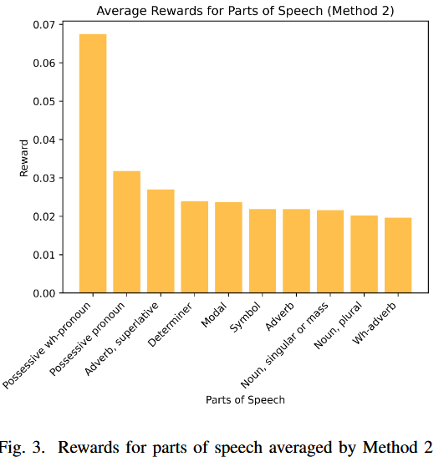
XAI on model decision making
State features frequency based on the reward.
Which features lead to positive rewards

Slide 9
XAI on model decision making
State features frequency based on the reward.
Which features lead to positive rewards
Visit status
Coordinates
Time windows
…

