Slide 1
Ideathon presentation
By Dimeth
18-05-2025

Slide 2


Dimeth NOUICER
From Tunisia
PhD in electrical engineering
Electric Mobility: A Fleet Management Framework Based on Reinforcement Learning and Graph Neural Networks

Slide 3


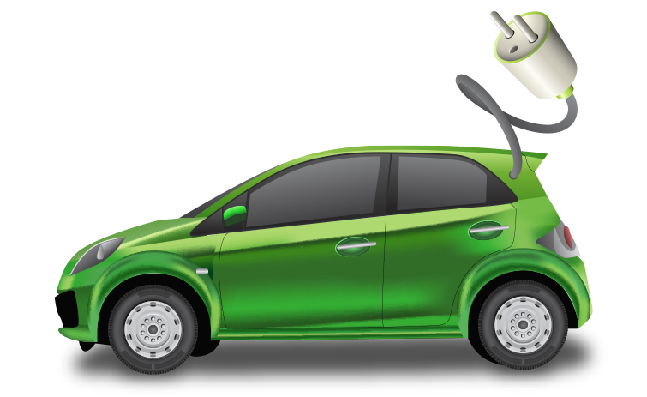
Ideathon 2024
Transparent Decision-Making for Electric Vehicle Routing:
Integrating DRL, GNN, and XAI
A Comparative Study of DRL Models with GNN and Explainable AI for Electric Vehicle Routing Optimization
Dimeth Nouicer; Elie N. Mulamba; Imen Habibi; Jérémie N. MABIALA; Mame Diarra Diouf; Souleymane Diallo
Notes:
Hello everyone. It’s a pleasure to be here at the Ideathon 2024.
So our research idea is Transparent Decision-Making for Electric Vehicle Routing.
Together with my colleagues—Ellie, Imen, Jérémie, Mame Diarra, and Souleymane
we want to conduct a comparative study of different models using RL, GNN and XAI techniques combined together to address these routing challenges.
—---------------------------------------
This project aims to tackle one of the most critical challenges in sustainable transportation: finding optimal and interpretable solutions for electric vehicle routing.
Which is not only technically challenging but also critically important in the context of sustainable transport and climate change:

Slide 4
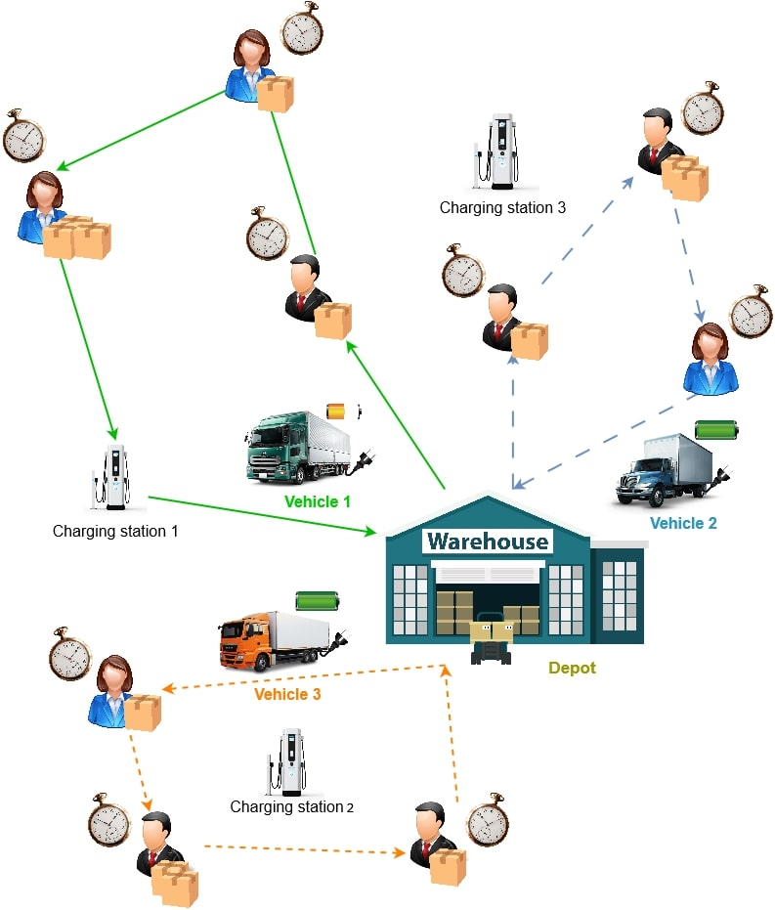
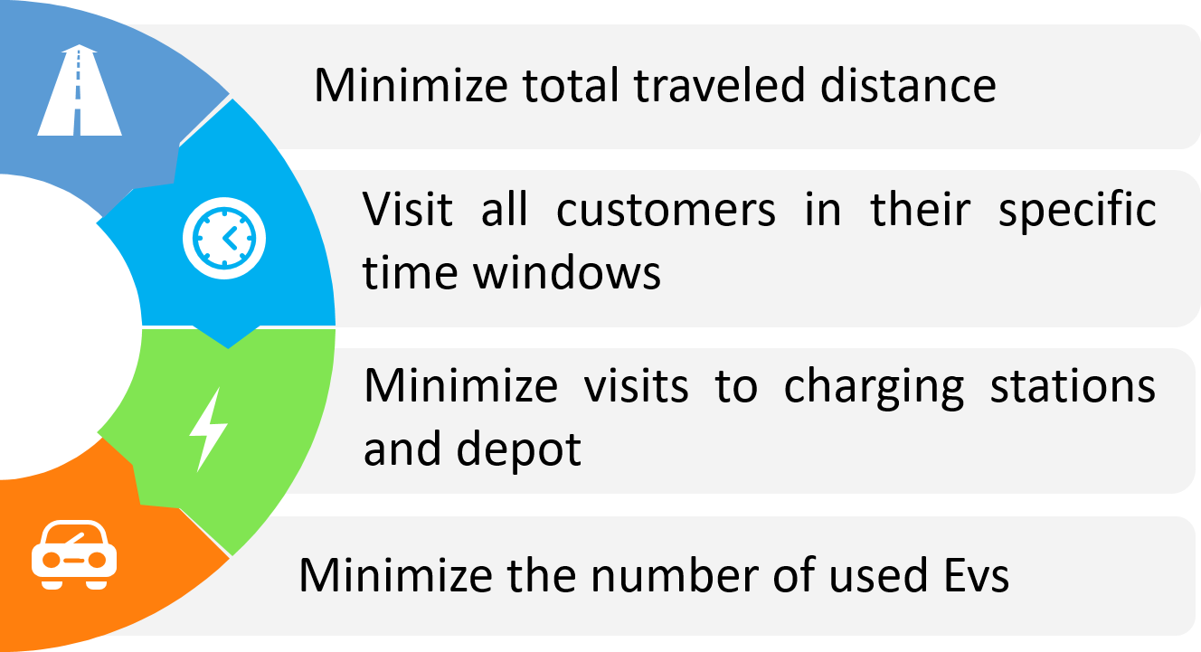
Electric Vehicle Routing Problem (EVRP)
Notes:
This is where the Electric Vehicle Routing Problem, comes into play.
It’s an Optimization problem that aims to determine the most efficient routes for a fleet of electric vehicles (EVs)
It’s a variant of vehicle routing problem which is a generalization of the TSP problem.
Similarly to VRP we want to visit all destinations, or customers location in the case of commercial fleets, within a minimum total distance
in a specific time window for each customer
Additionally, EVRP considers constraints related to EVs like battery limits and charging station availability.
and if possible to minimize the number of vehicles dispatched
All the references we used are listed at the end of the presentation
—---------------------------------
This growing demand for explainability has sparked interest from researchers in various fields, including transportation field and the common problem of Vehicle Routing.

Slide 5
Methodology Overview
Explainable AI (XAI)
03
For interpretability
Deep Reinforcement Learning (DRL)
01
02
To solve EVRP
Graph Neural Networks (GNN)
For better representation of EVRP
Notes:
, our methodology To achieve this is
Initial model development to tackle EVRP using DRL and GNN.
Then
Integration of XAI techniques for interpretability.

Slide 6
Methodology Overview
Explainable AI (XAI)
03
Deep Reinforcement Learning (DRL)
Different DRL models have different strengths and weaknesses
02
01
Graph Neural Networks (GNN)
Evaluate both performance:
How well each model solves EVRP
Interpretability: how well XAI “explains” the model's decisions
Notes:
Different DRL models have different strengths and weaknesses
So We want to
Evaluate both performance:
How well each model solves EVRP
And how well XAI “explains” the model's decisions

Slide 7
Research idea
Scalable & Explainable
Interpretable and optimized solution for EVRP leveraging DRL, GNN, and XAI techniques
Comparative analysis
Comparative analysis of various DRL models combined with GNN and XAI
AI for Sustainability
Evaluate both the optimization performance of each model and their interpretability
Notes:
Our key contributions to this research include:
Interpretable and optimized models for EVRP leveraging DRL, GNN, and XAI techniques
Comparative analysis of these various models
And we evaluate both the optimization performance of each model and their interpretability

Slide 8
Research papers
1 paper
DRL GNN models to solve EVRP
XAI for each model
Comparative study between models
Conference rank A

Slide 9
Research papers
One of the developed models applied to real world application
charging/discharging
Hydrogen vehicles (constraints of hydrogen vehicle)
Autonomous vehicles
Convert one of the developed models to
Multi objective
Multi agent
2nd paper
Q1 Journal or conference

Slide 10
Research papers
1st paper
Dimeth, Elie, Mame, Imen, Jeremie, Souleymane
Write paper: Dimeth & Elie
Review paper: Mame & Jeremie
2nd paper
Mame, Jeremie, Imen, Souleymane, Dimeth, Elie
Write paper: Jeremie & Imen
Review paper: Mame & Elie
Names and order are flexible to change based on work

Slide 11
1st paper development plan
Develop the models DRL GNN for EVRP
First phase of Fine tune models + reward function based on results
XAI to help fine tuning and decision making
Second phase of fine tuning + reward function based on XAI results
We document each fine tuning to save progress and results
In progress
Not started

Slide 12
1st paper development plan in details
Develop the models DRL for EVRP
Imen: Policy gradient model (PPO)
Souleymane: DQN model
Mame: Attention + REINFORCE
Dimeth & Eie: Apply XAI for each model
Jérémie: Add GNN for each DRL model
Teaching GNN, attention
Coding
Dimeth & Eie: Apply XAI after adding GNN

