Slide 1
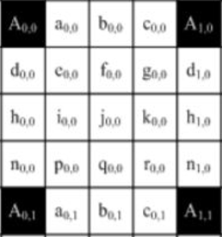
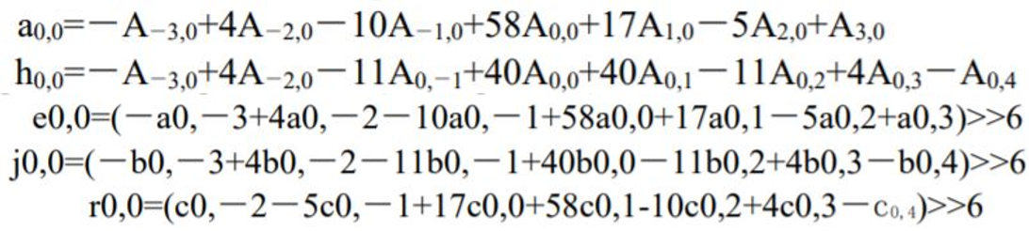
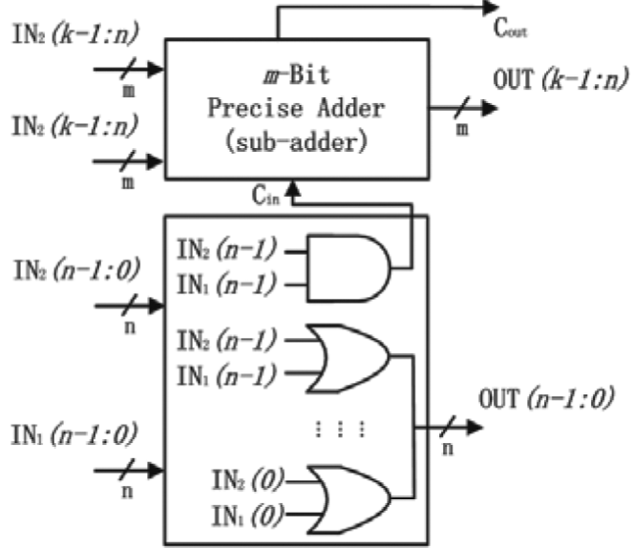
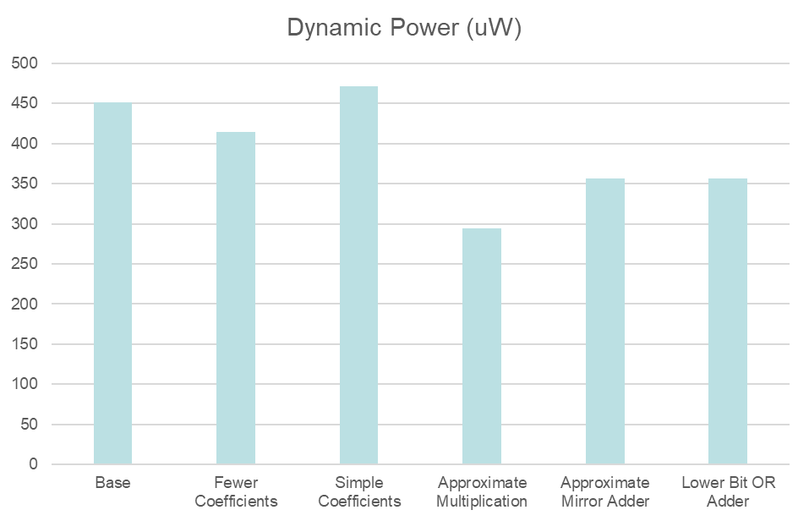
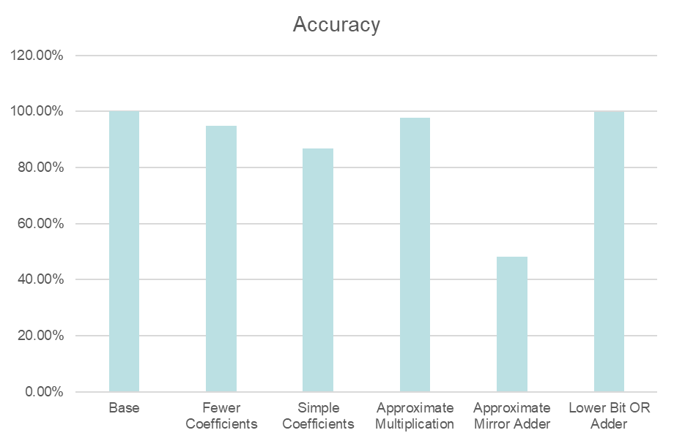
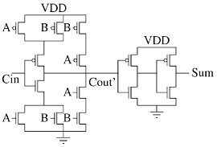
Approximate Computing for Sub-Pixel Interpolation
Nikolai Lenney & Charles Li
ECE 18-743 Poster Session
December 2018
1. Goals
2. System Overview
Power Savings on a Complex Algorithm
  What is Sub-Pixel Interpolation?
    A method used in video compression
    Helps accurately determine motion vectors
  Why do we want to save power?
    Video quality is continuing to rise
    The method of sub-pixel interpolation is extremely complex (see equations below)
    The process draws a lot of computational power
How Does Sub-Pixel Interpolation Work?
  Consider the grid of pixels below
  We calculate the values for the “Subpixels” based on nearby pixel values
  The relation is determined with the equations in Section 1
3. Approach
4. Results
Approximations
  Lower Bit Or Adder
  Fewer Multiplications
    Remove far away bits for simpler computation
    Have minimal effects since multiplier is low
  Less Complex Multiplications
    Change all multiplications to be powers of 2
    Simplifies to be only Shifting
  Approximate Mirror Adder
    Compute Sum as !Cout
Plots
Summary
  Where is power going?
    Seems that simplifying the multipliers is our best option
    Putting in approximate adders Lower Bit OR Adders give significant power reduction as well as accurate results

