Slide 1

HCI - Assignment n.2
Design and prototyping of an application using a human-centered approach
Deliverable n. 1: Requirement Analysis
Project Title: BatalhaBus, a entertainment/multimedia system for bus rides
Group: Rafael Ferreira, João Luís & Rodrigo Aguiar
Lab Class: P5
HCI 2022-2023

Slide 2

Introduction
BatalhaBus
Ever gone on a boring, long and dreadful bus ride?
We believe we could improve bus rides into something more fun and informative.
Could be an interesting project to apply other subjects knowledge, such as Databases or web/app development.
The members of the team regularly use bus as a transport method
HCI 2022-2023
‹#›
Notes:
Brief contextualization / motivation.
Why this project?
Relation to other courses? (e.g. Data Bases, Project…; optional)
Personal Interest? Elaborate.

Slide 3

Project Objectives
BatalhaBus
Provide the user with information about the bus ride while on the move
Provide an entertainment system integrated within the bus
Our project aims to provide a clean, beautiful and intuitive interface for every bus passenger
Integration of popular apps within the system
HCI 2022-2023
‹#›
Notes:
Define high-level goals.
What are the expected outcomes?
What are the benefits?

Slide 4

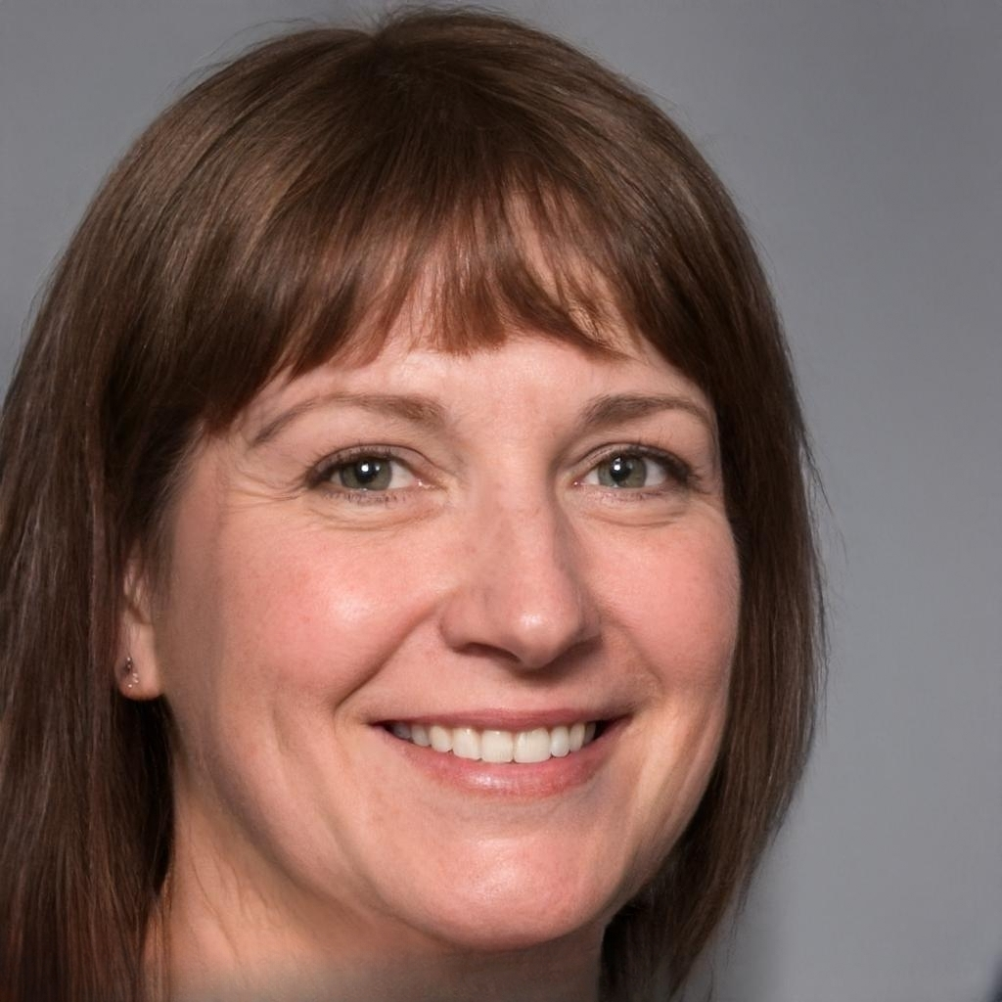
Personas
BatalhaBus
Name: Floribela Rodrigues
Gender: Female
Age: 48
Location: Lourosa
Profession: Industrial Worker in Ovar
Environment: Little experience with technology
Goals:
Be able to catch up on news in the bus.
Be able to see all details about her bus ride
Needs:
A system that is easy and intuitive to use
Integrations for applications she already uses on her phone
Floribela Rodrigues
HCI 2022-2023
‹#›
Notes:
Select 1 or 2 main target users;
Define the corresponding personas:
Include name, gender, age, profession, background, main motivations, goals and needs …
Do not void too much detail (include only information relevant to your problem

Slide 5
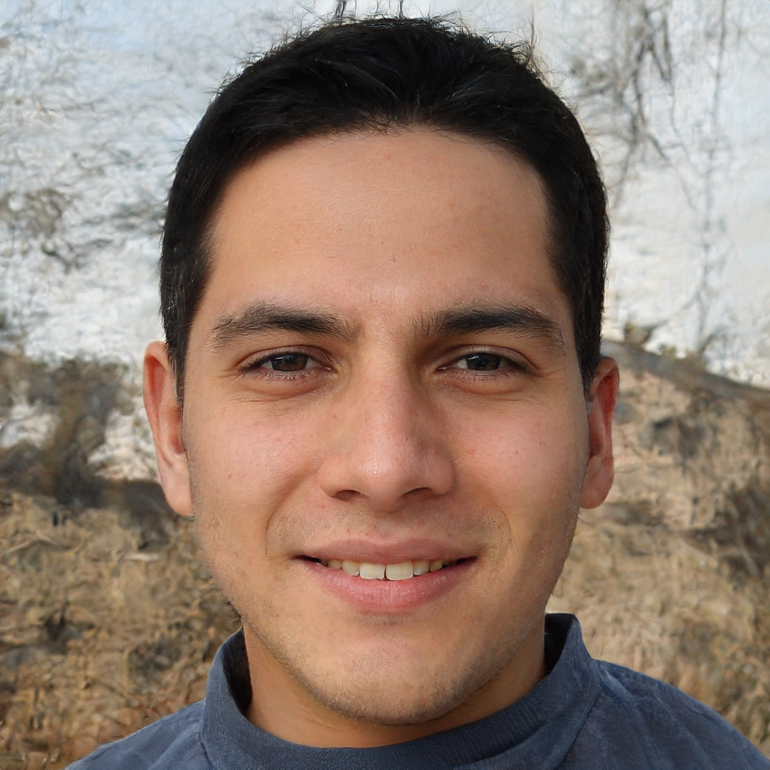
Personas
BatalhaBus
Name: Mário Silva
Gender: Male
Age: 20
Location: Golpilheira (Leiria)
Profession: Student in Covilhã
Environment: Fluent with technology
Problems: Eyesight issues
Goals:
Be able to watch YouTube videos or movies in the bus.
Be able to listen podcasts.
Needs:
A entertainment system that is built-in in the bus
A visible brightness slider in the device
Mário Silva
HCI 2022-2023
‹#›
Notes:
Select 1 or 2 main target users;
Define the corresponding personas:
Include name, gender, age, profession, background, main motivations, goals and needs …
Do not void too much detail (include only information relevant to your problem

Slide 6
Scenarios
BatalhaBus
Mario was previously listening to a podcast at home and wants to keep listening to it while he is on the bus.
Floribela is currently on a bus trip and forgot if she has to swap to another bus at the next stop or not
Floribela heard the bus on her trip back home will be delayed, so she checks the platform to see the updated timetables
HCI 20222-2023
‹#›
Notes:
Define context of use through 1 or 2 main scenarios including the personas you have defined
Define short concepts or descriptions of how users (personas) will use the application
Should not go into too much detail

Slide 7
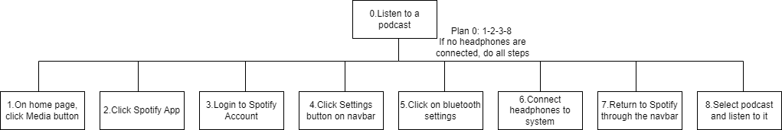
Task Pt.1
BatalhaBus
HCI 2022-2023
‹#›
Notes:
For each scenario indicate the main tasks that users will perform using the application;
Identify relevant issues of the context of use, if necessary (e.g. mobile usage, noise, dust, stress level, etc.);
Which tasks will become easier using the application (taking advantage of the new capacities) and how they are performed currently (without the application)?
Include the decomposition of the main task.

Slide 8
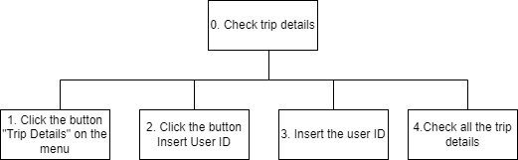
Task Pt.2
BatalhaBus
HCI 2022-2023
‹#›
Notes:
For each scenario indicate the main tasks that users will perform using the application;
Identify relevant issues of the context of use, if necessary (e.g. mobile usage, noise, dust, stress level, etc.);
Which tasks will become easier using the application (taking advantage of the new capacities) and how they are performed currently (without the application)?
Include the decomposition of the main task.

Slide 9
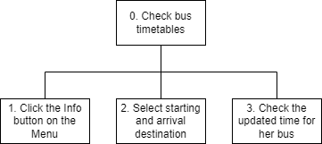
Task Pt.3
BatalhaBus
HCI 2022-2023
‹#›
Notes:
For each scenario indicate the main tasks that users will perform using the application;
Identify relevant issues of the context of use, if necessary (e.g. mobile usage, noise, dust, stress level, etc.);
Which tasks will become easier using the application (taking advantage of the new capacities) and how they are performed currently (without the application)?
Include the decomposition of the main task.

Slide 10

Requirements
BatalhaBus
Functional
The system must have a working gps sensor to be able to deduct its location.
Hardware must be appropriate, so the system doesn’t look slow to the users.
After a trip, all system cache and cookies must be reset in order to guarantee security for further using.
Must have integrations with other popular social media / entertainment applications
Support the tasks shown in the scenarios
Non-Functional
The system must support multiple languages
The various icons and buttons in the system must be clearly visible
Color theme must be appropriate
Buttons must have a clear tactile feedback
The system should be reliable and secure
HCI 2022-2023
‹#›
Notes:
Define a set of requirements (non-functional, functional, …) based on the objectives and personas:
Non-functional requirements – specify the main usability requirements
(ease of learn or ease of use? …) and other that would be the most relevant (privacy, …);
Functional Requirements - specify the main functionality the application should support.

Slide 11
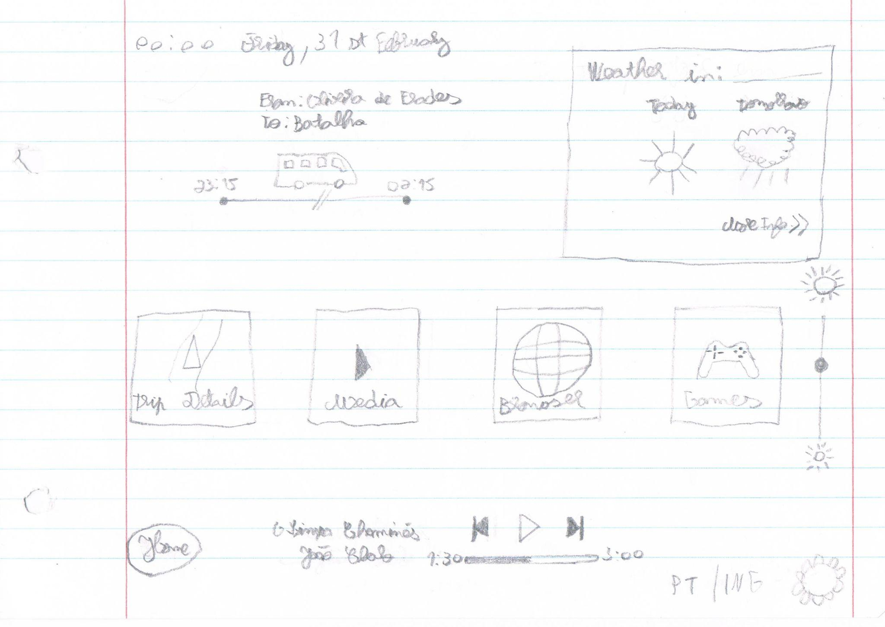
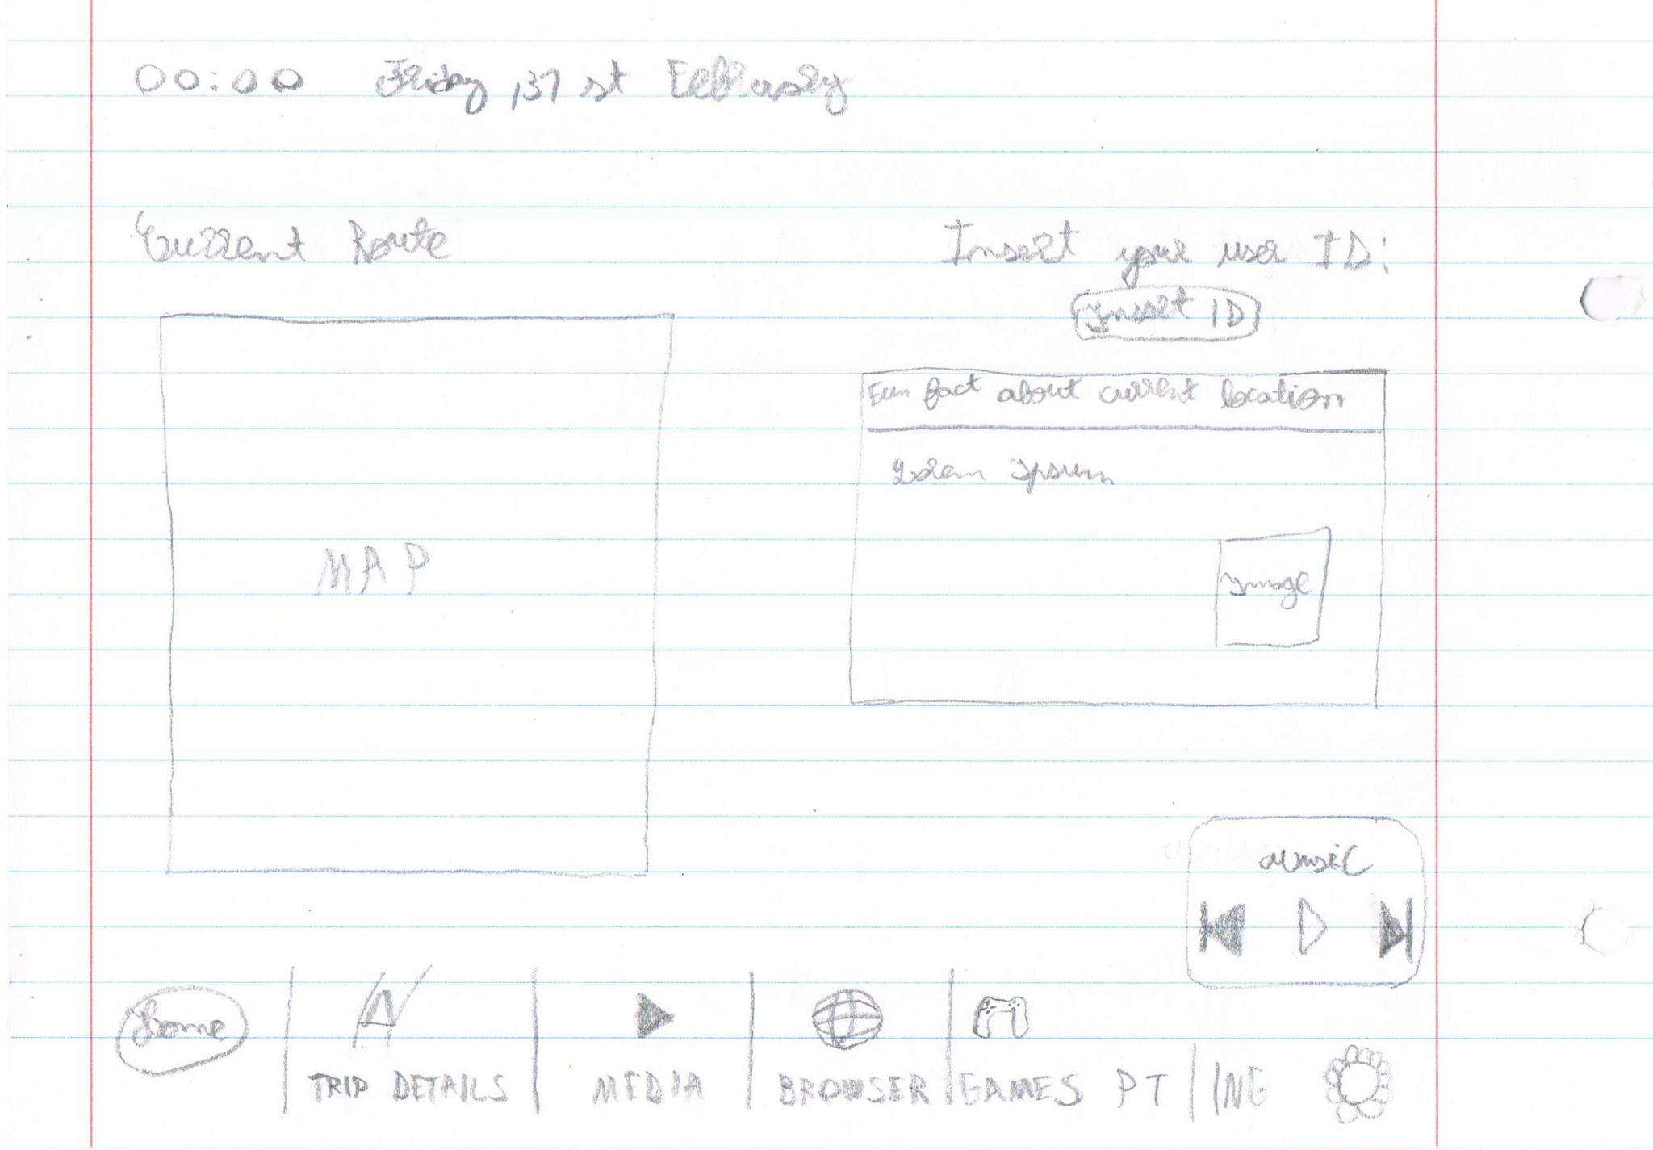
Next steps
BatalhaBus
We developed a first prototype in paper
We are considering doing a digital prototype using a online tool
HCI 2022 - 2023
‹#›
Notes:
What type of prototype are you considering? (Paper or digital prototype?)
How will you test it?

