Slide 1
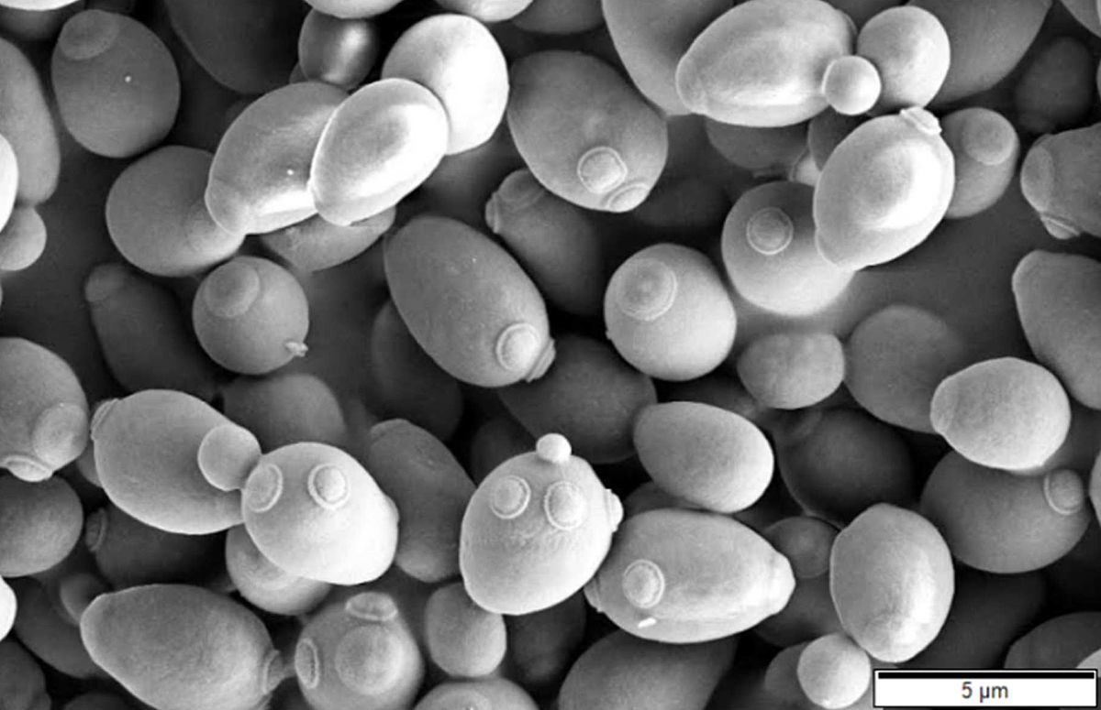
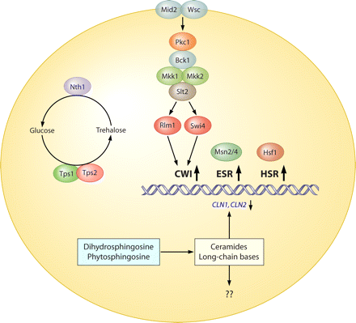
Heat shock
Baker’s yeast
Saccharomyces cerevisiae
25°C
37°C
Damaging effects of high temperature
Protein unfolding and aggregation.
Cell wall and membrane integrity affected.
Three molecular pathways induced to help yeast survive high temperatures:
CWI (cell wall integrity)
ESR (environmental stress response)
HSR (heat shock response)

Slide 2
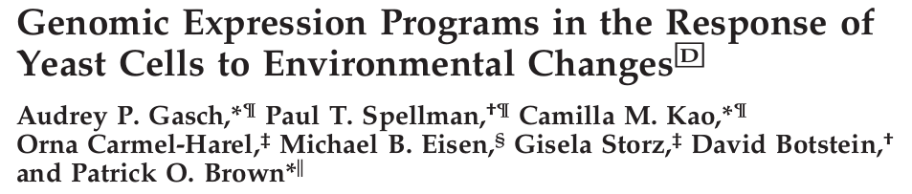
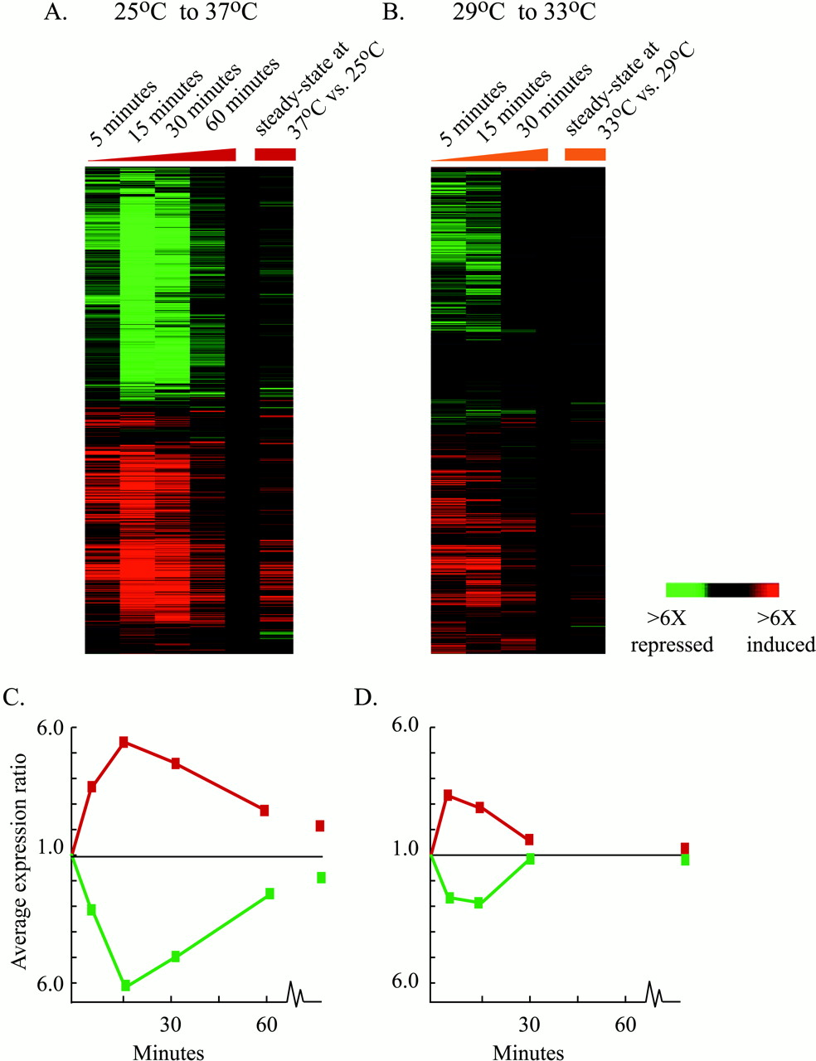
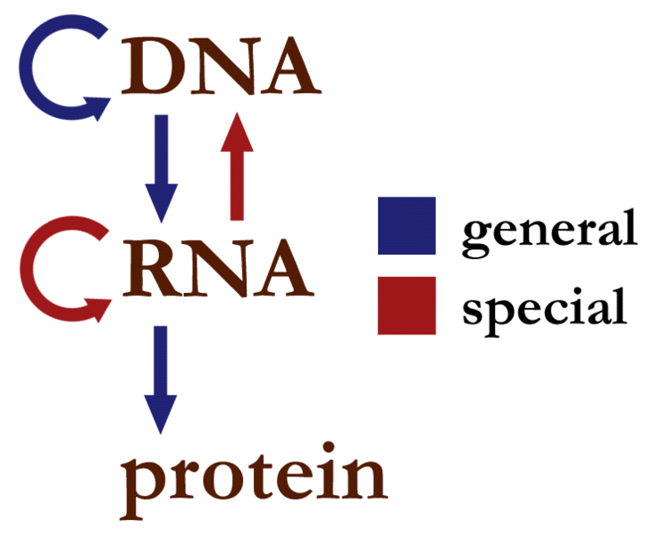
The data: Time course measurements of mRNA expression (relative to time zero control) for more than 6000 yeast genes.
Limitations:
Only 5 time measurements.
Network of interactions is (partially) known, but all kinetic parameters unknown.

Slide 3
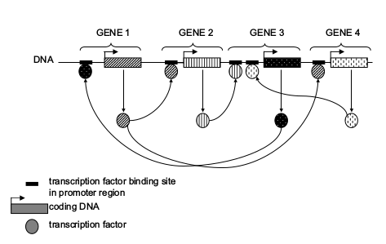
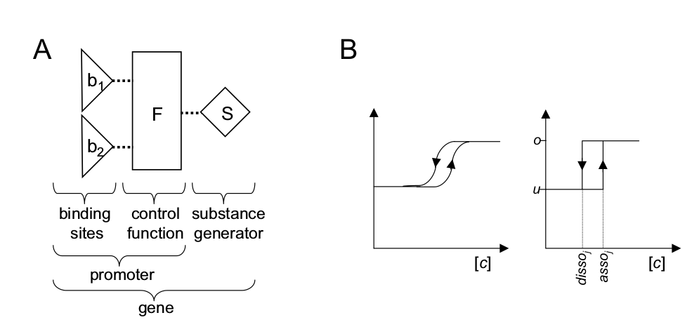
Hybrid models Example: Finite-state linear model
Binary
(bound/
not)
Binary
(on/off)
Rate
“real world”
Discrete approximation

