Slide 1
delete
Rqeust(요청)
웹서버
http://localhost:8088/guestbook3/delete?no=3&password=1234
Request header
(파라미터) No = 3
Password = 1234
Request body
Tomcat
phonebook1
spring-servlet.xml
rquest
Request header
(파라미터)
No = 3
Password = 1234
Request body
Handler Mapping
1
2
guestbookDao 객체
Front Controller
DispatcherServlet
4
3
Controller
0x123
delete()
jdbc *2
Response(응답)
6
ModelAndView
0x123
Response header
Response body (html)
response
리다이렉트
/addList
7
View
5
View Resolver
0x123
guestbookVo{
no = 3
password = 1234
}
http://localhost:8088/guestbook3/addList
Delete frome guestbook
Where no = ?
And password = ?

Slide 2
deleteForm
Rqeust(요청)
웹서버
http://localhost:8088/guestbook3/deleteForm?no=3
Request header
(파라미터) No = 3
Request body
Tomcat
phonebook1
spring-servlet.xml
rquest
Request header
(파라미터)
No = 3
Request body
Handler Mapping
1
2
3
Response(응답)
Front Controller
DispatcherServlet
4
ModelAndView
Controller
Response header
Response body (html)
response
포워드
No = 3
6
5
View Resolver
7
View
http://localhost:8088/ guestbook3/deleteForm?no=3

Slide 3
add
Rqeust(요청)
웹서버
http://localhost:8088/guestbook3/add?name=장성찬&password=1234&content=안녕하세요방명록입니다.
Request header
(파라미터)
Request body
Tomcat
DB서버
phonebook1
spring-servlet.xml
rquest
Request header
(파라미터)
name=장성찬
password=1234
content=안녕하세요방명록입니다.
Request body
Handler Mapping
Oracle
1
2
guestbookDao 객체
Front Controller
DispatcherServlet
4
3
Controller
0x123
insert()
jdbc *2
Response(응답)
6
ModelAndView
Count = 1
리스트 요청
Response header
Response body (html)
response
리다이렉트
(/addList)
7
View
5
View Resolver
http://localhost:8088/guestbook3/addList
insert into guestbook
.
.
0x123
guestbookVo{
name=장성찬
password=1234
content=안녕하세요방명록입니다.
}

Slide 4
addList
Rqeust(요청)
웹서버
http://localhost:8088/guestbook3/addList
Request header
(파라미터)
Request body
Tomcat
DB서버
phonebook1
spring-servlet.xml
rquest
Request header
(파라미터)
Request body
Handler Mapping
Oracle
1
2
guestbookDao 객체
Front Controller
DispatcherServlet
4
3
Controller
getGuestBookList()
jdbc *2
Response(응답)
6
ModelAndView
List<GuesBookVo>
리스트 요청
Response header
Response body (html)
response
포워드
(/addList.jsp)
7
View
5
View Resolver
http://localhost:8088/guestbook3/addList
select guestbook
.
.
List guestbookList

Slide 5
guestbook3

Slide 6
modify
Rqeust(요청)
웹서버
http://localhost:8088/phonebook3/modify?name=유재석&hp=010-3333-3333
&company=02-3333-3333
Request header
(파라미터) name=유재석
hp=010-3333-3333
company=02-3333-3333
Request body
Tomcat
DB서버
phonebook1
spring-servlet.xml
rquest
Request header
(파라미터)
name=유재석
hp=010-3333-3333
company=02-3333-3333
Request body
Handler Mapping
Oracle
1
2
phoneDao 객체
Front Controller
DispatcherServlet
4
3
Controller
0x123
personUpdate()
jdbc *2
Response(응답)
6
ModelAndView
Count = 1
리스트 요청
Response header
Response body (html)
response
리다이렉트
(/list)
7
View
5
View Resolver
http://localhost:8088/phonebook3/list
Update person
Set = ?
Hp = ?
Company = ?
Where person_id =?
0x123
personVo{
name=유재석
hp=010-3333-3333
company=02-3333-3333
}
controller 짜기.
파라미터 받아오기
Vo만들어서 Dao.update로 보내기
리스트로 리다이렉트하기

Slide 7
modifyForm
Rqeust(요청)
웹서버
http://localhost:8088/phonebook3/modifyForm?no=3
Request header
(파라미터) No = 3
Request body
Tomcat
phonebook1
spring-servlet.xml
rquest
Request header
(파라미터)
No = 3
Request body
Handler Mapping
1
2
phoneDao 객체
Front Controller
DispatcherServlet
4
3
Controller
No = 3
getPerson()
Response(응답)
6
ModelAndView
0x123
Response header
Response body (html)
response
포워드
personVo 0x123
7
View
5
View Resolver
0x123
personVo{
Name = 유재석
Hp – 010-3333-3333
Company = 02-3333-3333
}
0x999
http://localhost:8088/phonebook3/modifyForm?no3
Select person_id
name
hp
company
from person
where no = ?
personVo{
Name = 유재석
Hp – 010-3333-3333
Company = 02-3333-3333
}

Slide 8
delete
Rqeust(요청)
웹서버
http://localhost:8088/phonebook3/delete
Request header
(파라미터) no = 3
Request body
Tomcat
DB서버
phonebook1
spring-servlet.xml
rquest
Request header
(파라미터)
No=3
Request body
Handler Mapping
Oracle
1
2
phoneDao 객체
Front Controller
DispatcherServlet
4
3
Controller
No = 3
personDelete()
jdbc *2
Response(응답)
6
ModelAndView
Count = 1
리스트 요청
Response header
Response body (html)
response
Redirect
(/list)
7
View
5
View Resolver
http://localhost:8088/phonebook3/list
Delete from person
Where no = ?

Slide 9
list
Rqeust(요청)
웹서버
http://localhost:8088/phonebook3/list
Request header
(파라미터)
Request body
Tomcat
DB서버
phonebook1
spring-servlet.xml
rquest
Request header
(파라미터)
Request body
“personLIst” personLIst
(0x789)
Handler Mapping
Oracle
1
2
phoneDao 객체
Front Controller
DispatcherServlet
4
3
Controller
getPersonList()
jdbc *2
Response(응답)
6
ModelAndView
personList
0x789
리스트 요청
Response header
Response body (html)
response
포워드
(/list)
7
View
5
View Resolver
http://localhost:8088/phonebook2/pbc?action=list
0x789
List<personVo> personList = phoneDao.getPersonList
리스트

Slide 10
write
Rqeust(요청)
웹서버
http://localhost:8088/phonebook3/write?name=장성찬&hp=010&company=02
Request header
(파라미터) name=장성찬
Hp=010
Company=02
Request body
Tomcat
DB서버
phonebook1
spring-servlet.xml
rquest
*파라미터
name=장성찬
Hp=010
Company=02
*어트리뷰트
Handler Mapping
Oracle
1
2
phoneDao 객체
Front Controller
DispatcherServlet
4
3
Controller
personVo
personDelete(id)
jdbc *2
Response(응답)
6
ModelAndView
1
리스트 요청
Response header
Response body (html)
response
리다이렉트
(/list)
7
View
5
View Resolver
http://localhost:8088/phonebook3/list
0x333
PersonVo personVo{
name
hp
company
}

Slide 11
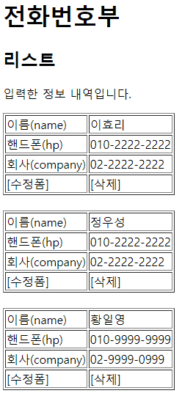
수정폼
Rqeust(요청)
웹서버
DB서버
http://localhost:8088/phonebook3/pbc?action=delete
&id=3
Request header
(파라미터) action=delete
id=3
Request body
Tomcat
phonebook1
PhoneController (Servlet)객체
phoneDao 객체
Oracle
rquest
*파라미터
action=delete
id=3
*어트리뷰트
getParameter("action")
personDelete(id)
delete일때
리다이렉트
id=3
jdbc *2
1
Response(응답)
리스트 요청
Response header
Response body (html)
response
리다이렉트
(pbc?action=list)
http://localhost:8088/phonebook2/pbc?action=list
spring-servlet.xml
Handler Mapping
1
2
3
Front Controller
DispatcherServlet
4
ModelAndView
Controller
6
5
View Resolver
7
View

Slide 12
수정폼
Rqeust(요청)
웹서버
DB서버
http://localhost:8088/phonebook3/pbc?action=delete
&id=3
Request header
(파라미터) action=delete
id=3
Request body
Tomcat
phonebook1
PhoneController (Servlet)객체
phoneDao 객체
Oracle
rquest
*파라미터
action=delete
id=3
*어트리뷰트
getParameter("action")
personDelete(id)
delete일때
리다이렉트
id=3
jdbc *2
1
Response(응답)
리스트 요청
Response header
Response body (html)
response
리다이렉트
(pbc?action=list)
http://localhost:8088/phonebook2/pbc?action=list
spring-servlet.xml
Handler Mapping
1
2
3
Front Controller
DispatcherServlet
4
ModelAndView
Controller
6
5
View Resolver
7
View

Slide 13
수정폼

Slide 14
삭제
Rqeust(요청)
웹서버
DB서버
http://localhost:8088/phonebook2/pbc?action=delete
&id=3
Request header
(파라미터) action=delete
id=3
Request body
Tomcat
phonebook1
Oracle
rquest
*파라미터
action=delete
id=3
*어트리뷰트
PhoneController (Servlet)객체
phoneDao 객체
getParameter("action")
personDelete(id)
delete일때
리다이렉트
id=3
jdbc *2
Response(응답)
1
리스트 요청
Response header
Response body (html)
response
리다이렉트
(pbc?action=list)
http://localhost:8088/phonebook2/pbc?action=list

Slide 15
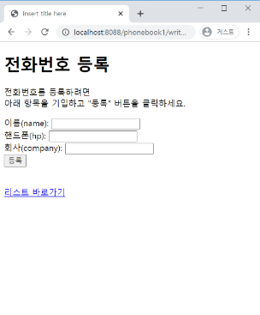
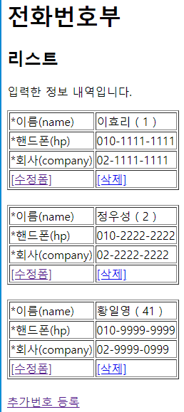
등록
Rqeust(요청)
웹서버
DB서버
http://localhost:8088/phonebook2/pbc?action=write
&name=유재석
&hp=010-2222-2222
&company=02-2222-2222
Request header
(파라미터) action=write
name=유재석
hp=010-2222-2222
company=02-2222-2222
Request body
Tomcat
phonebook1
Oracle
rquest
*파라미터
action=writeForm
name=유재석
hp=010-2222-2222
company=02-2222-2222
*어트리뷰트
"
PhoneController (Servlet)객체
phoneDao 객체
getParameter("action")
*4
personInsert(vo)
write일때
Vo
jdbc *2
Response(응답)
1
리스트 요청
Response header
Response body (html)
response
리다이렉트(pbc?action=list)
jsp가 DB연결하지 않는다
http://localhost:8088/phonebook2/pbc?action=list
jsp: html 작성하기 편함
a.jsp → a_jsp.java(servlet) → a.class
servlet: java 문법 작성하기 편함
a.java(servlet) → a.calss
action=write
pbc
action=list
list.jsp
리스트
action=list
등록

Slide 16
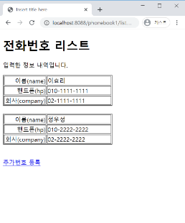
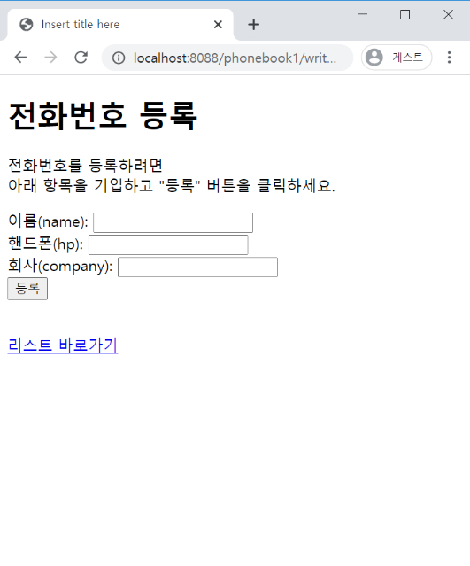
등록폼
Rqeust(요청)
웹서버
DB서버
http://localhost:8088/phonebook2/pbc?action=writeForm
Request header
(파라미터) action=writeForm
Request body
Tomcat
phonebook1
PhoneController (Servlet)객체
Oracle
getParameter("action")
writeFrom일때
Response(응답)
rquest
*파라미터
action=writeForm
*어트리뷰트
"
*포워드
Response header
Response body (html)
writeForm.jsp
response
html
jsp가 DB연결하지 않는다
wrtieForm.jsp
jsp: html 작성하기 편함
a.jsp → a_jsp.java(servlet) → a.class
servlet: java 문법 작성하기 편함
a.java(servlet) → a.calss
action=writeForm
pbc
action=list
list.jsp
리스트
등록

Slide 17
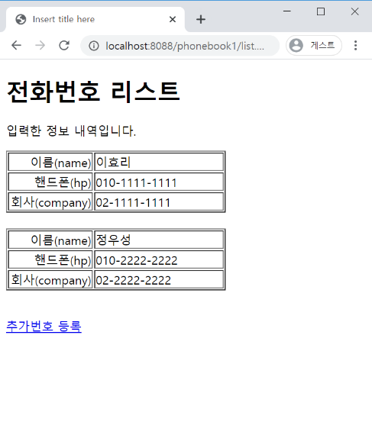
리스트
Rqeust(요청)
웹서버
DB서버
http://localhost:8088/phonebook2/pbc?action=list
Request header
(파라미터) action=list
Request body
Tomcat
phonebook1
Oracle
rquest
*파라미터
action=list
*어트리뷰트
"pList" personList
PhoneController (Servlet)객체
phoneDao 객체
getParameter("action")
getPersonList()
response
list일때
personList
List<PersonVo> personList
0x333
jdbc *2
Response(응답)
*포워드
Response header
Response body (html)
list.jsp
html+데이터
jsp가 DB연결하지 않는다
jsp: html 작성하기 편함
a.jsp → a_jsp.java(servlet) → a.class
servlet: java 문법 작성하기 편함
a.java(servlet) → a.calss
0x333
List<PersonVo>
List
PersonVo
PersonVo
PersonVo
리스트
등록

