Slide 1
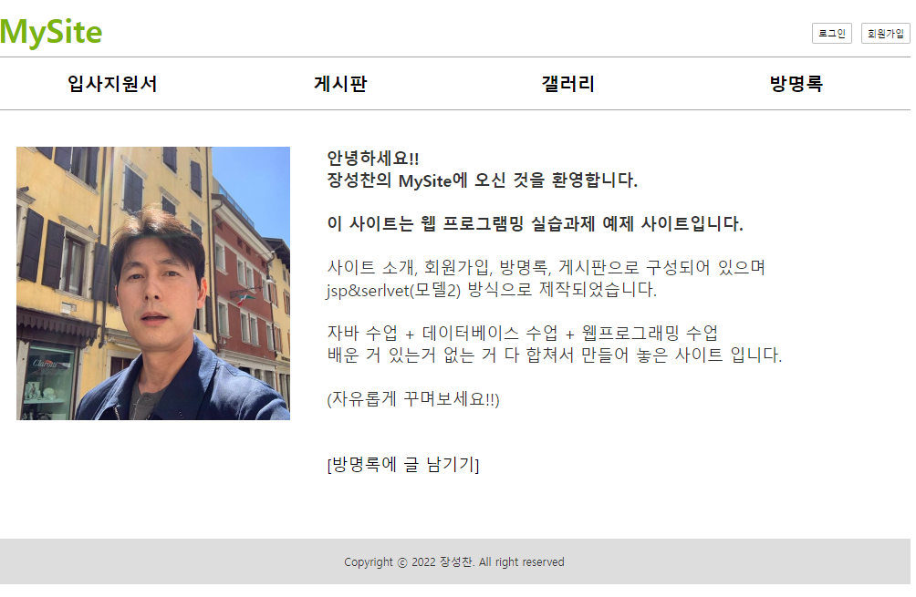
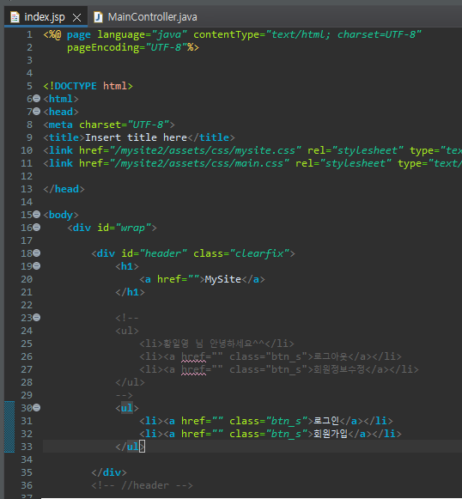
mySite2메인
Rqeust(요청)
웹서버
http://localhost:8088/mysite2/main
Request header
(파라미터)
Request body
Tomcat
mysite2
MainController (Servlet)객체
rquest
*파라미터
Response(응답)
포워딩
Response header
Response body
response
index.jsp
http://localhost:8088/mysite2/main
브라우저
MainController (Servlet)
/main
포워딩
index.jsp

Slide 2
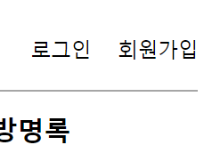
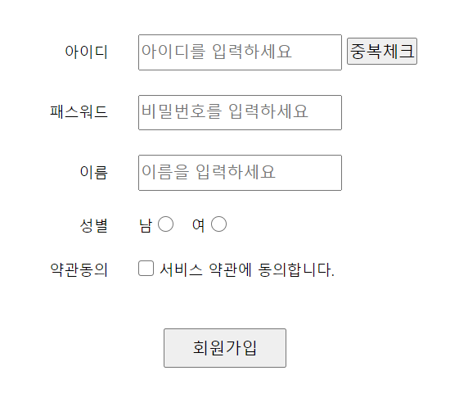
mySite2 > user > 회원가입 폼
Rqeust(요청)
웹서버
http://localhost:8088/mysite2/users?=joinForm
Request header
(파라미터)
Action=joinForm
Request body
Tomcat
mysite2
UserController (Servlet)객체 /users
rquest
*파라미터
Action=joinForm
joinForm
joinForm.jsp
Response(응답)
포워딩
Response header
Response body
(html)
response
joinForm.jsp
UserContoller (servlet)
브라우저
action=joinForm
/user
요청
포워드
응답
joinForm.jsp

Slide 3
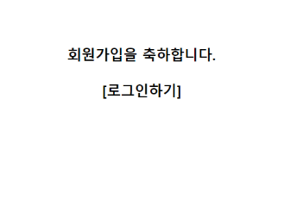
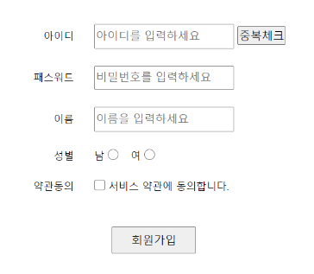
mySite2 > user > 회원가입
Rqeust(요청)
웹서버
1. 파라미터꺼내기x4
2. Vo로 만들기
3. Vo주소만 Dao로 넘기기
4. Dao에서 insert하기
5. joinOK로 보내기
DB서버
http://localhost:8088/mysite2/users?action=join
Request header
(파라미터)
Id
password
Name
gender
Request body
Tomcat
Id
Password
Name
gender
mysite2
rquest
*파라미터
Id
password
Name
Gender
*어트리뷰트
UserController (Servlet)객체 /users
userDao
Oracle
Join일 때
0x333
Insert(userVo)
jdbc
No(seq)
Id
Password
Name
gender
joinOk.jsp
Response(응답)
포워딩
Response header
Response body
(html)
joinOk.jsp
response
0x333
UserVo{
Id
Password
Name
gender
}
UserContoller (servlet)
UserDao
브라우저
action=join
/user
insert(vo)
요청
포워드
DB
응답
joinForm.jsp

Slide 4
mySite2 user>login
Rqeust(요청)
웹서버
1. 파라미터꺼내기x2
2. Vo로 만들기
3. Vo주소만 Dao로 넘기기
DB서버
http://localhost:8088/mysite2/user?action=login
Request header
(파라미터)
Action=login
Id
Password
Request body
Tomcat
Id
Password
mysite2
UserController (Servlet)객체
userDao
Oracle
rquest
*파라미터
Action=login
Id
Password
login
0x333
getUser(userVo)
jdbc
Select *
From users
Where id = aaa
and password = 1234
Response(응답)
0x555
Response header
Response body
response
0x333
0x555
UserVo{
Id = aaa
Password = 1234
}
UserVo{
no = 1
Id = aaa
Password = 1234
name = N
gender = G
}
브라우저
MainController (Servlet)
/main
포워딩
index.jsp

Slide 5
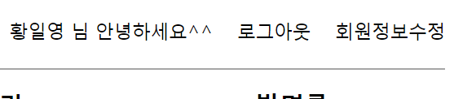
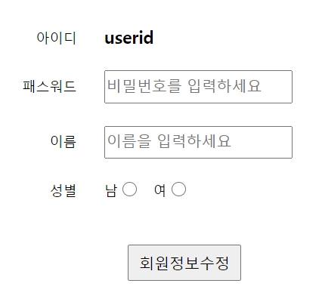
mySite2 user>회원정보수정
Rqeust(요청)
웹서버
DB서버
http://localhost:8088/mysite2/user?action=modifyForm&no=123
Request header
(파라미터)
Action=modifyForm
No=123
Request body
Tomcat
mysite2
UserController (Servlet)객체
userDao
Oracle
rquest
*파라미터
Action=modifyForm
No=123
modifyForm일때
No=123
getUser(userVo)
jdbc
Select no
,id
,password
,name
,gender
From users
Where no = 123
Response(응답)
포워딩
0x555
Response header
Response body
response
modifyForm.jsp
0x333
0x555
UserVo{
no = 123
}
UserVo{
no = 123
Id = aaa
Password = 1234
name = N
gender = G
}
세션에 있는 no
UserContoller (servlet)
UserDao
브라우저
action=modifyForm?
/user
getUser(no)
요청
응답
포워드
modifyForm.jsp
DB

Slide 6
dfsf

Slide 7
asdf

Slide 8
dfsf

Slide 9
asdf

Slide 10
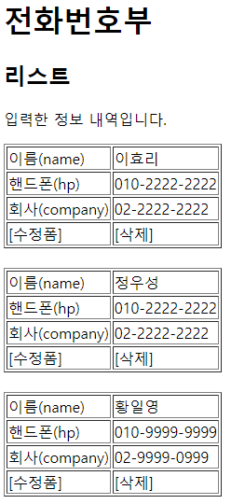
삭제
Rqeust(요청)
웹서버
DB서버
http://localhost:8088/phonebook2/pbc?action=delete
&id=3
Request header
(파라미터) action=delete
id=3
Request body
Tomcat
phonebook1
Oracle
rquest
*파라미터
action=delete
id=3
*어트리뷰트
PhoneController (Servlet)객체
phoneDao 객체
getParameter("action")
personDelete(id)
delete일때
리다이렉트
id=3
jdbc *2
Response(응답)
1
리스트 요청
Response header
Response body (html)
response
리다이렉트
(pbc?action=list)
http://localhost:8088/phonebook2/pbc?action=list

Slide 11
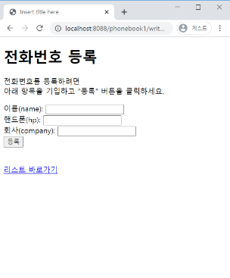
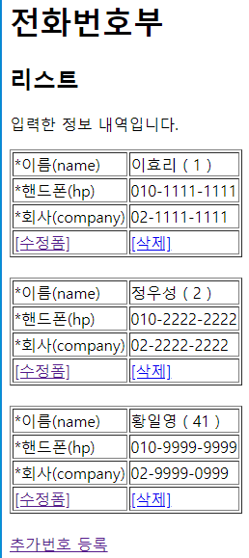
등록
Rqeust(요청)
웹서버
DB서버
http://localhost:8088/phonebook2/pbc?action=write
&name=유재석
&hp=010-2222-2222
&company=02-2222-2222
Request header
(파라미터) action=write
name=유재석
hp=010-2222-2222
company=02-2222-2222
Request body
Tomcat
phonebook1
Oracle
rquest
*파라미터
action=writeForm
name=유재석
hp=010-2222-2222
company=02-2222-2222
*어트리뷰트
"
PhoneController (Servlet)객체
phoneDao 객체
getParameter("action")
*4
personInsert(vo)
write일때
Vo
jdbc *2
Response(응답)
1
리스트 요청
Response header
Response body (html)
response
리다이렉트(pbc?action=list)
jsp가 DB연결하지 않는다
http://localhost:8088/phonebook2/pbc?action=list
jsp: html 작성하기 편함
a.jsp → a_jsp.java(servlet) → a.class
servlet: java 문법 작성하기 편함
a.java(servlet) → a.calss
action=write
pbc
action=list
list.jsp
리스트
action=list
등록

Slide 12
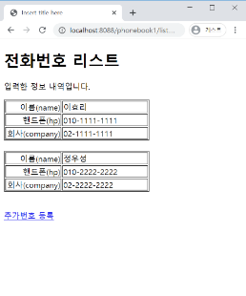
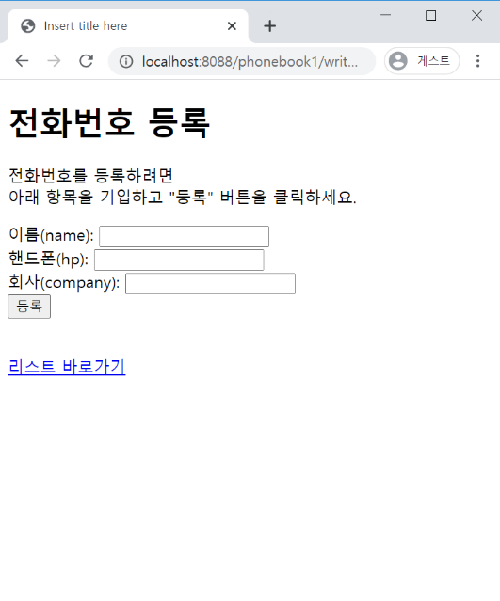
등록폼
Rqeust(요청)
웹서버
DB서버
http://localhost:8088/phonebook2/pbc?action=writeForm
Request header
(파라미터) action=writeForm
Request body
Tomcat
phonebook1
PhoneController (Servlet)객체
Oracle
getParameter("action")
writeFrom일때
Response(응답)
rquest
*파라미터
action=writeForm
*어트리뷰트
"
*포워드
Response header
Response body (html)
writeForm.jsp
response
html
jsp가 DB연결하지 않는다
wrtieForm.jsp
jsp: html 작성하기 편함
a.jsp → a_jsp.java(servlet) → a.class
servlet: java 문법 작성하기 편함
a.java(servlet) → a.calss
action=writeForm
pbc
action=list
list.jsp
리스트
등록

Slide 13
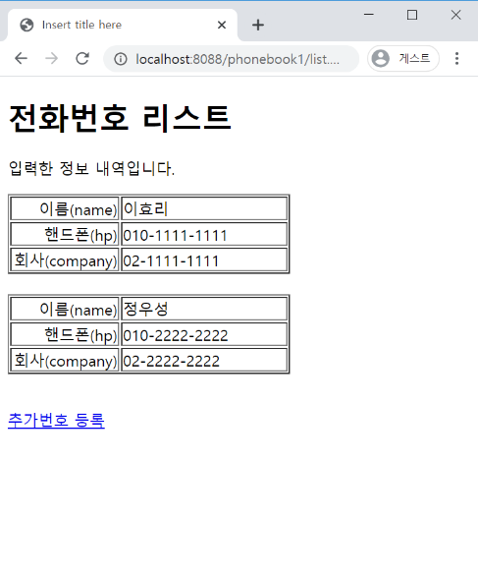
리스트
Rqeust(요청)
웹서버
DB서버
http://localhost:8088/phonebook2/pbc?action=list
Request header
(파라미터) action=list
Request body
Tomcat
phonebook1
Oracle
rquest
*파라미터
action=list
*어트리뷰트
"pList" personList
PhoneController (Servlet)객체
phoneDao 객체
getParameter("action")
getPersonList()
response
list일때
personList
List<PersonVo> personList
0x333
jdbc *2
Response(응답)
*포워드
Response header
Response body (html)
list.jsp
html+데이터
jsp가 DB연결하지 않는다
jsp: html 작성하기 편함
a.jsp → a_jsp.java(servlet) → a.class
servlet: java 문법 작성하기 편함
a.java(servlet) → a.calss
0x333
List<PersonVo>
List
PersonVo
PersonVo
PersonVo
리스트
등록

