Slide 1

Briefing for Judges

Slide 2
A Word to our Judges…
Thank You!!

Slide 3
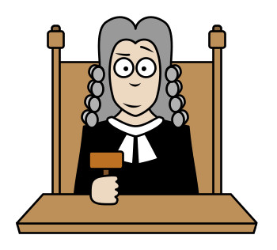
What Do Judges Do?
Watch the debate.
Award individual speaker points.
Record the winning team.
Give written feedback.
Debaters or moderators take care of the rest.

Slide 4
Are You Qualified?
Yes! Don’t worry!
There are some things you need to know
However, a lot of this job is simply listening to a debate and recording your honest reaction.

Slide 5
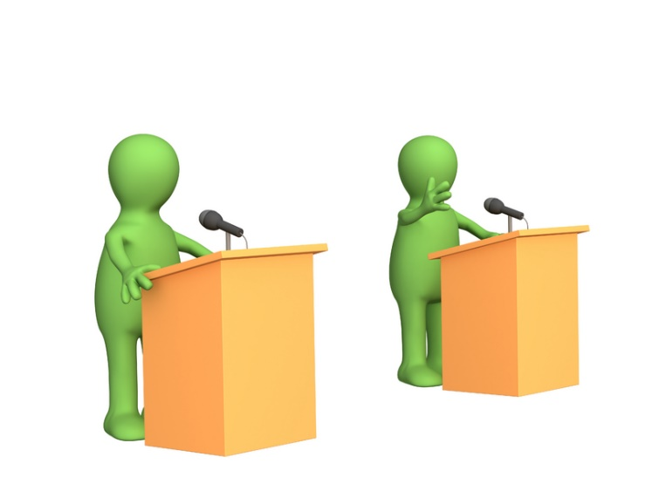
What is Debate?
Debate centers on the discussion of a RESOLUTION.
There are two sides:
Affirmative – supports the resolution
Negative – argues against the resolution (for the status quo or another idea).

Slide 6
Debate Formats

Slide 7
Format of the Tournament
Novice
Junior/Senior
Morning – 2 rounds of prepared Cross-Ex
Afternoon – 2 rounds of impromptu Cross-Ex
Morning – 2 rounds of prepared Cross-Ex
Afternoon – 2 rounds of impromptu CNDF

Slide 8
Cross-Examination Style (Novice/Jr.)
1st Affirmative Constructive Speech (4 min) | Cross X (3 min) | 1st Negative Constructive Speech (4 min) | Cross X (3 min)
2nd Affirmative Constructive Speech (7 min) | Cross X (3 min) | 2nd Negative Constructive Speech (7 min) | Cross X (3 min)
2 minute break for preparation
1st Negative Summary & Rebuttal (3 min) |  | 1st Affirmative Summary & Rebuttal (3 min)

Slide 9
Cross-Examination Style (Senior)
1st Affirmative Constructive Speech (5 min) | Cross X (3 min) | 1st Negative Constructive Speech (5 min) | Cross X (3 min)
2nd Affirmative Constructive Speech (8 min) | Cross X (3 min) | 2nd Negative Constructive Speech (8 min) | Cross X (3 min)
2 minute break for preparation
1st Negative Summary & Rebuttal (3 min) |  | 1st Affirmative Summary & Rebuttal (3 min)

Slide 10
CNDF Style – Juniors/Seniors
1st Proposition Constructive Speech (8 min) | 1st Opposition Constructive Speech (8 min)
2nd Proposition Constructive Speech (8 min) | 2nd Opposition Constructive Speech (8 min)
1st Opposition Reply Speech (4 min) | 1st Proposition Reply Speech (4 min)

Slide 11
Prepared Debate
Definition of the resolution should be fair and reasonable. It shouldn’t be obviously unfair to one team.
Usually the definition is agreed upon by both teams and not argued about.
However, it CAN be argued about if the opposition team believes it to be unfair.

Slide 12
Prepared Debate
Evidence should be very specific. They have had time to research this topic.
Keep in mind that younger students will probably have a weaker grasp of ideas.

Slide 13
Prepared Debate
The debate is prepared, the speeches are not.
Speeches should still be improvised from their notes (not read verbatim from a script).
Students who perform prepared speeches should receive lower marks.

Slide 14
Impromptu Debate
Students define the resolution. The definition should be fair and debatable.
Definitions should not turn the debate onto a topic that seems to have nothing to do with the resolution.
Expect less detailed content knowledge.

Slide 15
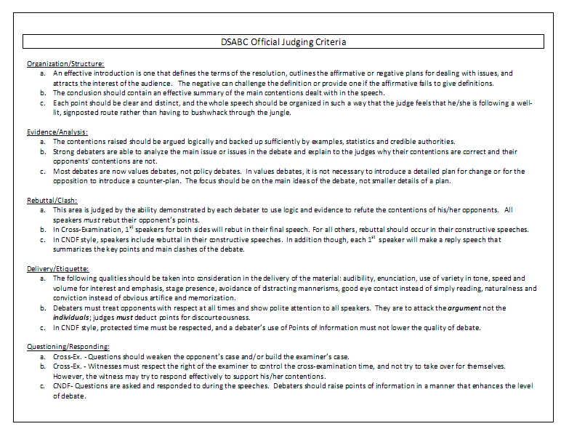
Scoresheet Categories

Slide 16
Scoresheet Categories
Complete your ballot by considering these five areas:
Organization/Structure
Evidence/Analysis
Rebuttal/Clash
Delivery/Etiquette
Questioning/Responding

Slide 17
ORGANIZATION/STRUCTURE
The speech should be well-structured, logical, and coherent. I.E. easy to follow.
Introductions and conclusions should explain what is going to be said and what has been said.
Transition words should mark stages in the speech.

Slide 18

EVIDENCE/ANALYSIS
Evidence can be in the form of facts, statistics, quotes, examples, or logic.
Though evidence should be accurate. Try not to let your own background knowledge influence your judging.
Analysis shows how that evidence applies to the case.

Slide 19
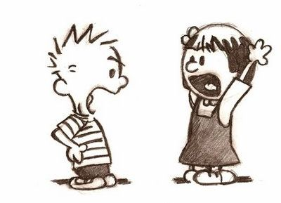
REBUTTAL/CLASH
Clash is a central principle of debate. Without clash, there is no debate.
Therefore, clash will usually be a major factor in deciding who won.
Debaters must clash directly and specifically with their opponents. They should say why the opponents’ main points are wrong.

Slide 20

DELIVERY/ETIQUETTE
Evaluate presentation style.
Is the speaker confident?
Does he/she keep your interest?
Is his/her voice dynamic?
What is his/her body language saying?

Slide 21
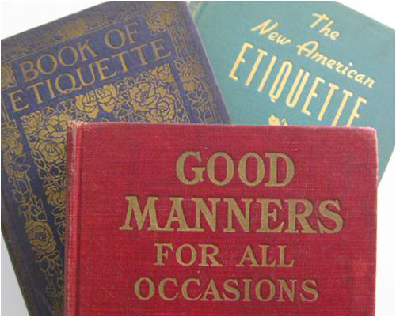
DELIVERY/ETIQUETTE
Debaters must treat one another with courtesy and respect. They should attack arguments, not individuals.
Debaters who show disdain, contempt or rudeness toward the opposing team should be heavily penalized.

Slide 22
SUMMARY/REPLY SPEECHES
Both teams summarize THEIR cases and explain why they’re right.
They also summarize main CLASHES and why you should ignore the opposition’s arguments
During summaries, there should be no new arguments, only reinforcing of old ones

Slide 23

Questioning/Responding (Cross-Examination)
This form of questioning is meant to gain valuable admissions and identify weaknesses of the opponents’ case.
Questioners control the cross-ex time. They ask questions. The witnesses must answer all relevant questions.

Slide 24
Questioning/Responding (Cross-Examination)
Questioners should be polite and provide enough time for the question to be answered. They can however interrupt verbose or evasive answers.
Consider both the questions and the answers when you mark.

Slide 25

Questioning/Responding (CNDF Style)
Debaters use Points of Information to interrupt a speech to challenge each other’s arguments.
Each debater should offer 2 questions or more during each opponent’s speech.
The speaker should take 2 questions.

Slide 26
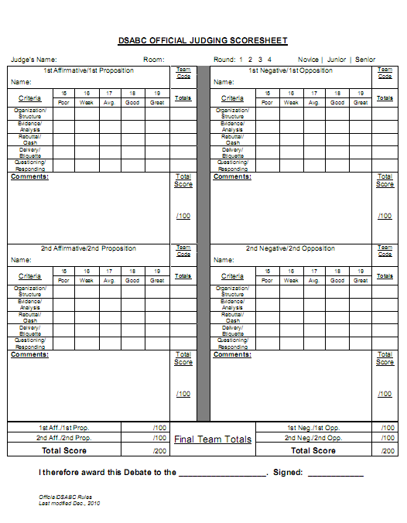
Filling in a Judging Scoresheet

Slide 27
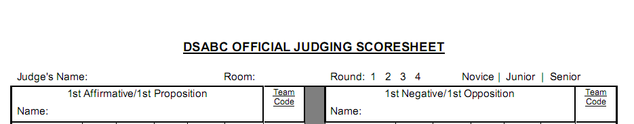
Filling in a Judging Scoresheet
Fill in all of the information at the top, please.

Slide 28
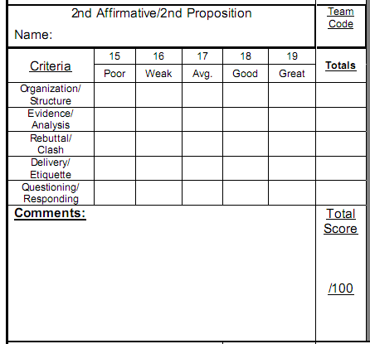
Filling in a Judging Scoresheet
Put in each person’s name and team code.
Make sure you provide a Total Score for each speaker!
Write in comments

Slide 29
Speaker Points
It can be difficult to assign speaker points.
Therefore, we use a very tight range and some detailed score descriptions to help.
Total marks must be between 75 and 95.
If you give a score outside of this range we will come and find you!

Slide 30
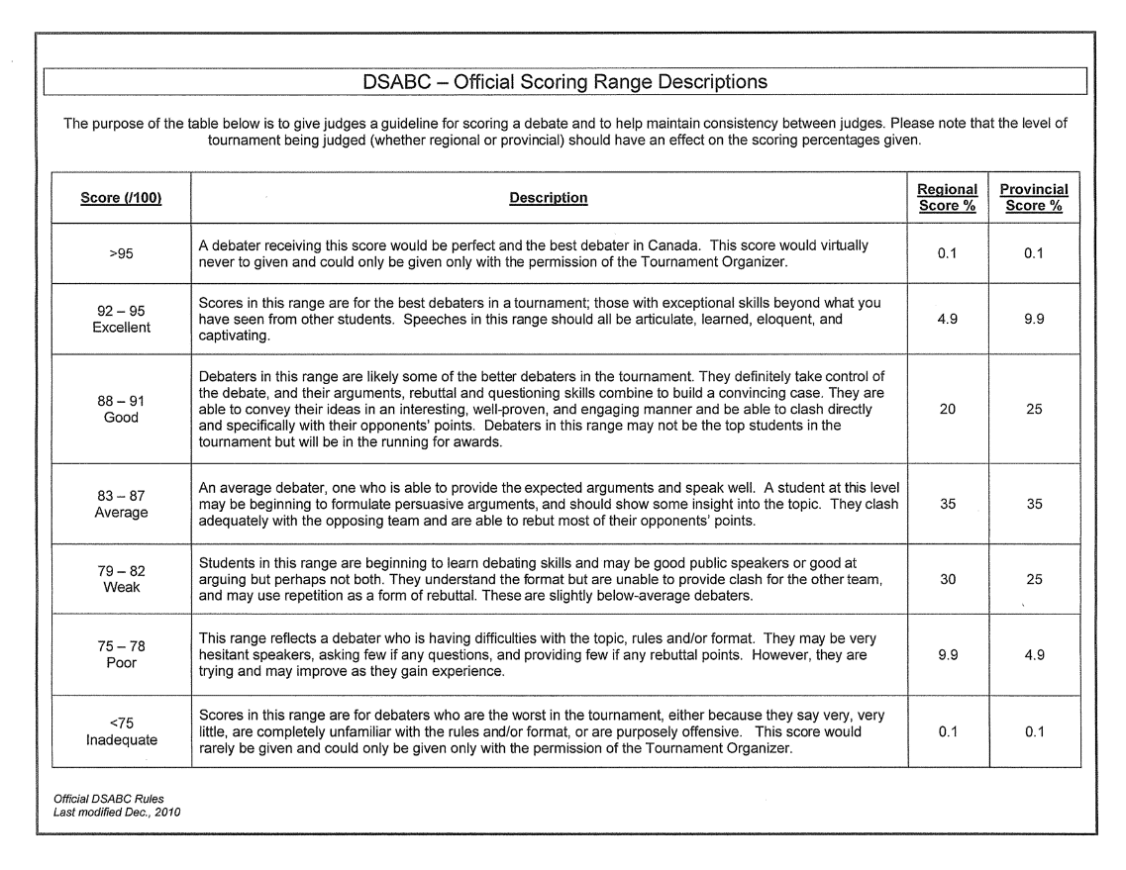
Scoring Range
Average:
85
Average:
85

Slide 31
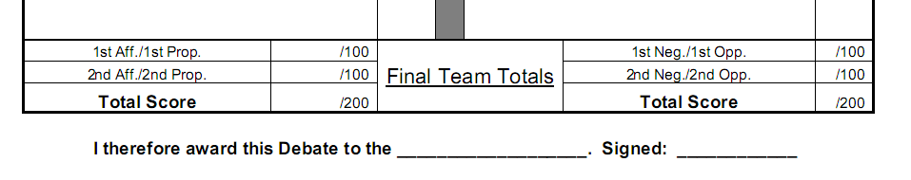
Record the Winning Team
Ties are not allowed in a debate.
You must explicitly mark the winning team by writing it and signing the bottom of the ballot

Slide 32
Record the Winning Team
The winning team MUST have more points, check!
We will not check your math, so whatever you say is the total score will be entered
Yes, you can use half marks if it helps!

Slide 33
Final Points

Slide 34
Final Points
If time permits you may make brief oral comments at the conclusion of the round
However, DO NOT indicate who won unless you have been told to do so by the organizer!
Debaters may also approach you during between rounds for comments, this is allowed but only if you feel comfortable doing so
Still no indication of winners please!

Slide 35
Final Points
Show no bias on the issue - act as though you know nothing but what the debaters present.
If you feel you have a conflict of interest in judging a debate, please switch rooms with another judge.

Slide 36
Final Points
Especially in your first debate, keep in mind if you have any doubts, err towards the middle ground.
Remain CONSISTENT for the rest of the tournament.

Slide 37

Final Points
Judges should not sit together or discuss their ballots. Decide on your own and submit your ballot to the moderator.
The judge’s decision is always right!

Slide 38
Enjoy the Experience.
Thanks again!

