Slide 1
Aviation Accidents Risk Assessment
Presented by John Njogu

Slide 2
Problem statement
Our company is entering the aviation industry by purchasing aircraft for commercial and private use.
However, aviation carries serious risks, including accidents that can cause financial loss and damage our reputation.
We need to identify which aircraft models are the safest, using historical accident data.
The goal is to select aircraft with the lowest risk to ensure safe operations and protect the company’s investment.

Slide 3
Objectives
To determine which aircraft brands are historically associated with the lowest accident frequencies and better safety records.
To quantify the number of accidents per aircraft, helping to identify low-risk models based on historical data.
To evaluate the relationship between engine configuration and fatalities, and identify engine types that demonstrate better safety performance.
To understand when accidents most commonly occur (e.g., Takeoff, Landing, Cruise), providing operational insights that can guide risk management strategies during flight operations.

Slide 4
Methodology
Data Cleaning
Data Aggregation
Calculating safety scores
Total Accidents: Fewer historical accidents indicate a safer aircraft model.
Recent Accidents: Priority given to aircraft with minimal accidents in recent years.
Accident Frequency: Aircraft with consistently low accident rates over time are favored.
Survivability: Models with fewer fatal injuries and higher survival rates are considered safer.
Analysis Visualization

Slide 5
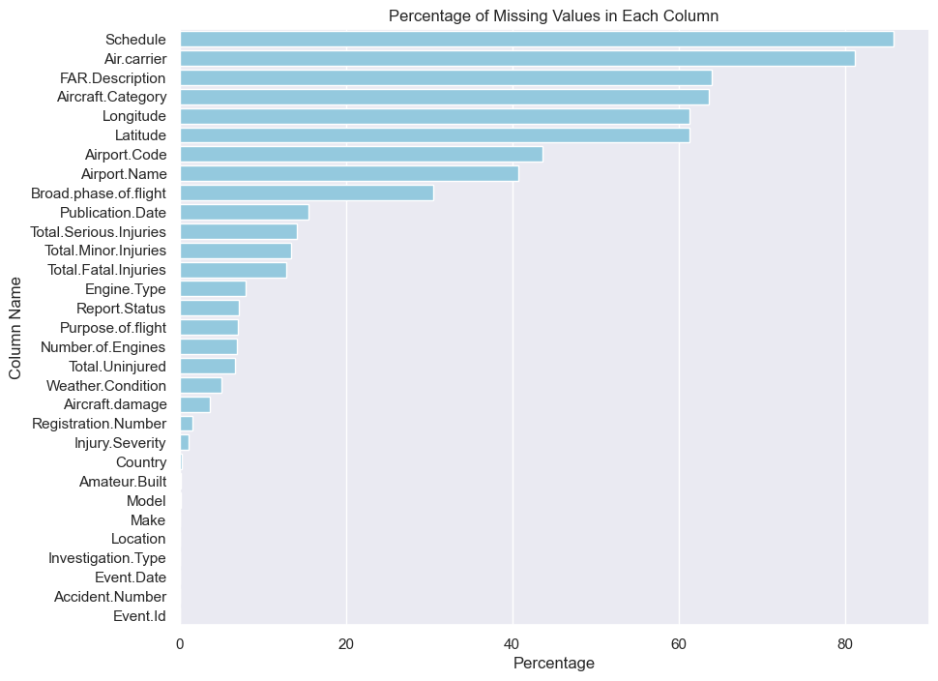
Percentage of missing values in each column

Slide 6
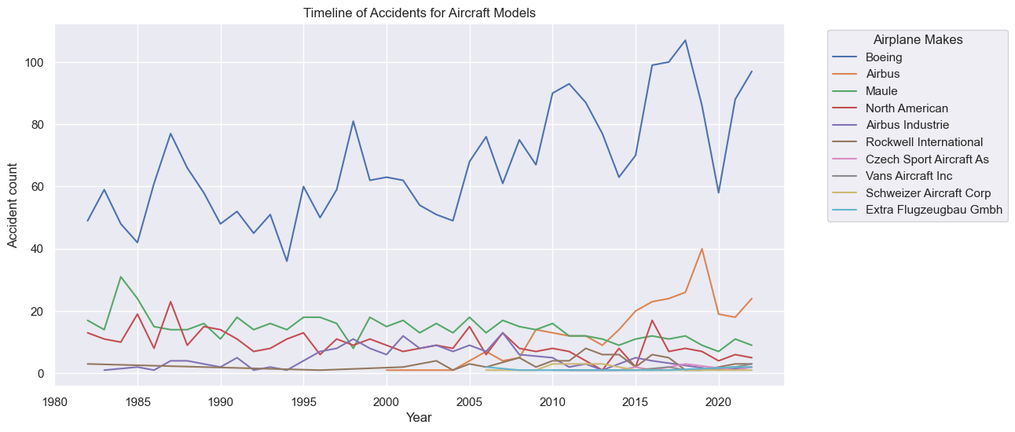
Airplane makes vs recent accidents

Slide 7
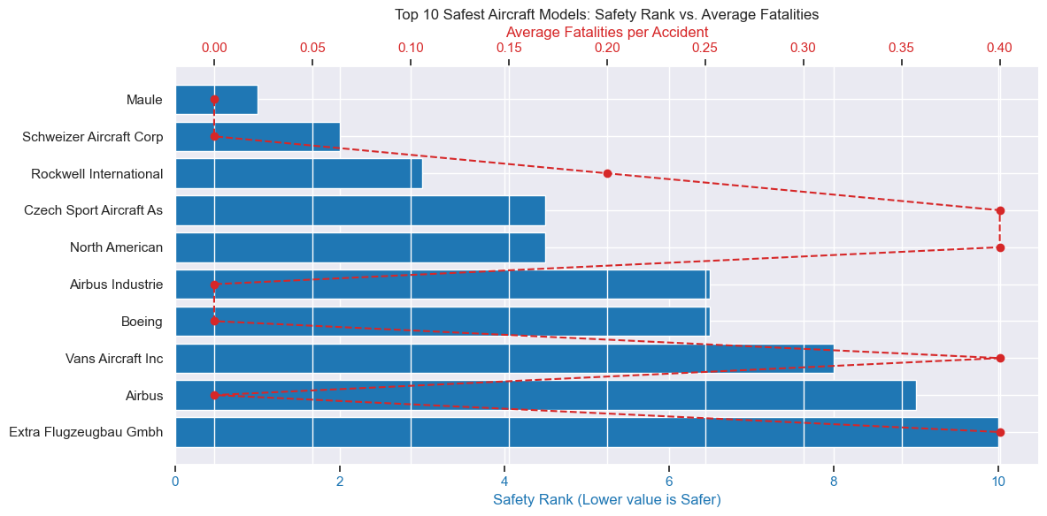
Aircraft Make and fatalities

Slide 8
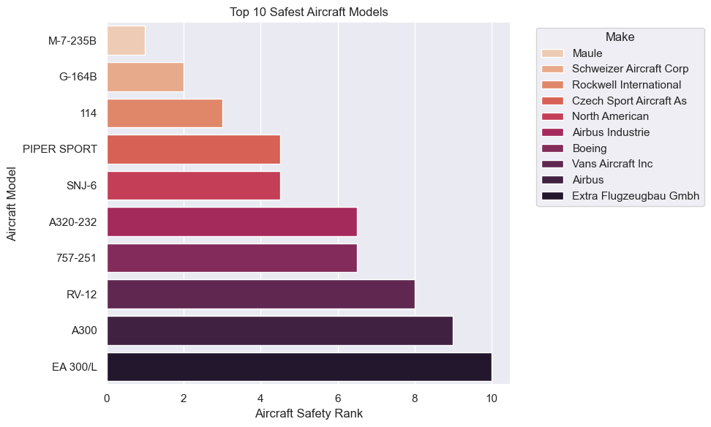
Top 10 safest aircraft models

Slide 9
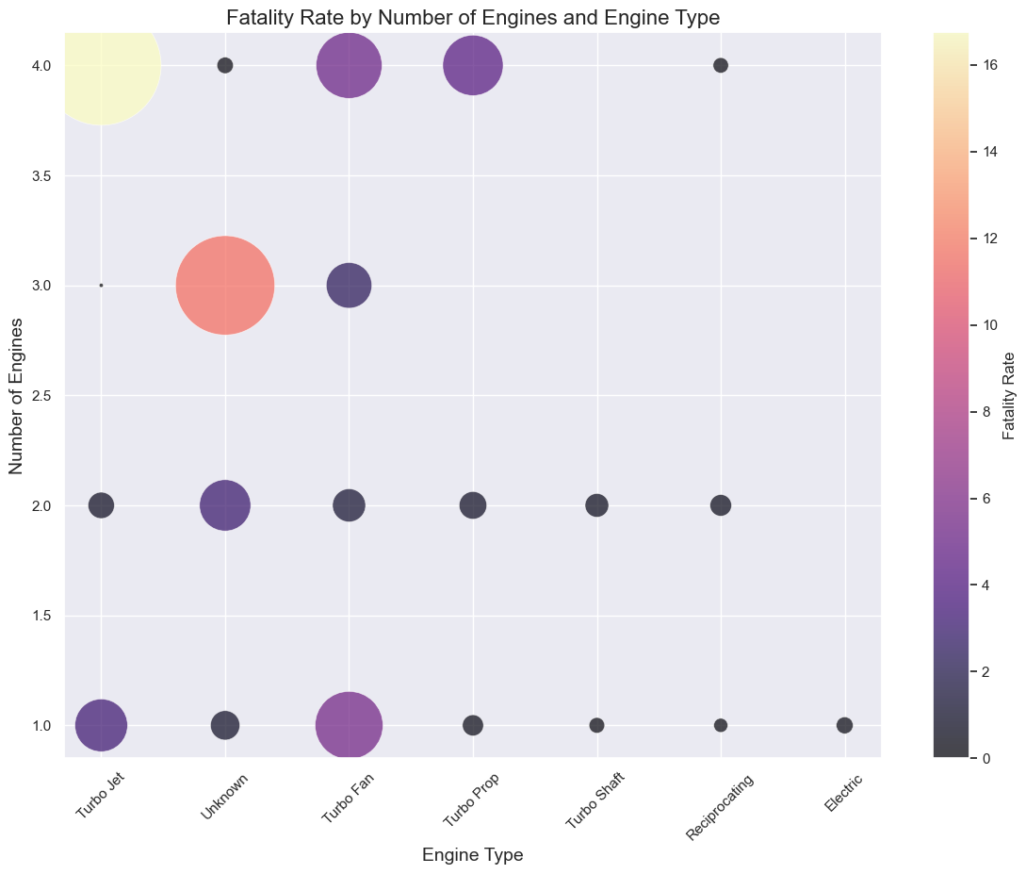
Fatality Rate vs Engine type

Slide 10
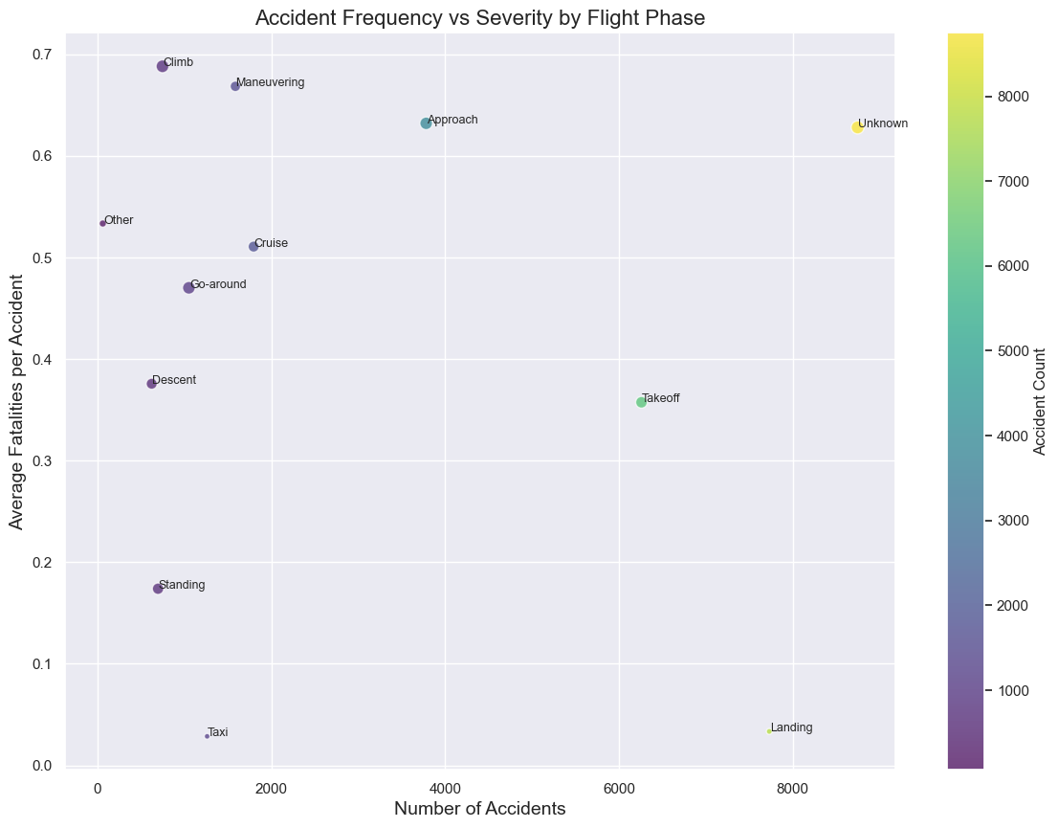
Accident frequency vs severity and flight phases

Slide 11
Recommendation
Aircraft Choice:
Prioritize purchasing the Maule Model M-7-235B for its strong safety record or the SCHWEIZER AIRCRAFT G-164B as a secondary option.
Engine Preference:
Favor aircraft with multi-engine turbojet systems, specifically three-engine models, which show lower fatality rates.
Pilot Safety Training:
Invest in intensive pilot safety and emergency response training programs.
Accident Review:
Investigate incidents with unknown causes to address hidden safety risks.

Slide 12
Thank you

