Slide 1
JNode a modern Java operating system
JNode.org
Ewout Prangsma

Slide 2
Contents
Introduction
History & Characteristics
Architecture
  Plugin framework
  Driver framework
Challenges
Future
Java benefits

Slide 3
Introduction
Simple to use & install operating system for personal use: written for and in Java
Targets:
  Modern devices
  Desktop
  Small servers
Only actively developed Java OS in the open source world
  5 active developers, 27K downloads

Slide 4
History
Original idea started in 1995
First attempt: JBS (Java Bootable System)
  Contained C code, did not work at all
Second attempt: JBS2
  Still did not work well, but was better
Then: JNode
  No C code anymore, Classpath classlibraries
Went public in May '03

Slide 5
Characteristics
All Java, minimal assembler, no C
All java build system (almost)
Extensible architecture
Single flat memory address space, no page swapping
JVM written in Java, Program isolation in Java
All Java code is compiled on the fly, no interpreter
Security is always on
LGPL license

Slide 6
Status (1)
Release 0.2.3
  Full device driver model
  Networking TCP/IP
  Filesystems EXT2, FAT, NTFS, ISO9660
  Graphics 2D, Java desktop
  J2SDK 1.5 support in VM (not classlibs)
  Simple heap managers & GC
    MMTk based heap manager & GC in development
  IA32 & AMD64 platform support

Slide 7
Status (2)
Release 0.2.4-dev
  Java Isolate support
    Java program's run in their isolates space (domain)
    Implemented in Java with assistance from native code compiler
    Conforms to JSR 121

Slide 8
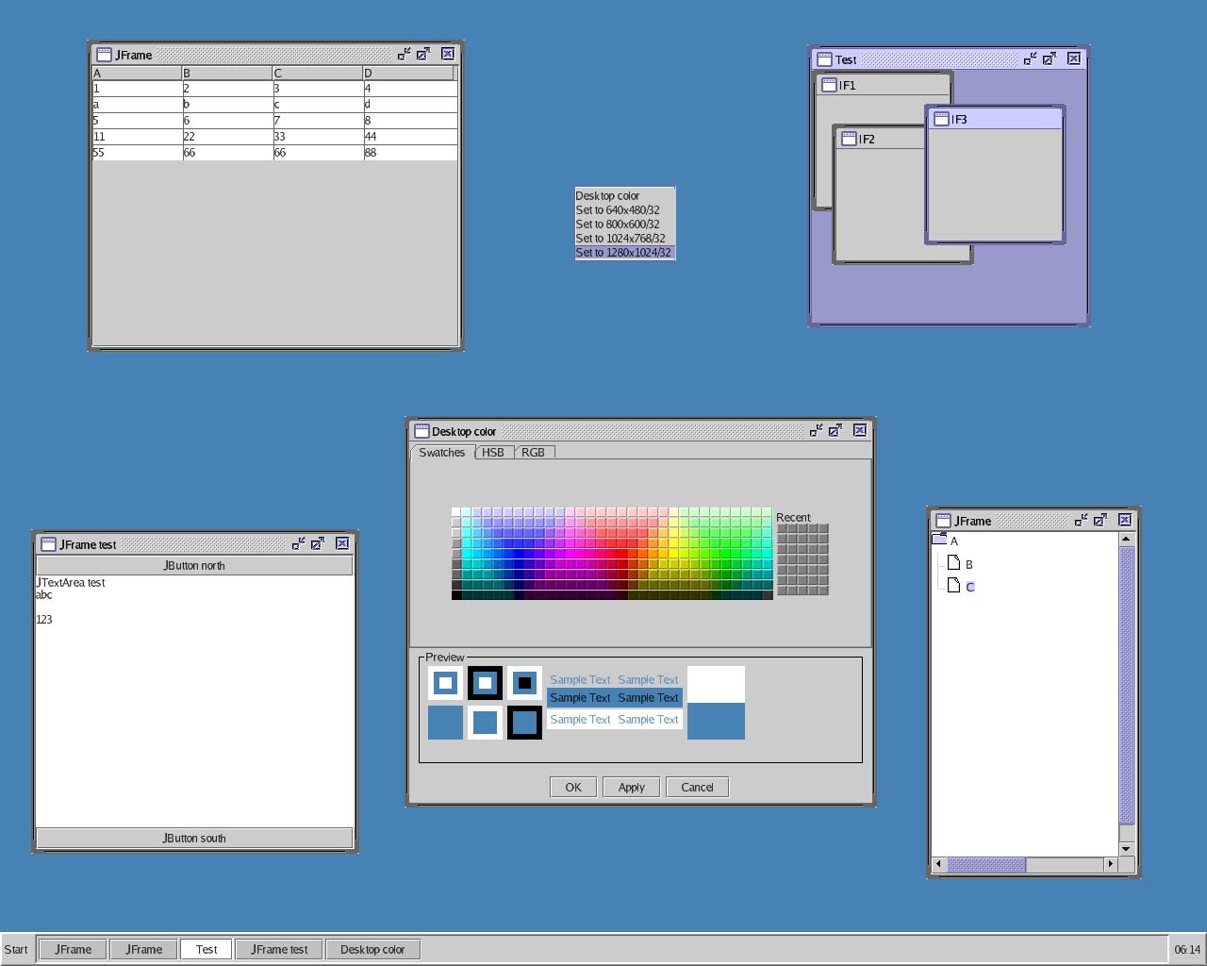
Status (3)
- JNode desktop
- JNode server connected to Internet

Slide 9
Architecture (1)
Shell
Desktop
framework
Deployment
framework
Debugging
framework
Driver
framework
Filesystem
framework
Partition
framework
Networking
framework
Graphics
framework
Build system
Java Virtual Machine
Plugin framework
Nano kernel (asm)
Hardware

Slide 10
Architecture (2)
Java Virtual Machine
Classpath
runtime library
Runtime library
support
Class
manager
Security
manager
Native code
compilers
Scheduler &
threading
manager
Heap
managers
Isolation
manager

Slide 11
Plugin framework (1)
Everything is contained in a plugin
  code, resources
  even JVM & the plugin framework itself
Plugins can:
  be loaded, unloaded & reloaded (at runtime)
  depend on other plugins
  provide well known extension points
  connect to well known extension points

Slide 12
Plugin framework (2)
Plugins are:
  described by a descriptor
    descriptor also contains license info
  JAR files
  inspired by Eclipse plugins

Slide 13
Plugin framework (3)
<plugin id="org.jnode.driver" name="JNode Driver Framework" version="@VERSION@"
provider-name="JNode.org" license-name="lgpl" class="org.jnode.driver.DriverPlugin">
<requires>
<import plugin="org.jnode.work"/>
</requires>
<runtime>
<library name="jnode-core.jar">
<export name="org.jnode.driver.*"/>
<export name="org.jnode.driver.util.*"/>
</library>
</runtime>
<extension-point id="finders" name="System device finders"/>
<extension-point id="mappers" name="Device to Driver mappers"/>
<extension point="org.jnode.security.permissions">
<permission class="java.util.PropertyPermission" name="jnode.cmdline"/>
</extension>
</plugin>
General info
Dependencies
Code & resources
Well known extension
points
Connection to well known
extension point

Slide 14
Driver framework (1)
Bus
Device
represents hardware
Driver
Device
finder
Device to
driver mapper

Slide 15
Driver framework (2)
Device
represents hardware
Driver
Device “user”
DeviceAPI

Slide 16
Driver framework (3)
Example: Radeon Graphicscard driver
finders
PCI
driver plugin
Driver
plugin
mappers
Radeon
driver plugin

Slide 17
Driver framework (4)
Device manager
Device finder
Device 2 driver mapper
Driver
Device
findDevices
registerDevice
findDriver
startDevice
registerAPI

Slide 18
Java Program Isolation
Goal:
  Avoid program interference
  Isolation should be “cheap”
Isolated v.s. Shared resources
  Isolated: program visible structures; threads, static variables, Class/Method/Field instances
  Shared: internal structures; VmThread, VmType, ..., compiled native code

Slide 19
Challenges
Performance
  Writing good optimizing compilers is hard
Perception
  “Java is slow ...”
  “ Why not use Linux ...”
Time and resources
  JNode is large... getting started is hard
  All volunteers

Slide 20
Future (short term)
Finalize Isolate support
Multi CPU support
Improved JVM stability & performance
Improved graphics

Slide 21
Future (long term)
Simple to use desktop environment
  Fully document oriented instead of app. oriented
Java powered servers
  e.g. Cooperation with ApacheDS
Technical future / dreams:
  Easily portable
  .Net (IL) support

Slide 22
Java benefits
Dynamic linking
Type safe language (even more in J2SDK 1.5)
Security
  Security manager
  No uncontrolled memory access
Great development tools:
  Eclipse, Ant

Slide 23
Where can you help?
More registers!
  X86 register set is so limited, X64 is better
Optimizing compiler knowledge & expertise
Good documentation
  Already pretty good, unlike GPU vendors
Visit http://www.jnode.org
Contact me: epr@jnode.org

Slide 24
Questions / Discussion

