Slide 1
Results from Field Team Interviews – Company X
Joshua norfolk
business Analyst
STEM Healthcare

Slide 2
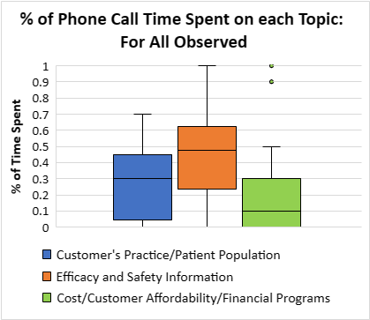
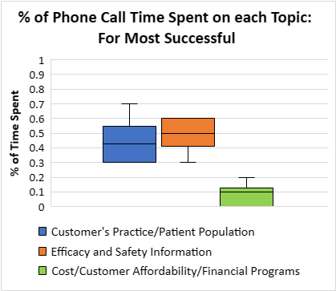
How much time do the Sales Representatives spend talking about each topic?
3 hours
6 hours total
2 hours:15 min total
2 hours
1 hour
Recommendations: Start calls with blue, finish calls with green.
Single topics should not dominate conversation.
Encourage phone calls to last for at least 9 minutes.
Notes:
Sample size: 30 calls total, including 6 most successful calls (customer committed to increasing usage/prescribing or influencing others)
Practice median: for all = 30%, for most successful = 42% (a bit less than half)
Efficacy median: for all = 48%, for most successful = 50% (about half)
Cost median: for all = 10%, for most successful = 10% (about 10%)
(Medians don’t perfectly add to 100% due to high variability in the data, and some incorrectly reported data.)
Distributions are much tighter for the successful calls.
Order for successful calls: cost always either came last or was omitted. Practice usually came first.
Recommendations:
Focus more at the start of a call on the customer's practice/patient population – this will provide the customer with an answer as to how their patients could benefit from this type of product – before the Rep focuses on the efficacy and safety of Company X's product specifically. (Answers first: is there a need?)
When strategizing for time devoted to each topic, continue keeping the discussion focused mostly on practice and efficacy, and a bit on cost – however, try not to let one topic dominate the discussion, unless the customer is specifically focusing on a topic. Make sure the Reps don't neglect any one topic, except perhaps cost.
The lengths of the most successful calls make up a disproportionately large total call time (2 hours:15 min out of 6 hours). The most successful calls were primarily around or above the median call length of 9 min. Trying to stay on the phone for 9 minutes or longer may help sway customers.

Slide 3
How do the Sales Representatives' beliefs relate to their performance?
Most Successful
Reasonably confident
Highly motivated
Appropriately assertive
Most Unsuccessful
Overly confident
Highly motivated
Too assertive
All performed above expectations
All performed far below expectations
Recommendation:
Discourage Reps from feeling overconfident and from being too assertive on calls.
Notes:
Each of the most successful Reps outperformed their expectations. These Reps were somewhat confident, each having a confidence level of 5-8. They were highly motivated, with motivation levels of 8-10.
The most unsuccessful Reps performed far below their expectations. They tended to be very confident, most with a confidence level of 10, and similar motivation levels as the most successful.
The most successful Reps mostly identified as being perfectly assertive. The most unsuccessful Reps generally identified as being too assertive.
Little correlation was found between performance and perceptions of tool/resource quality.
Recommendation: Encourage Reps to maintain a reasonable level of confidence while remaining highly motivated. Reps who are extremely confident and overly assertive may be more likely to push customers away, rather than draw them in. Encourage them to be appropriately assertive – not too assertive, but assertive enough. The least confident Rep had an unsuccessful Call Outcome; their lack of confidence may have discouraged them from asking for commitment, so be confident enough.

Slide 4
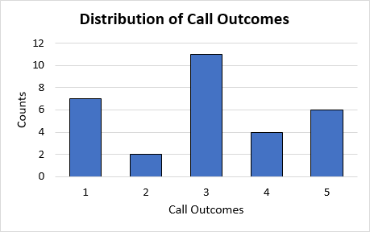
How are the Sales Representatives tracking towards securing commitments?
Call Outcomes:
1: Most Unsuccessful
2: Somewhat Unsuccessful
3: Neutral
4: Somewhat Successful
5: Most Successful
Recommendation:
Always close sales calls with a request for a commitment.
Notes:
The graph has three nodes, at the two extreme outcomes and at the neutral outcome.
Neutral calls rank high because these calls are not necessarily "sales" calls, and encompass mostly social and informational calls ("thank you" calls, answering questions about Product A, etc.). Many customers on these neutral calls were already using Product A.
Sales reps might expect to get mostly firm yes's and firm no's. The 5's are ideal, as firm yes's to increase usage/prescribing or to influence others, and the 4's are certainly on the right track, with commitments to think about prescribing or to a follow-up call.
A 1 is a firm no to prescribing.
The 2's are calls where the Rep did not ask for any commitment, and the potential customer has not indicated any intention to commit to increasing usage/prescribing or to influencing others. They likely are not already using Product A. The key difference between these "2" calls and "1" calls is that "2" calls seem like unsuccessful sales calls where the Rep didn’t ask for any commitment, whereas on "1" calls, the Rep at least asked for some commitment.
Recommendation: The Reps should, for all sales-focused calls, close by asking for some commitment, even if it is just to think about prescribing it. That way, the company has a more solid answer. A "1" indicates that the company might choose to commit no further resources to these customers, but you'll only know if you ask.

Slide 5

Final Recommendations
Familiar Recommendations
Additional Recommendations
Start calls with customer's practice/patient population, finish calls with cost discussion.
Single topics should not dominate conversation.
Encourage phone calls to last for at least 9 minutes.
Discourage Reps from feeling overconfident and from being too assertive on calls.
Always close sales calls with a request for a commitment.
Discuss 4 branded messages on calls.
Ensure cost resources are accurate for all regions.
Expand cost coverage for patients.
Market more to consumers – run commercials focusing on efficacy and safety.
Stabilize upper management and encourage managers to be more respectful.
Obtain more data!
Notes:
On each of the most successful calls, the Rep presented 4 branded product messages. This was correlated much more strongly with full success than asking probing questions was.
A couple of the Reps mentioned that the resources they use to discuss cost are inaccurate. The company should review each of the Reps' available resources to make sure that they are accurate. Other reps may also have inaccurate information, but not realize it. Update periodically.
Some Reps mentioned that there was no coverage for patients in their region. These Reps did not secure any commitments, and felt that it was too hard to argue the case for Product A without any cost coverage. It seems that Product A is covered in many areas by local Managed Care Coverage, but not in some areas. If you can't secure coverage for certain regions, it may not be of great benefit to commit further resources to these regions.
Some of the Reps felt that a lack of brand awareness in consumers has been hurting sales. Commercials may be a good opportunity to get the brand "out there," especially ones with a primary focus on efficacy and safety, as this was overall felt to be the most important factor by the Reps, perhaps with a consumer-friendly explanation of the brain volume data that was collected, and why it matters.
There are a few serious concerns about management at the company. Concerns summarize to: unapproachable management (some feel unsafe to approach managers with feedback) and lack of respect/recognition from management. Some said that upper management has been less stable lately and they fear for their job security.
Perhaps the company is already aware and is working to make adjustments – more communication with the employees may put minds at ease. Recommend HR to send an email and sit down with any reps who indicate concern, and ask for more focused info on any concerns with management - making them feel listened to will help with retention and motivation, and discuss the concerns with managers. Many reported a positive company culture, so tweaks to only some reps and/or managers may be sufficient.
The data we collected has a lot of value in that we collected beliefs from all members of your field team. However, we were authorized to spend one day collecting data from calls, getting only 30 samples in total, and the sample size is sufficient for a quick analysis; however, next time, perhaps in a month or two when Company X has had time to implement some changes, we may wish to gather data from at least 3 days to ensure an even more confidence-inspiring sample size.
The data from this sample posed some additional questions. How many customers with call outcomes of 1, 2, 3, and 4 eventually made a full commitment? Is management a serious concern for many Reps, or just a few, and does your Company feel these concerns are justified? How many customers make a full commitment in areas lacking cost coverage? These are some of the questions that STEM Healthcare can answer for you in the future, or that we can help guide you on for your own data collection.

